Slide 1

Modeling Soft X-ray emissions at the dayside magnetopause
Qiuyu Xu PhD student
LATMOS/IPSL, University of Paris-Saclay
Email: qiuyu.xu@latmos.ipsl.fr
Supervisors：
Dimitra Koutroumpa
Ronan Modolo
Notes:
0025

Slide 2
01
Introduction
Notes:
0030

Slide 3
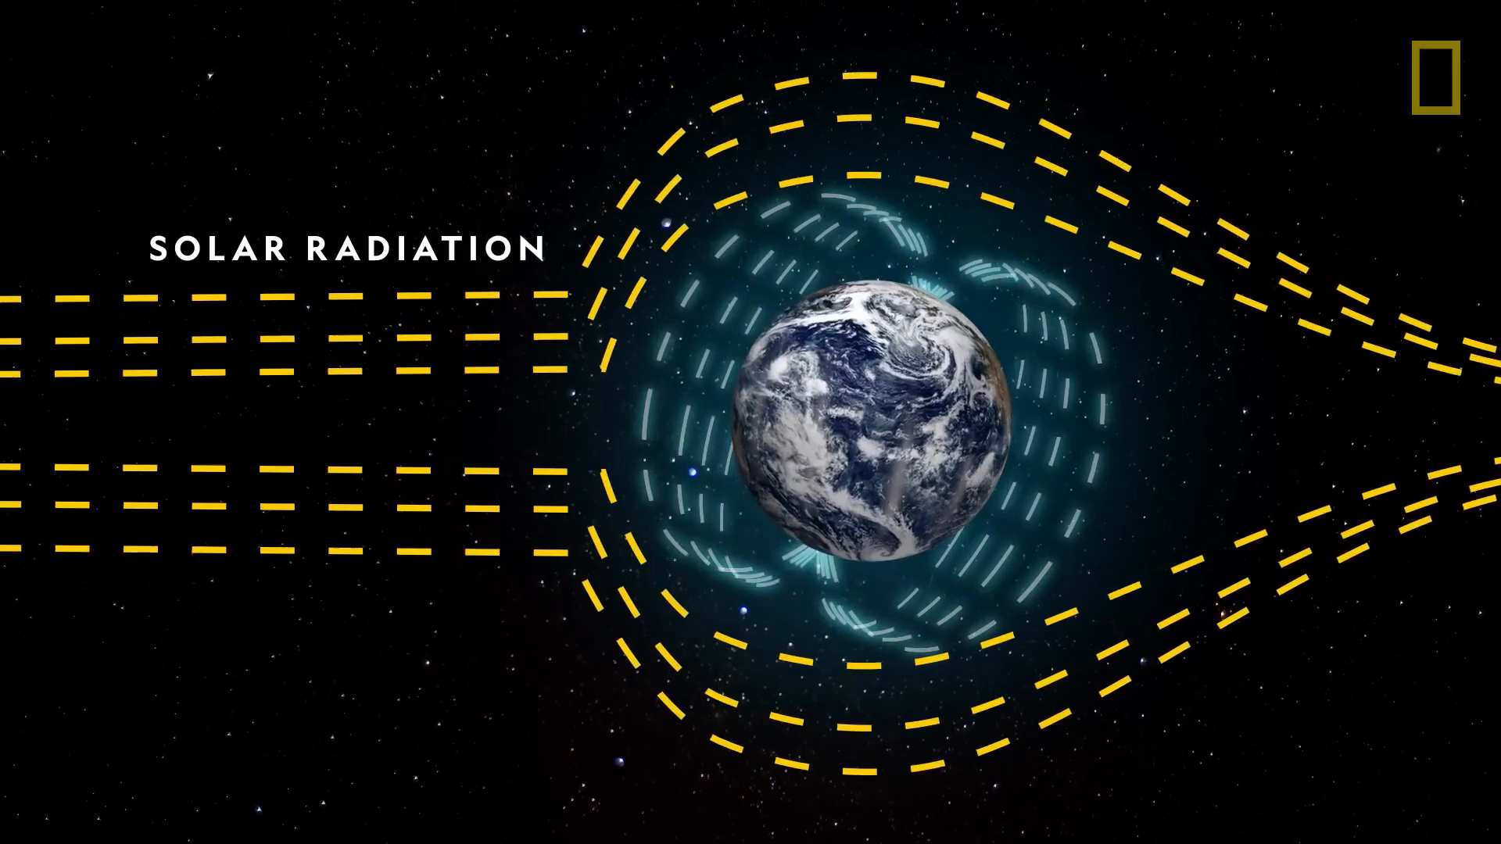
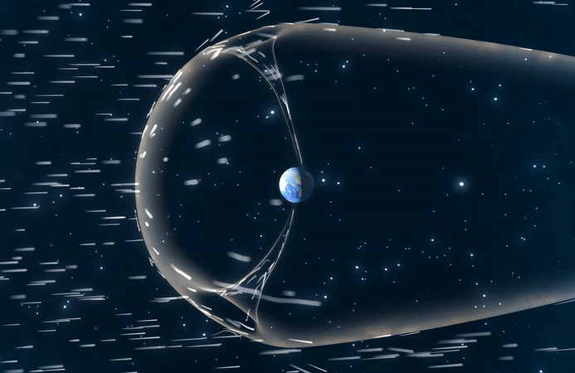
Introduction
Credit: National Geography
Magnetosphere
Region controlled by Earth’s magnetic field
Shields Earth from solar radiation
Magneto-sheath
Magnetosphere
Magnetopause
Boundary between the Earth’s and Solar magnetic field
Separates the Earth’s and solar plasma
Credit: NASA
Notes:
0115

Slide 4
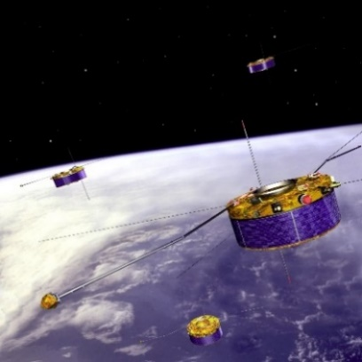
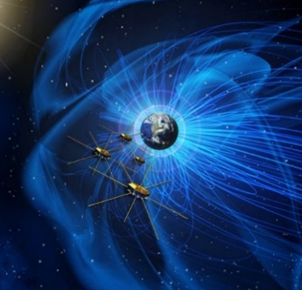
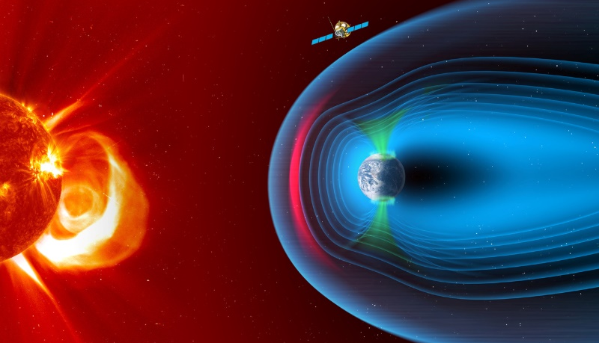
Introduction
In situ observation
X-ray imaging
Limitation
Advantage
In situ measurement is usually localized and hard to get the global view of magnetosphere
Remote X-ray imaging allows to continuously monitor the large-scale dynamics of magnetosphere
Notes:
0110

Slide 5
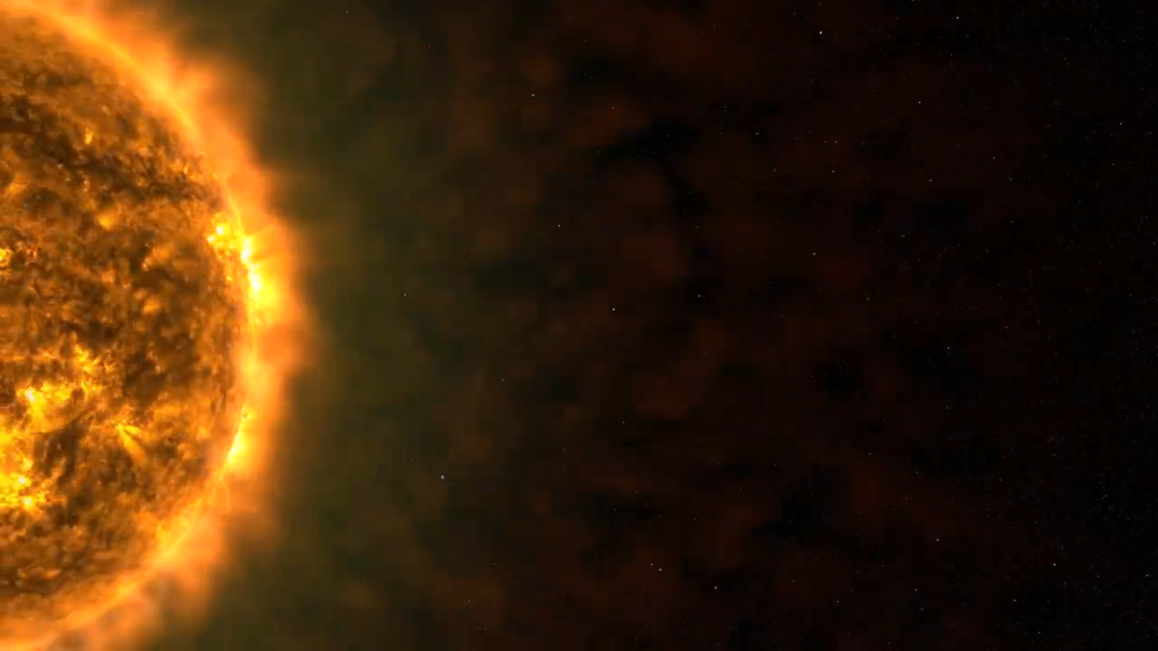
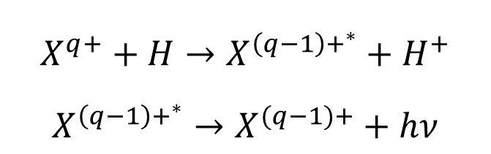
Introduction
X-ray emission
Charge Exchange
X-ray emissions are generated by Solar Wind Charge Exchange (SWCX) between the solar wind ions and hydrogen geocorona.
Neutral target atoms, H, in collision with the highly charged solar wind ions, X：
Emit photons in the soft X-ray band (E ≤ 2 keV).
$$X^{q+}+H→X^{{\left(q−1\right)+}^{∗}}+H^{+}$$
$X^{{\left(q−1\right)+}^{∗}}→X^{(q−1)+}+hν$
Credit: University Miami
Notes:
0145

Slide 6
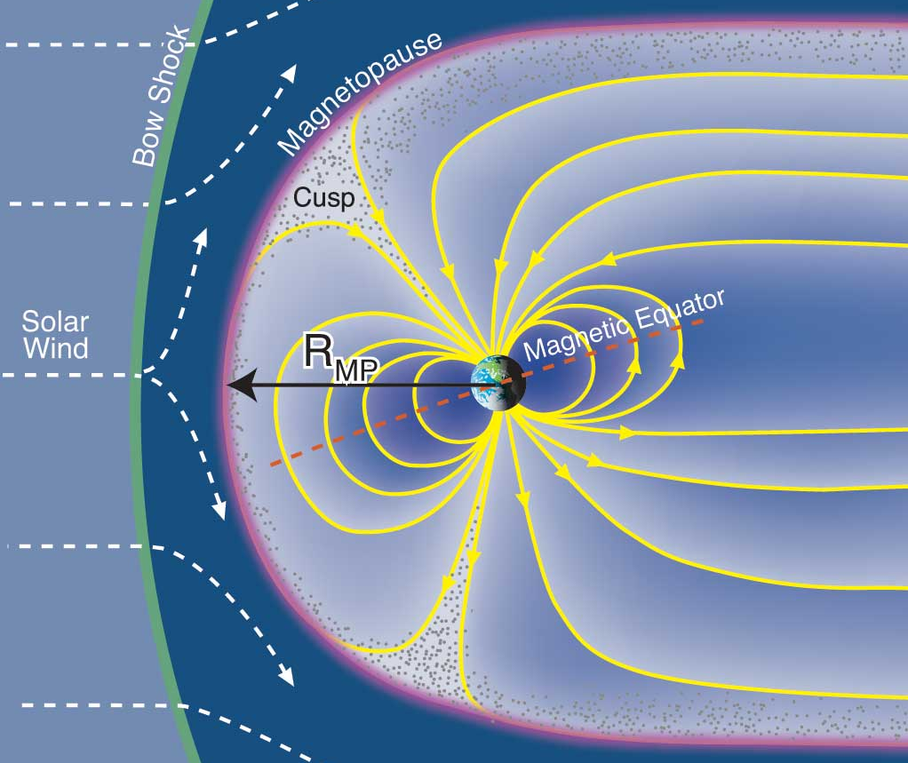
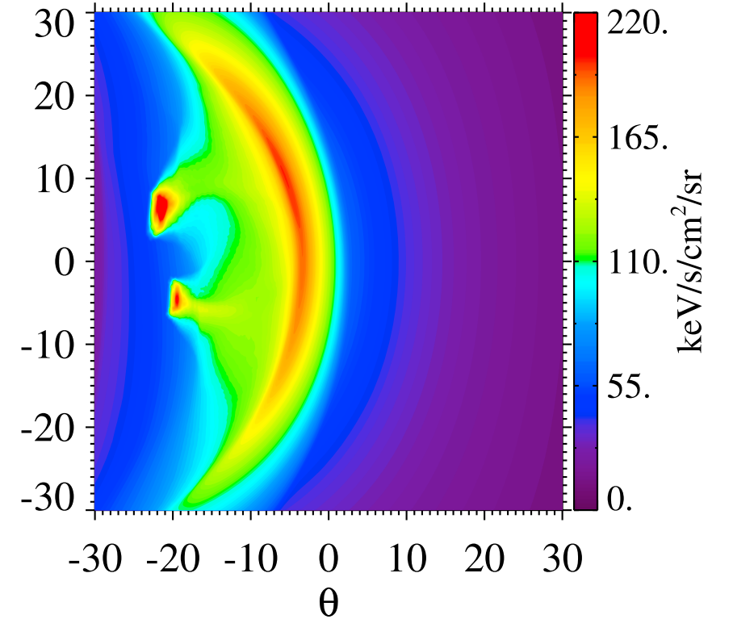
Introduction
 | Solar wind | Magneto-pause | Magneto-sphere
Neutral density | Very low | Medium | High
SW ion density | Medium | High | ~0
X-ray emission | Very low | High | ~0
Credit: Barlett and Bagenal
Sun et al.
A distinguished boundary at the magnetopause
Notes:
0355

Slide 7




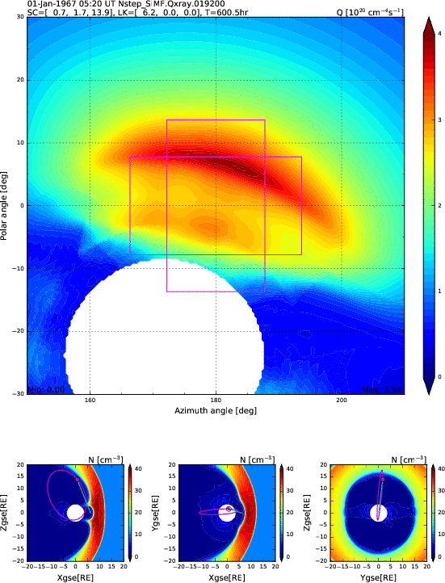
Introduction
Solar wind Magnetosphere Ionosphere Link Explorer
SMILE mission
Simulation
Main goal
Remotely detect the dynamic response of the magnetosphere to the solar wind impact in a global manner
SXI (Soft X-ray Imager)
MAG (Magnetometer)
UVI (Ultraviolet Imager)
LIA (Light Ion Analyzer)
Credit: ESA
Sun et al.
Notes:
0225

Slide 8
02
Simulate X-ray emissions of dynamic magnetosphere
Notes:
0230

Slide 9
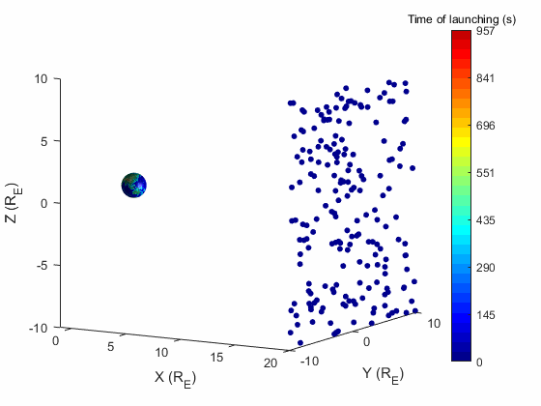
Method
LATMOS Test Particles (LaTeP) Model
Xu et al., 2024
Dynamic LATMOS Test Particles (D-LaTeP) Model
Xu et al., 2025
Includes kinetic effects and calculations for individual ion species
Requires external E&B input from other models (e.g. MHD models)
Update E&B field
Launch test particles
Push particles & compute CX production
Time-varying emission
Notes:
0315

Slide 10
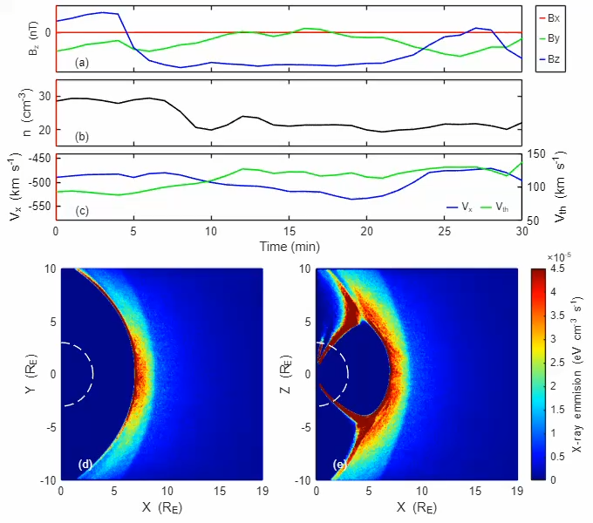
Application case 1
Simulate X-ray emissions for 2 real-time cases
Variations in magnetic field
Variations in dynamic pressure
magnetic field
density
velocity
Notes:
0405

Slide 11
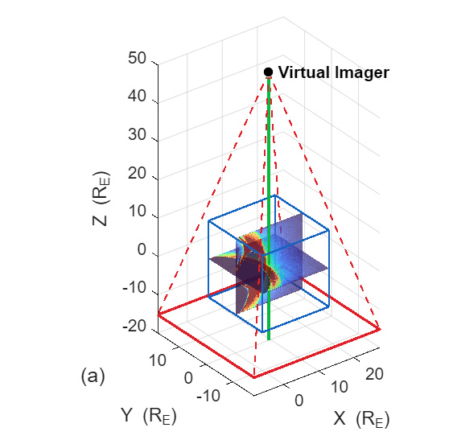
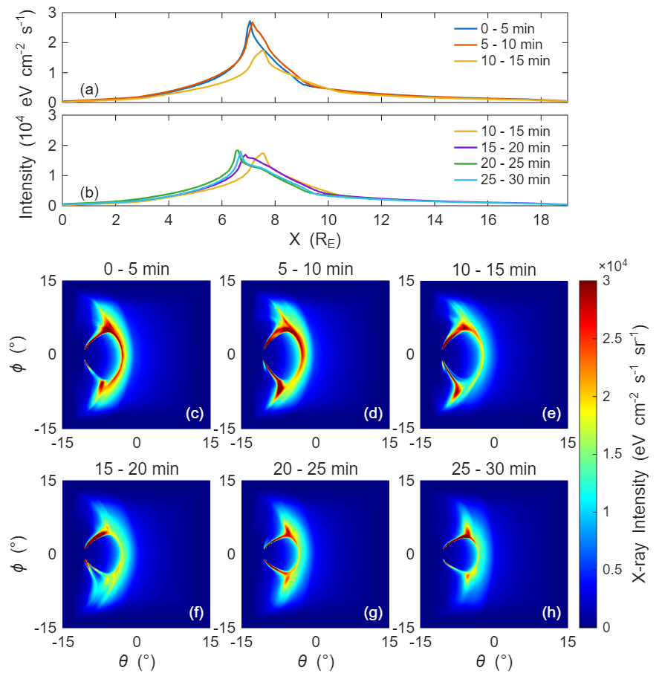
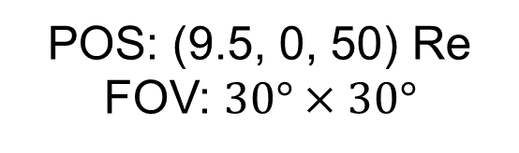
Application case 1
Compare with possible observed images
POS: (9.5, 0, 50) Re
FOV: $30°×30°$
Simulated images with 5-min exposure time
LOS: -Z direction
Notes:
0450

Slide 12
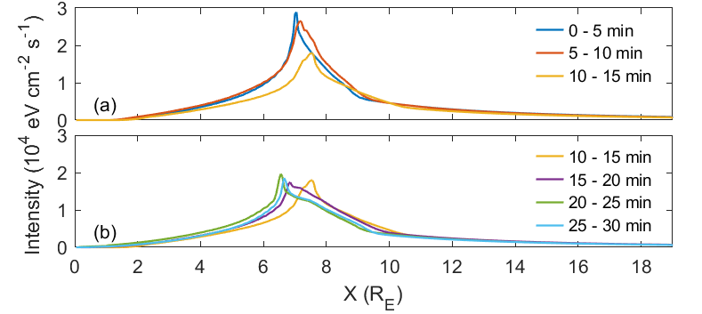
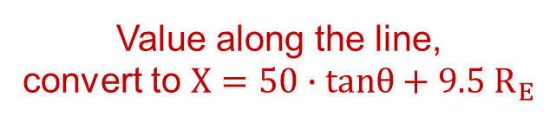
Application case 1
Compare with possible observed images
Simulated images
Intensity vs X positions
Value along the line,
convert to $X=50∙tanθ+9.5 R_{E}$
MP: Outward and weaker first
then inward and slightly enhanced
Under ideal observing conditions, the imaging missions (e.g. SMILE and LEXI) could detect the motion of magnetopause with 5-min exposure time
Notes:
0530

Slide 13
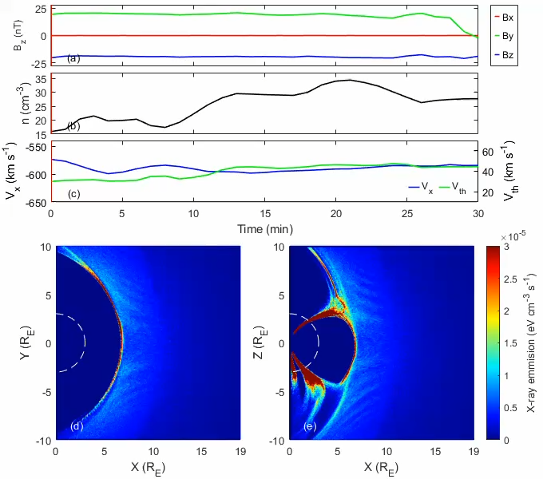
Application case 2
Simulate X-ray emissions for
Variations in magnetic field
Variations in dynamic pressure
magnetic field
density
velocity
Notes:
0625

Slide 14
Conclusion
Simulate X-ray emissions for
Variations in magnetic field
Variations in dynamic pressure
Conclusion
The D-LaTeP model can simulate the X-ray emissions under time-varying solar wind conditions
Notes:
0655

Slide 15
03
Compare with
XMM-Newton observation
Notes:
0700

Slide 16
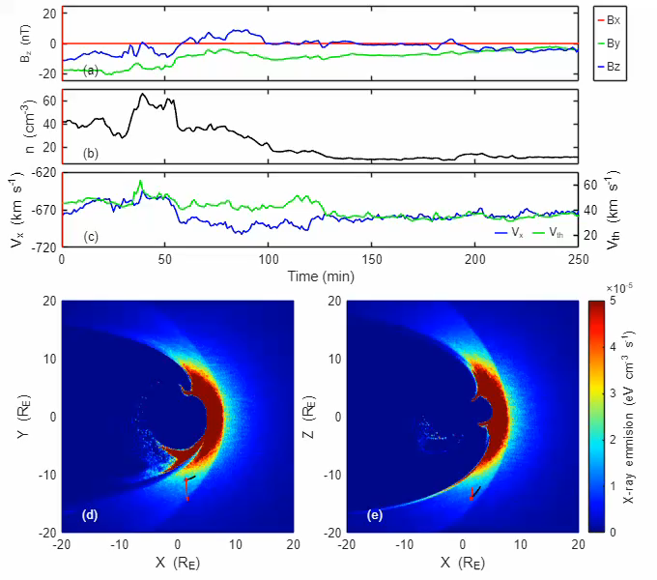
Simulated X-ray emission
Simulate X-ray emissions for a Coronal Mass Ejection event and compare with XMM-Newton observations
250 minutes simulation for the CME event
Xu et al., 2026
Notes:
0810

Slide 17
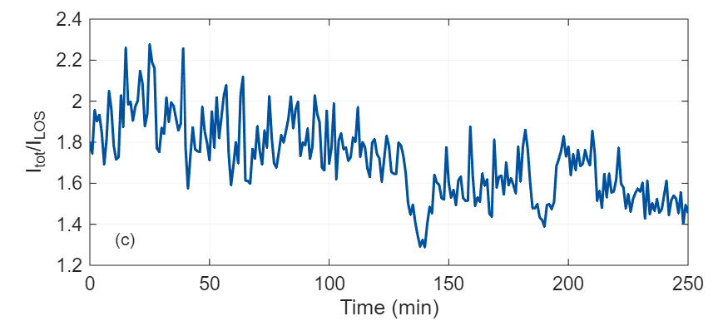


Comparison with observation
Simulation box only covers a finite LOS length
Temporal variation of the Correction factor
Path-length extrapolation
Decrease as CME passes through
$$I_{tot}$$
Apply correction factor point by point to the simulated intensity
$$I_{LOS}$$
Notes:
Because the simulation domain covers only a finite segment of the XMM-Newton line of sight, the direct line-of-sight integral may underestimate the total emission along the full observational path.

Slide 18
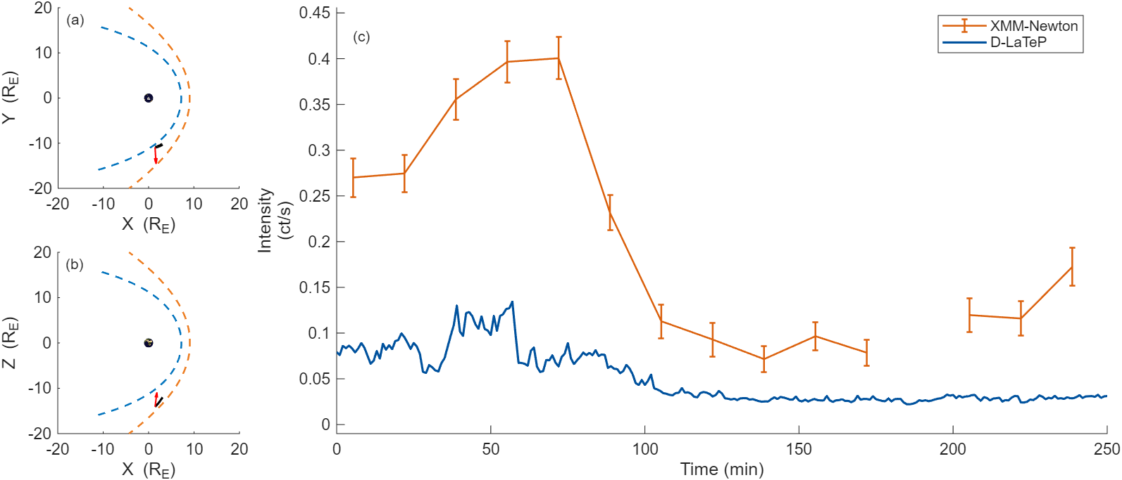
Comparison with observation
XMM-Newton orbit
Path-length corrected intensity
vs XMM-Newton Observation
From neutral density?

Slide 19
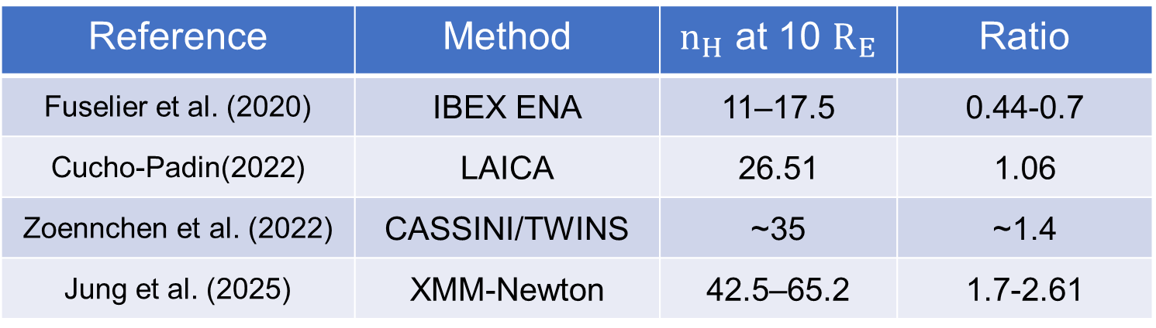
Comparison with observation
Our neutral density model: $n_{H}\left(r\right)=25{(\frac{10 R_{E}}{r})}^{3} {cm}^{−3}$
Reference | Method | $n_{H}$ at 10 $R_{E}$ | Ratio
Fuselier et al. (2020) | IBEX ENA | 11–17.5 | 0.44-0.7
Cucho-Padin(2022) | LAICA | 26.51 | 1.06
Zoennchen et al. (2022) | CASSINI/TWINS | ~35 | ~1.4
Jung et al. (2025) | XMM-Newton | 42.5–65.2 | 1.7-2.61
We therefore use a scaling range of 0.4 - 3 times the nominal neutral density model to revise the simulated intensity.

Slide 20
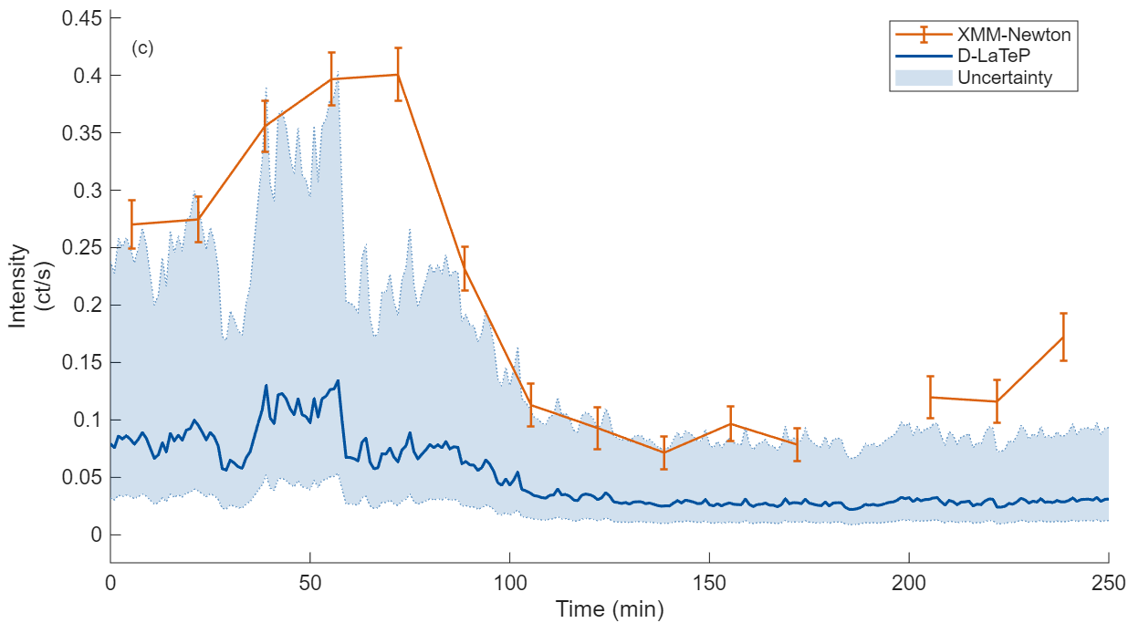
Comparison with observation
Including the uncertainty from neutral density model
The upper bound approaches the observed values
The simulated results remain generally lower
Notes:
. The shaded region shows that once the uncertainty in the neutral density is included, the simulated count rate reaches the same order of magnitude as the XMM-Newton observations. During the main intensity enhancement interval, the upper bound of the uncertainty range can approach the observed count rate, although the simulated intensity remains generally lower than the observations over the full interval.

Slide 21
Conclusion and discussion
Conclusion
After including neutral-density uncertainty, the upper bound of simulated intensity approaches the observed values.
Discussion
There were two X-class flares associated with the CME we simulated here. Enhanced solar irradiance and geomagnetic activity can heat and expand the upper atmosphere.

