Slide 1
Connecting Electrons at the Sun and in the Heliosphere through X-ray and Radio Diagnostics
Nicole Vilmer (1) , David Paipa (1) , Aikaterina Pesini (2) , Hamish Reid (3) , Antonio Vecchio (2) , Xavier Bonnin (1) , Milan Maksimovic (1)
¹LIRA, Paris Observatory
² : Radbout University Nijmegen
³University College London, MSSL
Thanks to the STIX, RPW teams

Slide 2
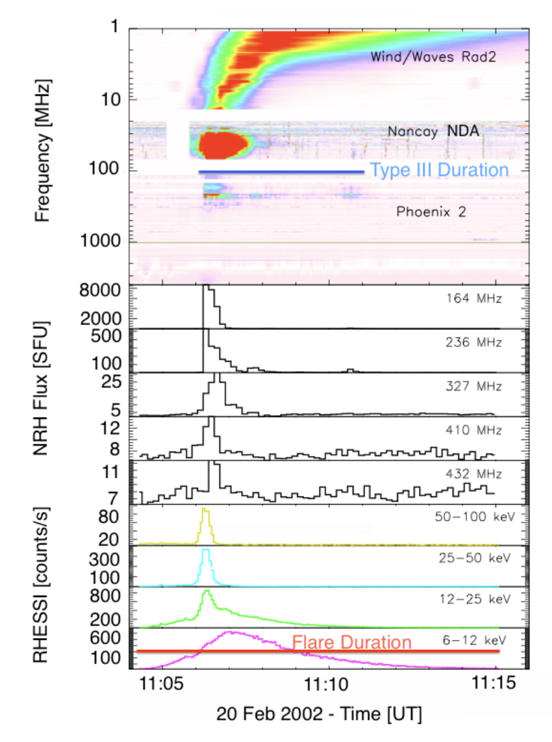
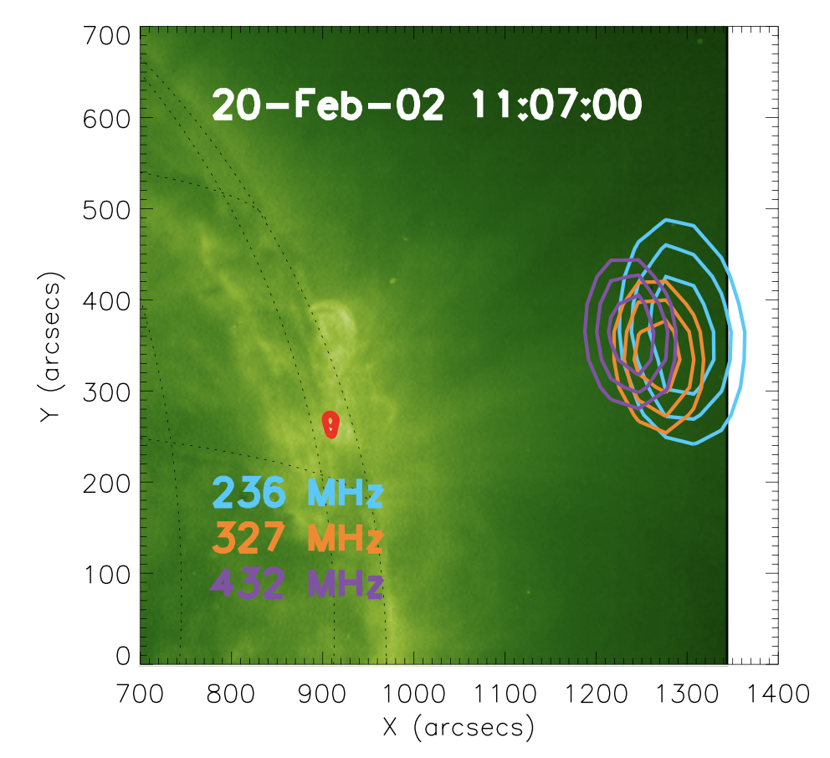
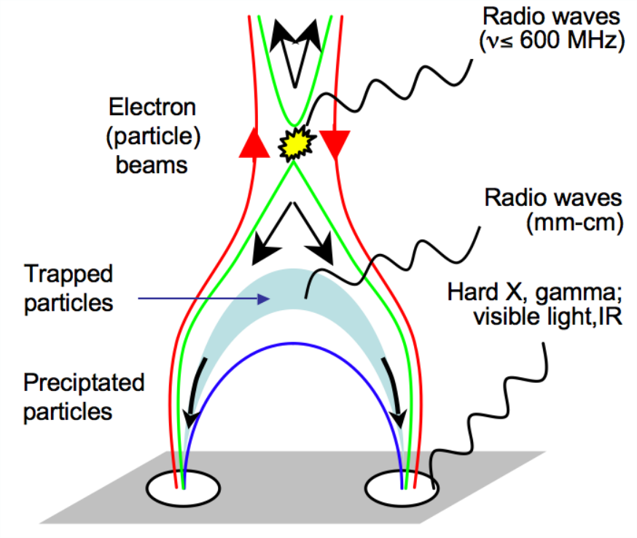
Energetic particles in solar flares: Particle acceleration and transport
Radio produced by upward beams from the plasma emission mechanism.
electrons escaping through
open magnetic field lines
Radio Spectrum
Faint X-rays?
Radio lightcurves
25-50 keV
HXR footpoints
X-Ray lightcurves
Adapted from
Reid & vilmer, 2017
Adapted from Klein, 2006
electrons fall back into the chromosphere
Reid et al. 2014
Reid & Vilmer 2017
X-rays produced by downward beams from Bremsstrahlung emission.
An already long story…

Slide 3
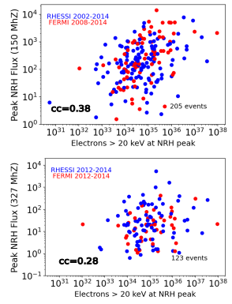
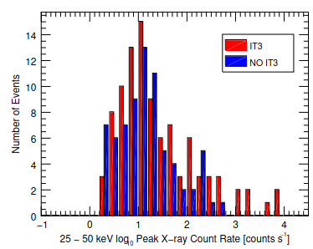
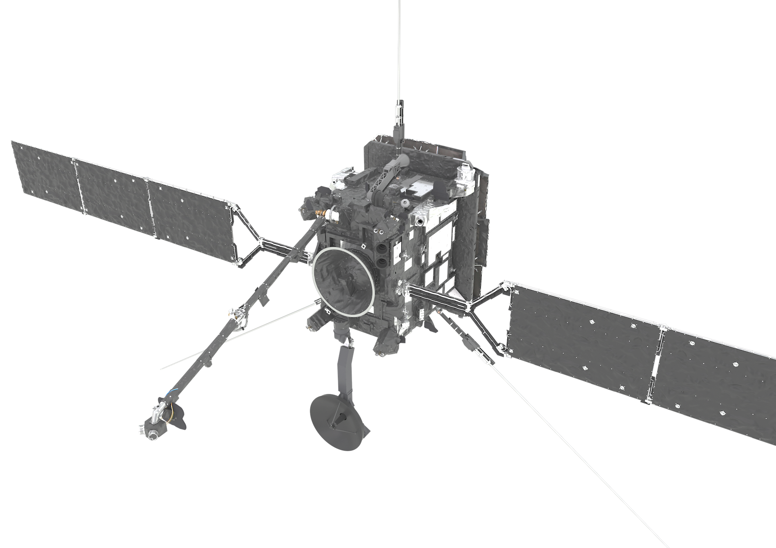
Context on Radio/X-ray observations: HXR & Type III statistics
Long history of HXR and Type III statistical correlated studies (Kane 1981; Raoult et al. 1985; Hamilton et al. 1990; Aschwanden et al. 1995a; Arzner & Benz 2005, Reid et al 2011, 2014, Reid & Vilmer 2017, James & Vilmer 2023.)
Correlation between non-thermal electron number with E > 20 keV and peak radio flux.
Correlation best
around (150 MHz).
> 200 events over 13 years of data (2002-2014)
James & Vilmer 2023, Reid & Vilmer 2017
Tendency of flares with a high signal in 25-50 keV to be associated with interplanetary type III bursts
(IT3,signal at frequencies < 14 MHz.
Reid & Vilmer 2017
With STIX and RPW investigate the link (if any) between HXR bursts and Interplanetary type III bursts

Slide 4
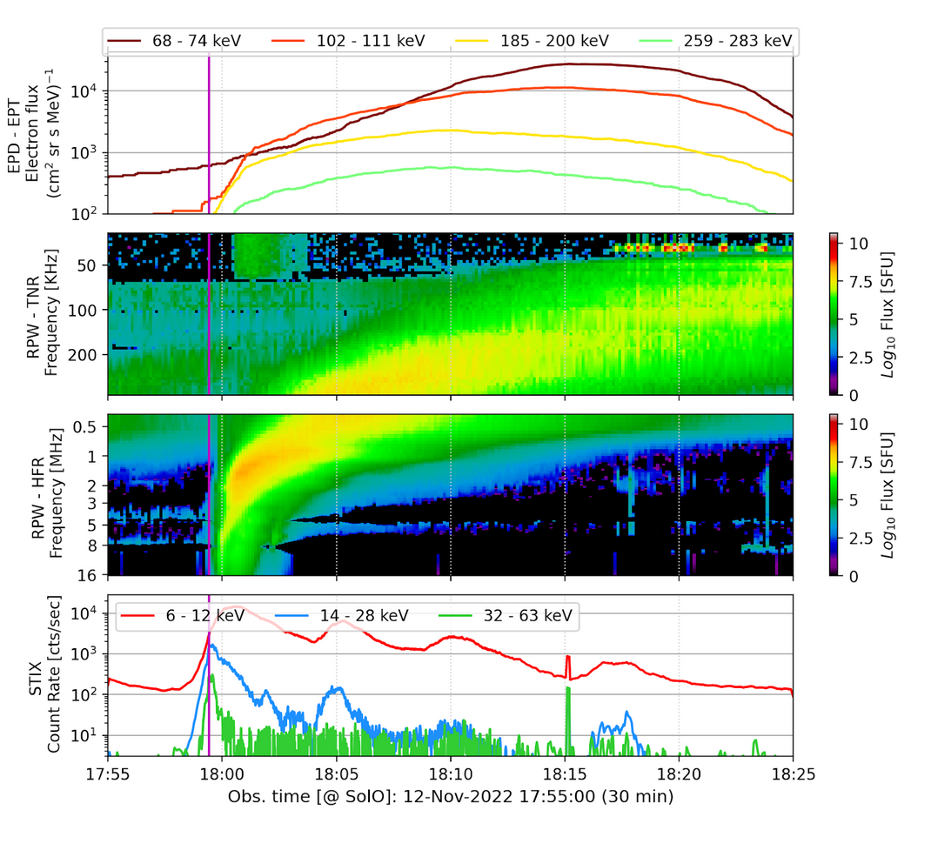
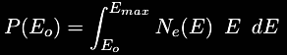

Link between X-ray and radio emitting electrons? (I)
How are the exciter velocities related to the properties of X-ray emitting electrons?
Does the radio intensity relate to the energy within the electron beams?
Sample: 38 Type IIIs with non-thermal HXR peaks associated (Sept 2021 – March 2023)
For each of the events, we keep track of:
EPD
Front & peak exciter velocities
Peak intensity (flux density)
from fitting radio time profiles
0.4 - 4 MHz
from radio time profiles
@ ~1 and ~2 MHz
RPW
Electron distribution function
Power released by electrons with E > Eo
from X-ray spectrum
STIX
Paipa, Reid, Vilmer, Maksimovic, A&A, in press (DOI (pending): 10.1051/0004-6361/202558525 )

Slide 5
Sample of events
38 events
between 09/21 to 05/23
- High time cadence of 7s for RPW
single, isolated type III burst (easy to measure frequency drifts)
Associated non-thermal HXR emission
Asocciated HR
peak

Slide 6
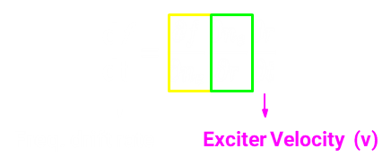

Radio Diagnostics: Velocity of the Type III exciter (using RPW)
t_{peak} = time of max intensity
t_{front}= time at HWHM
Model for n_{e} ( r/R☉)
Sittler & Guhathakurta (1999)
  Fundamental component (fp)

Slide 7
Association between HXR and radio bursts
First step: association of the IP type III to the nearest HXR burst taking into account the travel time of deka-keV electrons between the source and the height of the starting point assuming the density model of Sittler & Guhathakurta (1999) (dashed magenta line)
Then estimation of the delay between the HXR burst and the « front » time at each frequency. This allows to deduce an electron radial propagation velocity and comparison with the « front » velocity deduced from radio spectra.
For a few events, the two velocities disagreed. A new association was searched for so as to have a better agreement between the « front » velocity and the radial velocity (see solid magenta line).
Changes for 15 events among 38

Slide 8
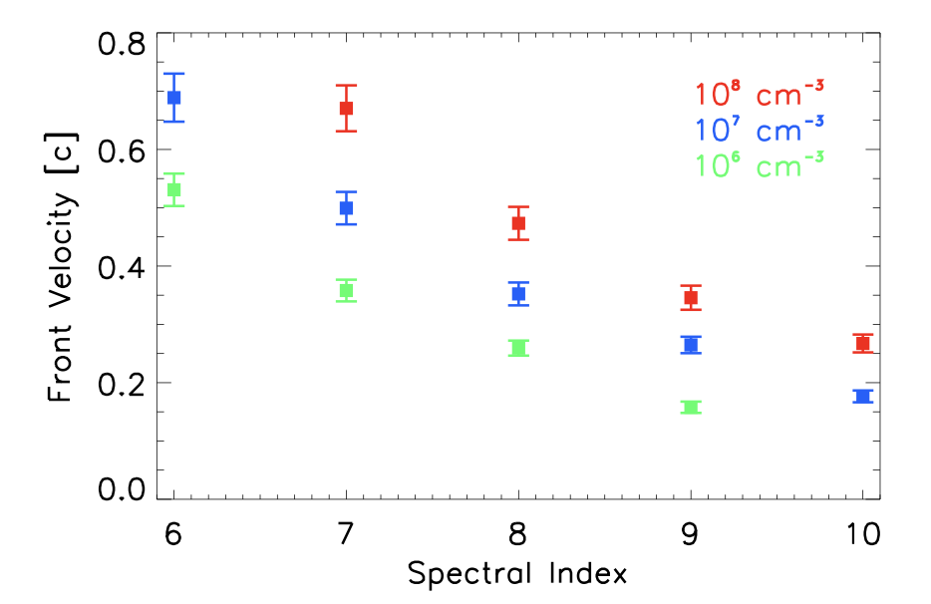
Radio emission exciter velocities vs Non thermal electron power and spectral index δ (from HXRs)
Sample: 38 Type IIIs with non-thermal HXR peaks associated (Sept 2021 - Mar 2023)
Anticorrelation between the front velocity from radio and the electron spectral index from HXRs.
Correlation between the front velocity from radio and the non-thermal electron power from HXR
C
Comparison with results of numerical simulations
of electron beams propagating in the corona
(and interplanetary space?), producing radio emissions
(Reid& Kontar, 2018)

Slide 9

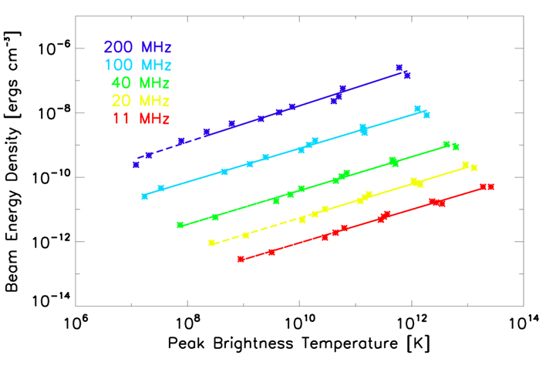
Peak radio intensities vs Non thermal electron power and spectral index δ (from HXRs)
Strong anticorrelation between the peak radio flux and the electron spectral index derived from X-rays
Good correlation between the peak radio flux and the electron power derived from X-rays
Comparison with results of numerical simulations of electron beams propagating in the corona (interplanetary space?, producing radio emissions.
The radio peak brightness increase with the
radio producing beam energy density
(Reid& Kontar, 2018)

Slide 10
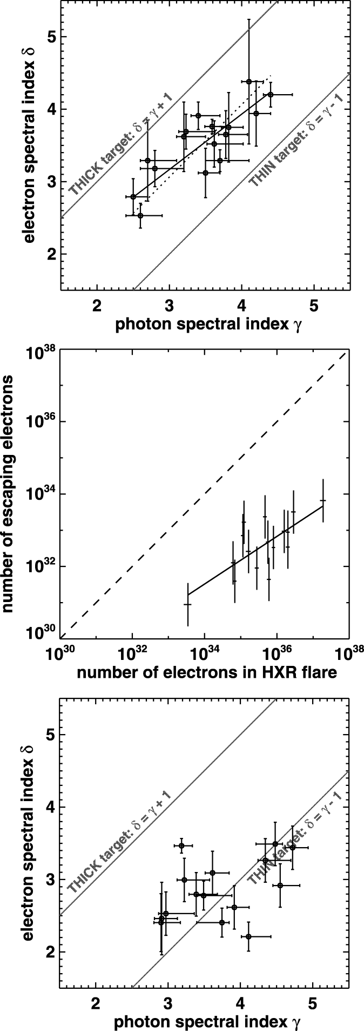
Energy content in X-rays and radio
Formula derived from simulations of Reid & Kontar (2018)
V mean velocity of the beam (V_{f}+V_{b})/2
t_{D} burst duration
ϴ size of the source (~12 ° at 1 MHz; 6 ° at 2 MHz )
From Kontar et al., 2019
From Krucker et al., 2007
Significant correlations between both energy contents (even if many caveats)
Energy contained in radio emitting electrons much less than energy contained in HXR emitting electrons ((∼ 10⁻³ − 10⁻⁵)
Consistent with previous studies (Krucker et al., 2007; James et al., 2017; Dresing et al., 2021

Slide 11

Connecting energetic electrons at the Sun and in the Heliosphere through X-ray and radio diagnostics (I)
How are the exciter velocities related to the properties of X-ray emitting electrons?
Does the radio intensity relate to the energy within the electron beams as deduced from X-rays?
Analysis of 38 events with associated hard X-rays and type III bursts (0.4-4 MHz)
Correlation between the front velocity from radio and the non-thermal electron power from HXRs.
Anticorrelation between the front velocity from radio and the electron spectral index from HXRs.
No (or less correlation) for the peak velocity
Correlation between the radio peak flux and the non-thermal electron power from HXRs.
(Stronger) anticorrelation between the radio peak flux and the electron spectral index from HXRs
Correlation between energy contained in HXR emitting electrons and type III producing electrons
More events to be included in the study?
This is the begginning of a long story with Solar Orbiter!
Thank you for your attention
Strong anticorrelation between peak radio flux and electron spectral index.
The velocity ratio Vp/Vf = 0.78, consistent with high frequencies (30-70 MHz).
Many radio bursts and X-ray flares without temporal correlation. Magnetic field geometry will play a significant role, and can affect X-ray/radio correlations.
Paipa, Reid, Vilmer, Maksimovic, submitted to A&A
PhD David Paipa (4 December 2025)

Slide 12

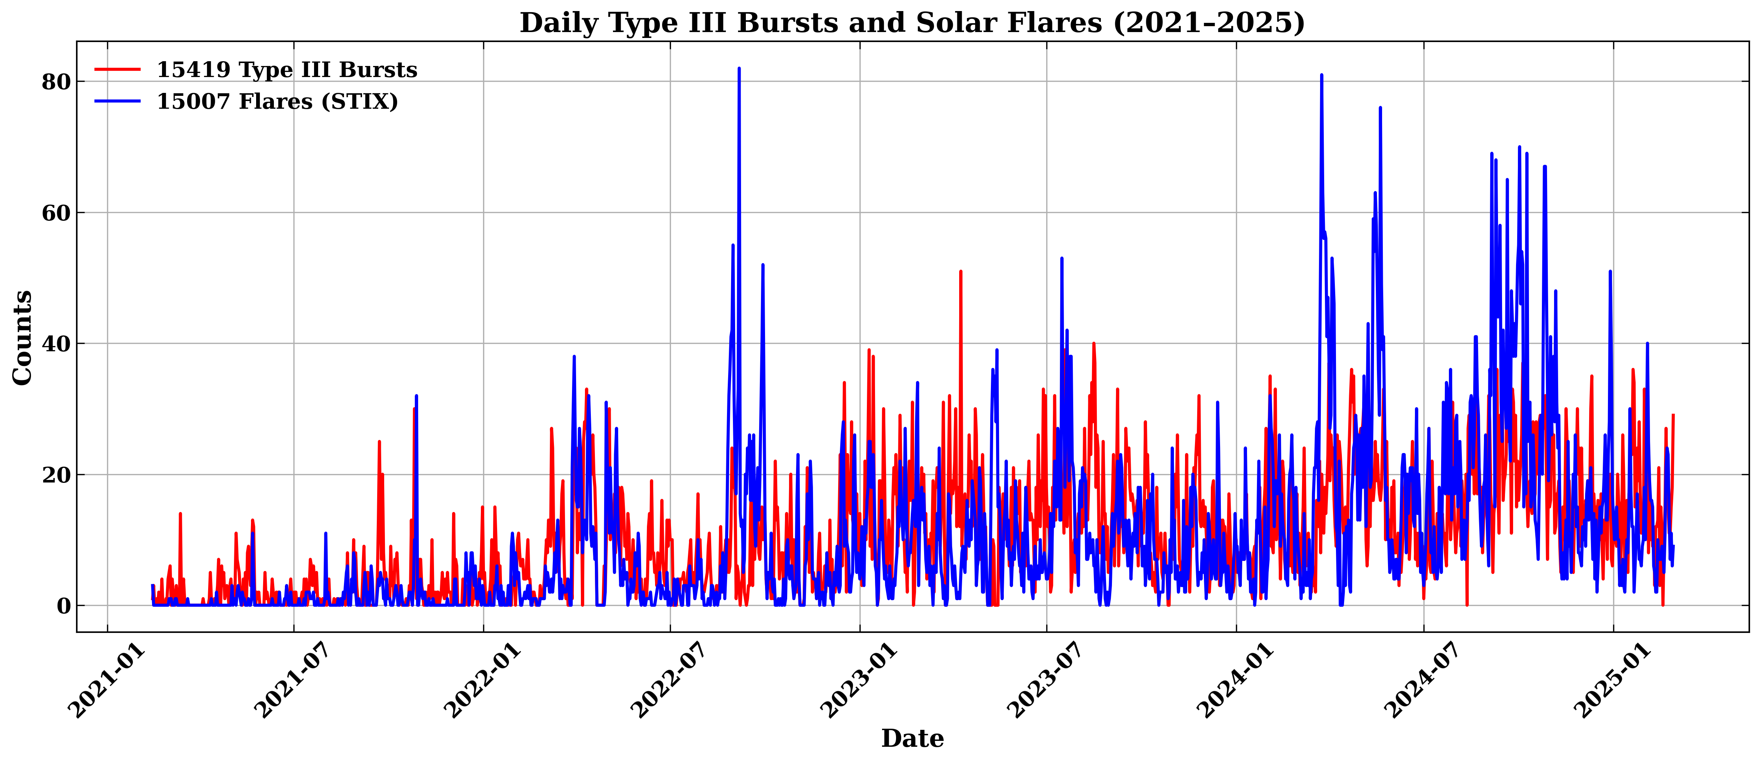
Statistical study of the association between type III and HXR bursts
Step 1
Input 1: all Type III bursts from Catalogue of Solar Type-III radio bursts
A citizen-science catalogue of interplanetary Type III solar radio
bursts and first statistical results
A&A, 709, A253 (2026)
https://doi.org/10.1051/0004-6361/202659339
Aikaterini Pesini , Antonio Vecchio , Xavier Bonnin , Milan Maksimovic et al.
Work in progress
K. Pesini
University Nijmegen
&LIRA
PhD in progress
Input 2: all flares from
stix_flarelist_science
(developed by Laura Hayes)
with counts > 5σ above background in energies > 15 keV

Slide 13
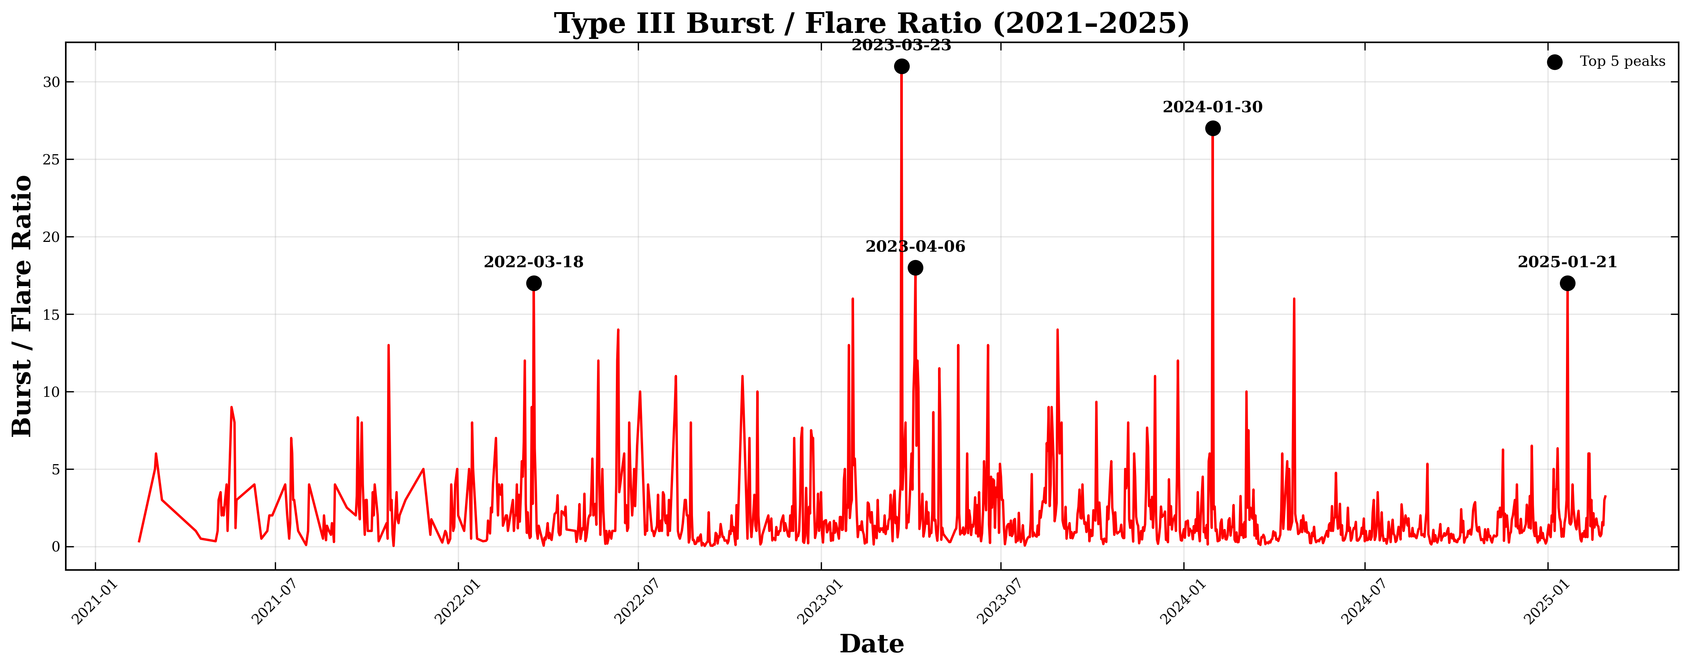
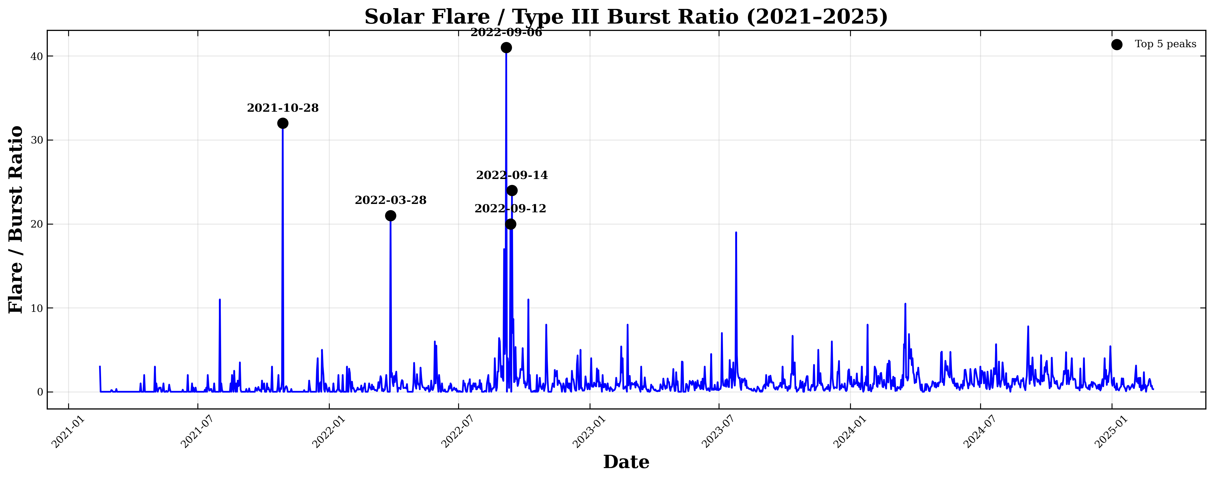
Highly variable daily ratio between X-rays and radio events
Not one to one correspondance between X-ray
flares and type III bursts
Srong X-ray flares not associated with type III
bursts
Type III burst not associated with strong
X-ray flares
see previous resuls from a short period
(Paipa et al., 2025)
Notes:
Remove the moving average and divide the plots into years
Exclude the SO distance

Slide 14
Association between type III bursts and X-ray flares
Step 2
Work in progress!!
Time of Type III bursts taken at the 5 highest frequency of the event => Type III time = Average of the time values of the 5 highest frequencies.
Time of Flares : flare start time – end time
Association time criterion: flare start time-1min <time of Type III<flare end time + 1 min
METHOD
RESULTS
Out of 15007 flares => 4061 are associated with at least 1 T3 (27%)
Out of 15934 Type IIIs => 4996 occur during a flare (>15 keV) (31,4%)
(to be compared with the proportion of “coronal”type III bursts associated with X-ray flares aboce 6 keV of 28% (Reid & Vilmer, 2017)

Slide 15
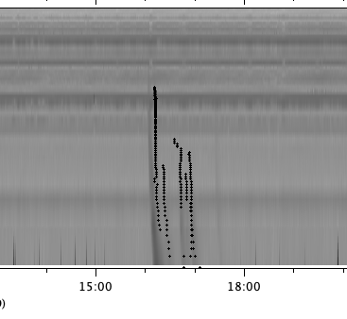
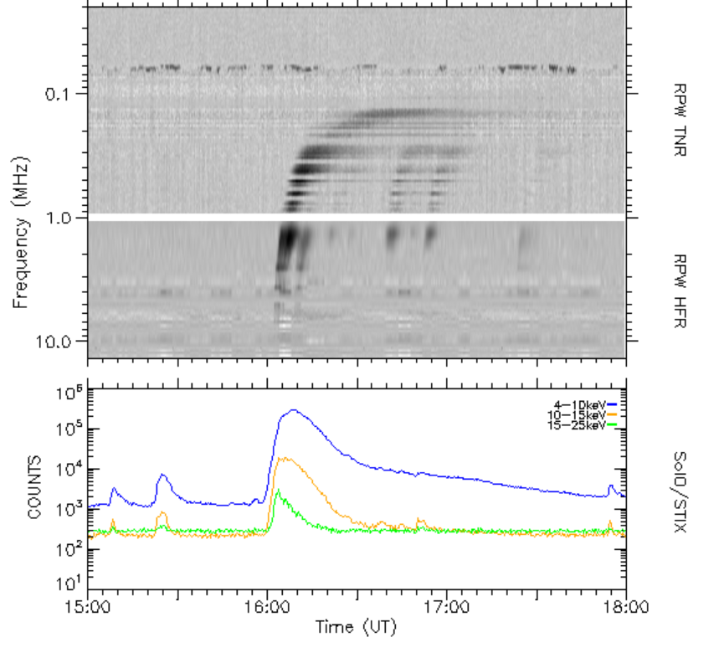
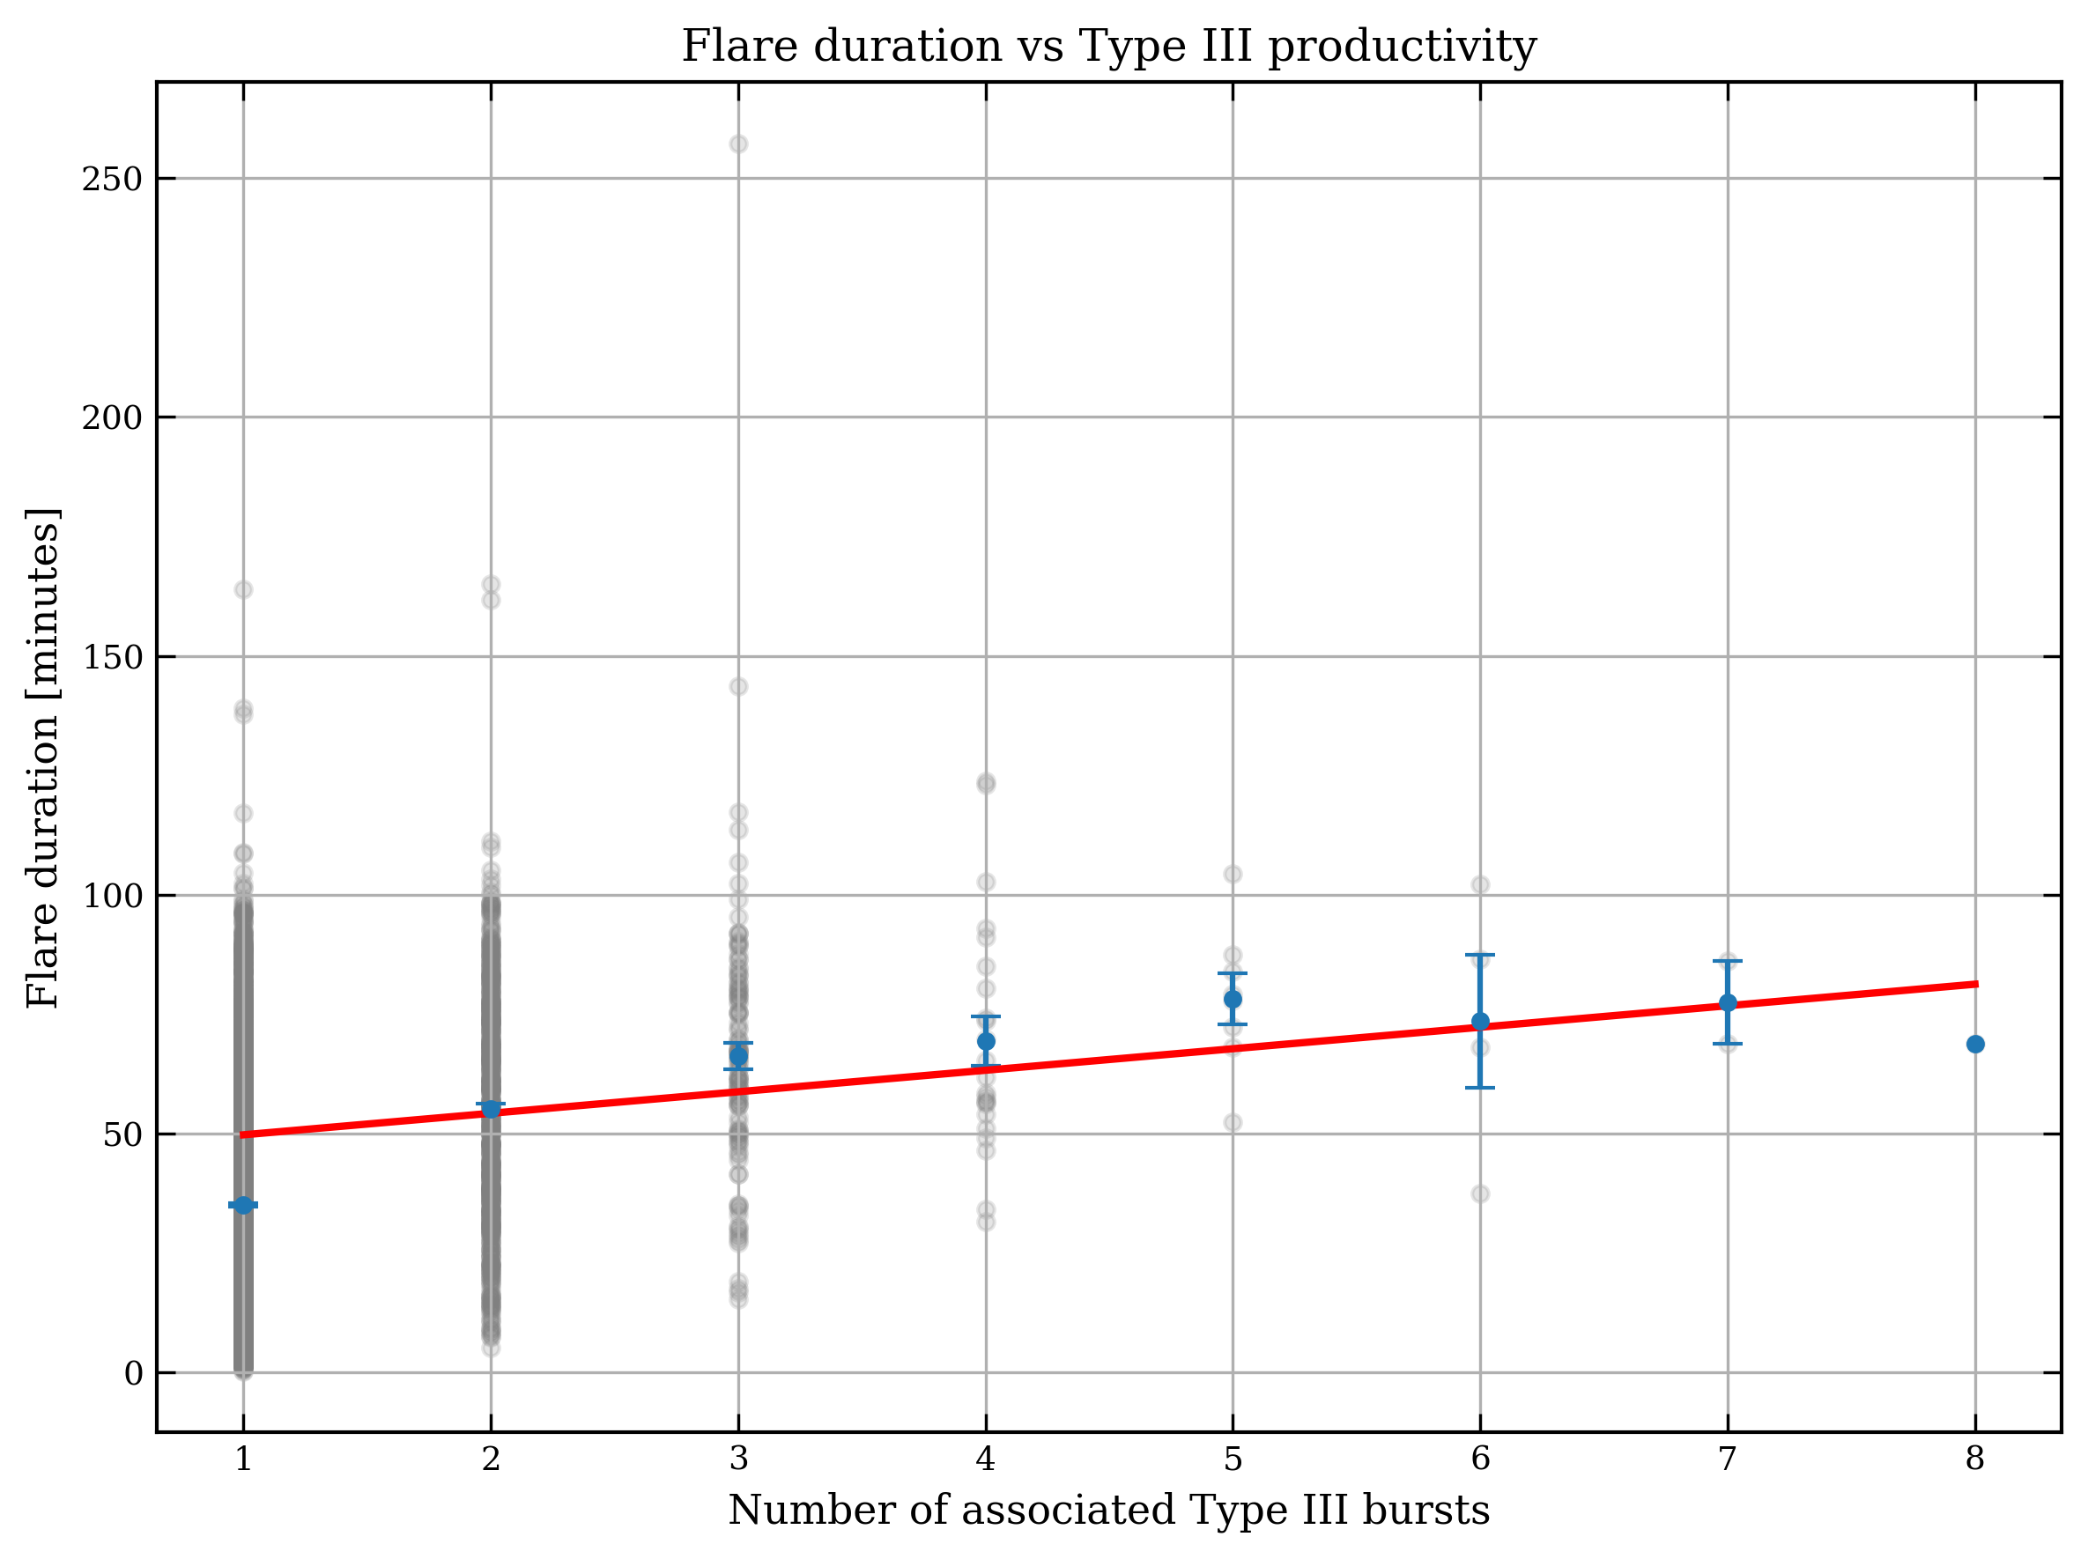
Association between type III bursts and X-ray flares
Step 2
Work in progress!!
From the catalog
Several type III bursts can be associated with a single X-ray flare!
Radio monitoring site

Slide 16
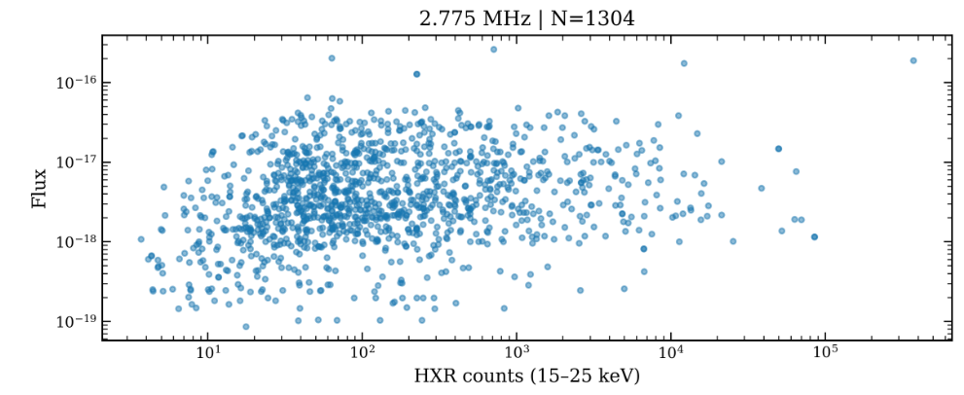
Association between type III bursts and X-ray flares step 3
After selection of the type III burst closely
Associated in time with the X-ray peak
1304 events
)
to be compared with results for Paipa et al 2026 (on 38 events
Preliminary results
K.,Pesini
Type III flux vs HXR counts (scaled to 1AU)
Non-thermal electron energy

Slide 17
Thanks for your attention

