Slide 1
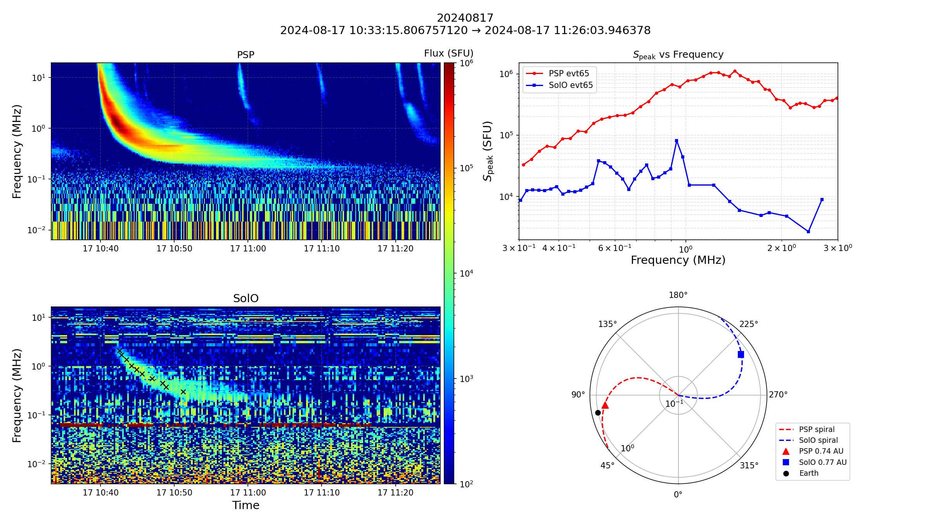




Fluctuations in
Solar Type III Radio Bursts Spectra: Observations with
PSP and SolO
Panisara Thepthong¹ , Matthieu Kretzschmar¹ , Milan Maksimovic² , Katerina Pesini^{2,3}
LPC2E, OSUC, CNRS, University of Orléans, CNES, 3A avenue de la Recherche Scientifique, 45071 Orléans, France
LIRA, Observatoire de Paris, Université PSL, CNRS, Sorbonne Université, Université de Paris, 92195 Meudon, France
Radboud Radio Lab, Department of Astrophysics, Radboud University Nijmegen, Nijmegen, The Netherlands
ATST : Colloque Scientifique| Biarritz, France | June 2026

Slide 2
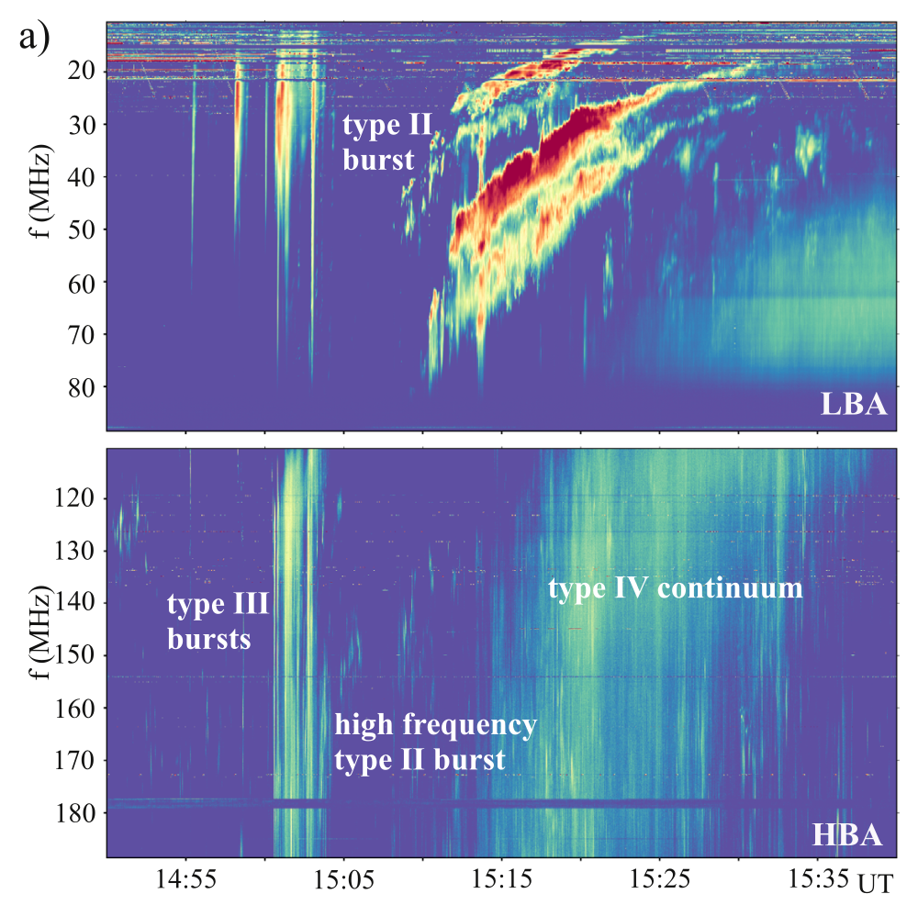
Introduction
Data & Analysis
Results & Discussion
Conclusion & TBC
Solar Radio Bursts
A sudden, intense increase in the radio waves emitted by the Sun.
Associated with different Solar activity. (e.g. Solar Flare, Coronal Mass Ejections (CMEs))
Come in a variety of forms, classified by how their frequency changes in time, known as their frequency drift rate.
  Type II : Slowly drift from high to low frequencies.
  Type III : Rapid drift in time towards lower frequencies.
  Type IV : broadband continuum radio wave emissions from the Sun.
Magdalenić et al. 2020

Slide 3
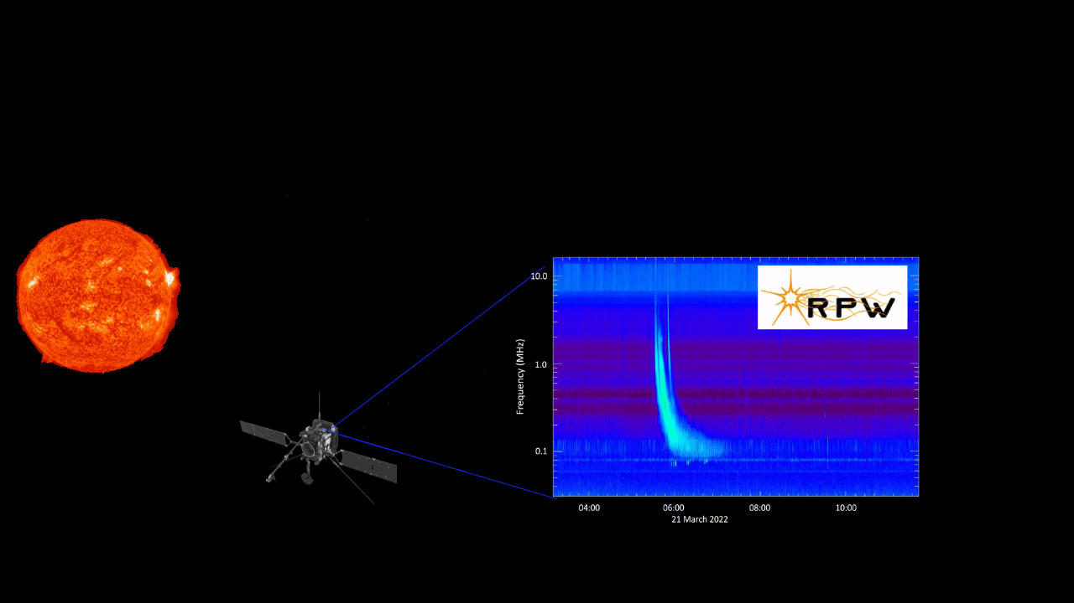

Introduction
Data & Analysis
Results & Discussion
Conclusion & TBC
Type III Radio Bursts
$$ω_{p} ∝ \sqrt{n_{e}}$$
Depending on the local plasma conditions,
Type III bursts serve as a powerful remote sensing diagnostic tool
for electron acceleration and transport, and the conditions of the background plasma they travel through.
Credit : https://www.esa.int/Science_Exploration/Space_Science/Solar_Orbiter/Catch_solar_bursts_in_new_citizen_science_project

Slide 4


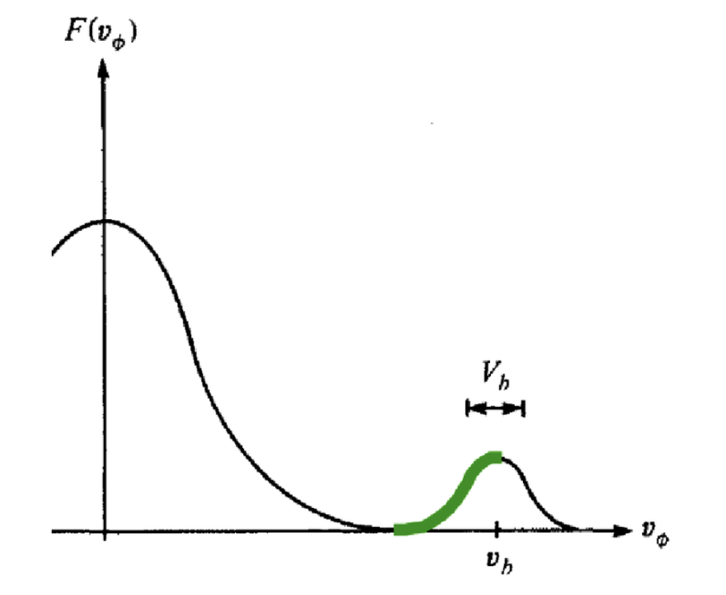
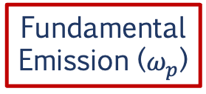









Introduction
Data & Analysis
Results & Discussion
Conclusion & TBC
Generation Mechanisms
Langmuir waves have to convert into electromagnetic (EM) waves near
the local plasma frequency
SUN
$e^{−}$beam
Nonlinear processes
Ion scattering
& 3 wave decay
Coalesence
$$δn$$
$$ℒ+ℒ^{′}$$
$$ℒ→ℒ^{′}+S$$
Bump-on-tail instability
Fundamental
Emission ($ω_{p}$)
Harmonic
Emission (${2ω}_{p}$)
Velocity
distribution
Function of the particle
$$\frac{∂f}{∂v}>0$$
Plasma is homogeneous
Linear mode conversion (LMC)
velocity
Random density fluctuations ($δn$)
$$v_{b}$$
Poster: Hannah Kirkwood
$$\overset{⃑}{B}$$
More electrons at slightly higher velocities, so electrons transfer energy to electrostatic plasma waves rather than damping them. This produces exponential growth of Langmuir waves (electrostatic waves). (Lin et al. 1981, Dulk 2000, Reid & Ratcliffe 20214)
EM Emission
(e.g., Ginzburg & Zhelezniakov 1958, Robinson et al. 1993, Krafft et al. 2013, Volokitin & Krafft 2018)

Slide 5
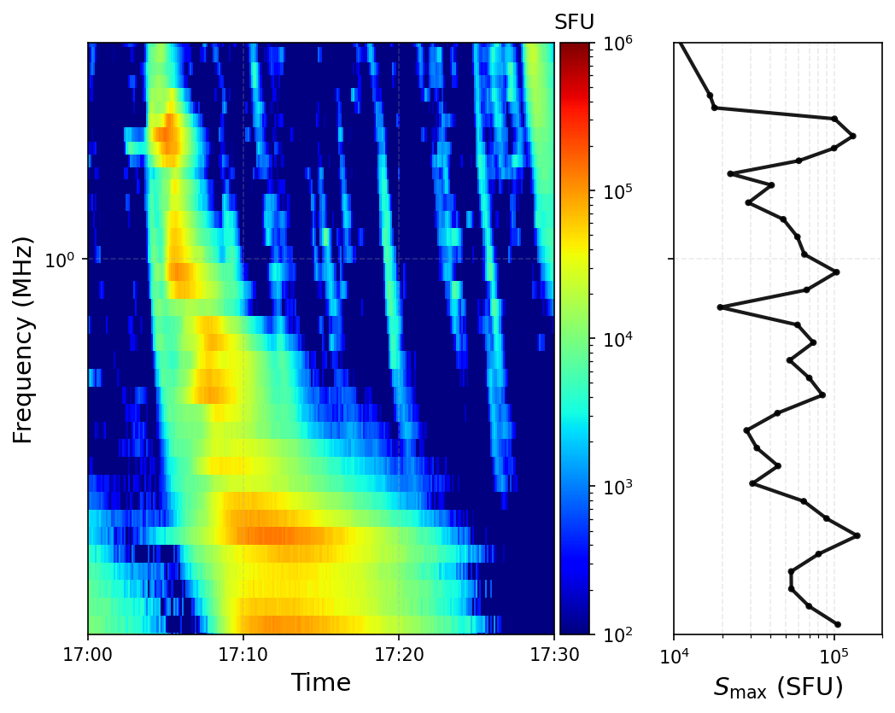
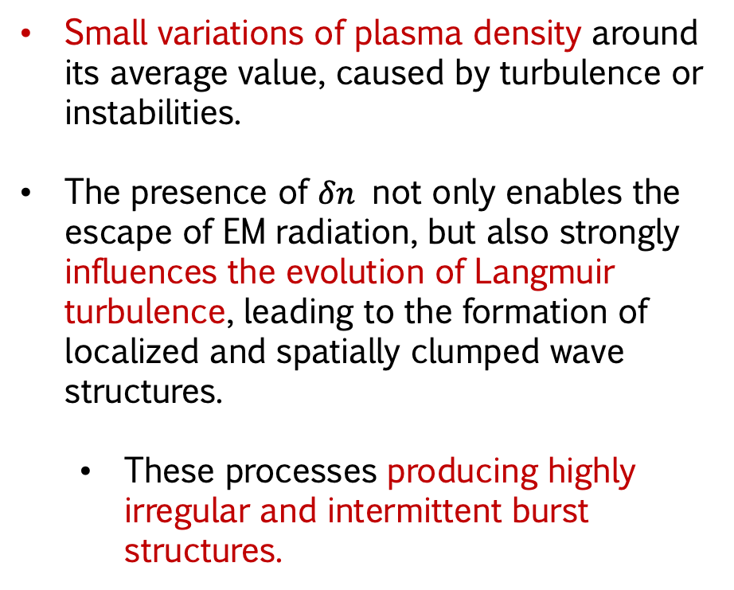

Introduction
Data & Analysis
Results & Discussion
Conclusion & TBC
Density Fluctuations ($δn$)
Structured Type III Bursts
Small variations of plasma density around its average value, caused by turbulence or instabilities.
The presence of $δn$ not only enables the escape of EM radiation, but also strongly influences the evolution of Langmuir turbulence, leading to the formation of localized and spatially clumped wave structures.
  These processes producing highly irregular and intermittent burst structures.
Fine Structures
Type IIIb bursts
Striae (substructure)

Slide 6
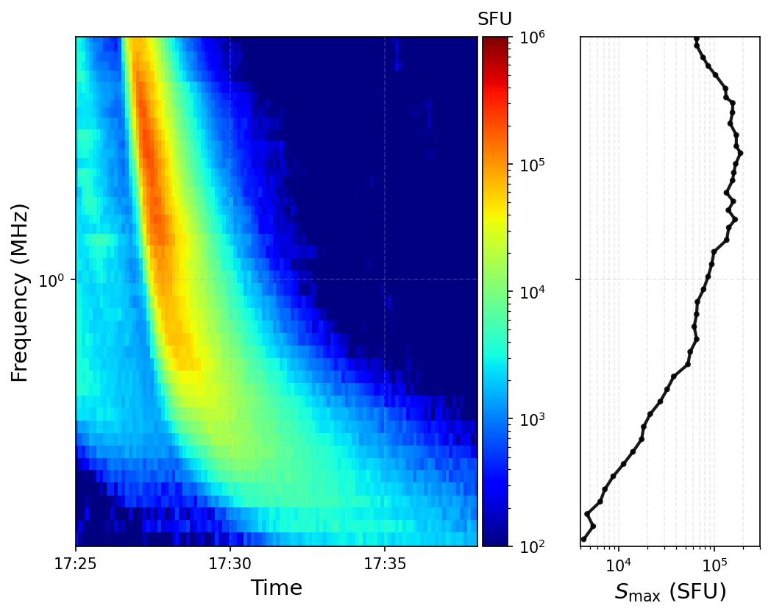
Introduction
Data & Analysis
Results & Discussion
Conclusion & TBC
Fluctuations in Type III bursts
Small
fluctuations
Are they real?
Exhibit fine-scale features within their dynamic spectra, while maintaining the same drifting behaviour as normal type III bursts.
Associated with the presence of ‘density fluctuations’ at different distances from the Sun (e.g., Chen et al. 2018, Krafft et al. 2022; Jebaraj et al. 2023, Krupar et al. 2025).

Slide 7
Introduction
Data & Analysis
Results & Discussion
Conclusion & TBC
Main Objectives
What can we learn from
type III radio burst fluctuations?
How do these features evolve with radial distance and the spacecraft's observing viewpoint?
Are the fluctuations driven by a local effect near the emission source region?
Do large and small fluctuations share the same underlying emission mechanisms?
Are they associated with density fluctuations?

Slide 8
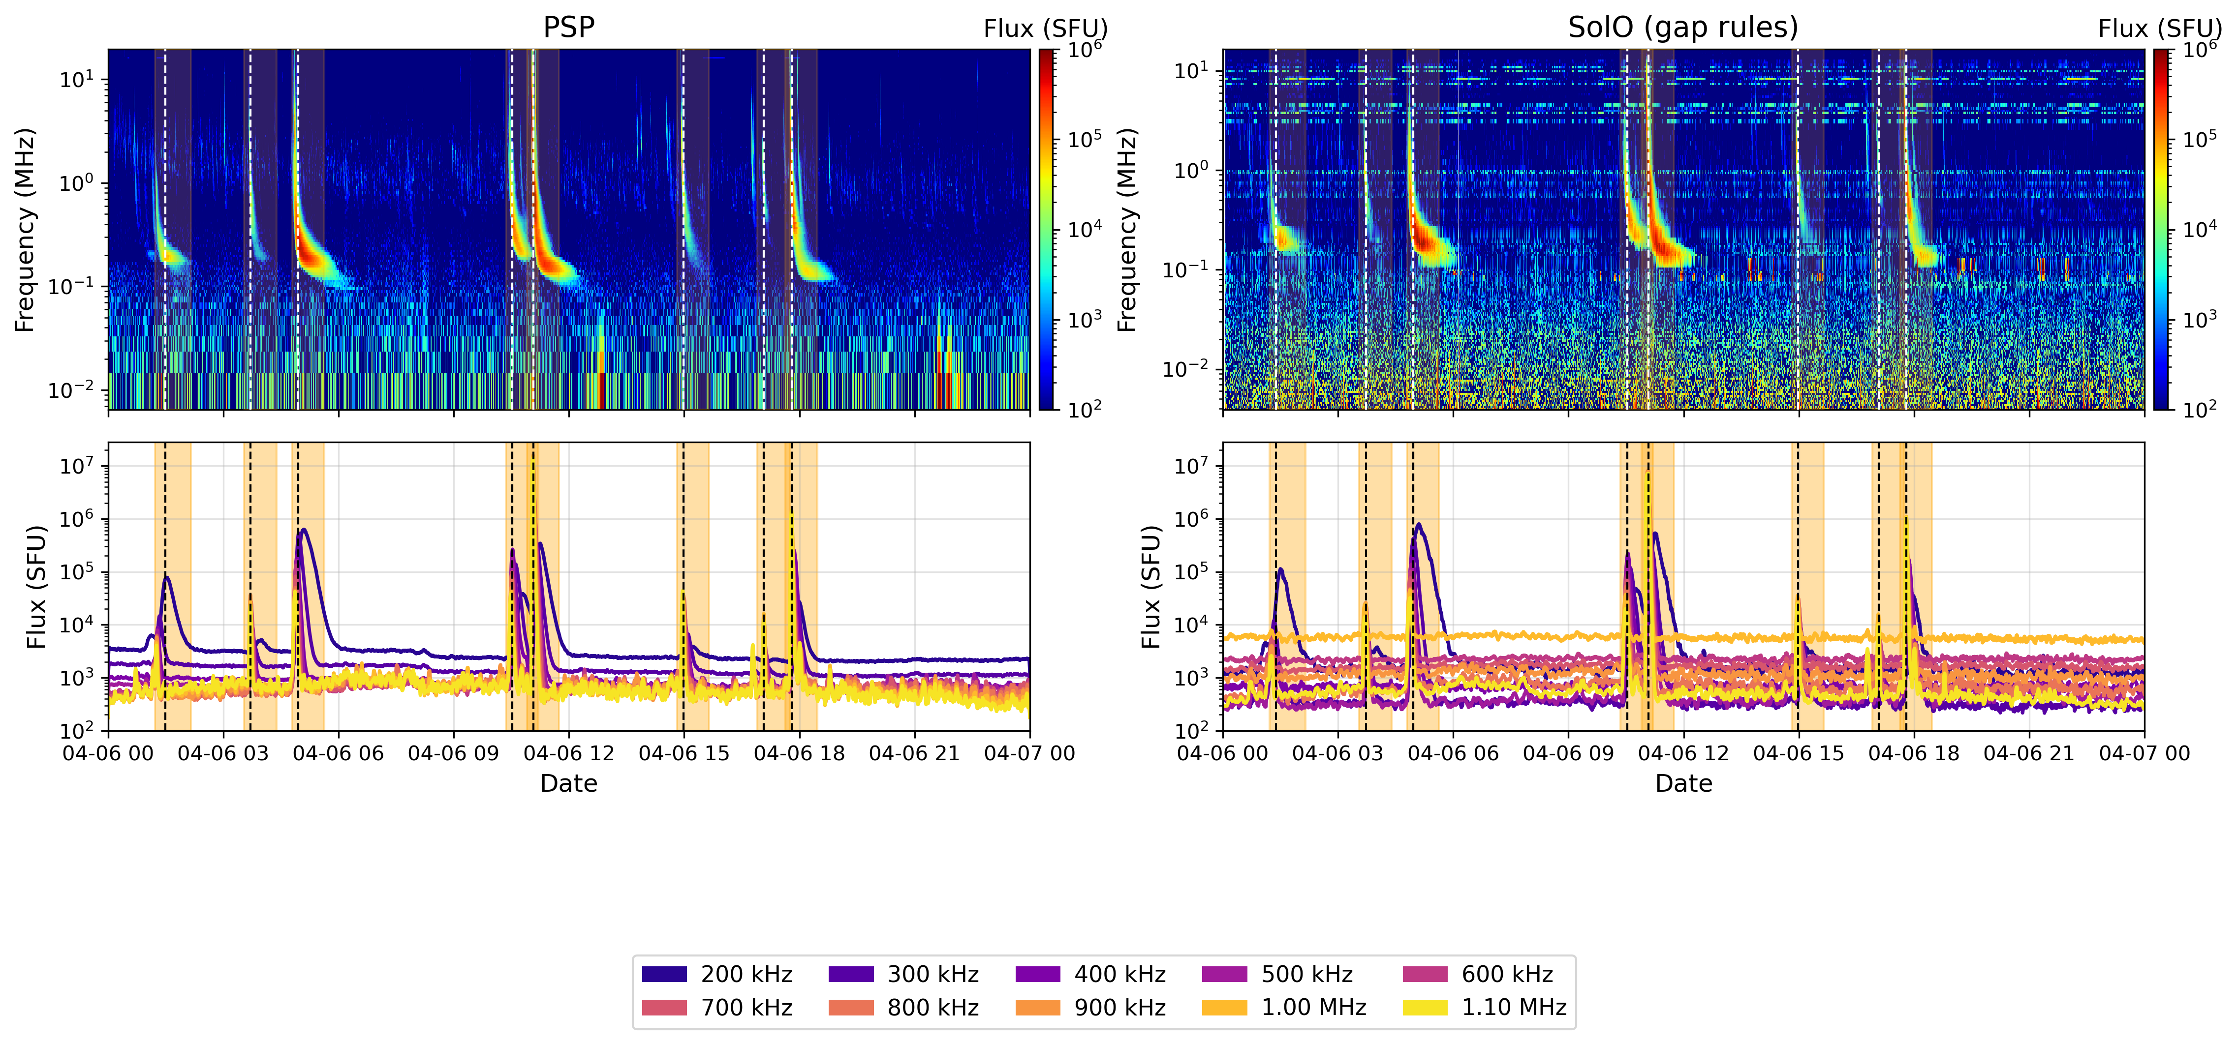
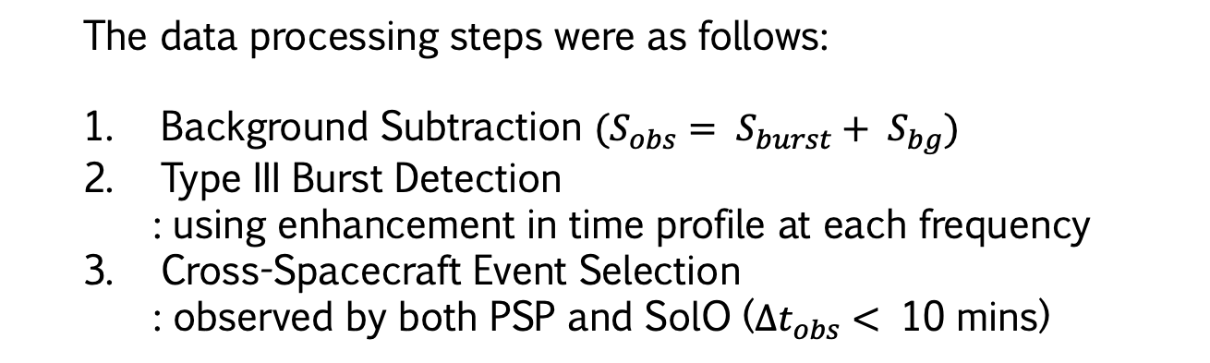
Introduction
Data & Analysis
Results & Discussion
Conclusion & TBC
Data and Analysis Method
Data & Processing
PSP : FIELDS L3 | SolO : RPW L3
Interval: 2023 - 2024
  The data processing steps were as follows:
  Background Subtraction $(S_{obs}= S_{burst}+ S_{bg})$
  Type III Burst Detection
    : using enhancement in time profile at each frequency
  Cross-Spacecraft Event Selection
    : observed by both PSP and SolO ($∆t_{obs}<$ 10 mins)
PSP
SolO
932 Bursts

Slide 9
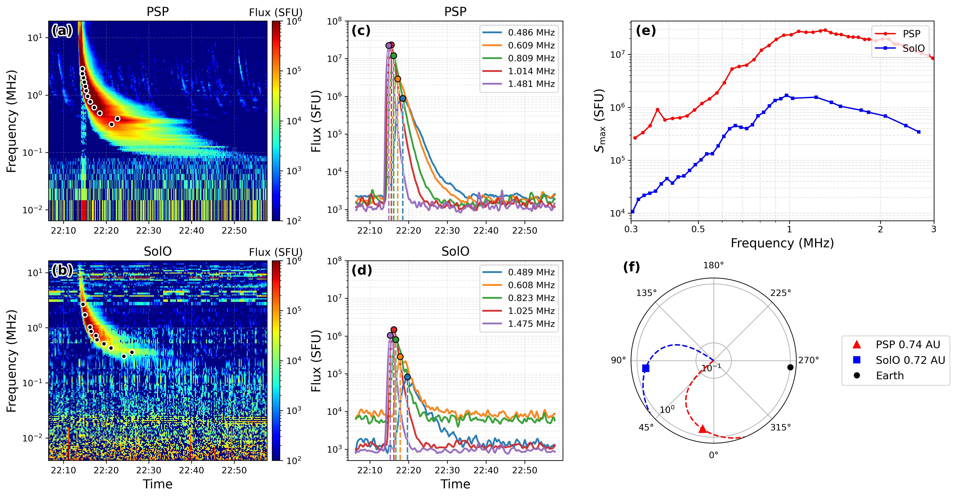

Introduction
Data & Analysis
Results & Discussion
Conclusion & TBC
Data and Analysis Method
Data & Processing
Maximum flux $S_{max}$

Slide 10
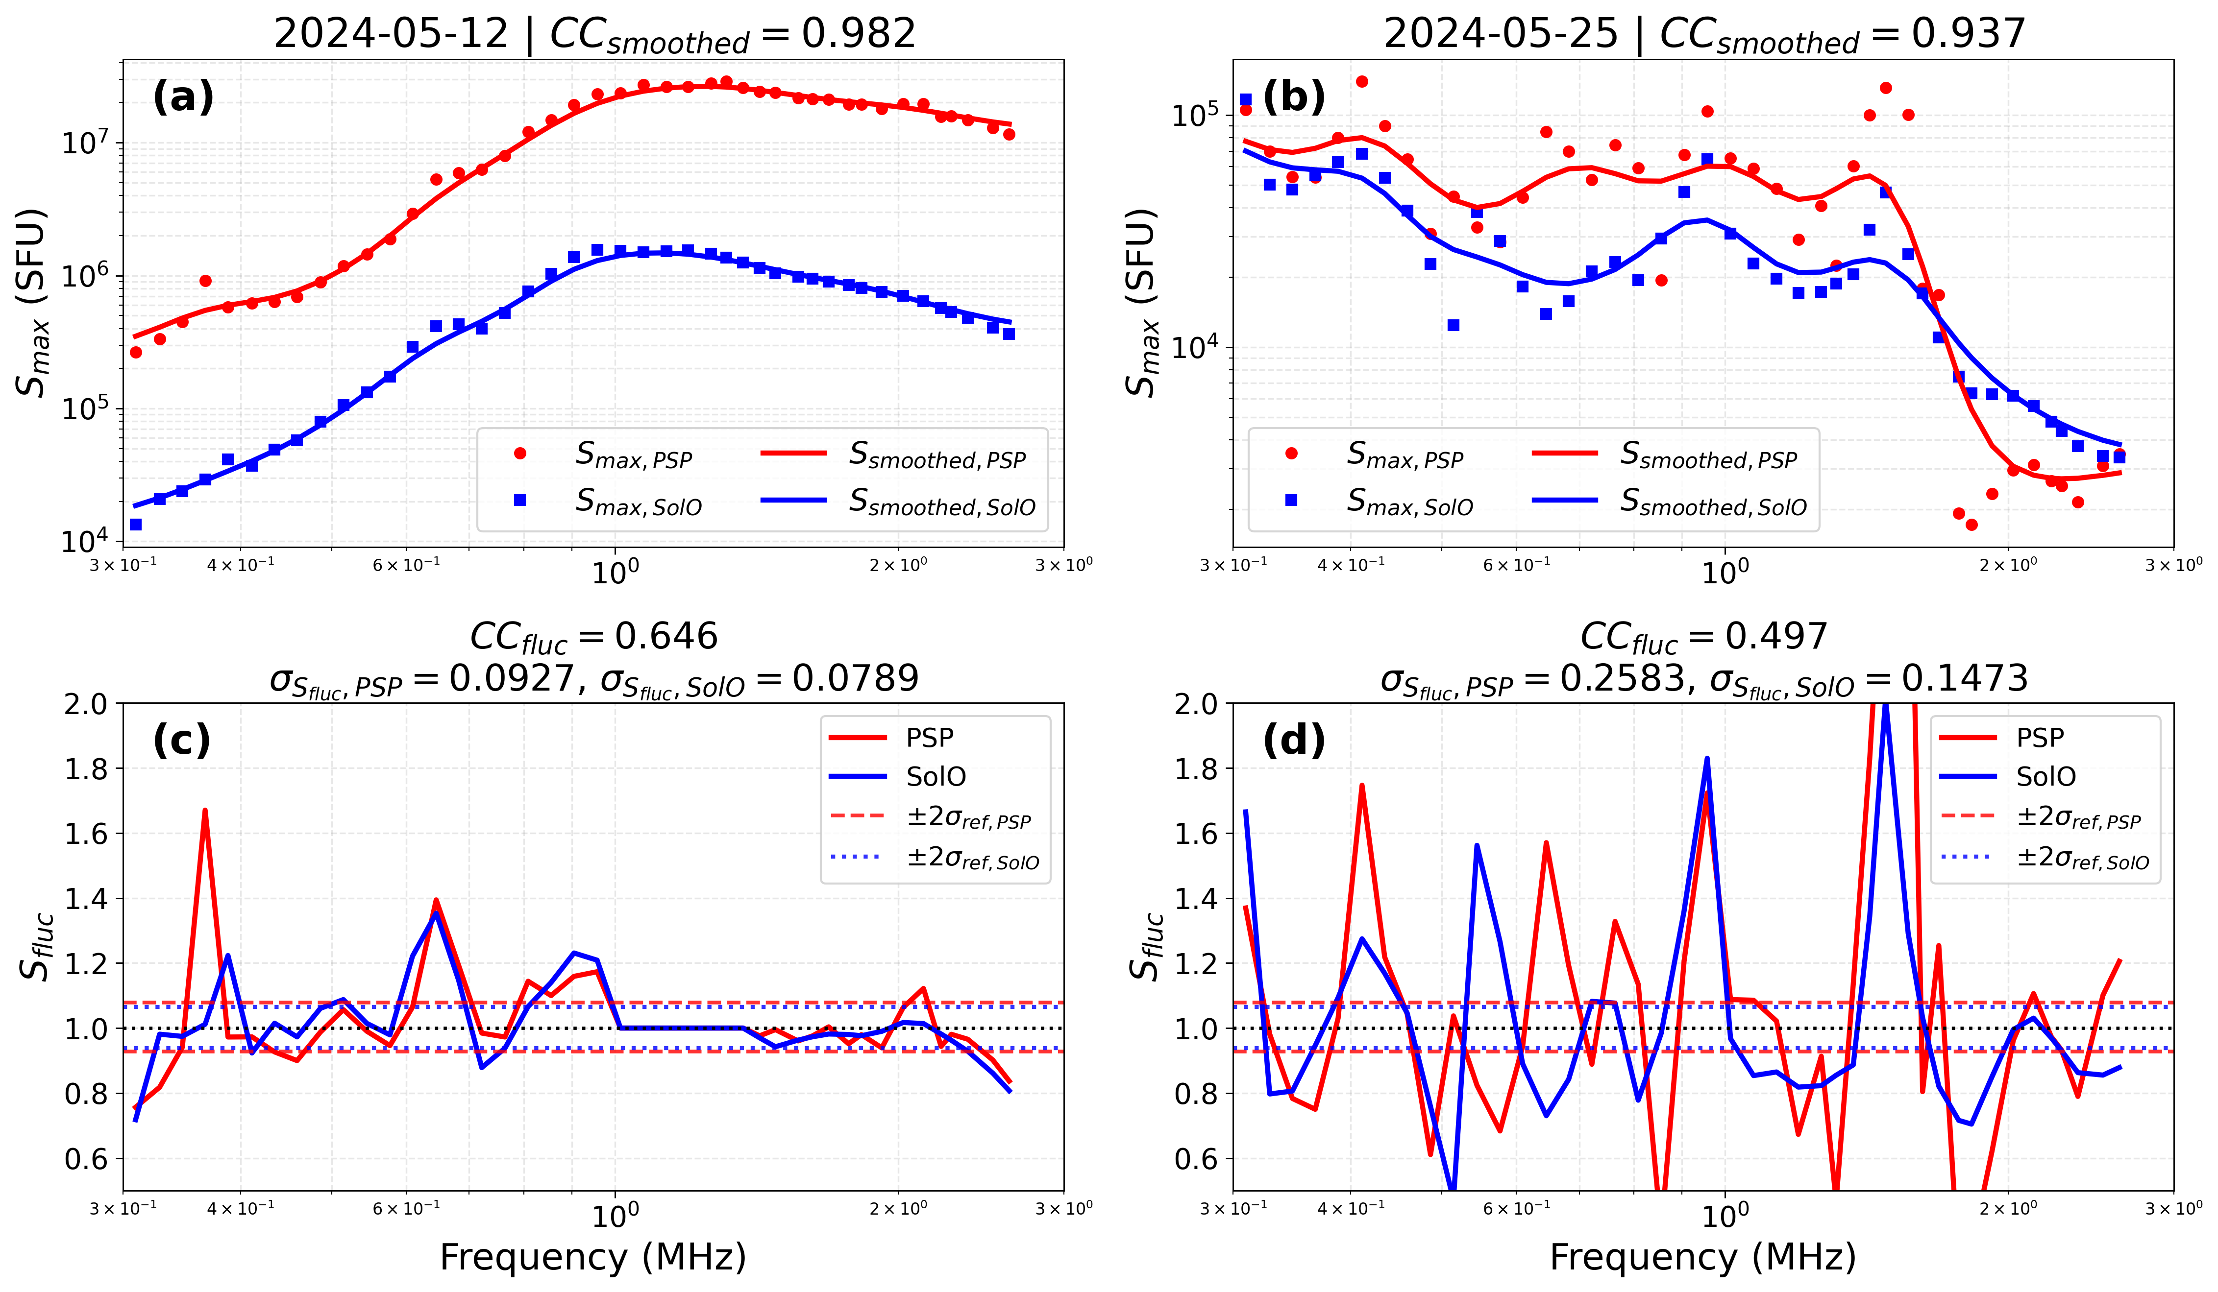

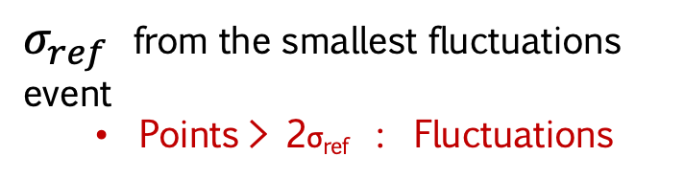

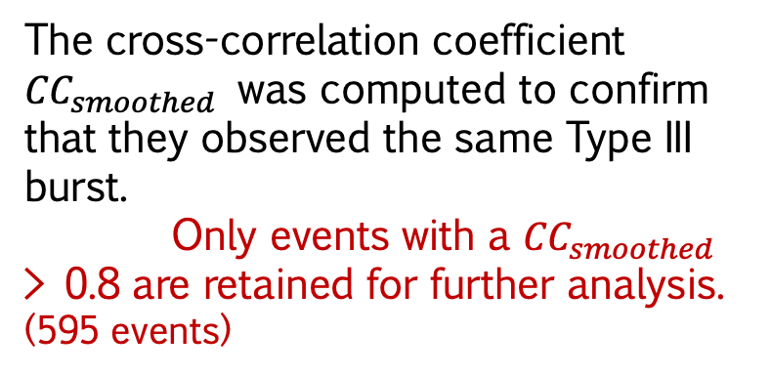

Introduction
Data & Analysis
Results & Discussion
Conclusion & TBC
Data and Analysis Method
Data & Processing
$$S_{fluc}=\frac{S_{max}}{S_{smoothed}}$$
The cross-correlation coefficient ${CC}_{smoothed}$ was computed to confirm that they observed the same Type III burst.
Only events with a ${CC}_{smoothed}$ > 0.8 are retained for further analysis. (595 events)
Maximum flux $S_{max}$
Fluctuations
$$S_{fluc}$$
$σ_{ref}$ from the smallest fluctuations event
  Points > 2σ_{ref} : Fluctuations

Slide 11
Introduction
Data & Analysis
Results & Discussion
Conclusion & TBC
Data and Analysis Method
Data & Processing
Maximum flux $S_{max}$
Fluctuations
$$S_{fluc}$$

Slide 12
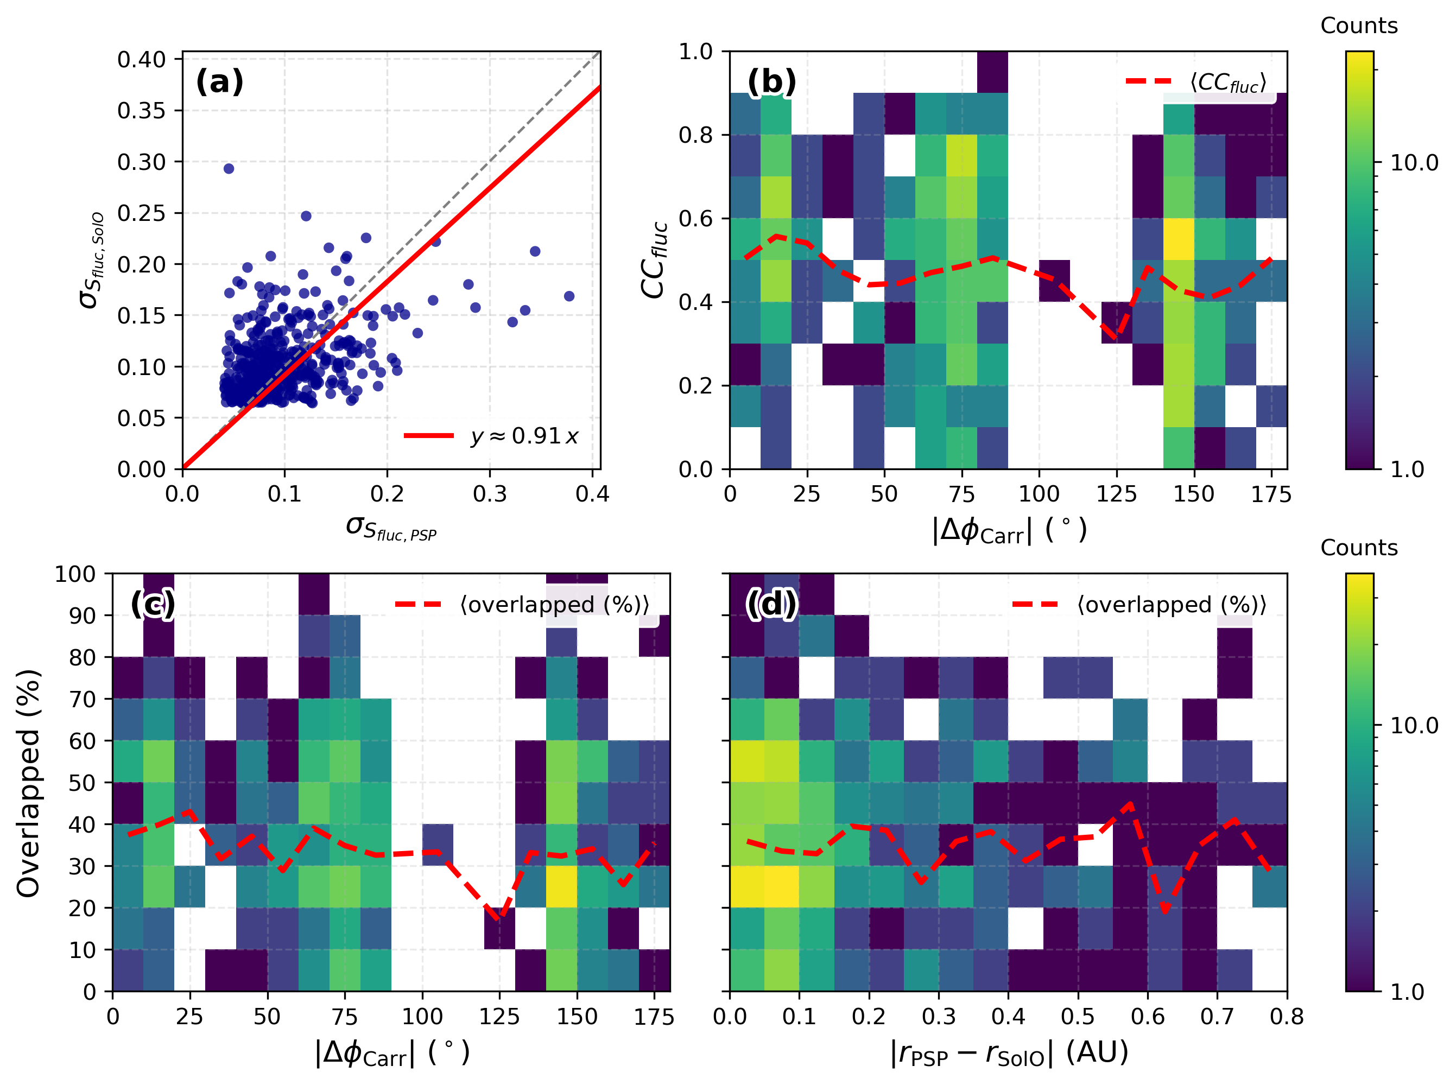
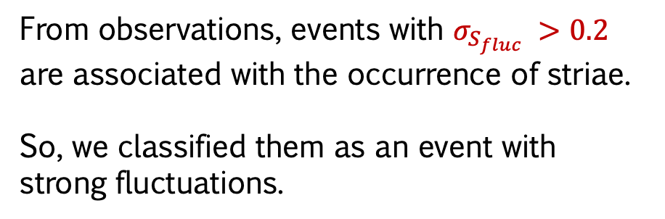
Introduction
Data & Analysis
Results & Discussion
Conclusion & TBC
Fluctuations Correlation: PSP vs. SolO
From observations, events with $σ_{S_{fluc}} >0.2$ are associated with the occurrence of striae.
So, we classified them as an event with strong fluctuations.
No clear dependence of the fluctuations on the angular separation is observed.

Slide 13
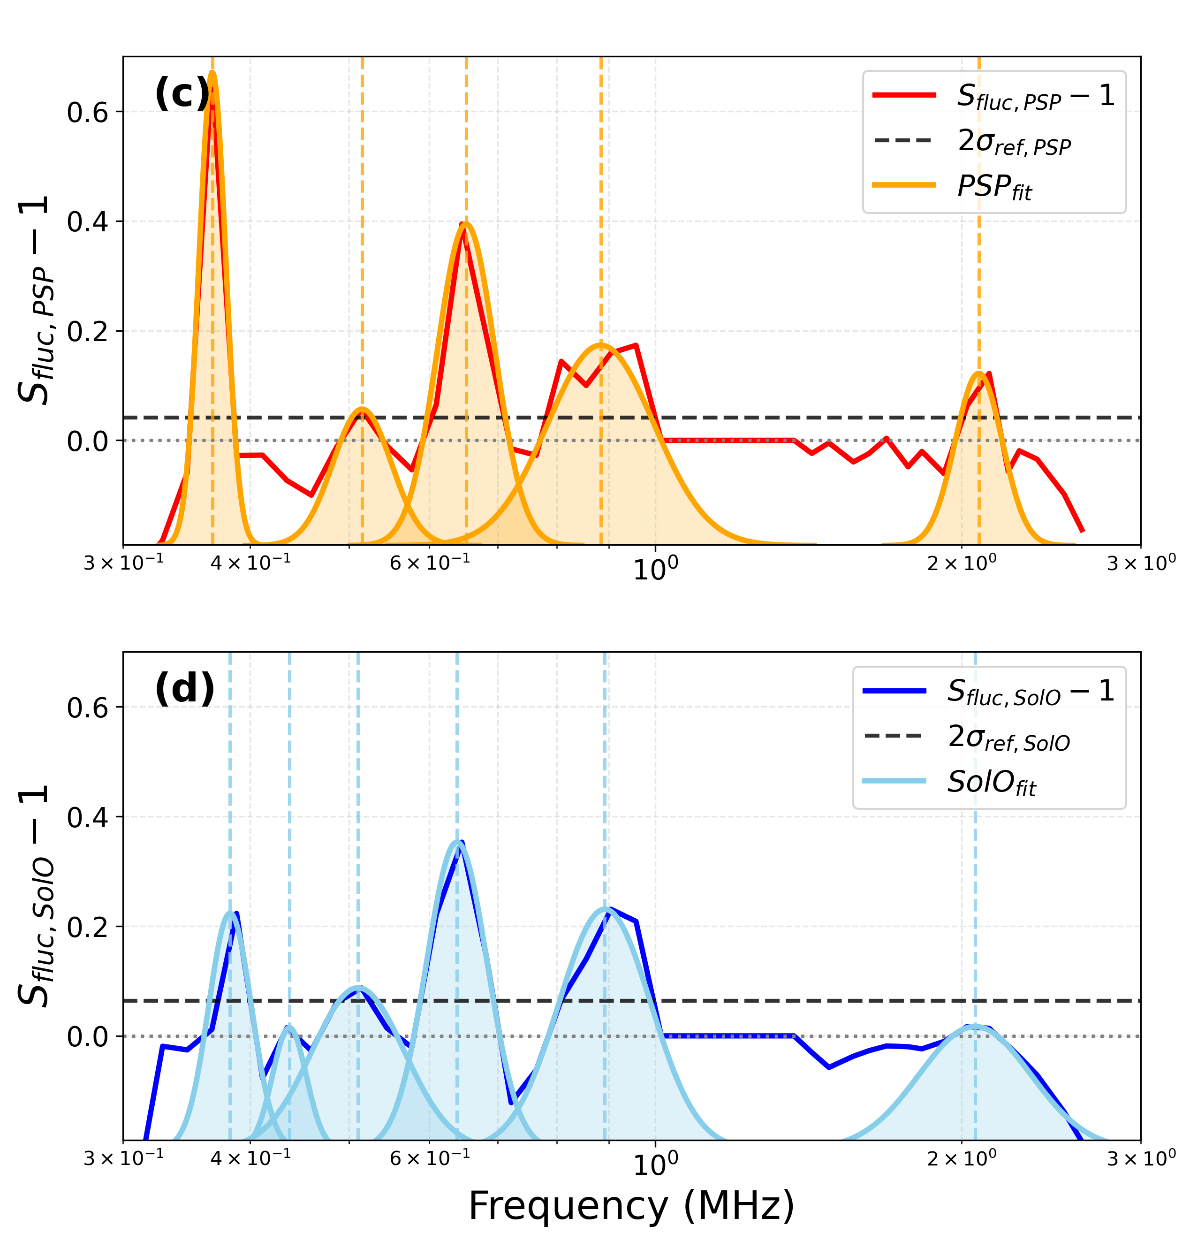

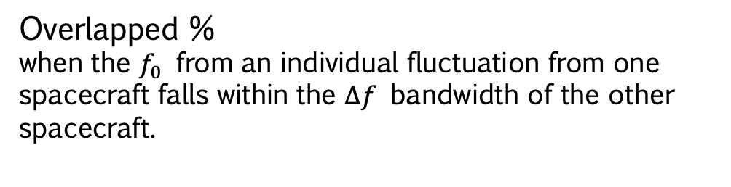


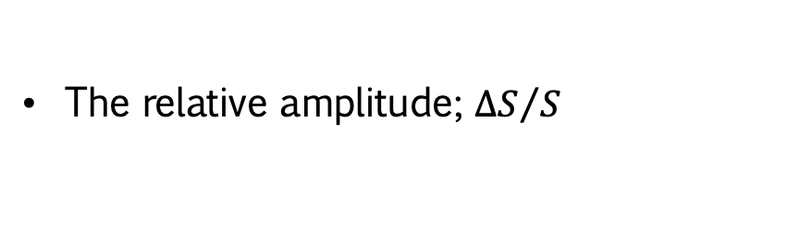





Introduction
Data & Analysis
Results & Discussion
Conclusion & TBC
Individual Fluctuations
Individual fluctuation was identified using zero-crossing boundaries, and the Gaussian fit was applied to the positive peak. (same method use in Krupar et al. 2025)
$$\frac{∆S}{S}$$
The relative amplitude; ${∆S}/S$
$$∆f$$
$$f_{0}$$
The frequency bandwidth; $∆f$
Centre of the observed peak; $f_{0}$
Overlapped %
when the $f_{0}$ from an individual fluctuation from one spacecraft falls within the $∆f$ bandwidth of the other spacecraft.
$$\frac{∆S}{S}$$
$$∆f$$
$$f_{0}$$

Slide 14
Introduction
Data & Analysis
Results & Discussion
Conclusion & TBC
Overlapped (%)
Both spacecraft may still sample comparable spectral features despite being located at different heliocentric distances.
  Krupar et al. 2024: There's no significant radial variation in type III radio burst properties (below 0.24 AU).

Slide 15
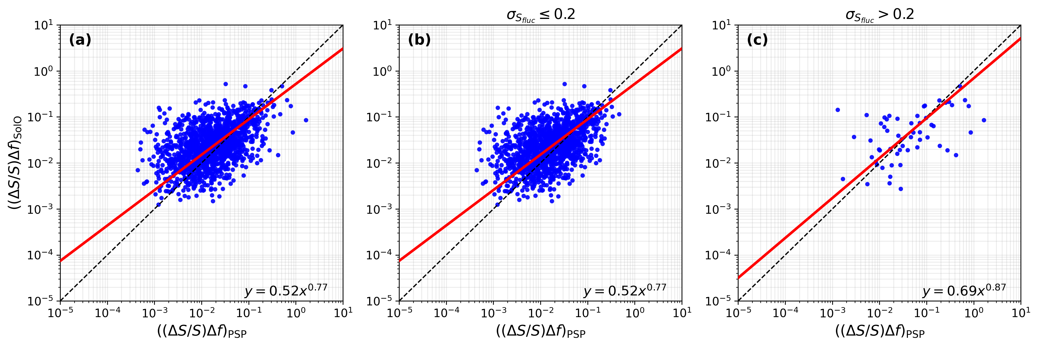
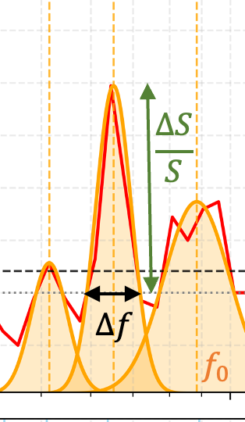
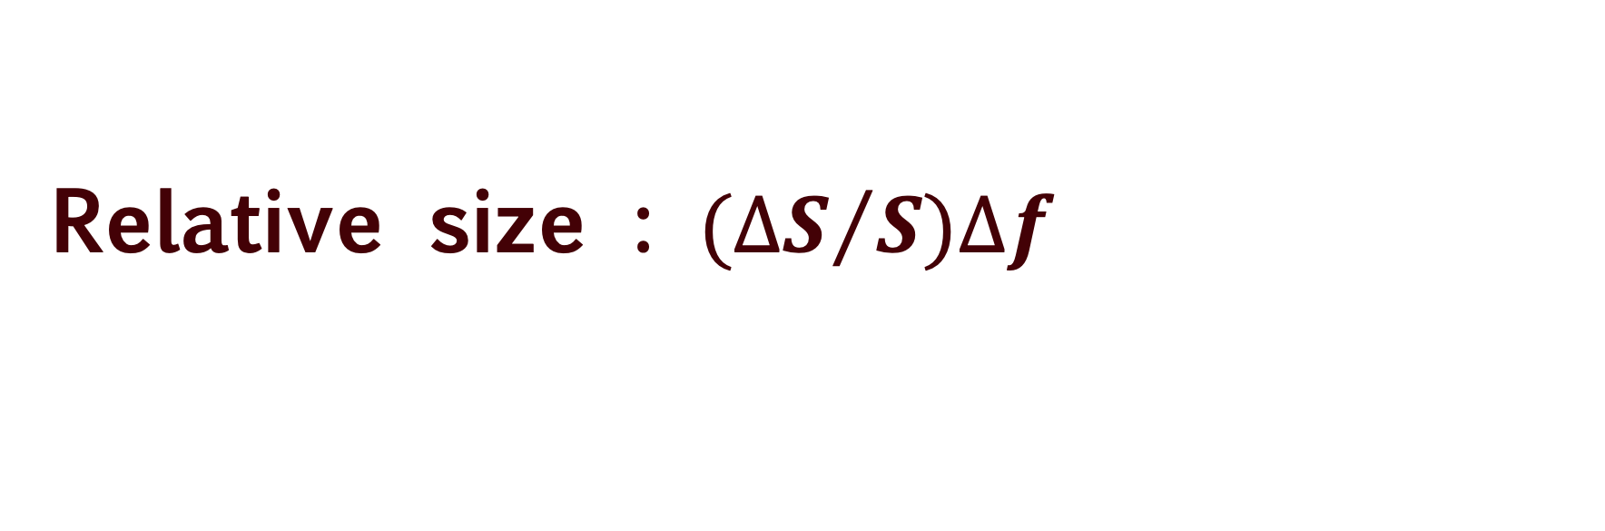
Introduction
Data & Analysis
Results & Discussion
Conclusion & TBC
Relative size : ${(∆S}/{S)∆f}$
The relative sizes of individual type III fluctuations observed with PSP and SolO show good agreement, with a similar trend for both small and large fluctuations.

Slide 16
Introduction
Data & Analysis
Results & Discussion
Conclusion
Conclusions
Thepthong et al. 2026 (in prep.)
Are small fluctuations real?
  Yes, we observed this structure's feature in both PSP and SolO
How do these features evolve with radial distance and the spacecraft's observing viewpoint?
  Fluctuations in maximum radio flux show strong similarity and high spectral correlation, regardless of differences in radial distance or heliolongitude separation.
Are the fluctuations driven by a local effect near the emission source region?
  Yes, we suggested that local effects are responsible for these fluctuations
Do large and small fluctuations share the same underlying emission mechanisms?
  Possibly, since we observed a continuum of fluctuations, and the same distribution between large and small fluctuations.
Are they associated with density?
  Future work!
Thank you for your attention

