Slide 1
Martian Atmospheric Ion Energization And Escape During The 2022 Disappearing Solar Wind Event: A Hybrid Simulation Study
M .Notonica¹, R. Modolo¹, N. Romanelli^{2,3}, L. Morales⁴, E. Dubinin⁵, J. Chaufray¹, F. Leblanc¹, Q. Nénon¹, C. Bertucci⁴
¹LATMOS, ²NASA-GSFC, ³Univ. Maryland, ⁴IAFE-Argentina, ⁵MPS-Germany
1st-year PhD student
Notes:
Title, who I am, what I’m doing

Slide 2
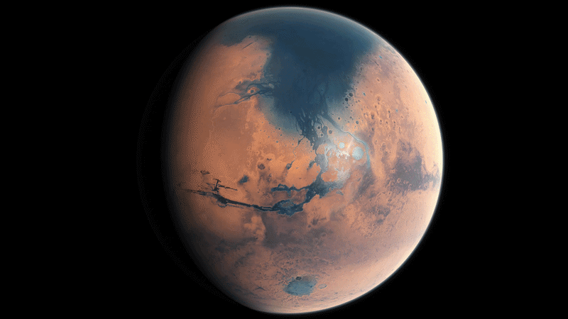
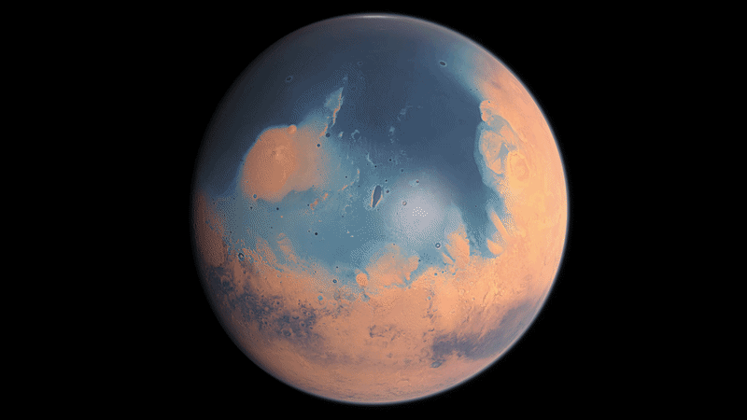
Mars in the past
Mars used to have a stable climate with liquid water (Pollack et al., 1987; Jakosky and Phillips, 2001)
(ESO/M. Kornmesser)
<1% atmospheric pressure than Earth’s
What caused this?
SOLAR WIND
Notes:
Mars used to have liquid wáter on the surface

Slide 3
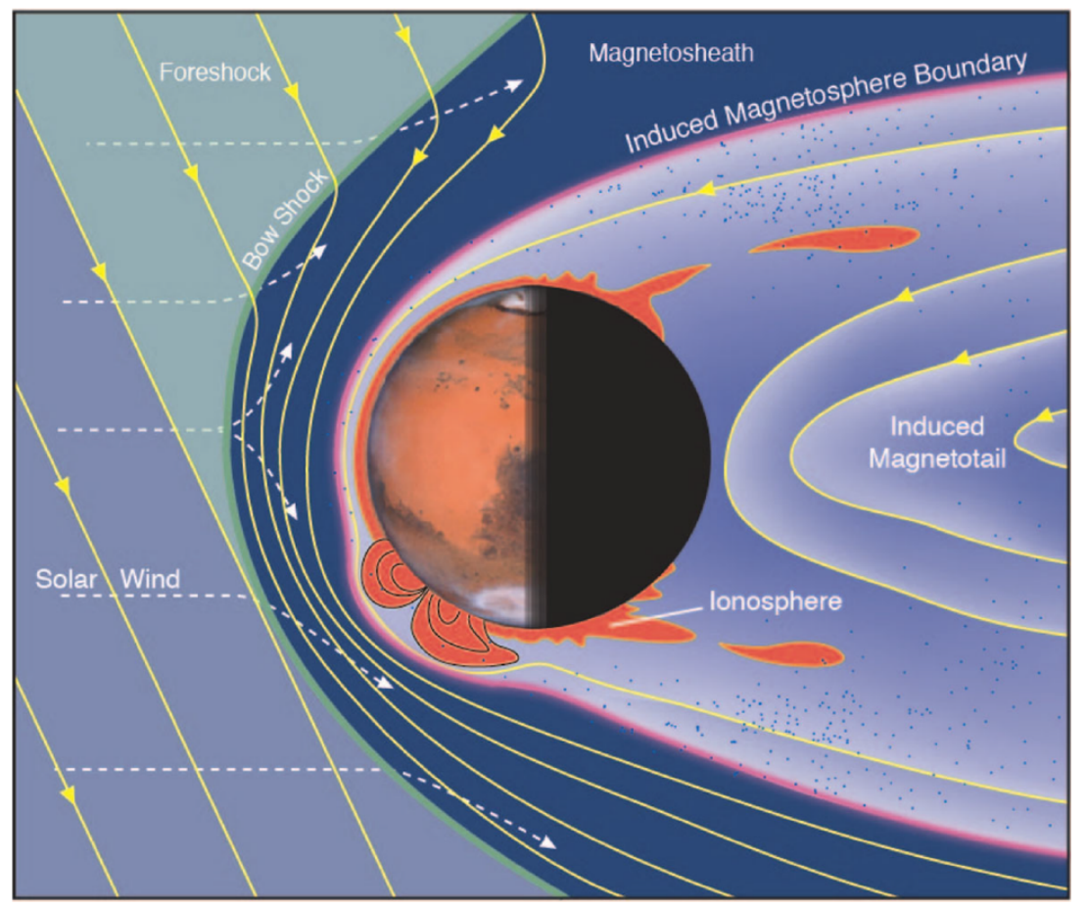
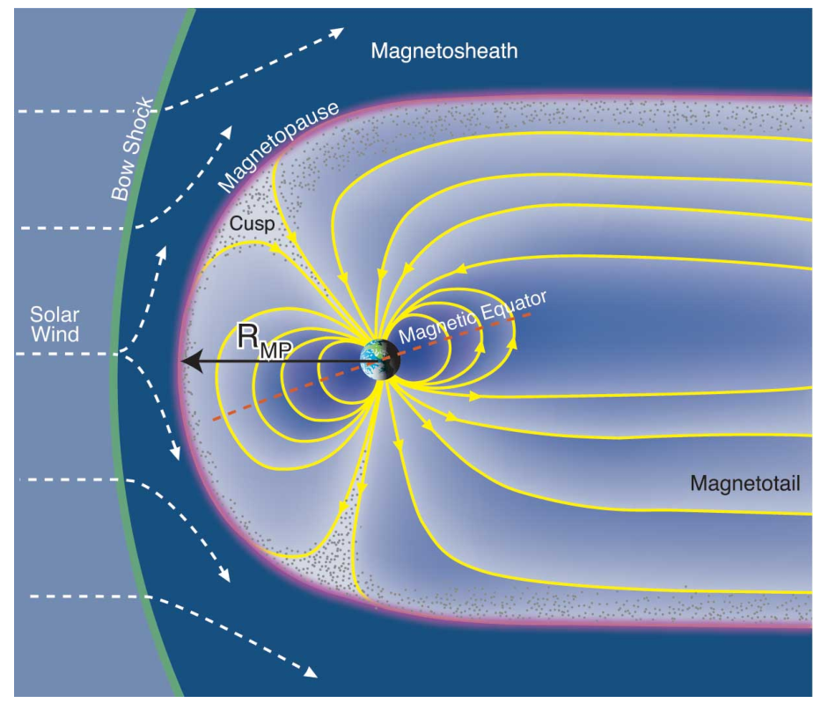
The Martian environment
Bowshock standoff distance:
~1.7 Mars radii
~ 15 Earth radii
(Brain et al., 2017 & Fran Bagenal & Steve Barlett)
Notes:
Just to introduce the Martian boundaries and the crustal fields

Slide 4
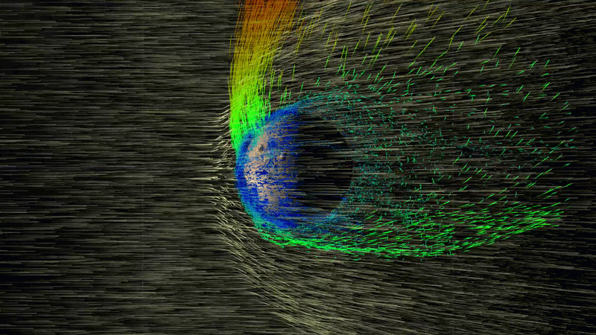
Ion flux structures
E
(NASA GSFC)
Main O⁺ escape channels:
Plume – high energy ions (up to few keV)
Tail – lower energy ions
Notes:
Introduce ion escape and how this was more intense in the Early Solar System

Slide 5

Extreme solar wind events
Early Solar System
Extreme events
(Jakosky et al., 2015a; Brain et al., 2016)
(NASA GSFC)
We want to simulate them!
Notes:
Example of extreme event: CME

Slide 6
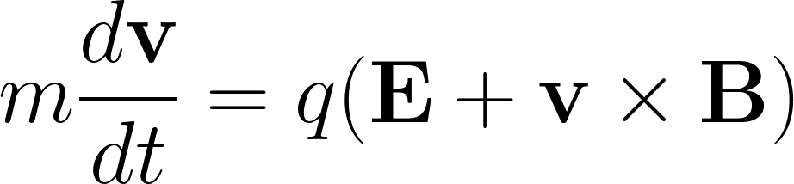
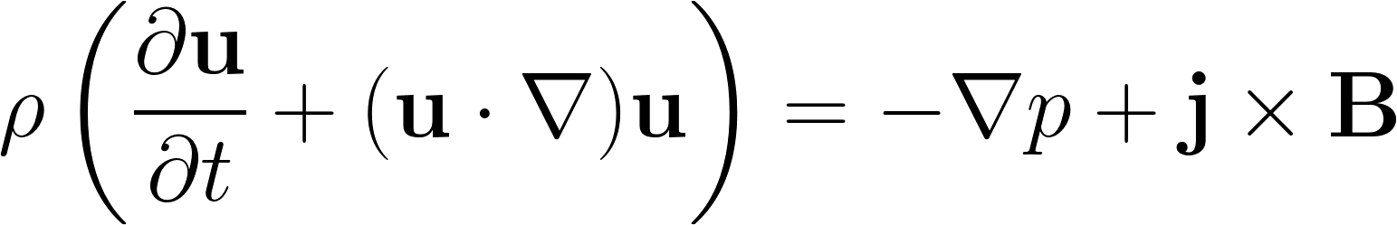
Simulation formalism
Solar wind:
protons
electrons
Newton
Magnetohydrodynamics
+ Maxwell equations, Ohm’s law, equation of state, other constraints
Ions
(macroparticles)
Electrons
(inertialess fluid)
Crustal fields initialization
Planetary vs. Solar wind ions
Multi-species
Local computation of ionization processes
Ionospheric chemistry scheme
Latmos Hybrid Simulation
(LatHyS)
(Modolo et al., 2016)
Notes:
The hybrid formalism

Slide 7
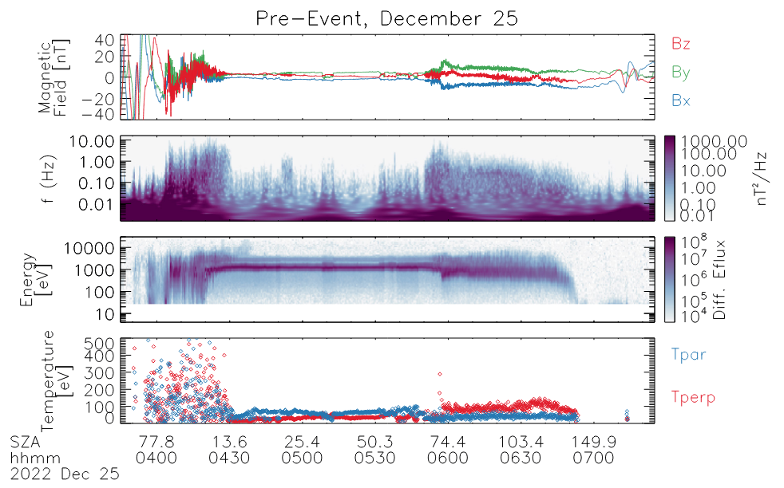
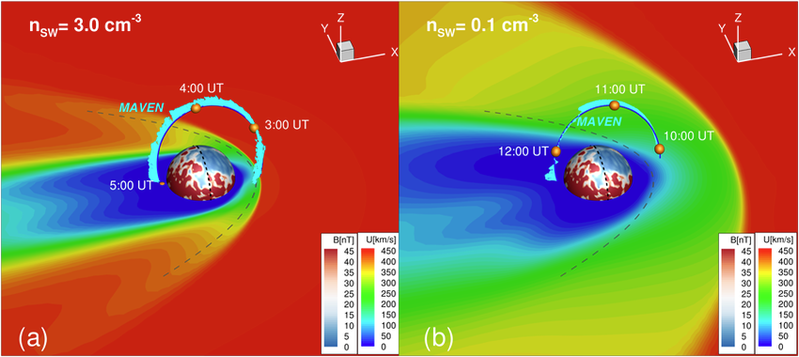
Dissapearing Solar Wind (DSW)
Around 26 December 2022
(Halekas et al., 2023)
MSH
n_{sw}
SW
MSH
1.8 R_{M}
3.0 cm⁻³
(Halekas et al., 2023)
(Ma et al., 2025)
0.1 cm⁻³
Notes:
The DSW event; what happened, why it is extreme, where was MAVEN

Slide 8
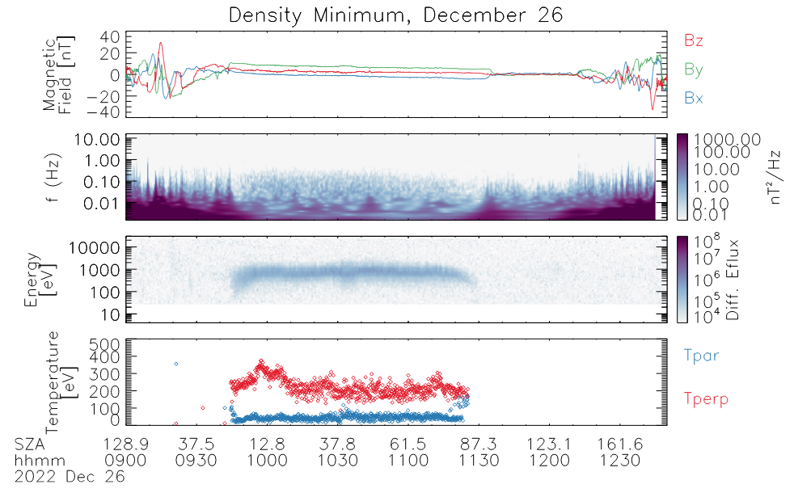
Dissapearing Solar Wind (DSW)
Around 26 December 2022
(Halekas et al., 2023)
MSH
n_{sw}
SW
MSH
1.8 R_{M}
3.0 cm⁻³
MSH
0.1 cm⁻³
4.2 R_{M}
(Halekas et al., 2023)
(Ma et al., 2025)
Notes:
The DSW event; what happened, why it is extreme, where was MAVEN

Slide 9
Dissapearing Solar Wind (DSW)
Around 26 December 2022
(Halekas et al., 2023)
n_{sw}
Effects of DSW:
Expansion of interaction region
Decrease in plume ion density & velocity
1.8 R_{M}
3.0 cm⁻³
(Halekas et al., 2023)
Ion escape:
Decreased for fast (>30eV)
Increased for slow (<30eV)
(Shen et al., 2024)
0.1 cm⁻³
4.2 R_{M}
We need:
Time-dependent simulations
Hybrid approach
(Ma et al., 2025)
Notes:
The DSW event; what happened, why it is extreme, where was MAVEN

Slide 10


Performed simulations
Steady-state
No crustal fields
U_{sw} = 450 km/s
SOLAR WIND
IONOSPHERE
n_{sw} = 3.0 → 0.1 cm⁻³
M_{alfven} = 12 → 2.2
β_{H} = 8.4 → 0.3
M_{sonic} = 3.9 → 3.9
β_{He} = 0.44 → 0.015
3nT
To Sun
M_{fast} = 3.7 → 1.9
β_{e} = 4.4 → 0.15
c/ω_{pH} = 717 → 131 km
Ω_{H+}⁻¹ = 3.45 → 3.45 s
Spatial resolution: 200km (1.53 → 0.28 c/ω_{pH})
PLANETARY IONS: H⁺, CO₂⁺, O⁺, O₂⁺
Time step:
0.0333 Ω_{H+}⁻¹ = 0.12 s
SOLAR WIND: 95% H⁺, 5% He⁺⁺, e
Notes:
The approach for the DSW event; what I did, what I’m doing and what’s left to do

Slide 11
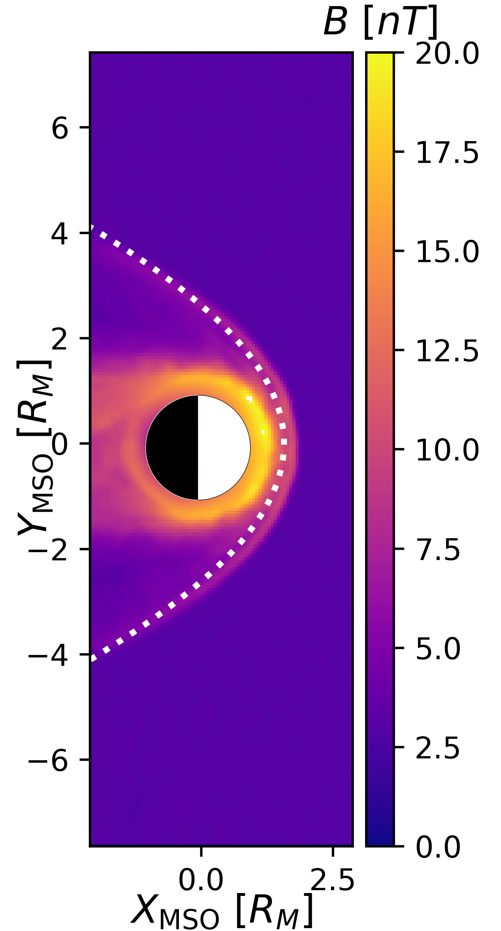
Nominal conditions
DOTTED LINE:
usual case (Edberg et al., 2009)
B
~1.7 Mars radii
n_{sw} = 3.0 cm⁻³
Notes:
Show my understanding on nominal conditions: the bowshock location and comparison with previous studies

Slide 12
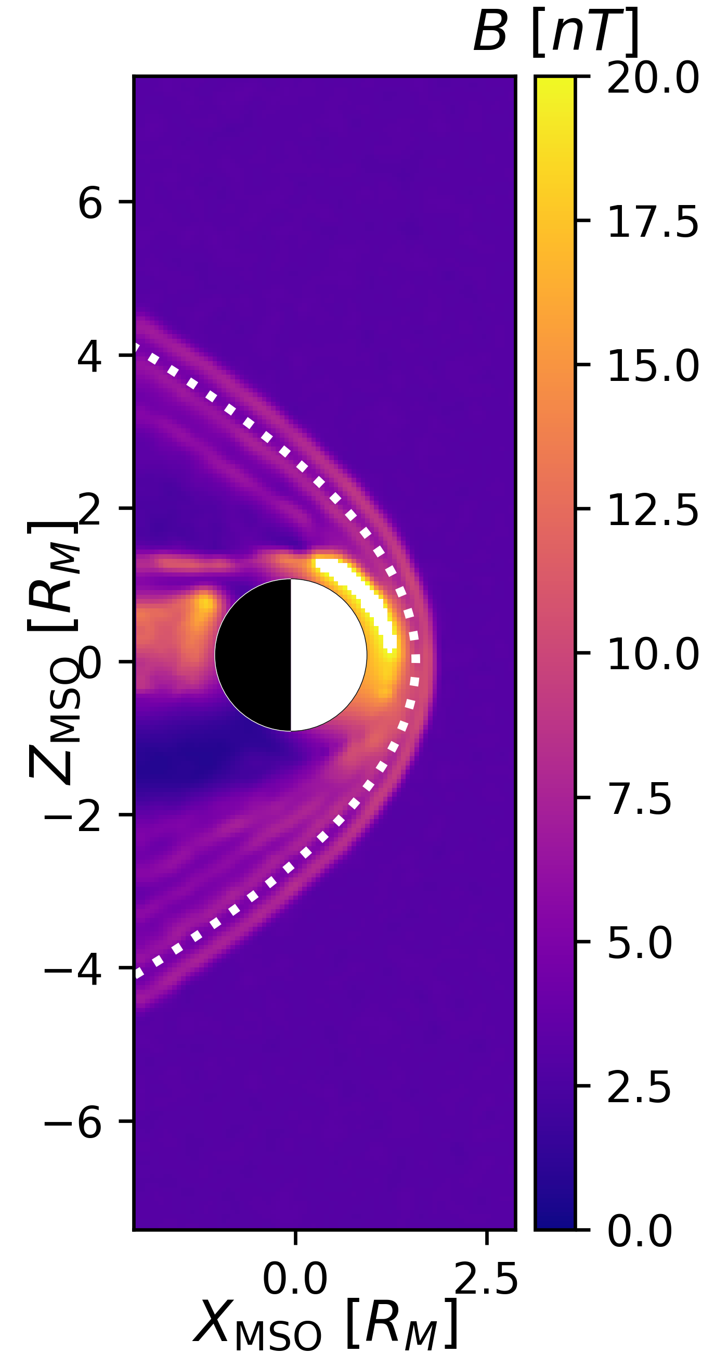
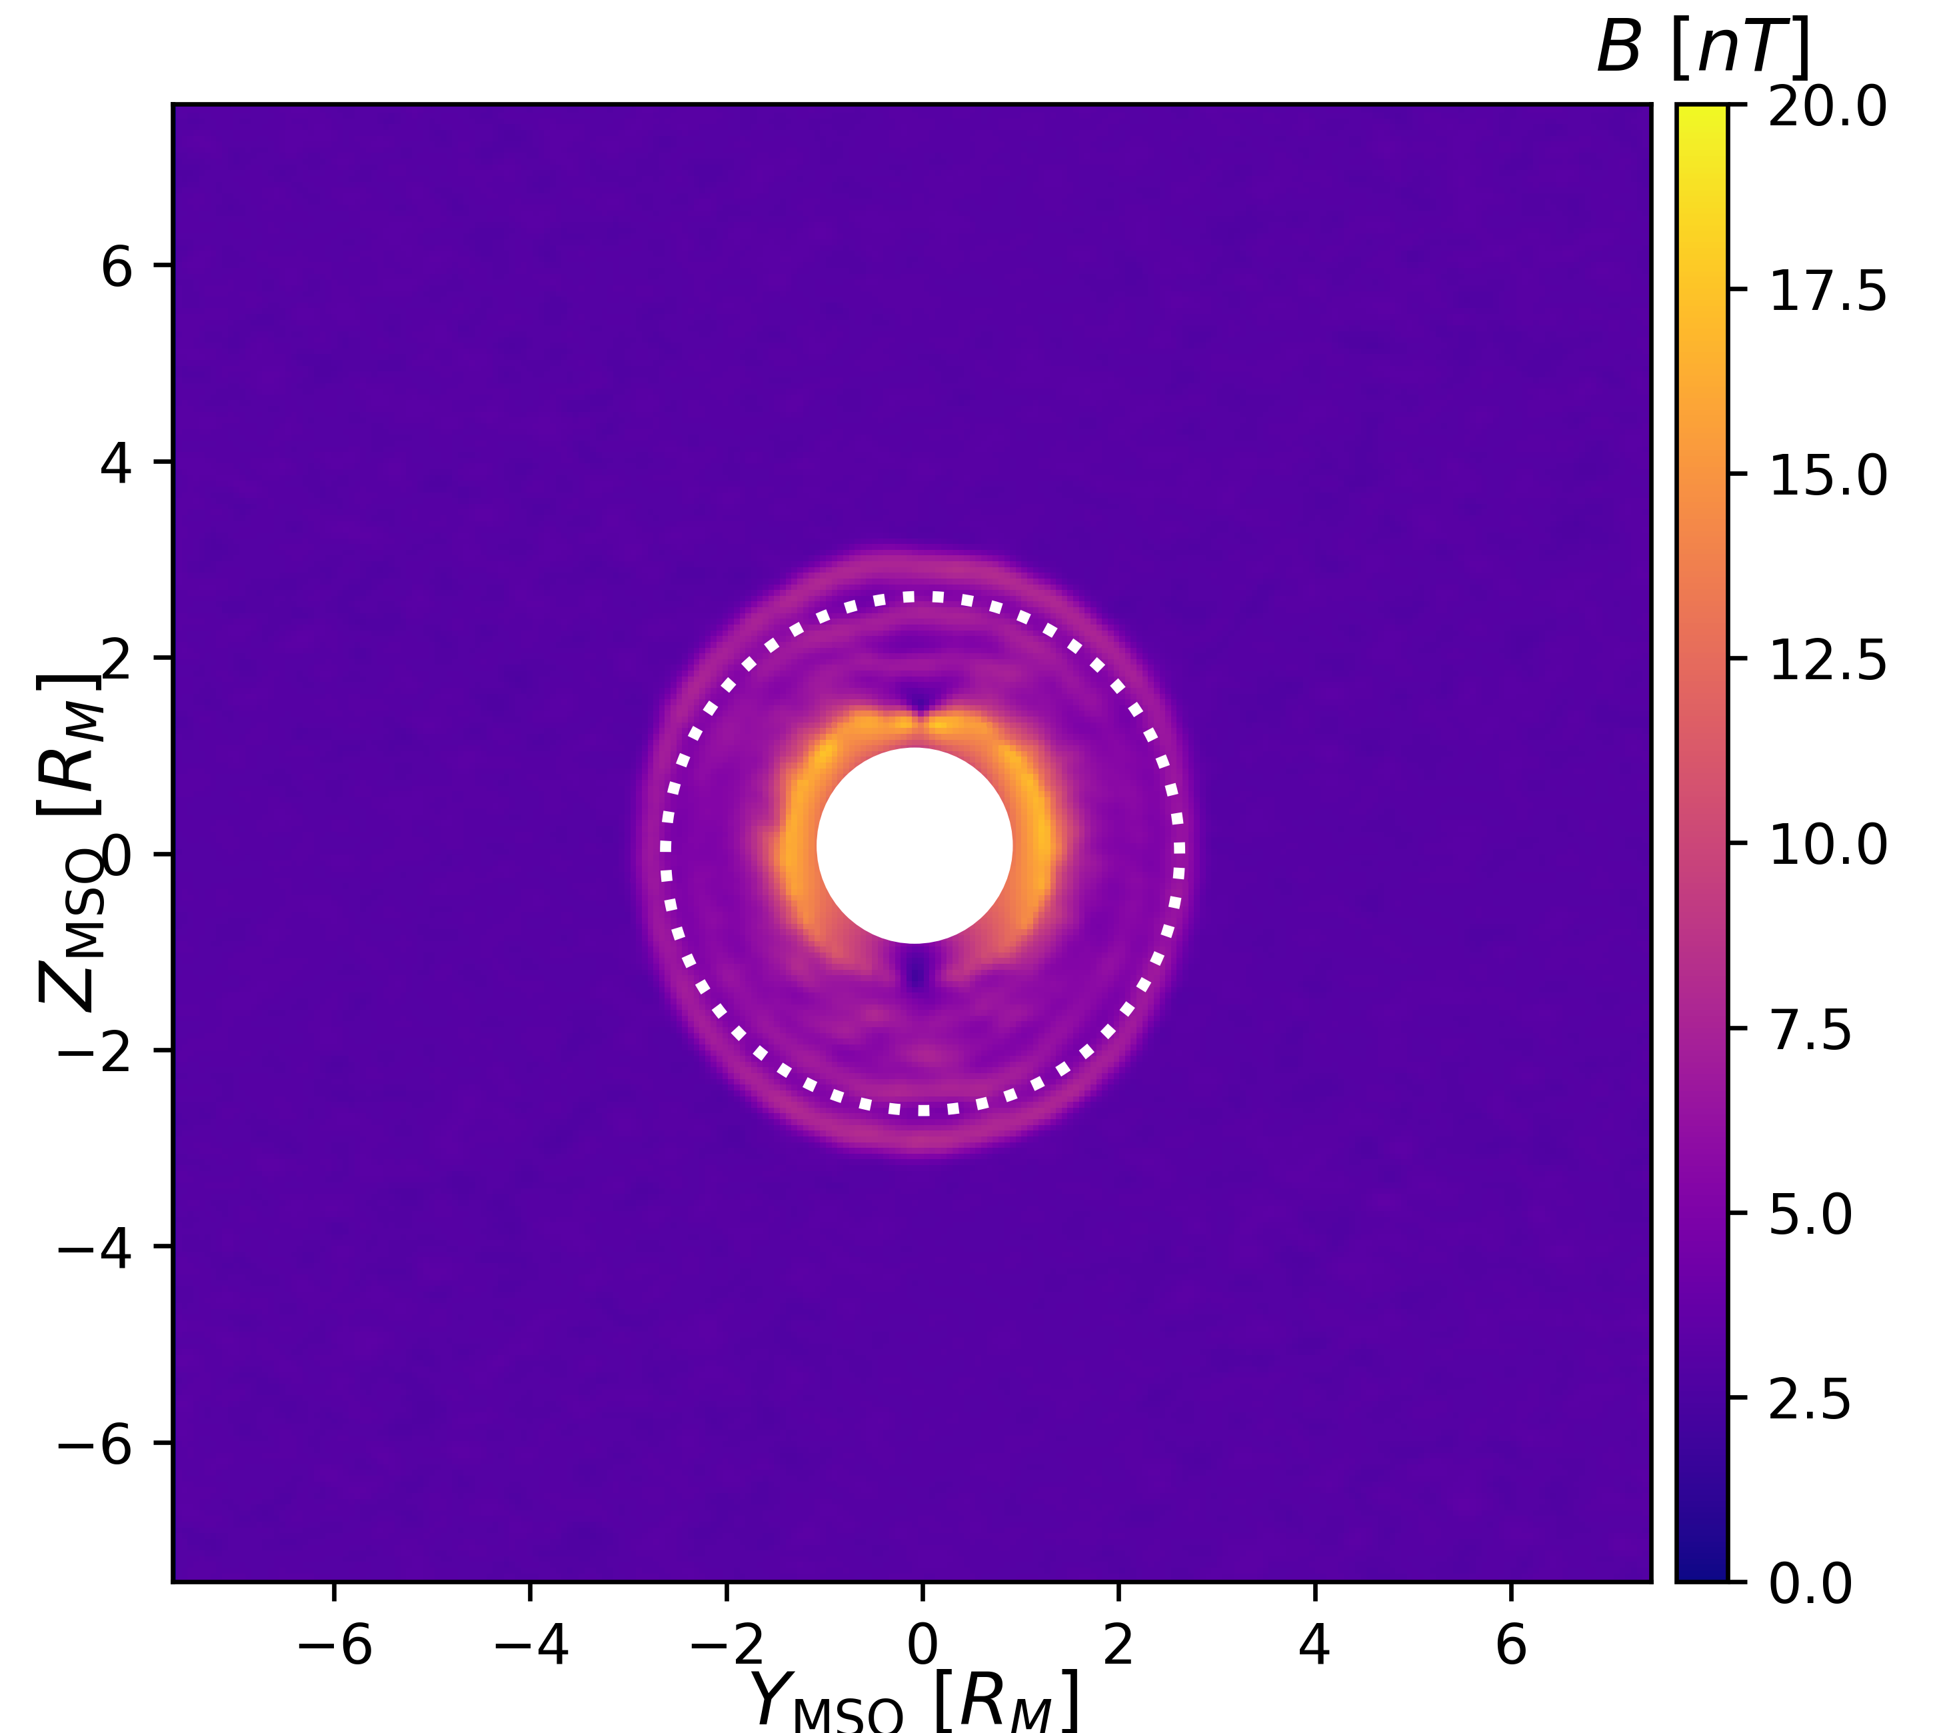
Nominal conditions
DOTTED LINE:
usual case (Edberg et al., 2009)
B
E
E
B
n_{sw} = 3.0 cm⁻³
Notes:
Show my understanding on nominal conditions: the bowshock location and comparison with previous studies

Slide 13
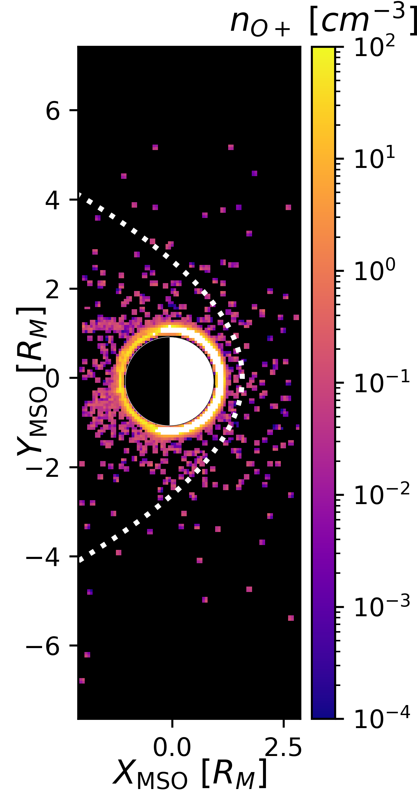
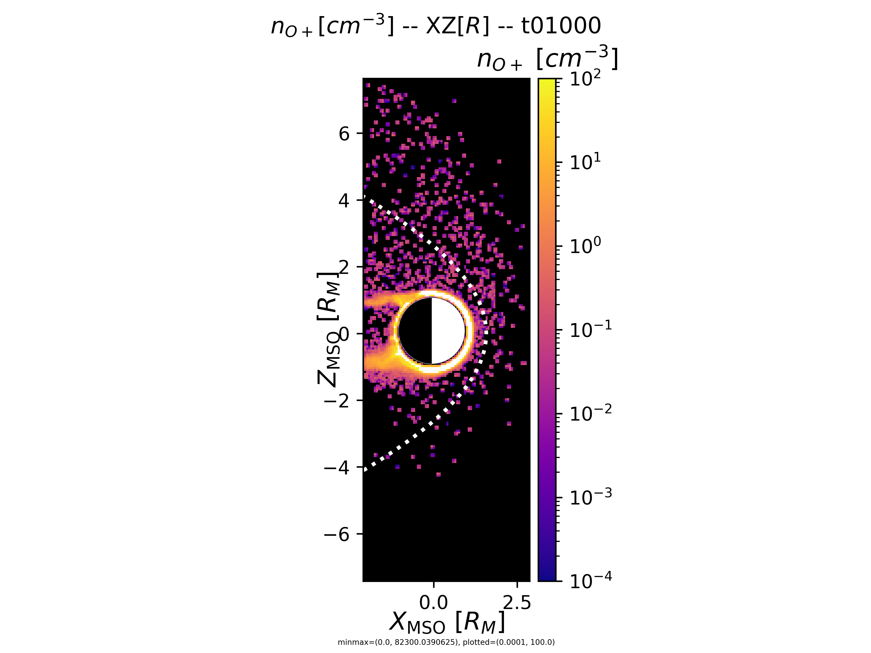
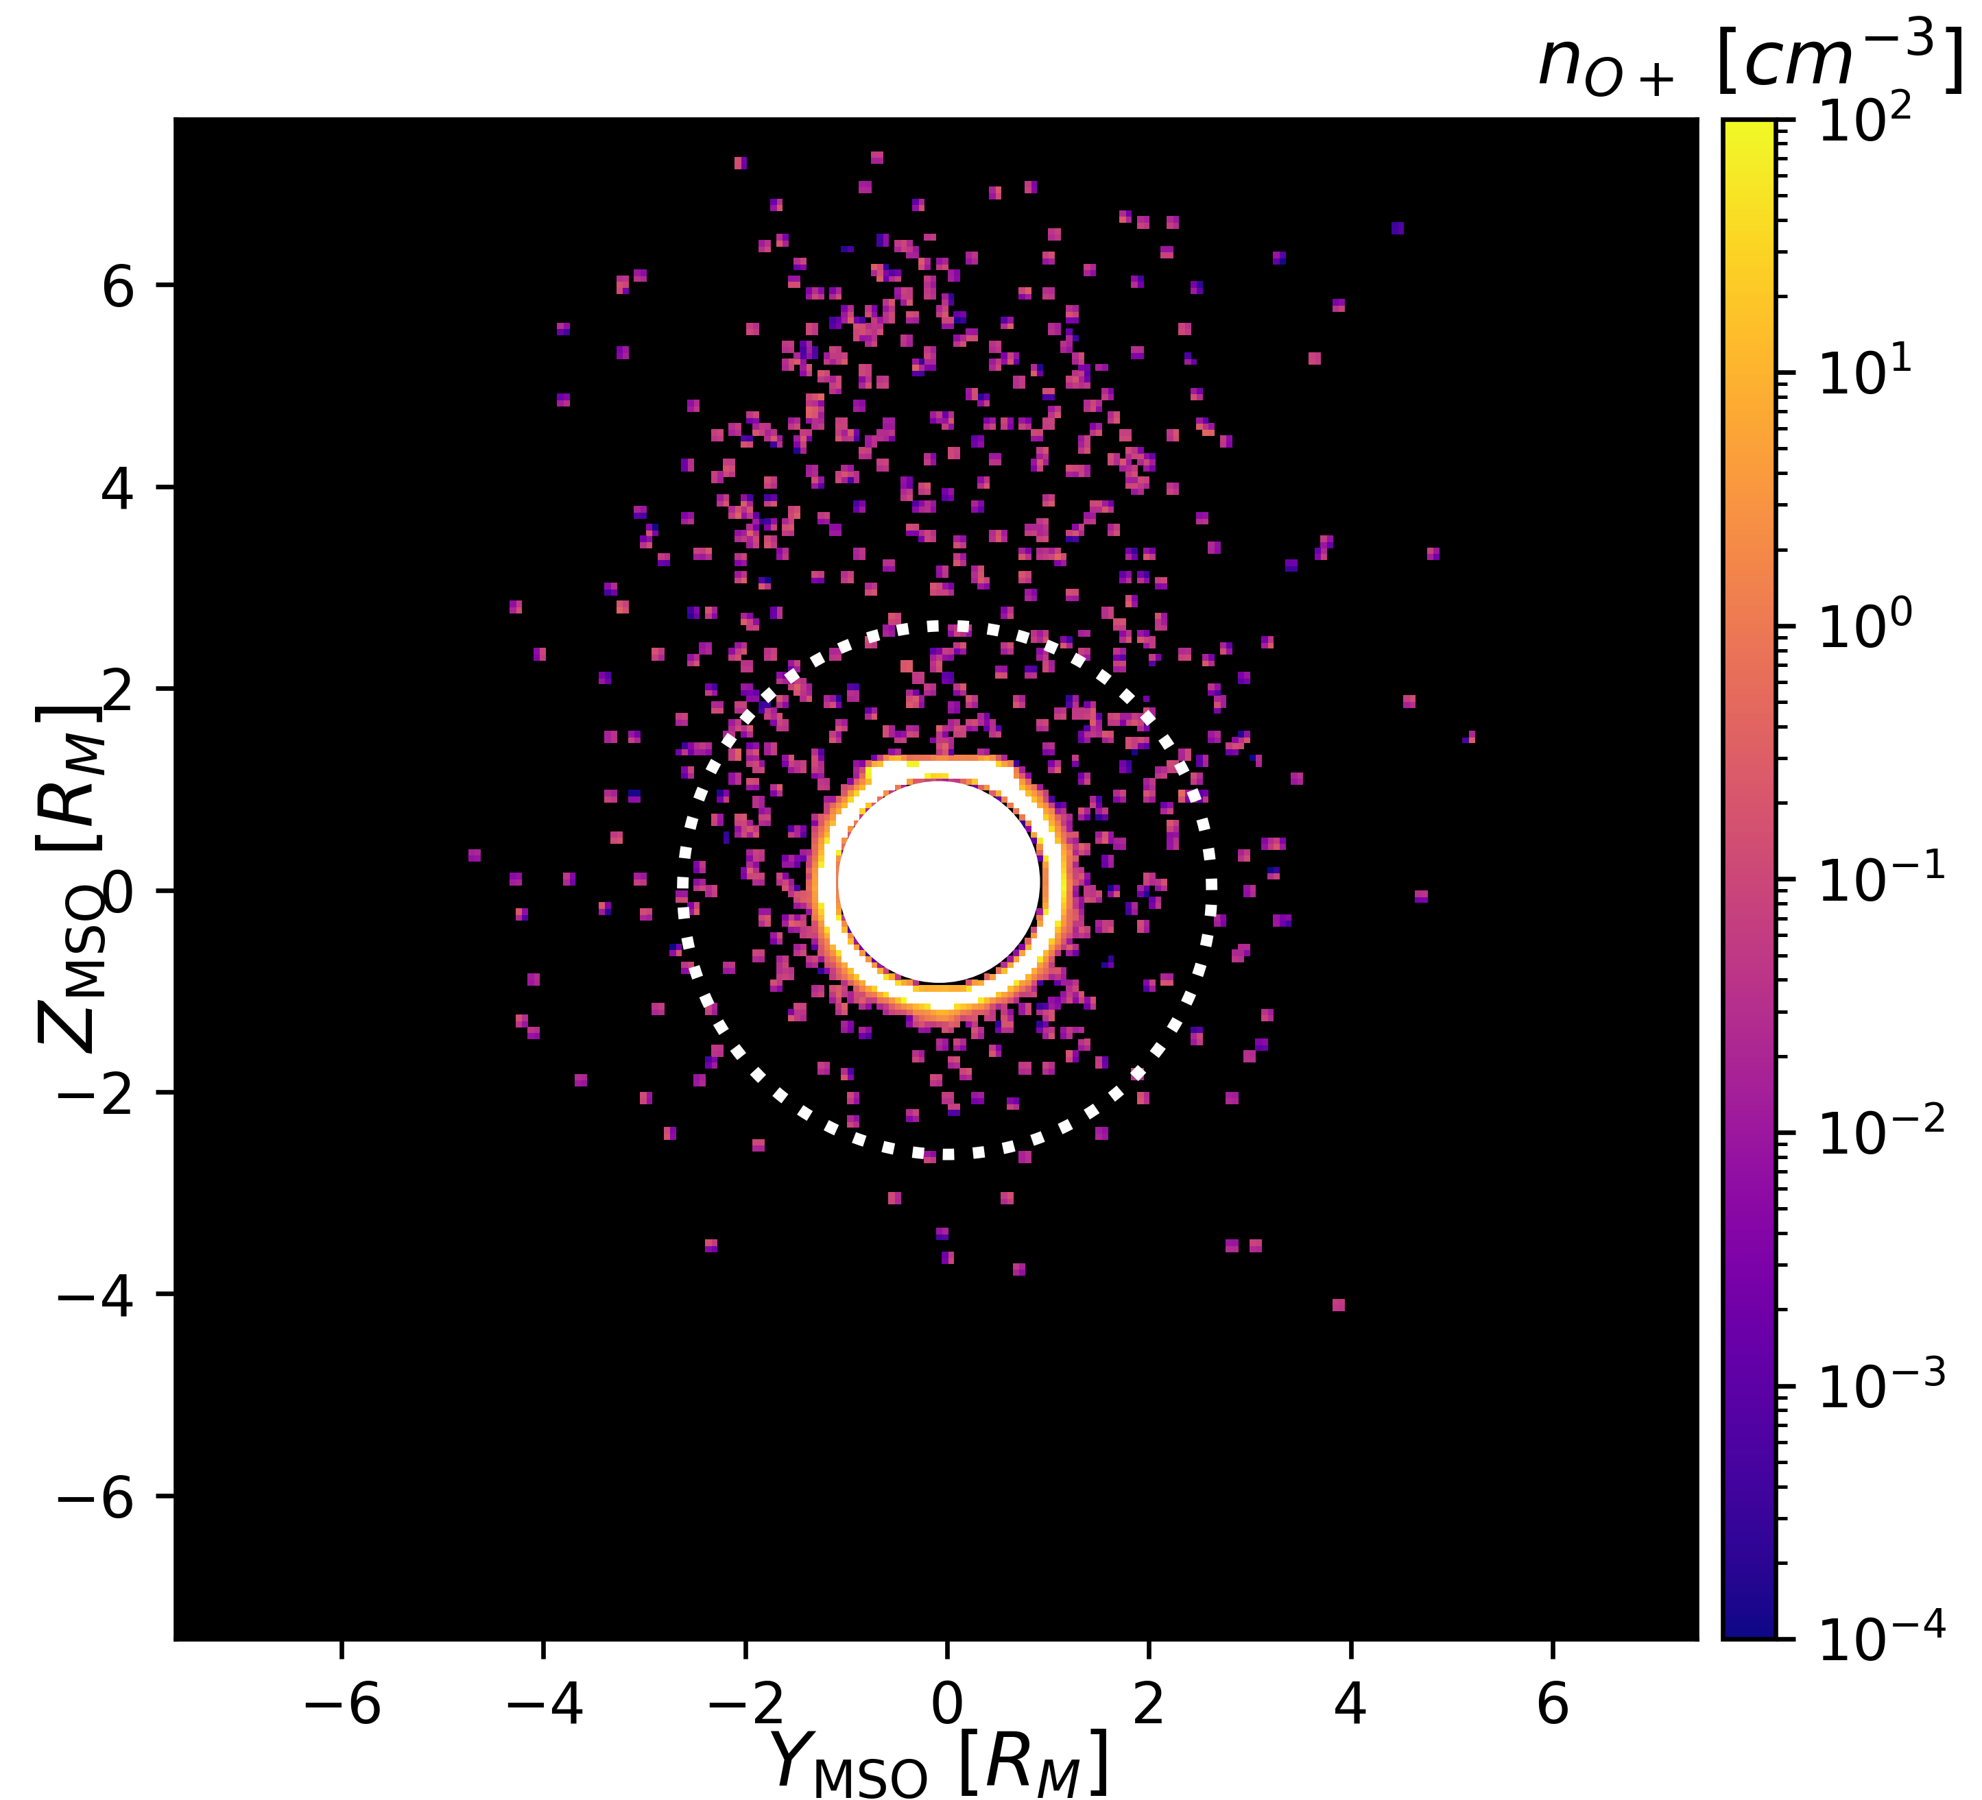
Nominal conditions
DOTTED LINE:
usual case (Edberg et al., 2009)
B
E
E
B
n_{sw} = 3.0 cm⁻³
Notes:
Show my understanding on nominal conditions: the ion plume structure and why it happens

Slide 14
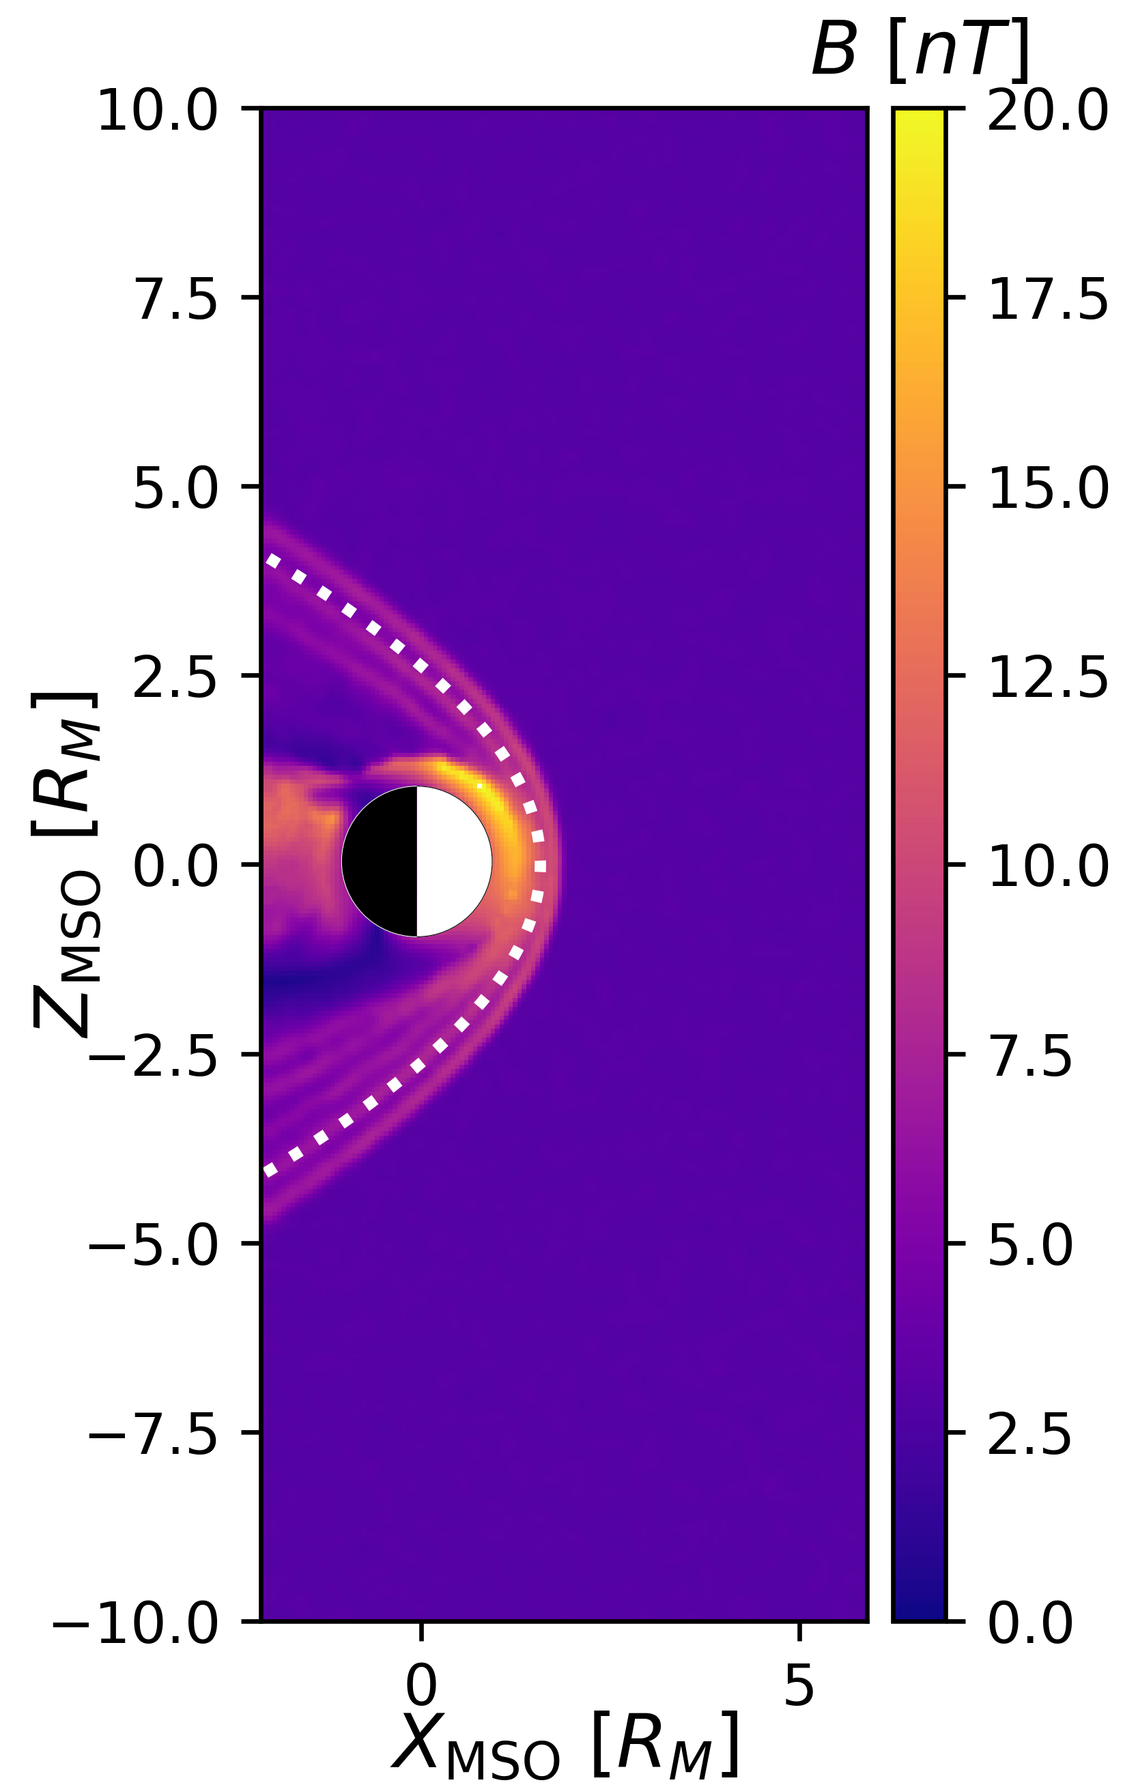
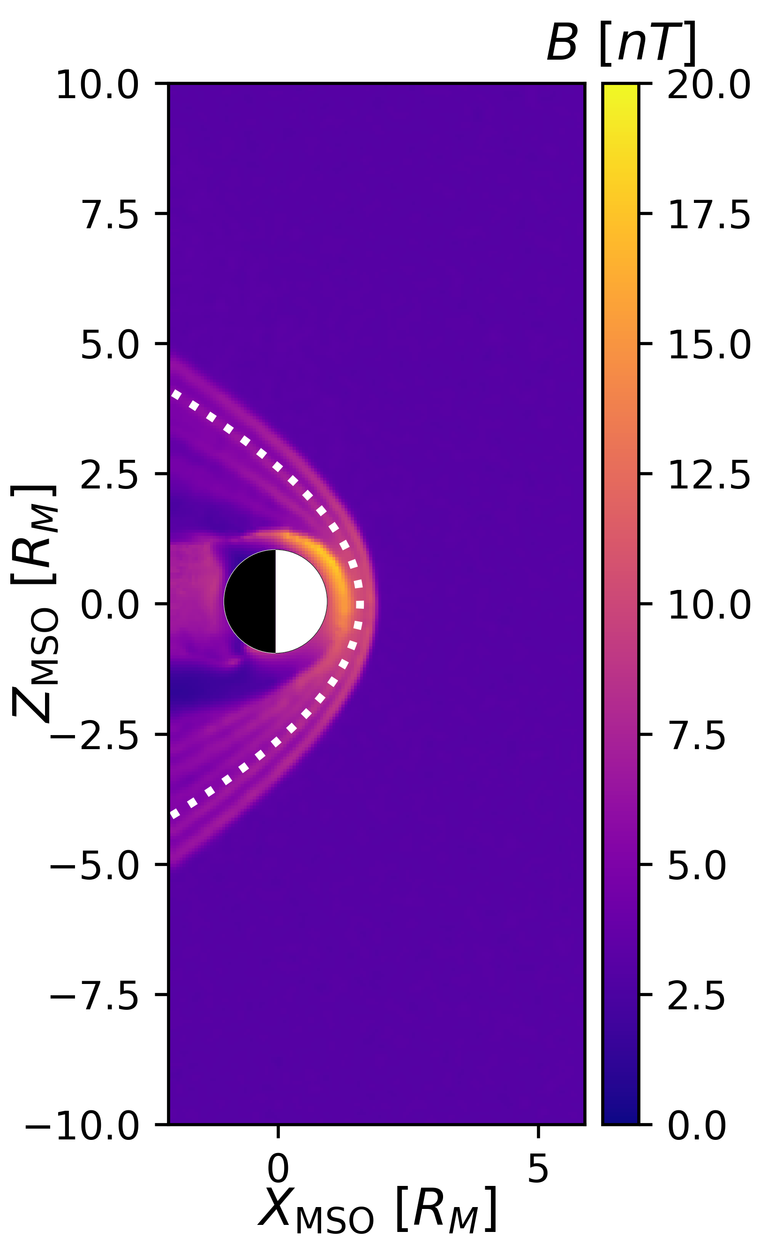
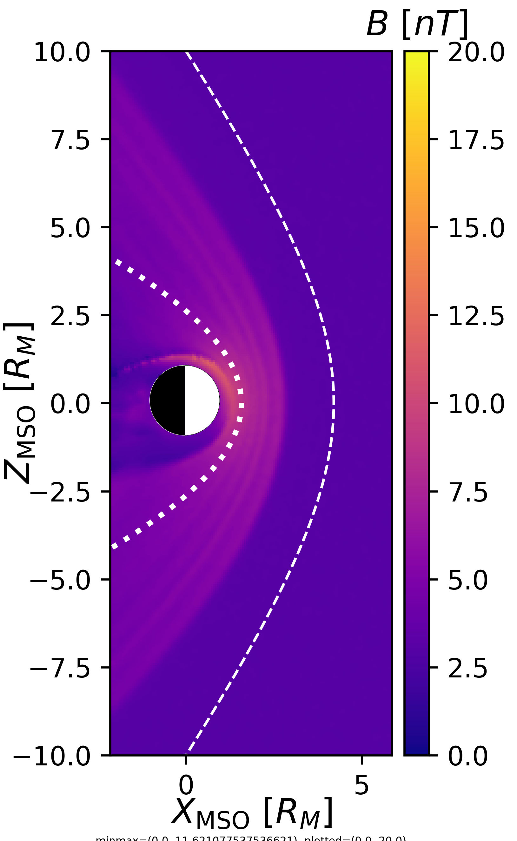
Bowschock expansion
DASHED LINE:
DSW case (Ma et al., 2025)
DOTTED LINE:
usual case (Edberg et al., 2009)
1.0 cm⁻³
0.5 cm⁻³
0.1 cm⁻³
3.0 cm⁻³
P_{dynamic} = 1.2 → 0.039 nPa (30 times less!)
Notes:
Effects of varying solar wind density: expansion of bowshock and less intense magnetic field overall

Slide 15
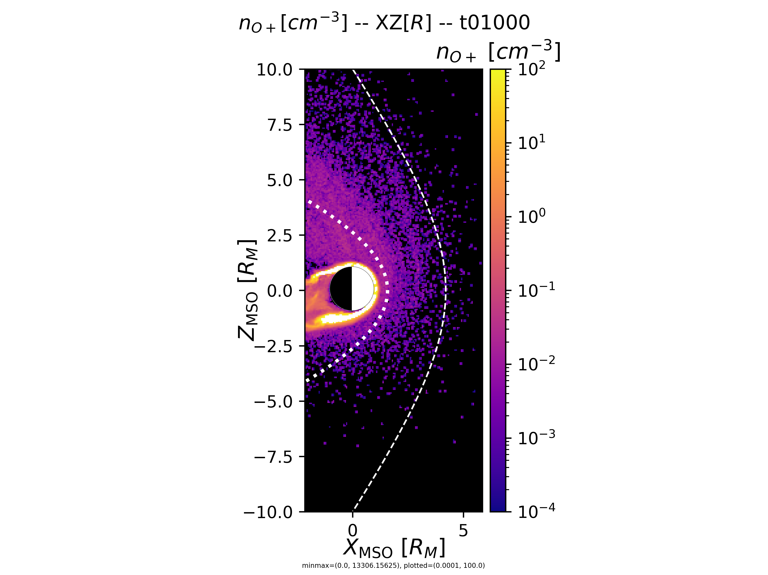
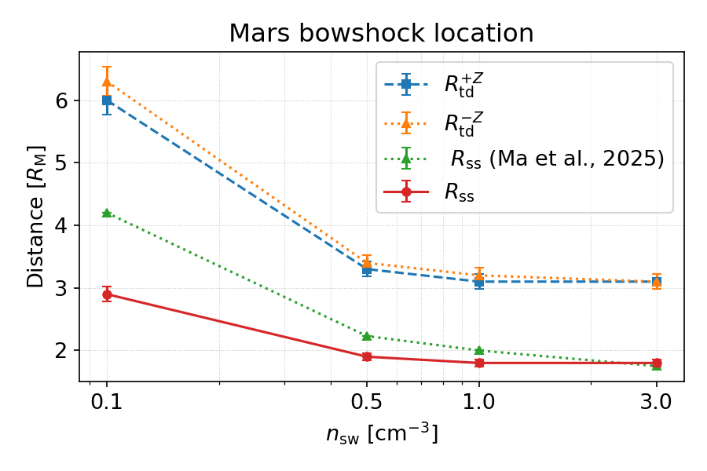
Bowschock expansion
n_{sw} = 0.1 cm⁻³
Notes:
Noticeable difference of location between simulations and Ma et al. Difference in +-Z terminator location is explained by O+ density near south pole.

Slide 16
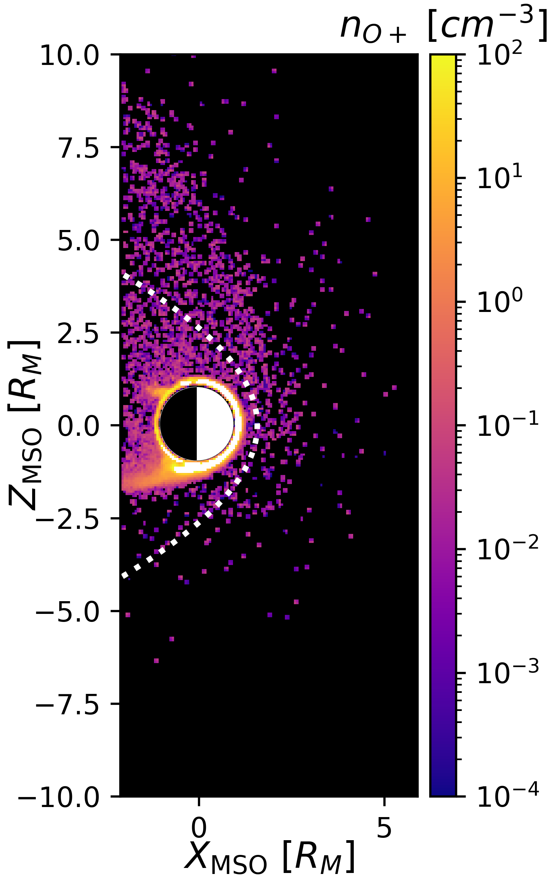
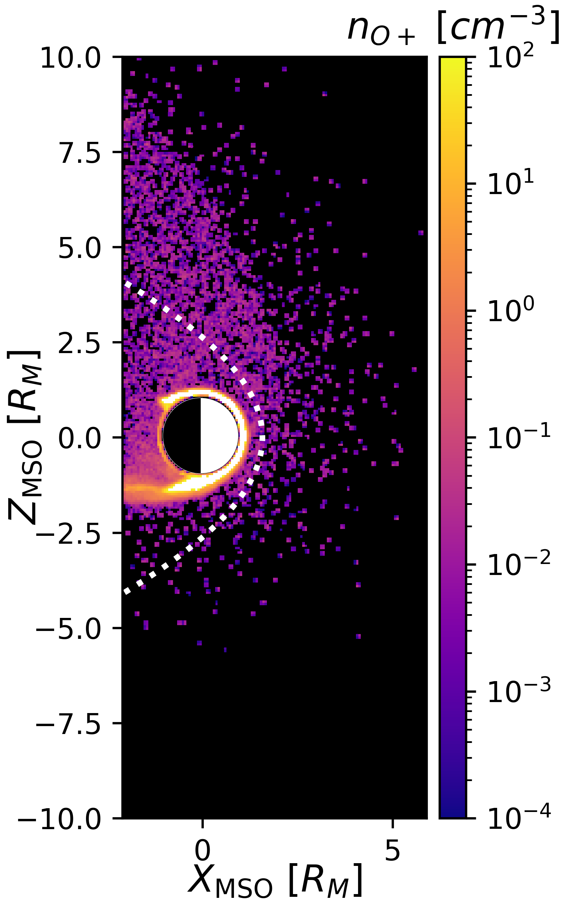
Ion escape
DOTTED LINE:
usual case (Edberg et al., 2009)
DASHED LINE:
DSW case (Ma et al., 2025)
1.0 cm⁻³
0.5 cm⁻³
0.1 cm⁻³
3.0 cm⁻³
Notes:
Effects of varying solar wind density: the plume becomes less dense

Slide 17
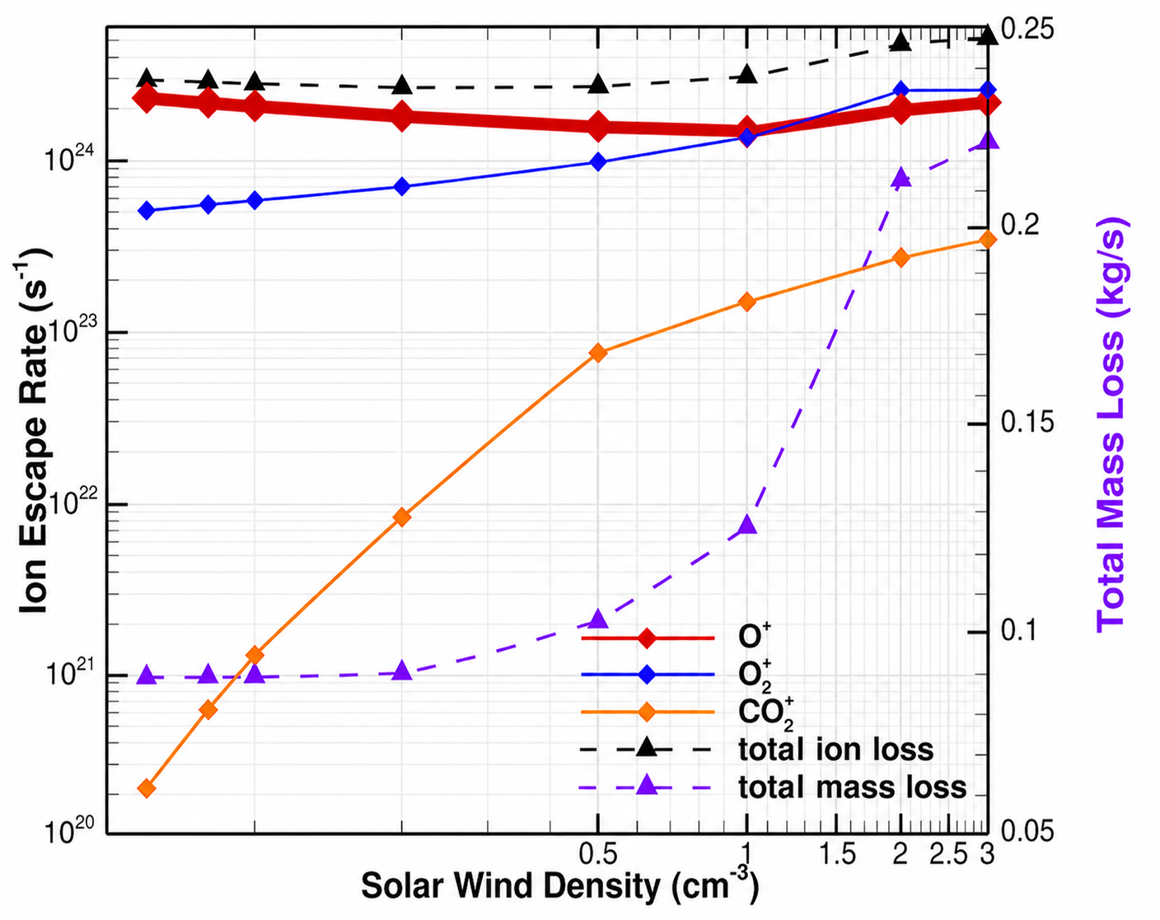
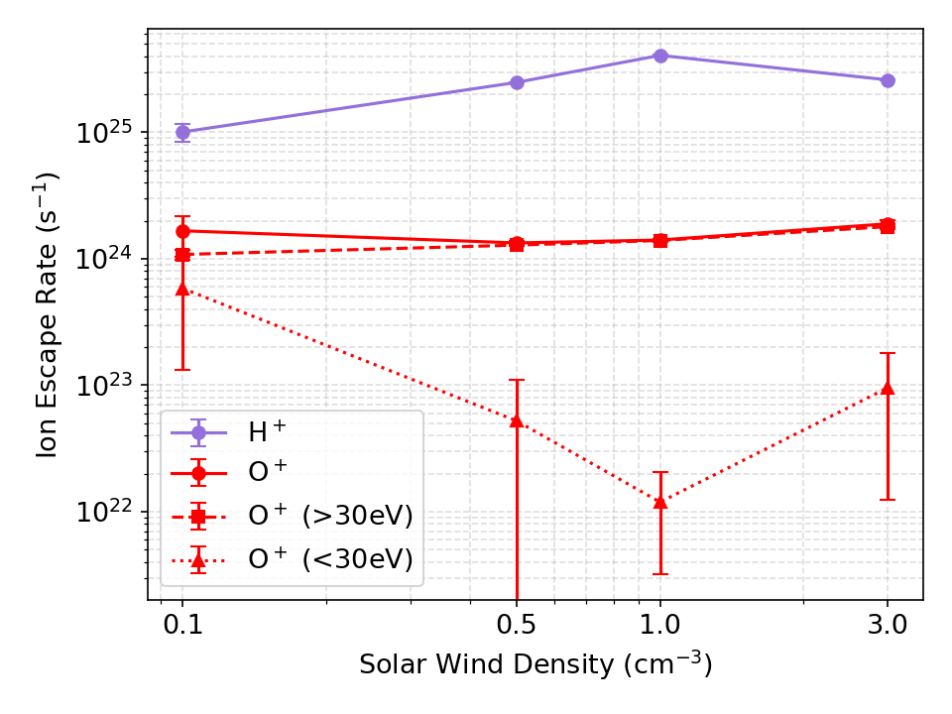
Ion escape:
Decreased for fast (>30eV)
Increased for slow (<30eV)
Ion escape
(Shen et al., 2024)
(Ma et al., 2025)
Consistent with previous studies
We can distiguish planetary protons
Notes:
O+ escape is consistent with Ma et al and separation in energy is consistent with Shen et al

Slide 18
Ion flux maps
r = 1.45 R_{M}
+90°
NORTH (+E)
NORTH
+45°
DAYSIDE
NIGHTSIDE
Latitude
DAYSIDE
NIGHTSIDE
-45°
SOUTH (-E)
SOUTH
E
-90°
-90°
0°
+90°
+180°
+270°
(MSE coords)
ʘ B
Longitude
SW
Notes:
Approach to the PhD

Slide 19
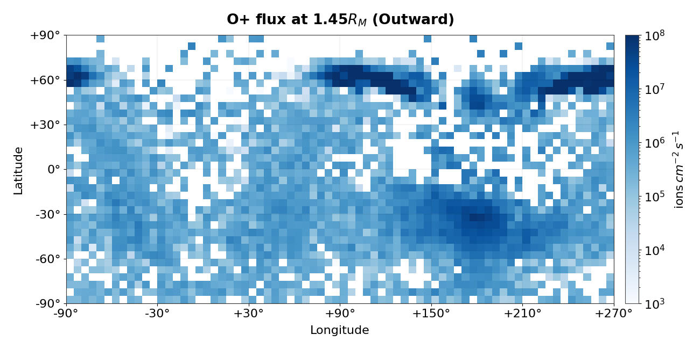
Ion outward flux
n_{sw} = 3.0 cm⁻³
Notes:
Approach to the PhD

Slide 20
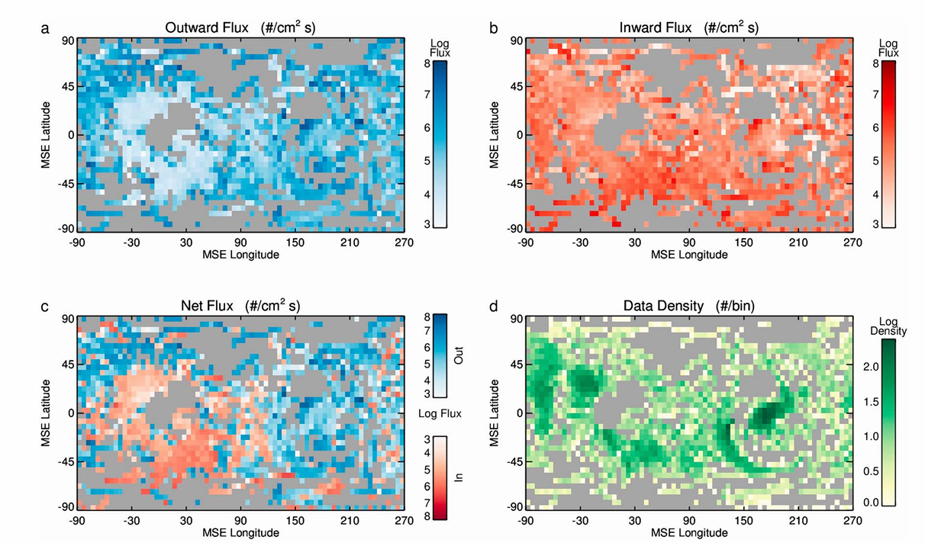
Ion outward flux
4 months of MAVEN measurements
(Brain et al., 2015)
Notes:
Approach to the PhD

Slide 21
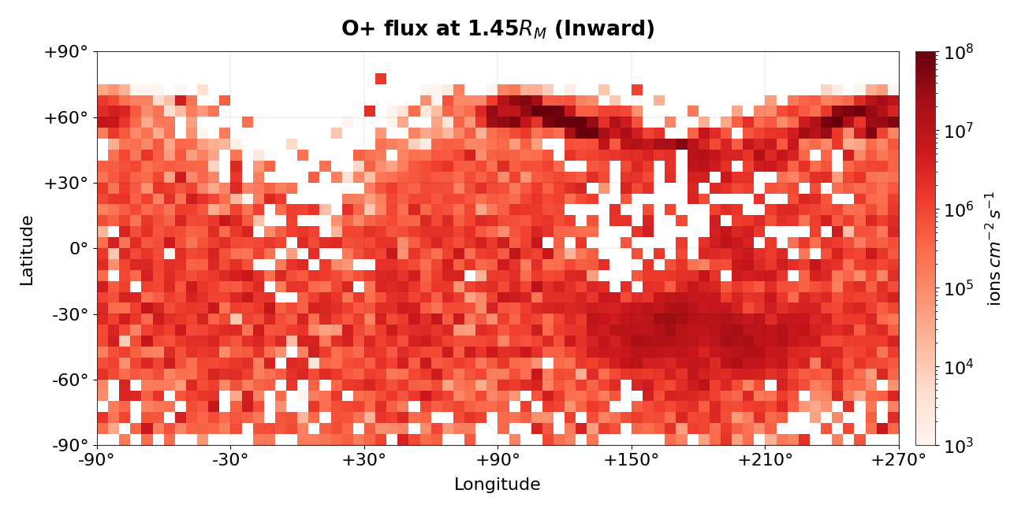
Ion inward flux
n_{sw} = 3.0 cm⁻³
Notes:
Approach to the PhD

Slide 22
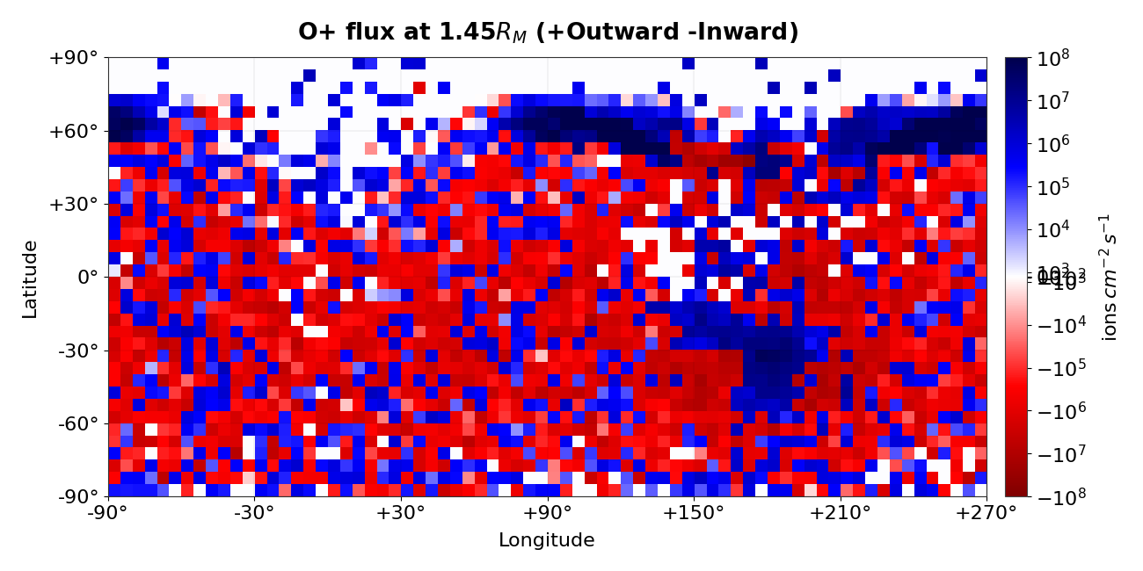
Ion flux balance
n_{sw} = 3.0 cm⁻³
0
Notes:
Approach to the PhD

Slide 23
Ion flux balance
0
4 months of MAVEN measurements
(Brain et al., 2015)
Notes:
Approach to the PhD

Slide 24
Ion flux maps
What we used:
n_{sw} = 3.0 cm⁻³
r = 1.45 R_{M}
outward fluxes
inward fluxes
What we can try:
other values of n_{sw}
other values of r
fast (>30 eV) fluxes
slow (<30 eV) fluxes
0
Notes:
Approach to the PhD

Slide 25
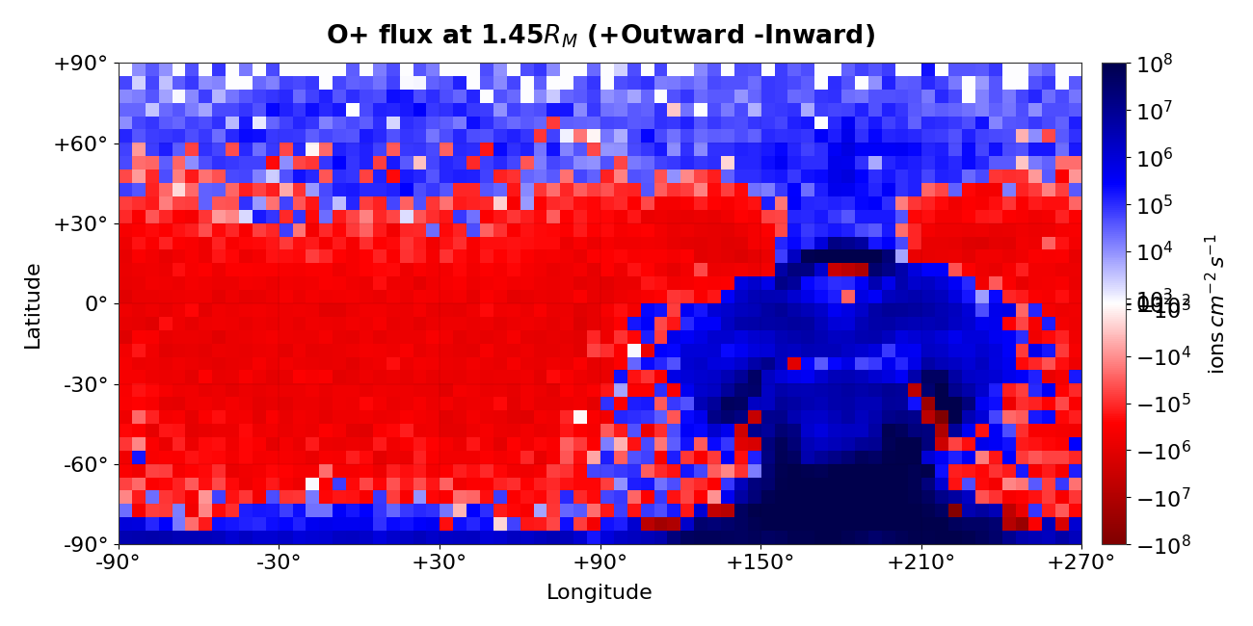
Ion flux balance (extreme case)
n_{sw} = 0.1 cm⁻³
0
Notes:
Approach to the PhD

Slide 26
Preliminary Conclusions & Perspectives
Summary:
Lack of global magnetic field leads to atmospheric erosion
Extreme events can help us understand the Martian past
The DSW event changed region morphology & ion fluxes
Simulated the DSW event with a hybrid approach
Conclusions:
Simulations of the nominal case are consistent with previous studies
Absence of crustal fields leads to insconsistencies with DSW region morphology
O⁺ escape rates as function of n_{sw} agree with previous studies
Global ion flux maps show expected locations of outward & inward fluxes
Next steps:
Analyze O⁺ escape rates for different planet regions
Study energy escape and deposition into the ionosphere
Initialize crustal fields for all performed simulations
Make time-dependent simulations using a n_{sw} temporal profile
Notes:
Approach to the PhD

Slide 27
Support slides

Slide 28
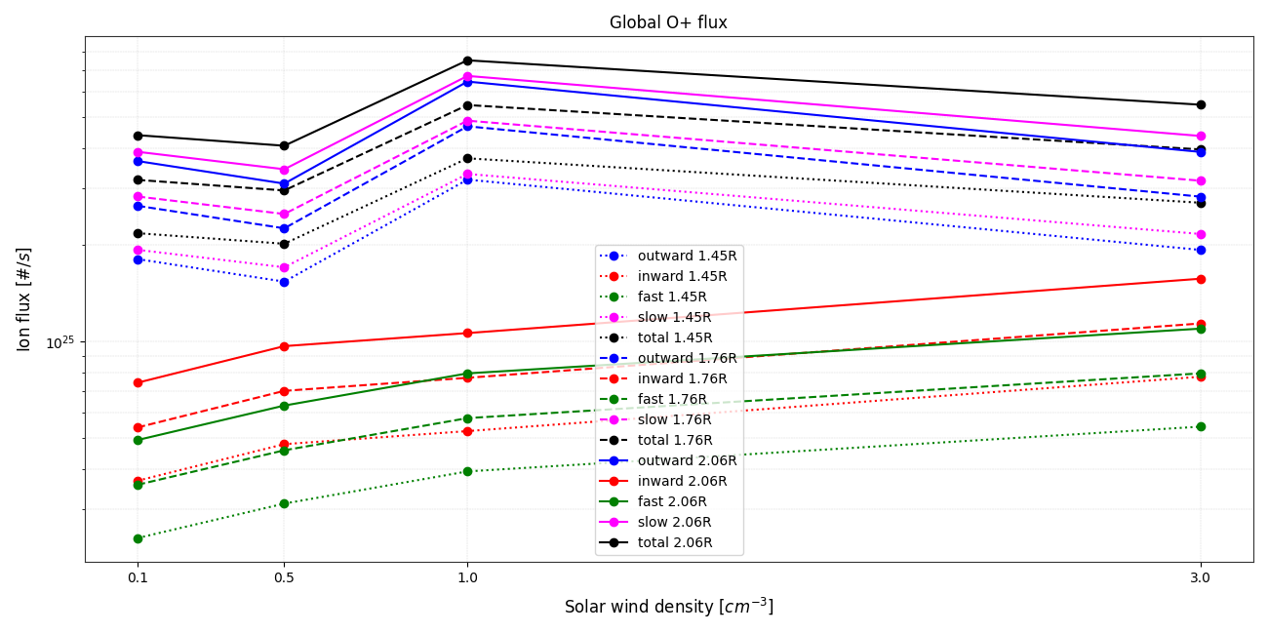
Altitude does not affect these observations, it just introduces a global vertical linear shift.
Notes:
Approach to the PhD

Slide 29
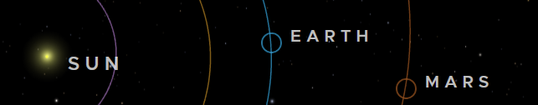
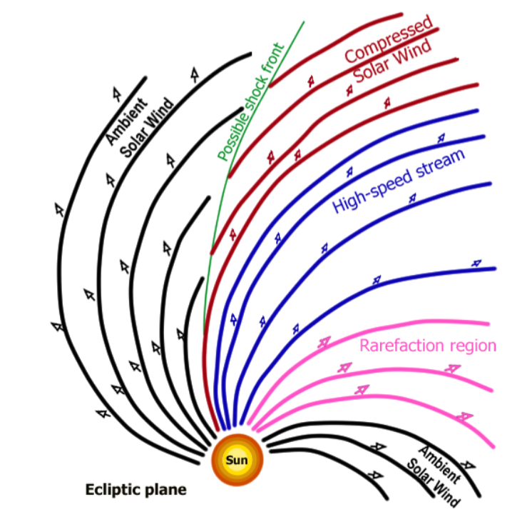
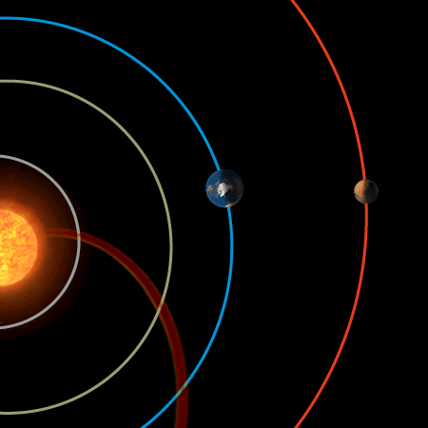
(eyes.nasa.gov/apps/solar-system/)
(ESO/M. Kornmesser)
(adapted from Hundhausen, 1972)

Slide 30
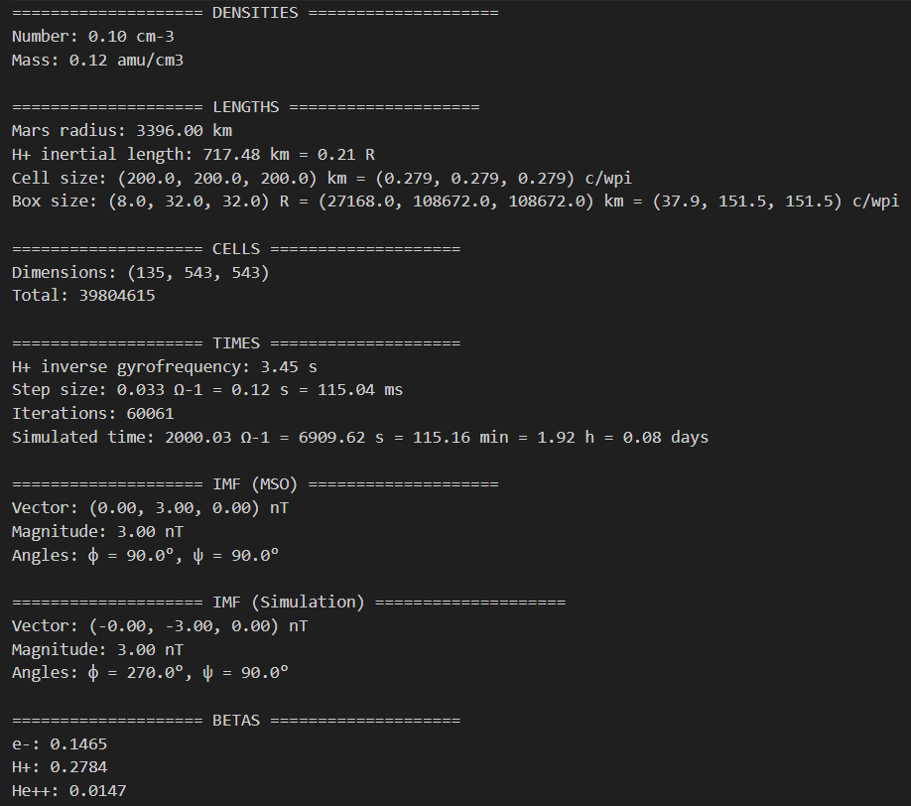
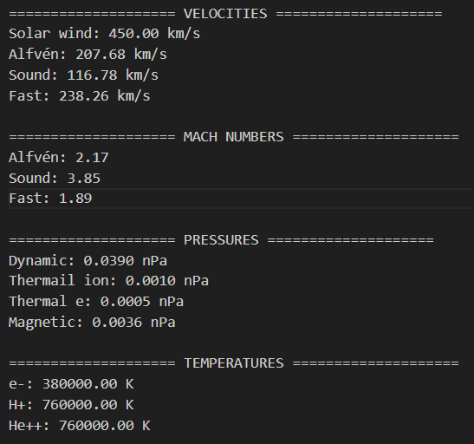

Slide 31
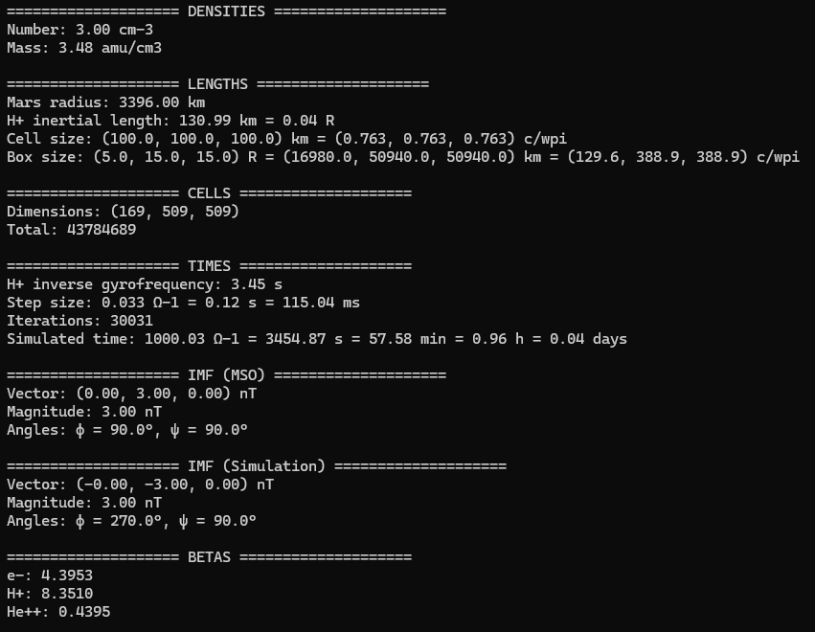
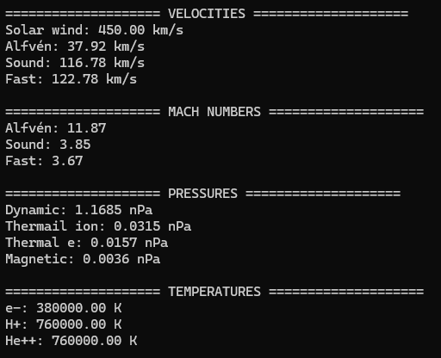

Slide 32
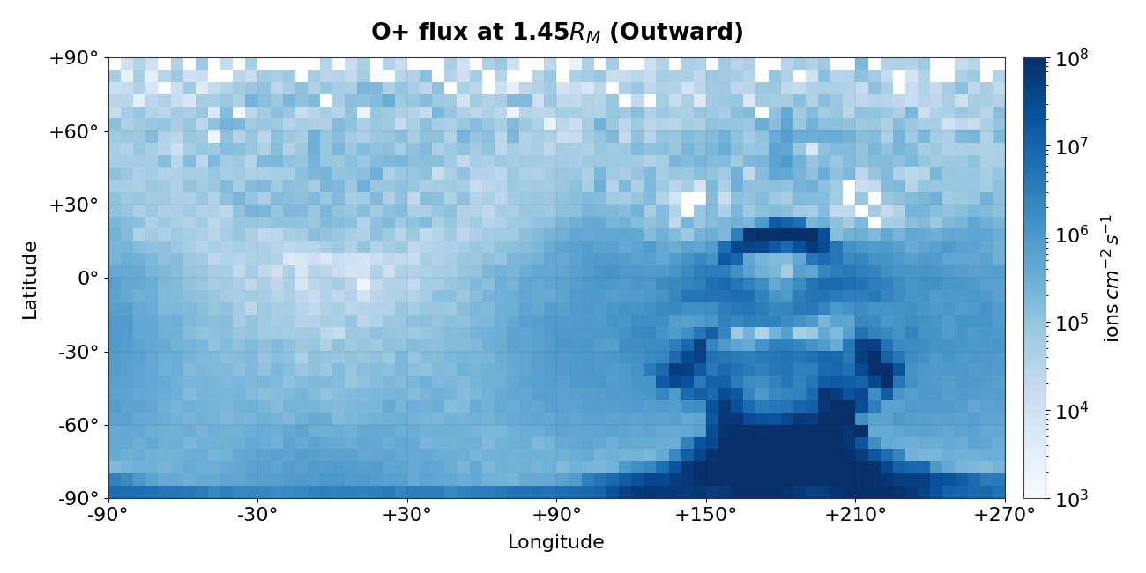
Ion outward flux (extreme case)
n_{sw} = 0.1 cm⁻³
Notes:
Approach to the PhD

Slide 33
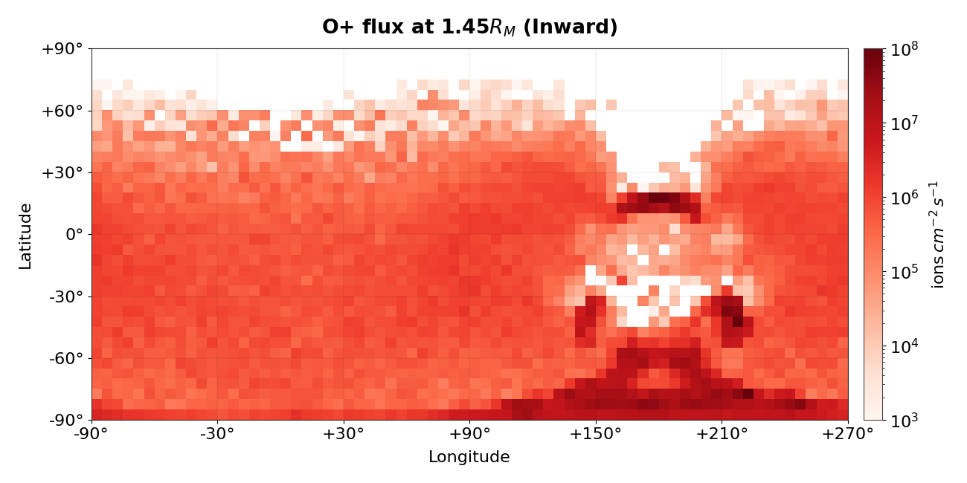
Ion inward flux (extreme case)
n_{sw} = 0.1 cm⁻³
Notes:
Approach to the PhD

Slide 34
Ion flux maps
n_{sw} = 0.1 cm⁻³
0
Notes:
Approach to the PhD

Slide 35
Ion flux maps
n_{sw} = 3.0 cm⁻³
0
Notes:
Approach to the PhD

Slide 36
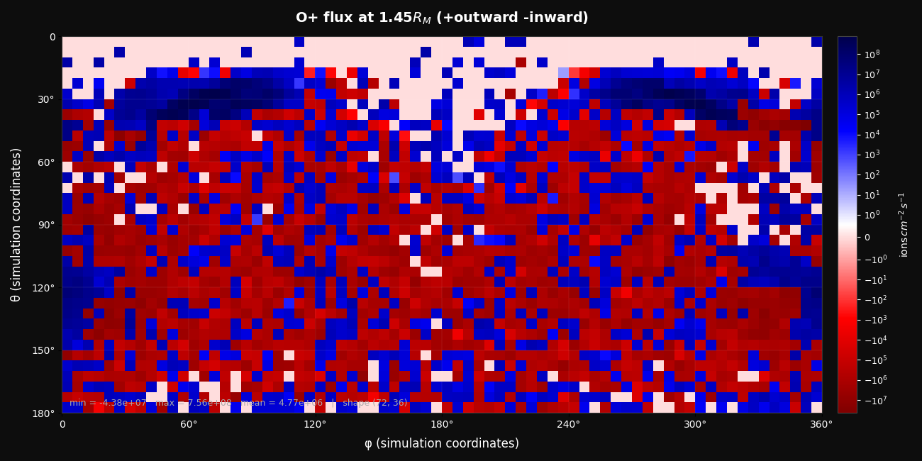
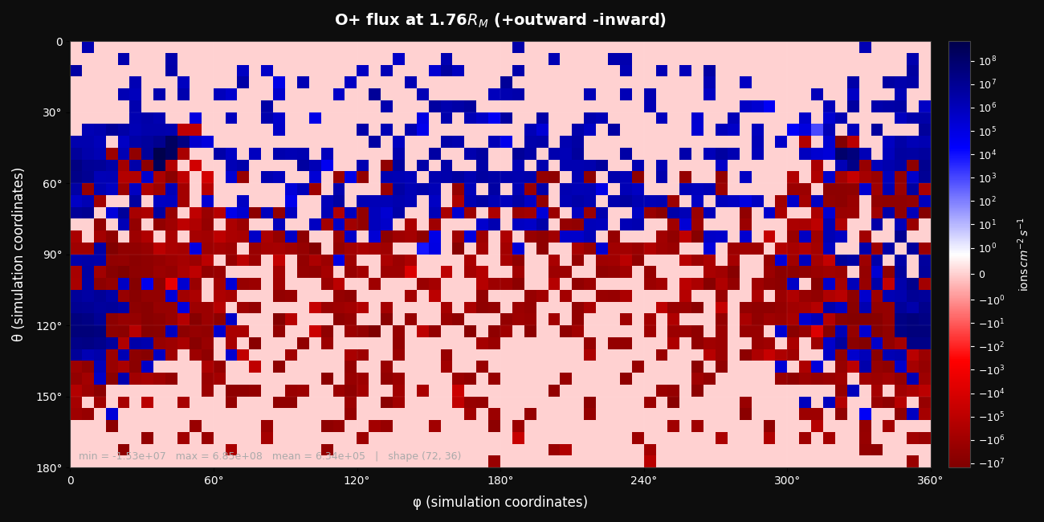
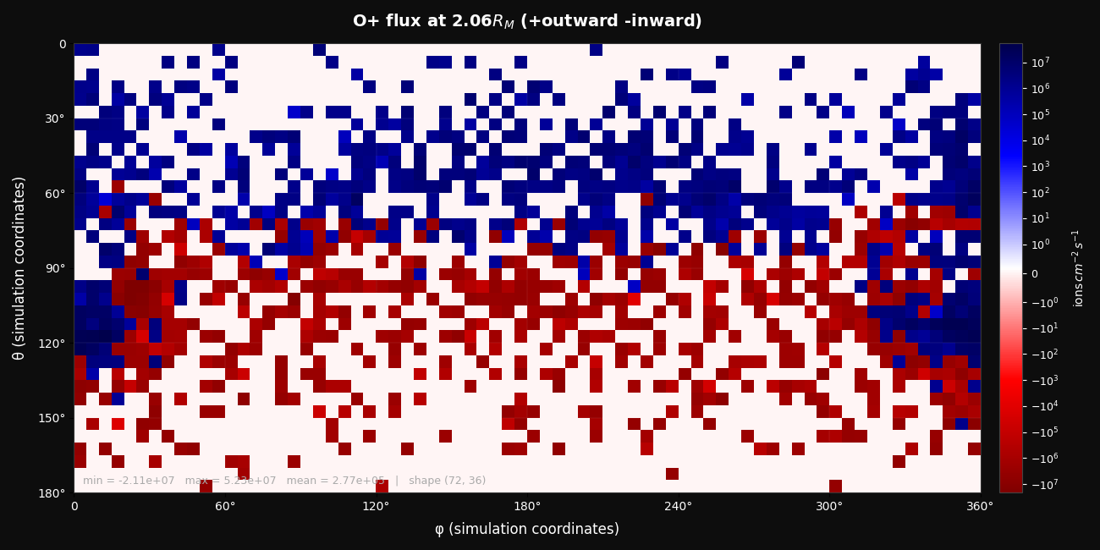
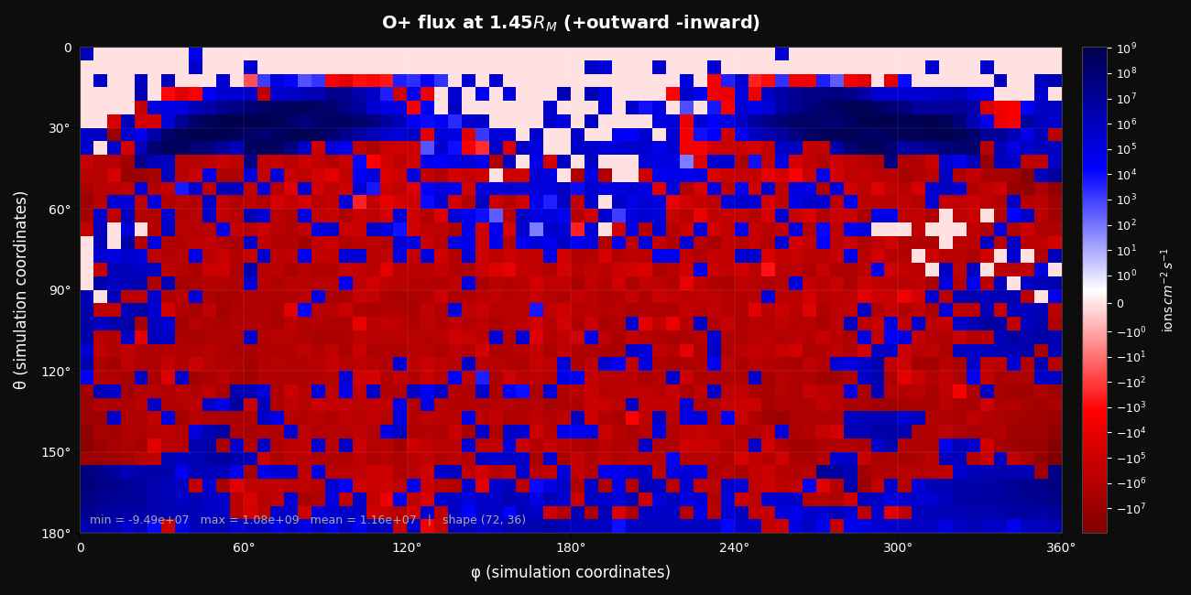
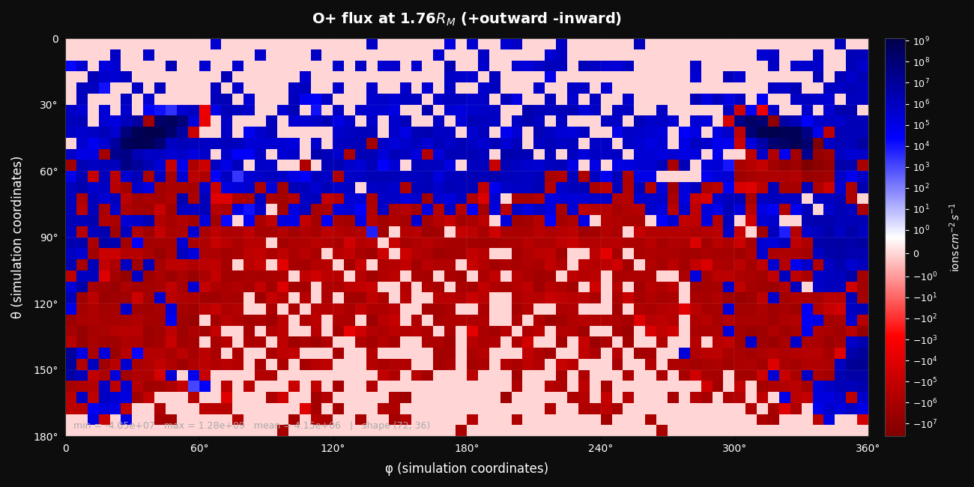
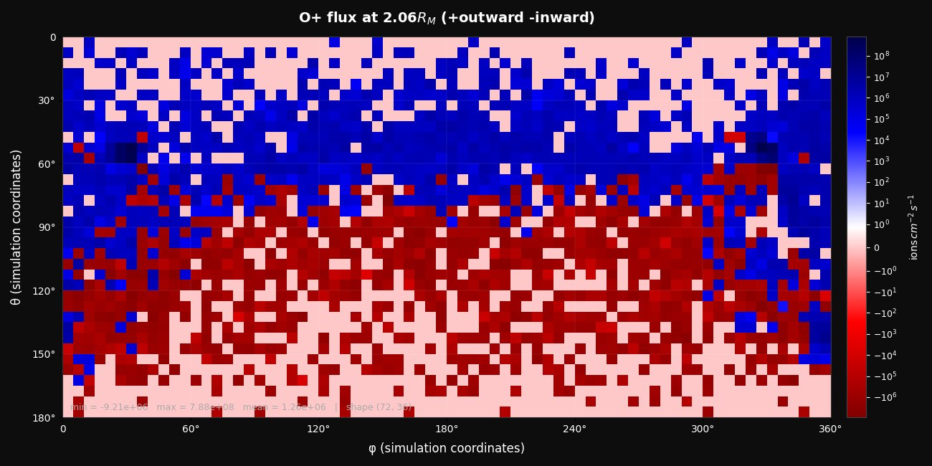
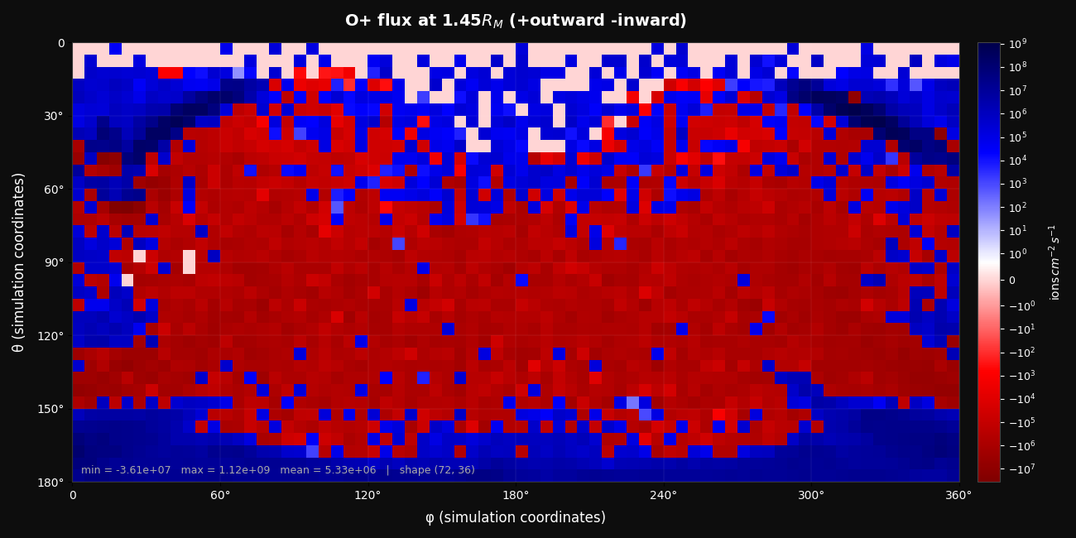
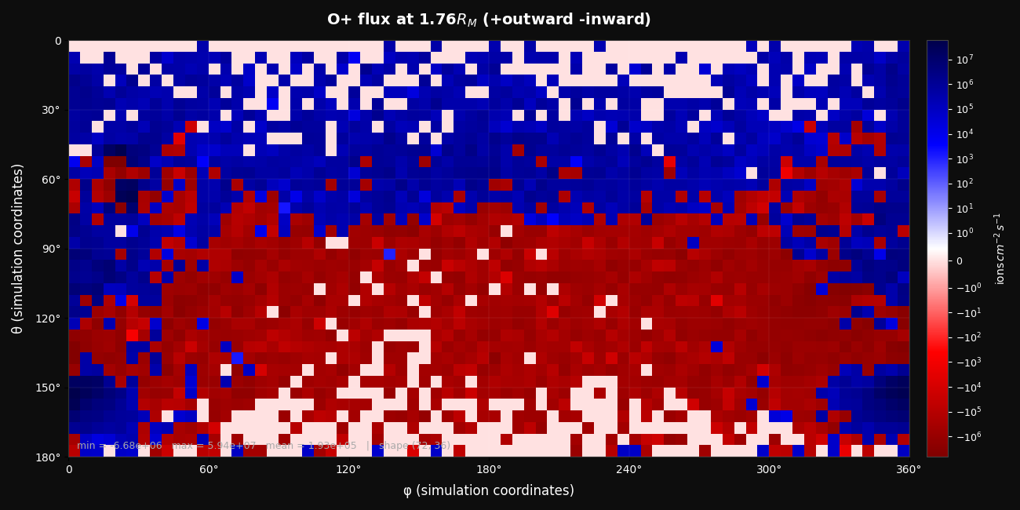
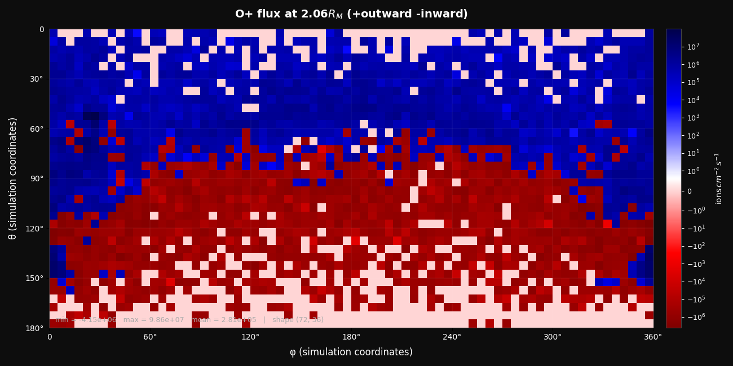
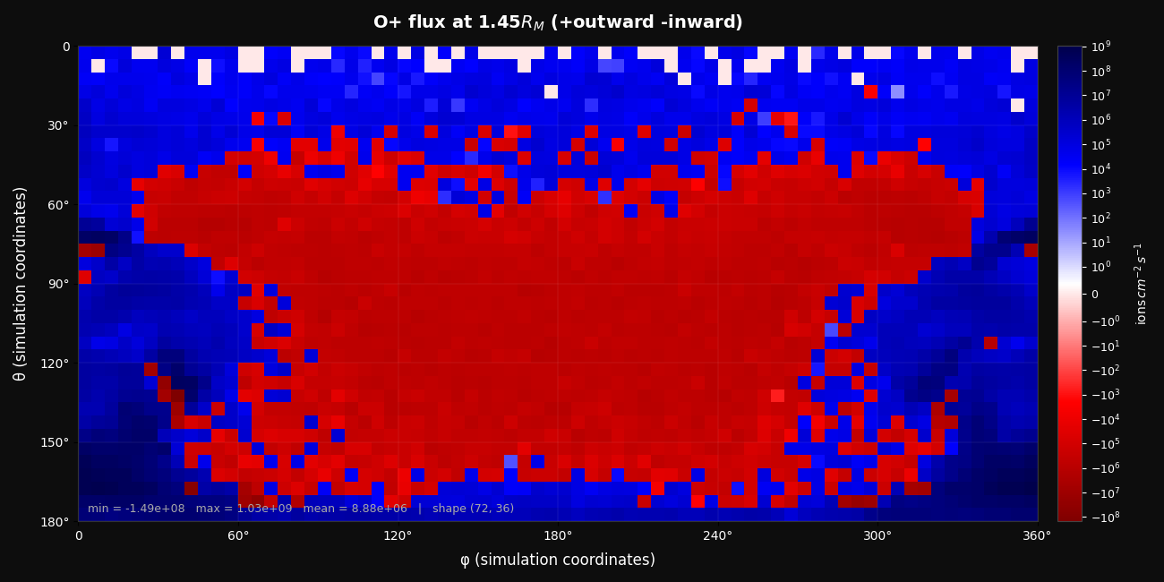


1.45 R
1.76 R
2.06 R
3.0 cc
1.0 cc
0.5 cc
0.1 cc

Slide 37












1.45 R
1.76 R
2.06 R
3.0 cc
1.0 cc
Fix label sizes, change background color to white, shift data to the right so that the longitude is consistent with the previous slide (already done, but I have to paste the images here)
0.5 cc
0.1 cc

Slide 38








Simulation ingredients
SOLAR WIND
Neutral atmosphere:
~350km altitude
Radial density profile
Ionization by electron impacts, charge exchange and photoproduction
IONOSPHERE
3nT
To Sun
Spatial resolution: 200km
PLANETARY IONS: H⁺, CO₂⁺, O⁺, O₂⁺
NO CRUSTAL FIELDS
SOLAR WIND: 95% H⁺, 5% He⁺⁺, e
Notes:
Show my understanding on nominal conditions: the bowshock location and comparison with previous studies

Slide 39

Ion escape distribution
(Brain et al., 2015)
Notes:
Distribution maps for longitude and latitude are done but need sanity checks

Slide 40
units: 10²³ s⁻¹
Ion flux rates
0.1 cm⁻³
0.5 cm⁻³
1.0 cm⁻³
n_{sw} = 3.0 cm⁻³
0.42
0.12
0.30
1.2x10²
20
1.0x10²
3.0x10²
17
2.8x10²
OUT: 1.5x10² (2.5 – 8.3)
IN: 31 (0.29 – 0.68)
NET: 1.2x10² (1.8 – 8.0)
1.6
6.4
-4.8
41
12
28
2.2
6.5
-4.3
9.0
8.8
0.22
3.5
8.3
-4.9
4.1
7.1
-3.0
5.9 (2.4 – 9.3)
13 (0.87 – 3.1)
-6.7 (-0.76 – 8.4)
13 (5.8 – 15)
14 (1.1 – 2.5)
-1.0 (3.3 – 14)
1.1x10²
10
1.0x10²
17
6.2
10
11
13
-1.7
5.2 (1.4 – 3.1)
7.7 (0.84 – 1.6)
-2.6 (-0.20 – 2.2)
1.8x10²
37
1.4x10²
1.5x10²
48
1.1x10²
3.2x10²
53
2.7x10²
GLOBAL: 1.9x10² (12 – 36)
78 (3.1 – 7.9)
1.2x10² (4.2 – 33)
Notes:
Approach to the PhD

Slide 41

Slow outward fluxes appear to dominate overall
Fast inward fluxes increase consistently with solar wind density
Total flux reaches a peak at 1.0cc
Notes:
Approach to the PhD

Slide 42

Fast inward fluxes dominate the dayside (as expected)
All fluxes increase consistently with solar wind density. Therefore, the existence of a peak in the previous slide is not due to dayside fluxes.
Notes:
Approach to the PhD

Slide 43

Total flux reaches a minimum at around 1.0cc, likely because of the outward flux, which also reaches a minimum there.
Slow flux dominates at low solar wind densities and then gets overtaken by fast fluxes at around 1.0cc, only to rise again towards 3.0cc. This is consistent with Shen et al.
Notes:
Approach to the PhD

Slide 44

Fast outward fluxes dominate only at 0.1cc, then it gets overtaken by slow outward fluxes.
Fast fluxes on the north pole are not affected by solar wind density as much as all other fluxes.
Notes:
Approach to the PhD

Slide 45

At low solar wind densities, slow outward fluxes dominate over fast inward, but then both get more balanced.
Fast inward fluxes reach a peak at 1.0cc
All south pole fluxes decrease from 1.0cc to 3.0cc
Notes:
Approach to the PhD

Slide 46


with crustal fields
dx = 200km
dx = 400km

Slide 47


without crustal fields
dx = 200km
dx = 400km

Slide 48






Understanding parameters
CRUSTAL FIELDS ON
CRUSTAL FIELDS OFF
got lazy
DASHED LINE:
DSW (Ma et al., 2025)

Slide 49
Approach for the DSW event
Understand simulation parameters:
  Spatial resolution
  Crustal fields
Preparing steady-states simulations:
  Varying solar wind density
  Without crustal fields
Results (structures vs. solar wind density):
  Ion fluxes (escape & precipitation)
  Location of boundaries
Repeat from step 2 with crustal fields:
  Initialization methods
Simulate DSW event with time dependence
DONE
IN PROGRESS
ON HOLD
Notes:
The approach for the DSW event; what I did, what I’m doing and what’s left to do

Slide 50

























