Slide 1
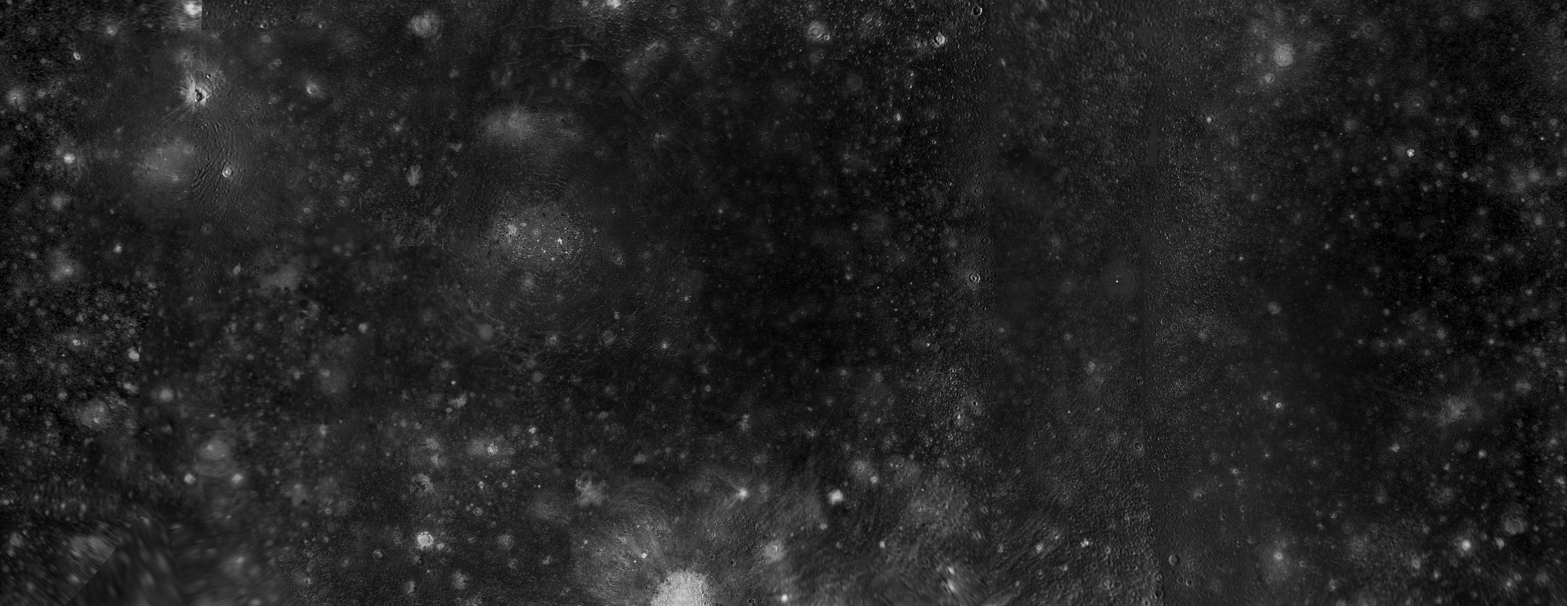


Hybrid Modeling of Callisto’s Environment Interaction with the Jovian Magnetosphere
Thomas LE LIBOUX, Ronan MODOLO, Nicolas ANDRÉ, François LEBLANC, et al.
Institut de Recherche en Astrophysique et Planétologie (IRAP), CNES-CNRS-UT3
Laboratoire Atmosphères, Observations Spatiales (LATMOS), Sorbonne Université, UVSQ, CNRS
ATST : Colloque Scientifique
Biarritz, 1-5 June 2026

Slide 2
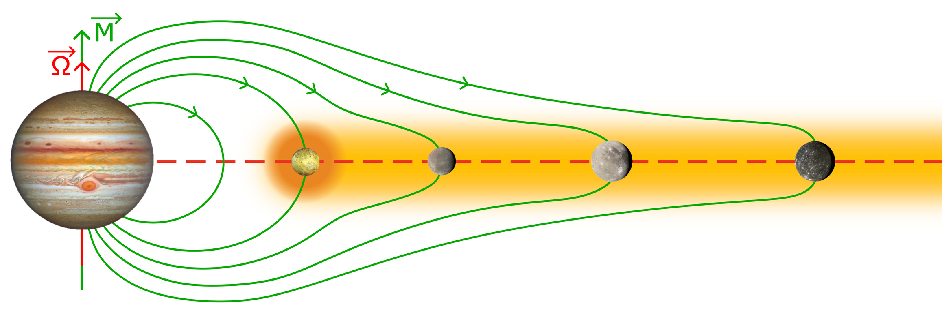
1/ Callisto in the Jovian Magnetosphere
Neutral cloud
=> Plasma torus
Current sheet = plasma confinement zone near centrifugal equator
Magnetic field
/!\ STATIC PICTURE /!\
Galilean moons =
Io
+
Europa
+
Ganymede
+
Callisto
1/10

Slide 3
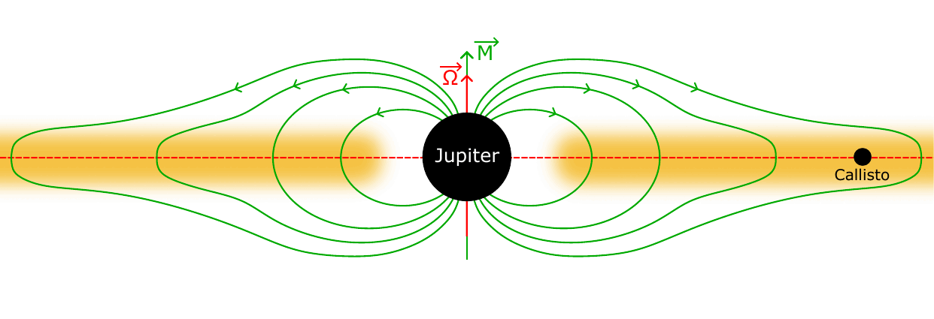
1/ Callisto in the Jovian Magnetosphere
➟ Magnetic dipole tilted from rotation axis : ~10°
➟ Magnetic field : tilted rotating structure
➟ Jupiter rotation period : ~10h
=> Highly variable magnetospheric environment
=> Fast time-varying environment
Magnetic field
Current sheet
Plasma
2/10

Slide 4
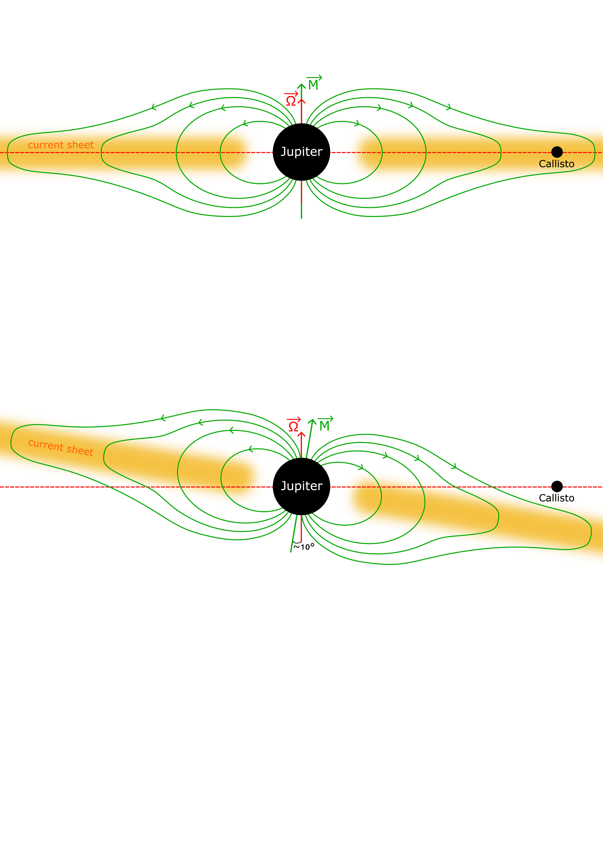
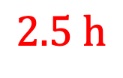
1/ Callisto in the Jovian Magnetosphere
➟ Two extreme magnetospheric positions for Callisto
1. Center of the current sheet
super-Alfvénic interaction
(e.g., Mars, Venus, ...)
$$2.5 h$$
2. Lobe of the magnetosphere
sub-Alfvénic interaction
(e.g., Europa, Ganymede, ...)
3/10

Slide 5
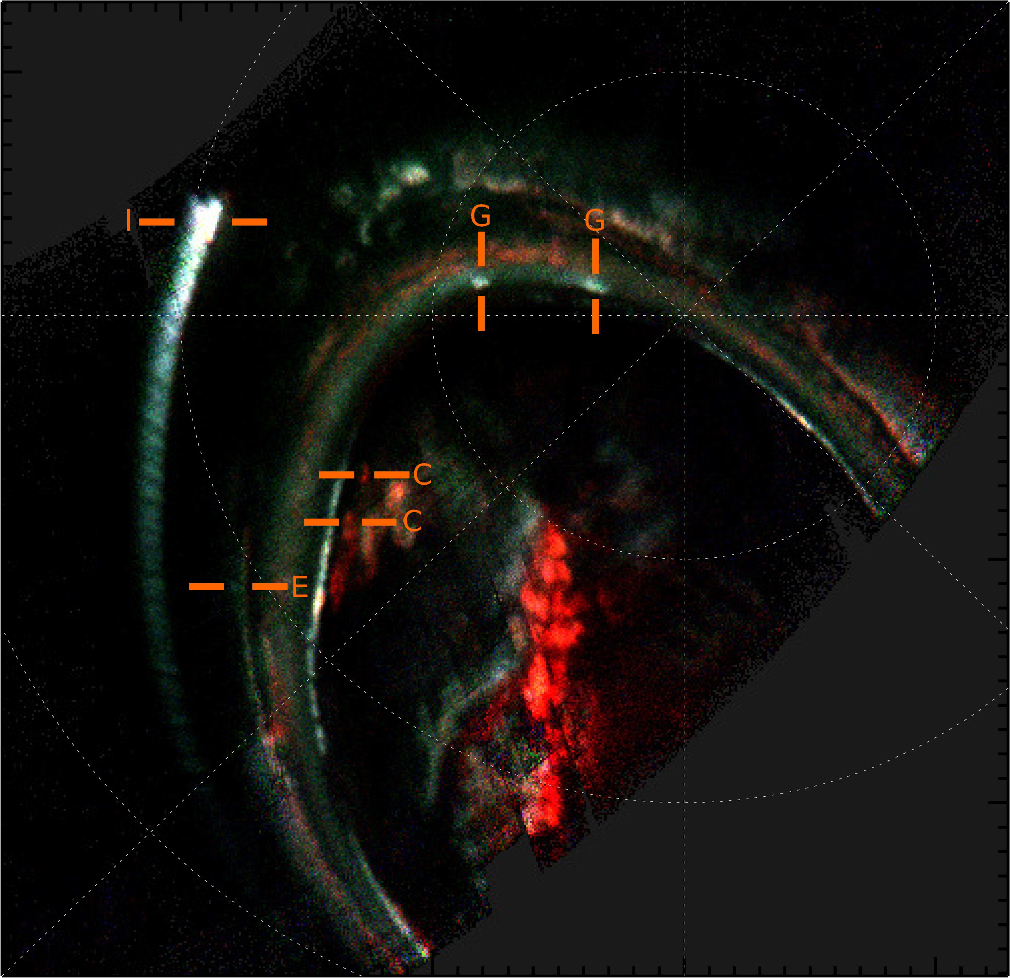
1/ Callisto in the Jovian Magnetosphere
➟ Two extreme magnetospheric positions for Callisto
1. Center of the current sheet
super-Alfvénic interaction
(e.g., Mars, Venus, ...)
2. Lobe of the magnetosphere
sub-Alfvénic interaction
[Rabia et al., 2025]
(e.g., Europa, Ganymede, ...)
3/10

Slide 6
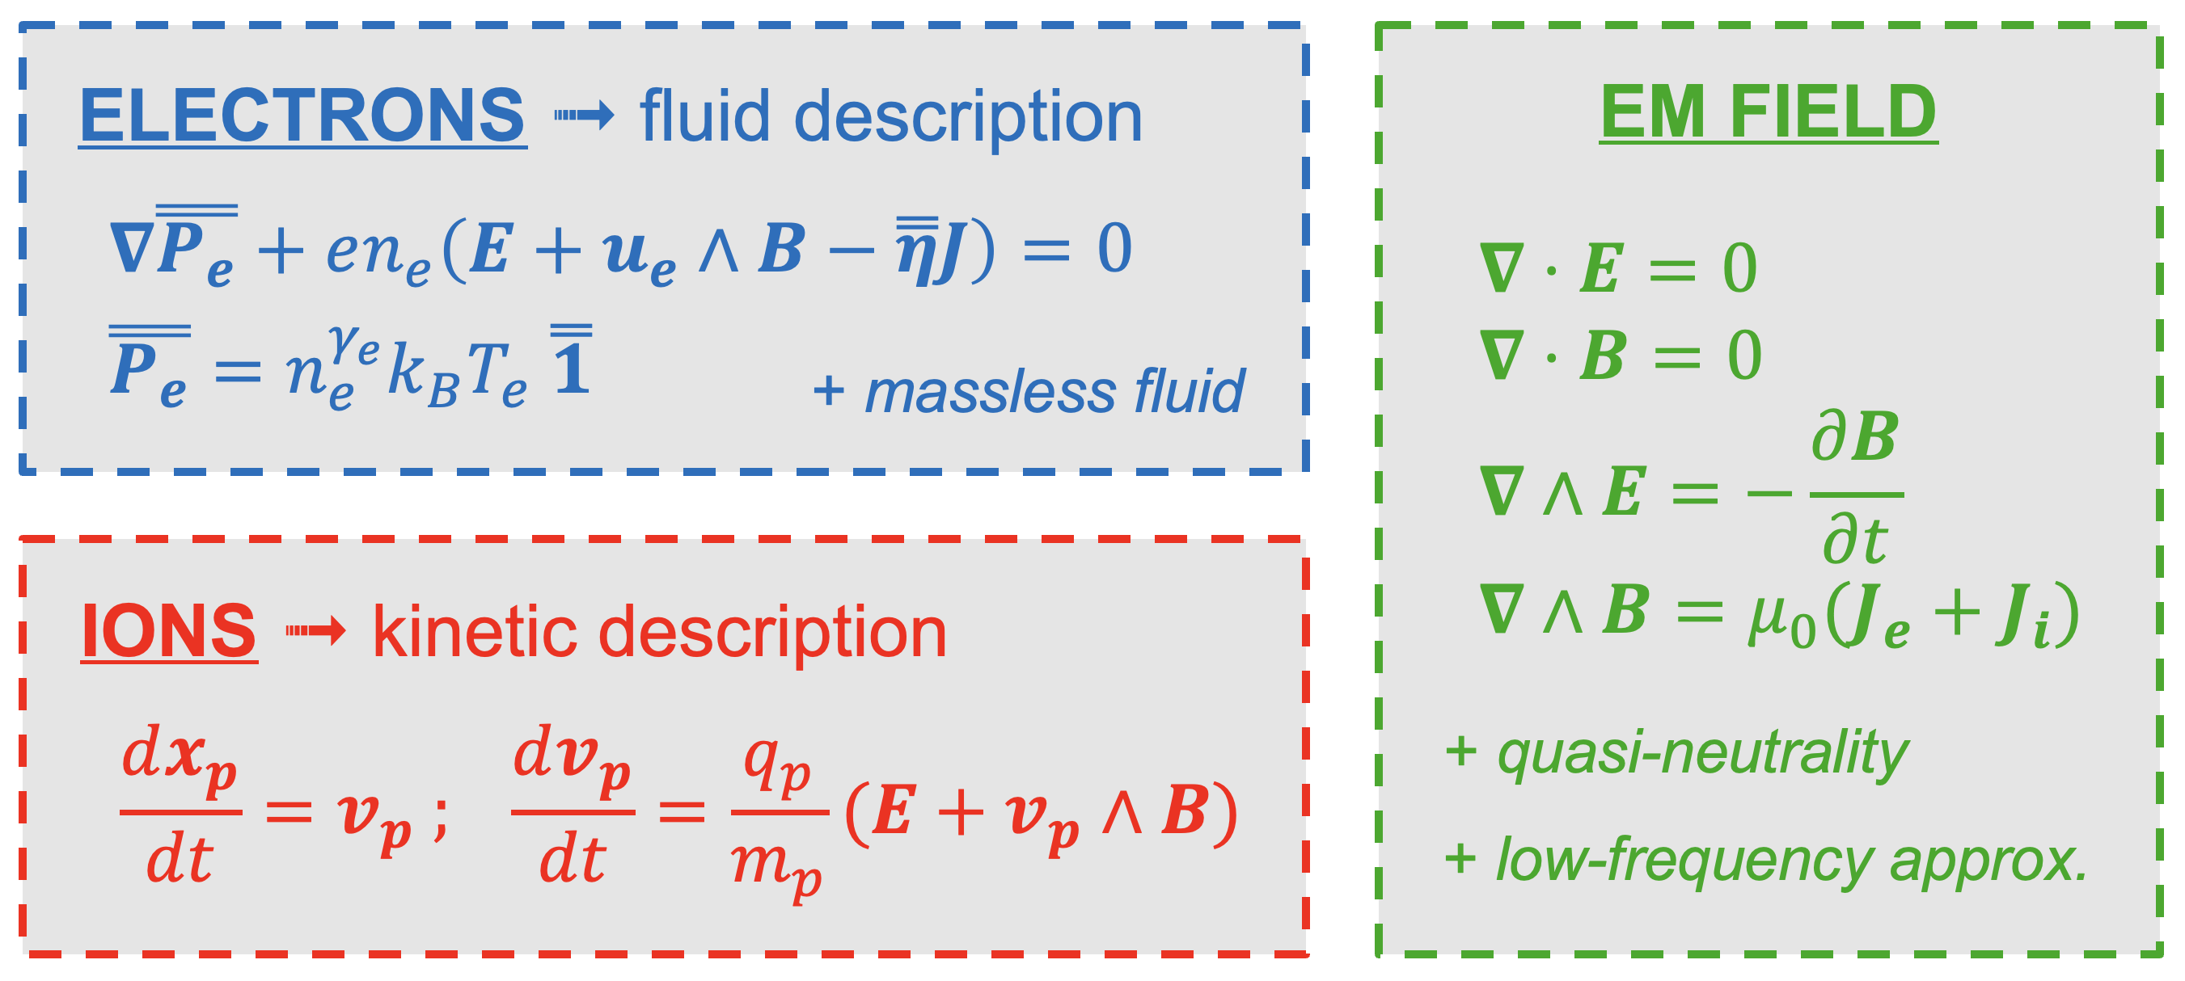
2/ LatHyS : Hybrid Simulations
➟ LatHyS : hybrid model [Modolo et al., 2016]
4/10

Slide 7
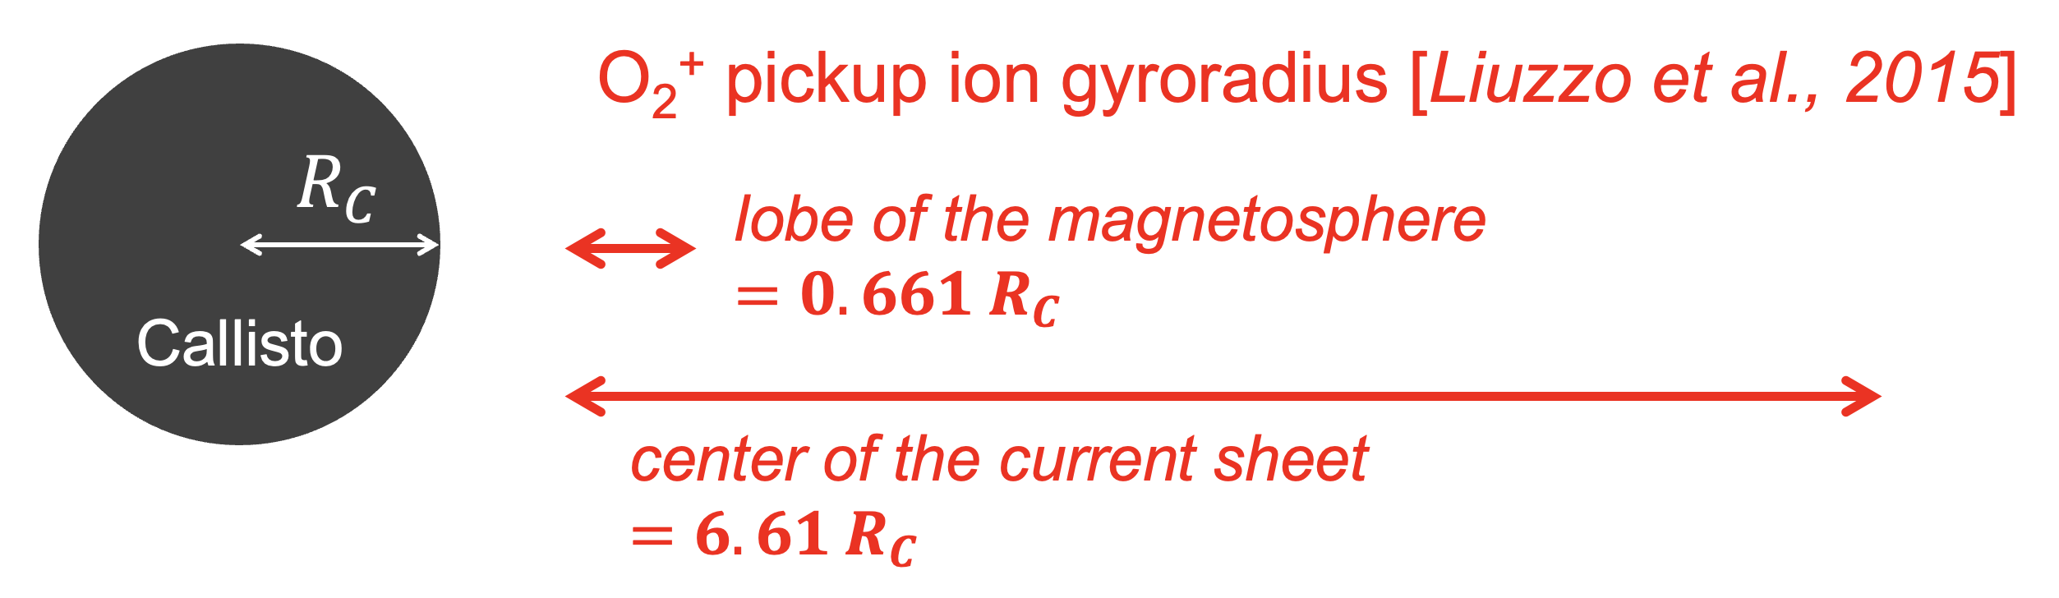
2/ LatHyS : Hybrid Simulations
➟ LatHyS : hybrid model [Modolo et al., 2016]
Why do we need hybrid simulations ? Why not simply MHD ?
=> essential to capture asymmetries due to kinetic effects
4/10

Slide 8
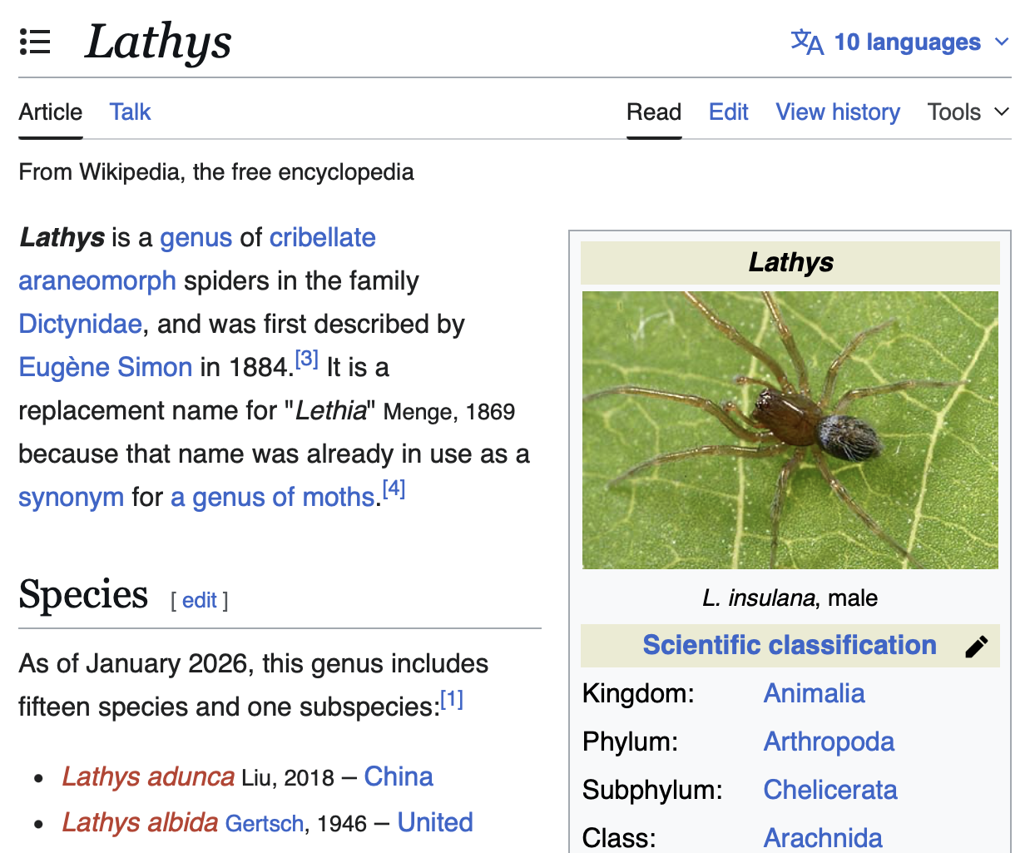
2/ LatHyS : Hybrid Simulations
➟ LatHyS : hybrid model
➟ Characteristics : 3D,
parallel, multi-species
➟ Modular Fortran code
4/10

Slide 9
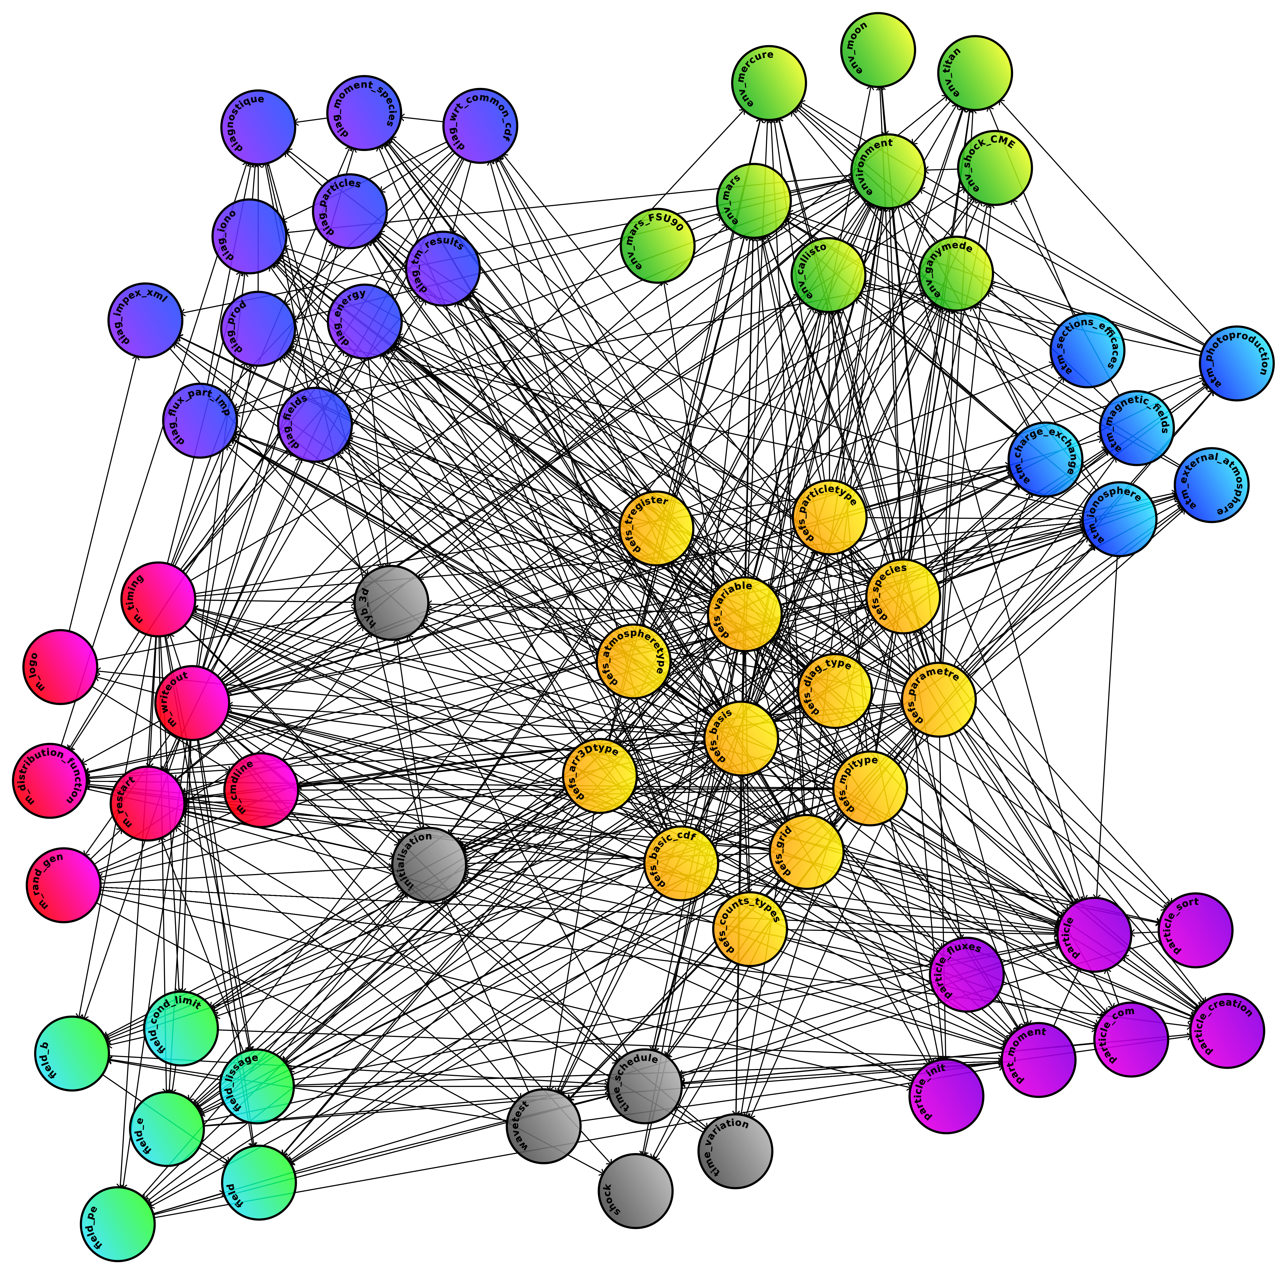
2/ LatHyS : Hybrid Simulations
➟ LatHyS : hybrid model
➟ Characteristics : 3D,
parallel, multi-species
➟ Modular Fortran code
➟ Towards Callisto …
➟ Create new module
➟ Adapt environment
➟ Add new features
4/10

Slide 10

2/ LatHyS : Hybrid Simulations
Ionization processes
1. Photoionization
2. Electron impact
3. Charge exchange
$$\vec{B}$$
Atmosphere
(O₂, CO₂)
SIMULATION BOX
What is in the
simulation box ?
to Sun
Umbra
Spherical obstacle
Jovian plasma
(composition, density,
relative velocity, plasma 𝛽)
5/10

Slide 11
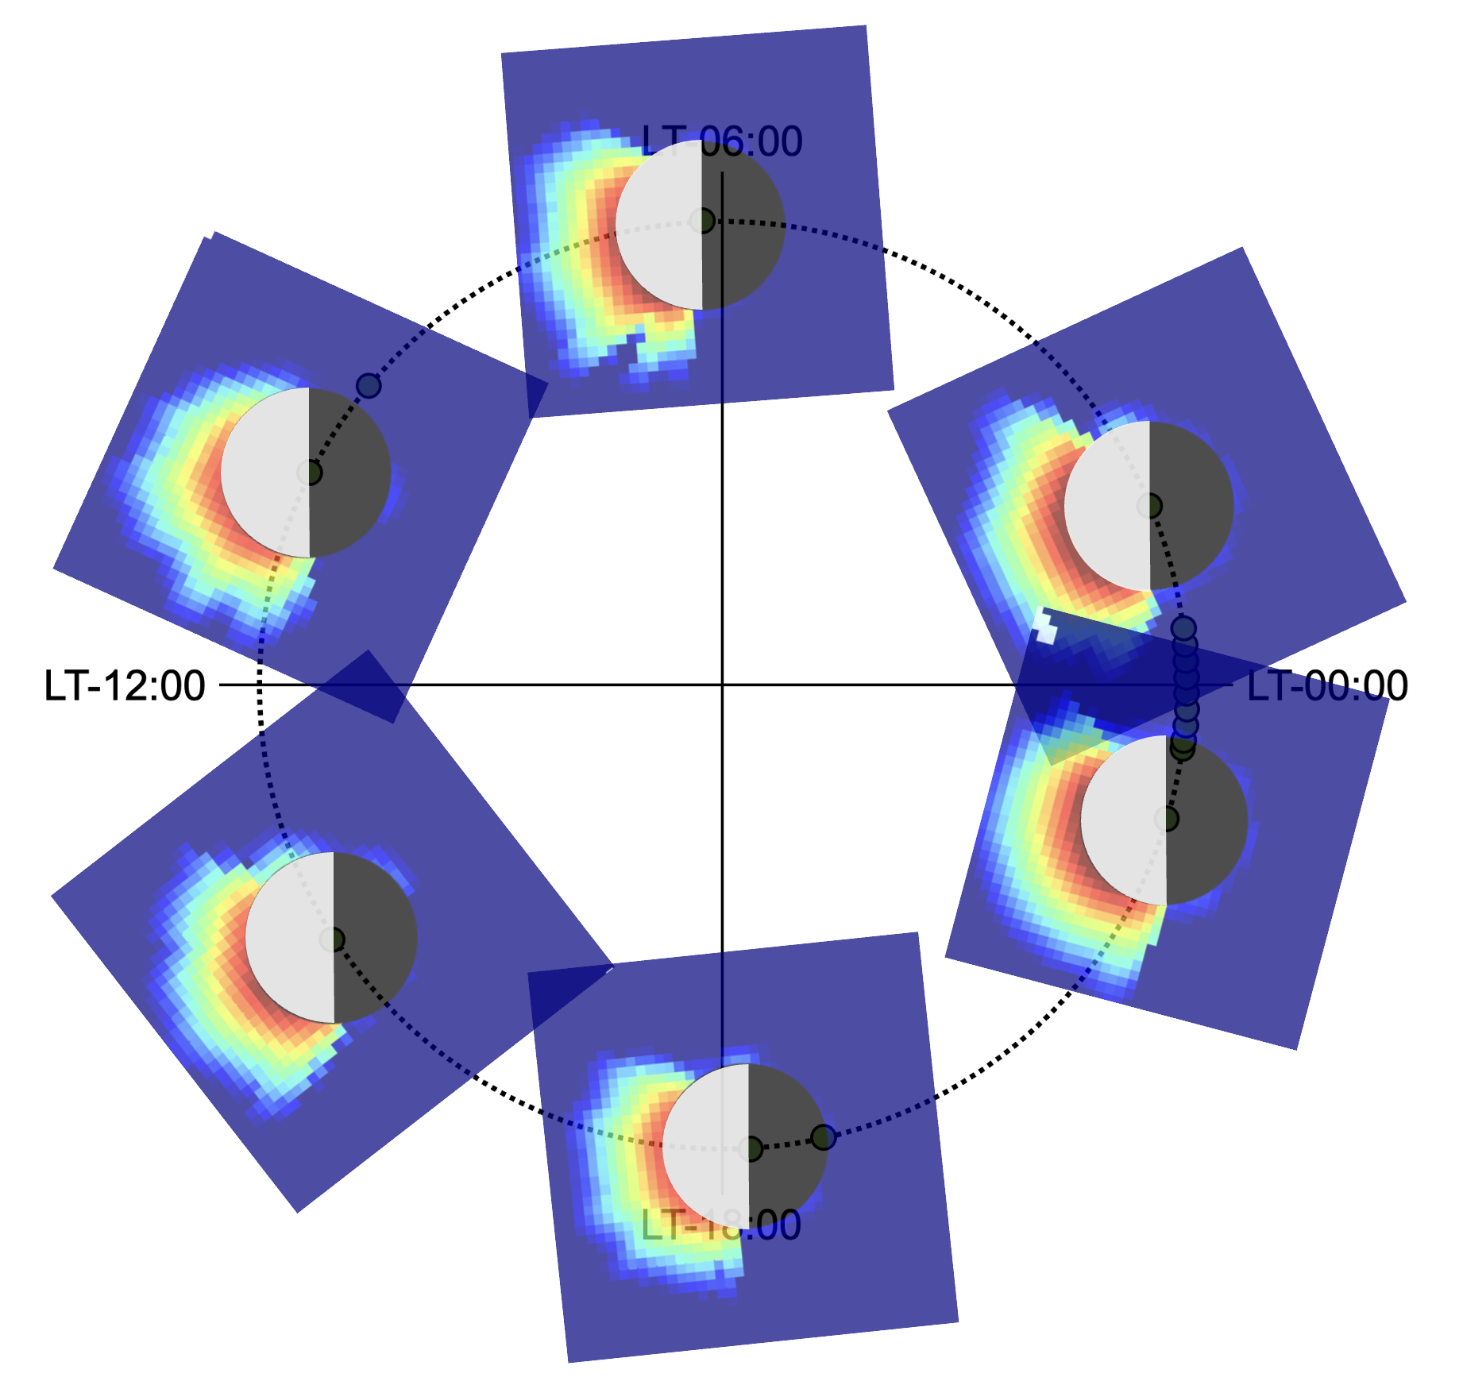

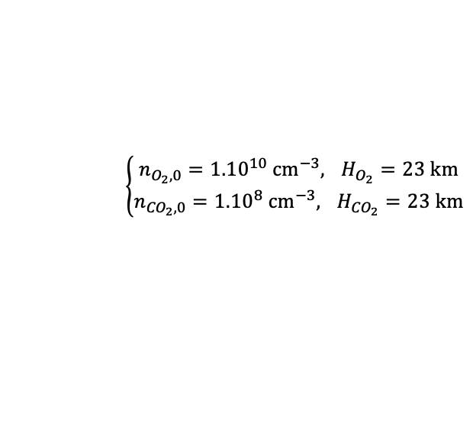
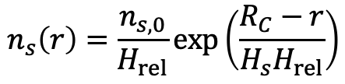
2/ LatHyS : Hybrid Simulations
Atmosphere model
3D spherically symmetric
barometric profile
Ionization processes
1. Photoionization
2. Electron impact
3. Charge exchange
$$\vec{B}$$
$$n_{s}\left(r\right)=\frac{n_{s,0}}{H_{rel}}exp\left(\frac{R_{C}−r}{H_{s}H_{rel}}\right)$$
$$\left\{\begin{aligned}n_{O_{2},0}={1.10}^{10} {cm}^{−3},uH_{O_{2}}=23 km \\ n_{{CO}_{2},0}={1.10}^{8} {cm}^{−3},uH_{{CO}_{2}}=23 km\end{aligned}\right.$$
$$H_{rel}=10$$
Atmosphere
(O₂, CO₂)
[Carlson, 1999; Kliore et al., 2002]
SIMULATION BOX
to Sun
Exospheric model output
Umbra
Spherical obstacle
EGM = Exospheric Global Model
[Leblanc, 2017]
/!\ need to be adapted /!\
Jovian plasma
(composition, density,
relative velocity, plasma 𝛽)
5/10

Slide 12
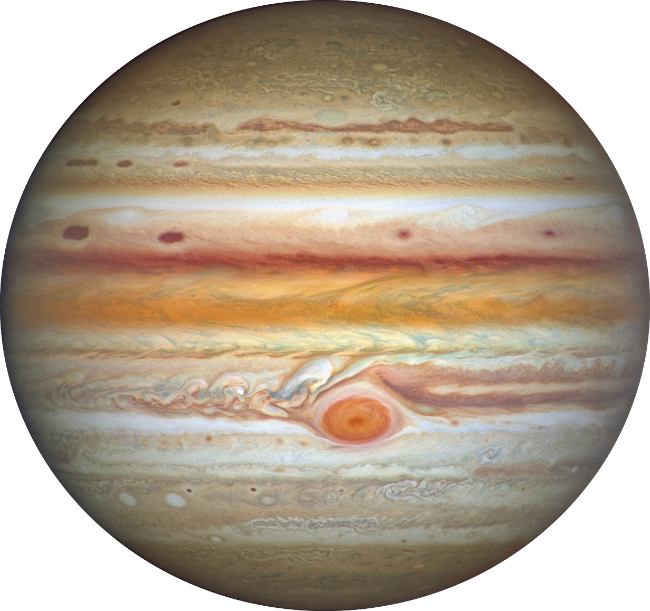


3/ LatHyS x Callisto : Simulations
XY-plan
LT-18:00
$$hν$$
aligned with Jovian spin axis
Z
pointed toward Jupiter
Y
Y
X
X
CphiO
coordinates
XZ-plan
aligned with corotational flow direction
Z
$$hν$$
X
6/10

Slide 13




3/ LatHyS x Callisto : Simulations
XY-plan
aligned with Jovian spin axis
Z
$$\vec{u}$$
pointed toward Jupiter
Y
Y
$$\vec{B}$$
X
X
CphiO
coordinates
XZ-plan
$$\vec{B}$$
aligned with corotational flow direction
Z
$$\vec{u}$$
X
6/10

Slide 14








3/ LatHyS x Callisto : Simulations
Center of the current sheet
Numerical parameters :
$$Δx=316 km=0.09 R_{C}$$
Physical parameters :
$$n_{0}=0.1 {cm}^{−3}$$
$$u_{0}=192 km/s$$
$$B_{0}=4 nT$$
$$M_{A}=2.77,$$
$$M_{MS}=0.835$$
$$β_{i}=10,$$
$$β_{e}=0.13$$
7/10

Slide 15
3/ LatHyS x Callisto : Simulations
Center of the current sheet
Numerical parameters :
$$Δx=316 km=0.09 R_{C}$$
Physical parameters :
$$n_{0}=0.1 {cm}^{−3}$$
$$u_{0}=192 km/s$$
$$B_{0}=4 nT$$
$$M_{A}=2.77,$$
$$M_{MS}=0.835$$
super-alfvénic
$$β_{i}=10,$$
$$β_{e}=0.13$$
7/10

Slide 16
3/ LatHyS x Callisto : Simulations
Center of the current sheet
Numerical parameters :
$$Δx=316 km=0.09 R_{C}$$
Physical parameters :
$$n_{0}=0.1 {cm}^{−3}$$
$$u_{0}=192 km/s$$
$$B_{0}=4 nT$$
$$M_{A}=2.77,$$
$$M_{MS}=0.835$$
sub-magnetosonic
$$β_{i}=10,$$
$$β_{e}=0.13$$
7/10

Slide 17
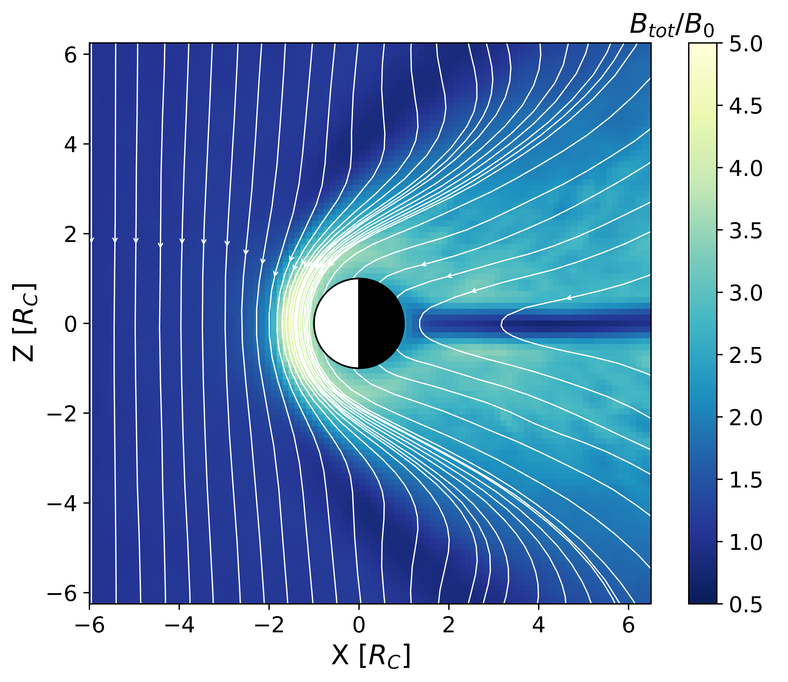
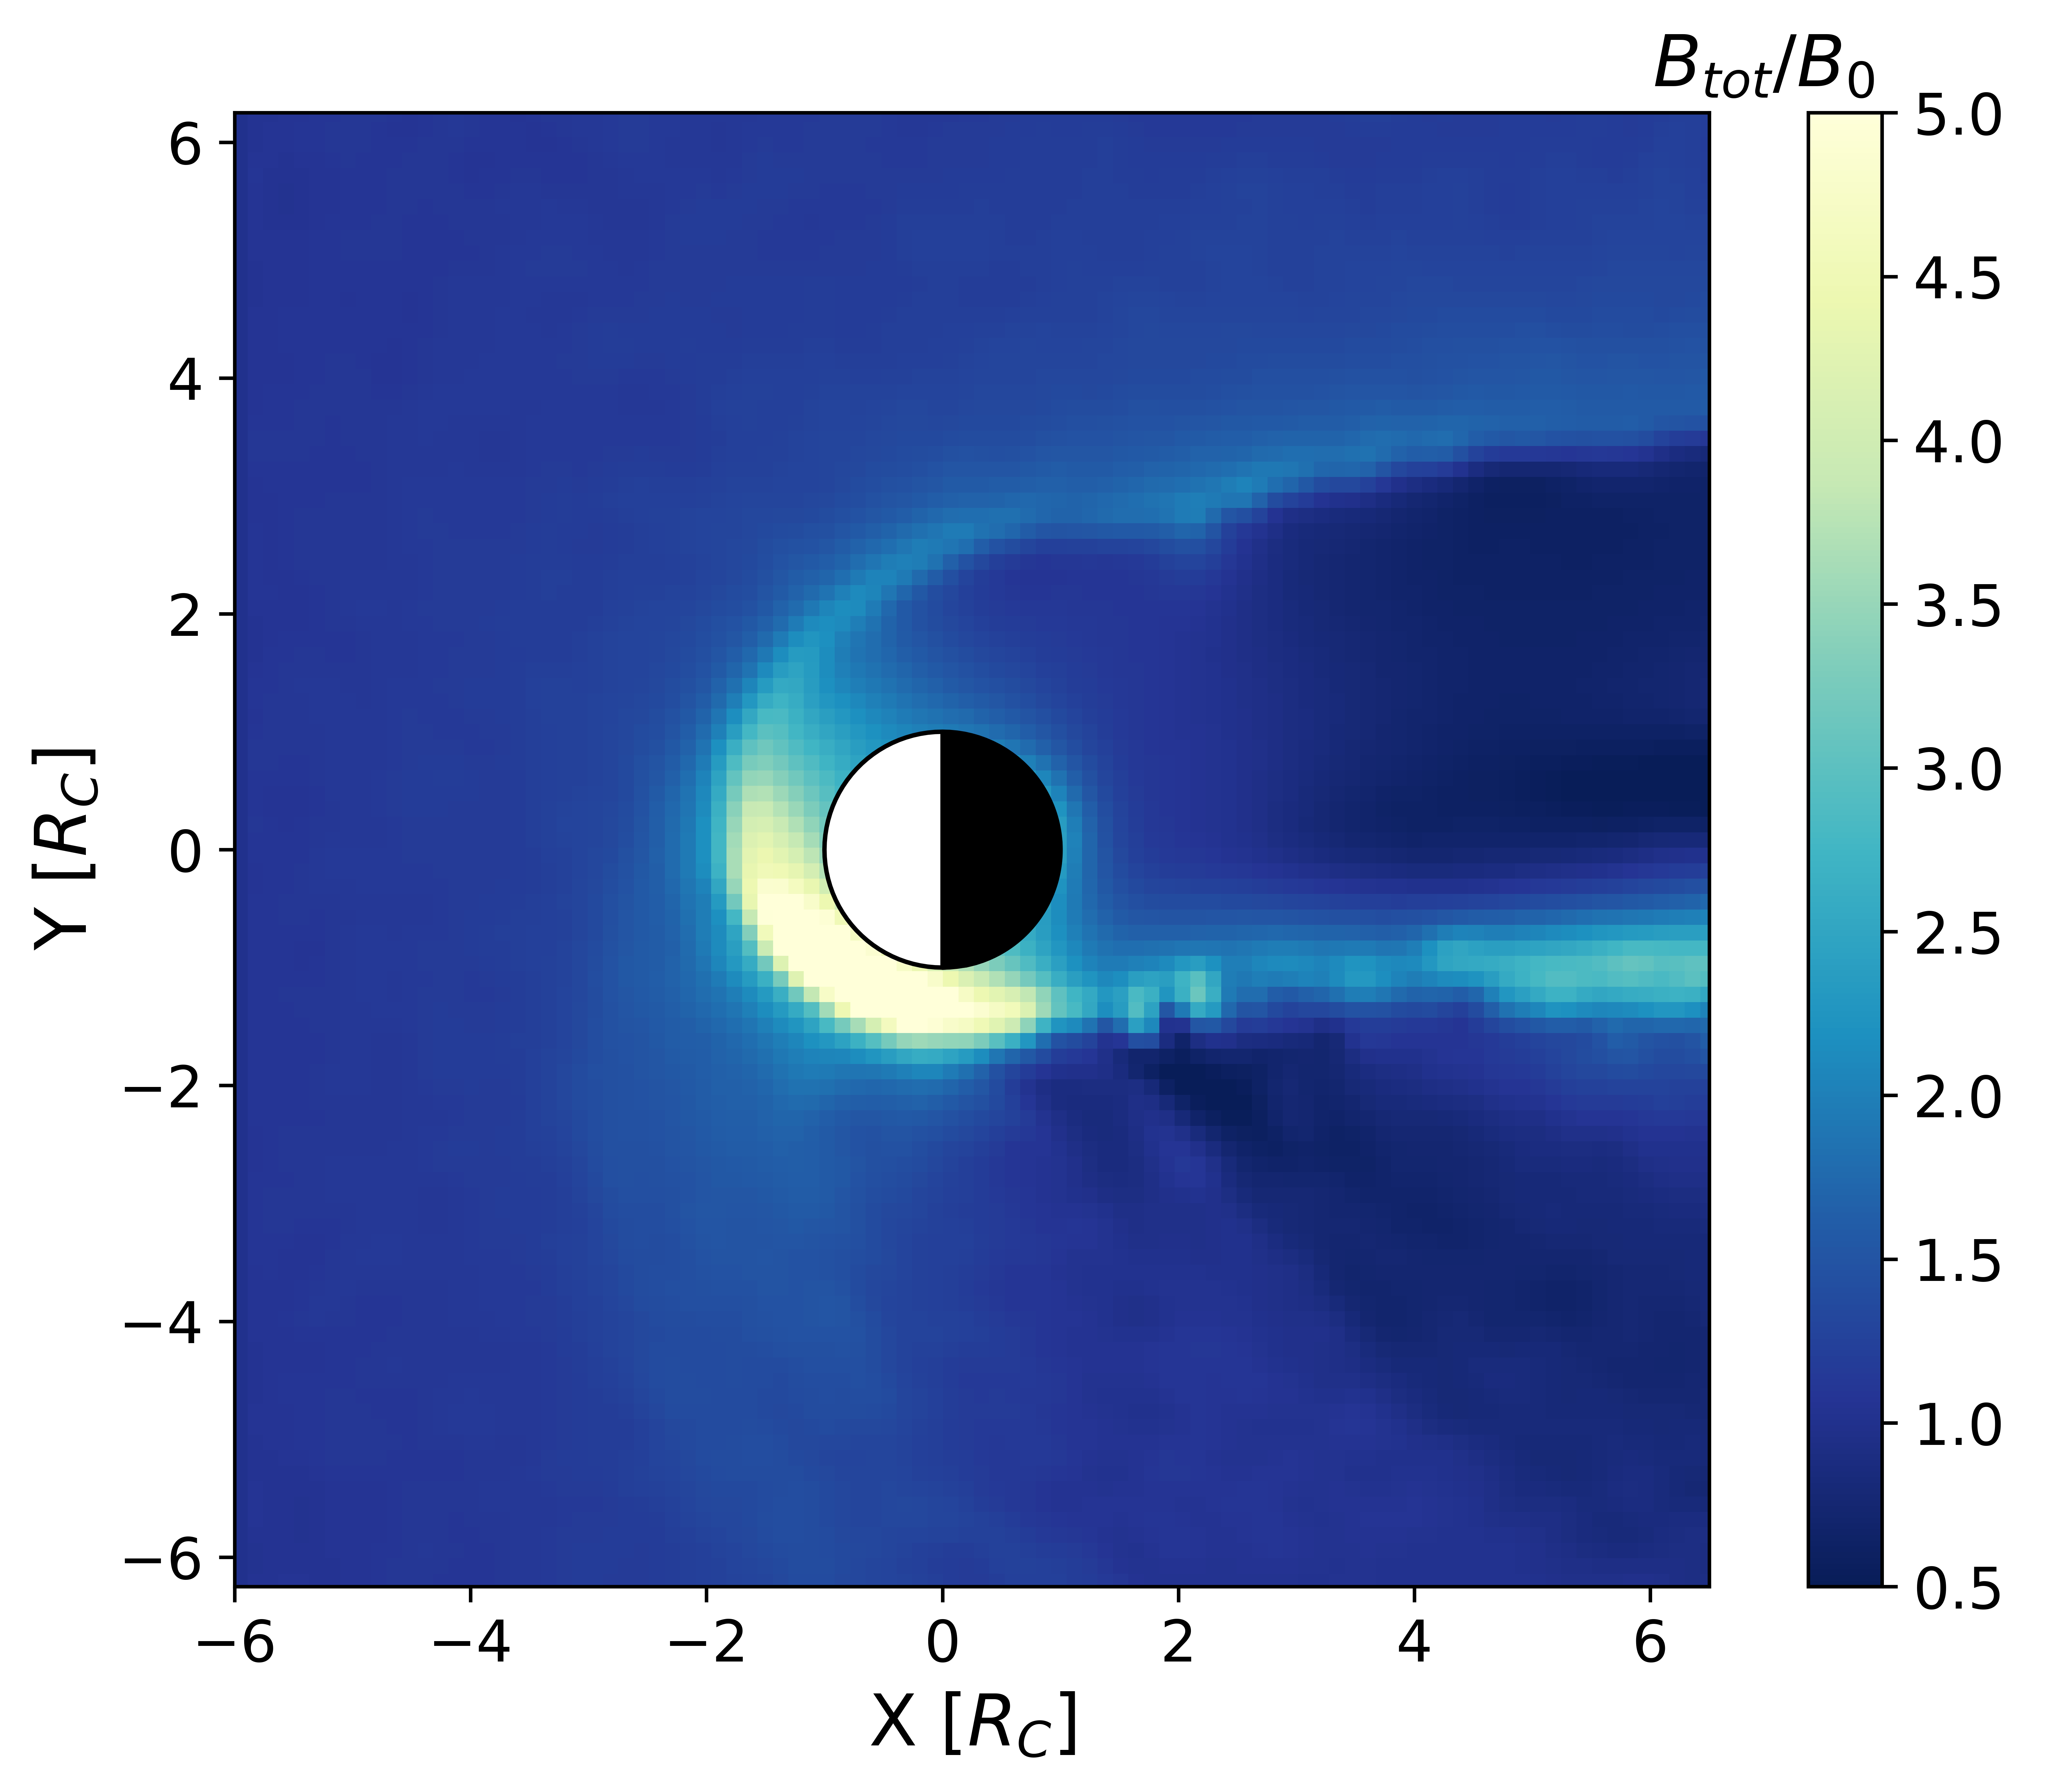
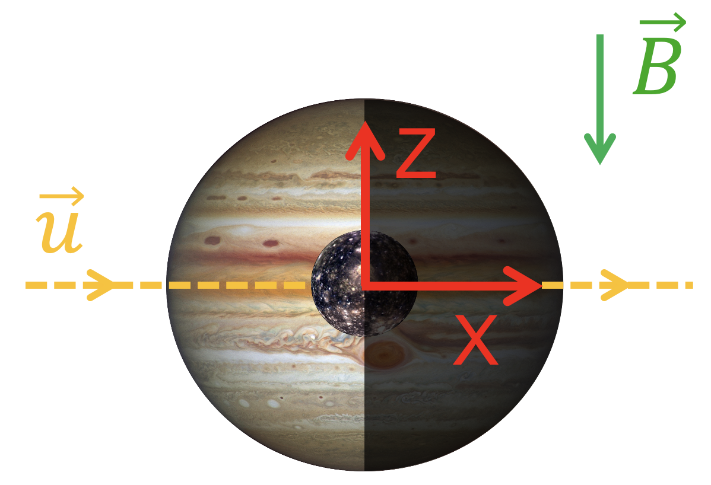
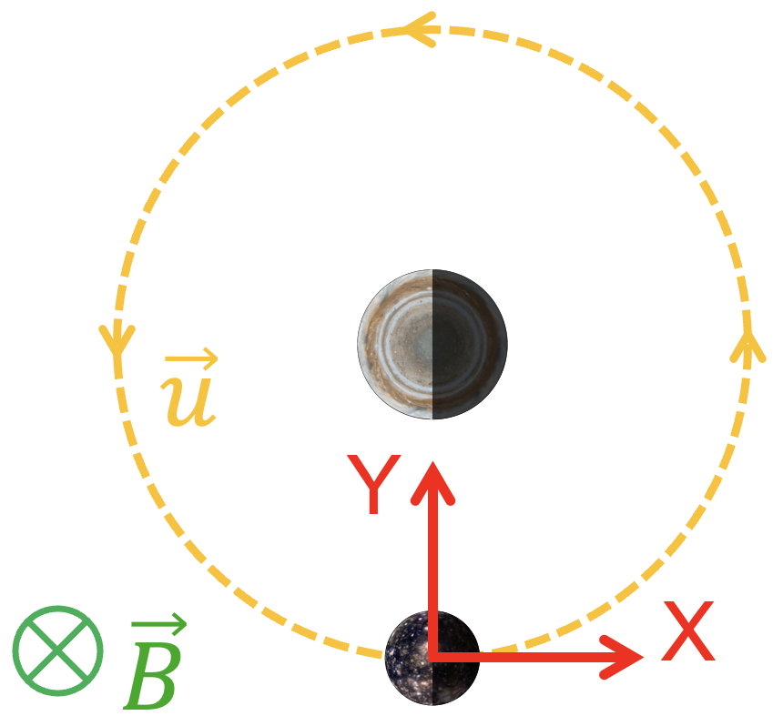
3/ LatHyS x Callisto : Simulations
Center of the current sheet
magnetic field
magnetic field
ramside:
pileup region
Numerical parameters :
$$Δx=316 km=0.09 R_{C}$$
Physical parameters :
$$n_{0}=0.1 {cm}^{−3}$$
$$u_{0}=192 km/s$$
$$B_{0}=4 nT$$
$$M_{A}=2.77,$$
$$M_{MS}=0.835$$
$$β_{i}=10,$$
$$β_{e}=0.13$$
7/10

Slide 18
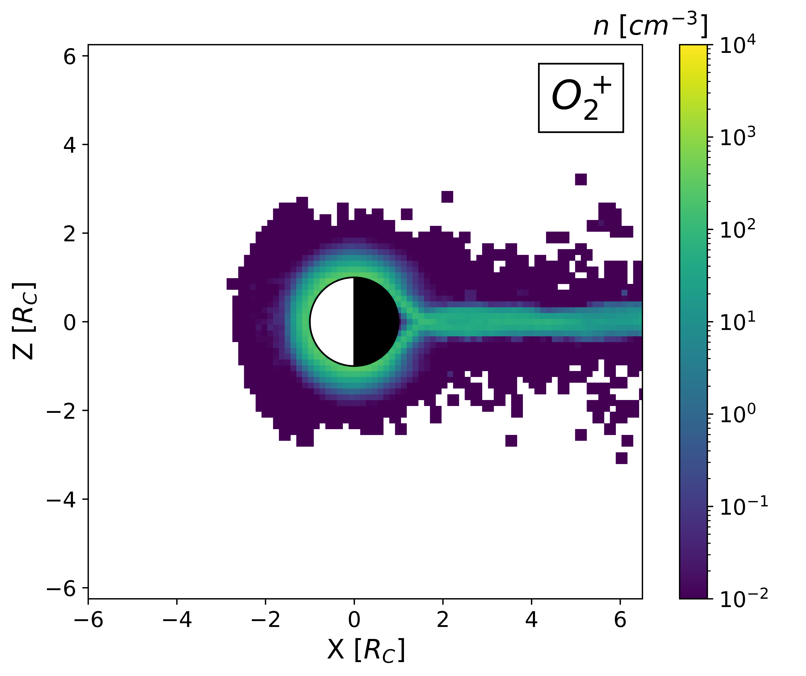
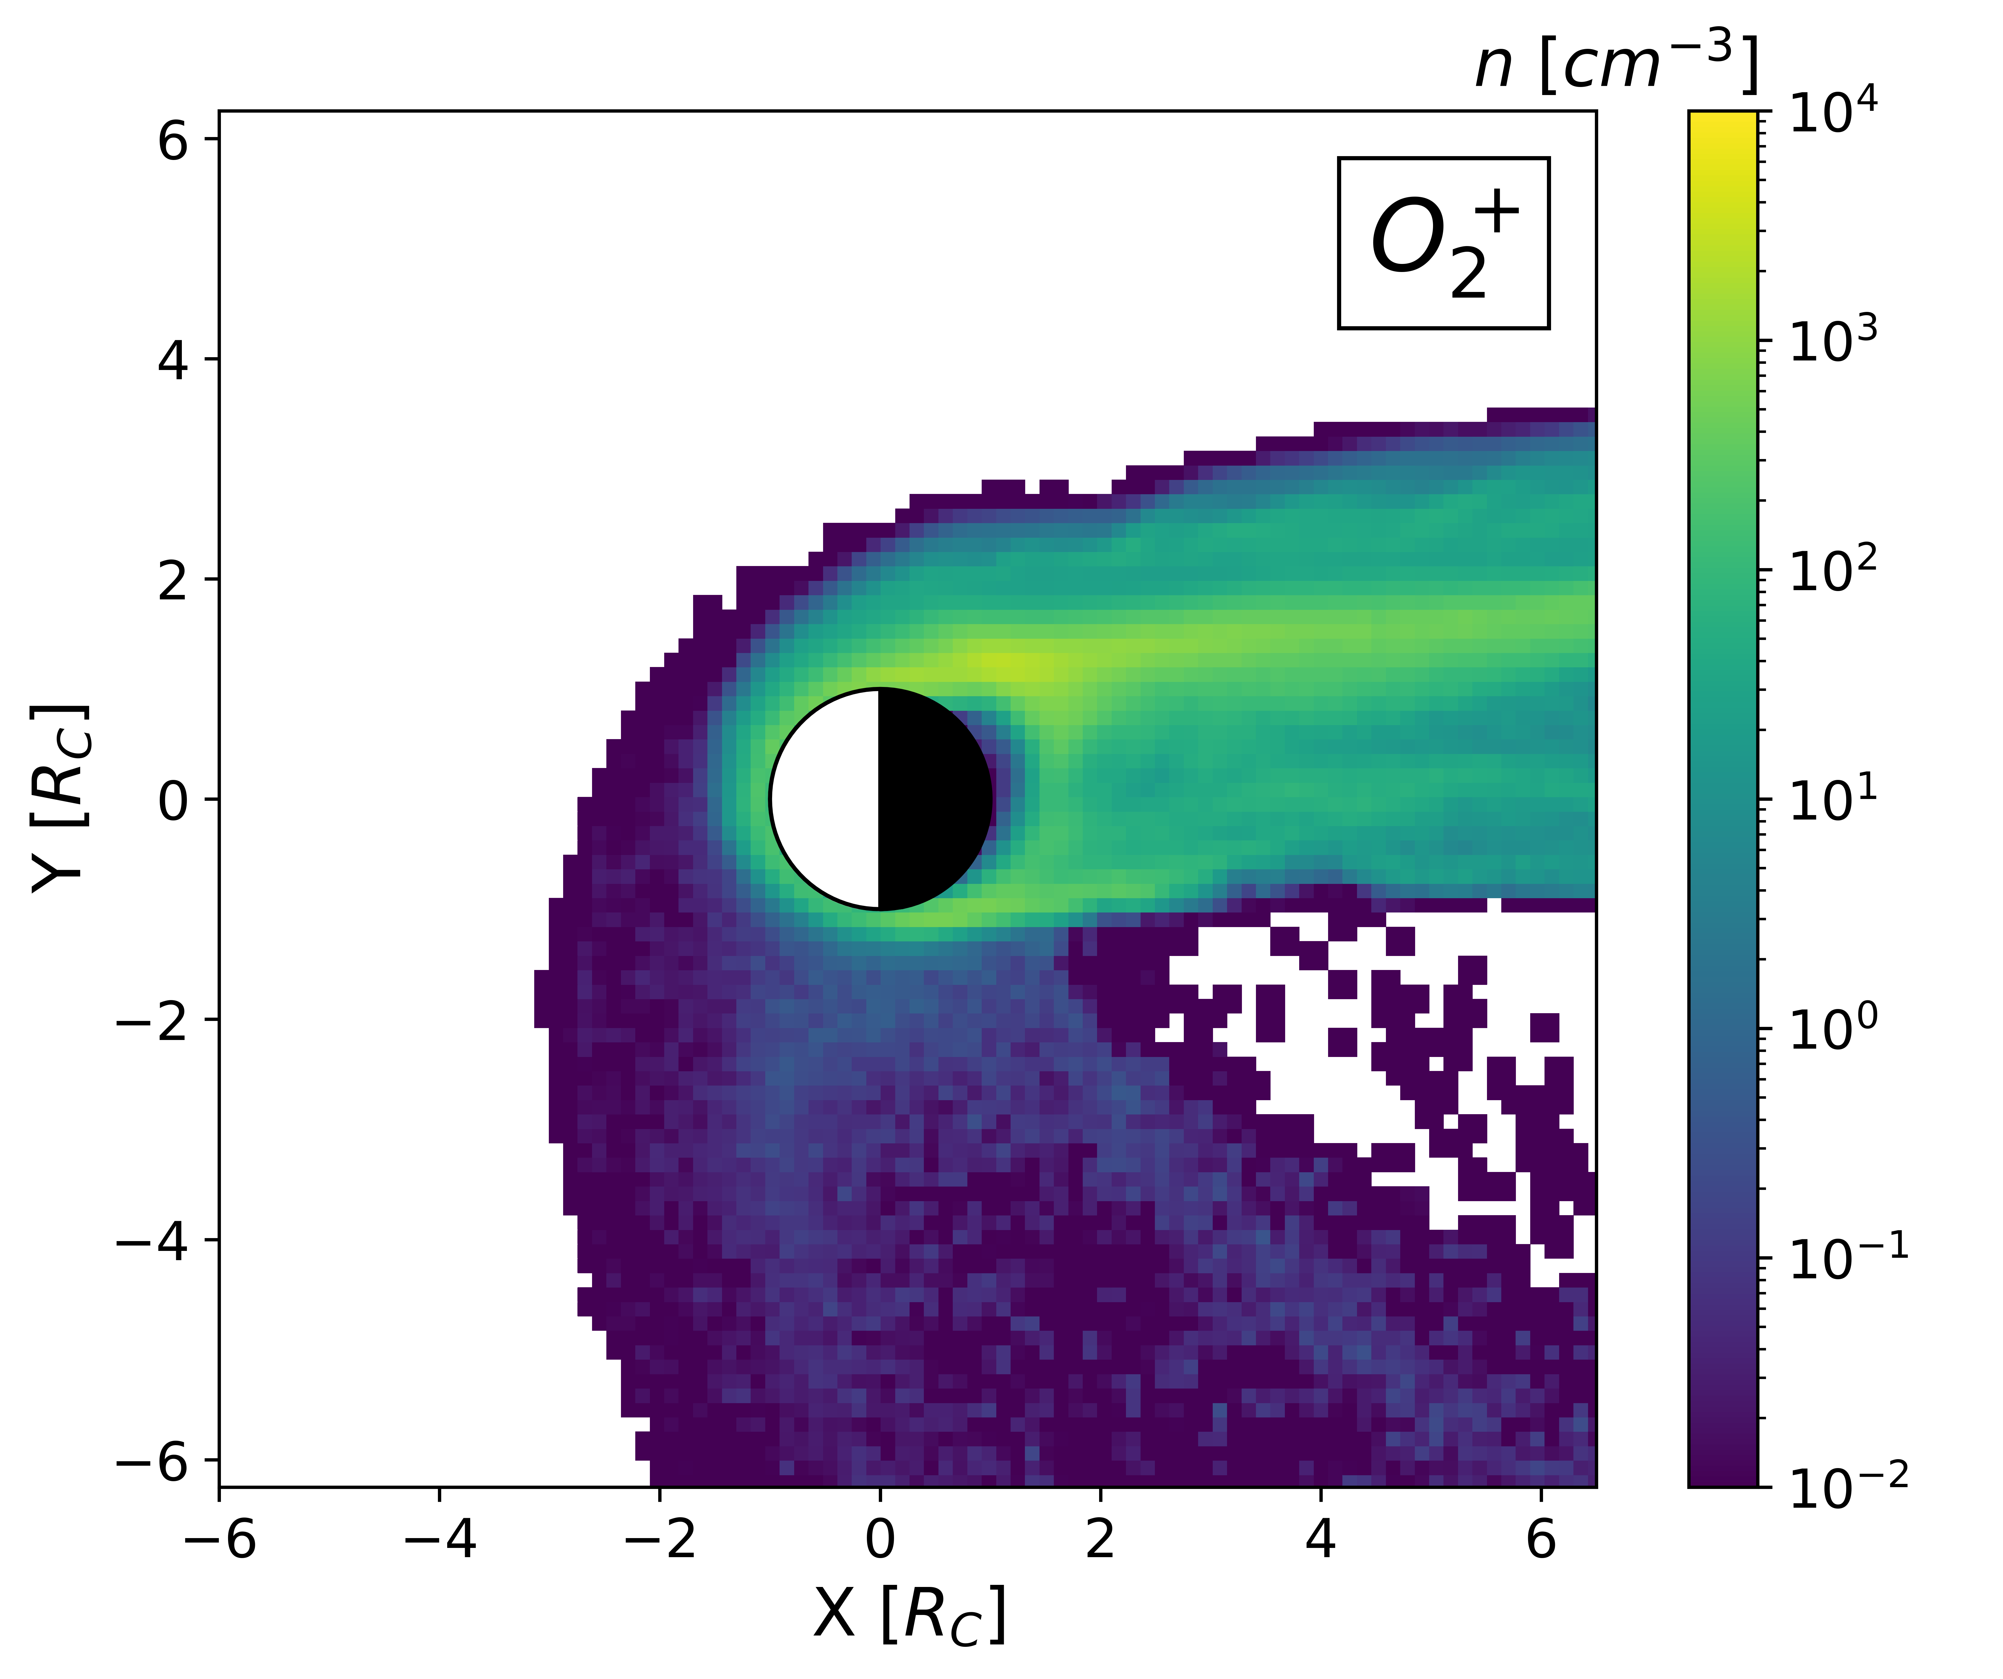
3/ LatHyS x Callisto : Simulations
Center of the current sheet
density
density
Numerical parameters :
wakeside:
neutral sheet
$$Δx=316 km=0.09 R_{C}$$
Physical parameters :
$$n_{0}=0.1 {cm}^{−3}$$
$$u_{0}=192 km/s$$
$$B_{0}=4 nT$$
$$M_{A}=2.77,$$
$$M_{MS}=0.835$$
$$β_{i}=10,$$
$$β_{e}=0.13$$
7/10

Slide 19
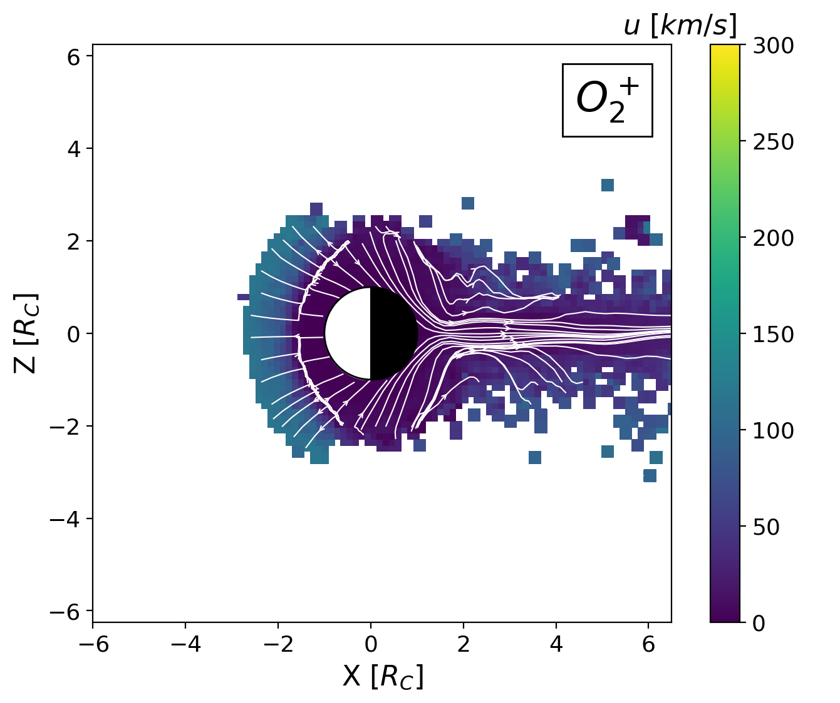
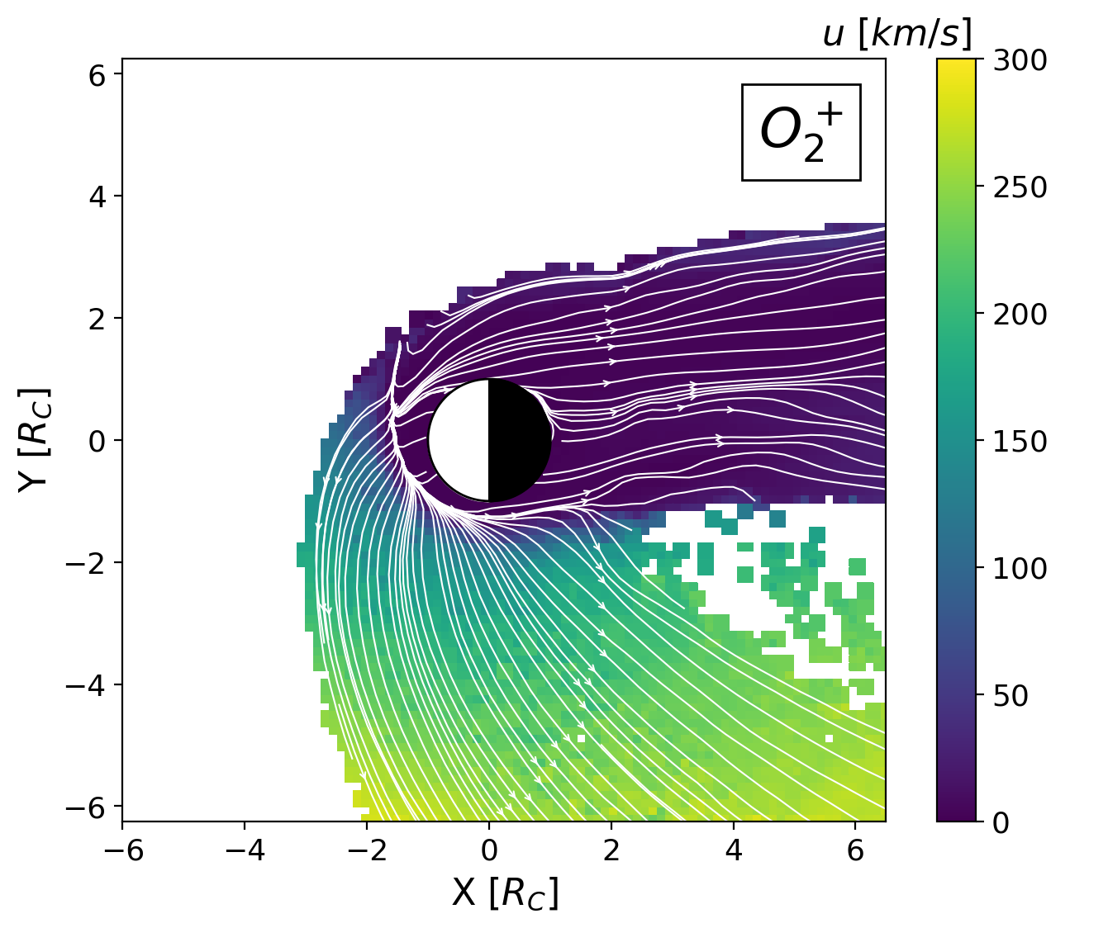
3/ LatHyS x Callisto : Simulations
Center of the current sheet
bulk velocity
bulk velocity
bulk velocity
bulk velocity
convective
electric field
Numerical parameters :
$$Δx=316 km=0.09 R_{C}$$
pickup ions:
cycloidal arcs
Physical parameters :
$$n_{0}=0.1 {cm}^{−3}$$
$$u_{0}=192 km/s$$
$$B_{0}=4 nT$$
$$M_{A}=2.77,$$
$$M_{MS}=0.835$$
$$β_{i}=10,$$
$$β_{e}=0.13$$
7/10

Slide 20
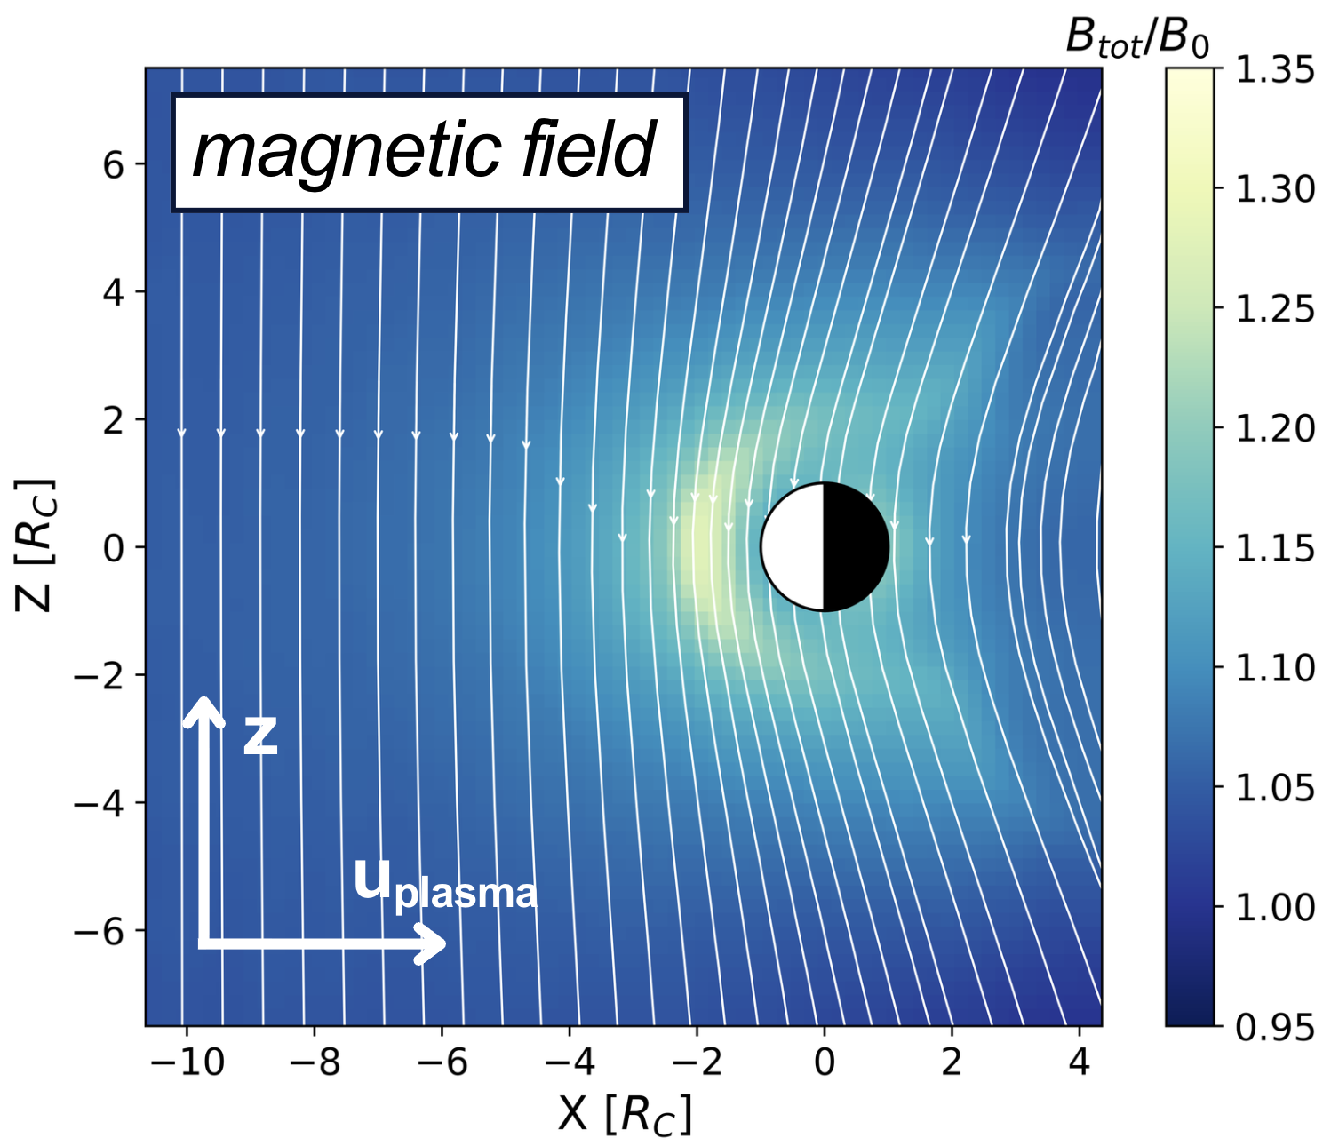
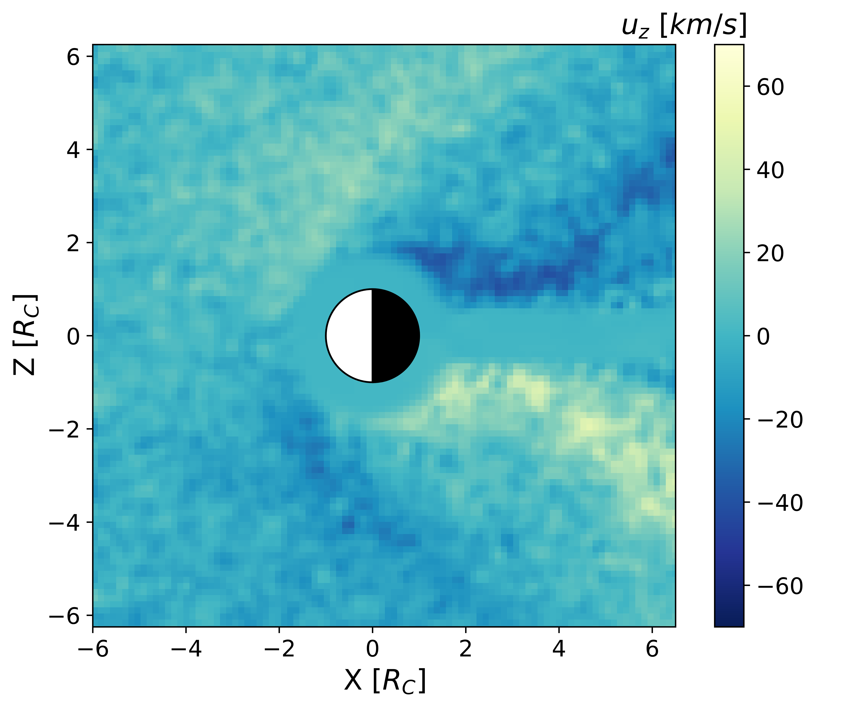
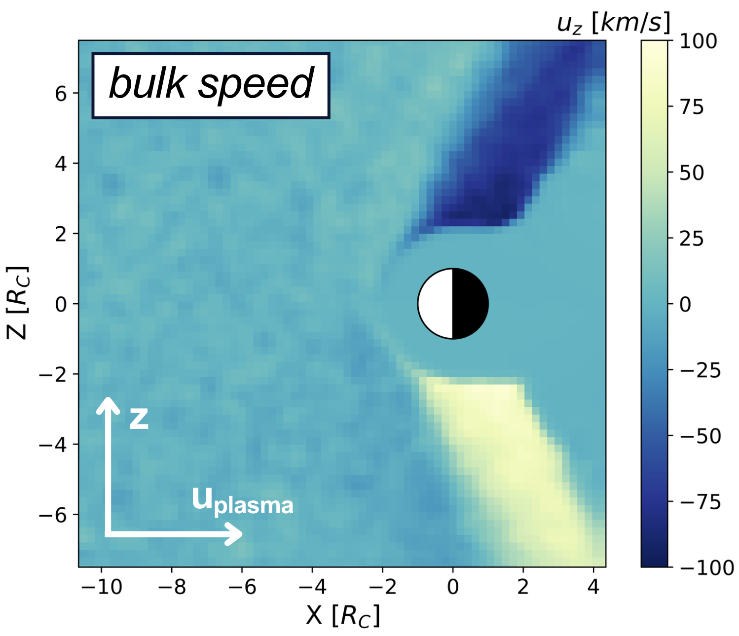

3/ LatHyS x Callisto : Simulations
Lobe of the magnetosphere
magnetic field
magnetic field
magnetic field
magnetic field
$$B_{0} ×10$$
bulk velocity
bulk velocity
bulk velocity
bulk velocity
sub-alfvénic
8/10

Slide 21
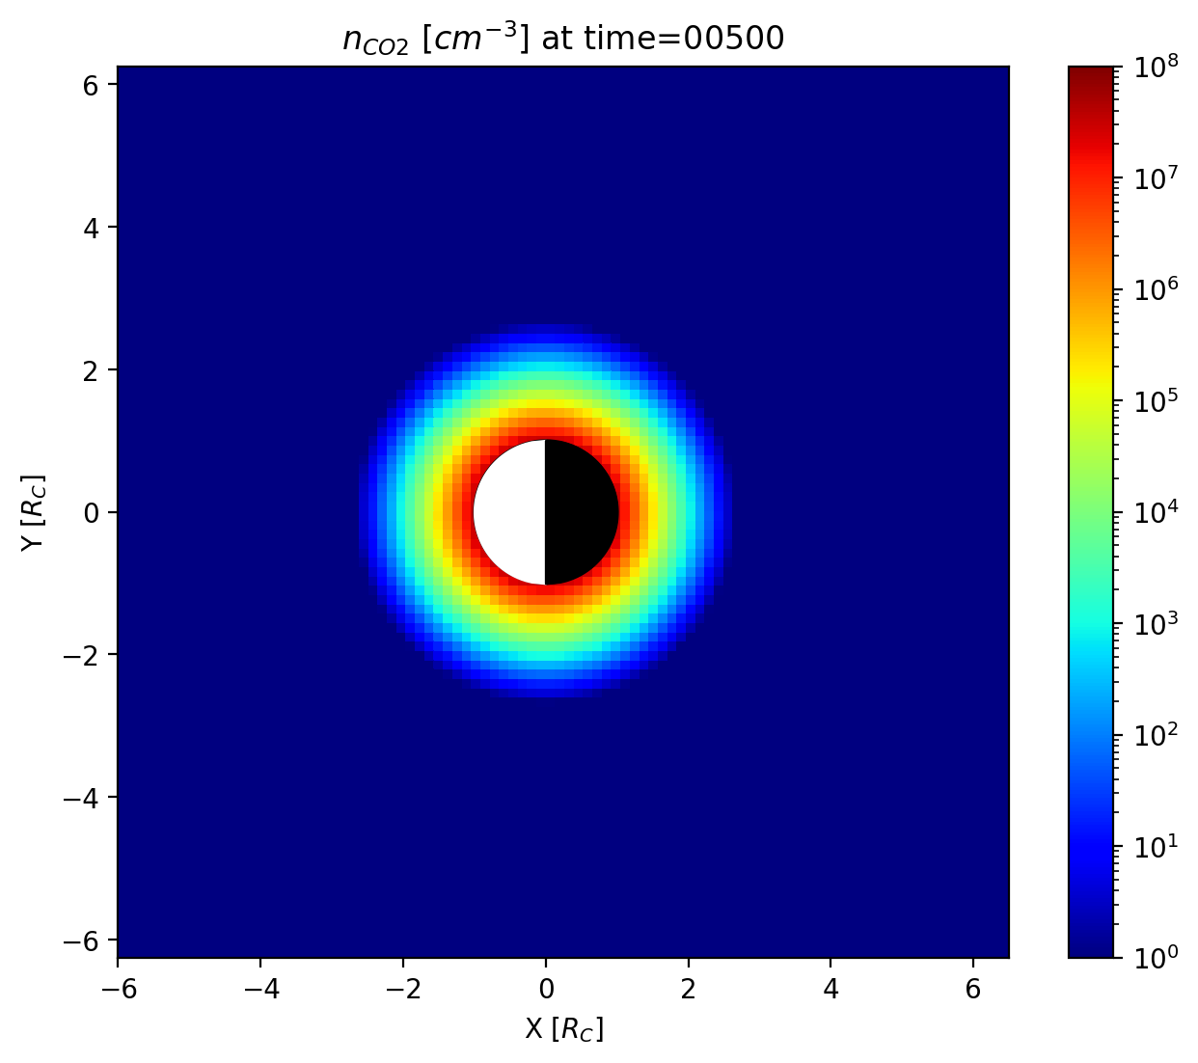
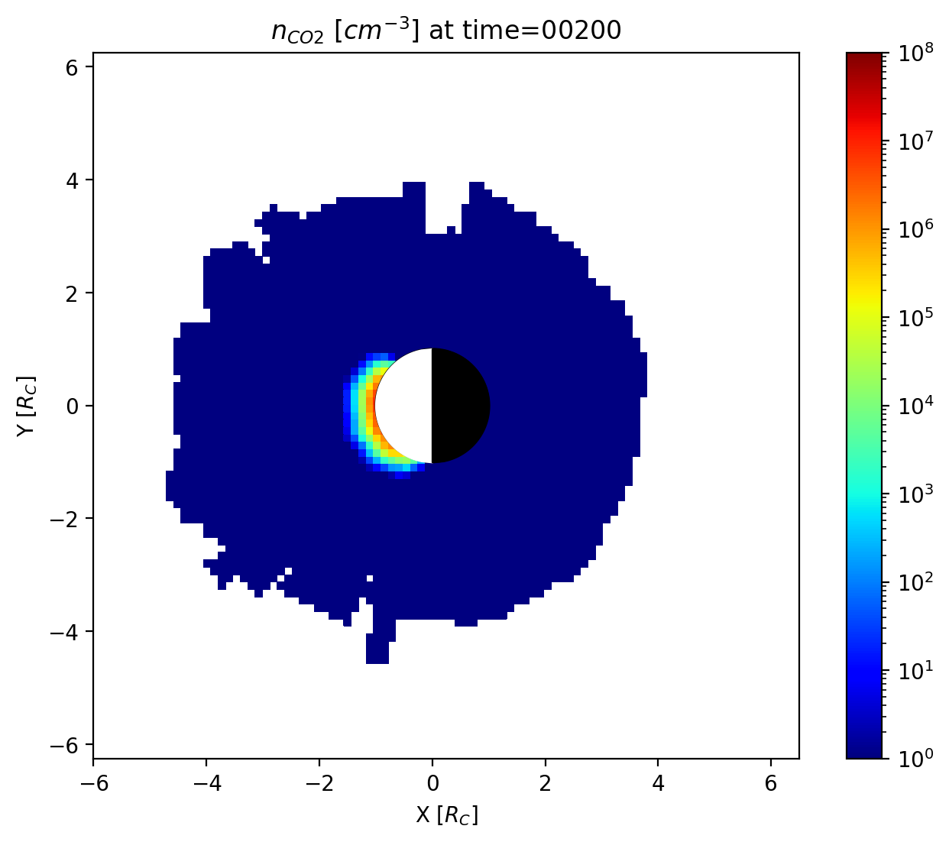
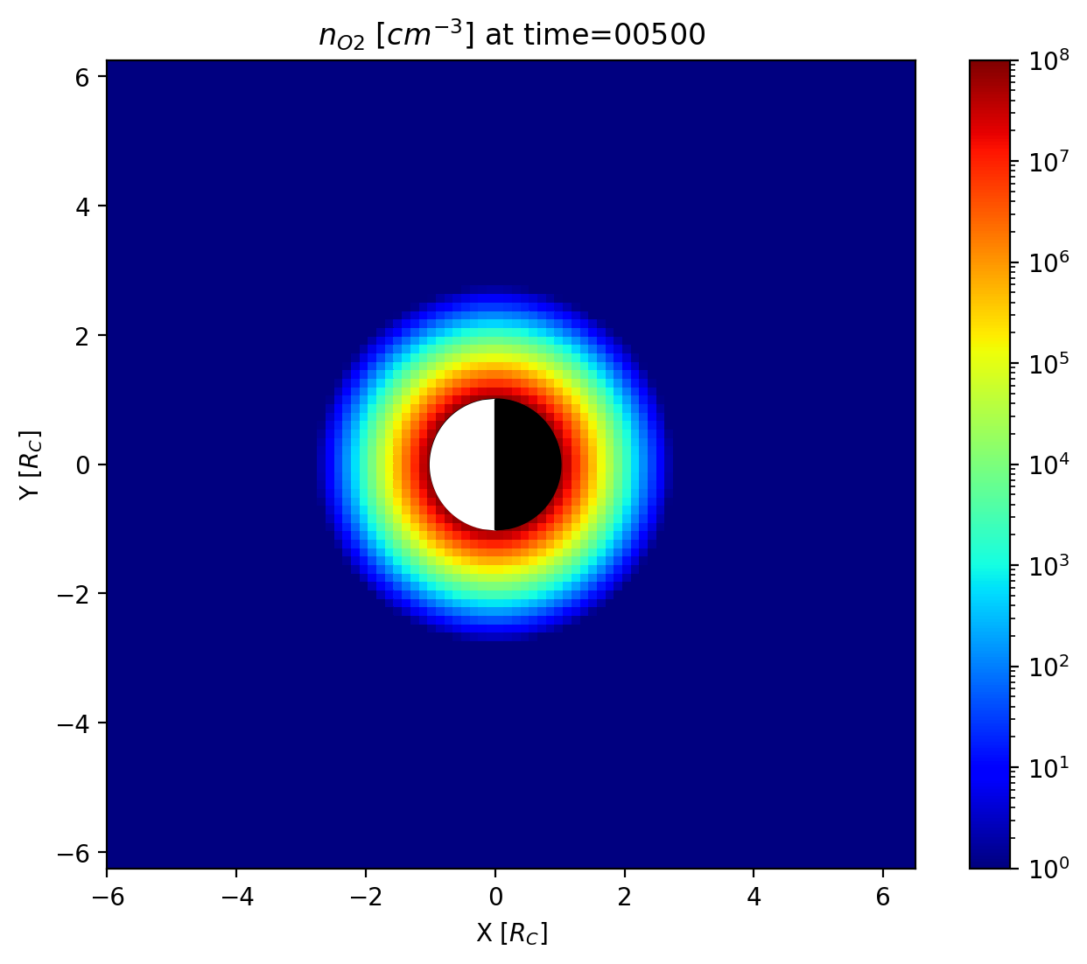
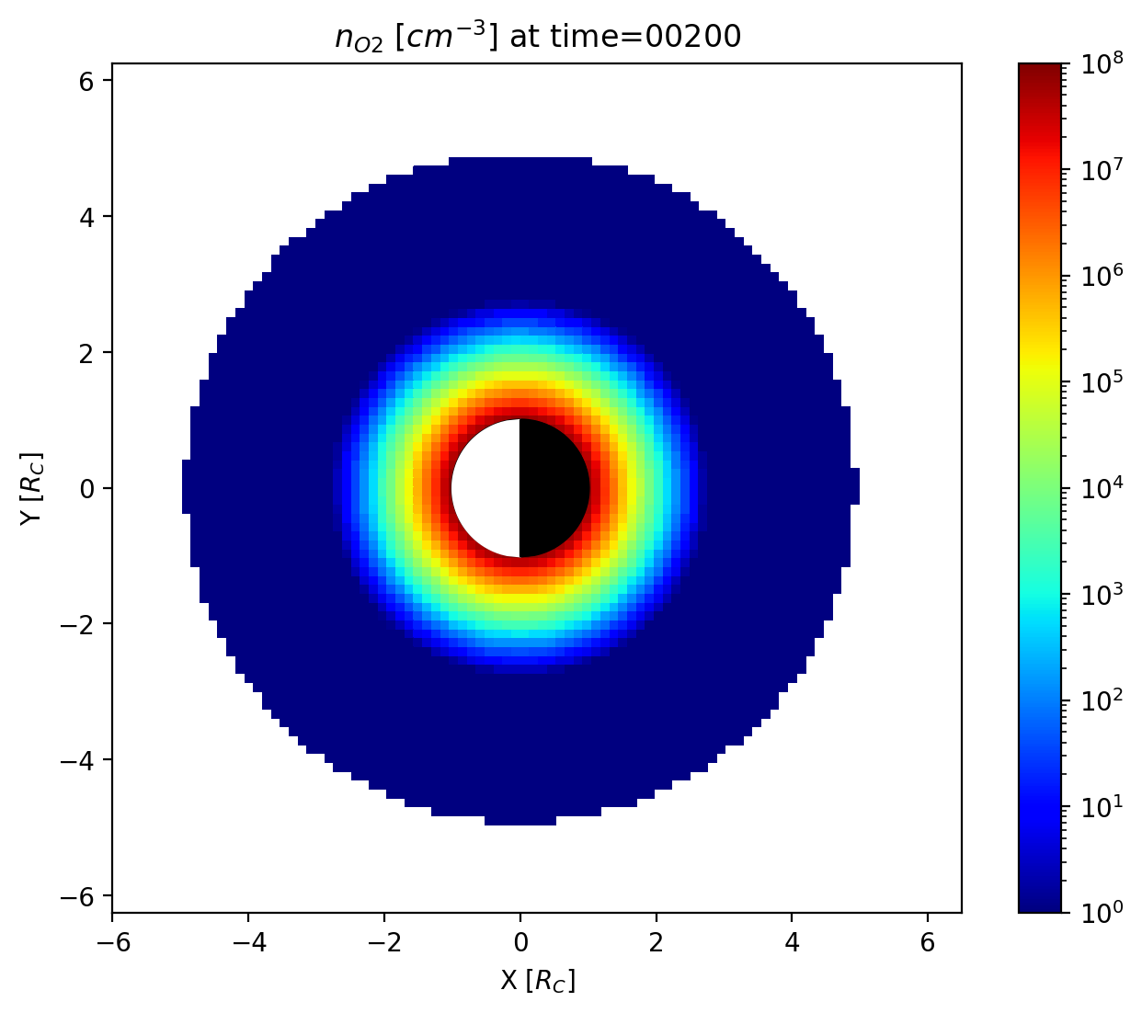
3/ LatHyS x Callisto : Simulations
CO₂ density
CO₂ density
EGM output
(exospheric global model)
O₂ density
O₂ density
9/10

Slide 22
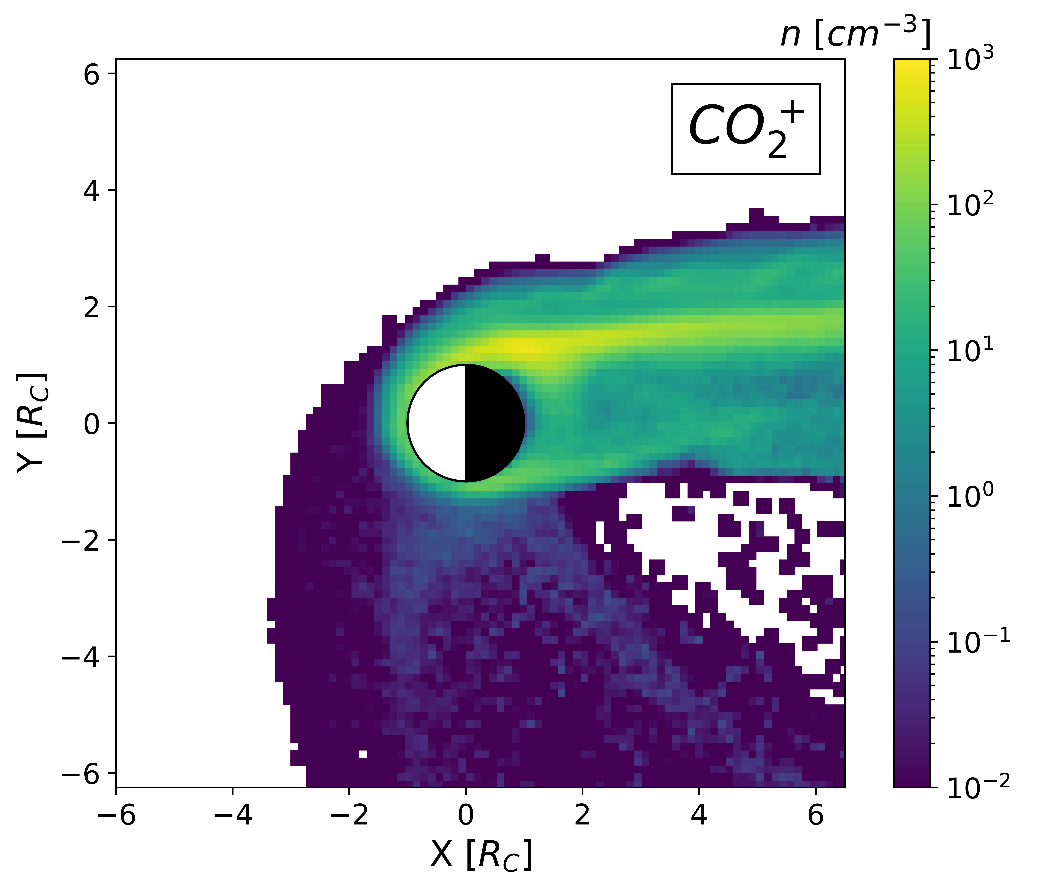
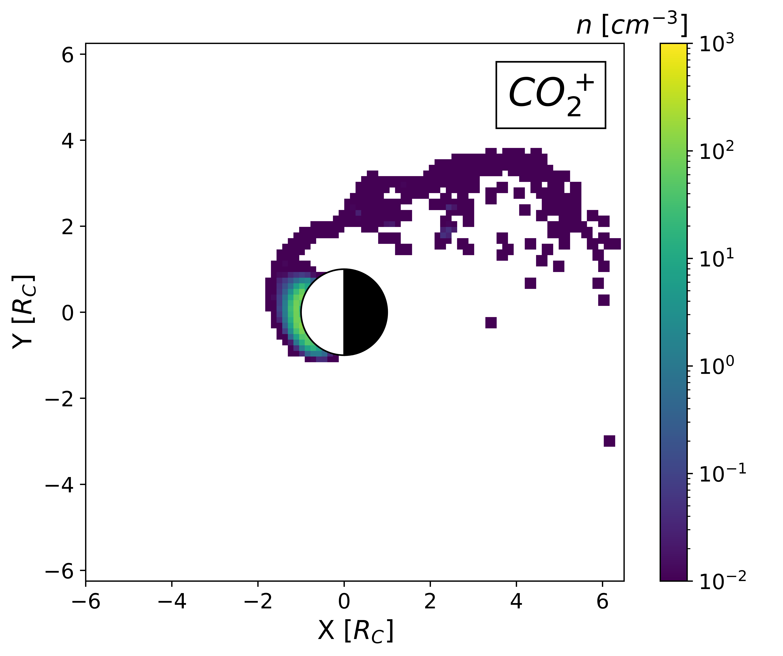
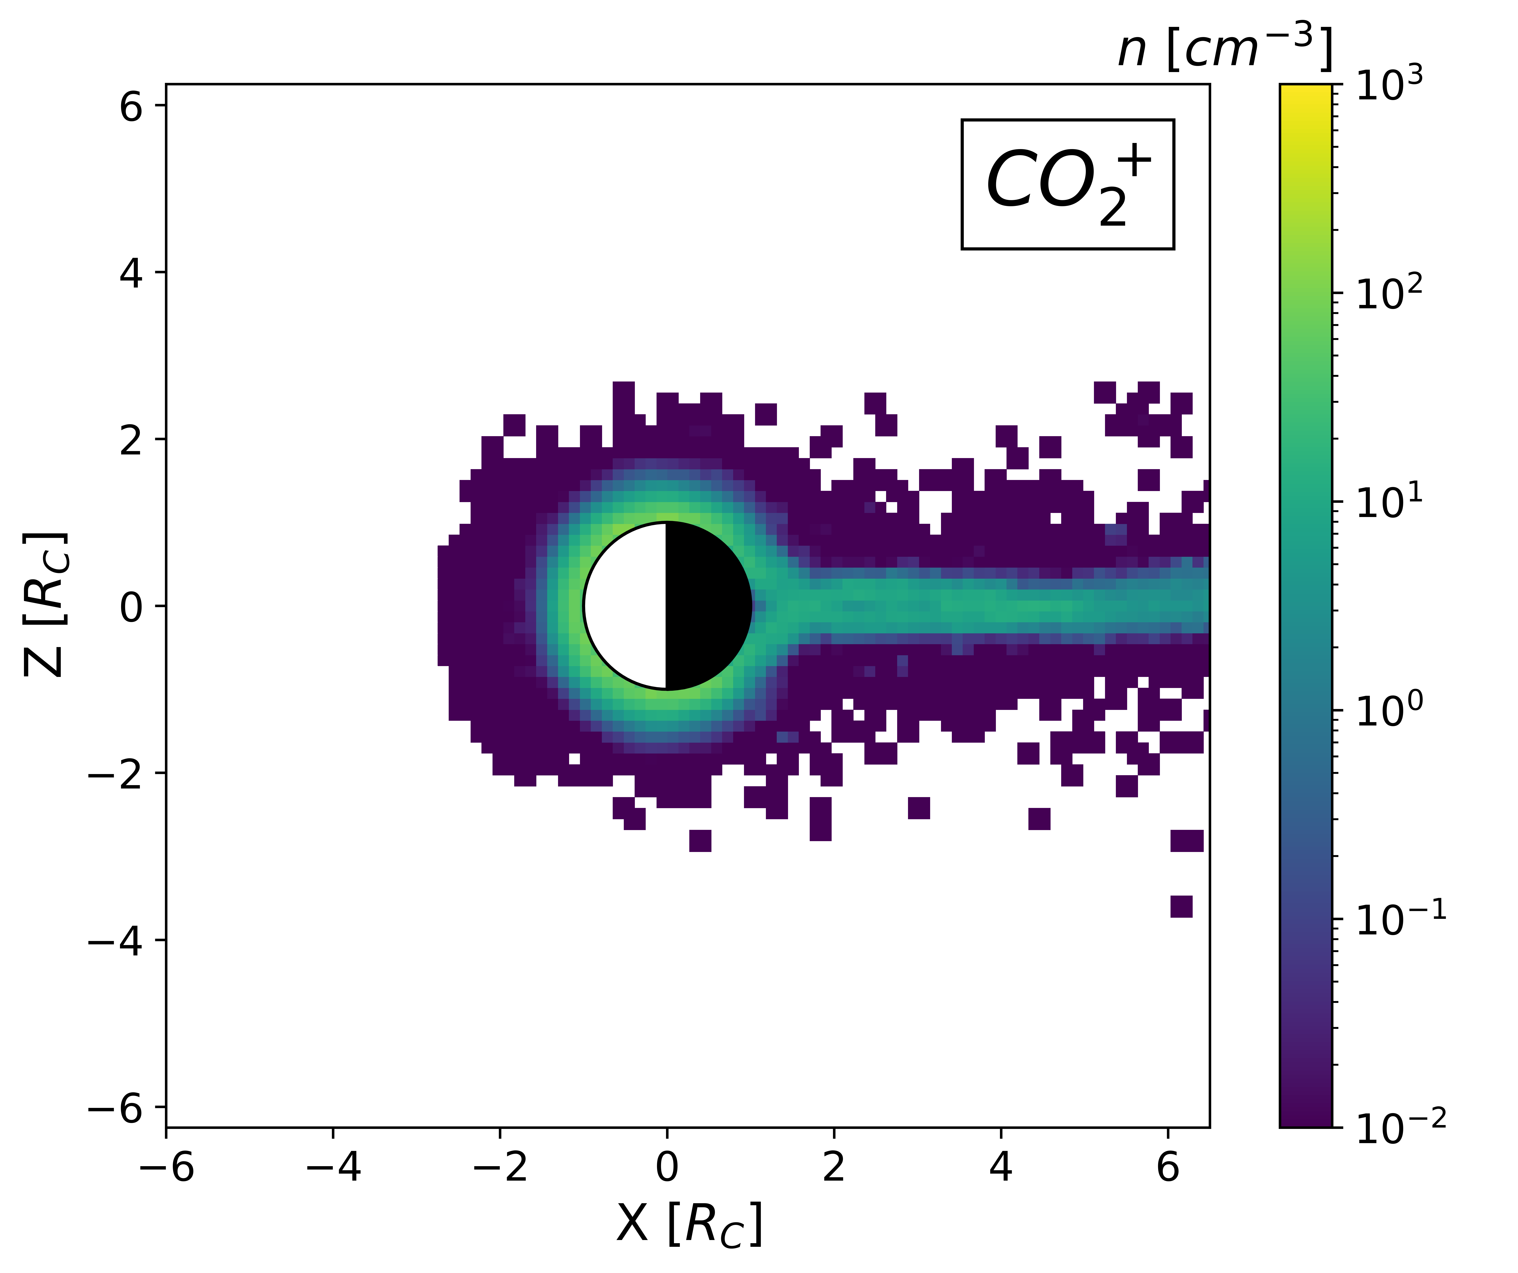
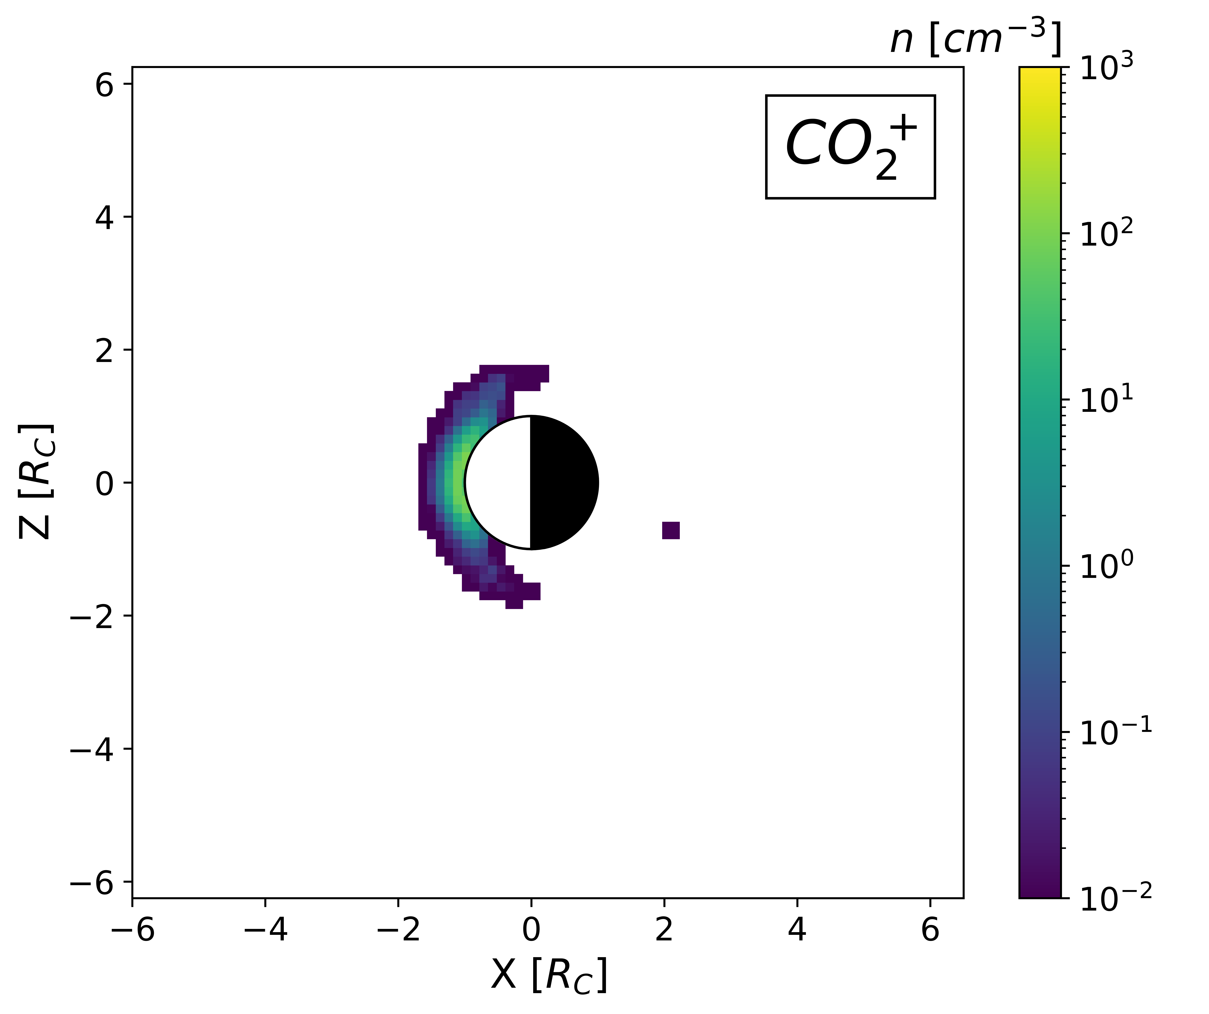
3/ LatHyS x Callisto : Simulations
density
density
density
density
EGM output
(exospheric global model)
density
density
density
density
density
10/10

Slide 23
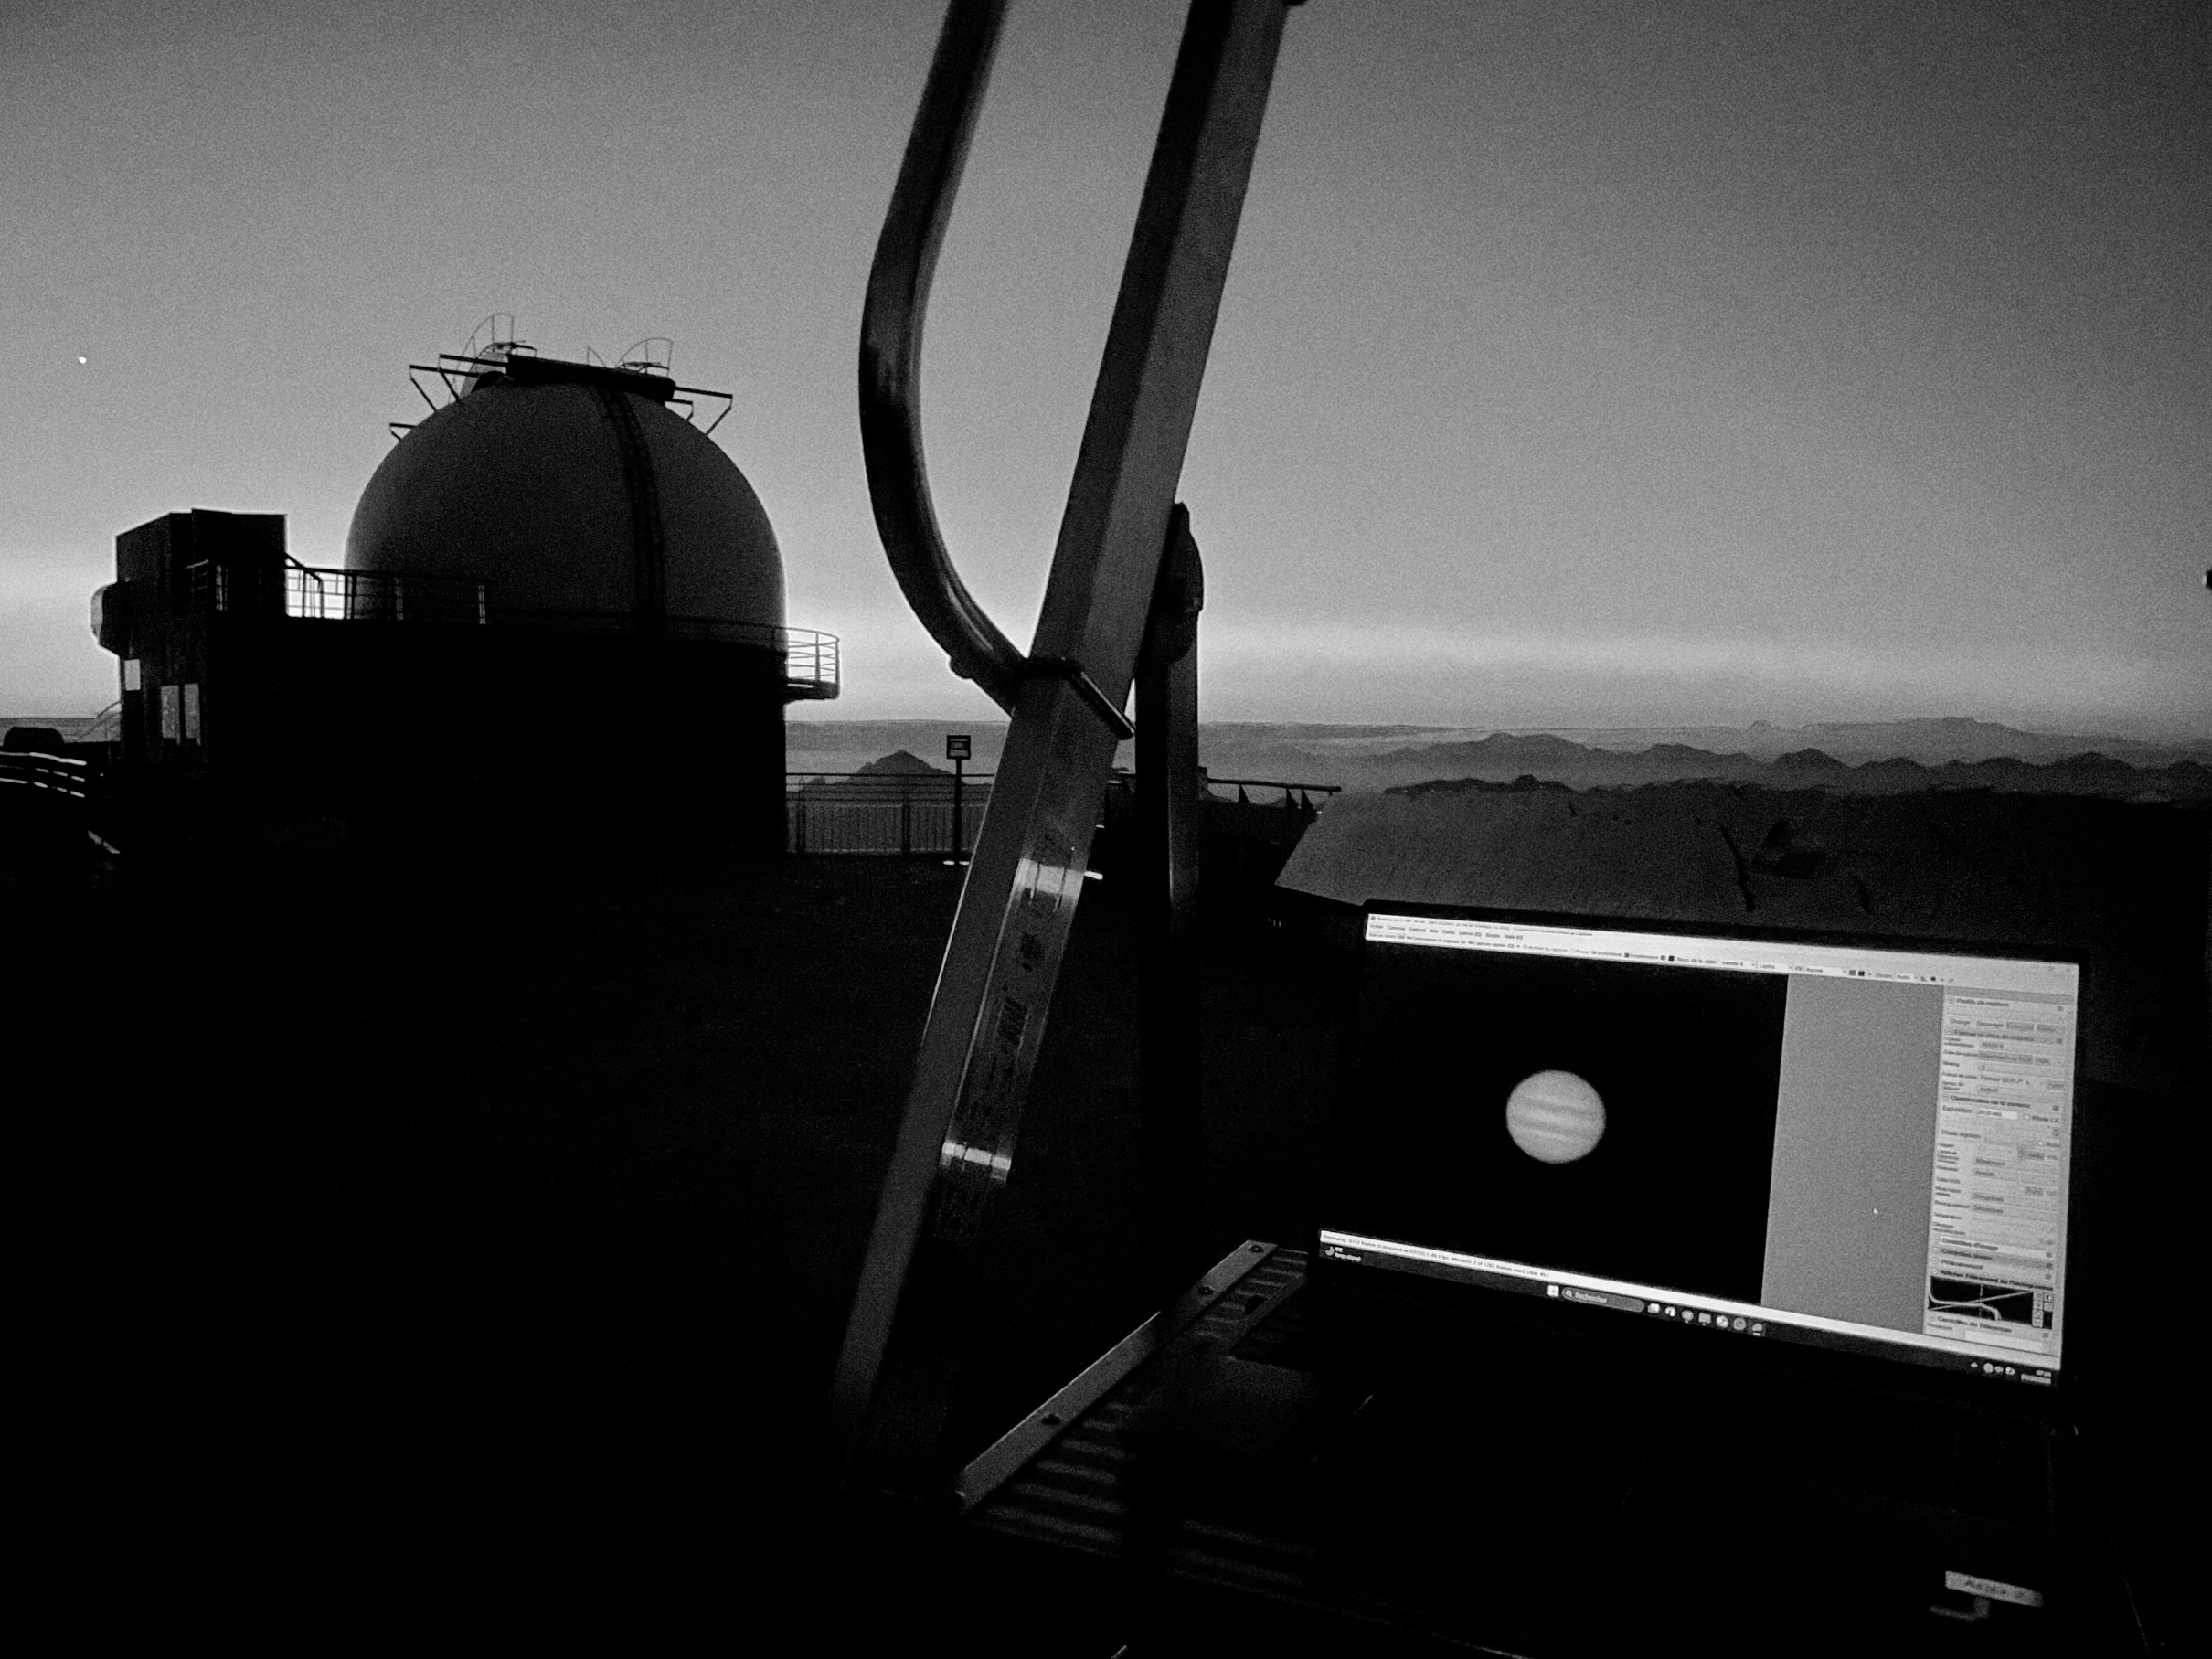
Pic du Midi, 14/10/2025
Thank you
for your attention !

