Slide 1
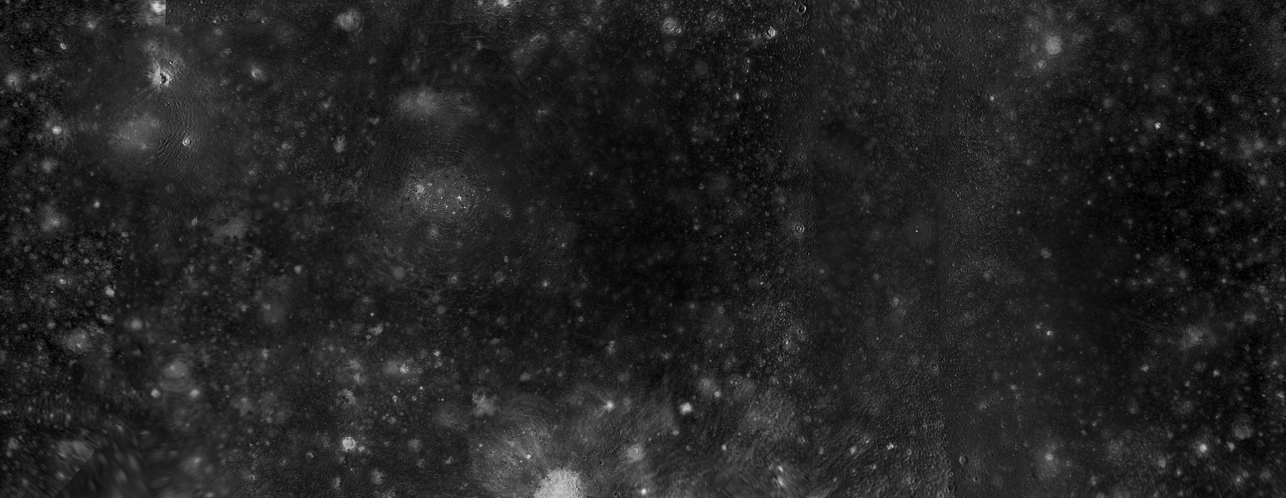


Characterizing Variabilities of Callisto’s Magnetospheric Orbital Environment
with the Galileo and Juno Missions
Thomas LE LIBOUX, Nicolas ANDRÉ, Ronan MODOLO, François LEBLANC, et al.
Institut de Recherche en Astrophysique et Planétologie (IRAP), CNES-CNRS-UT3
Laboratoire Atmosphères, Observations Spatiales (LATMOS), Sorbonne Université, UVSQ, CNRS
ATST : Colloque Scientifique
Biarritz, 1-5 June 2026

Slide 2
0/ From Simulations to Observations … to Simulations
Juno and Galileo to characterize Callisto’s orbital environment
OBSERVATIONS
Study of Galileo flybys of Callisto and comparison to simulations
MONDAY
Hybrid simulations development for Callisto
Preparation of JUICE and Europa Clipper flybys of Callisto
SIMULATIONS
0/10

Slide 3
0/ From Simulations to Observations … to Simulations
Juno and Galileo to characterize Callisto’s orbital environment
OBSERVATIONS
TODAY
Study of Galileo flybys of Callisto and comparison to simulations
Hybrid simulations development for Callisto
Preparation of JUICE and Europa Clipper flybys of Callisto
SIMULATIONS
0/10

Slide 4
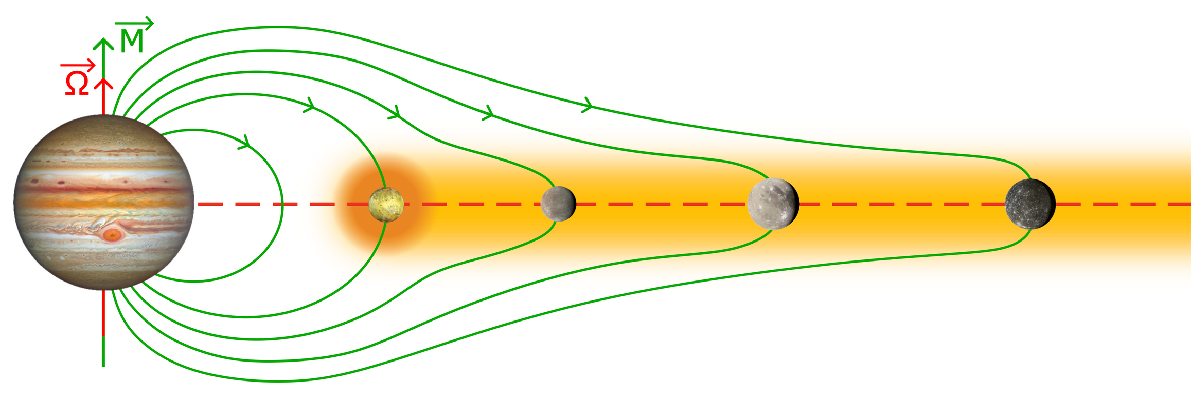
1/ Callisto in the Jovian Magnetosphere
Neutral cloud
=> Plasma torus
Current sheet = plasma confinement zone near centrifugal equator
Magnetic field
/!\ STATIC PICTURE /!\
Galilean moons =
Io
+
Europa
+
Ganymede
+
Callisto
1/10

Slide 5
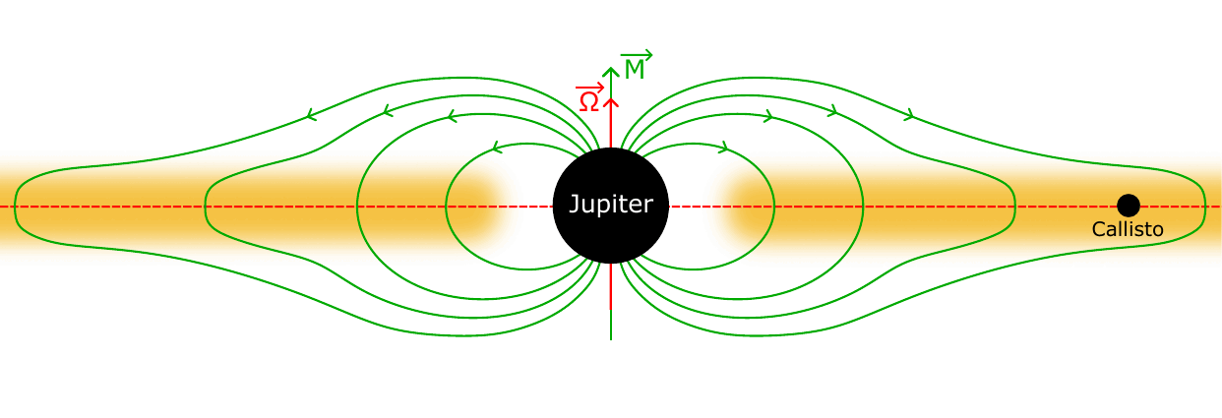
1/ Callisto in the Jovian Magnetosphere
➟ Magnetic dipole tilted from rotation axis : ~10°
➟ Magnetic field : tilted rotating structure
➟ Jupiter rotation period : ~10h
=> Highly variable magnetospheric environment
=> Fast time-varying environment
Magnetic field
Current sheet
Plasma
2/10

Slide 6
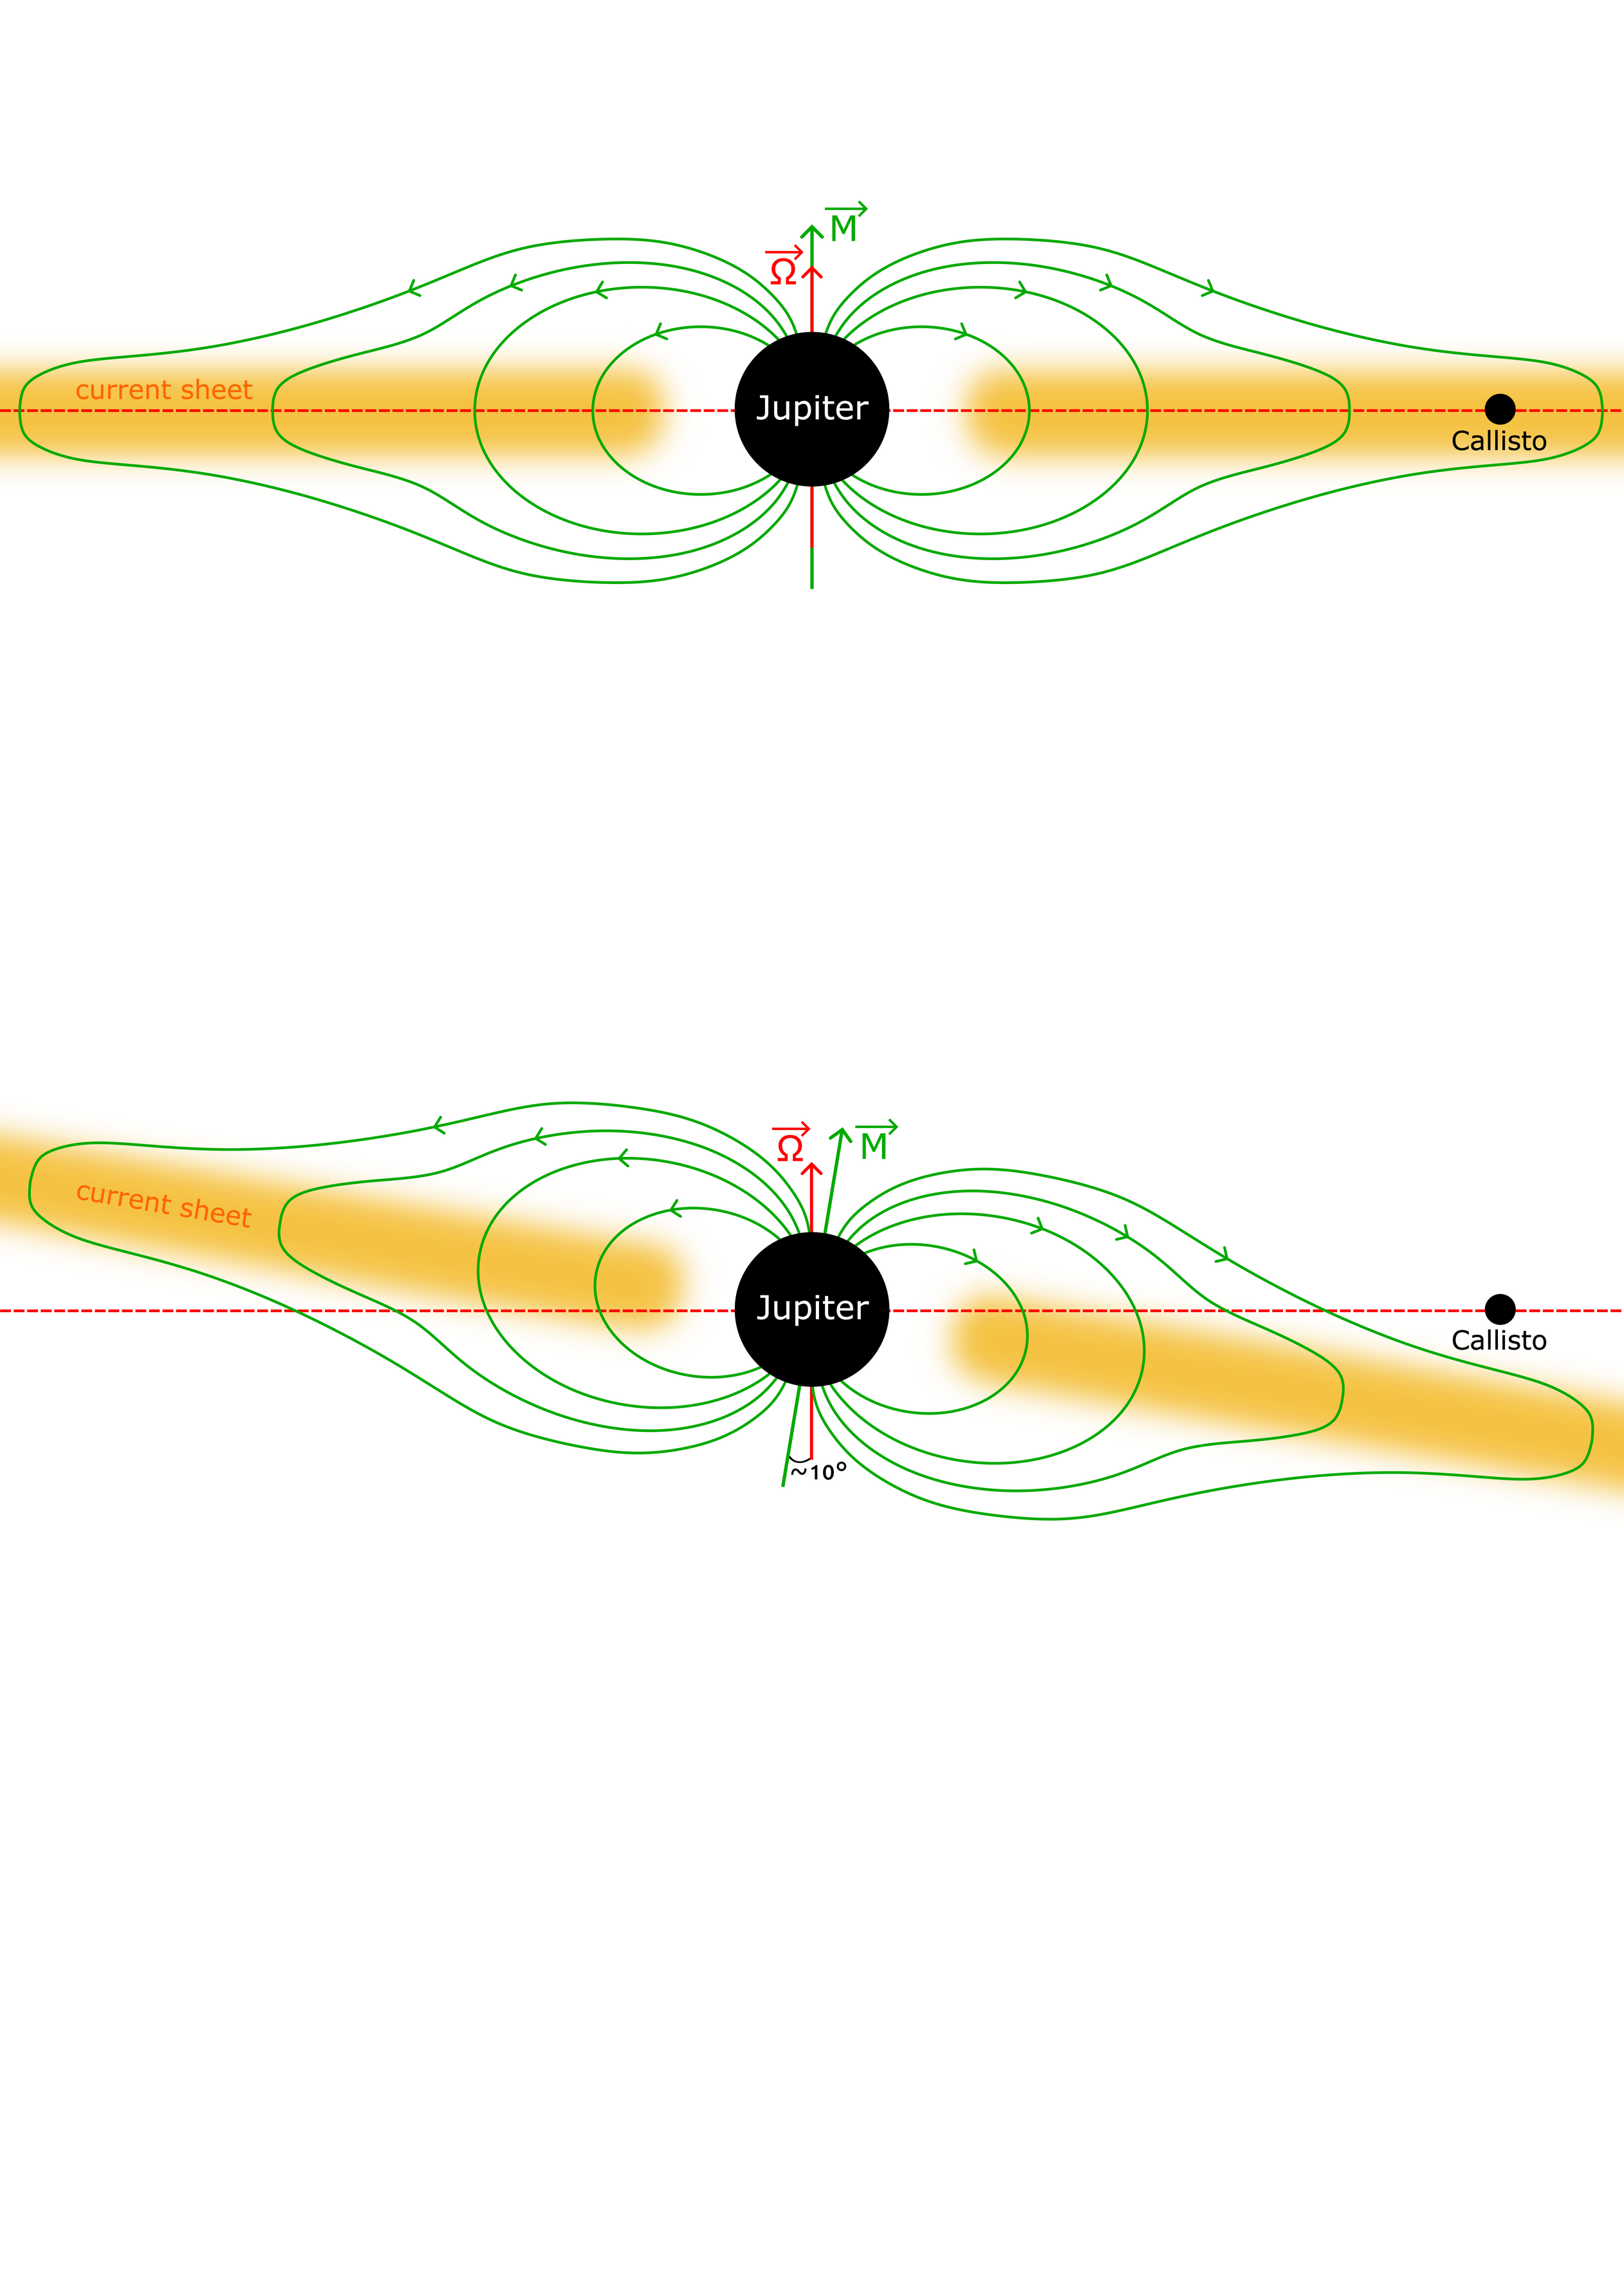
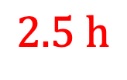
1/ Callisto in the Jovian Magnetosphere
➟ Two extreme magnetospheric positions for Callisto
1. Center of the current sheet
super-Alfvénic interaction
(e.g., Mars, Venus, ...)
$$2.5 h$$
2. Lobe of the magnetosphere
sub-Alfvénic interaction
(e.g., Europa, Ganymede, ...)
3/10

Slide 7
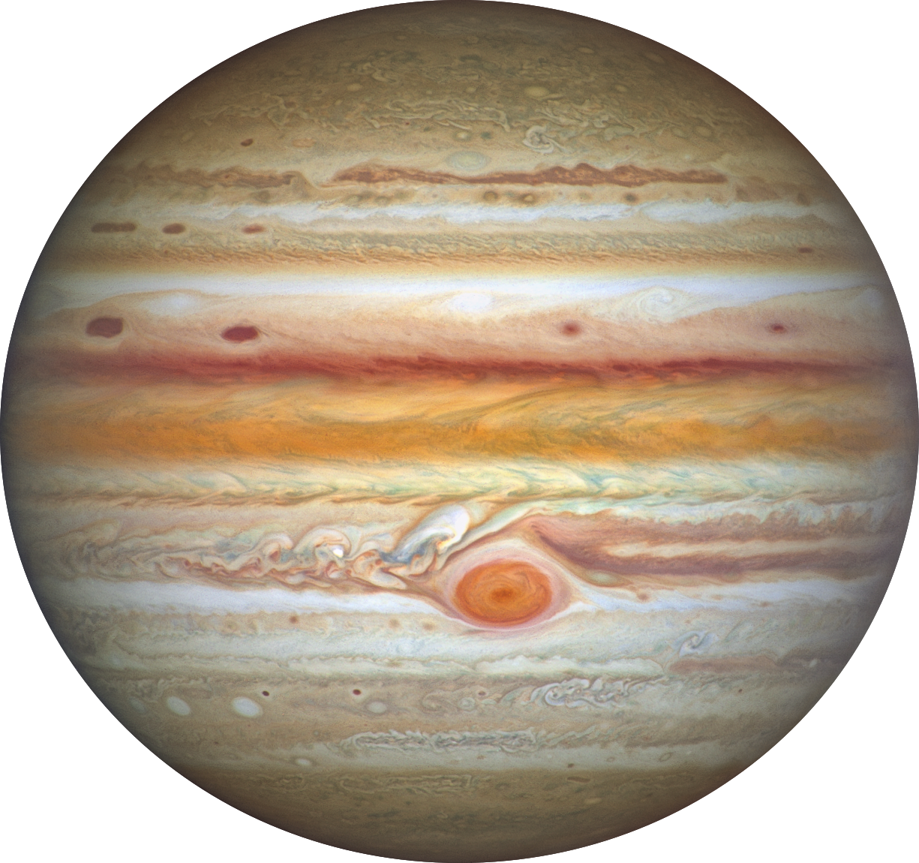
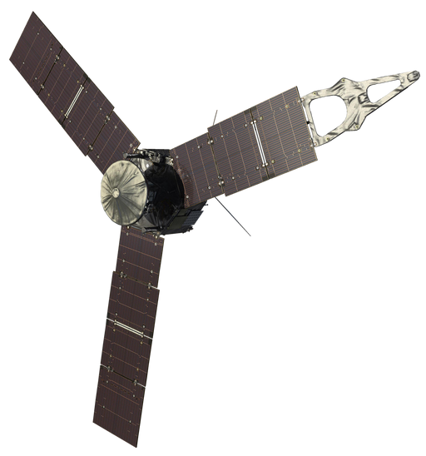
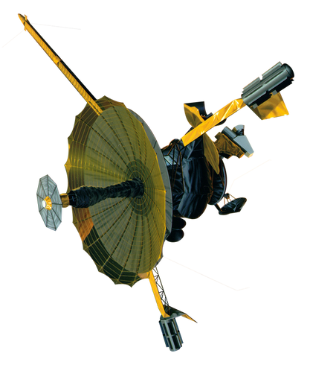
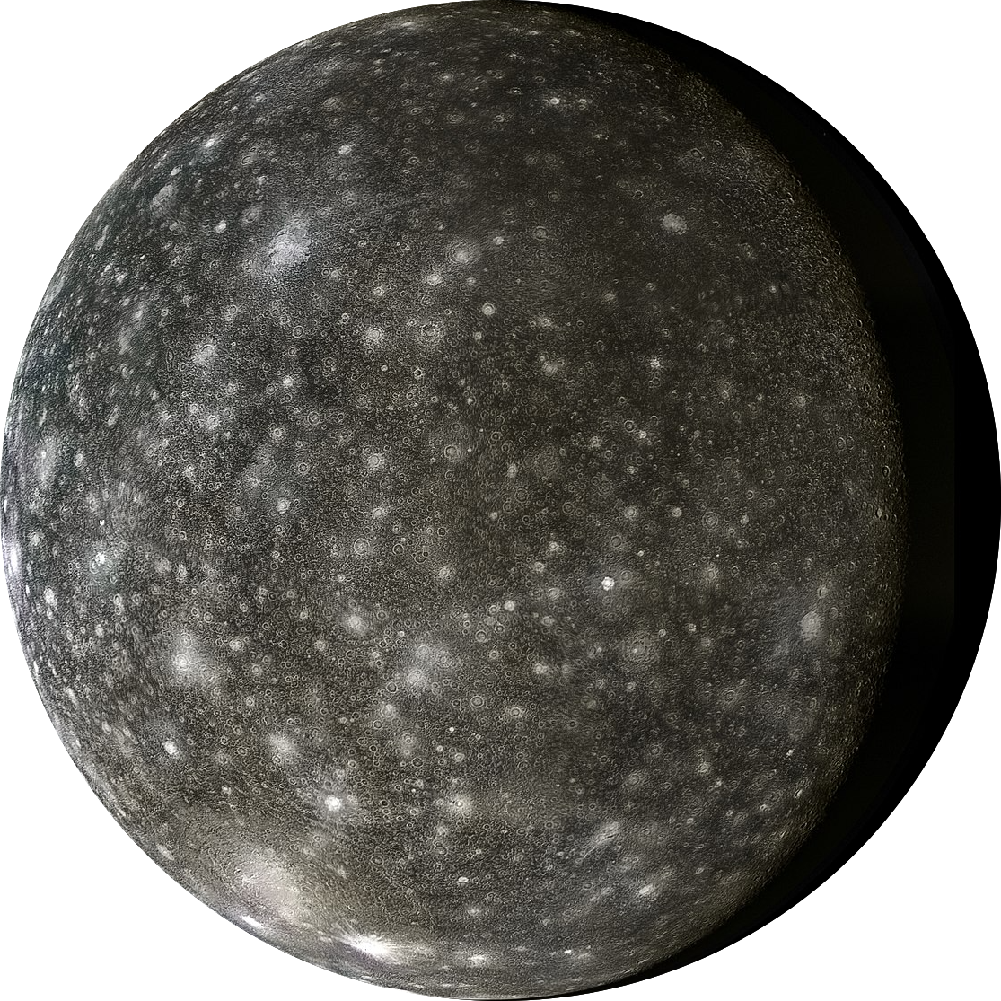
2/ Observational Characterization
➟ Goal : describe and quantify pristine magnetospheric environment at Callisto’s orbit
Juno
2016-present
➟ Two missions : Galileo and Juno
Galileo
1995-2003
➟ Instruments onboard :
energetic particle detectors :
- electrons
- heavy ions (O^{n+}, S^{n+})
- …
➟ Galileo-EPD
➟ Juno-JADE
➟ Juno-JEDI
➟ Magnetic field model : JRM33+CON2020
4/10

Slide 8
3/ Method
➟ How to characterize the plasma environment and its variability ?
« Ghost Flybys »
Juno
2016-present
Galileo
1995-2003
5/10

Slide 9
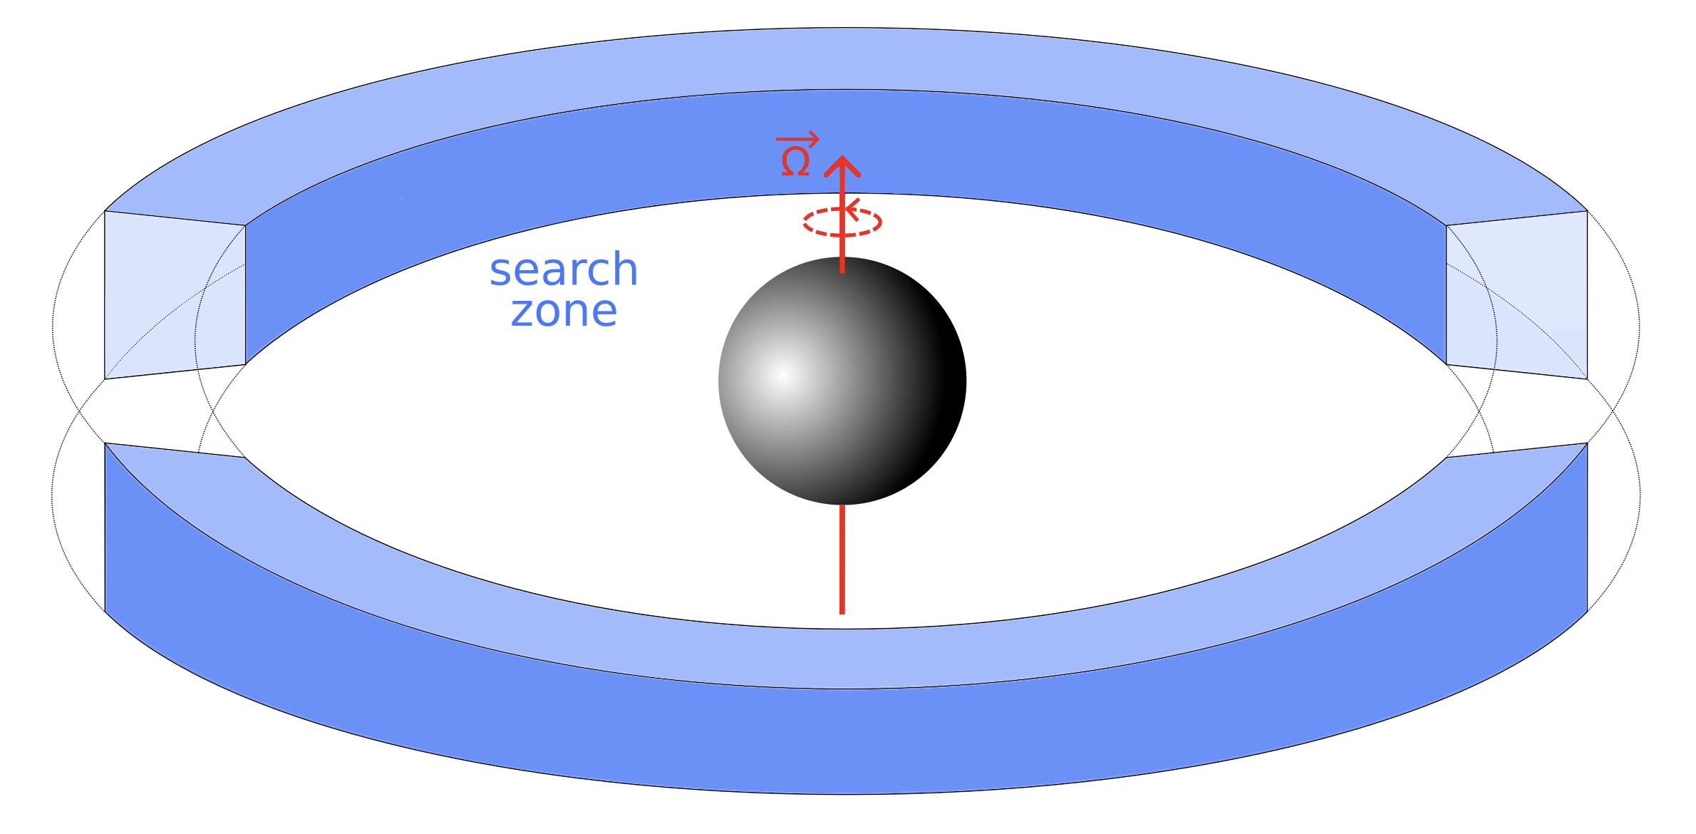
3/ Method
➟ How to characterize the plasma environment and its variability ?
1. Identification of Callisto’s orbit crossings
25.5 R_{J} ≤ r ≤ 27 R_{J}
-3° ≤ lat. ≤ +3°
5/10

Slide 10
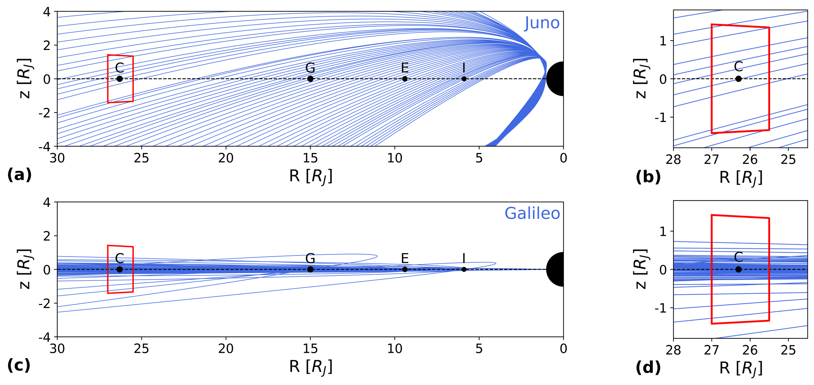
3/ Method
➟ How to characterize the plasma environment and its variability ?
1. Identification of Callisto’s orbit crossings
search zone
Juno
10 intervals
Galileo
62 intervals
5/10

Slide 11
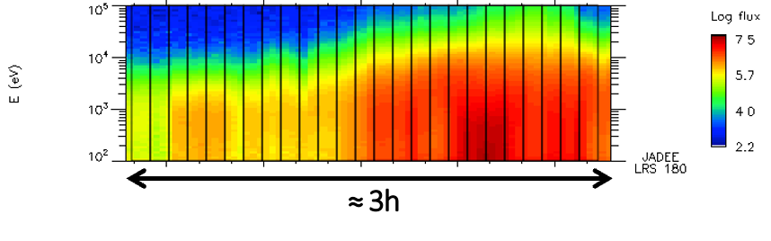
3/ Method
➟ How to characterize the plasma environment and its variability ?
1. Identification of Callisto’s orbit crossings
2. Cut each interval into subintervals (6 min long)
5/10

Slide 12
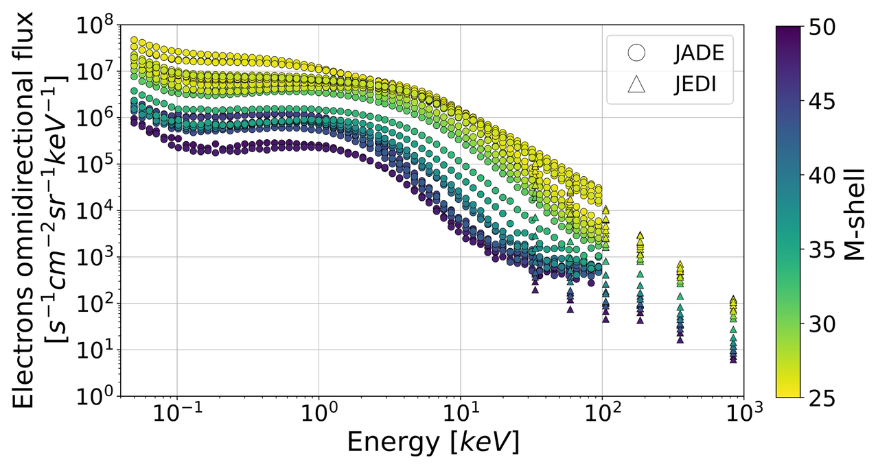
3/ Method
➟ How to characterize the plasma environment and its variability ?
1. Identification of Callisto’s orbit crossings
2. Cut each interval into subintervals (6 min long)
3. Calculate the mean spectrum over each subinterval
5/10

Slide 13
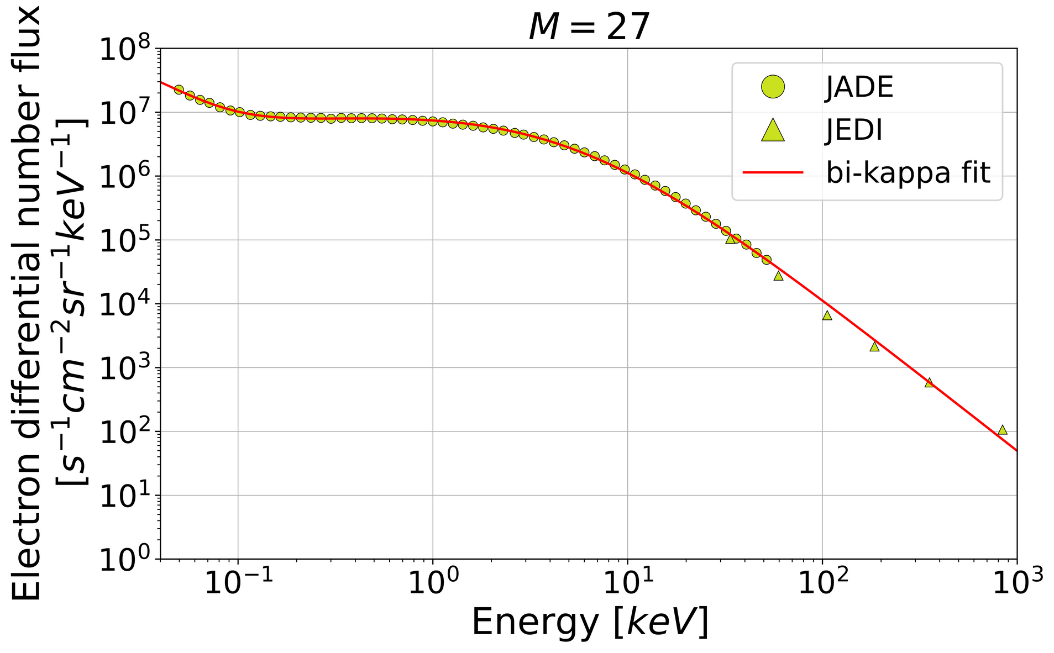
3/ Method
➟ How to characterize the plasma environment and its variability ?
1. Identification of Callisto’s orbit crossings
2. Cut each interval into subintervals (6 min long)
3. Calculate the mean spectrum over each subinterval
4. Fit averaged data using bi-kappa function (only for Juno data)
cf. method
[Paranicas et al., 2021]
5/10

Slide 14
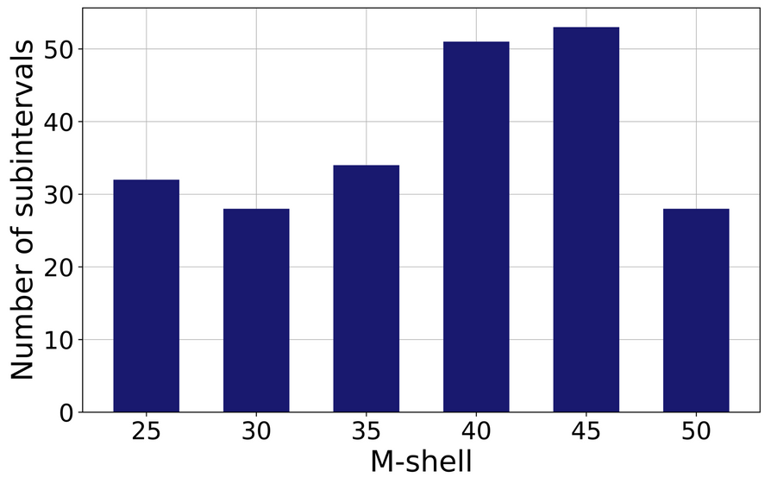
3/ Method
➟ How to characterize the plasma environment and its variability ?
1. Identification of Callisto’s orbit crossings
2. Cut each interval into subintervals (6 min long)
3. Calculate the mean spectrum over each subinterval
4. Fit averaged data using bi-kappa function (only for Juno data)
5. Characterize the position of the spacecraft for each spectrum
M-shell ⬄ Position relative to current sheet
50 ⬄ Lobe of the magnetosphere
25 ⬄ Center of the current sheet
5/10

Slide 15
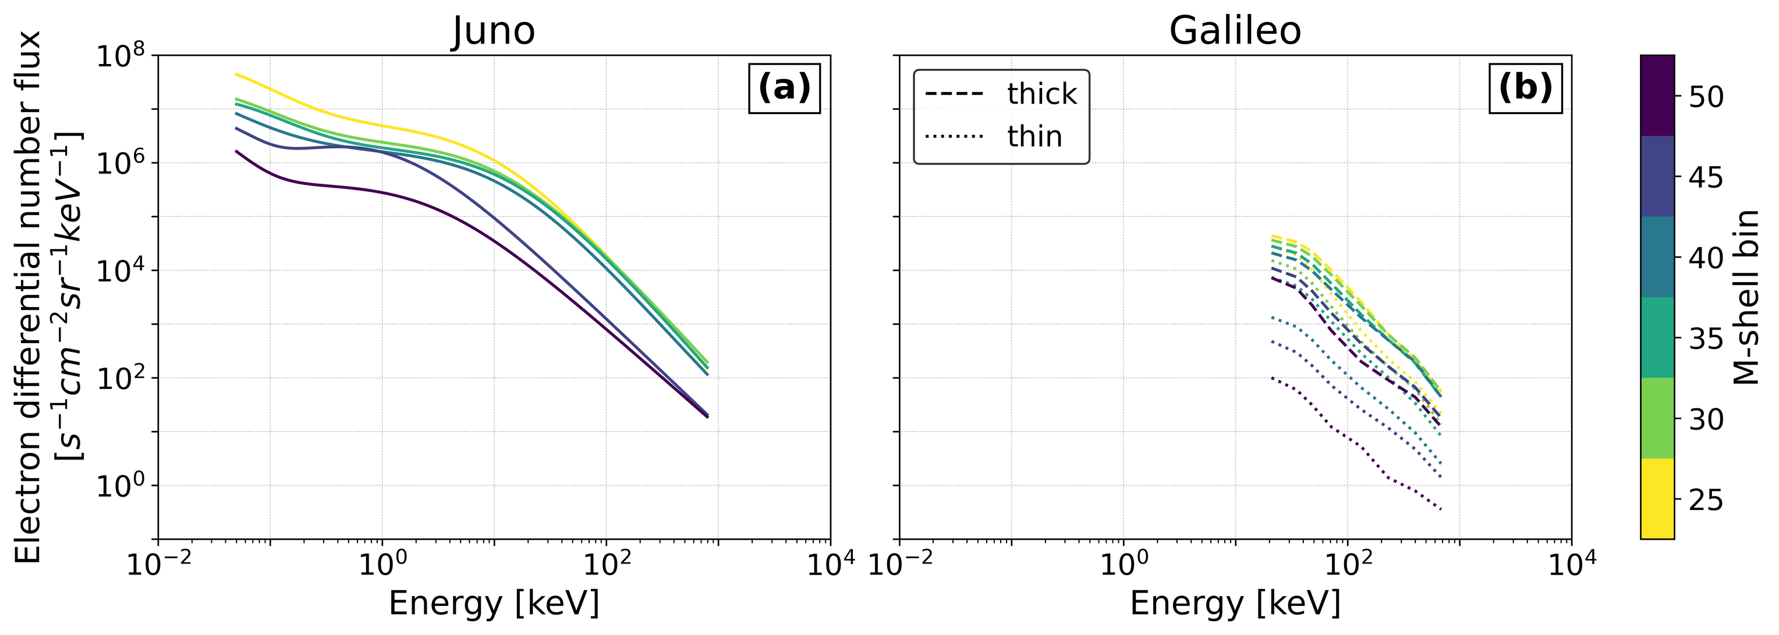
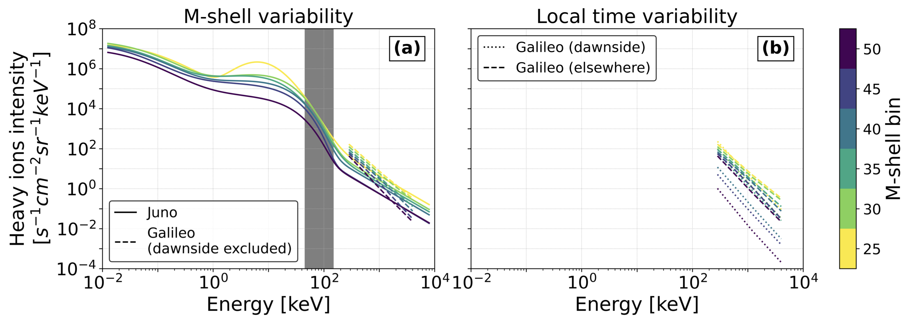
4/ Results : Variability with M-shell
➟ Juno + Galileo : variability with M-shell ⬄ magnetic latitude
⬄ position relative
to the current sheet
➟ Electron intensity : factor 20
lobe of the magnetosphere
electrons
center of the current sheet
6/10

Slide 16
4/ Results : Variability with M-shell
➟ Juno + Galileo : variability with M-shell ⬄ magnetic latitude
⬄ position relative
to the current sheet
➟ Electron intensity : factor 20
➟ Heavy ion intensity : factor 8 to 60
Juno + Galileo
heavy ions
electrons
6/10

Slide 17
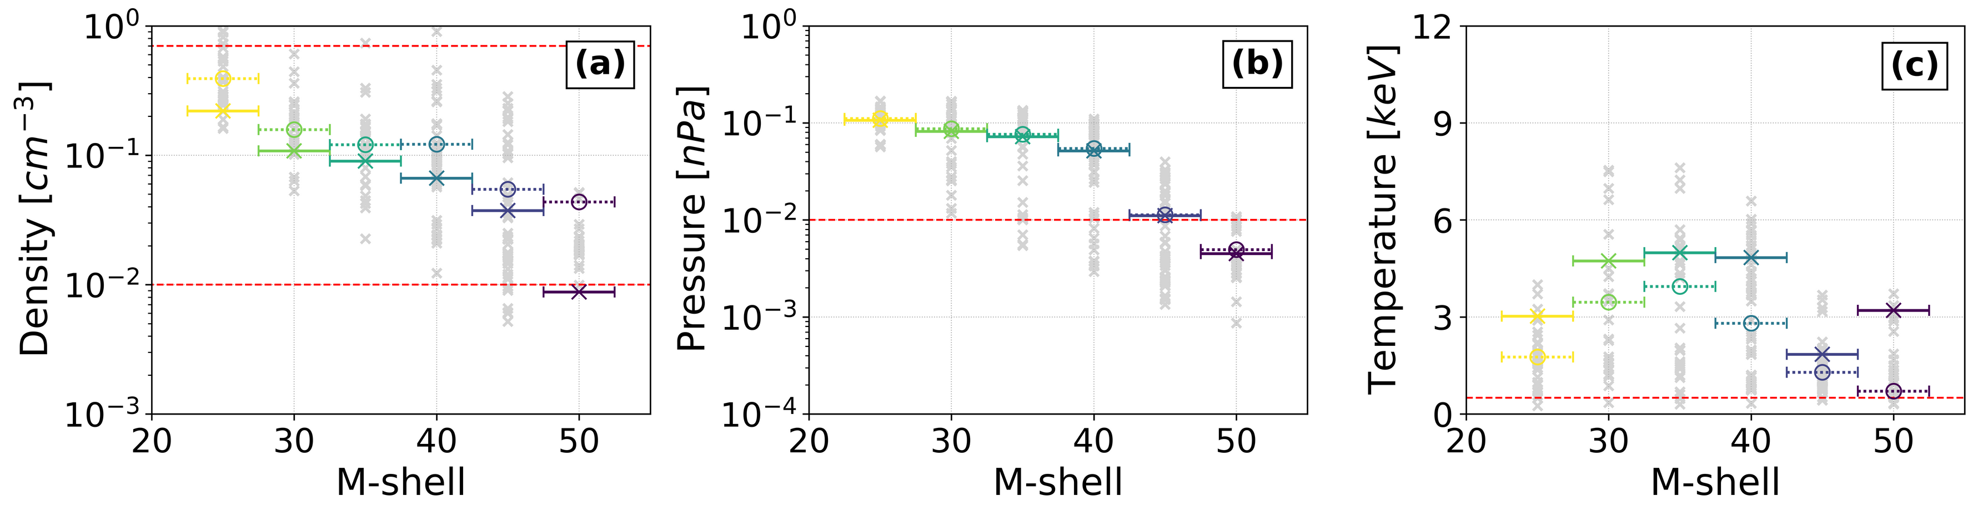
4/ Results : Variability with M-shell
➟ Calculation of electron distribution moments with Juno data
➟ Electron density : 0.2 – 0.009 cm⁻³
➟ Electron pressure : 0.1 – 0.004 nPa
➟ Electron temperature : a few keV
[Kivelson et al., 2004]
[Kivelson et al., 2004]
[Kivelson et al., 2004]
[Kivelson et al., 2004]
7/10

Slide 18
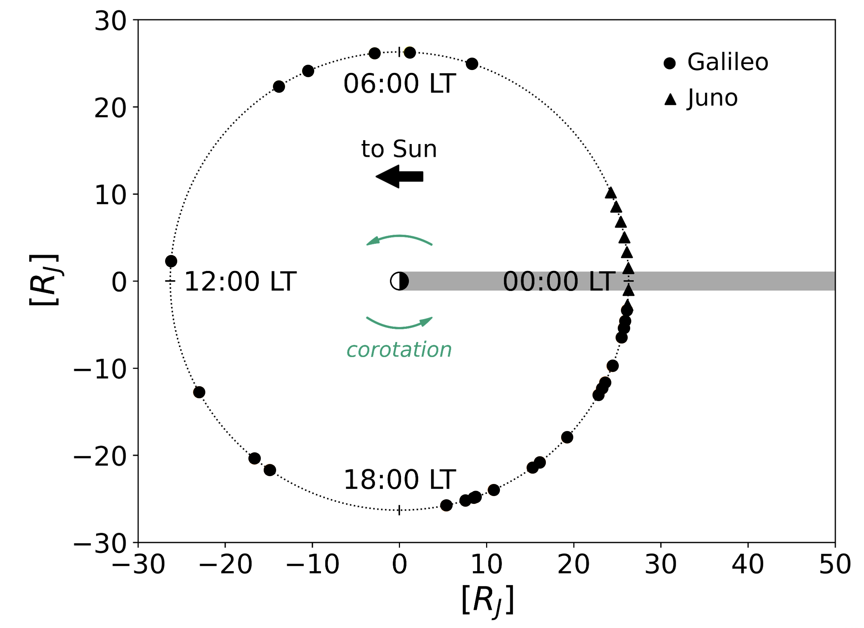
5/ Results : Variability with Local Time
➟ Galileo data : good coverage in local time
8/10

Slide 19
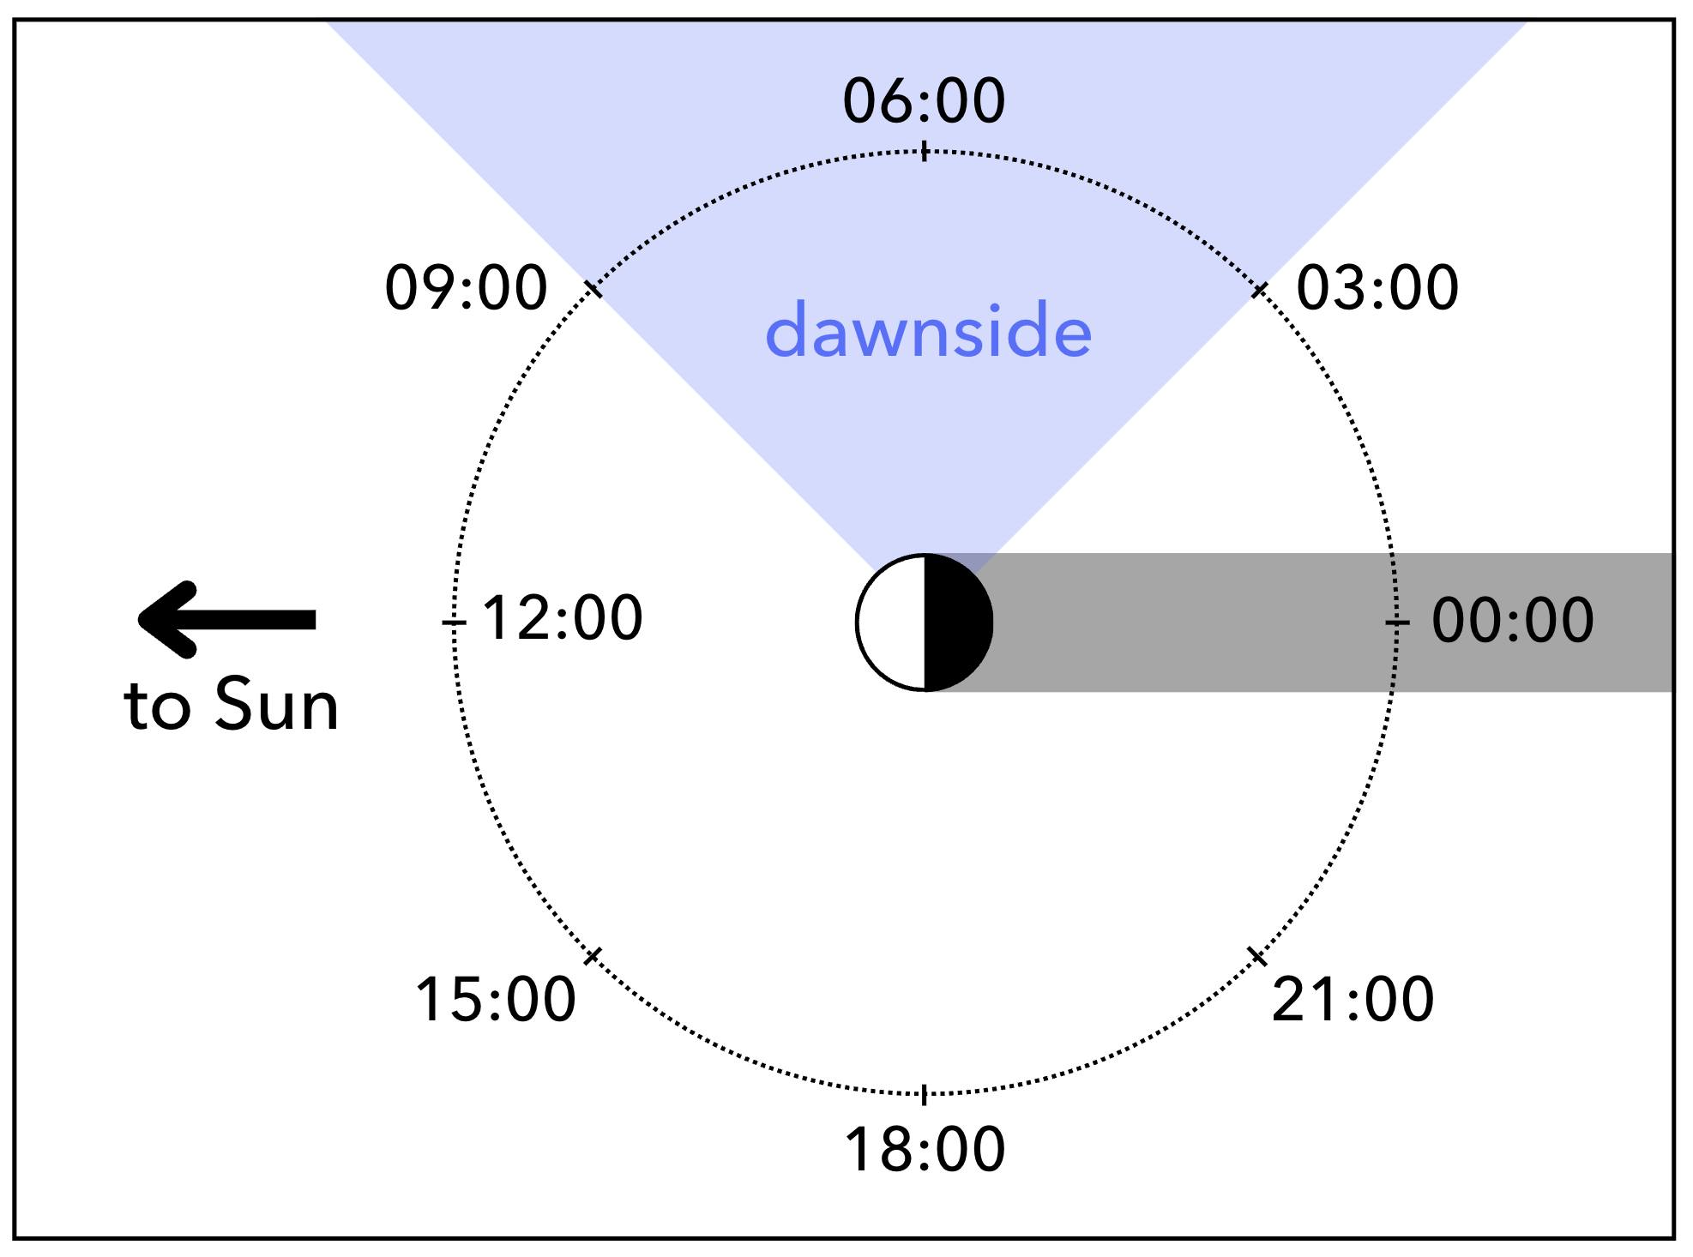
5/ Results : Variability with Local Time
➟ Galileo data : good coverage in local time
elsewhere
8/10

Slide 20
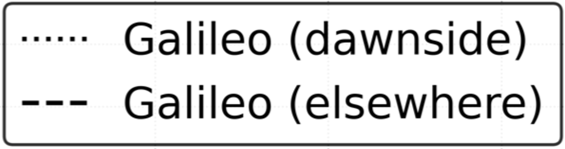
5/ Results : Variability with Local Time
➟ Galileo : variability with local time
➟ Dawnside vs. elsewhere : up to 2 orders of magnitude
➟ Dawnside : higher variability
➟ Elsewhere : lower variability
electrons
heavy ions
9/10

Slide 21
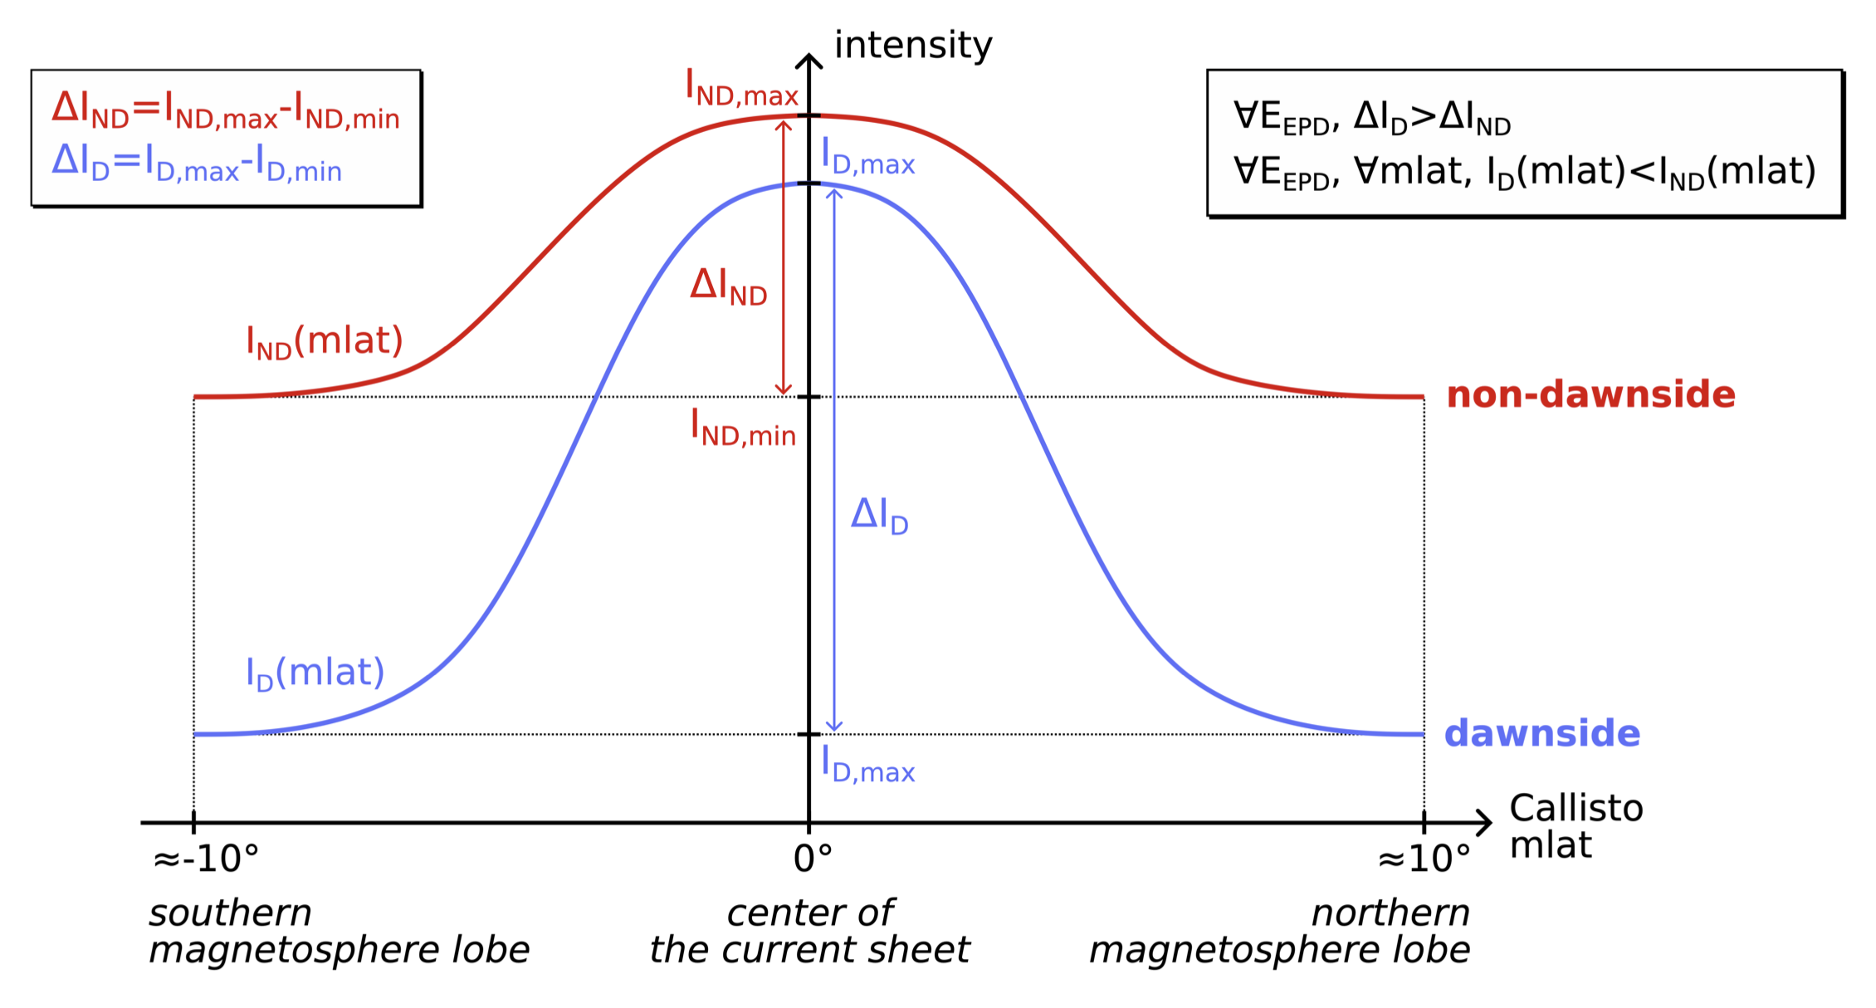
5/ Results : Variability with Local Time
9/10

Slide 22
[Le Liboux et al., 2025] + [Le Liboux et al., submitted]
6/ Conclusion

Slide 23
6/ Conclusion
Juno and Galileo to characterize Callisto’s orbital environment
OBSERVATIONS
Study of Galileo flybys of Callisto and comparison to simulations
Hybrid simulations development for Callisto
Preparation of JUICE and Europa Clipper flybys of Callisto
SIMULATIONS
10/10

Slide 24
6/ Conclusion
Juno and Galileo to characterize Callisto’s orbital environment
OBSERVATIONS
Study of Galileo flybys of Callisto and comparison to simulations
Hybrid simulations development for Callisto
Preparation of JUICE and Europa Clipper flybys of Callisto
SIMULATIONS
10/10

Slide 25
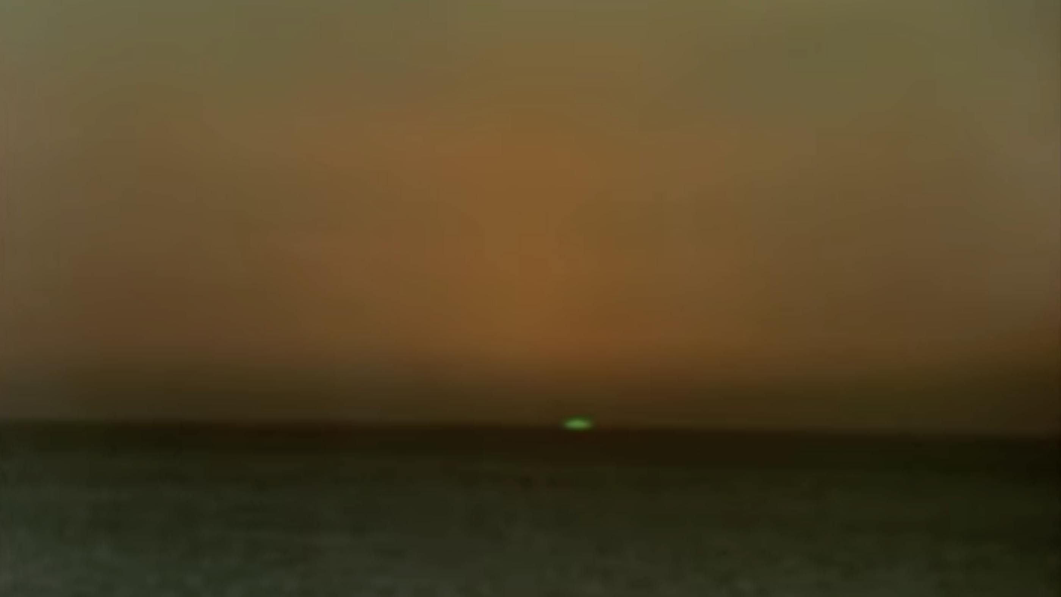
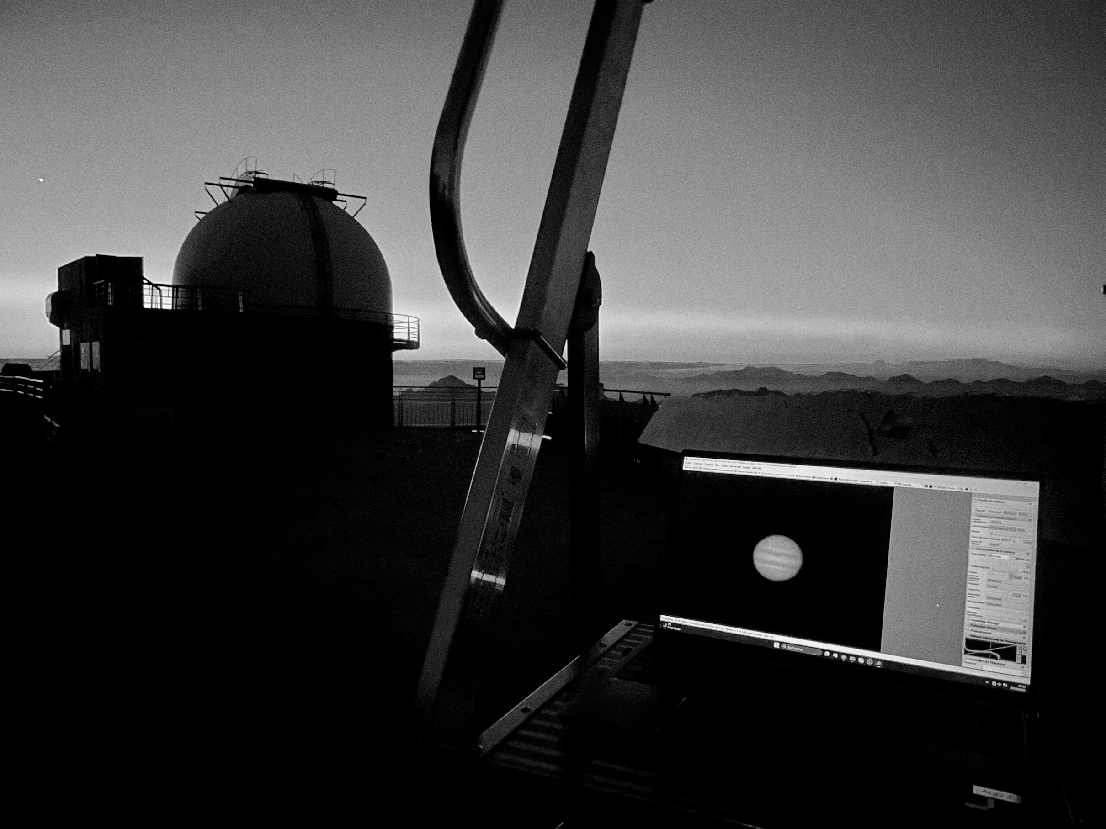
Le Rayon Vert, Éric Rohmer (1986)
Thank you
for your attention !

