Slide 1
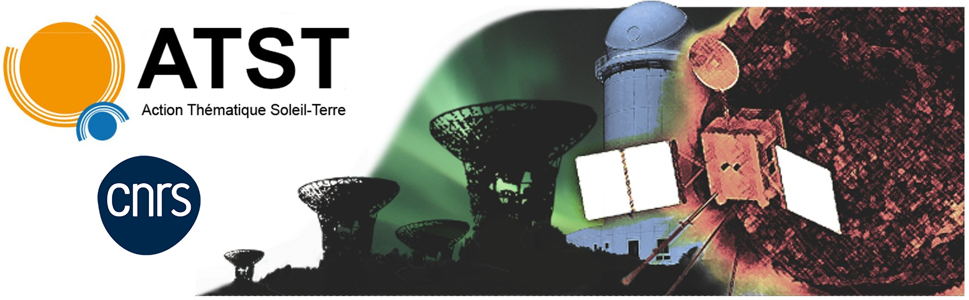


Etienne Berriot, Petr Hellinger,
Olga Alexandrova, Alexandra Alexandrova,
Pascal Démoulin
Colloque ATST, Biarritz, 1-5 juin 2026
Energy conversion and firehose instability during non-linear phase of tearing-driven reconnection: Hybrid simulation using Mobius boundary conditions
Action international CNRS-Académie des Sciences Tchèque 2024-2026

Slide 2
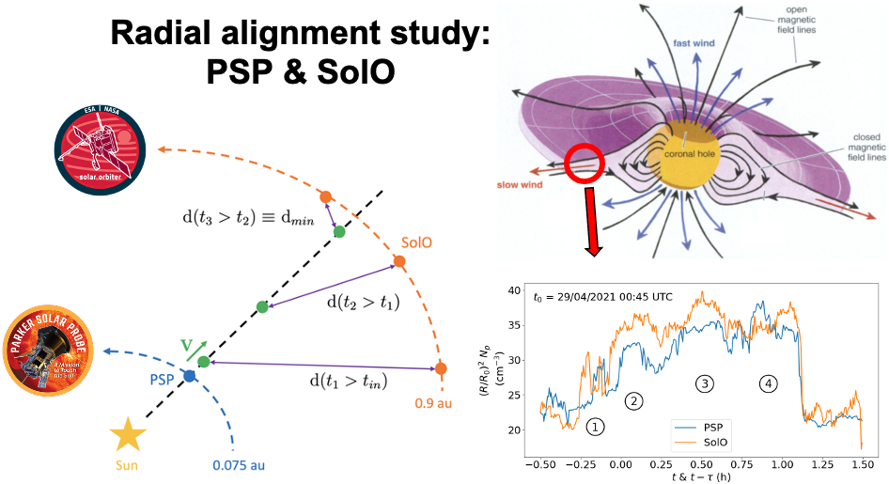
Berriot et al., 2024, A&A
Berriot et al., 2025, ApJ

Slide 3
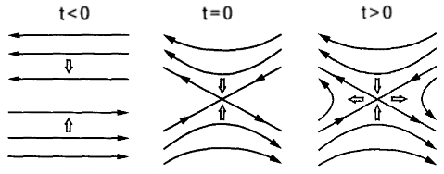
Berriot et al., 2024, A&A
Berriot et al., 2025, ApJ

Slide 4
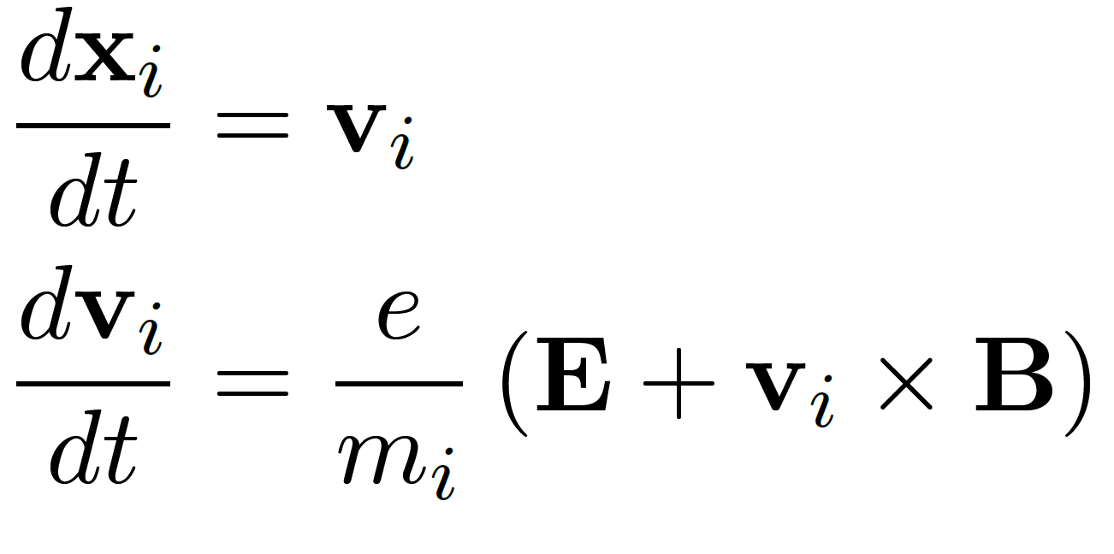

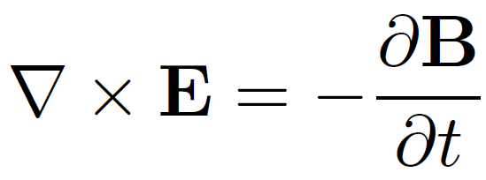
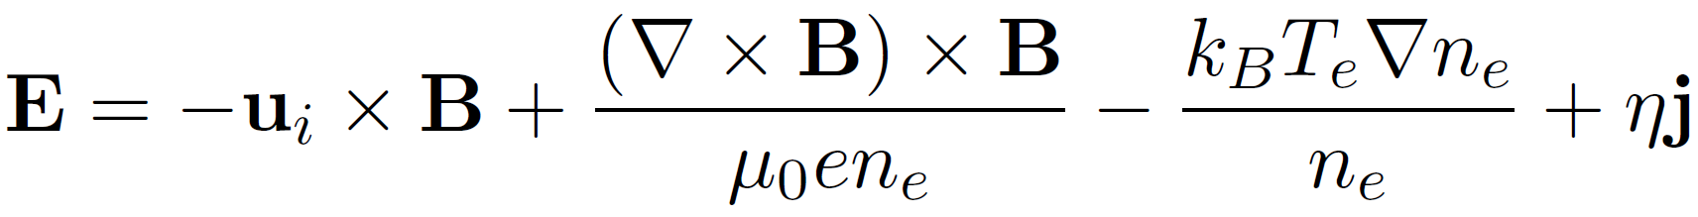
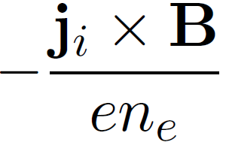
Hybrid-PIC model
Maxwell equations
Ions are treated as macro-particles
Generalized Ohm’s law
Charge-neutralizing, massless, isothermal e⁻ fluid
CAMELIA code (P. Hellinger) adapted from CAM-CL (Matthews 1994)

Slide 5
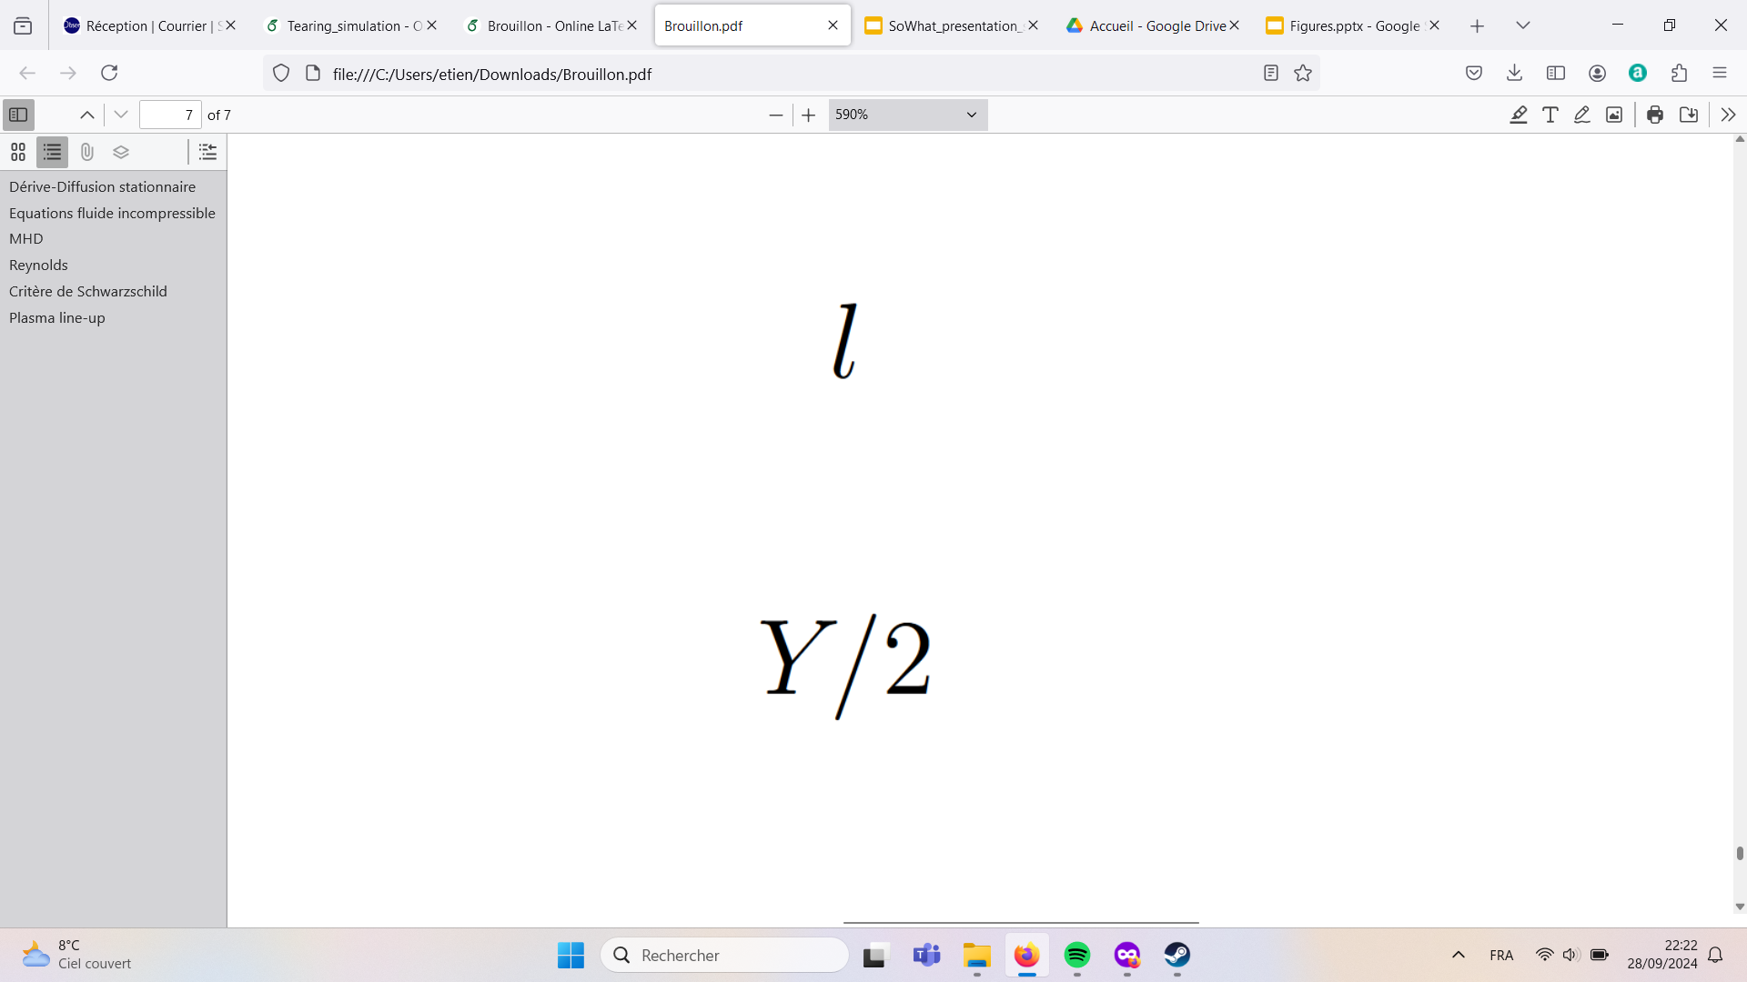
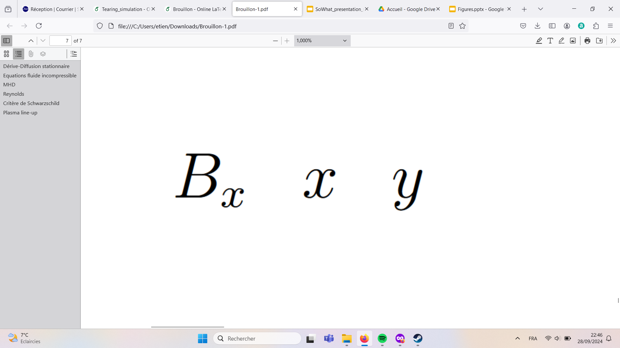
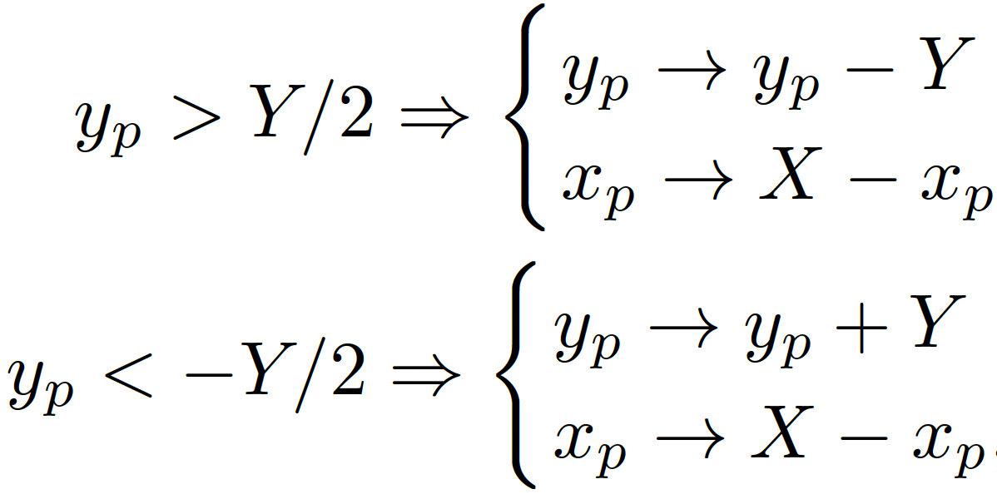

Simulation setup and Möbius boundary conditions
Standard periodic boundaries: 2 current sheets to keep the periodicity
Current sheet 1
Current sheet 2
Möbius boundaries, parallely developed by Xia & Swisdak (2024): 1 current sheet
Vector fields:
Particles:

Slide 6
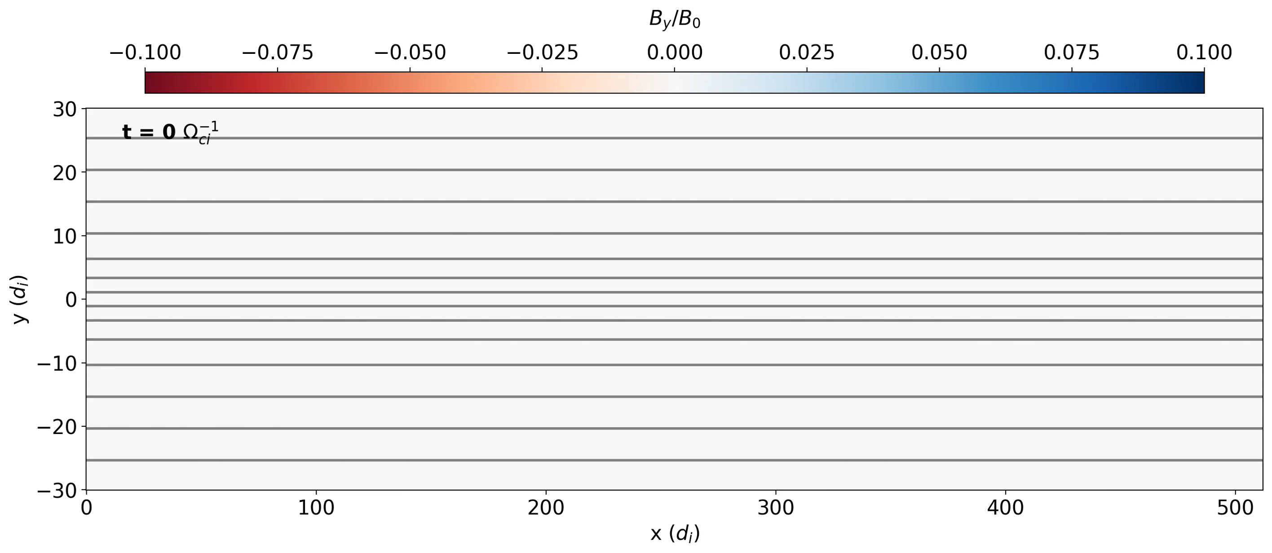
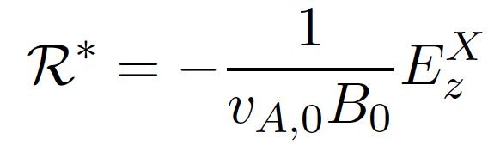
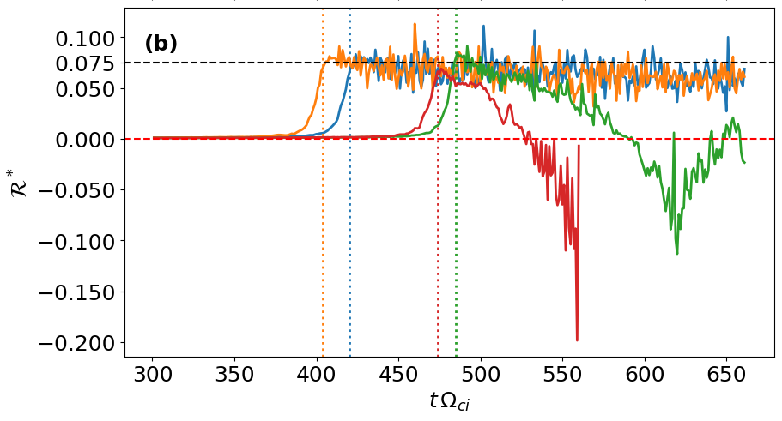
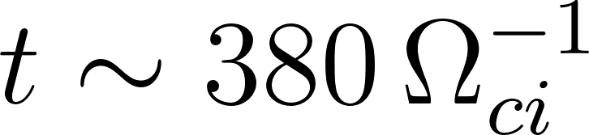
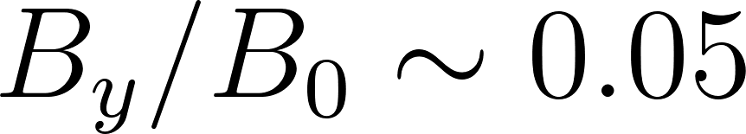
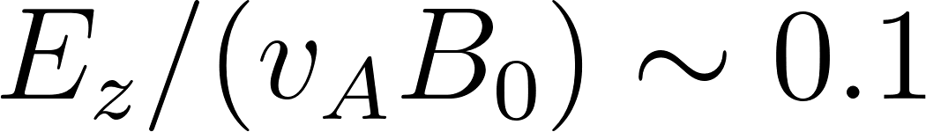
Linear and non-linear evolution of the tearing instability
Grid (4096, 2048) ; Δx = Δy = 1/8 di ; 2048 particles per cell.
Initial conditions: thin (di) Harris CS Harris in the center and no perturbation.
Reconnection rate proxy:
Transition from linear to NL at , when perturb. amplitudes and rec rate proxy

Slide 7
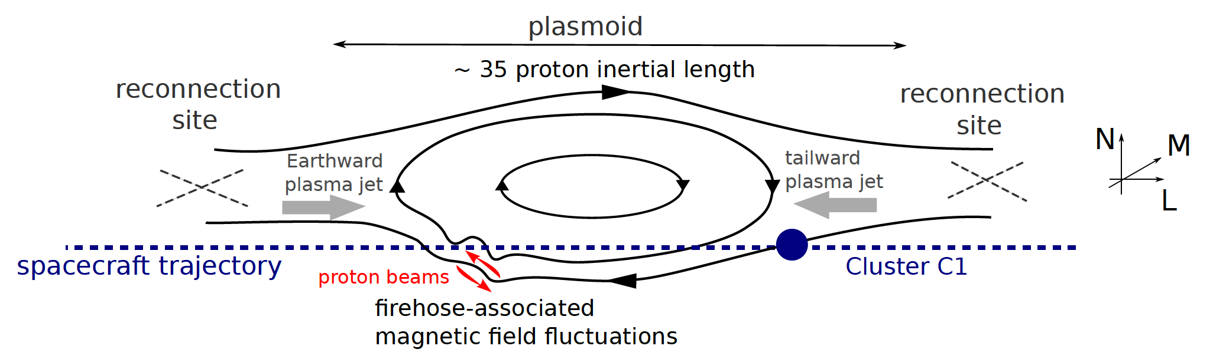
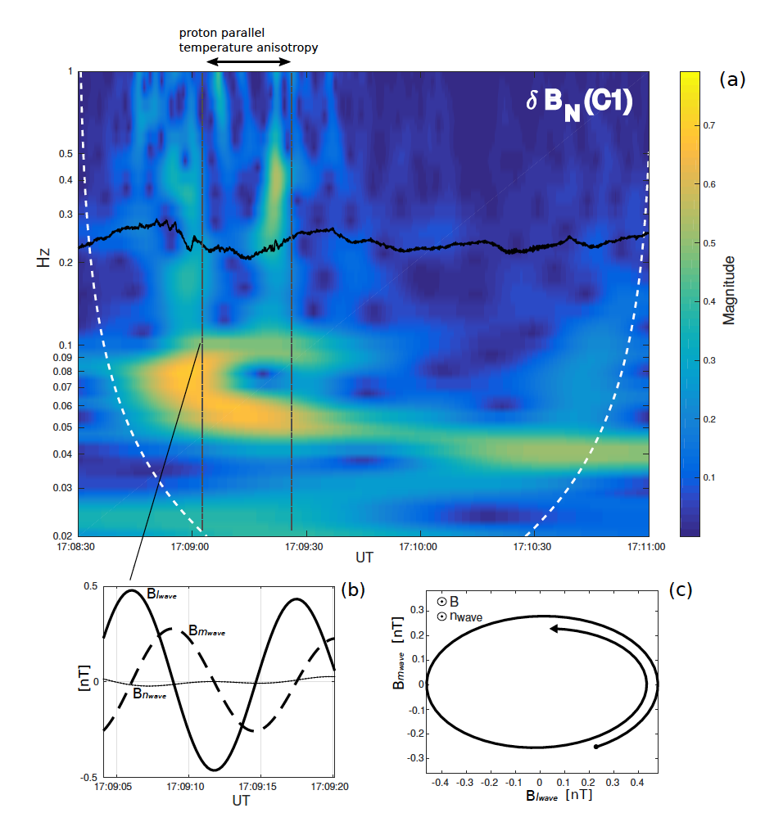
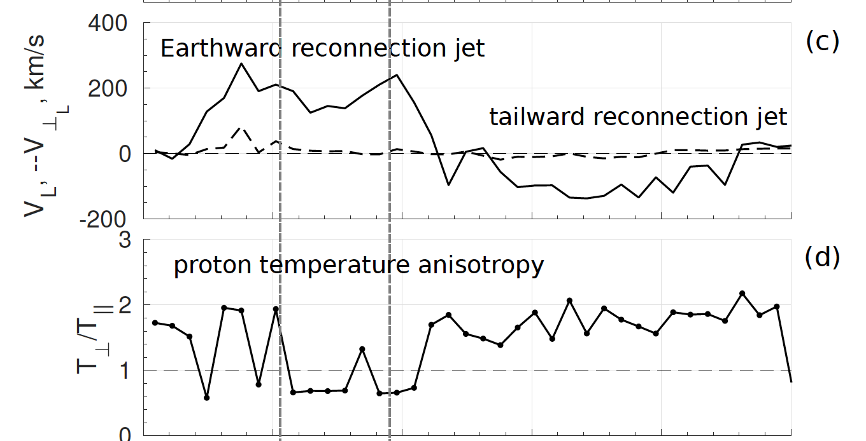
Firehose instability (FH) in multiple reconnection: Cluster observations in the Earth’s magnetotail
[Alexandra Alexandrova
et al., 2020, arxiv]

Slide 8
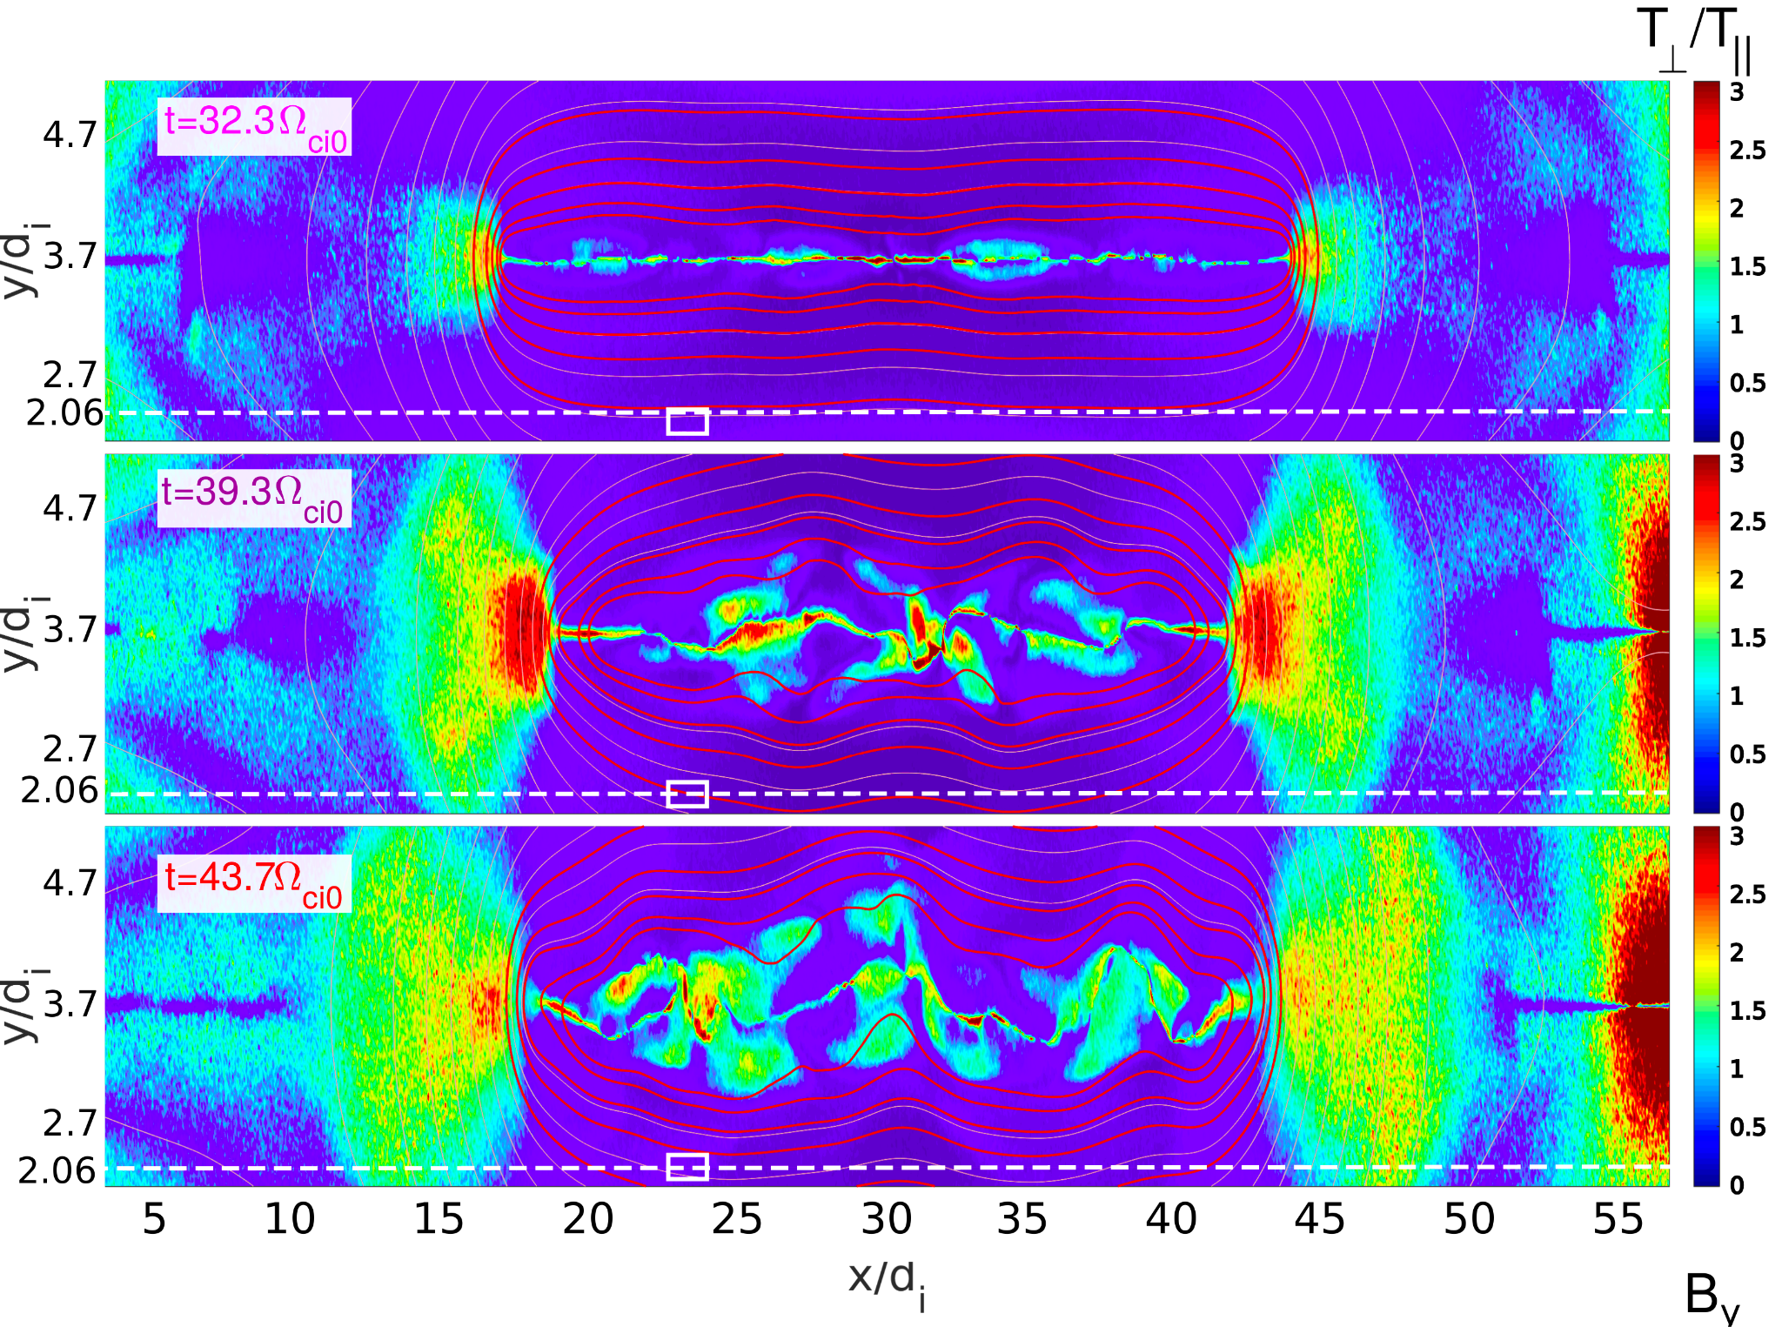
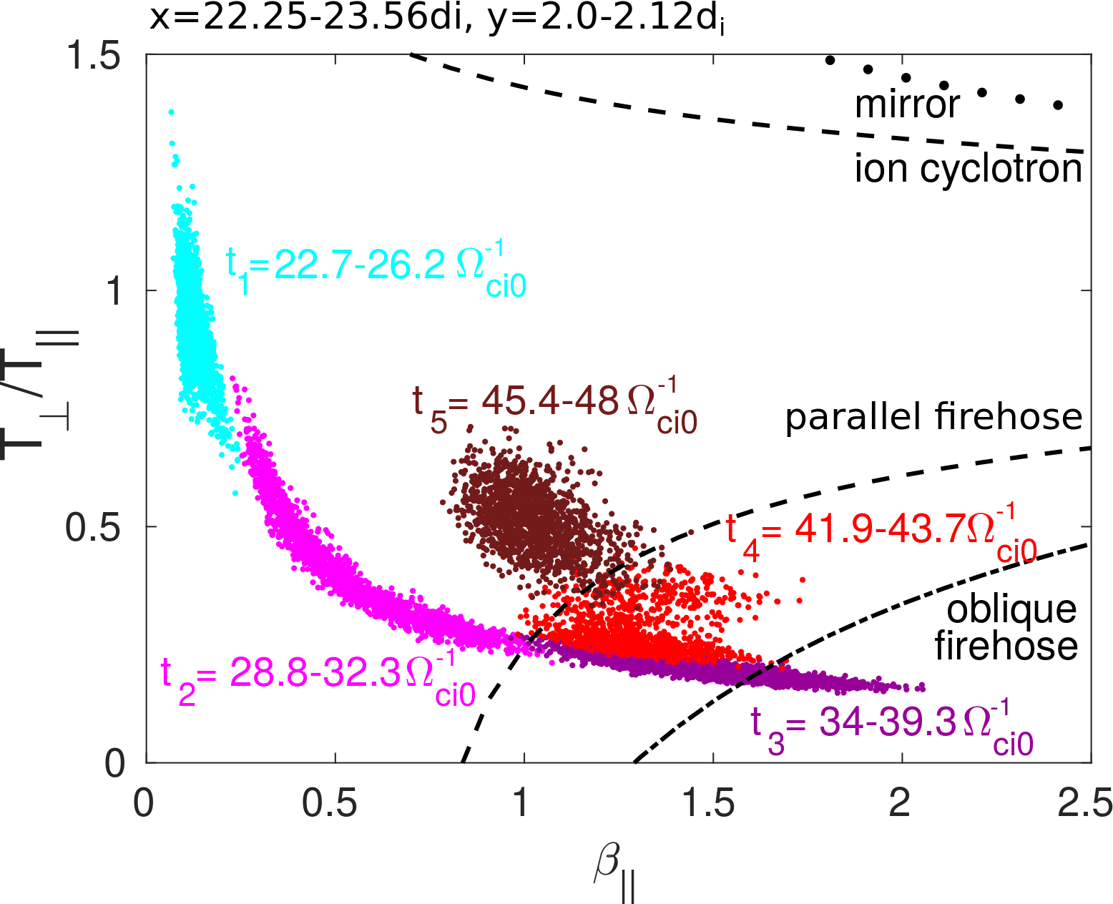
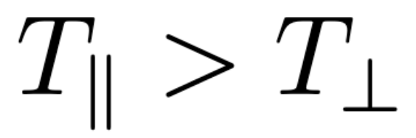
PIC simulations of multiple reconnection and evidence for Firehose (FH) instability
In outer layers of the plasmoid:
FH fluctuations are observed at the edge of the magnetic island.
The anisotropy then gets regulated.
[Alexandra Alexandrova et al., 2020]

Slide 9
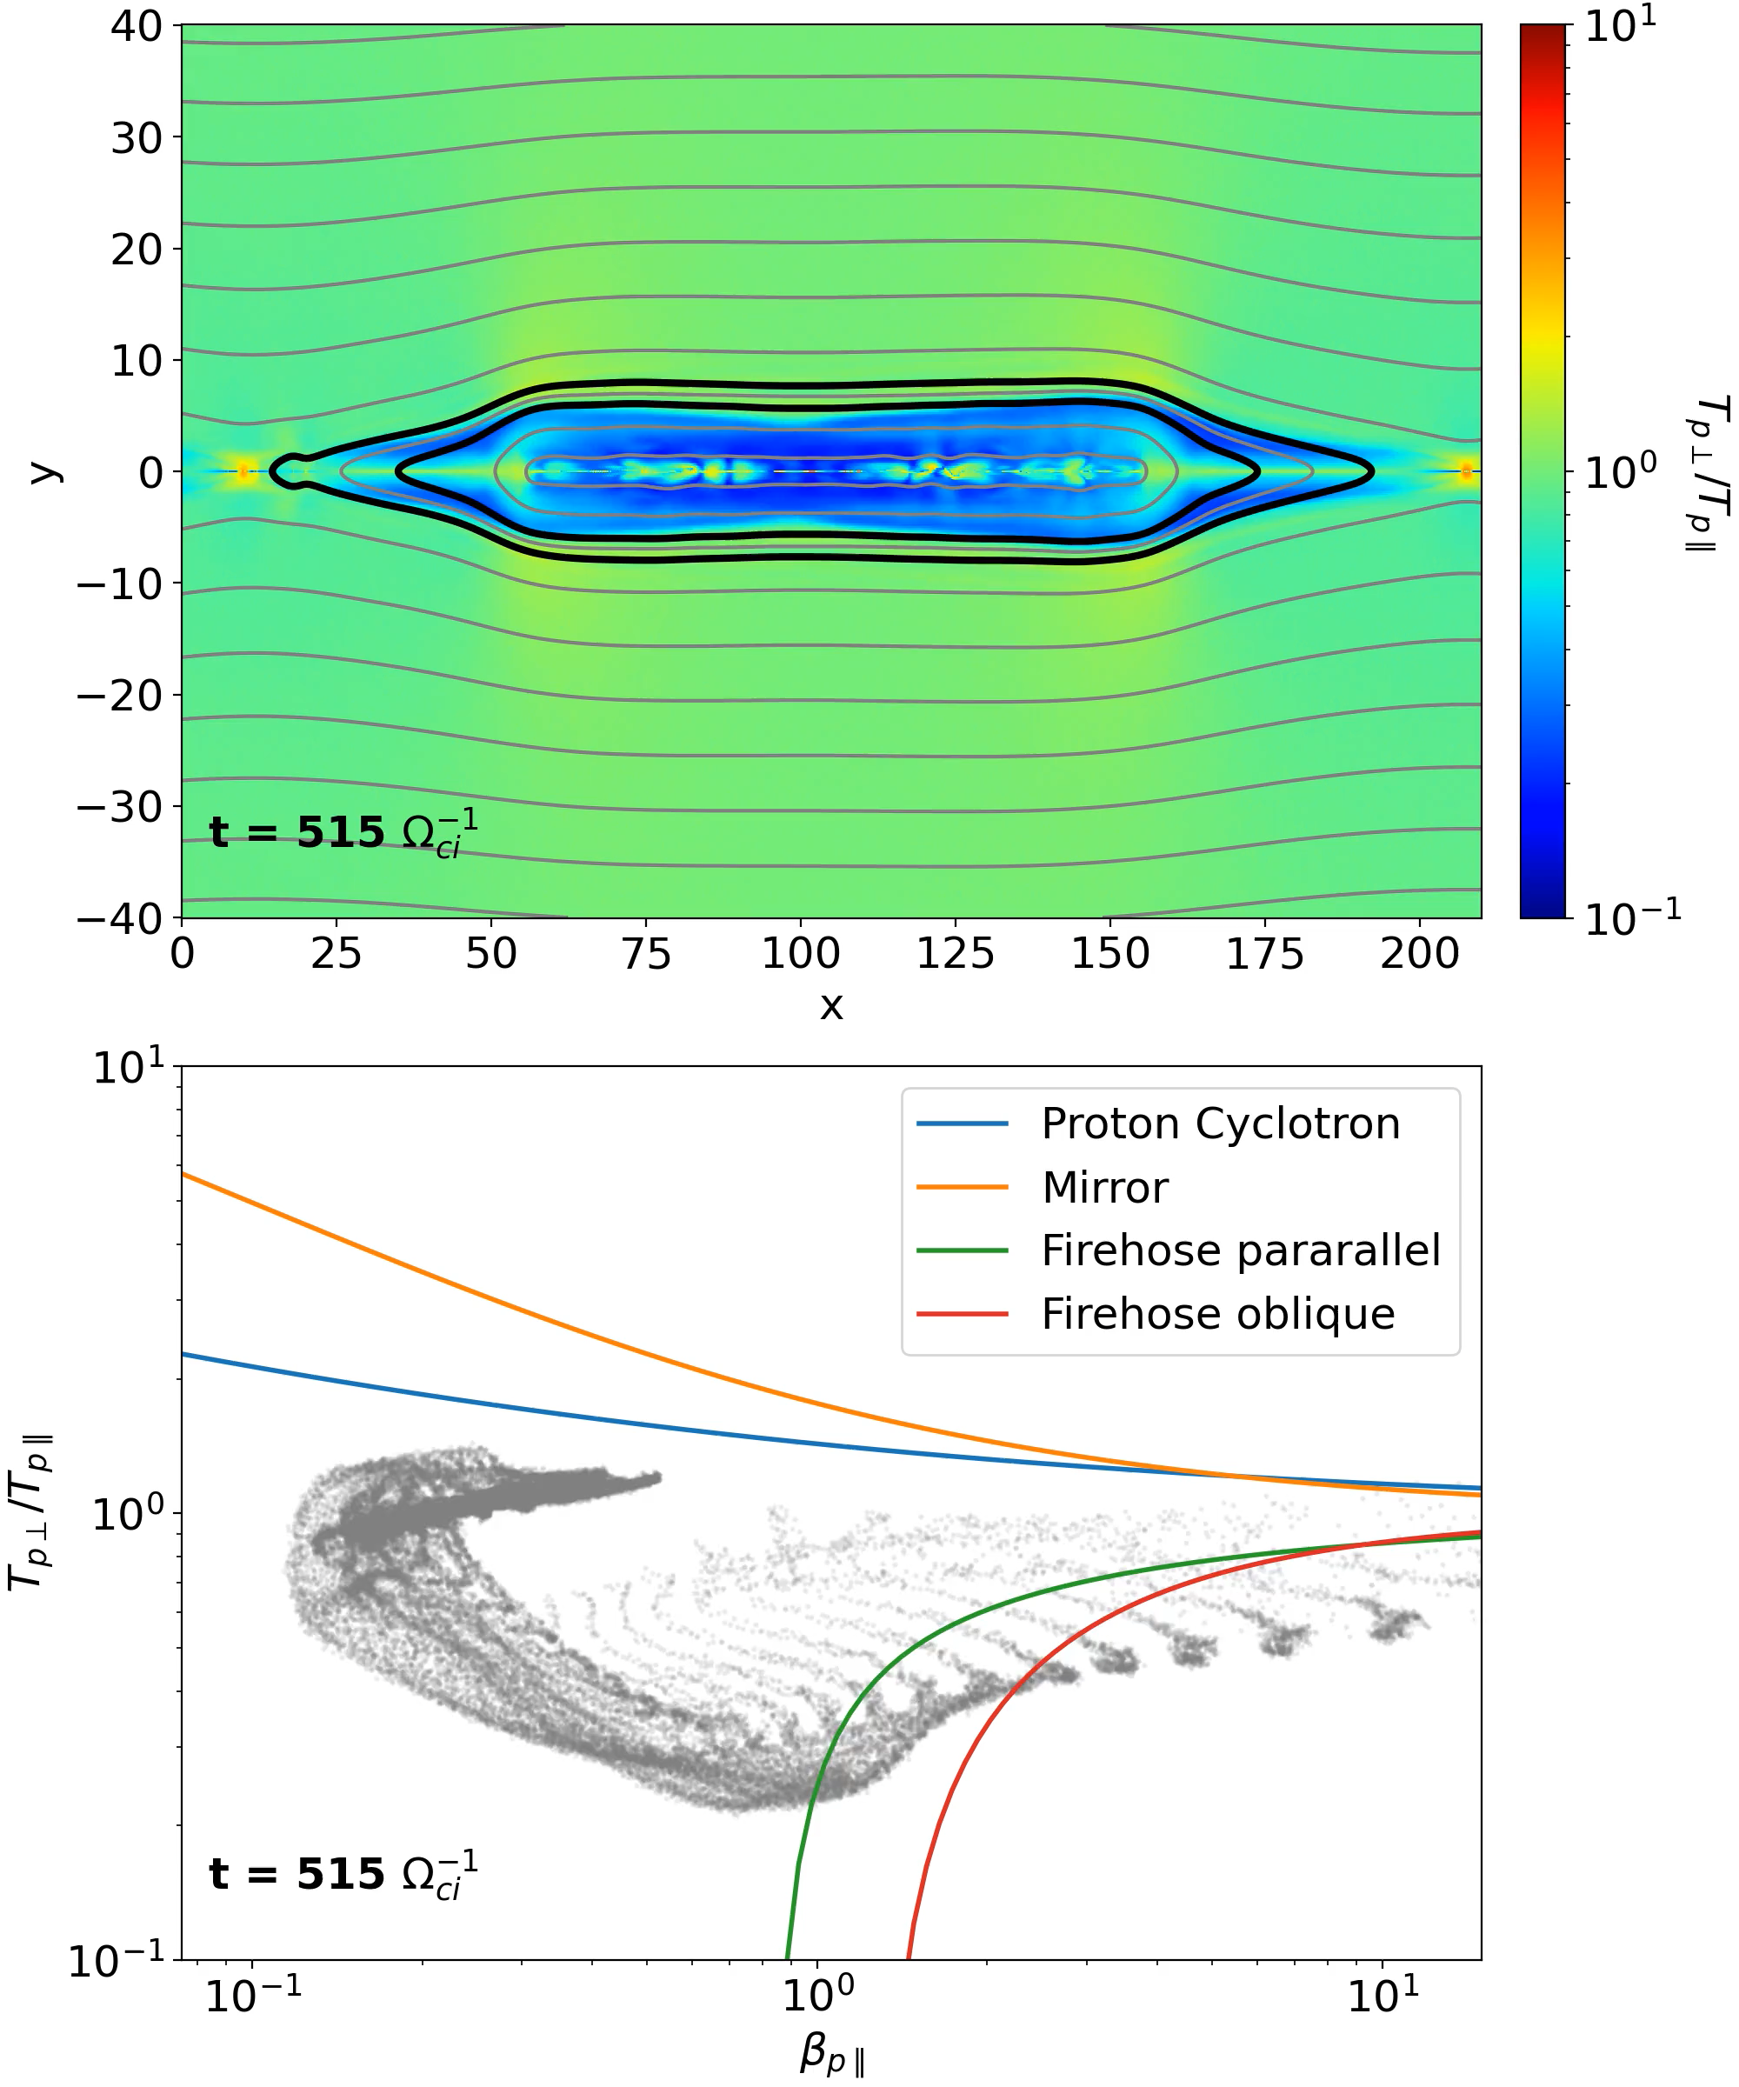
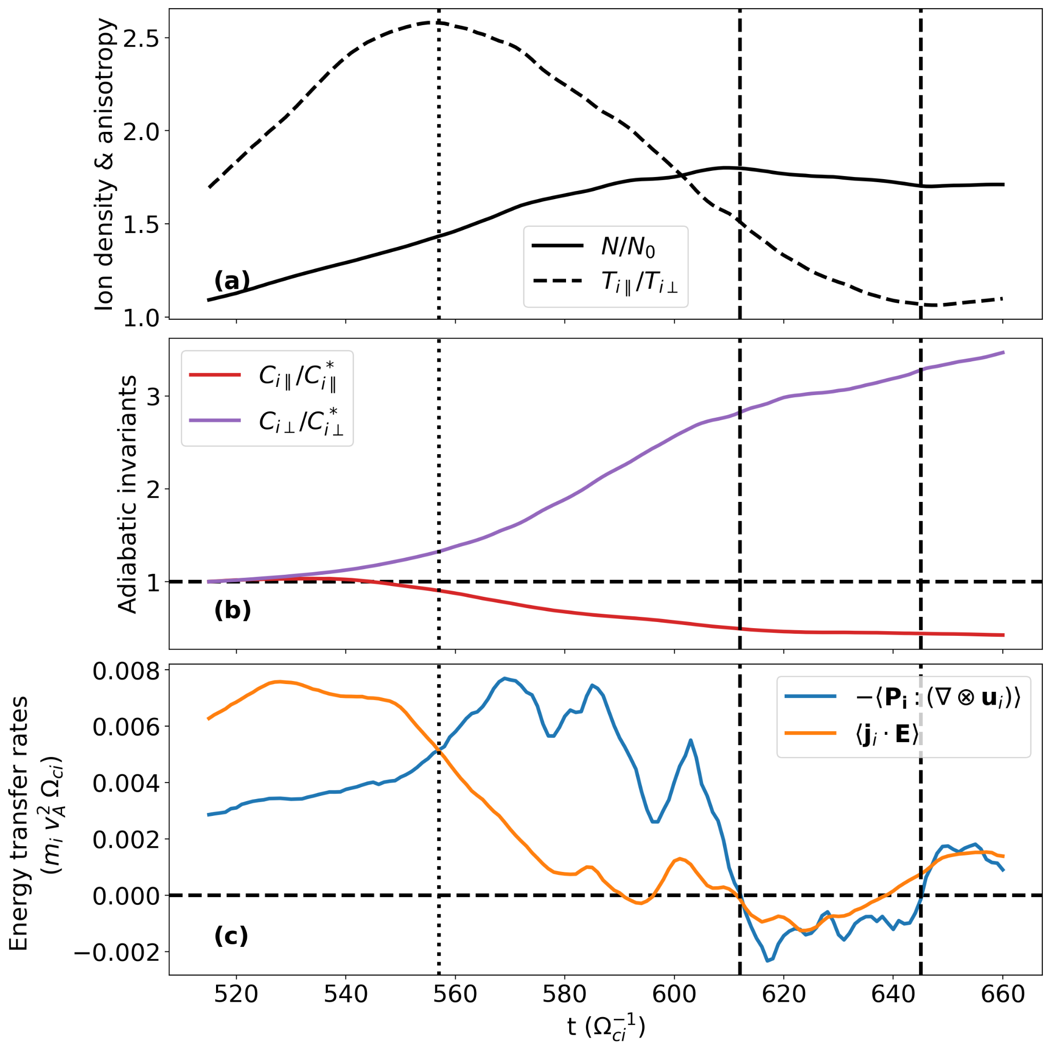
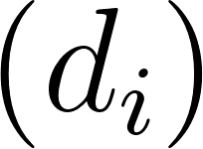
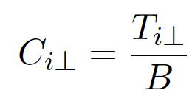
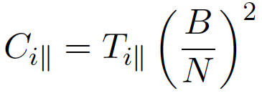
Temperature anisotropy induced by reconnection during NL phase and firehose instability
weakly non-adiab. compression
compression + non-adiab. (FH) effects
dominant non-adiab. (FH) effects
Regulation of the T-anisotropy by FH is non-adiabatic.
[E. Berriot, P. Hellinger, O. Alexandrova, A. Alexandrova,
P. Demoulin, 2026, under review in ApJ]

Slide 10
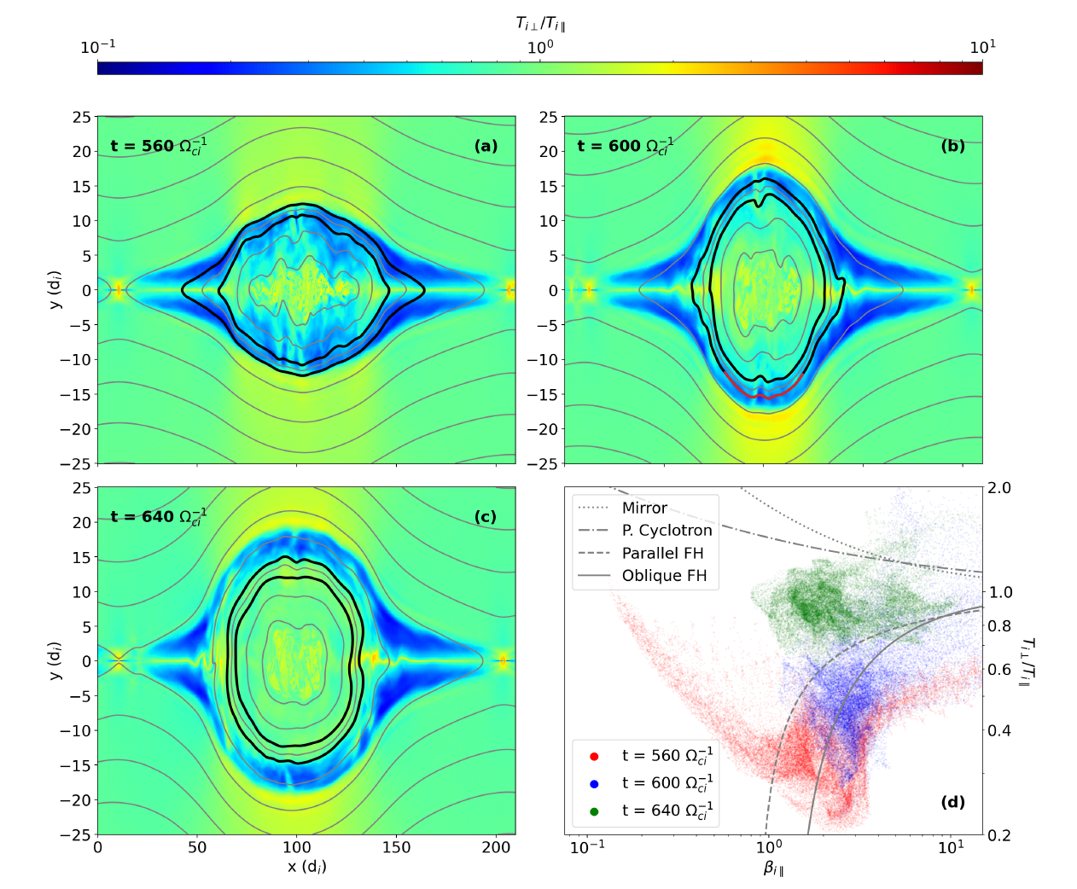
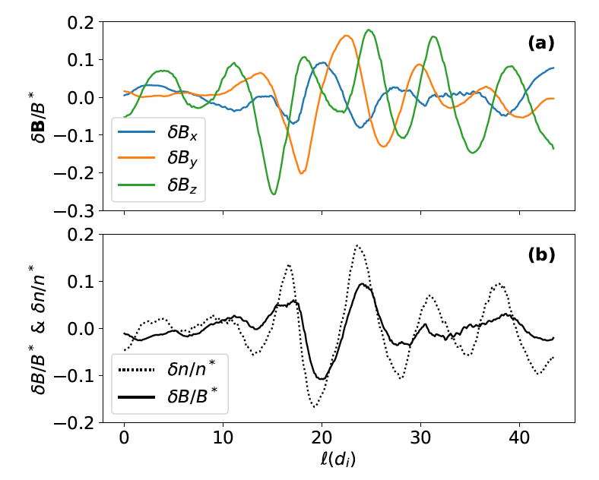
Temperature anisotropy induced by reconnection during NL phase and firehose-like instability
Wave generation in magnetic islands via Firehose-like instability in inhomogeneous plasma => compressible fluctuations

Slide 11
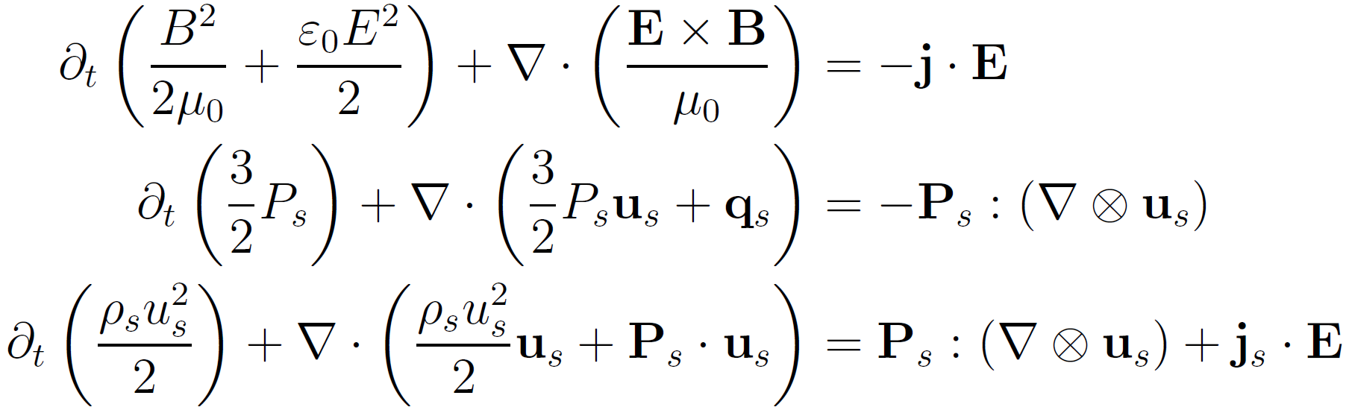
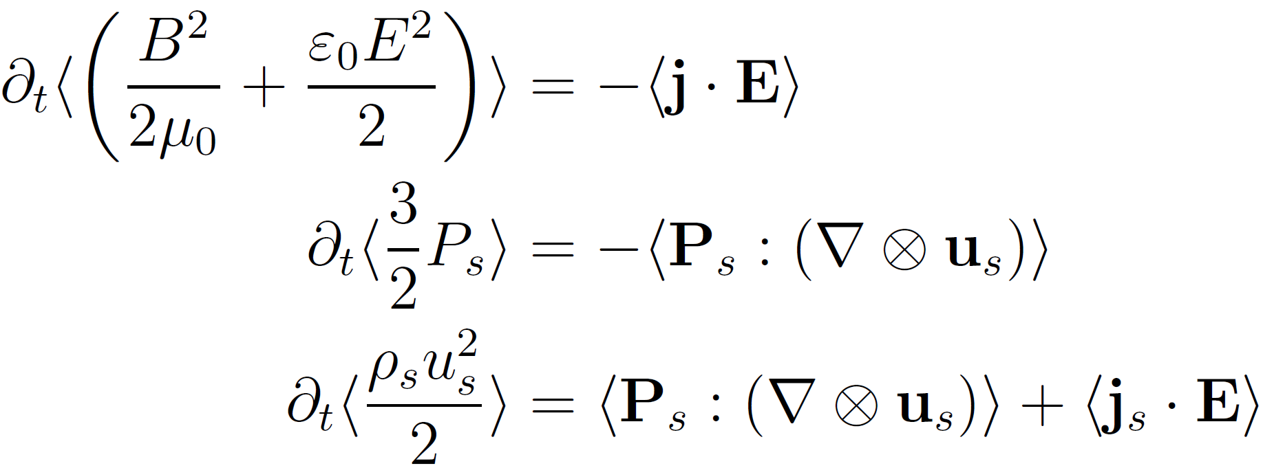
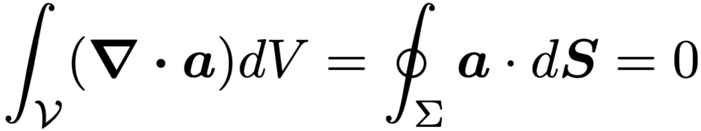
Energy evolution and conversion
Electromagnetic energy evolution
(Poynting theorem)
Internal (thermal) energy evolution of the different species
Kinetic (fluid) energy evolution of the different species (s)
Green-Ostrogradski theorem for periodic condition:
Internal (thermal) energy evolution of the different species
Kinetic (fluid) energy evolution of the different species (s)
Averaged energy evolution
See Yang et al. (2017)

Slide 12
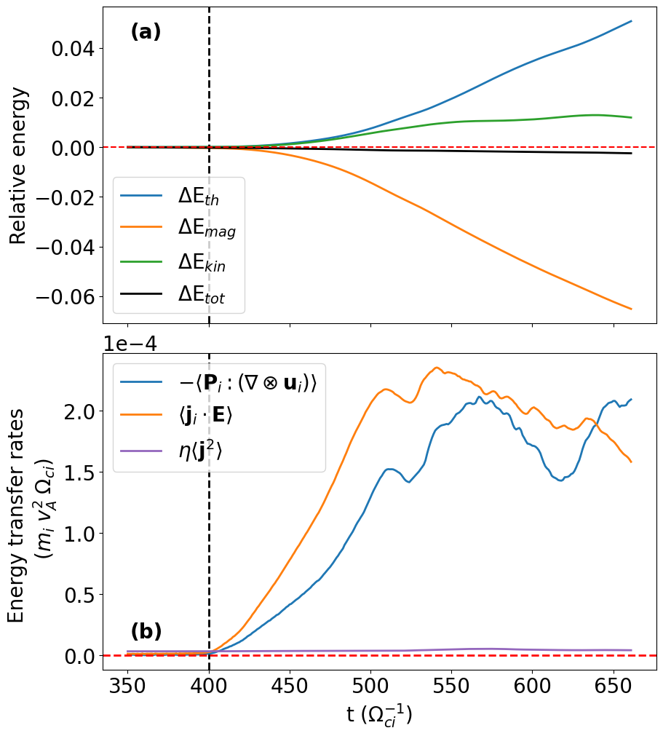
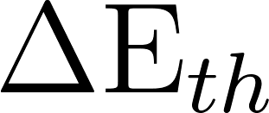
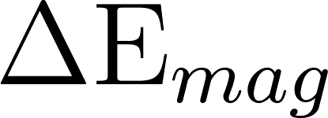
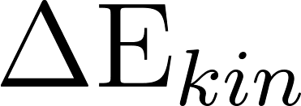
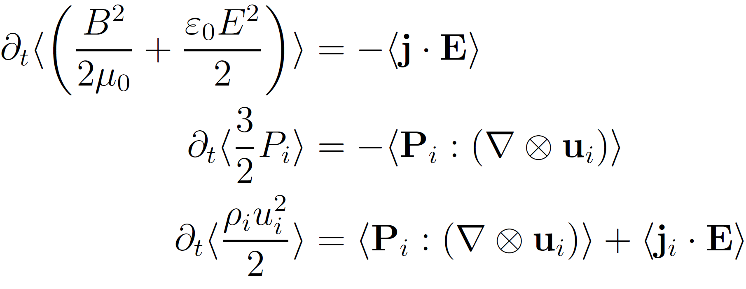
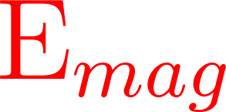
Energy conversion & dissipation: average over the domain
NL stage
During NL stage, efficient energy conversion:
Continuous increase of internal energy
at the expense of mag. energy
Increase of kinetic energy before it
saturates.
> 0 (heating)
Coalescence of mag. islands
> 0
( to ions)

Slide 13
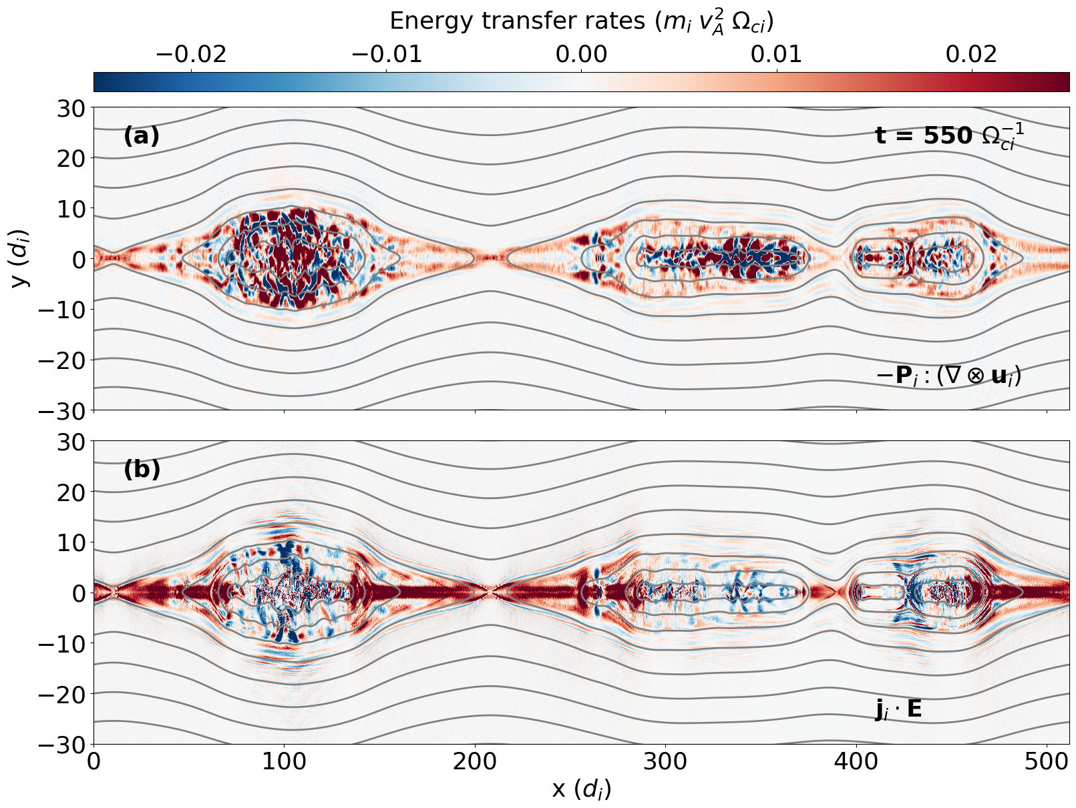
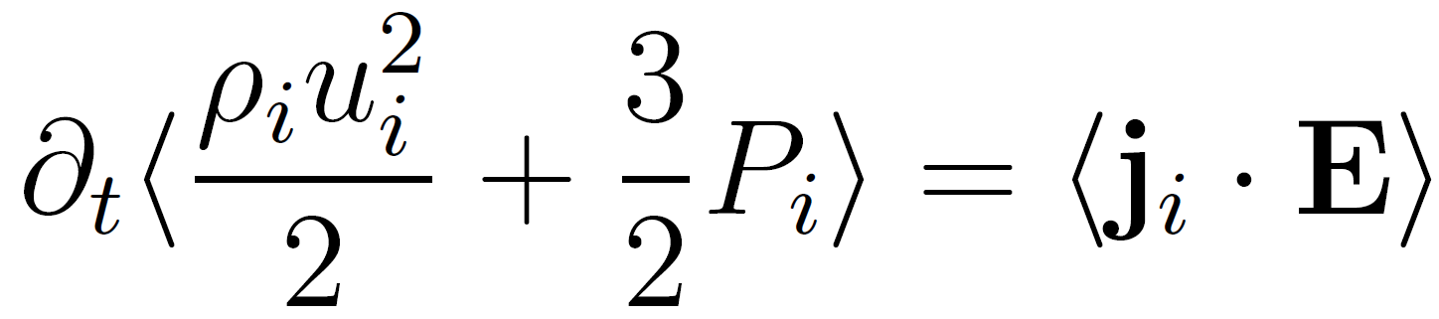
Energy conversion: spatial distribution at a given time
Inhomogeneous energy transfers.
EM energy conversion and heating at X-line.
Positive and negative conversion rates in the plasmoids.
On avg. heating plasmoid > at X-point.

Slide 14
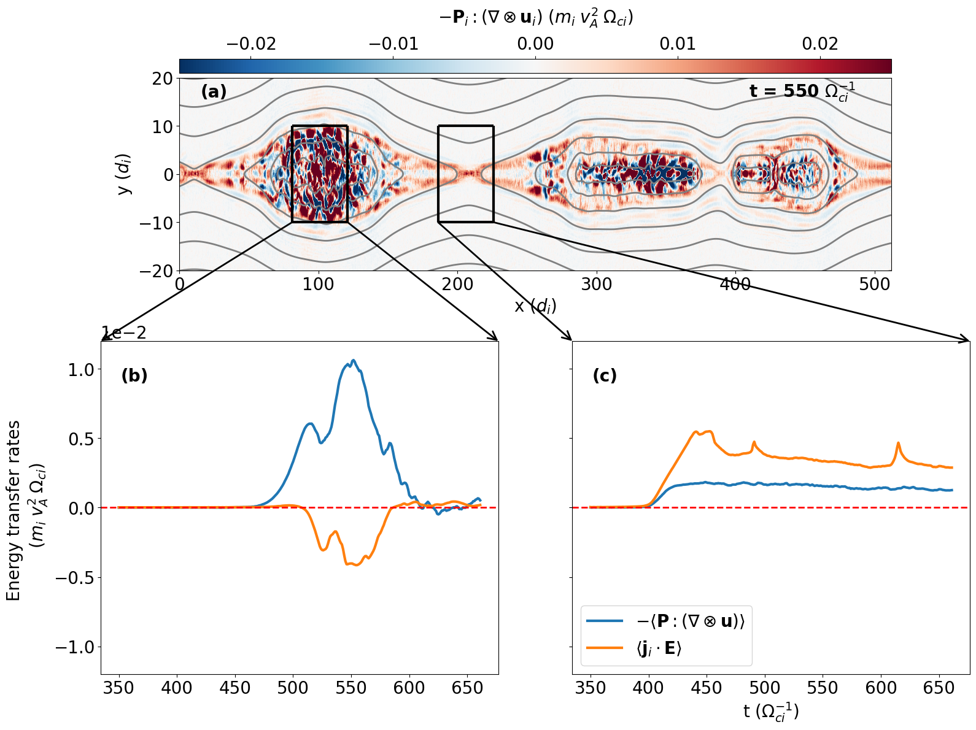
Energy conversion: around X and O points time evolution
Near a reconnecting X-point:
Conversion goes from EM energy to both plasma bulk flow and internal energy.
~ 55-60 % of EM energy conv. towards plasma jetting.
Heating
EM energy conversion
Center of magnetic island:
Important heating > than around the X-point.
Conversion towards EM energy.

Slide 15
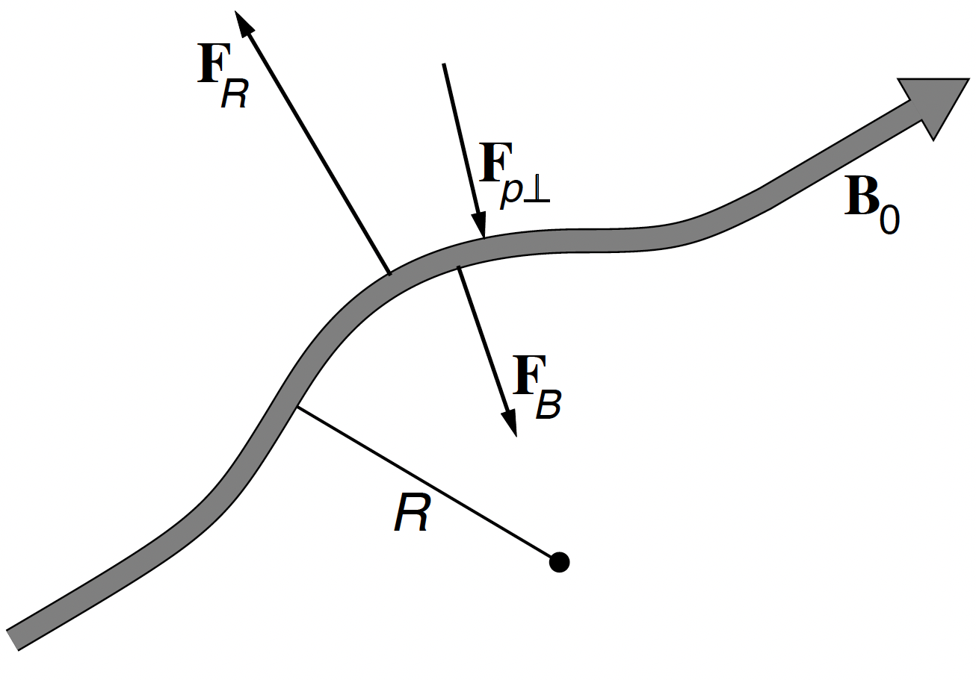
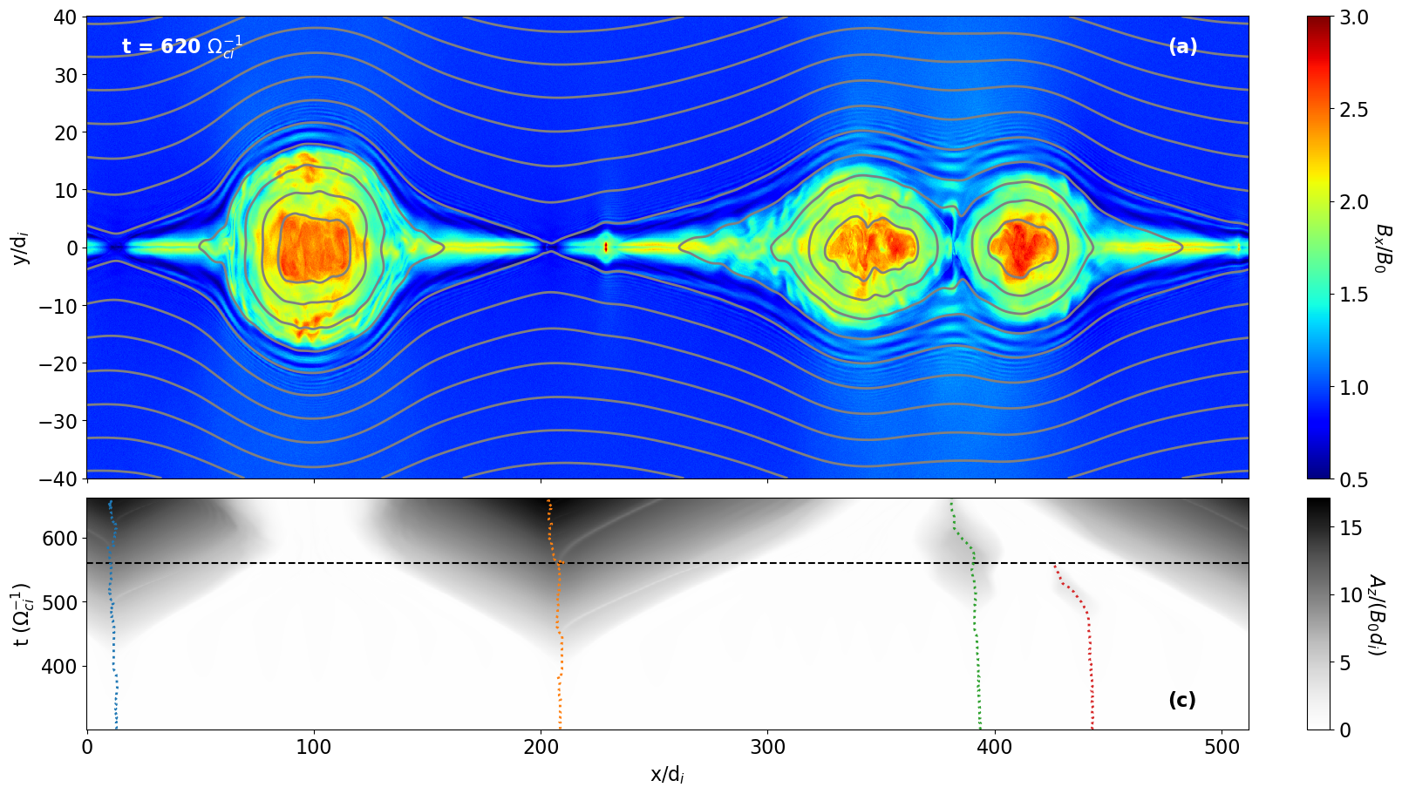
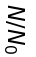
Conclusions
Hybride simulation of Tearing instability with novel Möbius boundary conditions.
Reconnection rate of 0.1 is attained during the NL stage.
Reconnection jets exhibit T° anisotropy.
The anisotropy is regulated by the firehose instability in a non-adiabatic way.
The energy conversion occurs principally during the NL stage.
Most of the heating occurs within magnetic islands.
[Berriot, Hellinger, Alexandrova, Alexandrova, Demoulin, 2026, accepted in ApJ]

