Slide 1
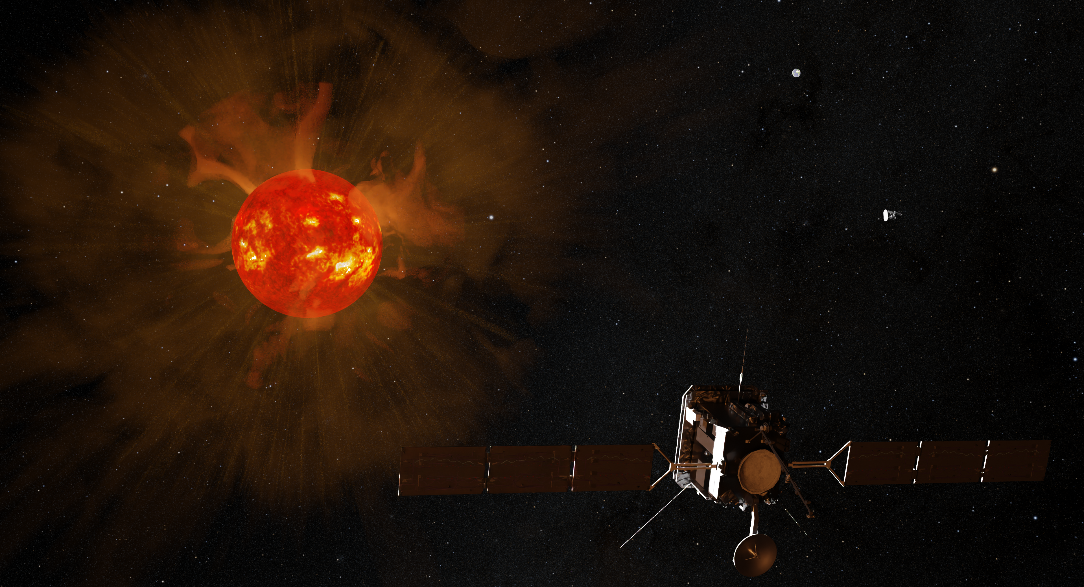
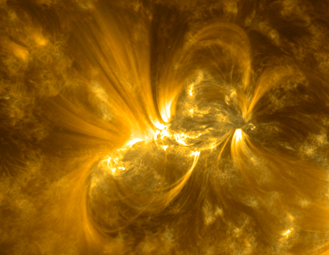


Characterising a flaring active region through data-driven MHD simulations
M. Valeria Sieyra, Antoine Strugarek, Alexis Blaise, STORMGENESIS and WHOLESUN collaborators
Image credit: Adam Finley
maria-valeria.sieyra@cea.fr

Slide 2
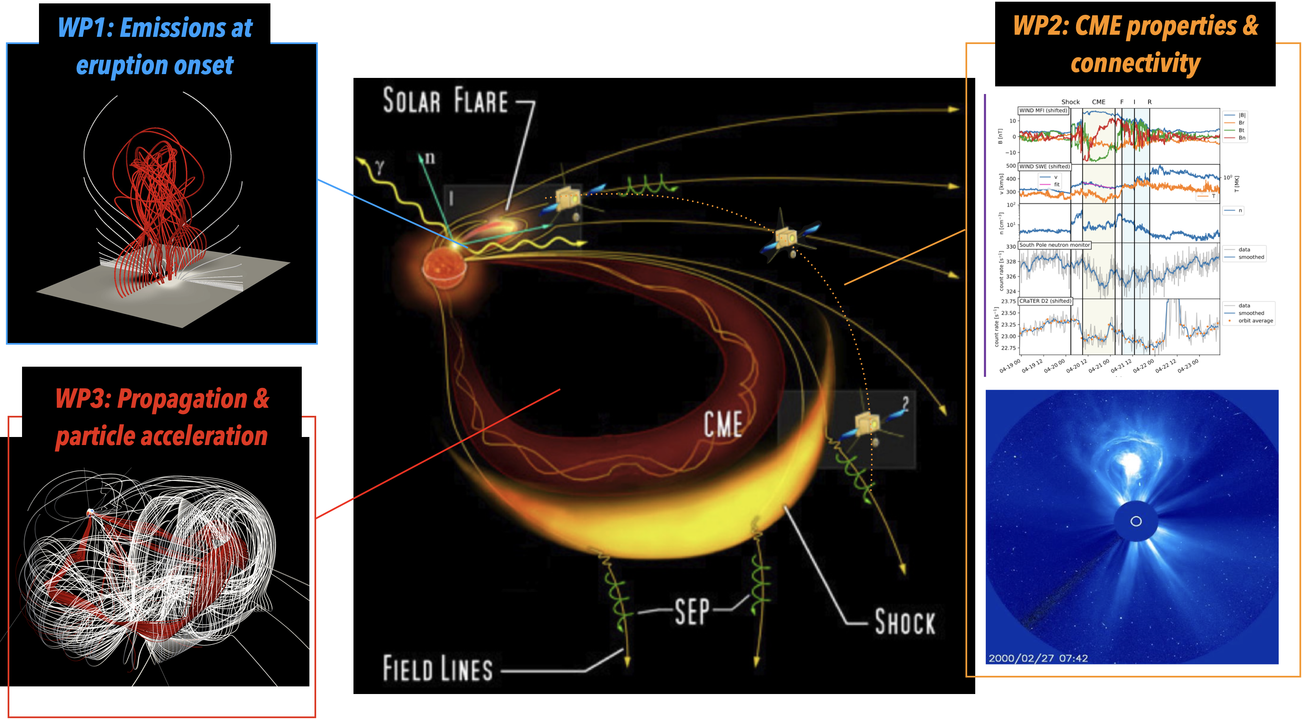
Stormgenesis Project
PI: A. Strugarek
maria-valeria.sieyra@cea.fr
PNST2024
Notes:
This project aims to characterize the initiation, propagation and connectivity of solar storms using innovative and ambitious numerical simulations based on the PLUTO code combined with the latest space weather observations such as Solar Orbiter and Parker Solar Probe with the aim of improving our predictive and forecasting abilities for space weather purposes.
What is this about? Space weather
Why do we need to work on this? improve predictions -> early warning
How? Models to understand the physics

Slide 3
Stormgenesis project
Numerical simulations PLUTO code (Mignone+ 2007, 2023):
-> Open-source, well established, modular, easily adaptable
MHD:
  Magnetic field data
  Line-tying at bottom boundary (Aulanier+ 2005)
  Thermal conduction and radiative cooling
  Resistivity
Particle acceleration:
  Guiding-center approximation
  No feedback on MHD
maria-valeria.sieyra@cea.fr
PNST2024
Notes:
In particular I will be working in this two work packages that focused on the initiation and propagation of the solar eruptions and how do they produce energetic particles radiation that fills the heliosphere? Today I will introduce first results of WP1. How are we going to do this? With numerical simulations using PLUTO code.
Why Pluto? Why Pluto? It is a well established code in the community, modular, and it has the physics can be adaptable
For the MHD part I will use a magnetogram as input for the photospheric magnetic field + line-tying boundary conditions, thermal conduction, radiative cooling and resistivity. For the particle acceleration part I will use guiding center approximation and test particles, meaning no feedback on MHD.
What is this about? Space weather
Why do we need to work on this? improve predictions -> early warning
How? Models to understand the physics

Slide 4
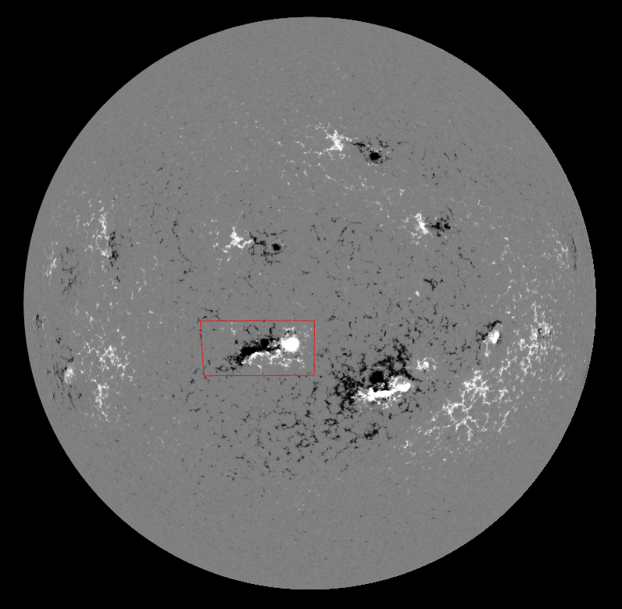
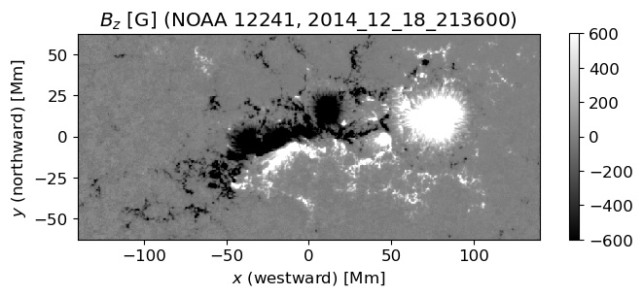
Observations: AR12241
https://hinode.isee.nagoya-u.ac.jp/nlfff_database/download/noaa_12241.html
maria-valeria.sieyra@cea.fr
PNST2024
Notes:
Why this AR? It has an eruption, is well visible (central meridian)

Slide 5
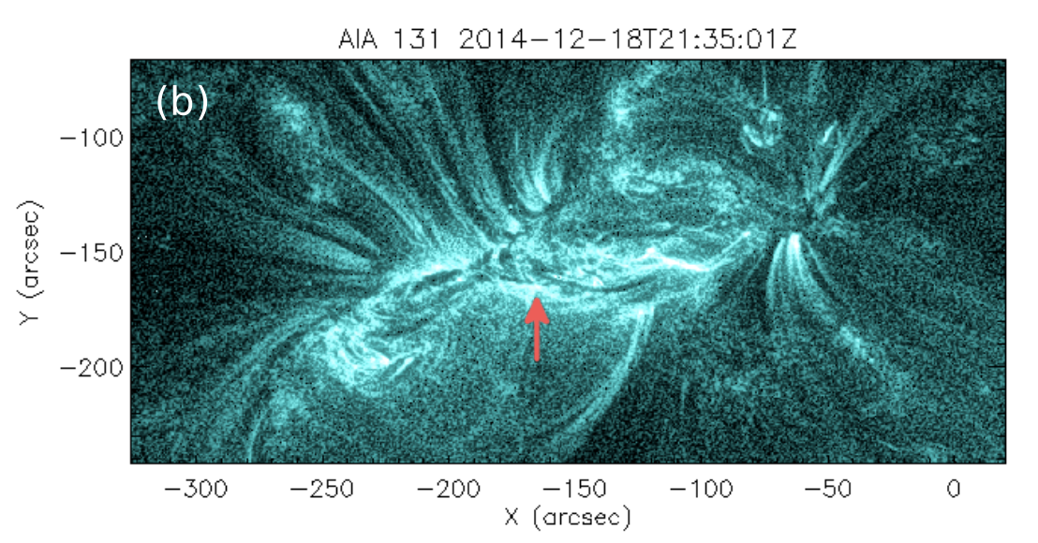
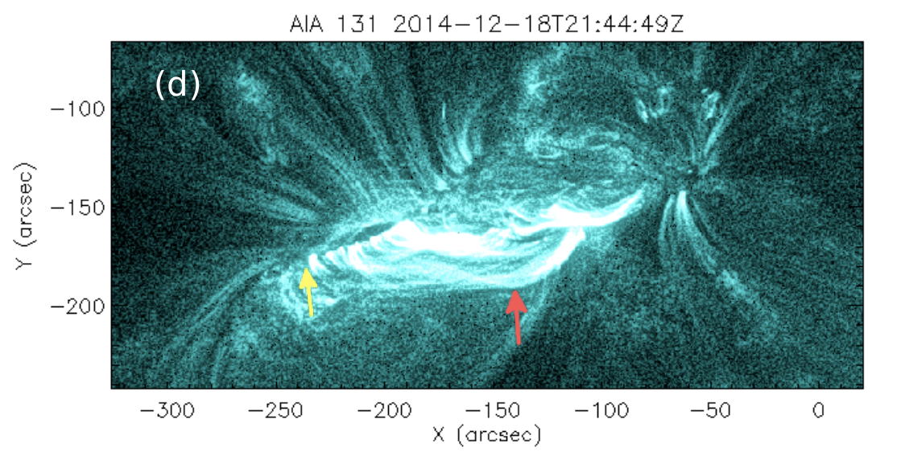
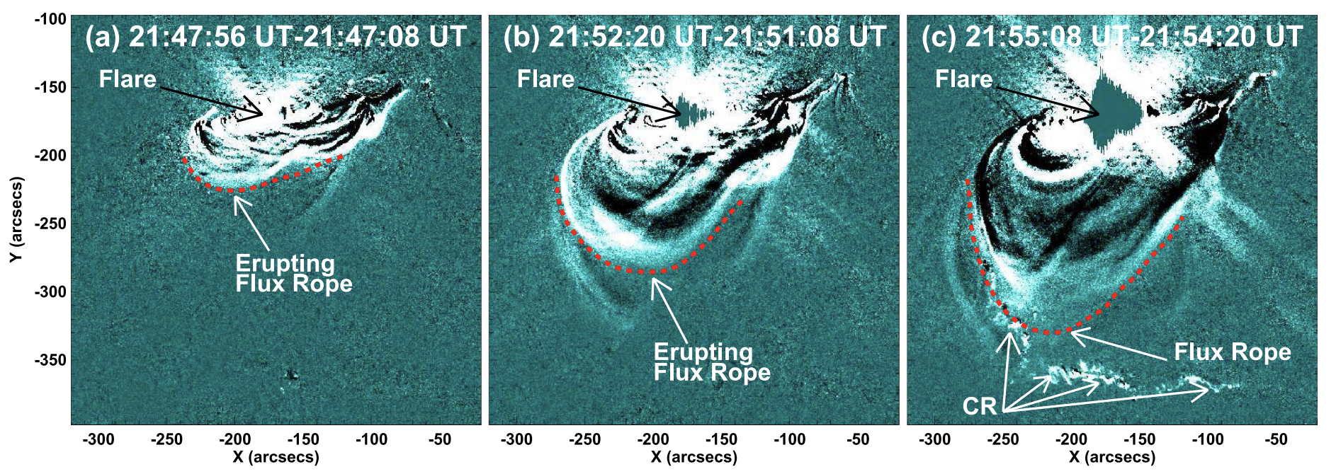
Observations: AR12241
21:45
Two-ribbon component (Joshi+ 2017)
Prasad+ 2023
22:26
Joshi+ 2017
maria-valeria.sieyra@cea.fr
PNST2024
Notes:
the active region is bipolar with much of its positive-polarity magnetic ﬂux in the large leading sunspot and much of its negative ﬂux in the three following sunspots, and it has a long PIL. The ﬂare starts at around 21:41 UT and peaks at ≈ 21:58. The ﬂaring process has two components: the ﬁrst component corresponds to the development of a ﬂux rope over the PIL and its rise, leading to parallel ﬂare ribbons. In the second component, the erupting ﬂux rope reaches the three-dimensional (3D) magnetic null located at a much higher height and initiates MR at the null, forming the larger quasi-circular ribbon.

Slide 6
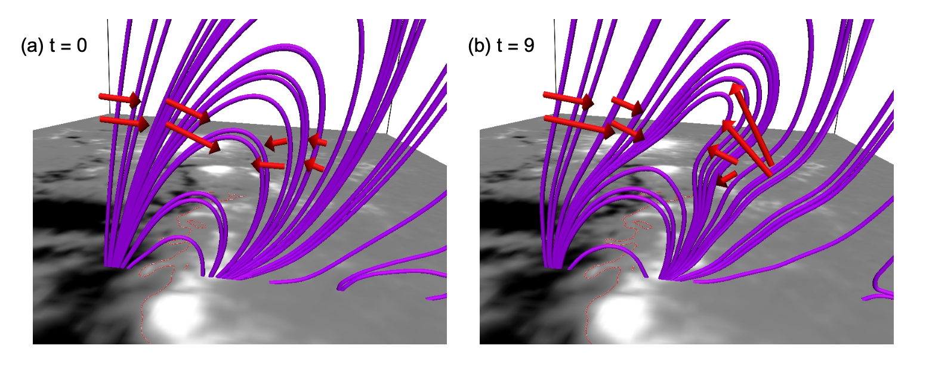
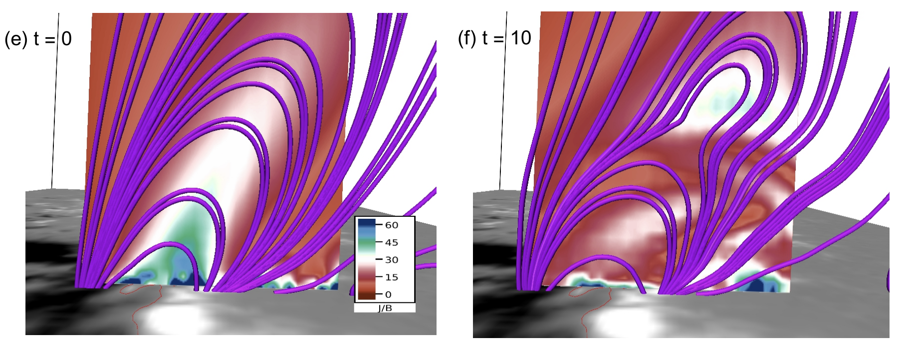
Modelling the eruption
Prasad+ 2023: isothermal and incompressible MHD + Non Force Free Field (NFFF) extrapolation
Eruption triggered by non-zero initial Lorentz Force
Is it the only way to generate the eruption?
Are thermal effects important?
‘Photosphere’
‘Chromosphere’
Transition region
Corona
HLL solver
Res (156x156x52)km
Cells 896x384x1152
Resistivity = 1.e11 cm²/s
Magnetogram @ the bottom
Non Force Free Field
(Hu+ 2008,2020, Prasad+ 2018)
Extrapolations Non-Linear Force Free Field*
Potential*
*Kusano+ 2020, https://hinode.isee.nagoya-u.ac.jp/nlfff_database/index.html
PNST2024
Notes:
We want to model the eruption. We take into account the results obtained by Avijeet Prasad where they analyse the same AR. Focused more on the envolution of the magnetic field, they performed MHD simulations but considering constants the density and the temperature and the NFFF extrapolations.They determine that the eruption is triggered by the initial non-zero Lorentz force of the NFFF. The initial Lorentz force is deforming the ﬁeld lines of the arcade to give rise to the current sheet formation and consequent reconnection. Is it the only way to produce an eruption?
For our model we are going to consider MHD simulations that involve a stratified atmosphere with a “photosphere” and “chromosphere” between quotes because we neglect the neutrals. For the magnetic field we will consider a magnetogram at the bottom boundary and three different extrapolations in the corona. And the question that we want to answer is, in case that we have an eruption, what drives it? Is it the imbalance of the lorentz force or is it the thermal imbalance that can trigger the imb of the lorentz forces?
For the simulations we use Harten, Lax and Van Leer solver

Slide 7
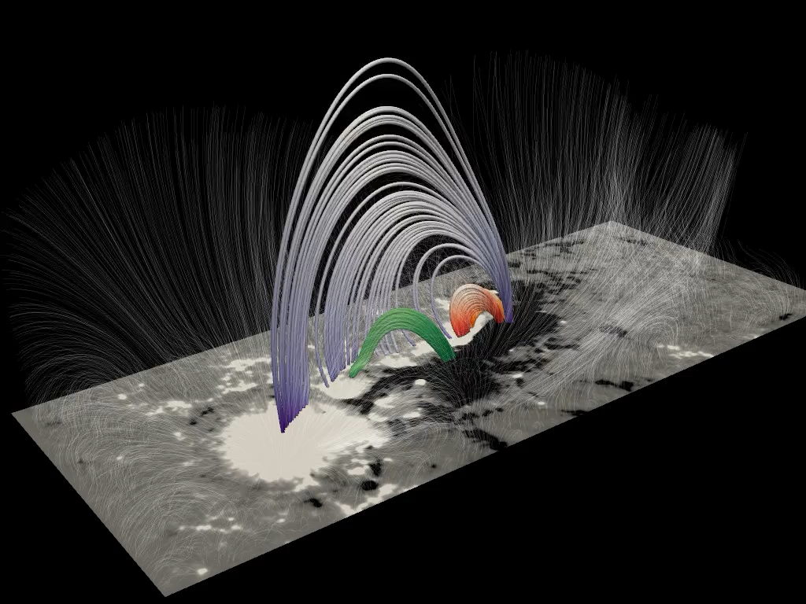
Modelling the eruption
Non Force Free Field extrapolation
z
(0,60) Mm
y
(-30,30) Mm
x
(-70,70) Mm
maria-valeria.sieyra@cea.fr
PNST2024
Notes:
For this extrapolation we are under the same conditions that Avijeet in terms of the imbalance of the lorentz force
The first part of the movie is the settling down of the simulation due to the heat conduction along the magnetic field

Slide 8
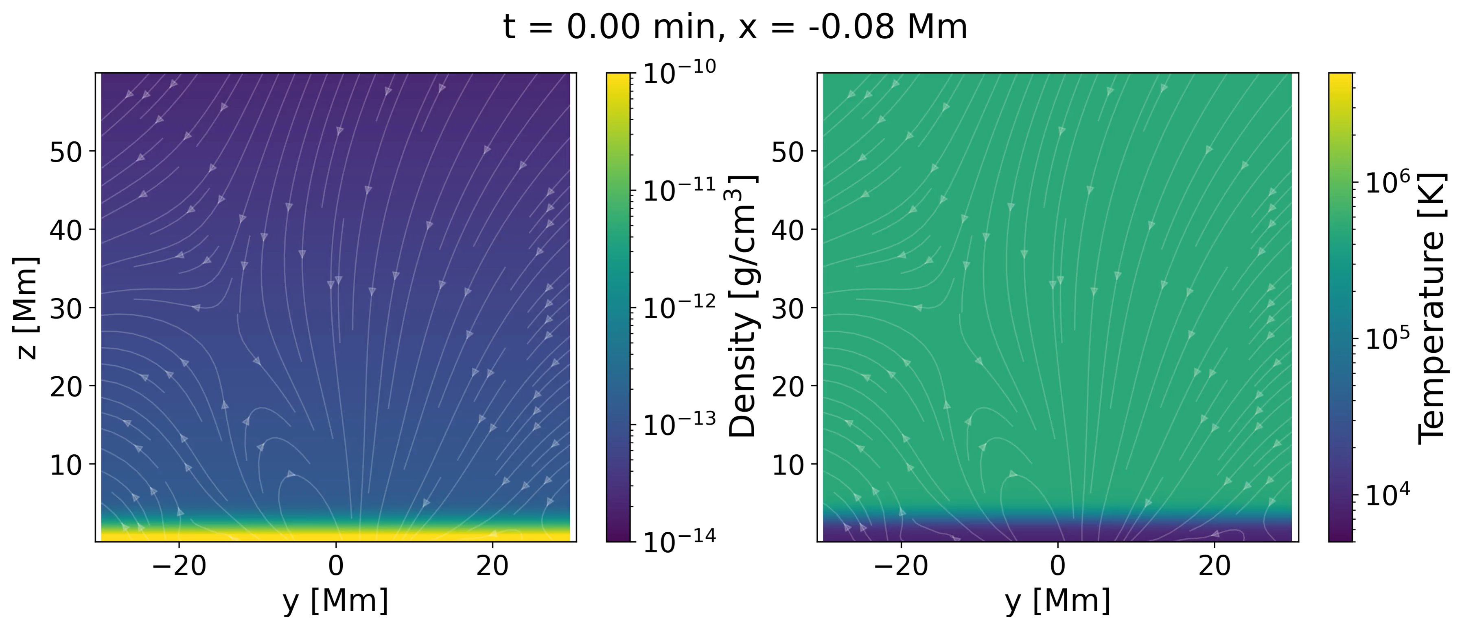
Modelling the eruption
Non Force Free Field extrapolation
maria-valeria.sieyra@cea.fr
PNST2024

Slide 9
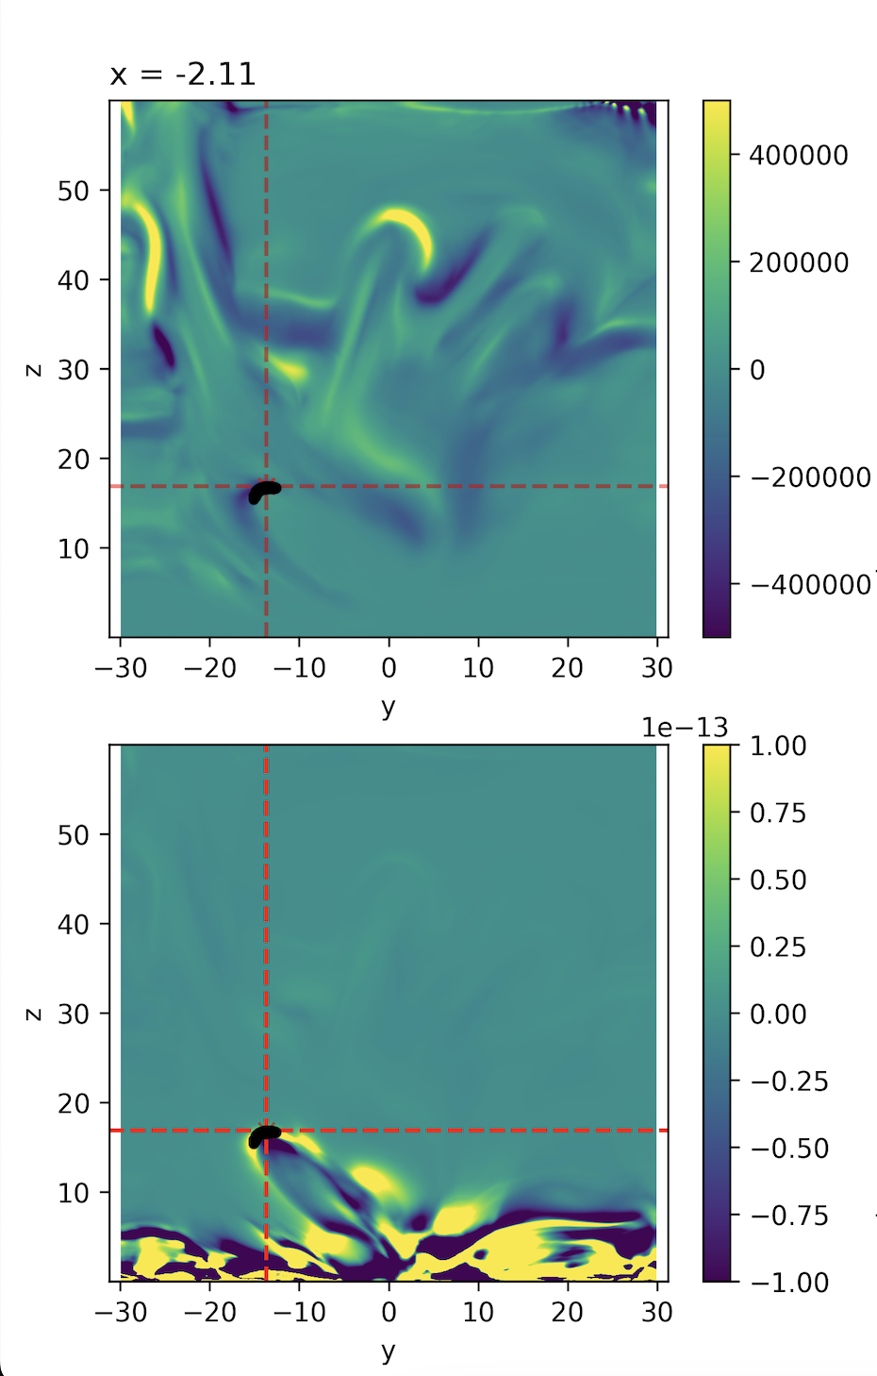
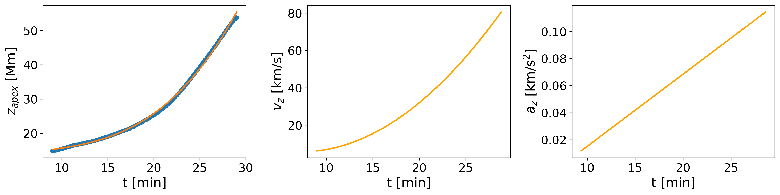
Force analysis
Tracking the apex of the Flux Rope (FR): Running difference
Temperature
Density
maria-valeria.sieyra@cea.fr
PNST2024

Slide 10
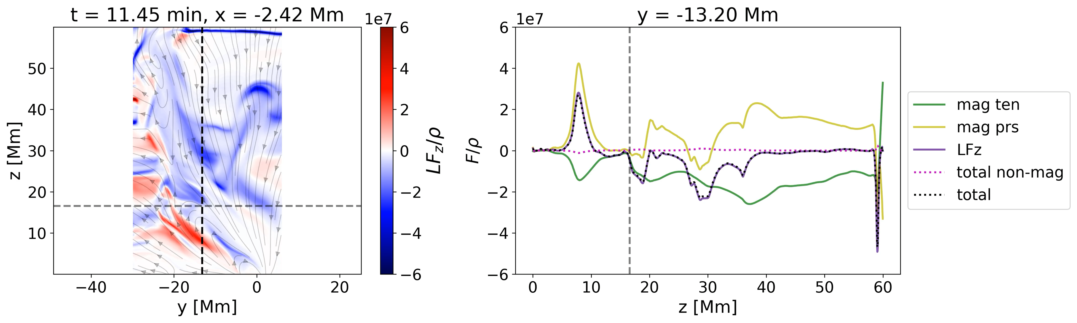
Force analysis
Calculating the forces involved in the plane of the FR
Magnetic Pressure
Lorentz Force
Total Force
Magnetic Tension
Non-magnetic forces
Lorentz force dominates
maria-valeria.sieyra@cea.fr
PNST2024

Slide 11
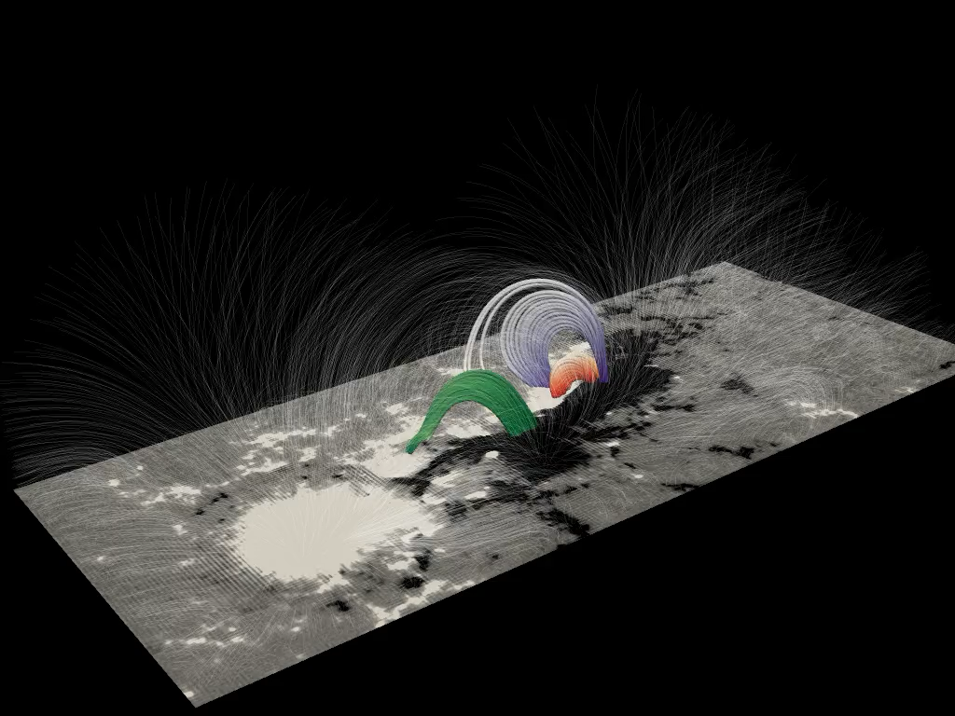
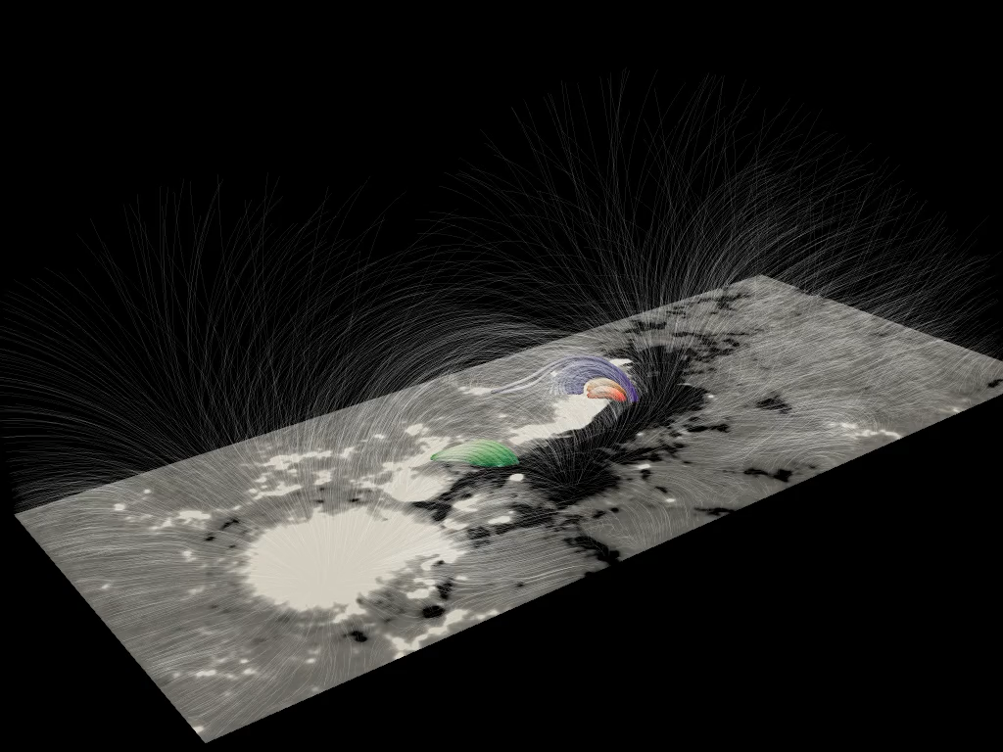
Comparison different extrapolations
Non Linear Force Free Field
Potential
Initial Lorentz Force = 0, Eruption!
Initial Lorentz Force = 0, No Eruption!
maria-valeria.sieyra@cea.fr
PNST2024

Slide 12
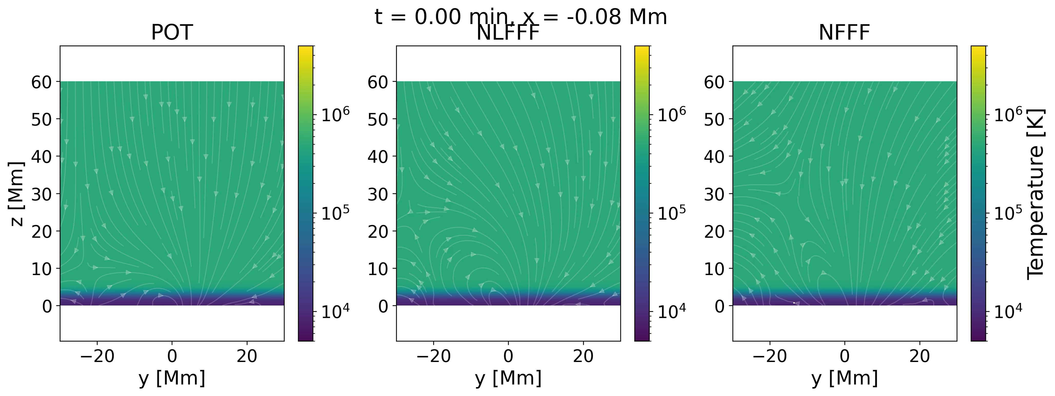
Comparison different extrapolations
PNST2024

Slide 13
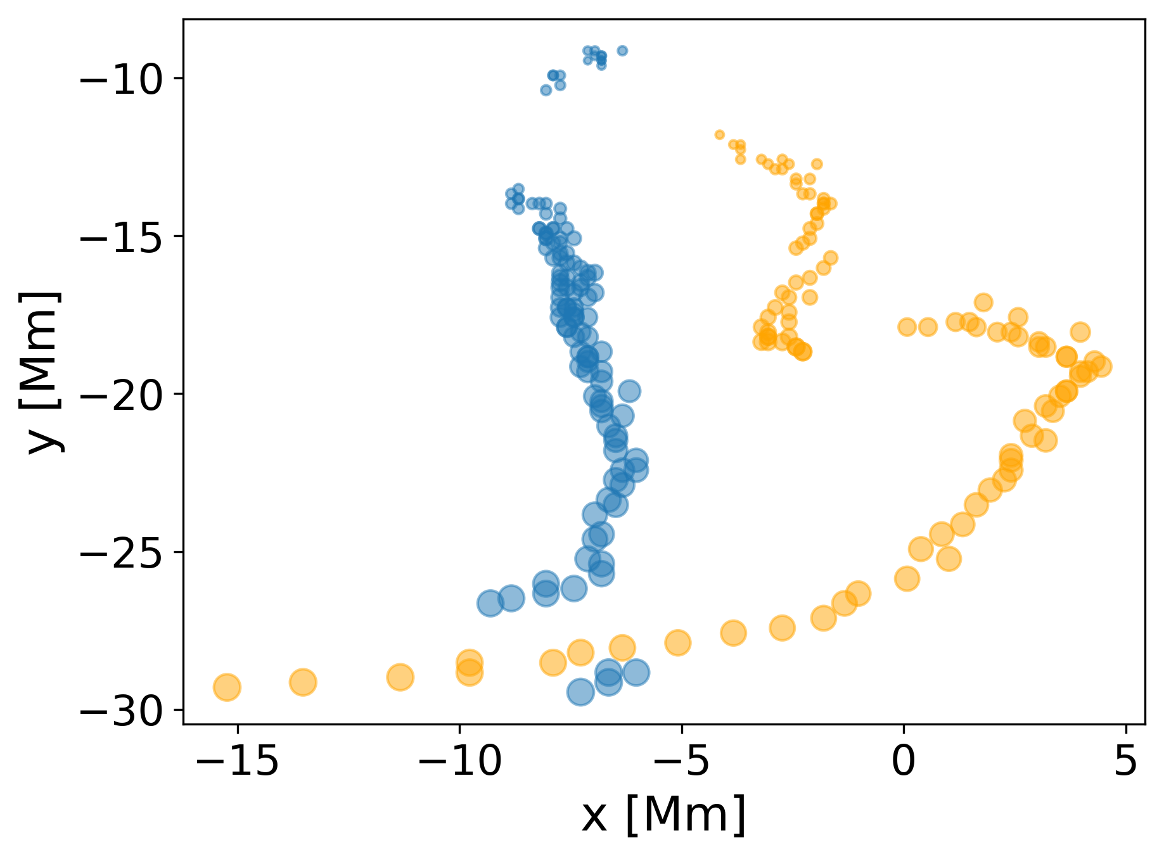
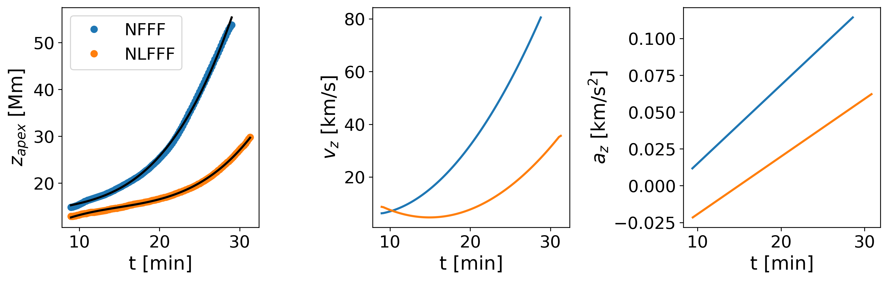
Comparison different extrapolations
FRs from different extrapolations exhibit different dynamical behaviour
Height
Speed
Acceleration
maria-valeria.sieyra@cea.fr
PNST2024
Notes:
Something that is clear from the movies is that the FR for the NFFF and the NLFFF extrapolations has different trajectories, because the magnetic configuration is different. Using the tracking of the apex of the FR we can obtain the trajectories for the different extrapolations and we can see in a quantitative way the difference

Slide 14
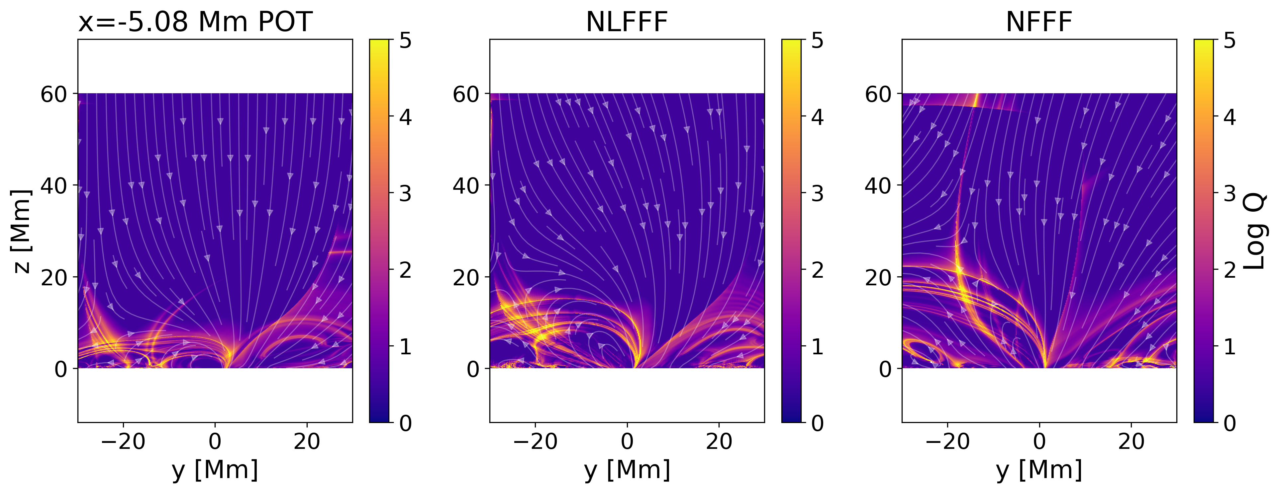
Comparison different extrapolations
Squashing factor Liu+ 2016, http://staff.ustc.edu.cn/~rliu/qfactor.html,
(needs more study…)
maria-valeria.sieyra@cea.fr
PNST2024
Notes:
Something that is clear from the movies is that the FR for the NFFF and the NLFFF extrapolations has different trajectories, because the magnetic configuration is different of course
A way that this can be predicted is with the squashing factor, they have different inclinations. Which corresponds approximately with the evolved position of the FR. I think it is predicting where the FR would go

Slide 15
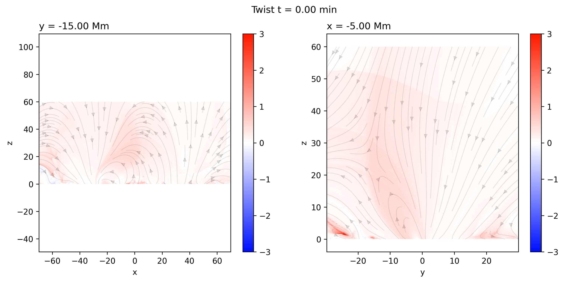
Identification and Tracking of the flux rope
Compute the twist: J . B/B² integrated along the field line (Berger & Prior, 2006). Numerical method inspired by MAFIAT (Magnetic Field Analysis Tools package) https://github.com/pricedj/mafiat/tree/master
Automatic identification and tracking of coronal flux ropes by Andreas Wagner (Wagner+ 2023, Part I and II)
maria-valeria.sieyra@cea.fr
PNST2024
Notes:
Something that is clear from the movies is that the FR for the NFFF and the NLFFF extrapolations has different trajectories, because the magnetic configuration is different of course
A way that this can be predicted is with the squashing factor, they have different inclinations. Which corresponds approximately with the evolved position of the FR. I think it is predicting where the FR would go

Slide 16
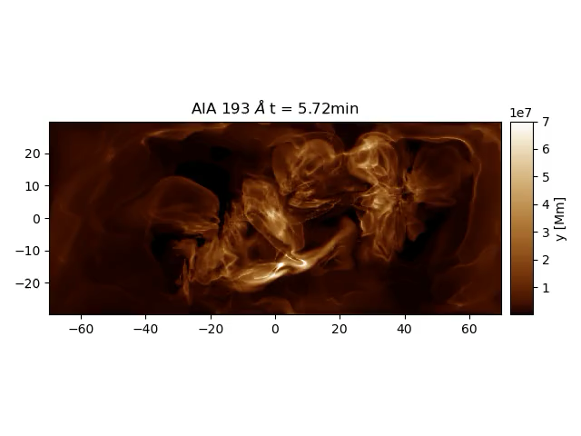
Conclusions & Perspectives
NFFF simulation in agreement with Prasad et al. 2023. Eruption seems to be trigger by the imbalance of the initial Lorentz force.
For the NLFFF extrapolation (null initial Lorentz force) the trigger could be related to the thermal imbalance that leads to magnetic reconfiguration
Adding the thermodynamic evolution may generates different conditions that induce the eruption and provides observables comparables with real data.
FoMo
Van Doorsselaere+ 2016
More EUV wavelengths and Soft-X ray emission
Include particles -> Hard-X ray emission
maria-valeria.sieyra@cea.fr
PNST2024
Notes:
For the NLFFF there is zero net lorentz force (initially) so the thermal imbalance leads to magnetic reconfiguration generating the lorentz force (maybe)

