Slide 1

Modeling Soft X-ray emissions at the dayside magnetopause
Qiuyu Xu PhD student
LATMOS/IPSL, Université Paris-Saclay
Supervisor：
Dimitra Koutroumpa
Ronan Modolo
Notes:
Hello everyone, my name is Qiuyu Xu. I am a PhD student at LATMOS. Today my topic is Modeling Soft X-ray emissions at the dayside magnetopause

Slide 2
CONTENTS
01
Introduction
02
Method
03
Results
04
Discussion

Slide 3
01
Introduction
Notes:
Firstly, the introduction part.

Slide 4
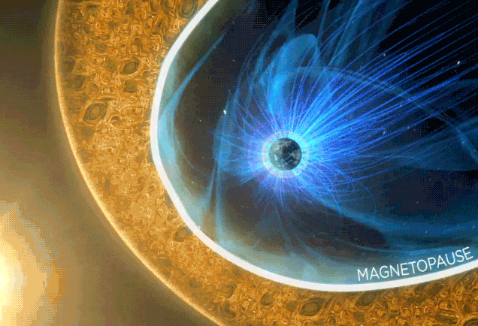
Introduction
Magnetopause：
Important region in SW-M-I system
· Boundary between magnetosphere and magnetosheath
· Separating plasma and magnetic field in solar wind and magnetosphere
· Channel for transferring energy, momentum and plasma from solar wind to magnetosphere
Notes:
In the solar wind-magnetosphere-ionosphere coupling system, there is an important boundary region – the magnetopause. Magnetopause is the boundary between magnetosphere and magnetosheath, which can separate plasma and magnetic field in solar wind and magnetosphere. Therefore, it is a channel for transferring energy, momentum and plasma from solar wind to the magnetosphere.

Slide 5
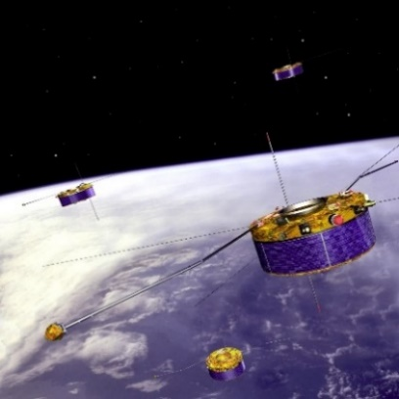
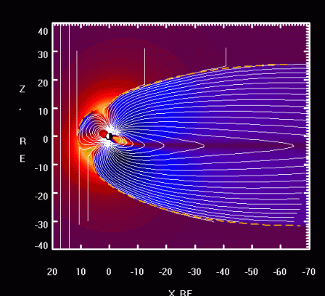
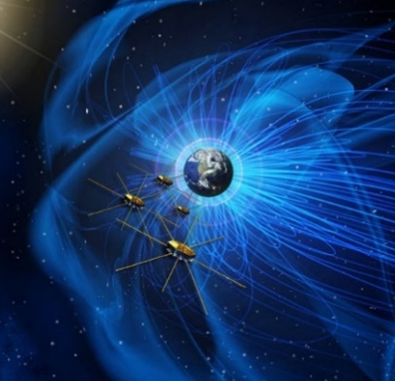
Introduction
In situ observation
Numerical simulation
Traditional method
Limitation
Difficult to obtain a real and global view of the motion of magnetopause
Notes:
The traditional methods of investigating the location of magnetopause are:
Firstly, in situ satellite observation, such as Cluster from ESA and MMS from NASA and so on.
Secondly, performing numerical simulations, such as the MHD models. But these methods all share a common limitation,
It is difficult to obtain a real and global view of the motion of magnetopause

Slide 6
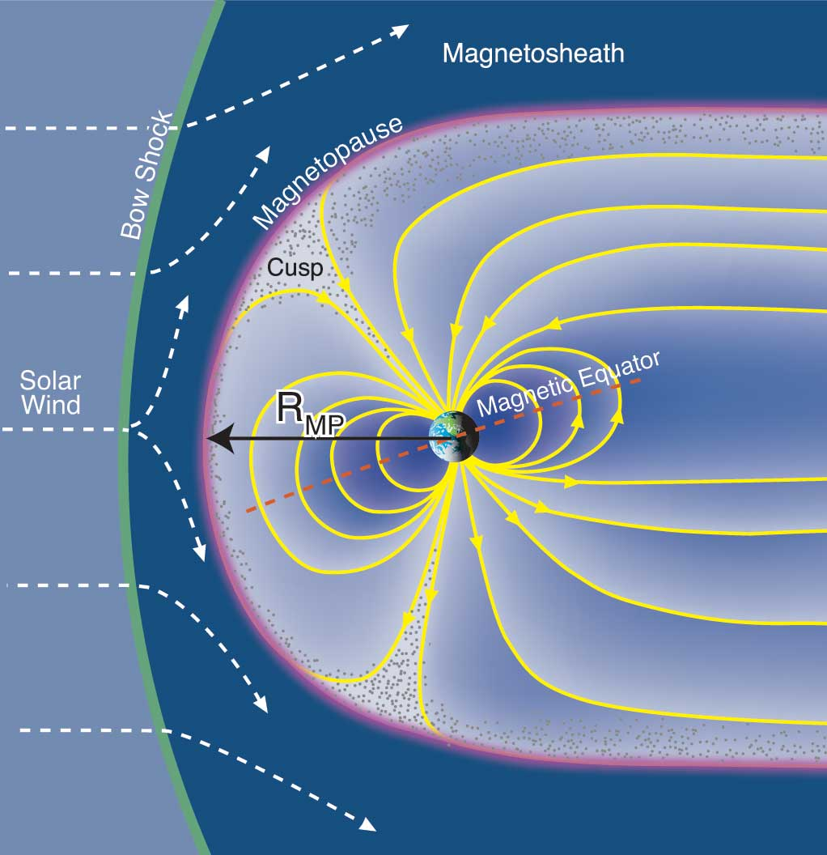
Introduction
X-ray imaging
At the magnetopause, X-ray emissions are generated by Solar Wind Charge Exchange (SWCX) between solar wind ions and the hydrogen geocorona.
SWCX X-ray emission
Heavy solar wind ions, X, in collision with neutral target atoms, H：
$$X^{q+}+H→X^{{\left(q−1\right)+}^{∗}}+H^{+}$$
$X^{{\left(q−1\right)+}^{∗}}→X^{(q−1)+}+hν$
Notes:
1:30 X-ray imaging is an appropriate technique to study the large-scale motion of magnetopause in response to solar wind variations.
Because at the magnetopause, X-ray emissions are generated by Solar Wind Charge Exchange (SWCX) between solar wind ions and the hydrogen geocorona.
Here is a brief introduction to the SWCX process:
When heavy solar wind ions, in collision with neutral target atoms, this process will emit X-ray.

Slide 7



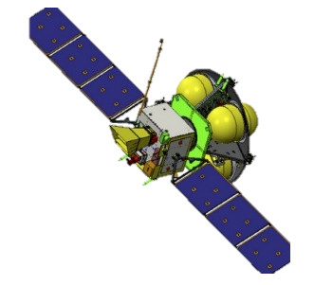
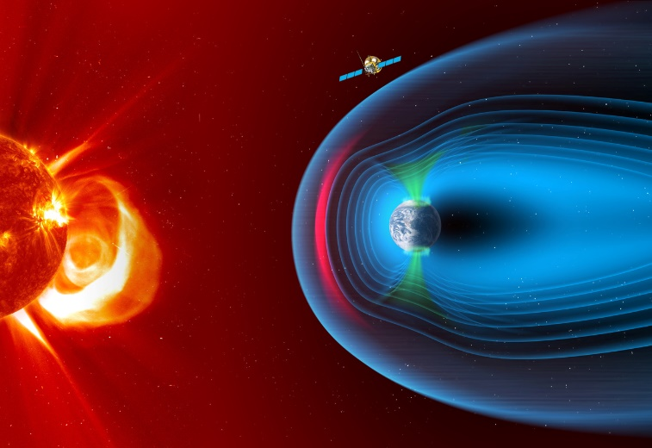
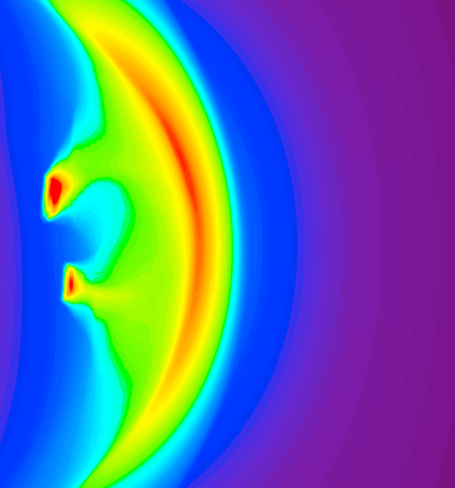
Introduction
Solar wind Magnetosphere Ionosphere Link Explorer
SMILE mission
Main Goal
Investigate the dynamic response of the magnetosphere to the solar wind impact in a unique and global manner
SXI (Soft X-ray Imager)
MAG (Magnetometer)
UVI (Ultraviolet Imager)
LIA (Light Ion Analyzer)
Notes:
2:15 To overcome the limitations of the traditional methods we mentioned before, here comes the SMILE mission
SMILE is a joint mission between the European Space Agency (ESA) and the Chinese Academy of Sciences (CAS), it is scheduled to launch in late 2024.
The main goal of the SMILE mission is to investigate the dynamic response of the Earth’s magnetosphere to the solar wind impact in a global manner through simultaneous X-ray and UV imaging and in situ plasma and magnetic field measurements.
And the SXI onboard SMILE (click) will spectrally map the location, shape, and motion of Earth's magnetospheric boundaries, including the bow shock, magnetopause, and cusps, by observing emission from the solar wind charge exchange process.

Slide 8
02
Method
Notes:
3:30 Then I will introduce the method we use.

Slide 9
Method
SWCX X-ray emission: MHD and TP models
Magnetohydrodynamics (MHD) | Test Particle (TP)
Single-fluid description | Collision probability
$$σ=constant$$ | $$σ=σ(V_{X^{q+}})$$
No separate ion calculations | $Q_{TP}^{ X^{q+}}∝$ $N_{X^{q+}}(t)(1 – e^{−σn_{H}V_{X^{q+}}△t})$
$Q_{MHD}$ = $αn_{H}n_{p}v_{p}$ | $Q_{TP}$ =$\sum_{X^{q},E}{Q_{TP}^{X^{q+}}}Y_{X^{q+},H}$(E)[$\frac{{Xq}^{+}}{p}$]
Self-computed E&B fields | Requires external E&B field input
TP model introduces kinetic effects
TP model can estimate whether the kinetic effects are detectable by SXI
Notes:
There are two kinds of model to simulate the SWCX X-ray emission: one is the Magnetohydrodynamics MHD model, another is the Test Particle, TP model.
This table shows the comparison between the MHD and the TP model.
Firstly, MHD model uses single-fluid description. TP model introduces kinetic effects due to the ion gyromotion, This will allow us to Estimate whether the kinetic effects are detectable by SXI

Slide 10
Method
SWCX X-ray emission: MHD and TP models
Magnetohydrodynamics (MHD) | Test Particle (TP)
Single-fluid description | Collision probability
$$σ=constant$$ | $$σ=σ(V_{X^{q+}})$$
No separate ion calculations | $Q_{TP}^{ X^{q+}}∝$ $N_{X^{q+}}(t)(1 – e^{−σn_{H}V_{X^{q+}}△t})$
$Q_{MHD}$ = $αn_{H}n_{p}v_{p}$ | $Q_{TP}$ =$\sum_{X^{q},E}{Q_{TP}^{X^{q+}}}Y_{X^{q+},H}$(E)[$\frac{{Xq}^{+}}{p}$]
Self-computed E&B fields | Requires external E&B field input
TP model can distinguish solar wind from magnetospheric plasma
MHD model cannot
TP model gives a clear view of the SWCX X-ray emission
Notes:
4:15 Secondly, the TP model has separate ion calculations. It can distinguish solar wind from magnetospheric plasma, while the MHD model cannot. These are the advantages of the TP model.

Slide 11
Method
SWCX X-ray emission: MHD and TP models
Magnetohydrodynamics (MHD) | Test Particle (TP)
Single-fluid description | Collision probability
$$σ=constant$$ | $$σ=σ(V_{X^{q+}})$$
No separate ion calculations | $Q_{TP}^{ X^{q+}}∝$ $N_{X^{q+}}(t)(1 – e^{−σn_{H}V_{X^{q+}}△t})$
$Q_{MHD}$ = $αn_{H}n_{p}v_{p}$ | $Q_{TP}$ =$\sum_{X^{q},E}{Q_{TP}^{X^{q+}}}Y_{X^{q+},H}$(E)[$\frac{{Xq}^{+}}{p}$]
Self-computed E&B fields | Requires external E&B field input
TP model cannot self-compute E&B field
MHD model can
TP –– a complementary approach to calculate the SWCX emission
Notes:
4:30 However, TP model just simulate the behavior of the particles in a given E and B field, it requires external E&B field input. This is exactly what MHD model can provide.
We use MHD model to provide the E and B field that TP model needs. Therefore, TP model is a complementary approach to calculate the SWCX emission.

Slide 12
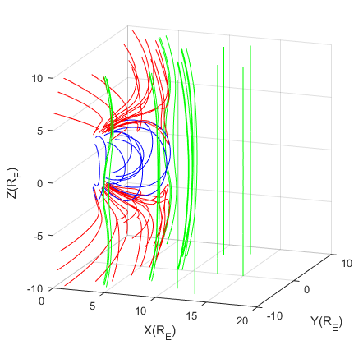
Method
Solar wind conditions
MHD model
Electric field Magnetic field
MHD/TP simulation library
TP model
Highly valuable for SMILE team, and users of other X-ray observatories
Notes:
5:00 Here is the general workflow of this project.
First, use different solar wind conditions as the input of the MHD model.
Then obtain the Electric field and magnetic field data from the MHD model.
And use them as the input of the TP model to get the simulation results of TP model,
And finally build a MHD/TP Simulation library for various solar wind conditions
It is highly valuable for the SMILE team, as well as users of other X-ray observatories

Slide 13
03
Results
Notes:
5:50 Then I will present the results we have

Slide 14
Results
MHD model
Open Geospace General Circulation Model (Open GGCM)
  Raeder et al., 1999
Piecewise Parabolic Method with LagRangian remap (PPMLR)
  Hu et al., 2007
Solar wind conditions
Model | Vx (km/s) | Bz (nT) | N (${cm}^{−3}$)
PPMLR | 400 | -5 | 12.5
Open GGCM
Notes:
As I mentioned, we use E and B field data from MHD model as the input of TP model.
Actually, two different MHD models are adapted here:
One is the PPMLR model and another is the Open GGCM model.
We use these models to calculate electric and magnetic field under this given solar wind conditions:
Vx is 400, Bz is -5 and N is 12.5

Slide 15
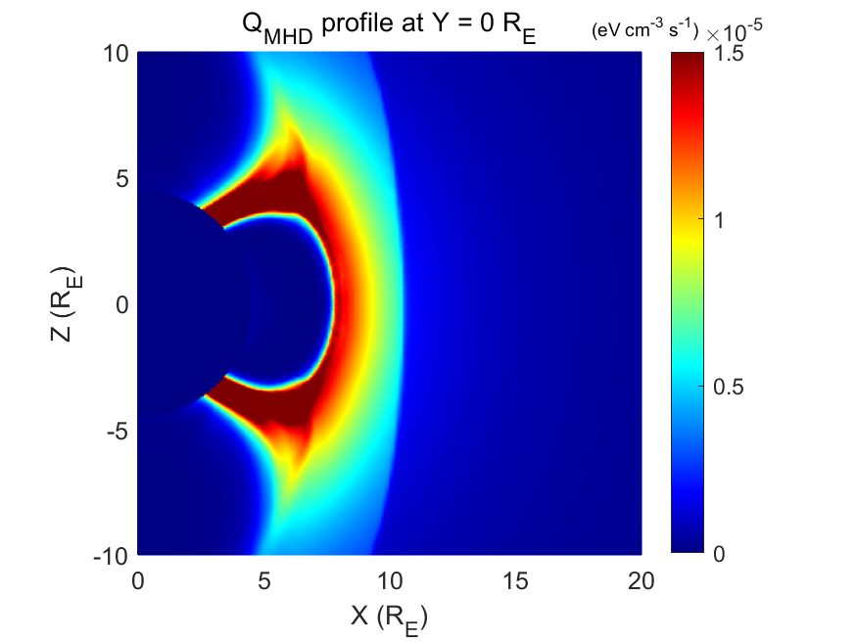
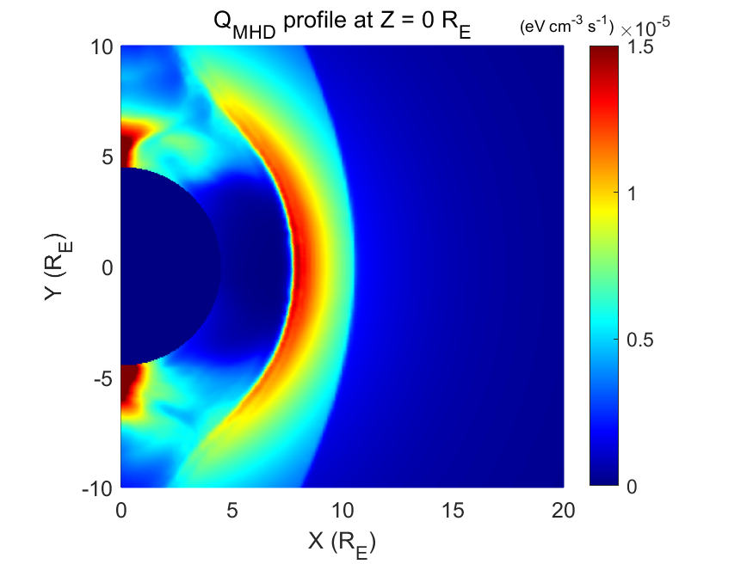
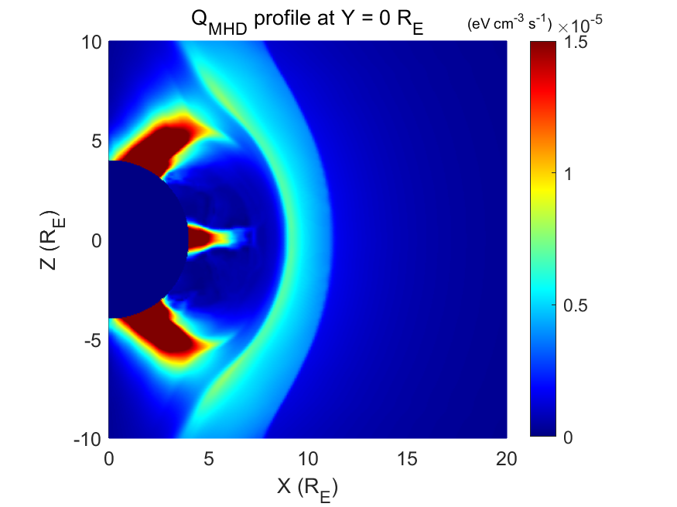
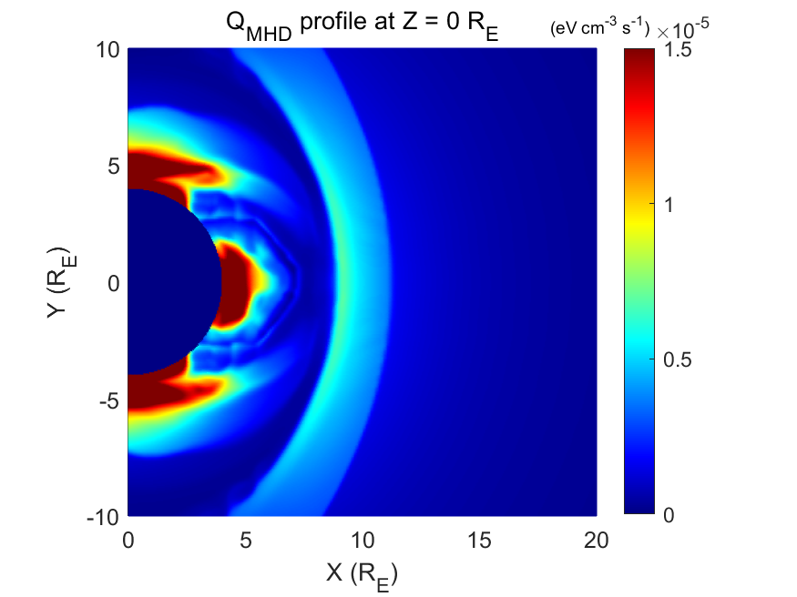
Results
Pure MHD approach
Pure Open GGCM
Pure PPMLR
$Q_{MHD}$ = $αn_{H}n_{p}v_{p}$
α is a combined coefficient contains the information about all the heavy SW ions that contribute to the Soft X-ray emission.
Notes:
6:40 We can only use MHD model to calculate the X-ray emissivity according to this equation. Here α is a constant that contains the information about all the heavy SW ions that contribute to the Soft X-ray emission. Here are the results of the X-ray emissivity in the equatorial plane and meridional plane from pure Open GGCM and pure PPMLR approach.

Slide 16
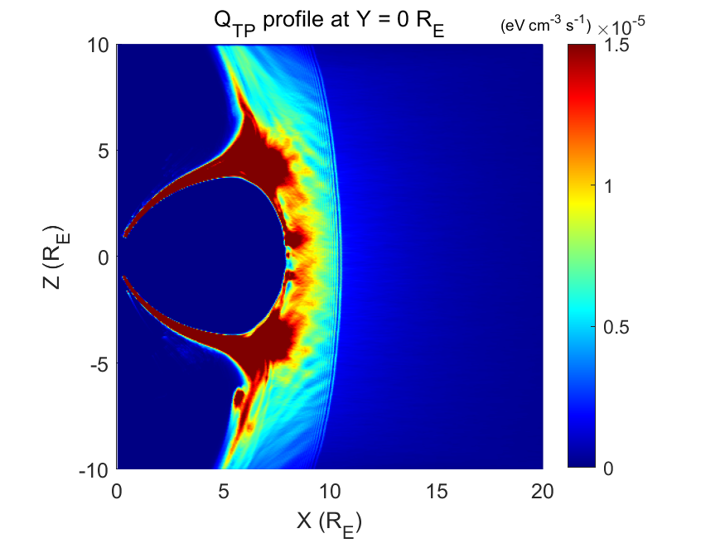
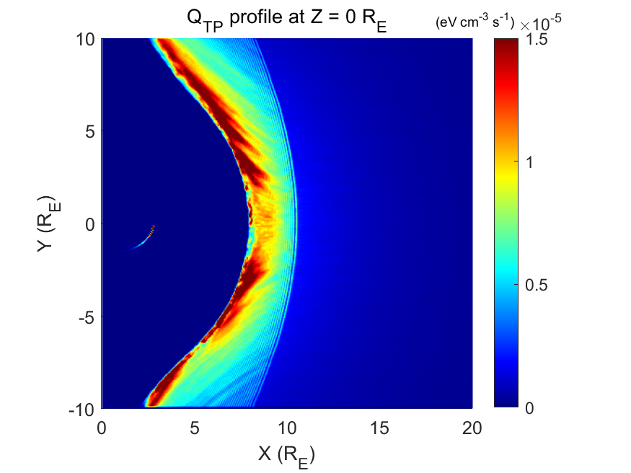
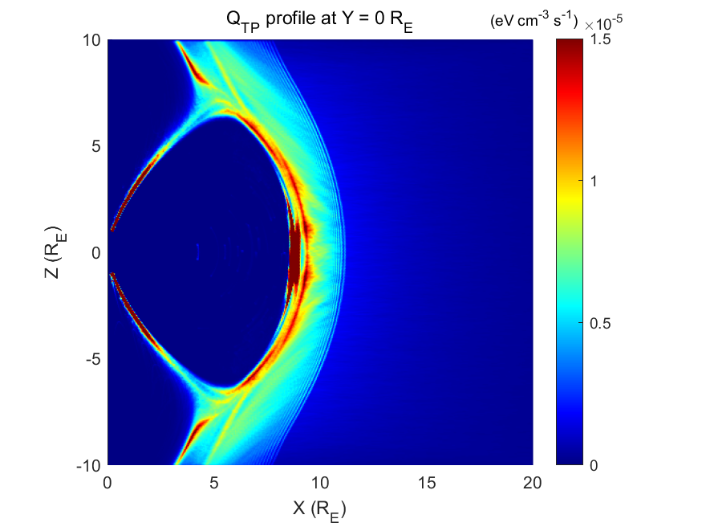
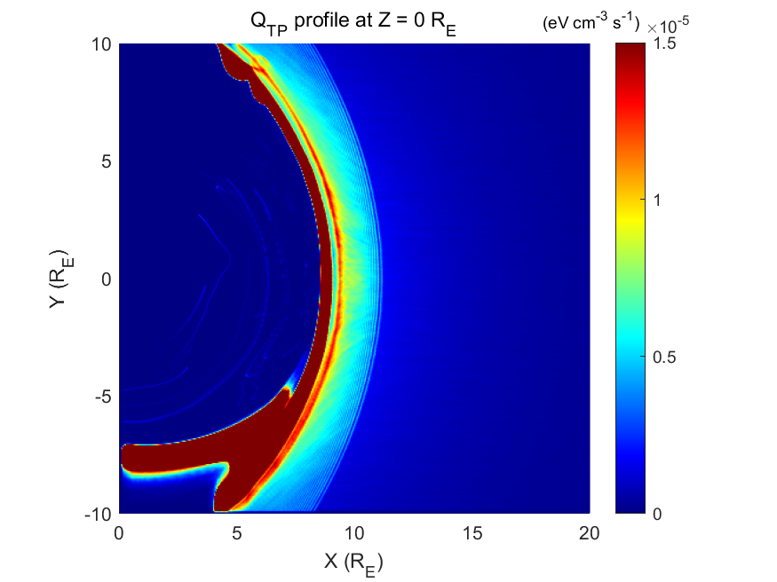
Results
TP-MHD approach
TP-Open GGCM
TP-PPMLR
With the same initial solar wind conditions, there are still some difference between TP-Open GGCM and TP-PPMLR approaches.
Notes:
7:15 Here are the results of the X-ray emission simulated from TP-MHD approaches in the equatorial plane and meridional plane . The left figures are TP-Open GGCM results. The right ones are TP-PPMLR results.
Even with the same initial solar wind conditions, there are still some difference between TP-Open GGCM and TP-PPMLR approaches. Such as the cusp region and magnetosheath.

Slide 17
Results
Pure Open GGCM
Pure PPMLR
TP-Open GGCM
TP-PPMLR
Notes:
8:00 According to these comparison, we can see that there are some differences between the TP approach and MHD approach, also between Open GGCM and PPMLR.

Slide 18




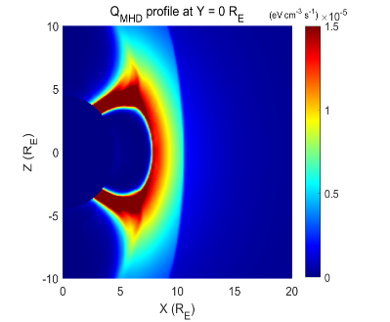
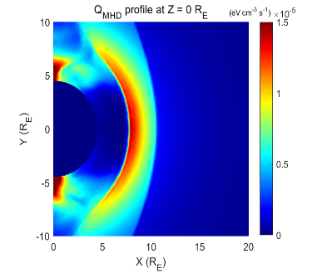

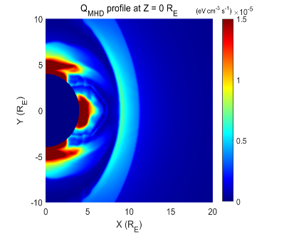
Conclusion
TP-Open GGCM
TP-PPMLR
Pure Open GGCM
Pure PPMLR
TP approach introduces kinetic effects due to the ion gyromotion. This will allow us to estimate if these effects are detectable by SXI.
TP approach allows a clean view of the emission, since TP model can distinguish solar wind from magnetospheric plasma.
This project combines the advantages of both TP and MHD models and can help on the interpretation of SMILE observations
Notes:
In summary,
First, the TP approach introduces kinetic effects due to the ion gyromotion. This will allow us to estimate whether these effects are detectable by SXI and define the science requirements accordingly.
Also, the MHD approach is based on single-fluid simulations that cannot distinguish solar wind from magnetospheric plasma, therefore some inner regions of the simulated magnetosphere have to be artificially masked in order to reveal the magnetosheath SWCX emission. The TP approach allows a clean view of this emission, since the SW ions are treated as particles and there can be no confusion with magnetospheric ions.
This project combines the advantages of both TP and MHD models and can help on the interpretation of SMILE observations

Slide 19
04
Discussion
Notes:
9:35 Finally, the discussion.

Slide 20
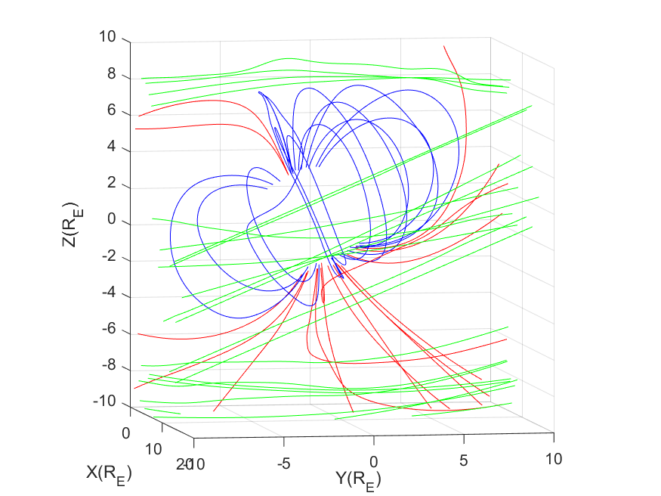
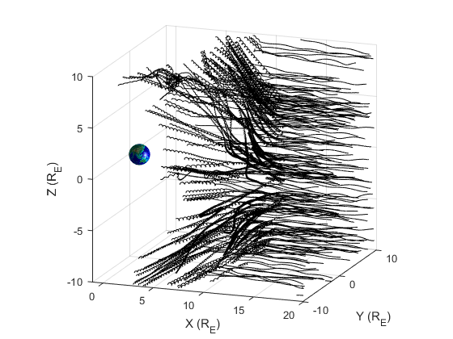
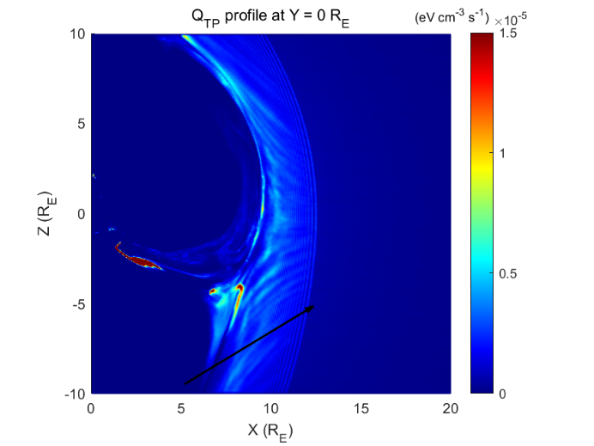
Perspective
Stable B&E field
Particle motion
Emission
TP model simulates the motion of particles under given B&E field, which means it pre-assumes that the magnetosphere is in a steady state.
Notes:
10:05 As I mentioned before, the TP model uses the given B&E field to simulate the motion of particles then generate the emission map. Apparently, the TP model pre-assumes that the magnetosphere is in a steady state. And it can only apply to the steady state magnetosphere.

Slide 21
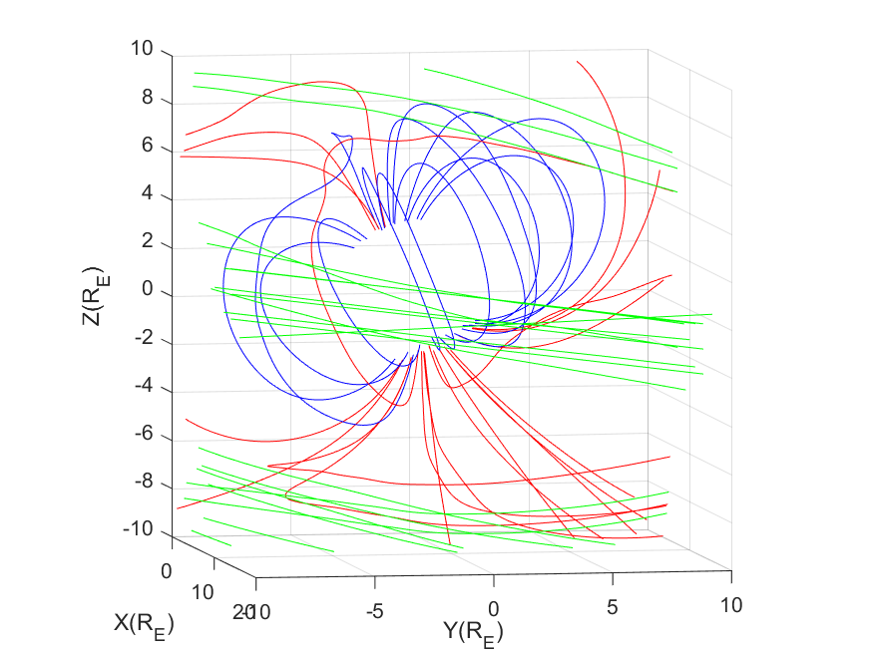
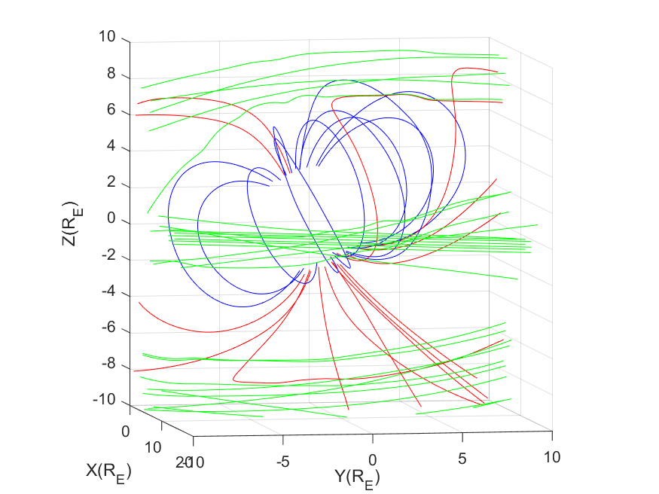
Perspective
Solar wind 1
Solar wind 2
Solar wind 3
changing
changing
Typical time of life of particles: ~8 min
Improve TP model to apply to the time-varying magnetosphere
Notes:
However, the magnetosphere is not always in a steady state in reality. The solar wind conditions is dynamic and can change rapidly. The typical time of life of particles is 8 min, which means the magnetic and electric field may change considerably during this period when the particles are still moving in the simulation box. Therefore, our next step is to improve the TP model so that it can be applied to time-varying magnetosphere and solar wind conditions.

Slide 22
Thank You!
Notes:
11:15 Thank you for your attention. That is the end of my talk.

Slide 23
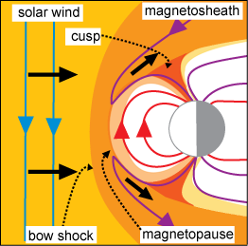
Introduction
Position of Magnetopause
Pressure balance between the magnetosphere and magnetosheath：
Notes:
01:30 并且磁层顶位形的预报也是空间环境预报的重要组成部分。磁层顶位置主要由两侧的压强平衡决定。
即磁鞘中的热压动压和磁压=磁层中的热压动压和磁压。(点)不过主要是磁鞘中的动压与磁层中的磁压相平衡，其他量影响比较小。00:25

