Slide 1
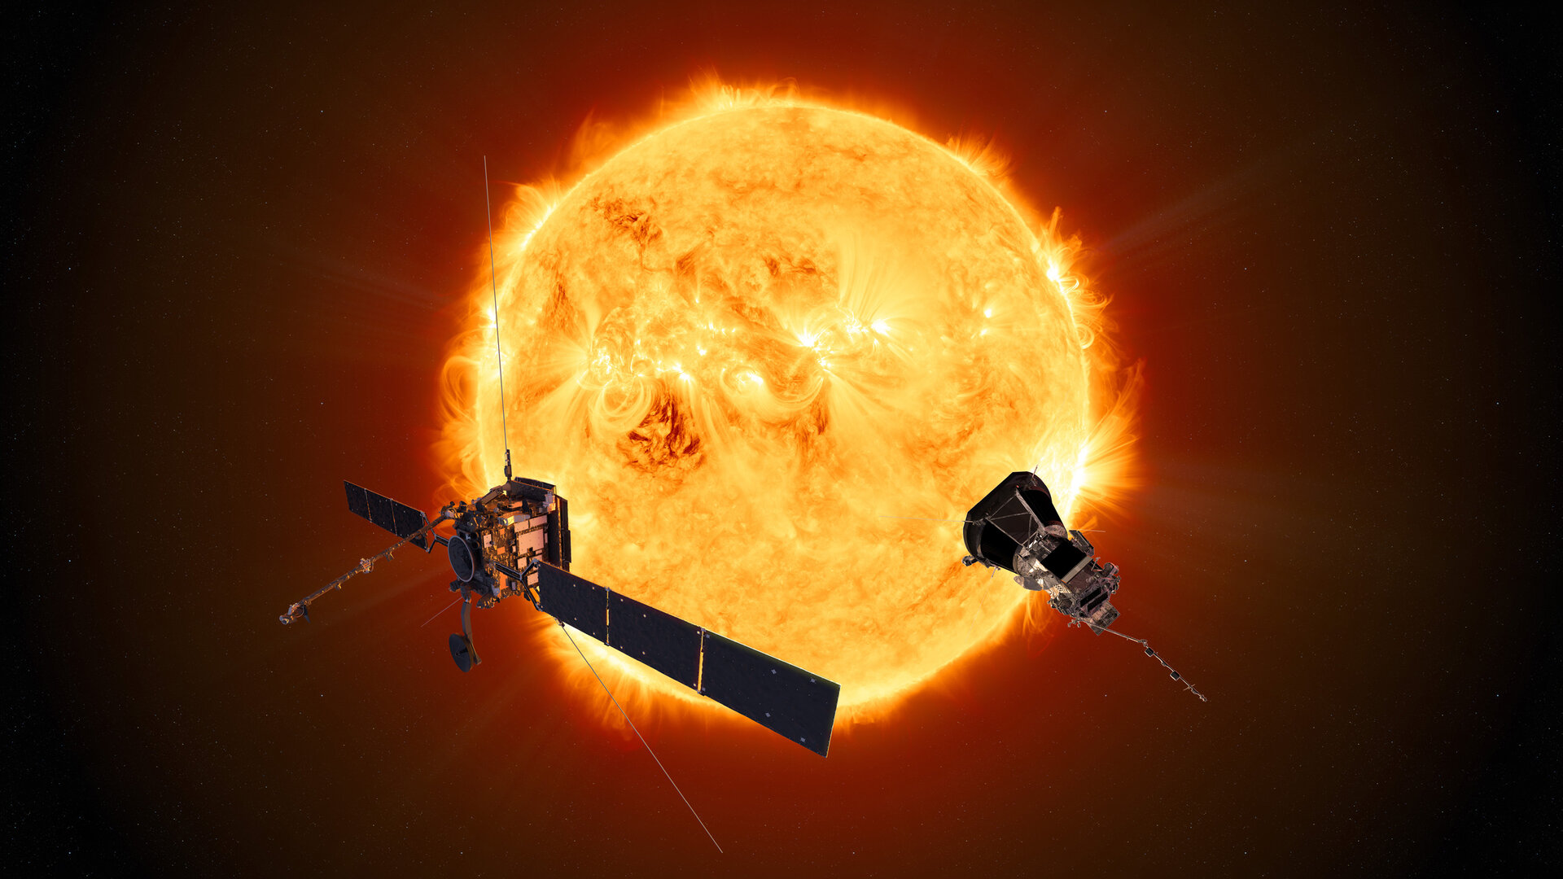






PNST 2024
Statistical Analysis of the Solar Winds Radial Evolution between 0.1 and 1 au, and their Semi-empirical Iso-poly Fluid Modeling
J-B DAKEYO, Milan MAKSIMOVIC, Pascal DEMOULIN, Alexis ROUILLARD, Paul LOMAZZI, Jasper HALEKAS, Michael STEVENS, Philippe LOUARN

Slide 2
Context and Objectives :
Better understand solar wind acceleration mechanisms :
In-situ observations (speed, density, temperature) → infer wind properties
Modeling contraints by observations → establish energy balance for the heating of the wind depending its final speed

Slide 3
In-situ Observations and Wind classification

Slide 4
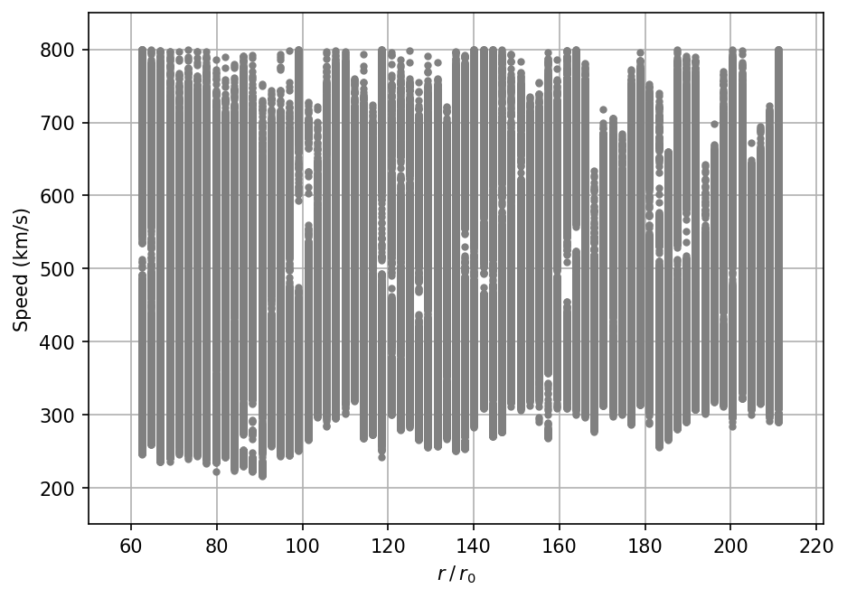
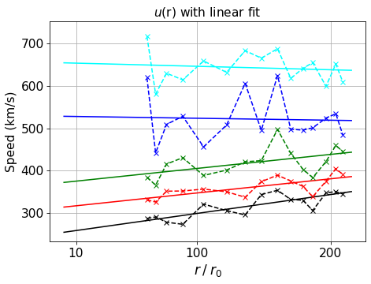
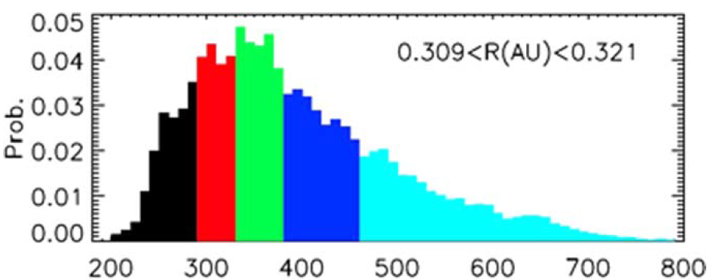
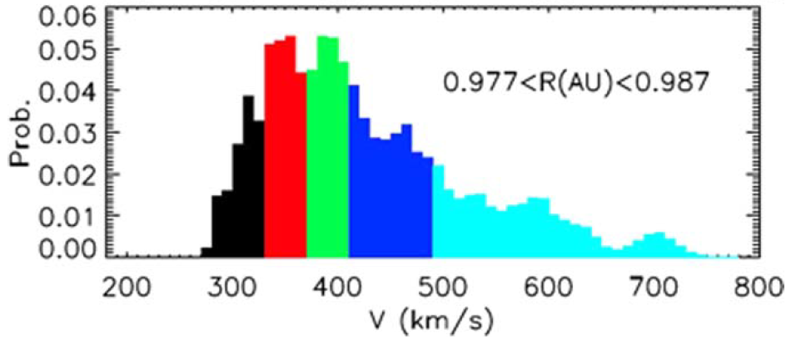
The faster the wind is, the smaller is the acceleration
E
D
Full speed coverage at all distances
→ Statiscial analysis
C
B
A
Helios data (minimal solar activity)
ẟr1
ẟrN
Bulk speed distribution
B
C
Keep the median
of each quantile
B
C
A
D
Maksimovic et al. 2020
....
D
A
A
E
Analyse all the radial boxes
E
Classify wind by bulk speed using quantiles in 5 populations

Slide 5

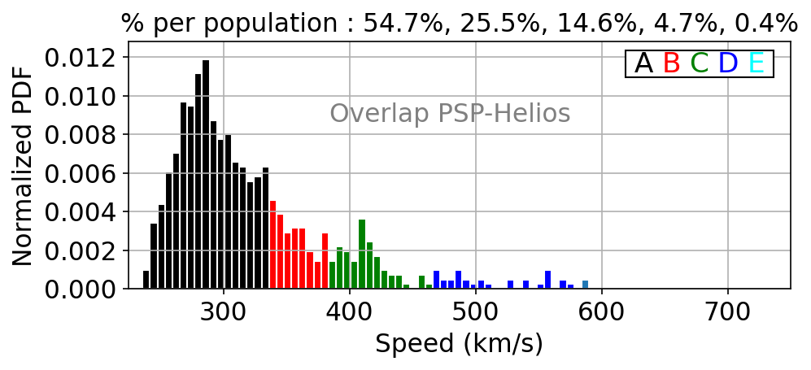
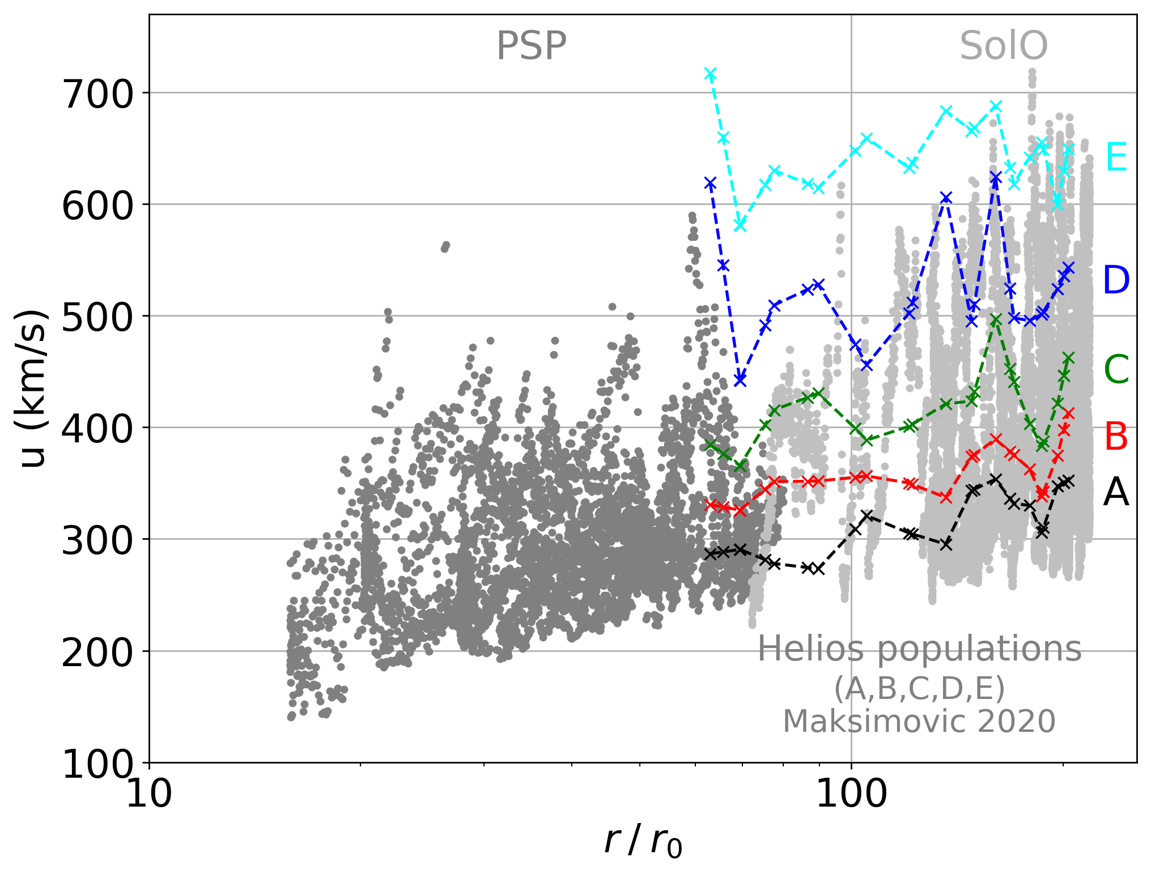
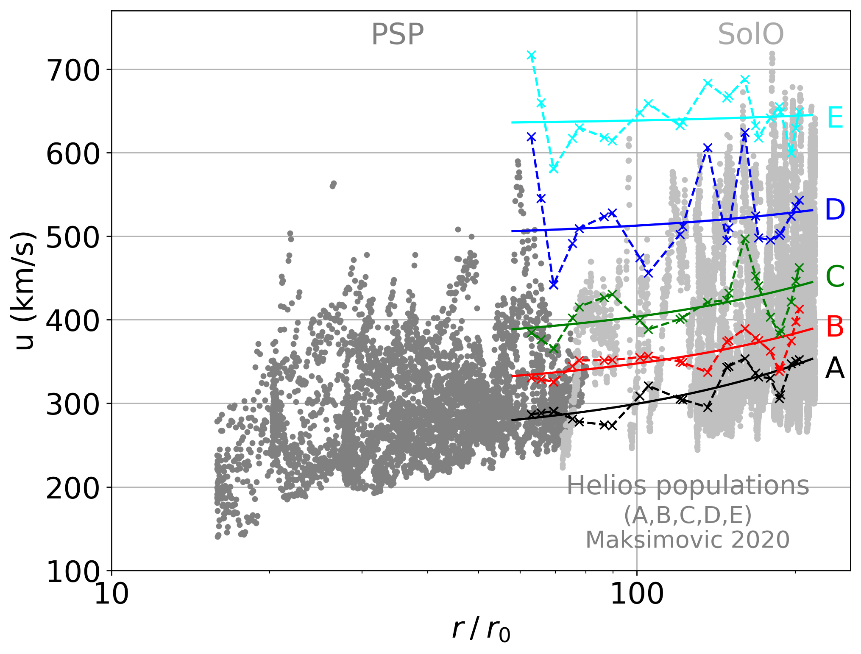
Statistical classification of the PSP and SolO data, based on the Helios 5 winds populations
Bulk speed coverage at each distance is not optimal
Use overlap percentage to classify instead of the 20% quantiles percentage

Slide 6
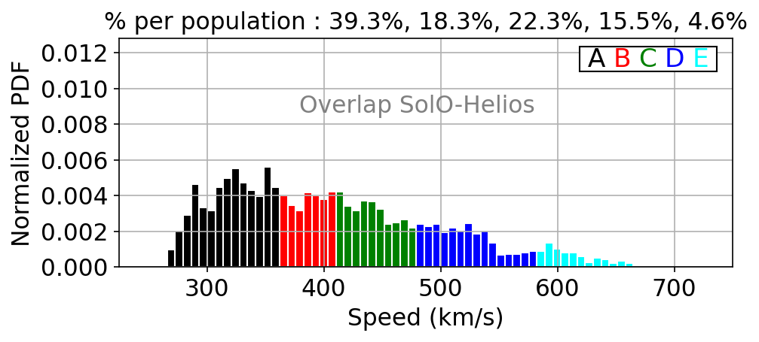
Statistical classification of the PSP and SolO data, based on the Helios 5 winds populations

Slide 7
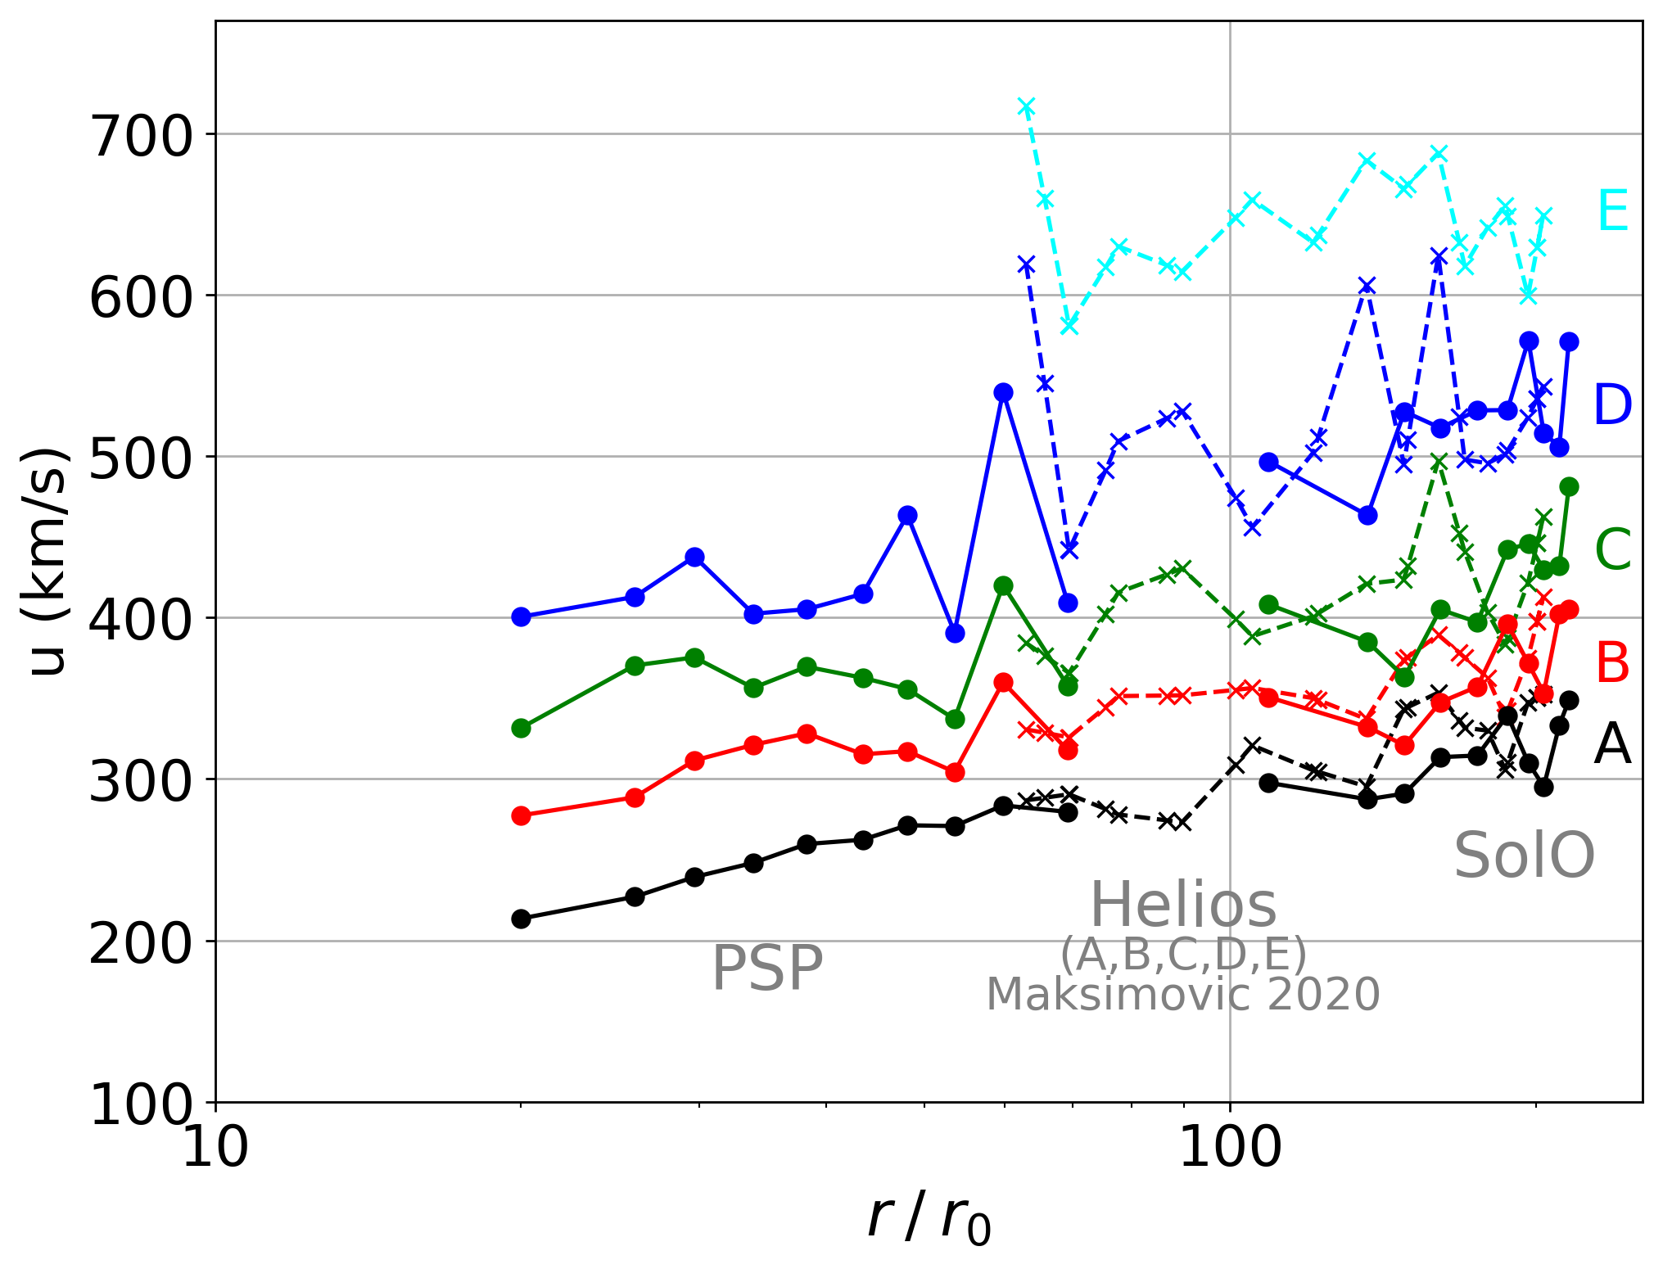
Statistical classification of the PSP and SolO data, based on the Helios 5 winds populations
It looks well but we have classified in speed, so it’s normal right ?
→ YES
Dakeyo et al. 2022

Slide 8
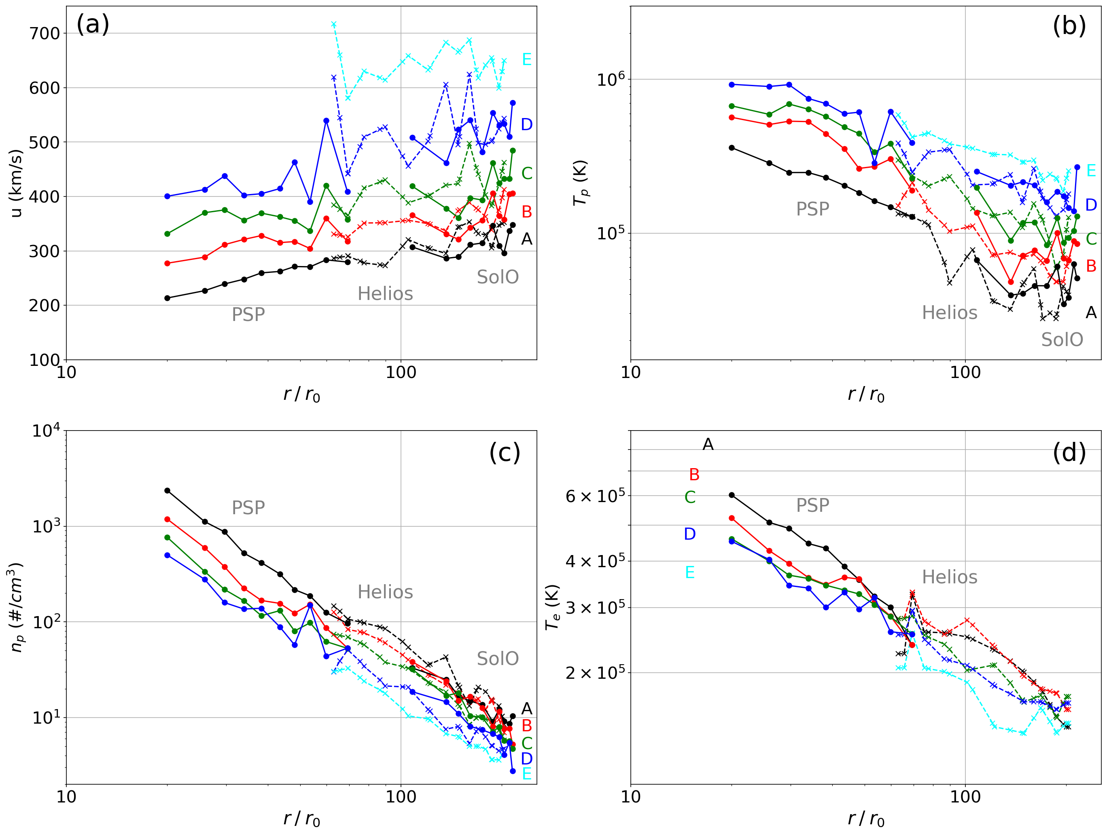
Tp and np :
All the populations respect the expected correlation for solar wind while a classification on wind speed (Maksimovic 2020)
Te :
The range variation is similar for all the populations
Te correlated with u at 200 Rs, while anti-correlated at 20 Rs.
u(r) :
Slow solar wind from gain 150km/s between 20 and 215 Rs
Fast wind is not well observed close to the Sun for PSP

Slide 9
Wind Modeling with Observational constraints

Slide 10
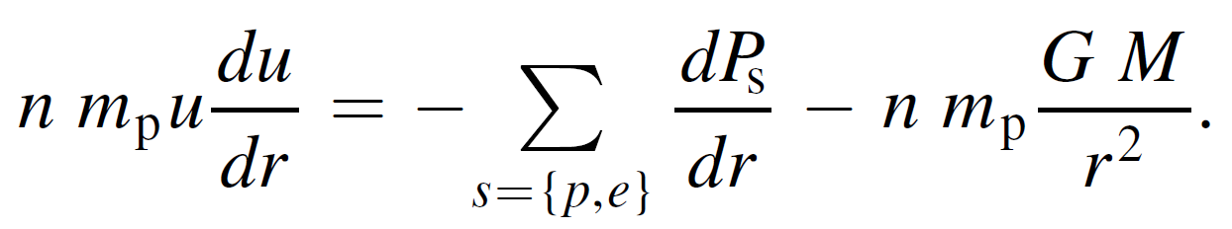
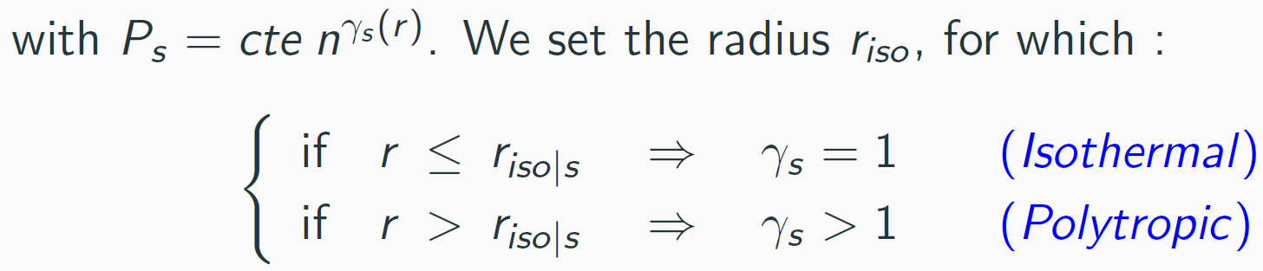
Solar wind modeling : Parker’s equations
Inertia
Thermal Pressure
Gravity
Determined from T - n power law
→ Parker’s like solutions : ’’Iso-poly ’’ solutions

Slide 11
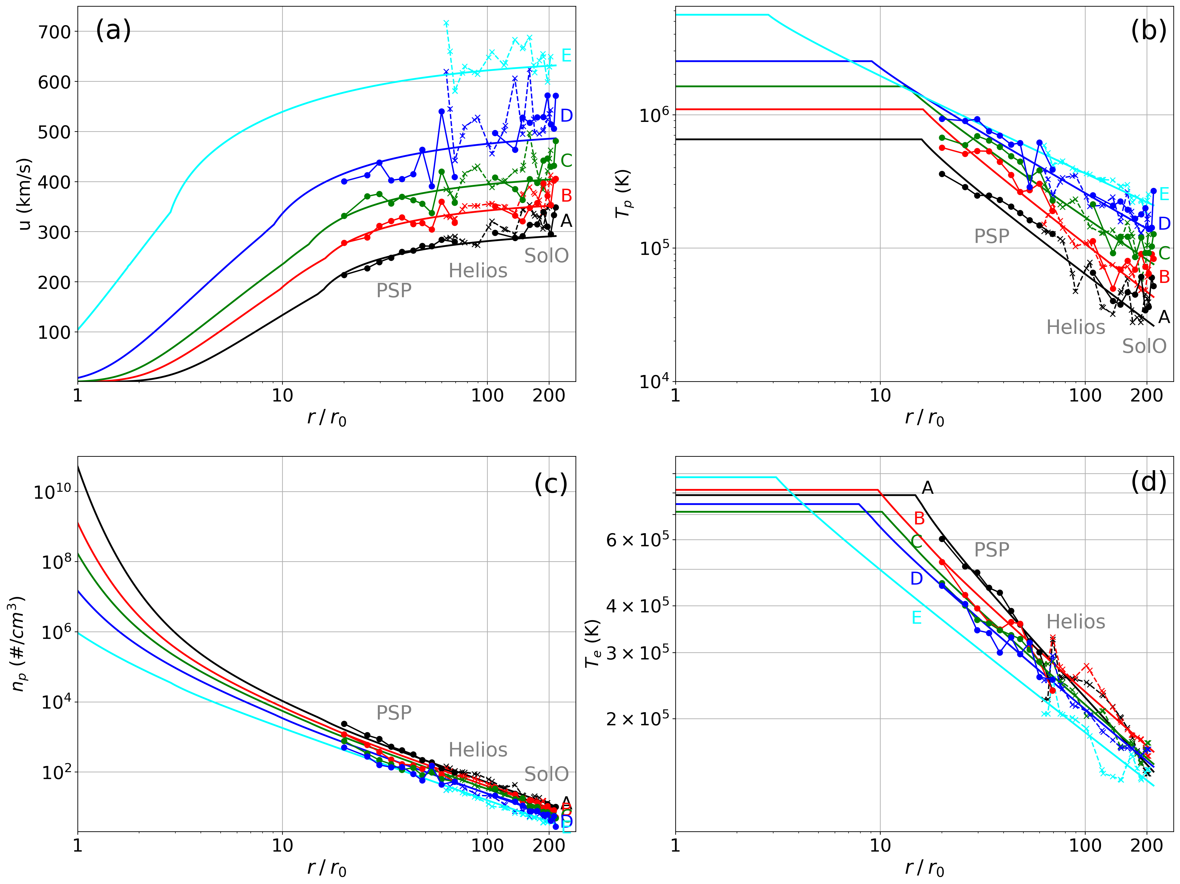

Best iso-poly fit to Helios, PSP and SolO observations
u(r) :
Very slow wind : large distance acceleration not reproduced
Tp :
Fast wind : too large $T_{p0}$ in the corona compared to spectroscopy observations
Te :
No clear anti-correlation of $T_{e0}$ compared to state charge ratio prediction

Slide 12
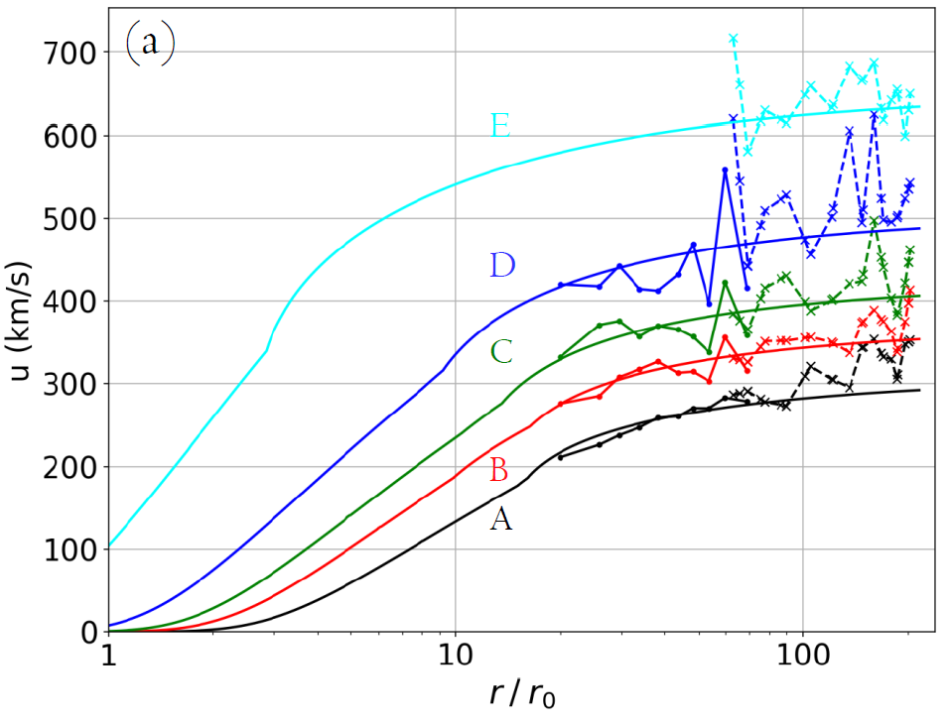
Great modeling of the global behavior
Summarized in Dakeyo et al. 2022
What about solar wind heating ?

Slide 13
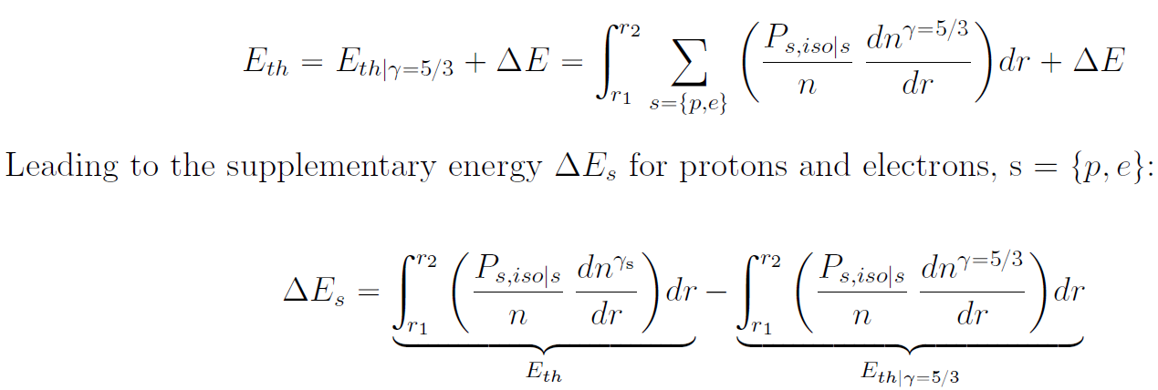
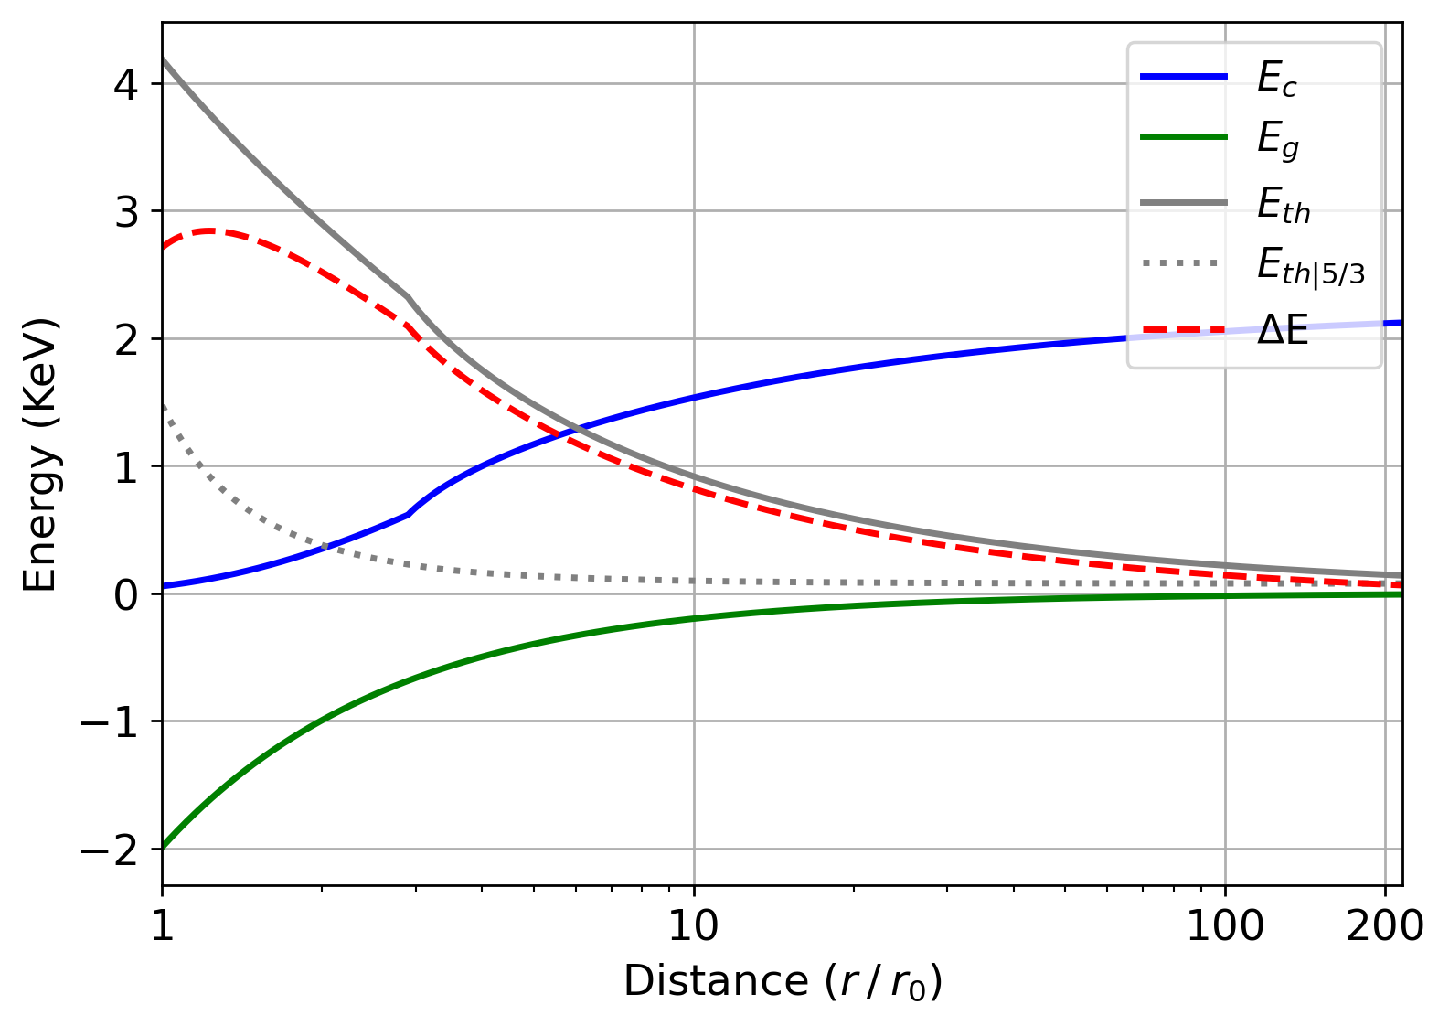
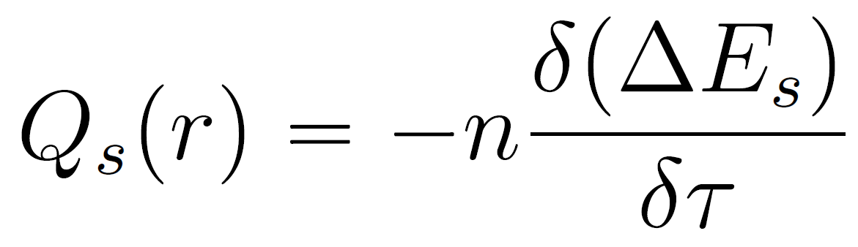

We can estimate heating retrieving to the thermal energy ($γ=γ_{obs})$, the one from a theroretical adiabatic expansion ($γ=5/3)$
Extra thermal energy
Heating is directly expressed from extra thermal energy

Slide 14
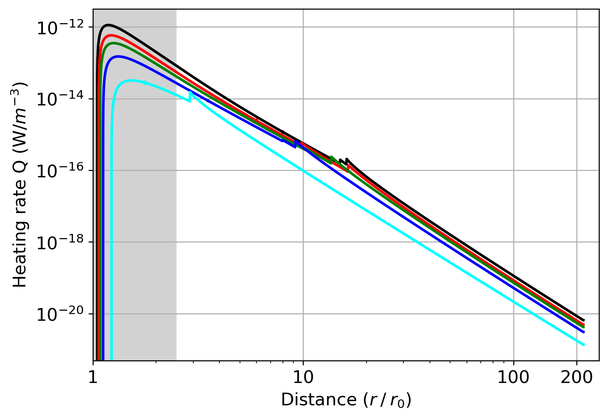
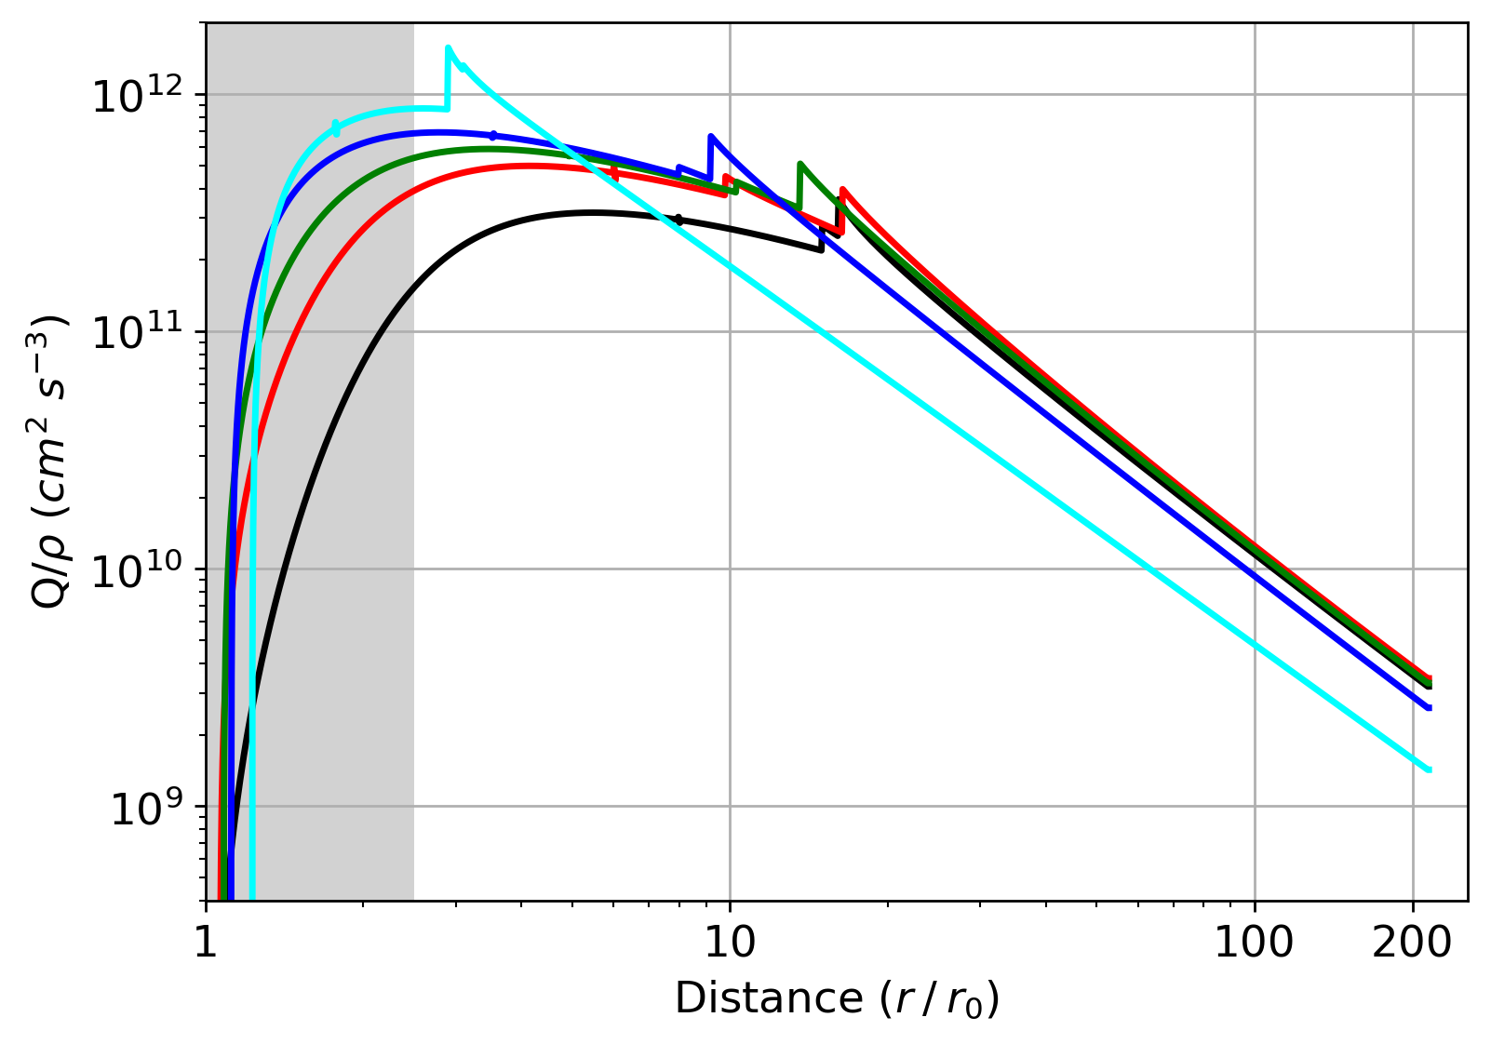
Heating per particule:
below 10 Rs , correlated to 1au speed
the slower the wind, the more heating is spread over large radial distance
Heating rate magnitude :
inversely correlated to 1au speed
A (<350 km/s)
B (400 km/s)
C (450 km/s)
D (550 km/s)
E (>600 km/s)

Slide 15
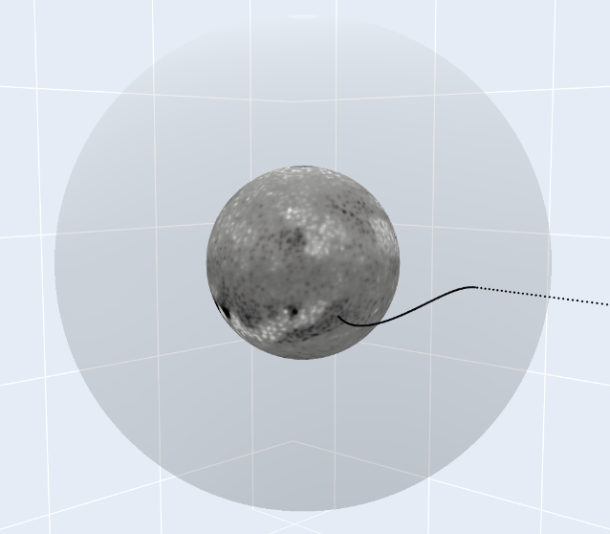
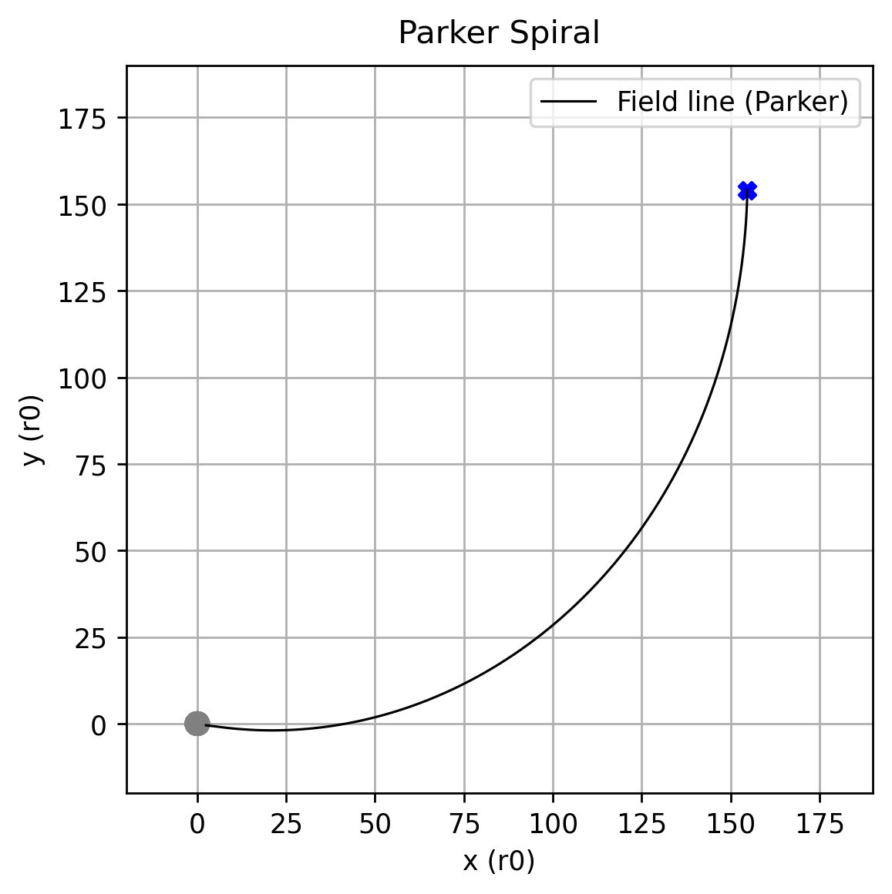



Perspective : Statistical correlations In-situ – Wind source
Magnetic Connectivity on Solar Orbiter and PSP
$$r_{ss}$$
Solar Orbiter
Parker Spiral
($B_{r}$ in-situ)
PFSS
reconstruction
($B_{r}$magnetogram)

