Slide 1
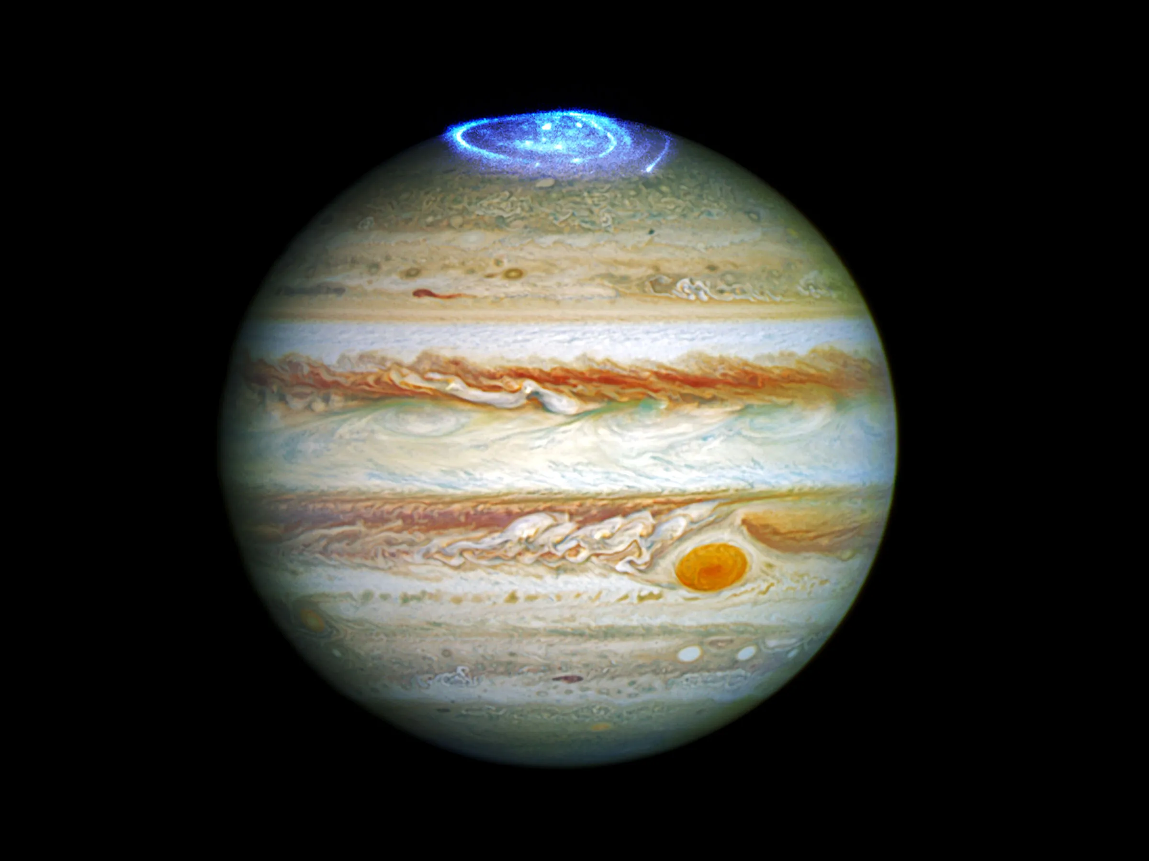
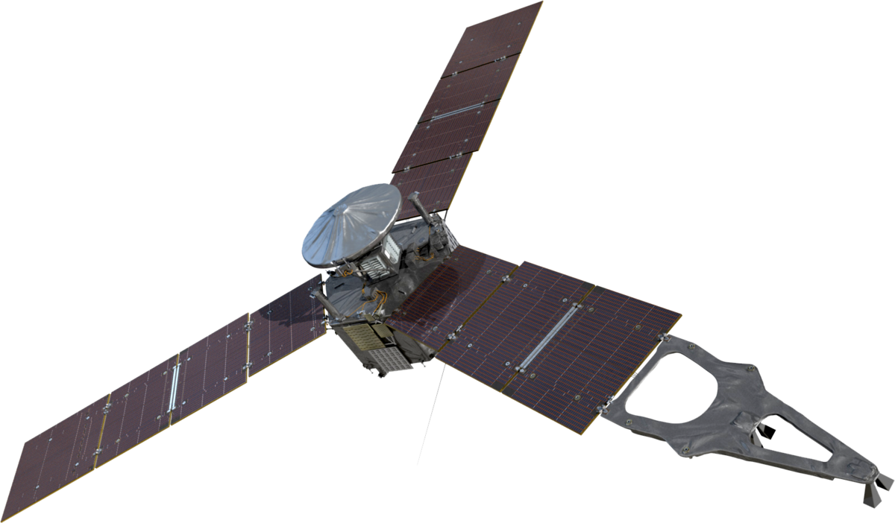
Energy mapping of the Jupiter's auroral electrons from the Juno/UVS data with a new H₂ UV emission model
Bilal Benmahi et al.
LPAP, Université de Liège
bilal.benmahi@uliege.be
Notes:
Hello everyone, I'm Bilal Benmahi, and I'm currently a Postdoctoral Fellow at the University of Liège, Im working to study the interaction of the magnetosphere with the lower atmosphere in the polar zones of Jupiter. Today I'm going to talk you about a study which concerns the mapping of the characteristic energy of electrons precipitating in auroral regions, using the CR observed by UVS.

Slide 2
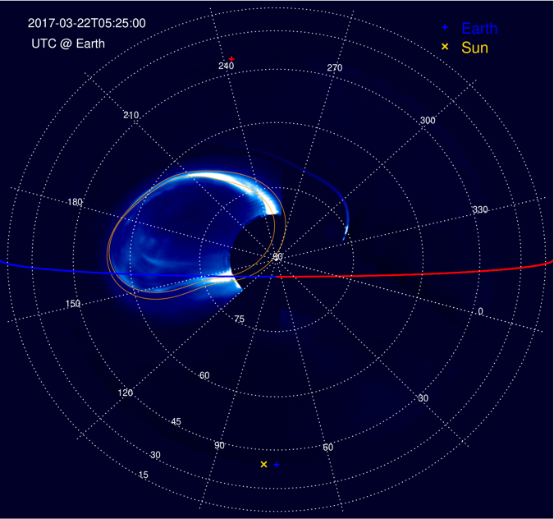
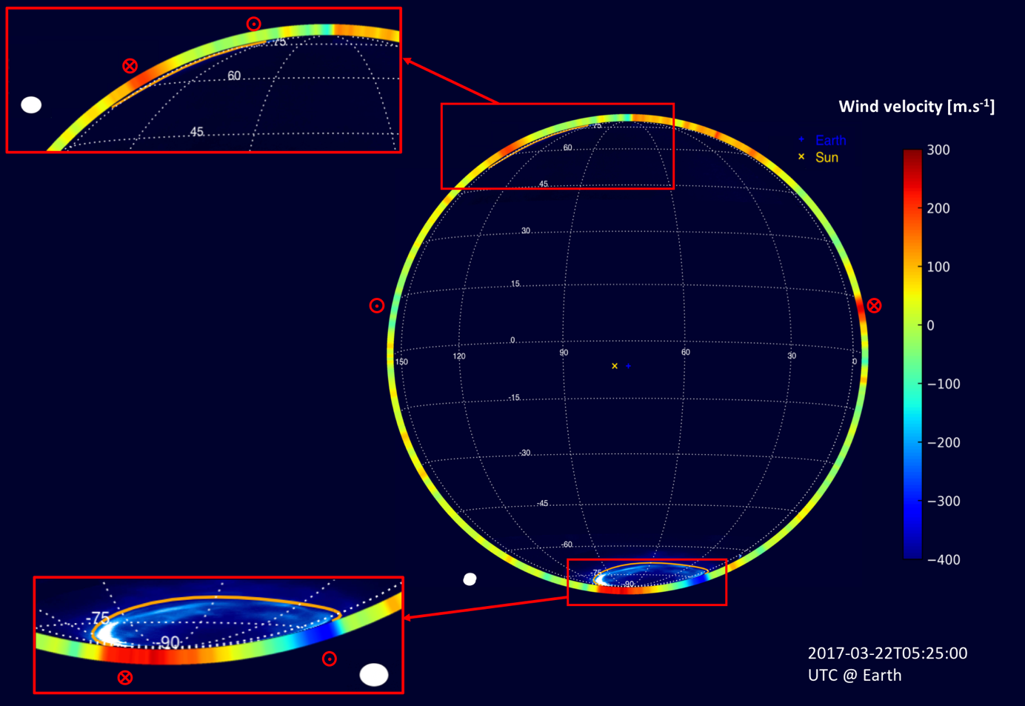
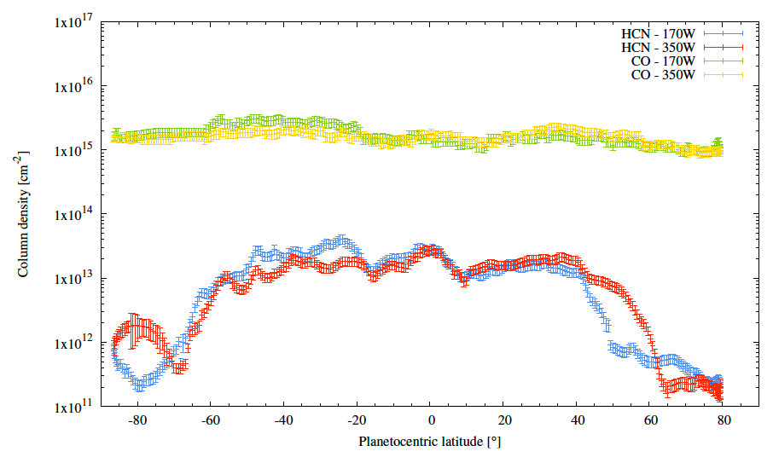
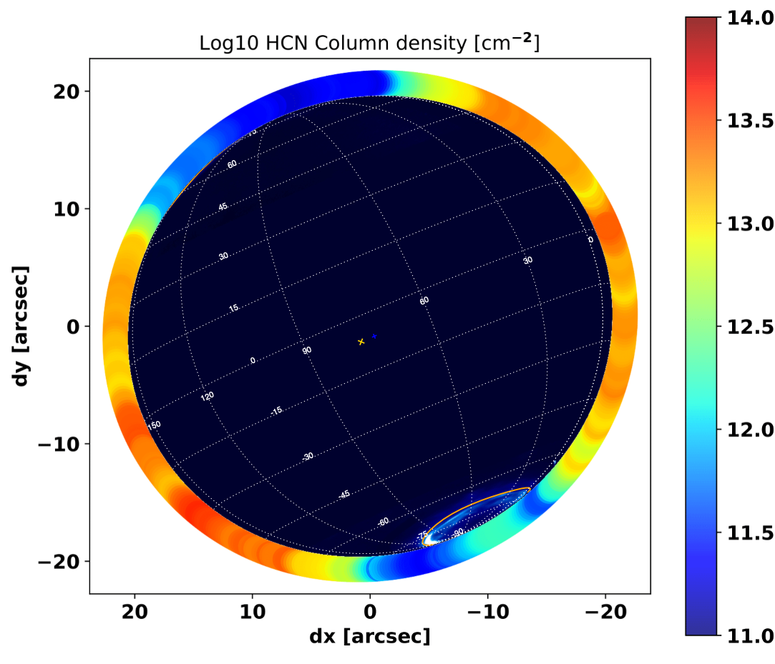
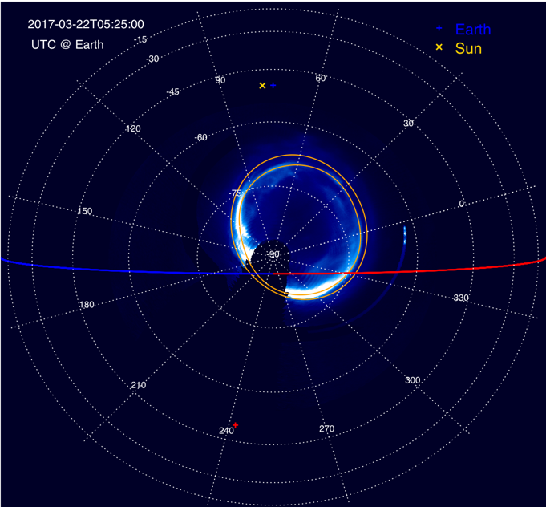
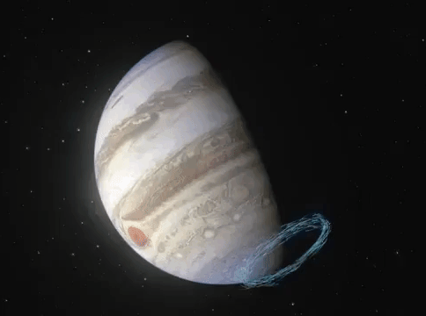
Introduction
The first measurements of the Jovian stratospheric auroral jets by ALMA
T. Cavalié, B. Benmahi et al. (2021)
Evidence for auroral influence on Jupiter’s nitrogen and oxygen chemistry revealed by ALMA
Cavalié et al. (2023)
The north and south polar jets that we discovered in the stratosphere are located under the north and south auroral ovals respectively.
B. Benmahi et al.
Tuesday, January 9th, 2024
Notes:
Recently, we discovered that Jupiter's polar regions host dynamics and chemistry phenomena that are particularly intriguing, as shown in these two figures.
On the left, these are the first measurements of winds correlated with Jupiter's main auroral oval, and on the right, thanks to the same observation, we have observed evidence of the influence of auroral precipitation on the chemical composition in Jupiter's auroral regions.
In order to investigate this discovery more deeply in our future modelling, we need to better characterize the electrons that precipitate in the auroral regions.

Slide 3
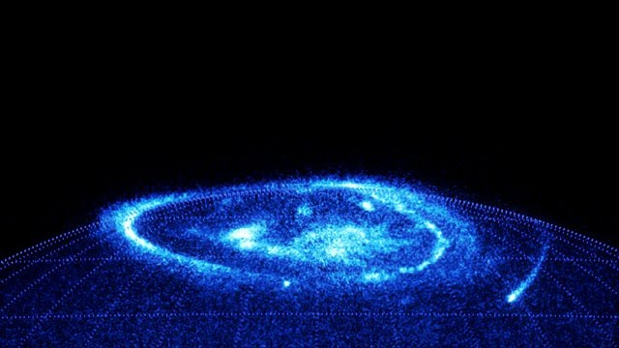
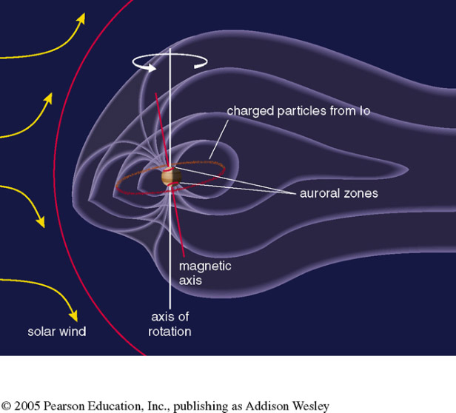
Introduction
$$e^{−}$$
$$e^{−}$$
$$e^{−}$$
$$e^{−}$$
$$e^{−}$$
$$e^{−}$$
$$e^{−}$$
$$e^{−}$$
$$e^{−}$$
$$e^{−}$$
$$e^{−}$$
$$e^{−}$$
$$e^{−}$$
$$e^{−}$$
$$e^{−}$$
$$e^{−}$$
The electrons undergo complex processes, such as acceleration by inertial Alfvén waves as well as whistler waves and ion and electron inverted-V structures
$$e^{−}$$
$$e^{−}$$
$$e^{−}$$
$$e^{−}$$
$$e^{−}$$
$$e^{−}$$
$$e^{−}$$
$$e^{−}$$
$$e^{−}$$
$$e^{−}$$
$$e^{−}$$
$$e^{−}$$
$$e^{−}$$
$$e^{−}$$
$$e^{−}$$
$$e^{−}$$
B. Benmahi et al.
Tuesday, January 9th, 2024
Notes:
We know that (1) Jupiter has a very intense magnetic field. It therefore has the largest magnetosphere in the solar system, extending as far as Saturn's orbit.
This magnetosphere is composed by plasma (an ionized gas). Then, (2) these charged particles are accelerated by EM fields and precipitate in the polar regions along magnetic field lines. And finally, at high energies, the interaction of this accelerated plasma with atmospheric particles generates (3) the phenomena of the polar aurora.
Since electrons represent the majority of particles precipitated in Jupiter's auroral regions, they are also the principal cause of auroral emissions. This is why, in this study, we're only interested in the energetic flux of electrons precipitating in the auroral regions.
Thanks to Juno's flyby (4), we can measure these distributions with instruments such as JEDI and JADE.
But (5) between Juno's flyby altitude and the atmosphere, these electrons are affected by external forces that modify and alter their energy distribution.
Thus, we can't know the distribution of these electrons when they interact with the atmosphere.
In this study, we aim to determine the distributions of electrons that precipitate in the auroral regions just before interacting with Jupiter's atmosphere.
To do this, we'll be using observations of the UV spectral emission of H2 obtained by the UVS instrument on board Juno.

Slide 4
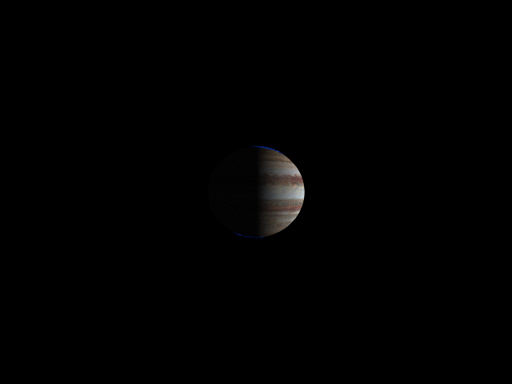
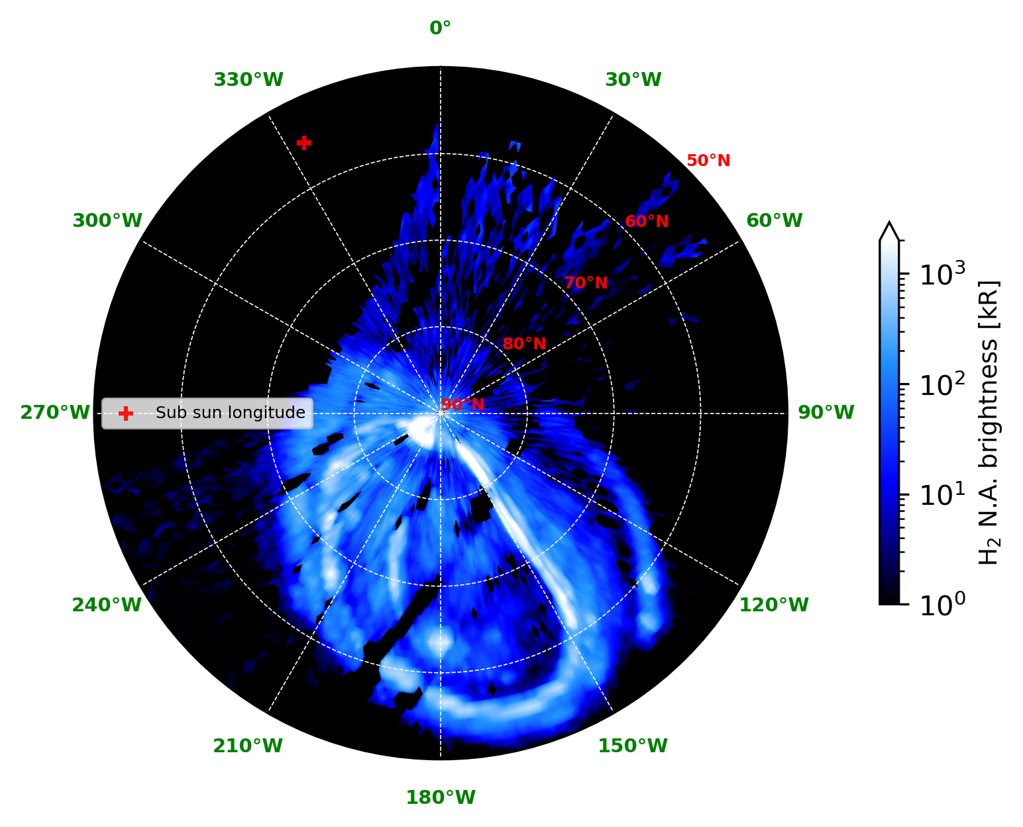
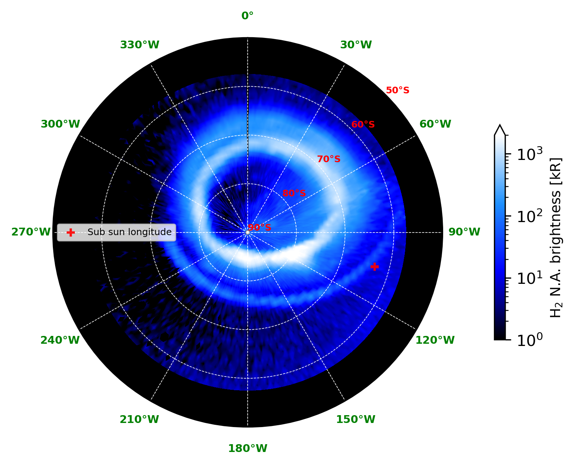
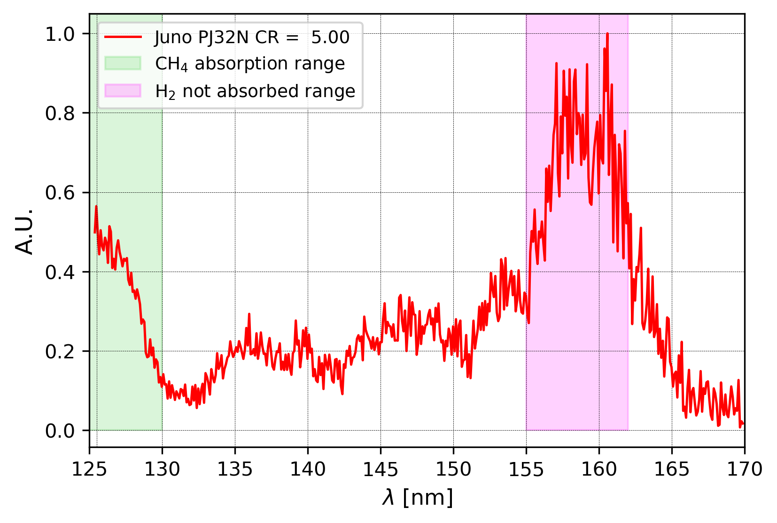
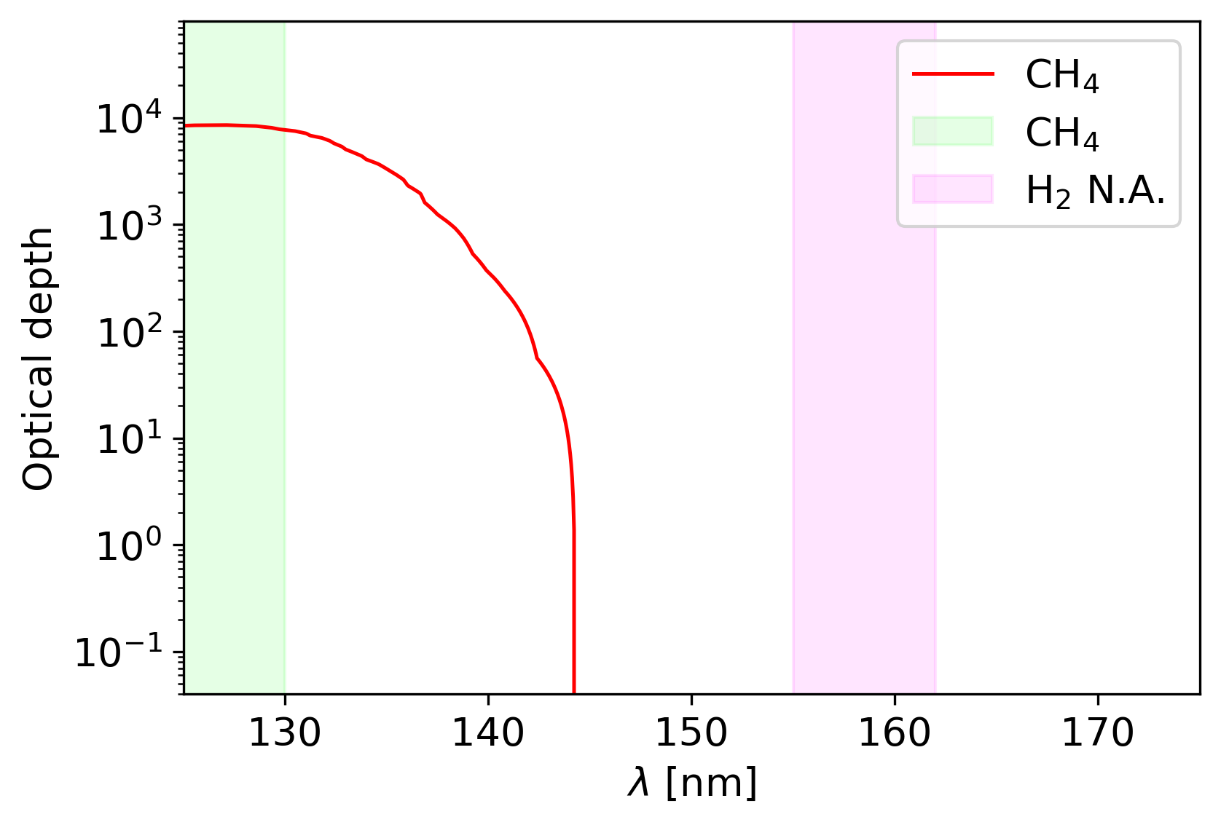
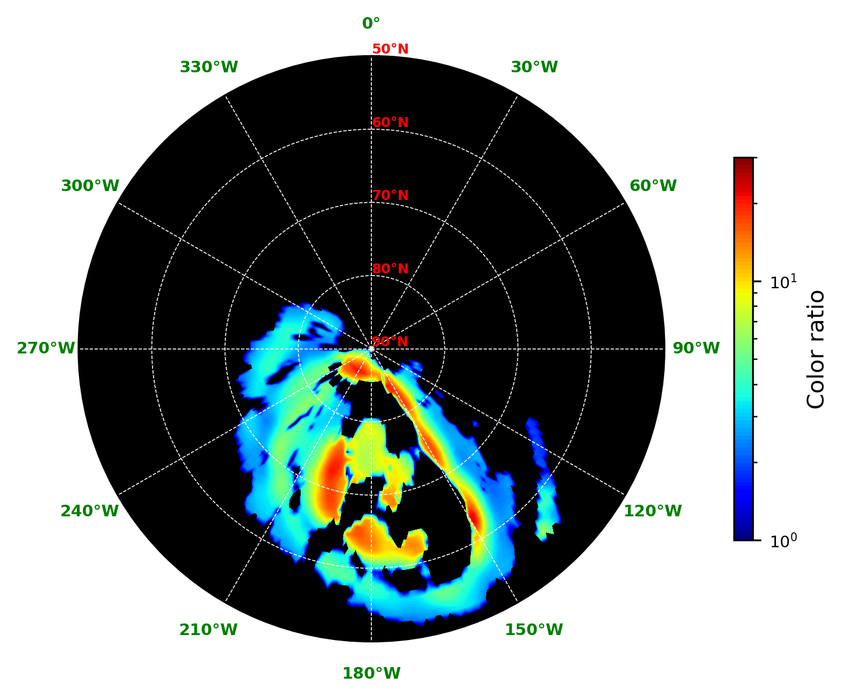
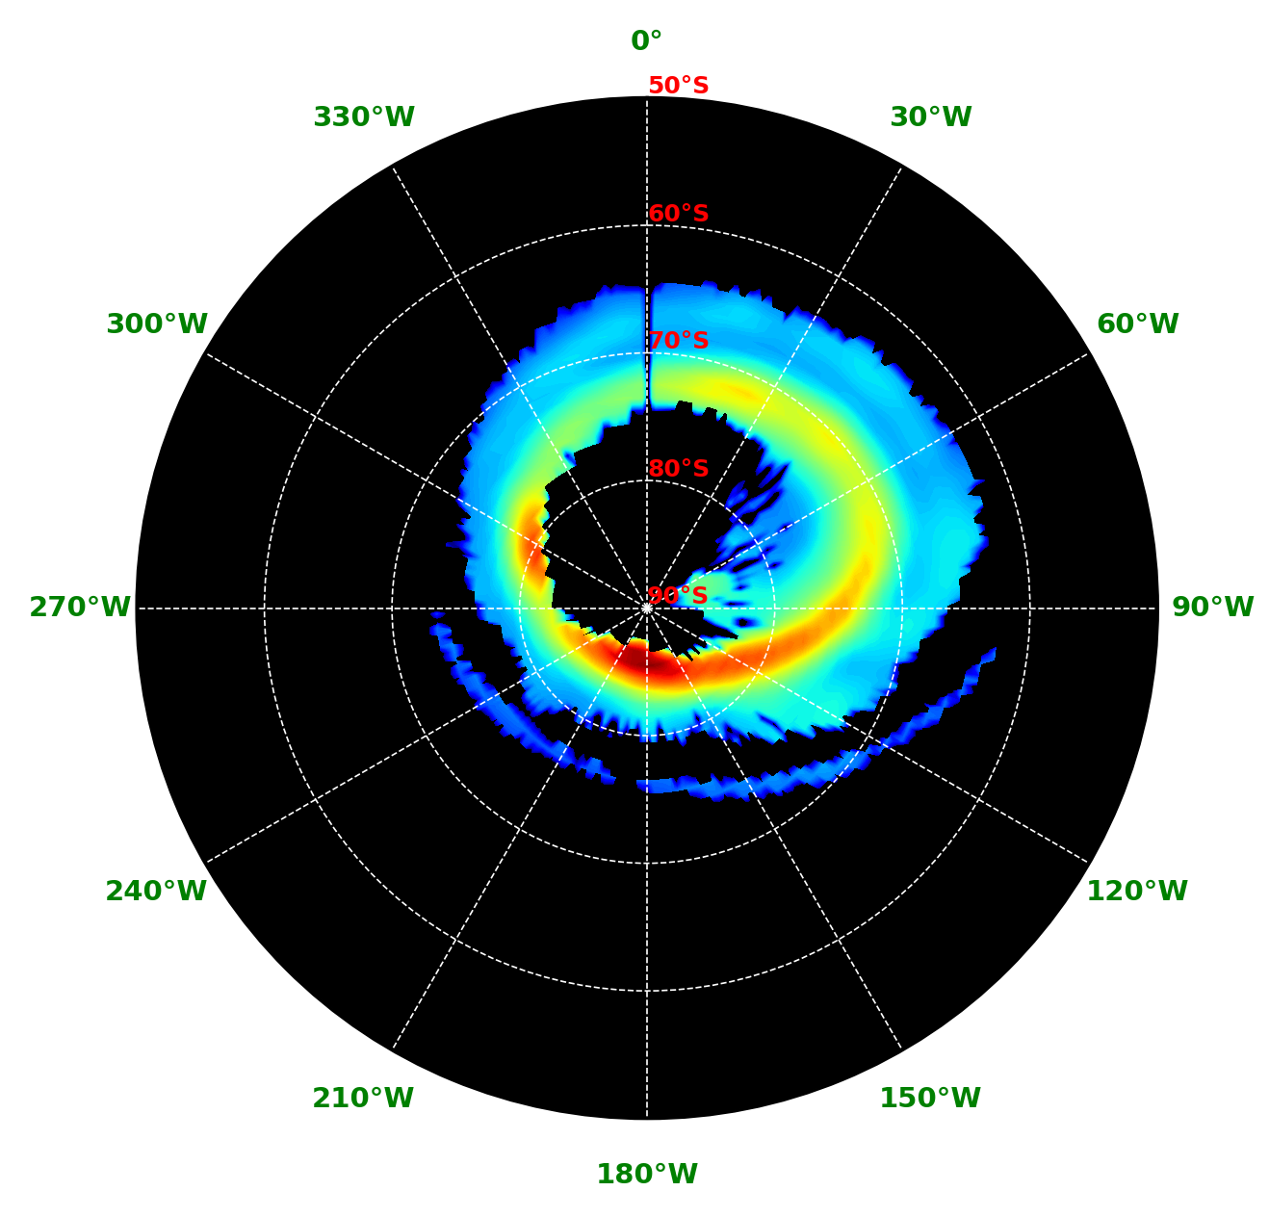
Observations
Example of a Juno/UVS observation during 1 perijove
Juno UVS PJ32 observation
With spectral resolution ∼ 1.1 - 2.9 nm
$CR=\frac{I(155nm−162nm)}{I(125nm−130nm)}$
Where : $I\left(λ_{min}−λ_{max}\right)=\int_{λ_{min}}^{λ_{max}}{I\left(λ\right)dλ}$
B. Benmahi et al.
Tuesday, January 9th, 2024
Notes:
For this study, we used the (1) UVS observations from PJ32 shown in these figures for the Northern and soutehrn auroral regions. This PJ was chosen arbitrarily.
Thanks to these spectral observations, (2) we have now access to the spectra of auroral emissions at each point observed in these polar regions.
And Now, We'll be able to deduce a CR linked to the absorption of the emission spectra by methane (CH4) (3) below 145 nm as shown in this figure of the optical depth of CH4 in Jupiter's atmosphere.
This color ratio is defined by this formula (4), which relates the unabsorbed part of the spectrum to the part absorbed by methane.
Thus, by applying this formula to our spectral cube, we obtain these CR maps (5). This allows us to deduce, for a fixed emission angle, that the increase of the CR means that electrons penetrate deeper into the atmosphere before thermalization, and are therefore more energetic.
This gives us a CR(E,theta) relationship that we can model to deduce the energies of the electrons precipitating in these auroral regions from the observed CR maps.

Slide 5
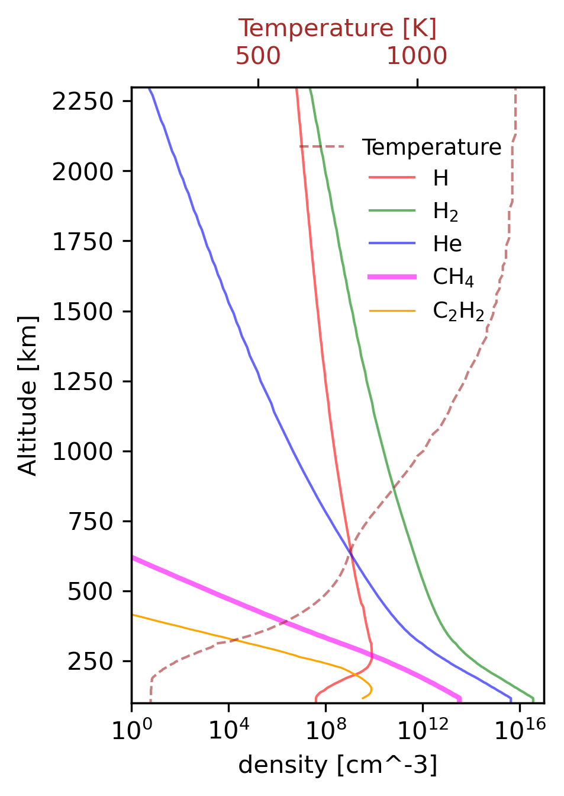
Methods
Atmospheric model
For Jupiter (H, H₂, He, CH₄)
Initial electron flux distribution
Initial mean energy of precipitating electrons ($E_{0}$)
Electronic transport
TransPlanet
(H₂) UV emission spectrum modeling following emission angle $θ$
ɸ_{e-}(E,z)
$$CR(E_{0},θ)$$
In this study we used :
Grodent et al. (2001) auroral atmospheric model
B. Benmahi et al.
Tuesday, January 9th, 2024
5/9
Notes:
This method has been used previously on HST observations, and in this study we will apply it for the first time on UVS observations.
To do this, we will combine our (1) TransPlanet electronic transport model with a UV emission by H2 model that I initially developed for this study.
So, By considering an (2) atmospheric model and an initial electron flux distribution, characterized by an average energy E0, this model calculates electron transport and outputs (3) electron flux as a function of altitude and energy. (4) In This study we use the Grodent et al. (2001) atmospheric model, which is the most advanced model of the atmospheric composition of Jupiter's auroral regions.
Then, this electron flux is used to calculate H2 excitation and emission rates, before calculating the synthetic spectrum in a given theta viewing angle.
Finally, for each synthetic spectrum, (5) we calculate the CR value as a function of the characteristic energy E0 and the theta emission angle we consider.

Slide 6
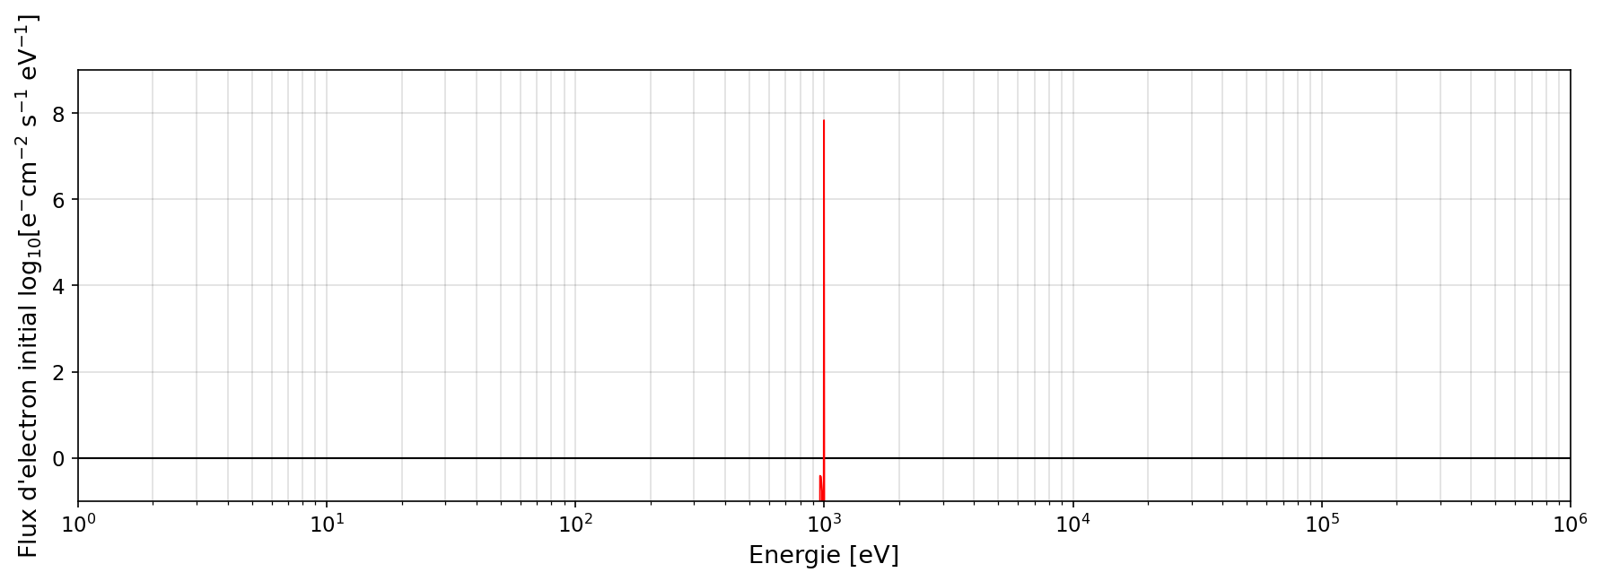
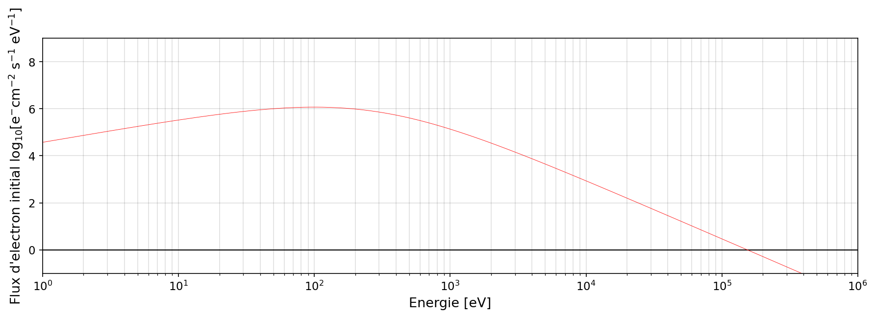
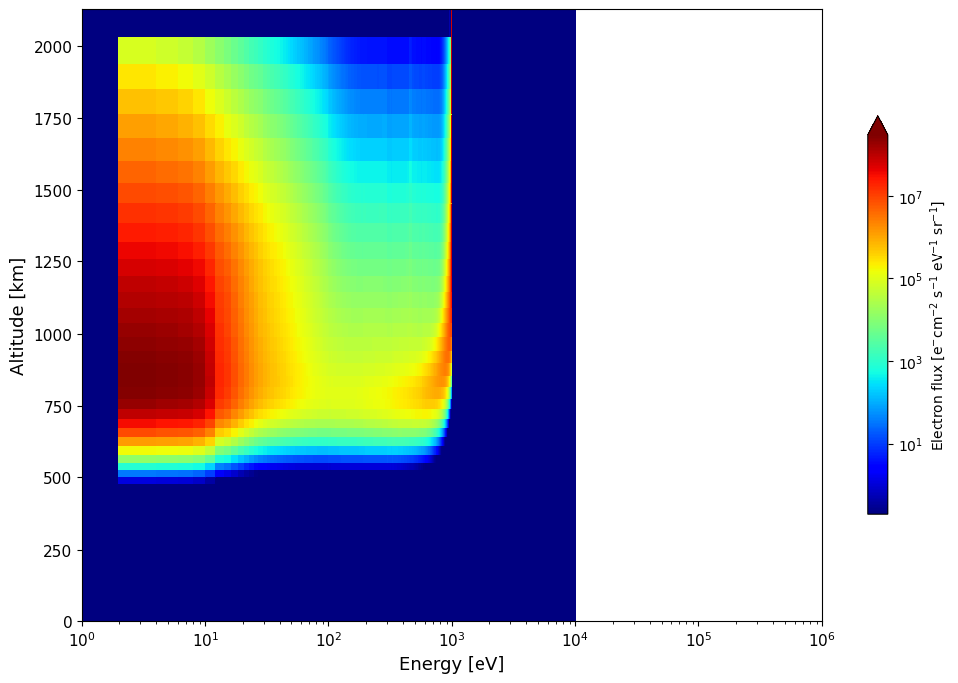
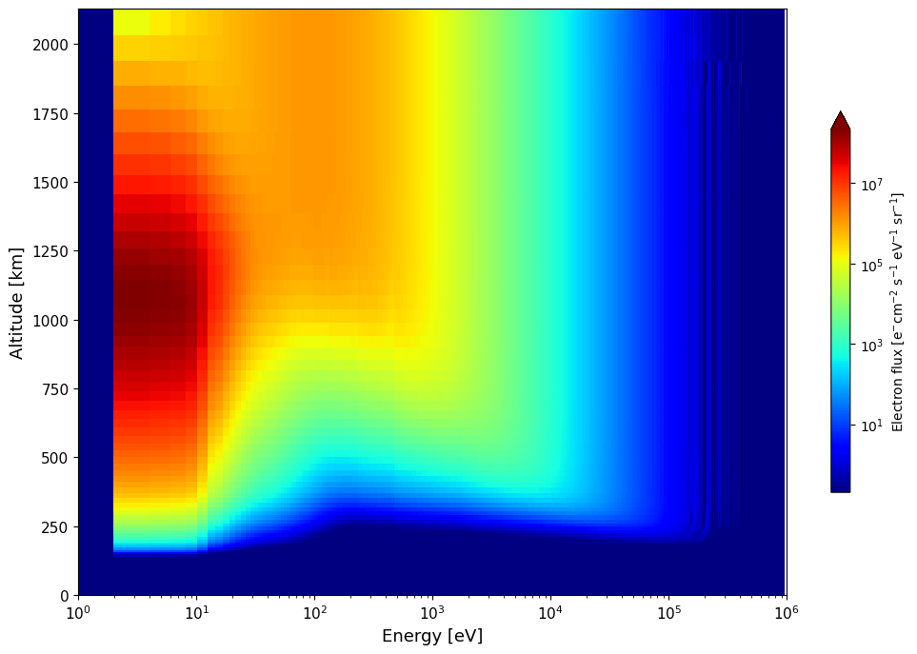
Electron flux distribution examples
Both distributions have the same <E>
Q₀ = 1 mWm⁻² [erg cm⁻² s⁻¹ ]
<E> = 1000 eV
Q₀ = 1 mWm⁻² [erg cm⁻² s⁻¹ ]
<E> = 1000 eV
Type of initial flux energy distribution for precipitating electrons:
Mono-energetic distribution 𝝓(𝑬,𝒛_{𝒎𝒂𝒙} ) ~ 𝜹(𝑬-<𝑬>)
Kappa distribution such as Coumans et al. (2002) 𝝓(𝑬,𝒛_{𝒎𝒂𝒙} ) ~ 𝒇_{𝜿} (𝑬, <𝑬>) with 𝜿=𝟐.𝟓
𝜿=𝟐.𝟓 was determined thanks to Salveter et al. (2022)’s JEDI particle measurements during the 20 first PJ.
B. Benmahi et al.
Tuesday, January 9th, 2024
Notes:
In this study we used two types of initial electron flux distribution to modelise the CR(E,THETA)
We used (1) a mono-energetic distribution and a kappa distribution (given by this formula).
Thus, by modeling electron transport for these two types of distribution (2), we obtain these results describing electron flux as a function of energy and altitude after precipitation.
This clearly shows the difference between these two initial electron flux distributions, which precipitate in the auroral regions for the same average energy.
Moreover, this difference is essentially due to the tail of the kappa distribution, which contains energetic electrons that can penetrate deeper into the atmosphere.

Slide 7
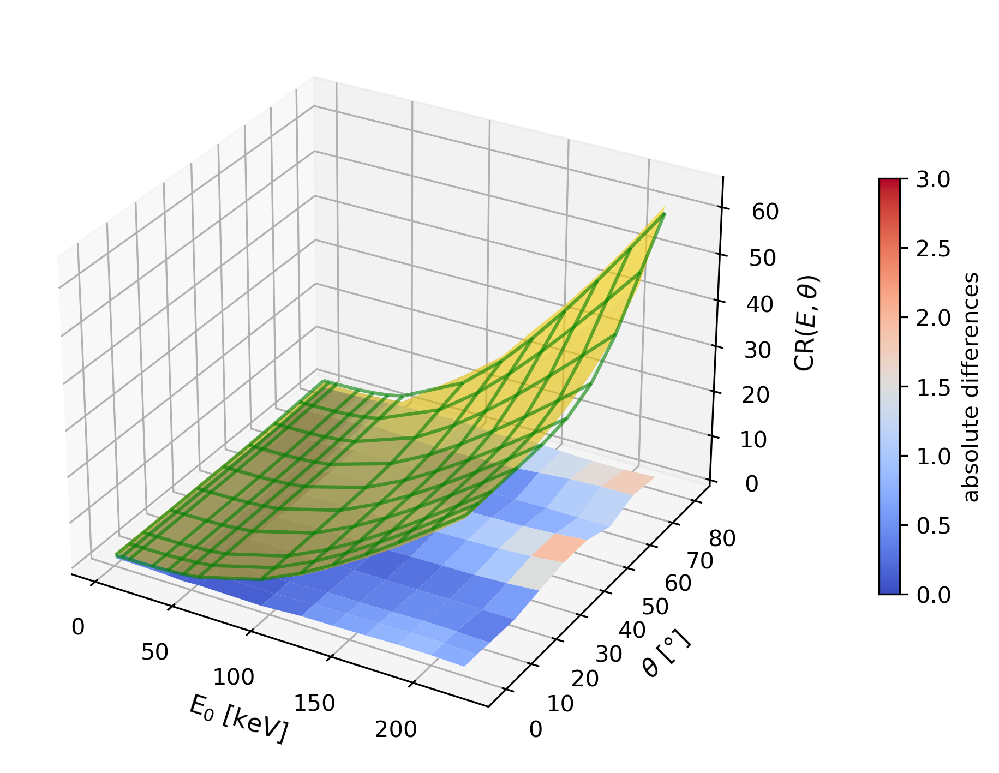
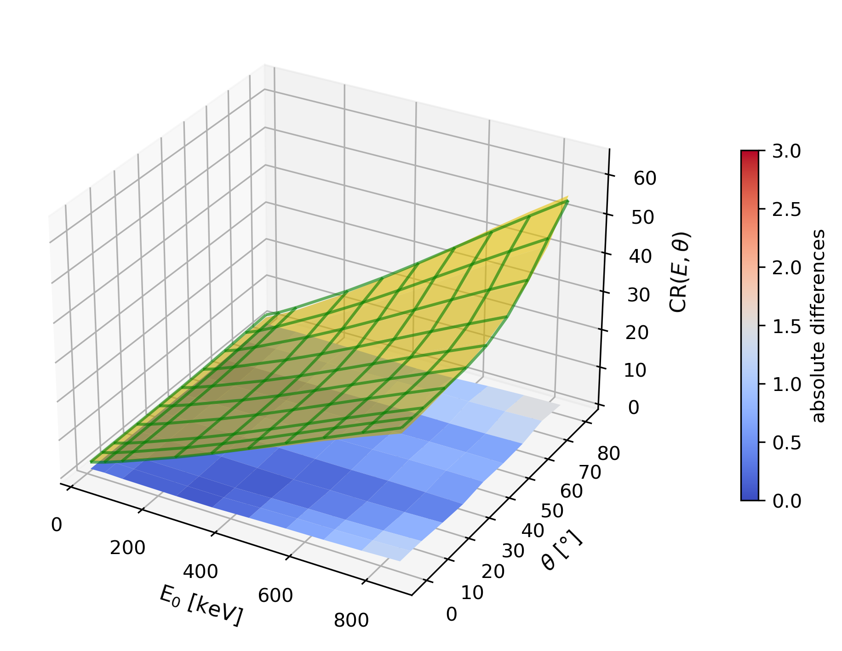
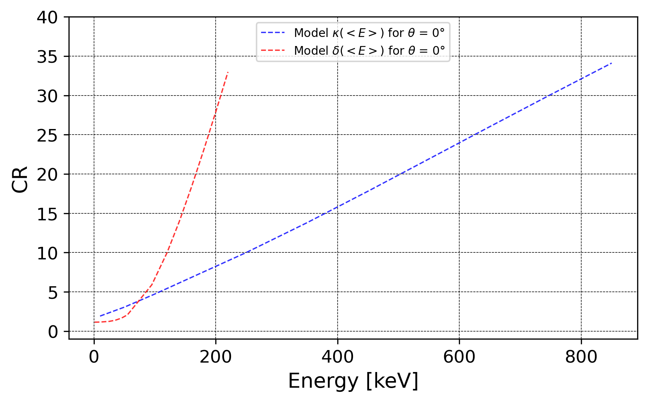
Method & Results
Atmospheric model
For Jupiter (H, H₂, He, CH₄)
Initial electron flux distribution
Initial mean energy of precipitating electrons ($E_{0}$)
Electronic transport
(H₂) UV emission spectrum modeling following emission angle $θ$
ɸ_{e-}(E,z)
$$CR(E_{0},θ)$$
In this study we used :
Grodent et al. (2001) auroral atmospheric model
Monoenergetic case
Kappa distribution case
B. Benmahi et al.
Tuesday, January 9th, 2024
7/9
Notes:
Thus, By varying the mean initial energy of the precipitating electrons and the emission angle, (1) we can build the relationship of the CR(E,phi). For each type of initial electron flux distribution.
As shown in these figures, the CR(E,theta) relationship is represented with the surface in gold color.
Following this result, the CR(E,theta) relationships are also different for each of these initial electron flux distributions used.
For a fixed emission angle (2), these differences can be seen more clearly. We deduce that when we consider the monoenergetic distribution case to estimate the average energy of electrons precipitating in auroral regions, for a fixed CR , the (3) low energies are overestimated (below this intersection point) and high energies are underestimated.

Slide 8
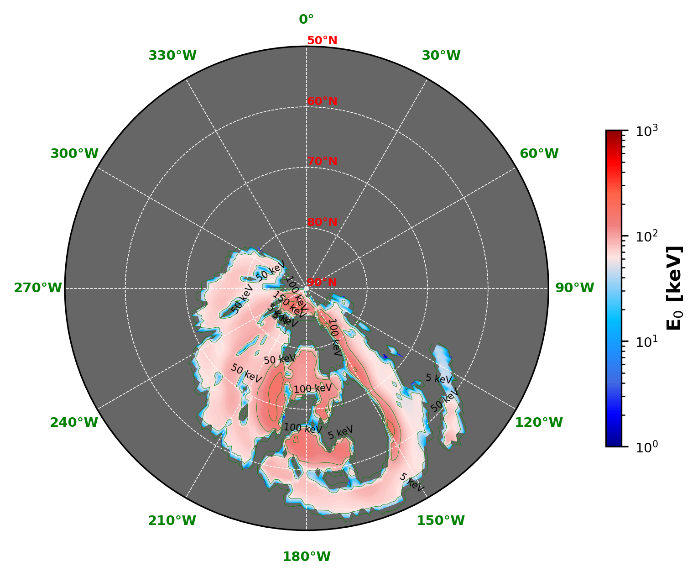
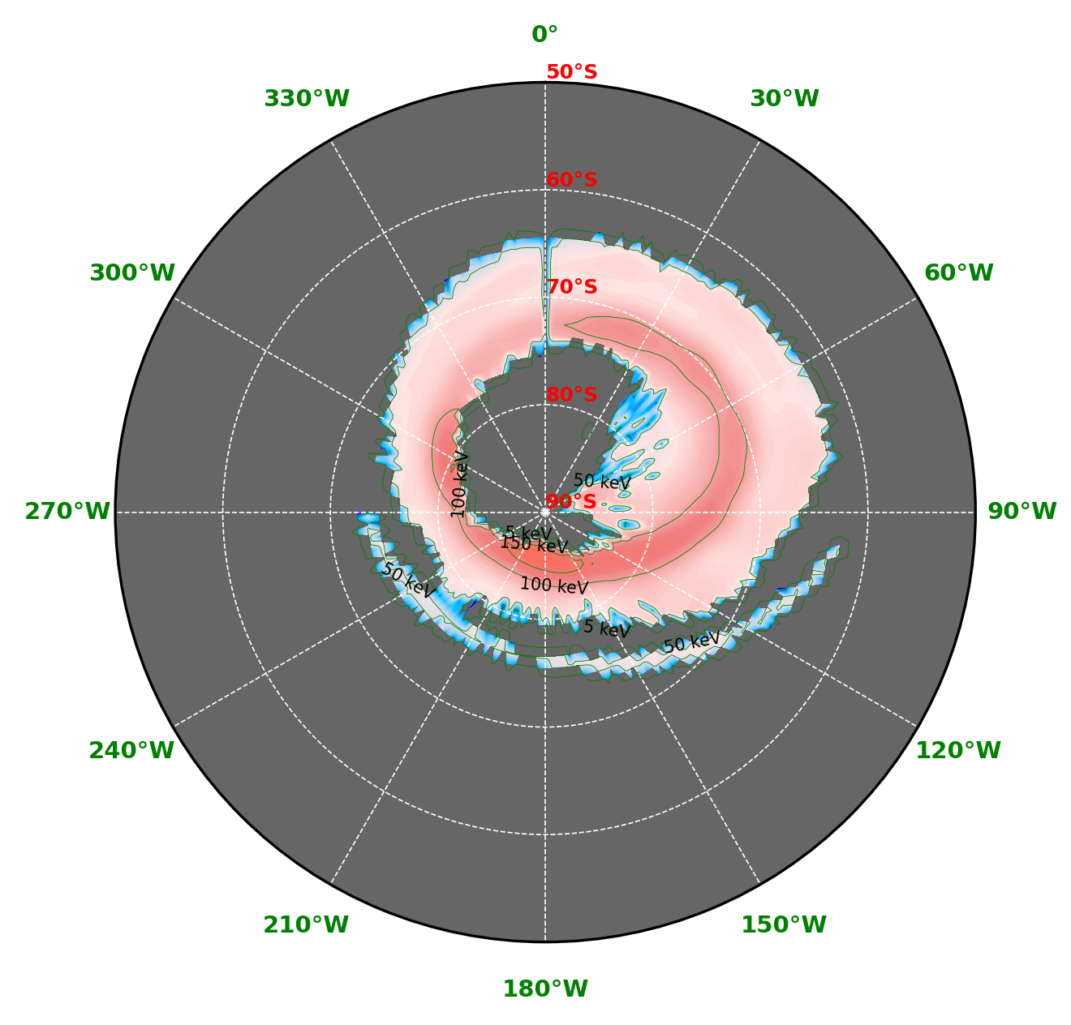
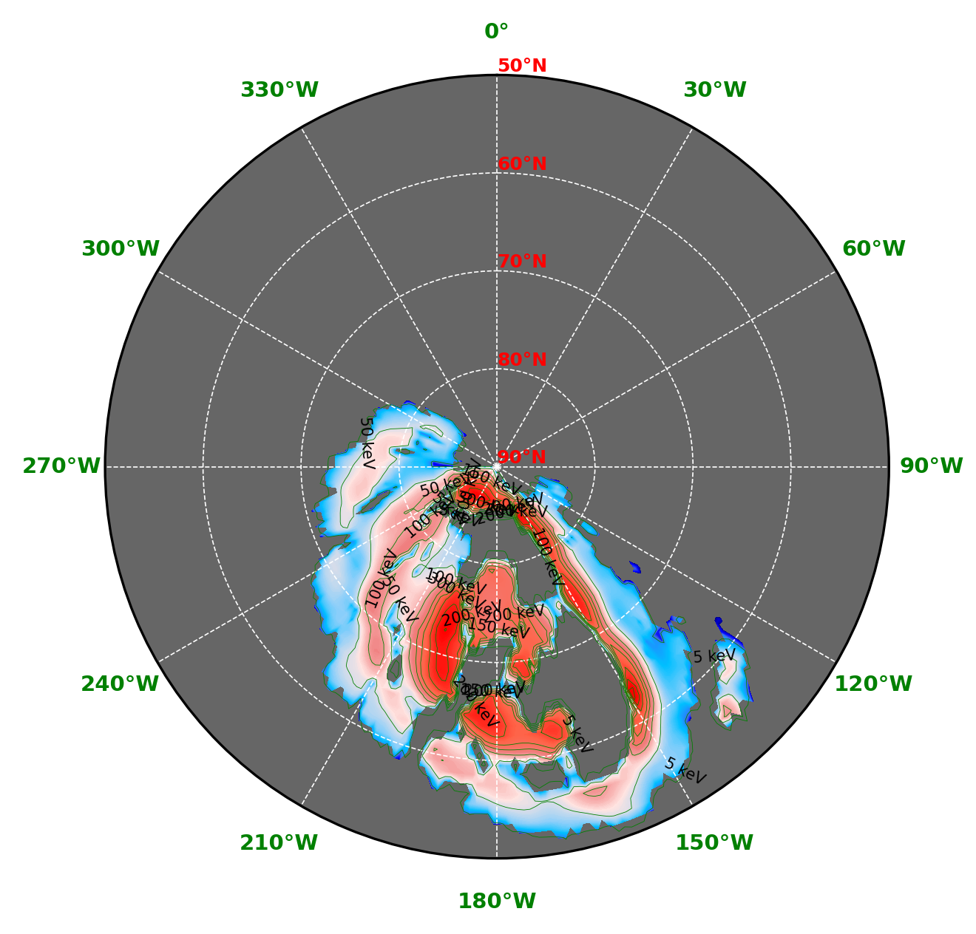
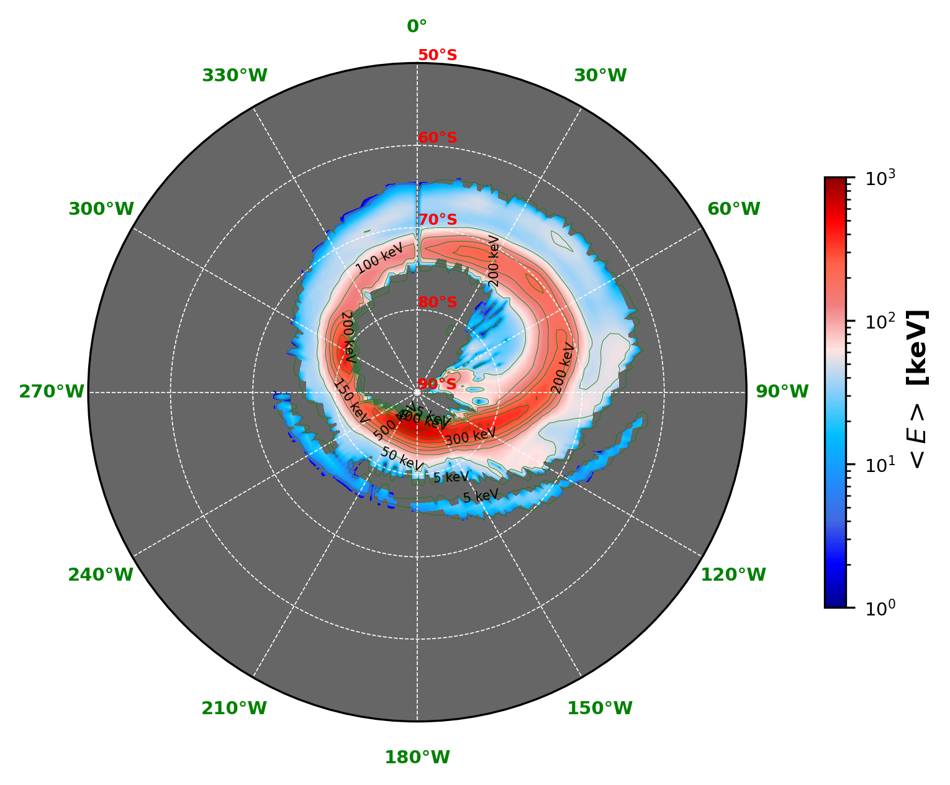
Results
Monoenergetic case
Kappa distribution case
B. Benmahi et al.
Tuesday, January 9th, 2024
Notes:
Now, Using the CR(E,theta) relationship and the observed CR maps (1), we can deduce the average energy maps of the precipitating electrons for the two initial electron flux distributions considered in this study.
So, Here we see that for a realistic kappa distribution, the average energies of precipitating electrons are about a few hundred keV, with peaks of up to 600 keV in the main emission regions.

Slide 9
Conclusion
The comparison between${CR(E,θ)}_{mono−energetic}$ & ${CR(E,θ)}_{kappa}$ maps, show us that the average energies of electrons precipitating in auroral regions are underestimated.
For 𝑬_{𝟎} < 5 keV electrons can't penetrate under methane homopause to influence CR, This is why we can’t maps the low energies
The atmospheric model used in this study is a 1D and therefore does not take into account the variability of CH₄ abundance in auroral regions.
This study is curently in publication process (Benmahi et al. submitted)
All the algorithms I have developed for this study are generic, and the same calculations can be applied to all UVS data to produce the energy maps for all PJs.
B. Benmahi et al.
Tuesday, January 9th, 2024
Notes:
En conclusion :
- By using a kappa distribution to model the CR(E,theta) relationship, we can obtain a realistic estimation of the average energy of electrons precipitating in Jupiter's auroral regions.
# - The resulting CR(E,theta) relationships for each type of electron flux distribution are different, and show us that when we consider a monoenergetic distribution for electrons precipitating in auroral regions, the average electron energy is underestimated.
- It's important to know that In this study, we used a 1D atmospheric model and therefore we do not take into account the variability of CH4 homopause in auroral regions because some observations of hydrocarbon in these regions (Sinclair et al. 2018) show variabilities in their abundances, which means that CH4 might not be homogeneous. This could have potentially significant differences in estimating the average energy of electrons precipitating in these auroral regions.
- Thus, one of the important perspectives of this study is to take into account this CH4 homopause variability when modeling the CR(E,theta) relationship.
Thunk you fr listning …
#- Finally, we also plan to use the CR(E,theta) relationship to map the average energy of other PJs and make a temporal comparison.

Slide 11
Appendix

Slide 12
$$e^{−}$$
$$e^{−}$$
$$e^{−}$$
$$e^{−}$$
$$e^{−}$$
$$e^{−}$$
Alt max
UV emission
$$θ$$
Alt penetration max 1
Alt penetration max 2
1000 mbar / 0 km
Notes:
Pour illustrer cette méthode Voici un schema de l’atmosphère de Jupiter.
Tout d’abord, ici on va considérer seulement les composé chimiques majoritaire de cet atmosphere incluant le CH4.
Ensuite, prenons un electrons d’une energie donnée et qui precipite dans l’atmosphère jusqu’à la profondeur en couleur verte.
Cet electron, le long de son parcours va exciter des H2 et donc produire de l’emission spectral jusqu’à sont altitude de penetration maximale.
L’emission spectrale produite que l’on observe depuis un angle de vue donné ne va pas etre absorbée par le méthane puisque on voit qu’ici le CH4 est présent en dessous de cette altitude.
Maintenant, prenns un autre electron un peu plus energétique et qui va cette fois-ci pouvoir penetrer jusqu’à sont altitude de penetration maximale en rouge.
Cette fois-ci, l’emission spectrale est produite à des altitudes où il y a de l’absorbtion par le CH4. Ainsi pour ces deux electrons qui des energies différentes, on obtient deux spectres d’emission UV différents et donc deux rapport de couleurs différents.
On en déduit donc ici que ce rapport de couleur dépend de l’energie des electrons qui precipitent et de l’angle d’emission.

Slide 13
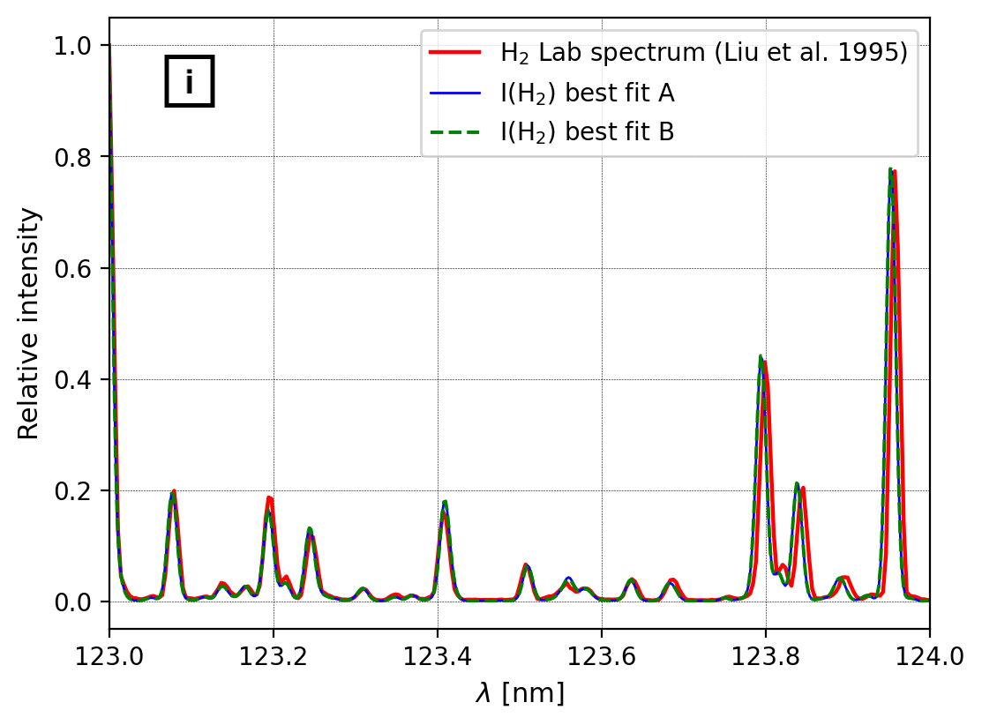
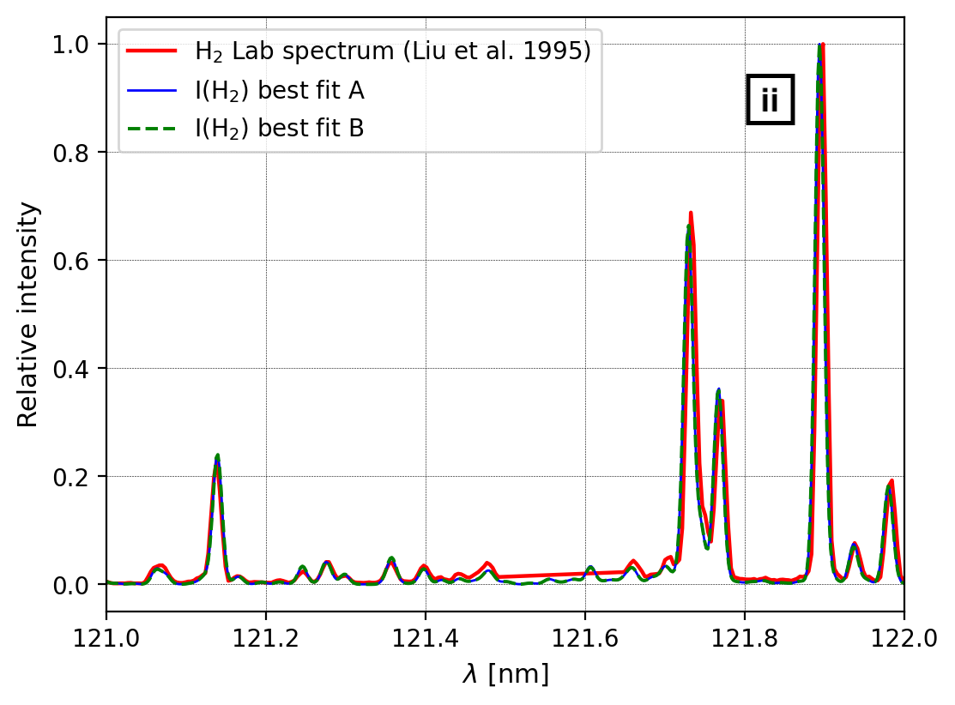
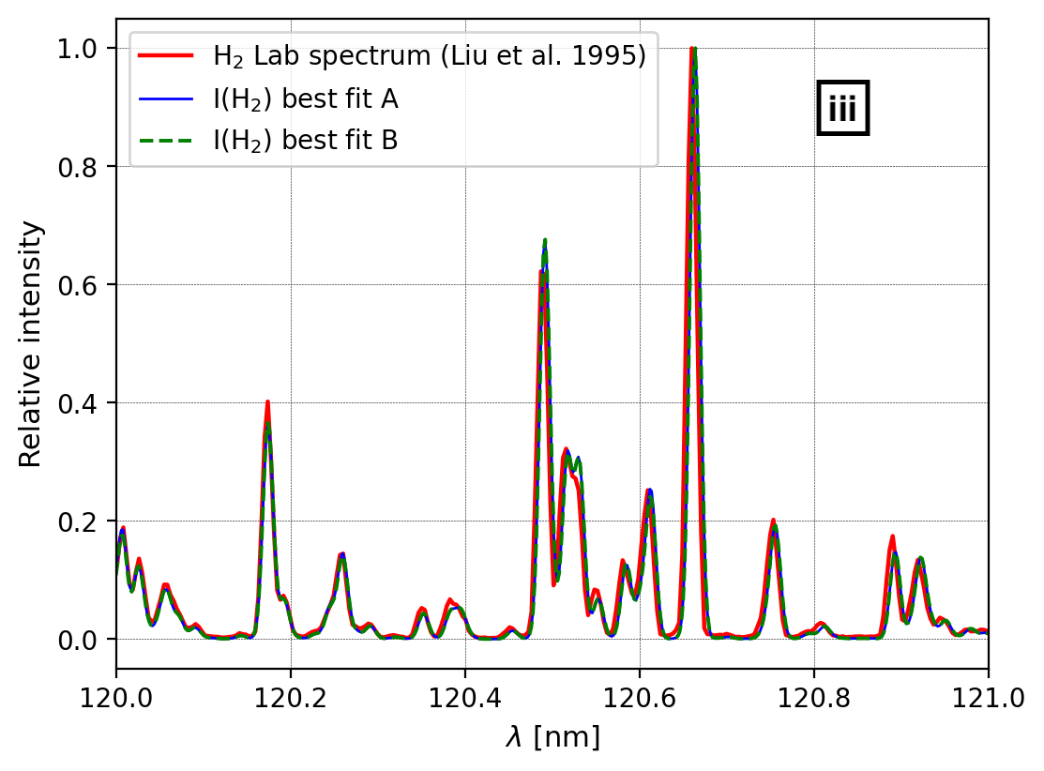
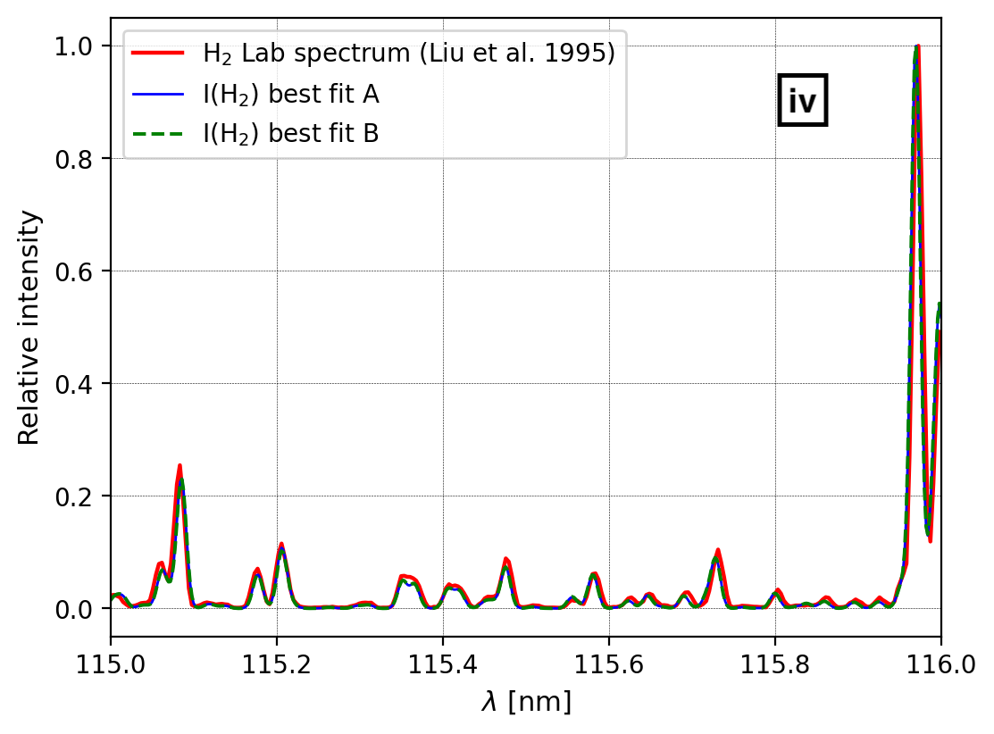
Comparison with a laboratory spectrum AND VALIDATION
In red: UV emission spectrum of the H₂ molecule produced in the laboratory with T = 300°K and an electron beam (monoenergetic) of 100 eV. Spectral resolution ~0.0125 nm.
In blue (best fit A): spectrum modelized with the H₂ emission model, with an atmosphere at T = 300°K and an initial monoenergetic distribution of electron precipitation flux of 100 eV
In green (best fit B): spectrum modelized with the H₂ emission model, with an atmosphere at T = 300°K and an initial maxwelian distribution electron precipitation flux with E₀ = 100 eV
Notes:
I've also performed the same fit again, this time modeling a synthetic spectrum produced by a 100 eV Maxwellian electron beam (Best fit B). It seems that at this energy there is not much difference between a spectrum produced by the collision of a mono-energetic or a Maxwellian electron beam. In both cases, the fit of the experimental data is very good. ## Concerning comparisons, I chose to compare relative spectra because the quantity of H2 in my model and the total energy of the modeled electron flux are different from experimental settings. ## PS: the spectral interval around 121.6 here is where the Lyman-alpha line of atomic Hydrogen is located, which I took care to hide.

Slide 14
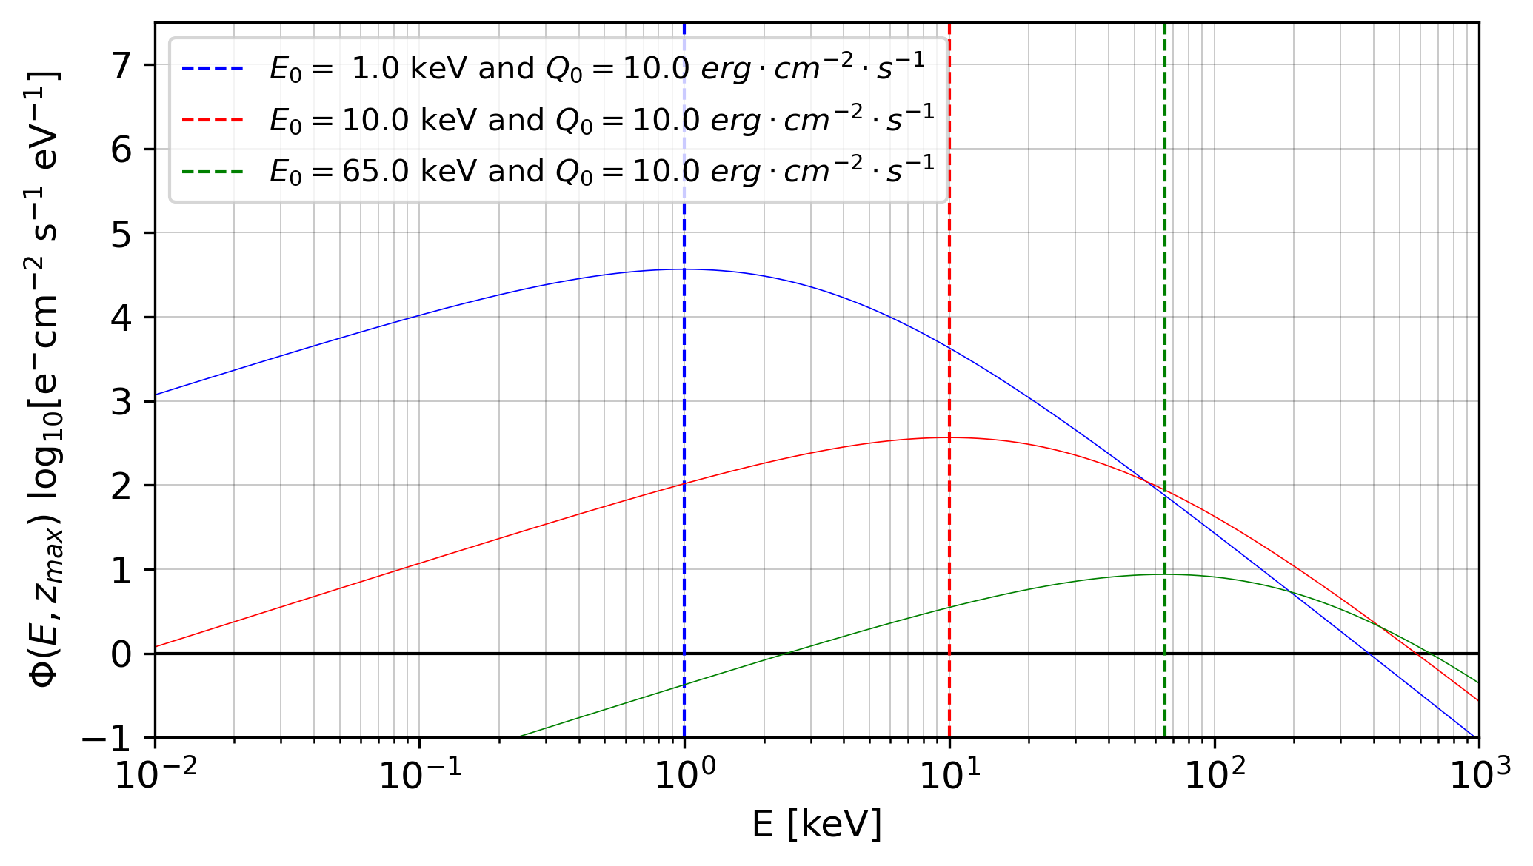
Model grid and problems with Kappa (or any continus) distributions
Since the initial distribution is continuous we need to extend the energy grid above E₀ until 𝝓(𝑬,𝒛_{𝒎𝒂𝒙} ) is insignificant.
This means that we have to manipulate very energetic electrons and therefore to consider the hybridization of the code in the relativistic domain (the electron-matter interaction cross sections evolve in power laws). Thus we have :
elastic cross sections above 400 eV are proportional to E^-0.65
elastic cross sections above 2200 eV are proportional to E^-1
Inelastic cross section are extrapolated as linear function outside the known range

Slide 16
