Slide 1
Observations multi-satellites des émissions radio solaires de Type III
M. Maksimovic
CNRS & LESIA, Observatoire de Paris-PSL
A. Vecchio, S. Musset, X. Bonnin, V. Krupar, J. Souček, S. D. Bale, T. Chust, Y. Khotyaintsev, M. Kretzschmar, E. Lorfèvre, D. Plettemeier, M.Steller, Š. Štverák et l’ensemble de l’équipe RPW
PNST 2022, Marseille

Slide 2
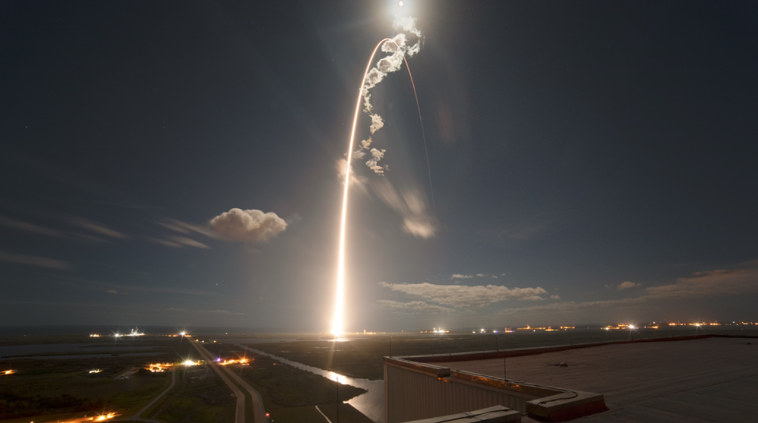
February 10, 2020
KSC, Florida

Slide 3
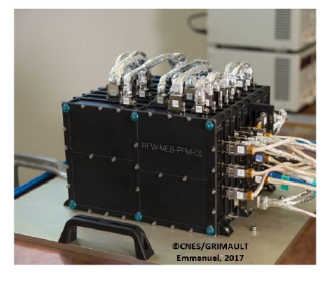
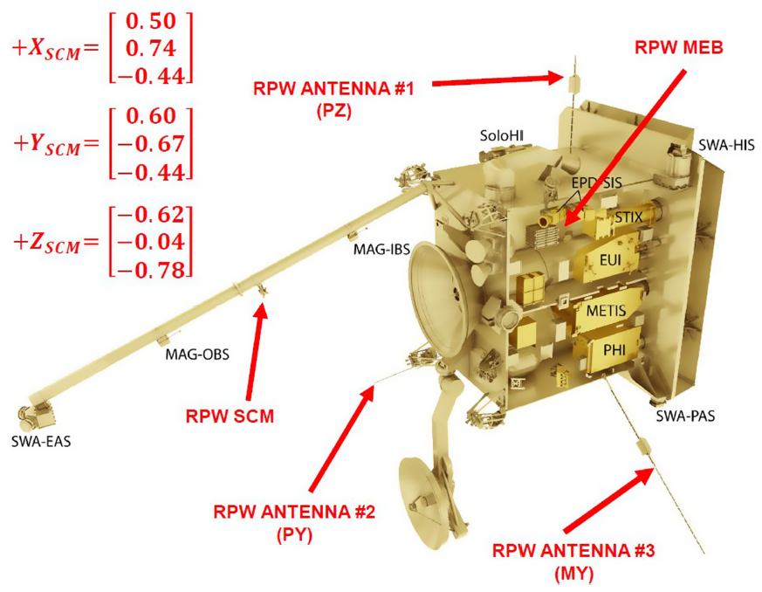
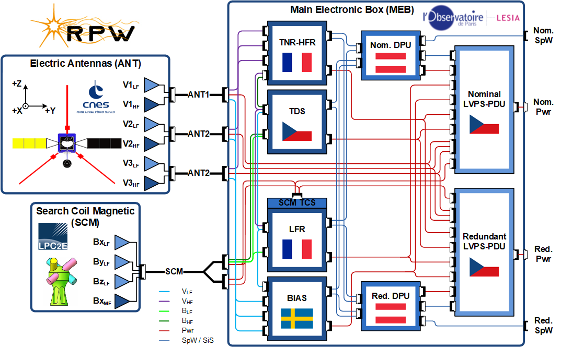
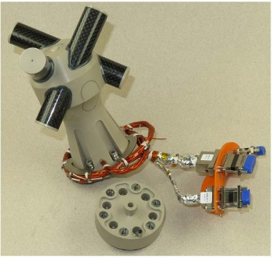
The RPW instrument

Slide 4
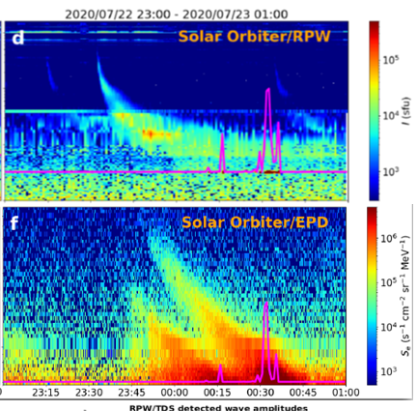
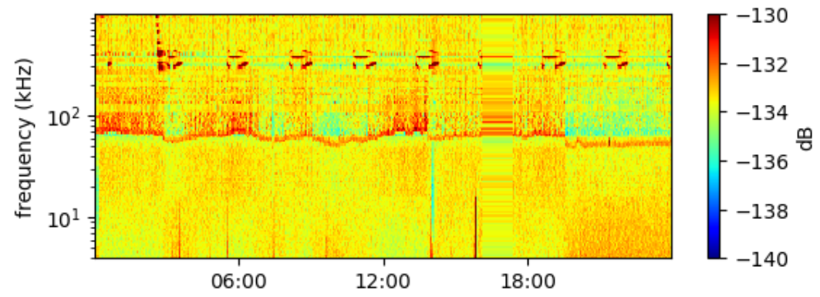
)
T. Chust et al., poster, Le récepteur LFR/RPW : Performances en vol et observations d'ondes sur le mode sifflement
L. Colomban et al., What is the role of whistler waves in shaping of the solar wind electron function between 0.17 and 1 AU ?
More than 20 papers for the A&A first results special issue in 2021
4

Slide 5
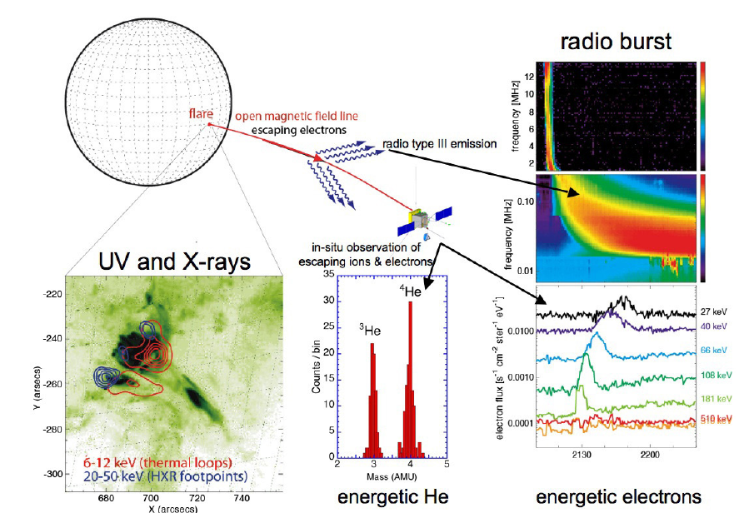
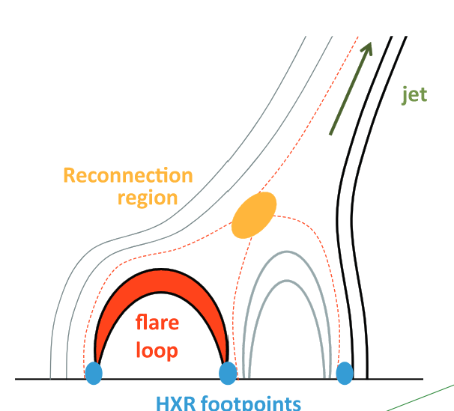
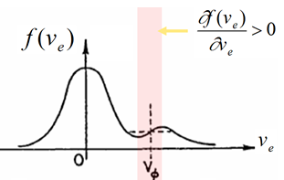
Synergetic science on flare electrons
RPW
EUI & STIX
SWA
Ondes de Langmuir élec.
→ émission E.M.

Slide 6
Ground based radio observatories
Synergetic science on flare electrons
RPW
EUI & STIX
N. Vilmer, Etude statistique du lien entre émissions X et émissions radio de type III des électrons énergétiques solaires - Nicole
SWA
Ondes de Langmuir élec.
→ émission E.M.

Slide 7
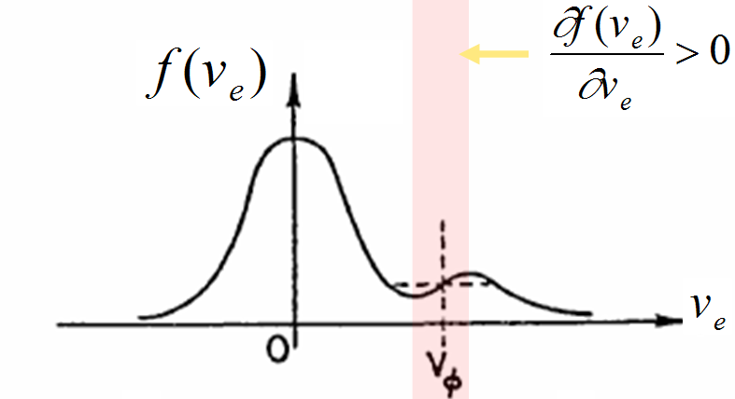
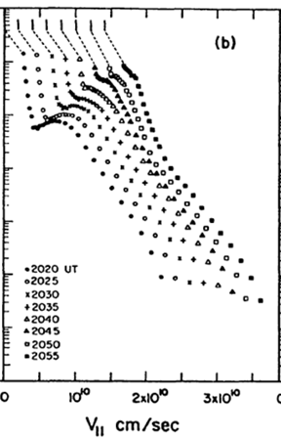
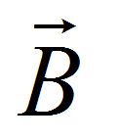
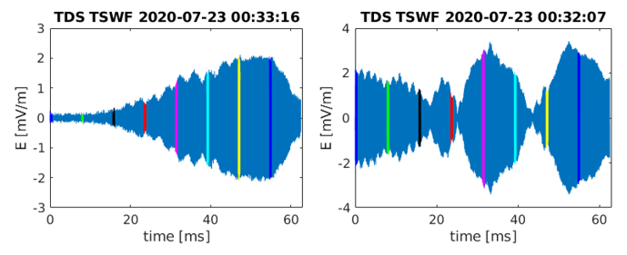
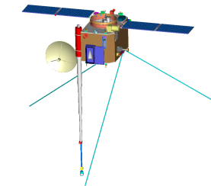
C. Krafft, Electromagnetic radiation emitted at fundamental and harmonic plasma frequencies by weak electron beams in inhomogeneous solar wind plasmas : 2D PIC simulations
T. Dudok de Wit et al., Langmuir-Slow Extraordinary Mode Magnetic Signature Observations with Parker Solar Probe
Solar Type III radio emissions
100 KhZ
300 KhZ
Electrostatic Langmuir waves
→ radio emission
1 MhZ
1 MHz
F
300 KHz
100 KHz
time

Slide 8
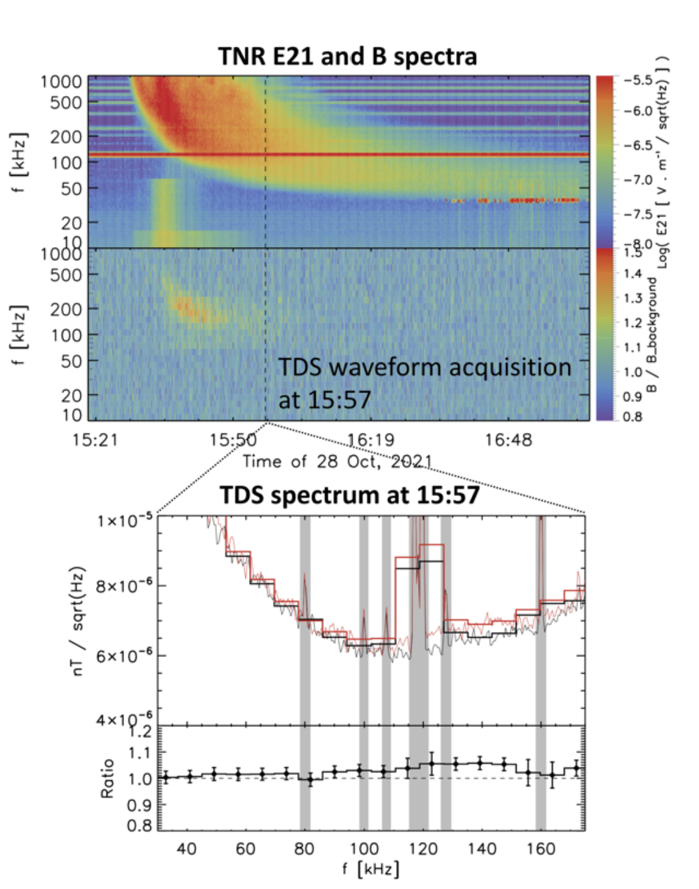
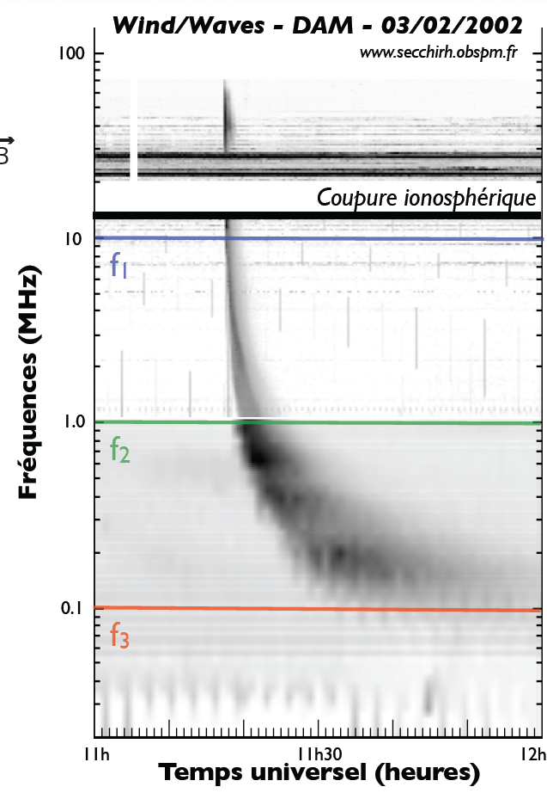
Long time decays
Short (sec → hrs) & very intense (→10⁻¹⁴ W.m⁻².Hz⁻¹) radio emissions (Strongest radio source in the Solar System)
M. Kretzschmar et al, First detection of the magnetic component of a radio wave emitted by the Sun, poster

Slide 9
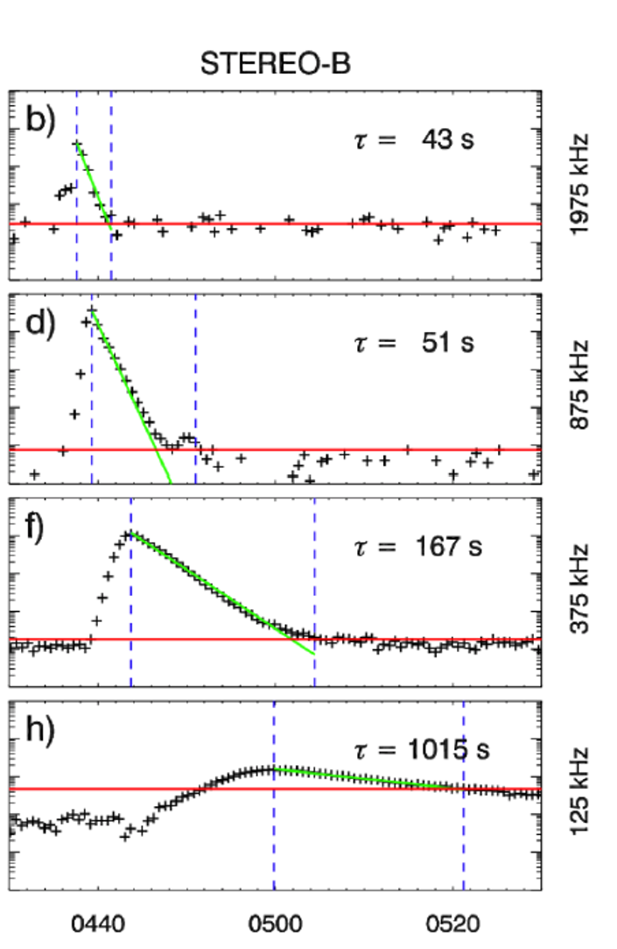
Long time decays
Short (sec → hrs) & very intense (→10⁻¹⁴ W.m⁻².Hz⁻¹) radio emissions (Strongest radio source in the Solar System)
Type profile exhibit both increase and decrease exponential times
With $P\left(t\right)=P_{0}e^{−t/τ_{D}}$ for the decay part Evans (1973) found $τ_{D}(f)∝f^{−1.09±0.05}$
Krupar et al., 2018

Slide 10
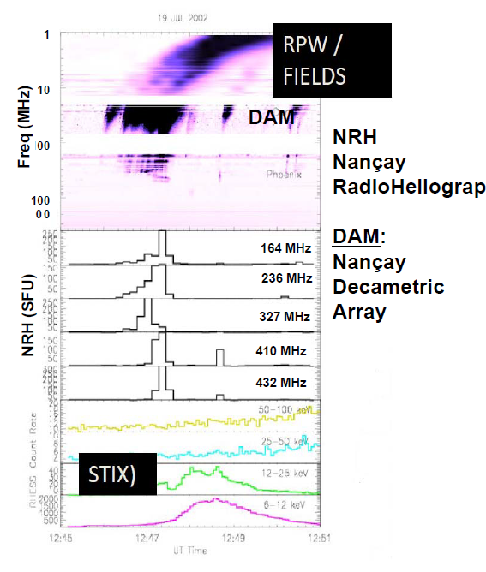
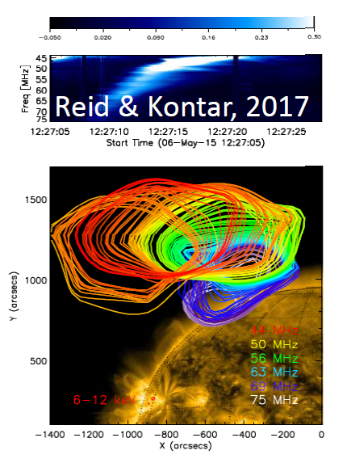
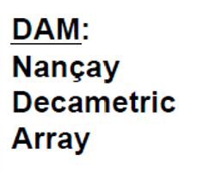
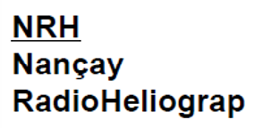
Ground based radio observatories
LOFAR

Slide 11
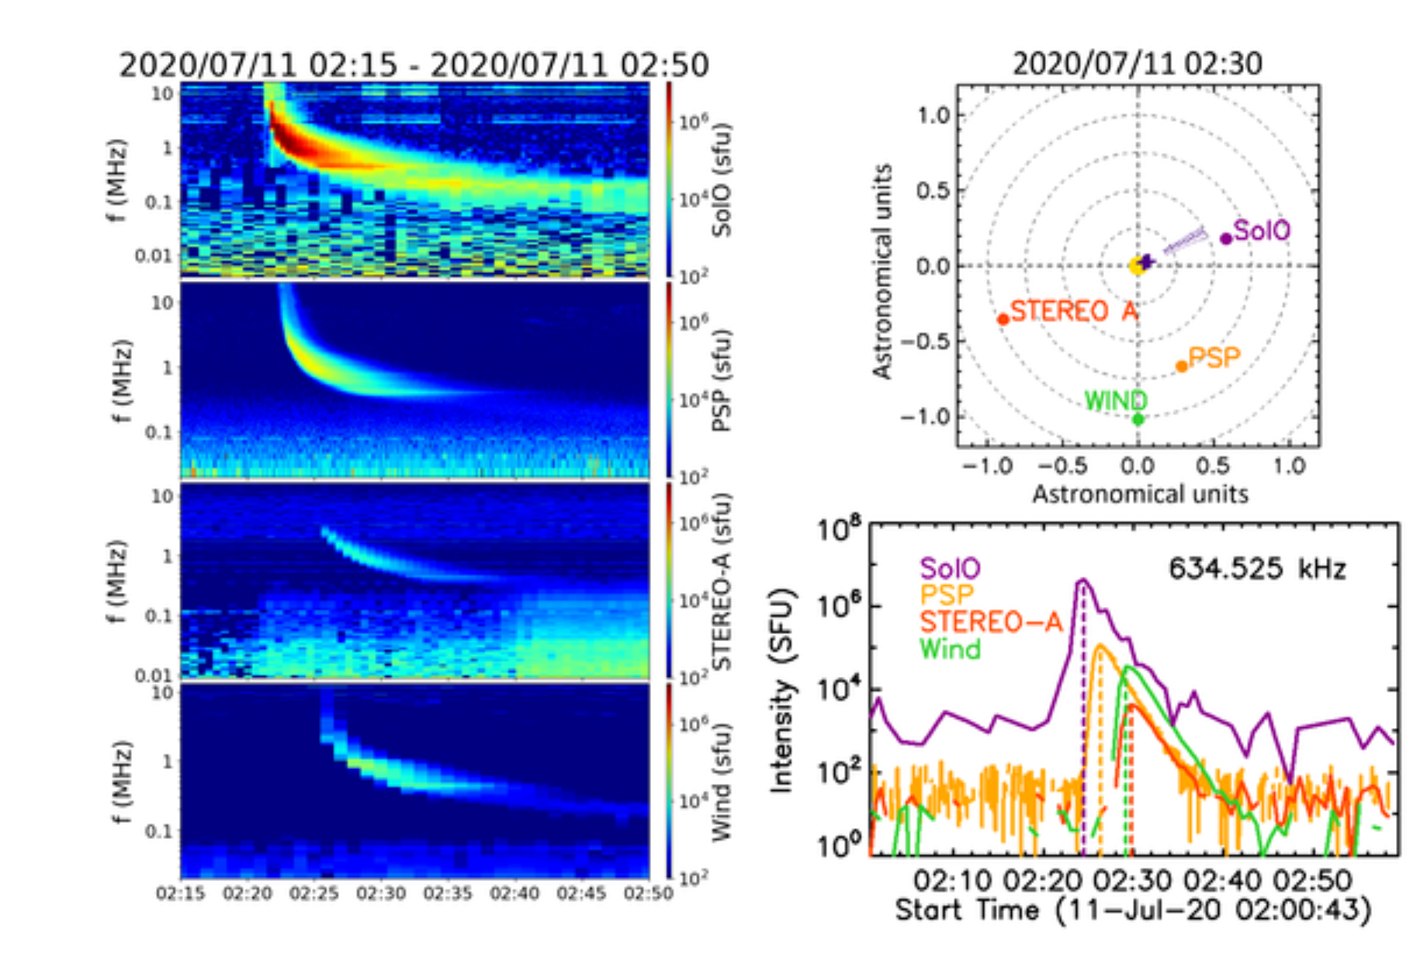
Musset et al, 2021
N. Chrysaphi & M. Maksimovic, The angular dependence of spectroscopic solar radio measurements using multi-spacecraft observations, poster

Slide 12
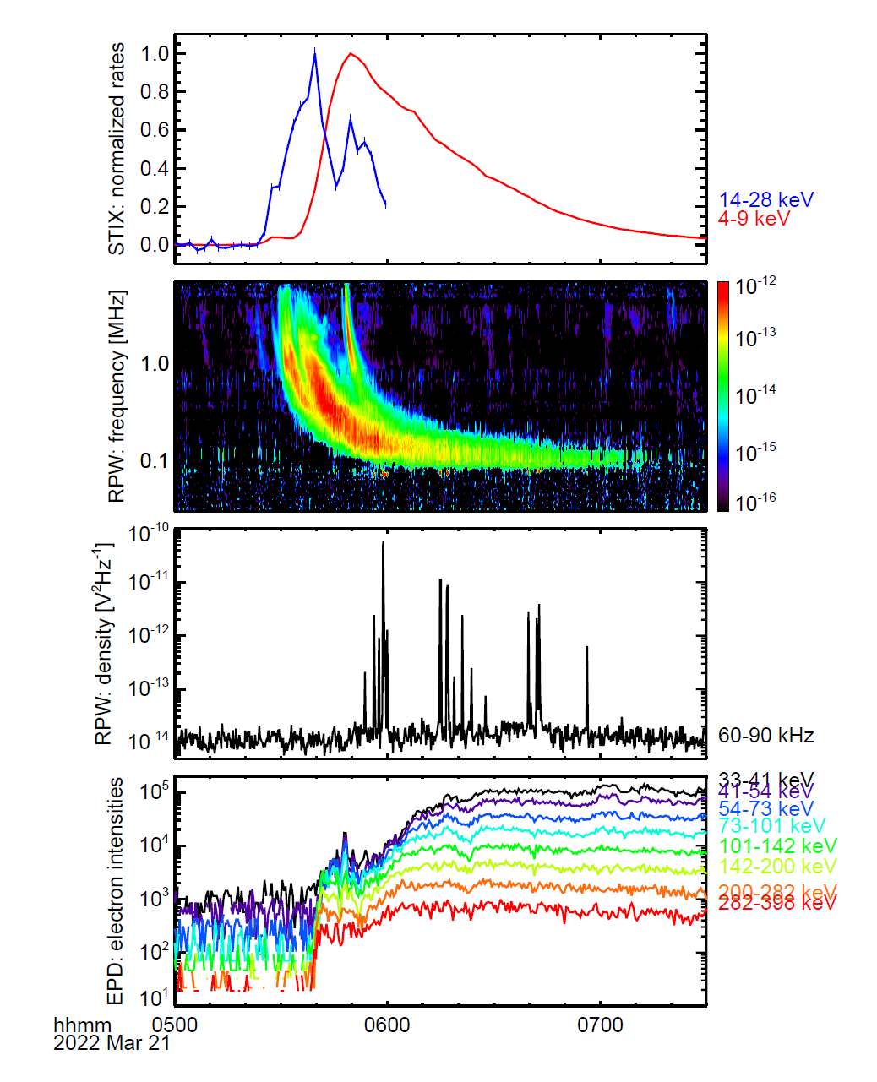
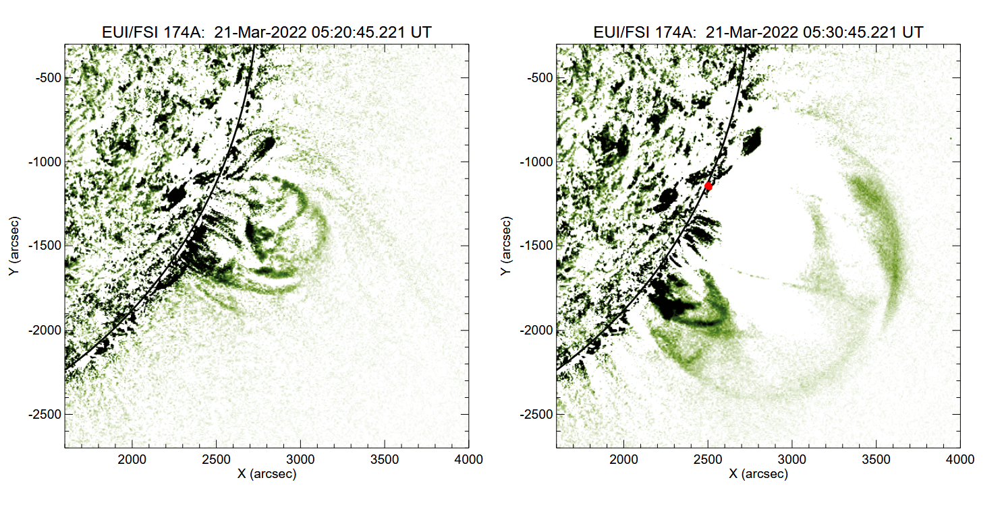
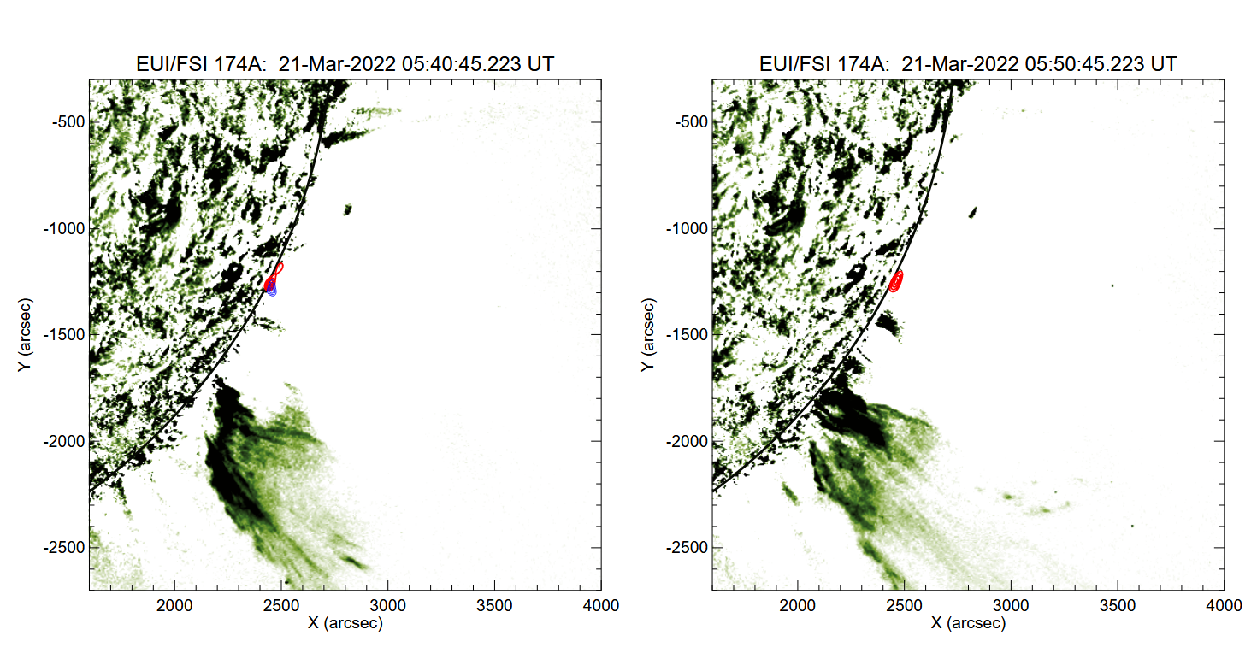
21 March 2022
Perihelion event
Courtesy S. Krucker

Slide 13
Conclusions
The RPW instrument is operating extremely well …
… but is unfortunately sitting on a very noisy spacecraft (Many S/C and a few instrument) EMC perturbations.
First Magnetic component of the EM radio wave
First In-situ Type III bursts associated with Langmuir waves and energetic electrons
Already ~40 events involving EUI, STIX, EPD & RPW

