Slide 1
Fundamental and harmonic electromagnetic emissions in solar wind plasmas
with density fluctuations : 2D PIC simulations
Catherine Krafft and Philippe Savoini
LPP, Laboratoire de Physique des Plasmas, Palaiseau
Université Paris Saclay, Sorbonne Université, Institut Polytechnique de Paris

Slide 2
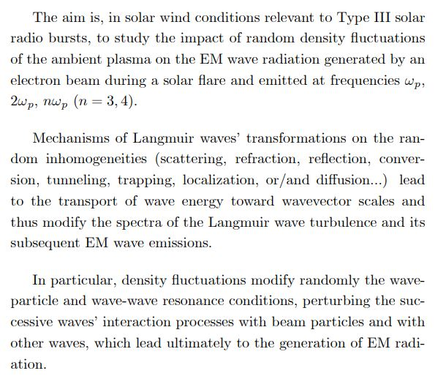
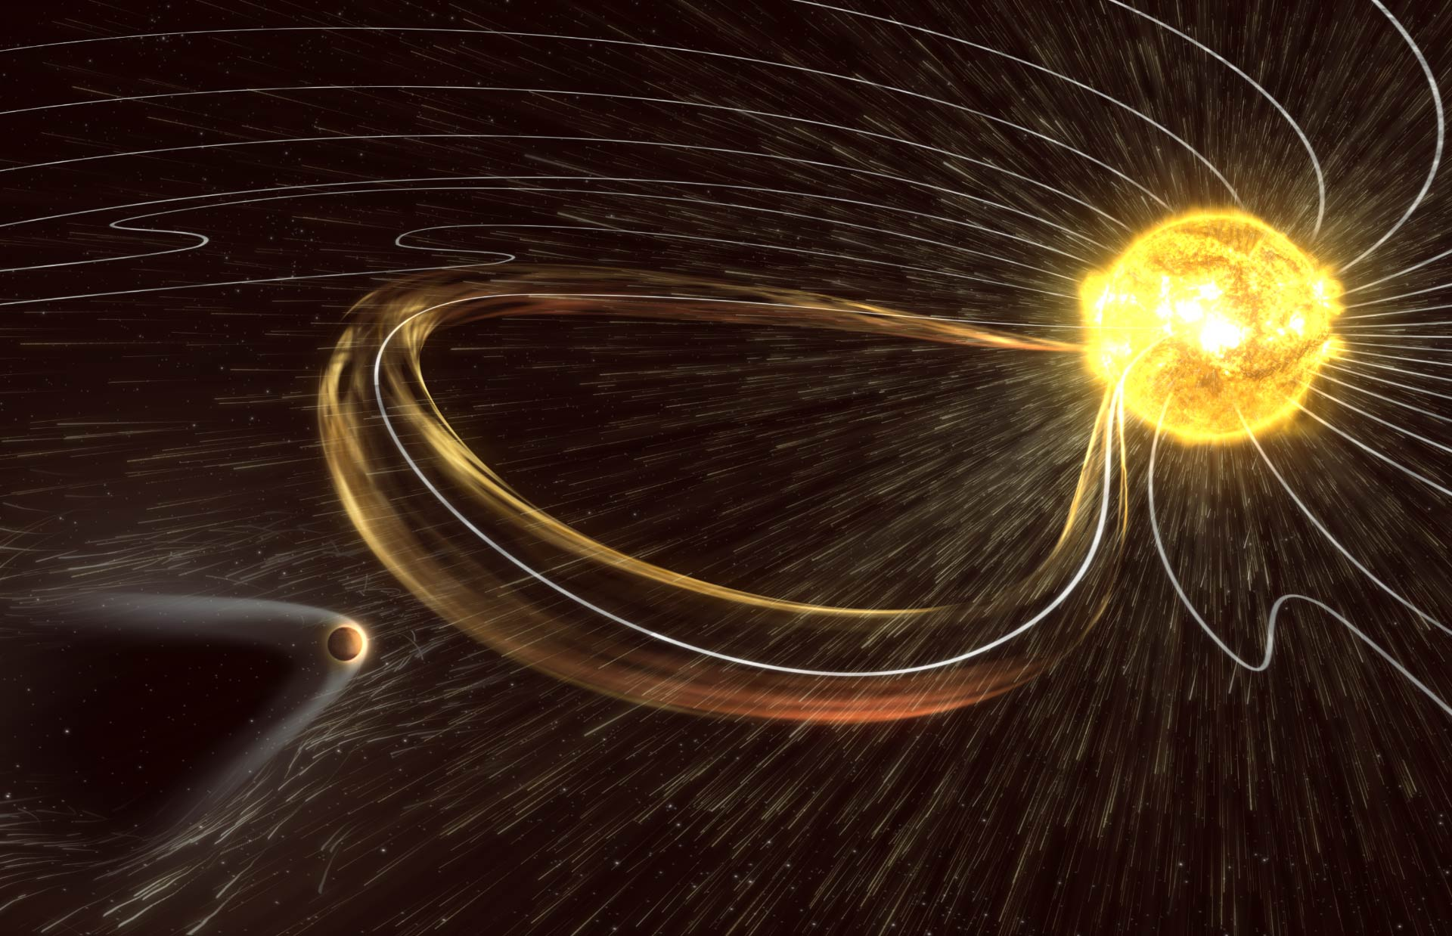
OBJECTIVES
Solar radio bursts
EM radiation
Langmuir wave turbulence
Electron beam
Solar wind with density fluctuations
Krafft and Savoini, ApJL, 917:L23, 2021
Krafft and Savoini, ApJL, 924:L24, 2022
Krafft and Savoini, ApJ, submitted, 2022

Slide 3
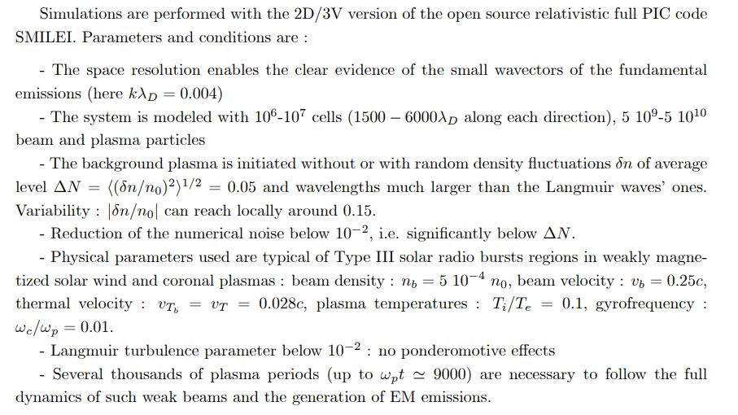
MODEL AND PARAMETERS
https://smileipic.github.io/Smilei/

Slide 4
FUNDAMENTAL ELECTROMAGNETIC EMISSION F
AT FREQUENCY ω_{p}

Slide 5
MAGNETIC ENERGY SPECTRA B_{zk}²(k_{x},k_{y})
ΔN=0
$ω=ω$_{p}
ΔN=0.05
Krafft and Savoini, ApJL, 924:L24, 2022

Slide 6
TIME VARIATIONS OF WAVE ENERGIES
Krafft and Savoini, ApJL, 924:L24, 2022

Slide 7
HARMONIC ELECTROMAGNETIC EMISSIONS H
AT FREQUENCY 2ω_{p}

Slide 8
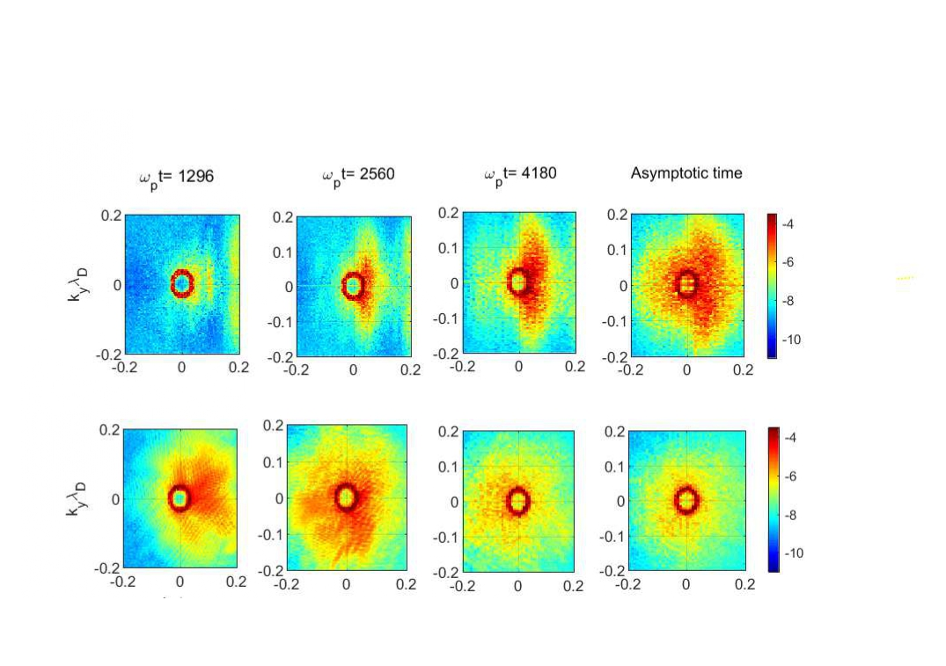
MAGNETIC ENERGY SPECTRA B_{zk}²(k_{x},k_{y})
ΔN=0
$ω=2ω$_{p}
ΔN=0.05
k_{x}λ_{D}
k_{x}λ_{D}
k_{x}λ_{D}
k_{x}λ_{D}
Krafft and Savoini, ApJL, 917:L23,2021

Slide 9
TIME VARIATIONS OF ENERGIES
Krafft and Savoini, ApJL, 917:L23, 2021

Slide 10
HARMONIC ELECTROMAGNETIC EMISSIONS H₃ and H₄
AT FREQUENCIES 3ω_{p} and 4ω_{p}

Slide 11
MAGNETIC ENERGY OF H₃ and H₄ : SPECTRA AND GROWTH
ΔN=0
ΔN=0.05
H₃
H₃
H₄
H₄
Krafft and Savoini, ApJ, submitted, 2022

Slide 12
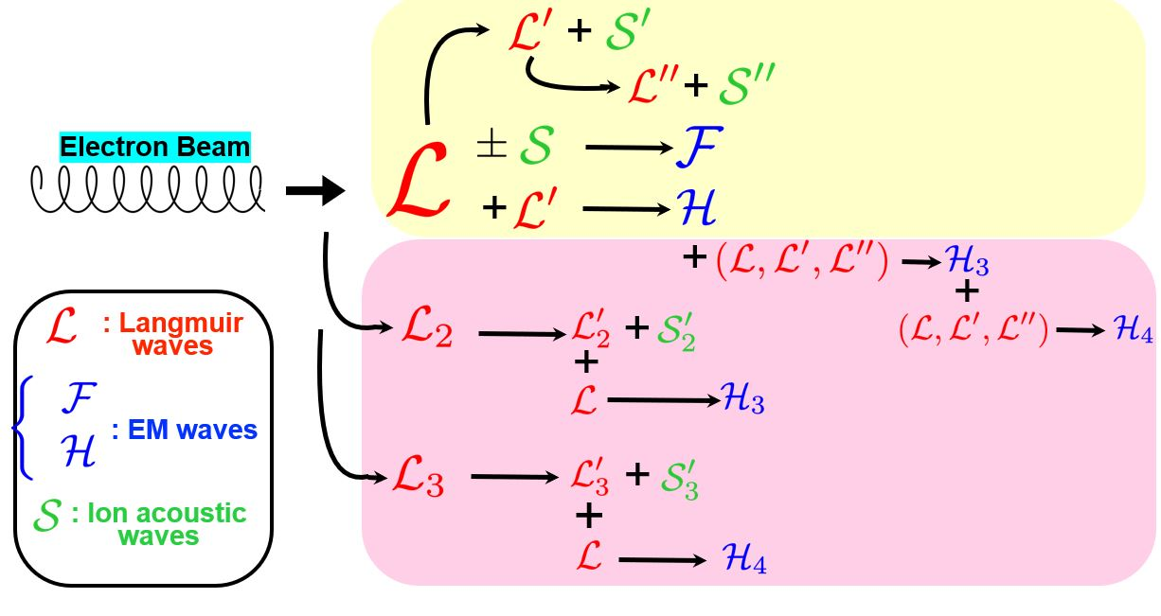
GENERATION OF EM HARMONICS by NONLINEAR WAVE INTERACTIONS
Generation of F and H
Generation of H₃ and H₄
Krafft and Savoini, ApJ, submitted, 2022

Slide 13
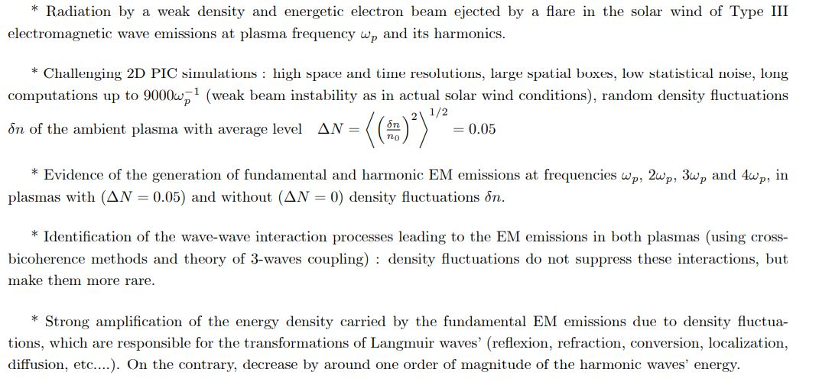
CONCLUSION

Slide 14
THANKS FOR YOUR ATTENTION

Slide 15
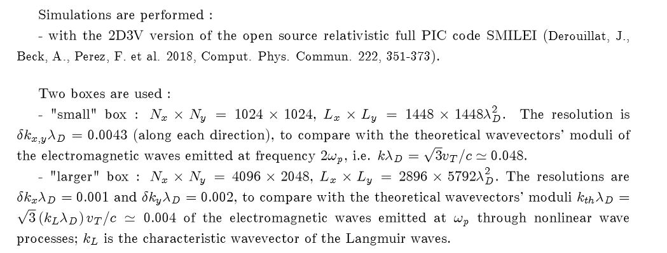
MODEL AND PARAMETERS (1)

Slide 16
MODEL AND PARAMETERS (3)

Slide 17
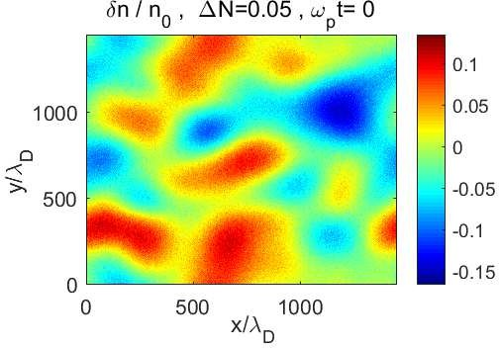
MODEL AND PARAMETERS (2)
Size of boxes : L_{x}=L_{y}=1448λ_{D} (left) and L_{x}=5792λ_{D ,} L_{y}= 2896λ_{D} (right)

Slide 18
RADIATED MAGNETIC FIELD B_{z}(x,y)
Krafft and Savoini, ApJL, 917:L23, 2021

Slide 19
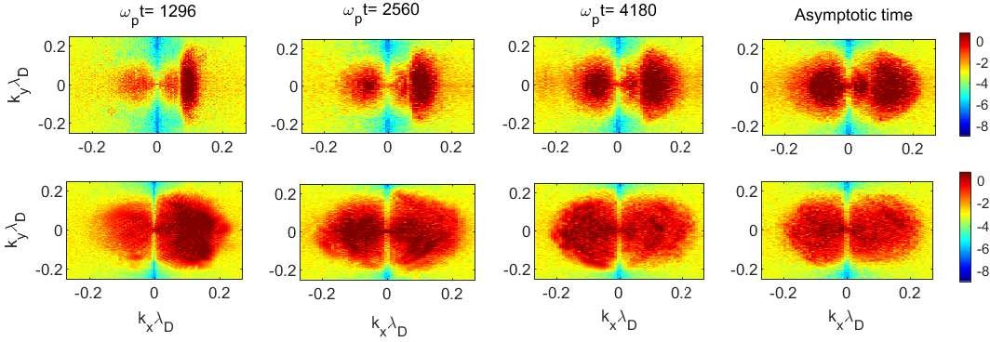
LANGMUIR WAVE SPECTRA AT ω_{p}
Krafft and Savoini, ApJL, 917:L23, 2021

Slide 20
MAGNETIC FIELD SPECTRA B_{zk}²(k_{x},k_{y}) at ω_{p} for ΔN=0.05
theory
theory
Krafft and Savoini, ApJL, 924:L24, 2022

Slide 21
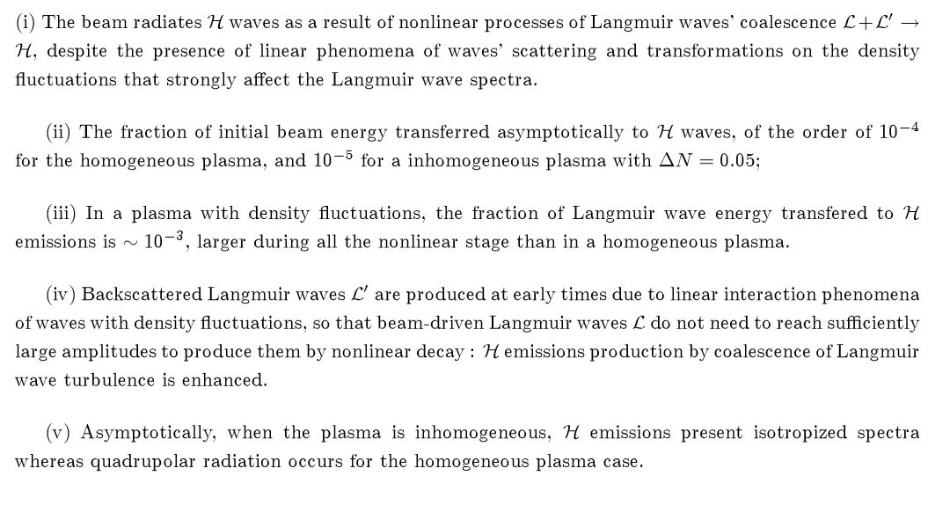
CONCLUSION : HARMONIC EM EMISSION

Slide 22
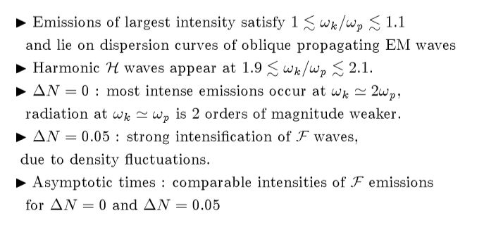
DISPERSION CURVES B_{zk}²(ω_{k} , k_{x})
Krafft and Savoini, ApJL, in press, 2022

Slide 23
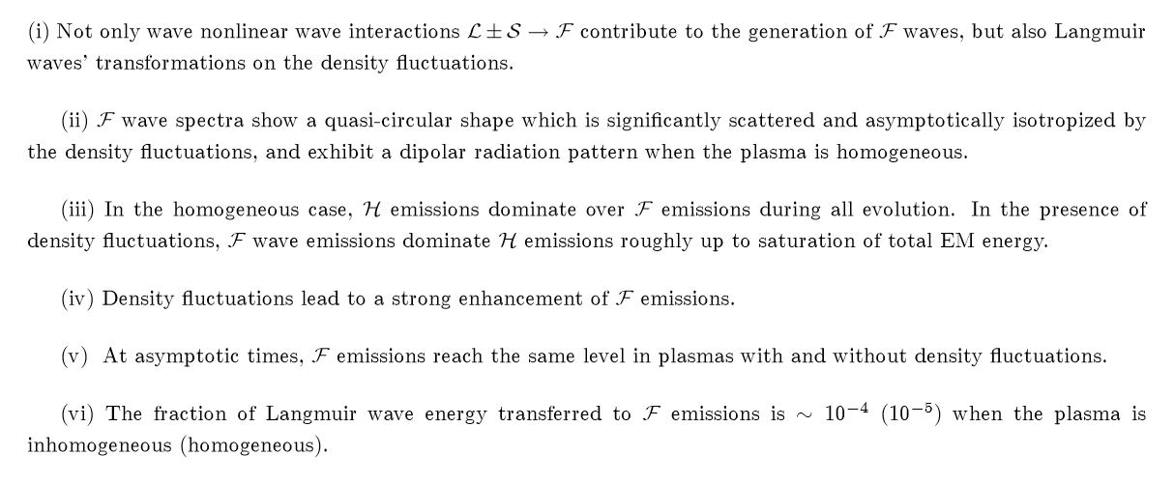
CONCLUSION : FUNDAMENTAL EM EMISSION

