Slide 1
Parker Solar Probe observations of solar wind coherent structures
Vinogradov Alexander
LESIA
Alexandrova O., Artemyev A.V.,
Maksimovic M., Mangeney A., Vasilyev A., Petrukovich А.
19-05-2022

Slide 2
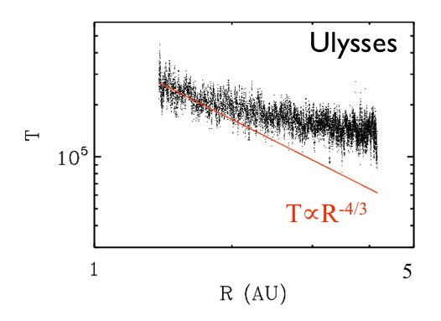
Non-adiabatic solar wind expansion
Wind temperature (T_{ions}) decays less than adiabatic (~R^{-4/3})
Heating problem
Turbulent fluctuations could be the energy source
[Image credit: Lorenzo Matteini]

Slide 3
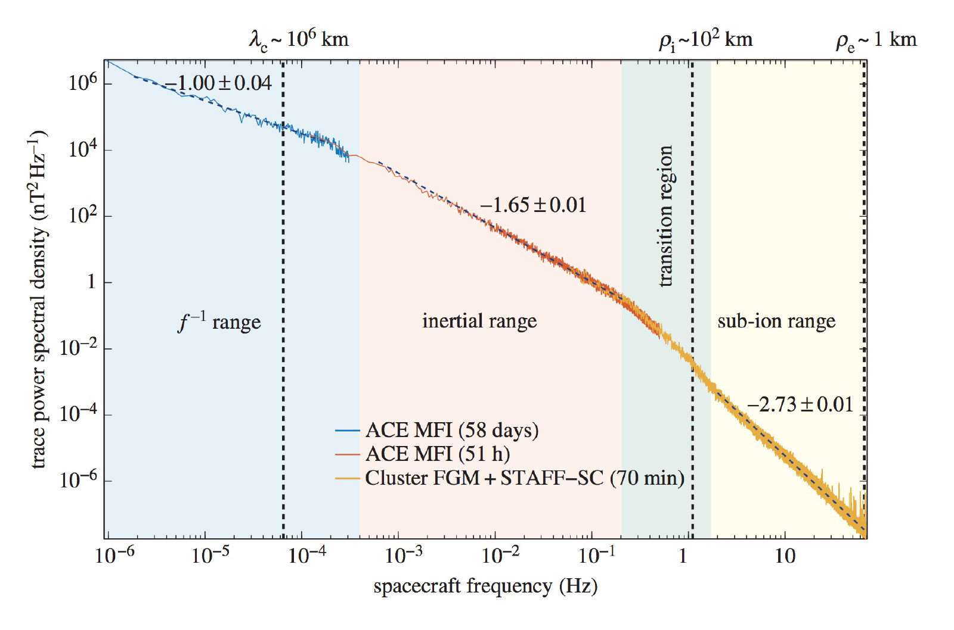
Solar wind turbulence
[Kiyani et al. 2015]
[Sorriso-Valvo et al. 1999]
Fast wind
Slow wind

Slide 4
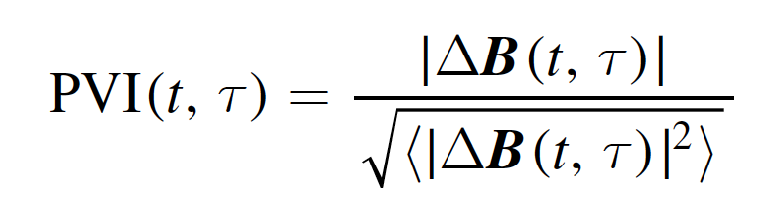
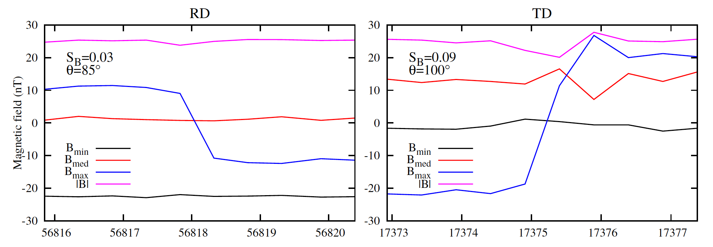
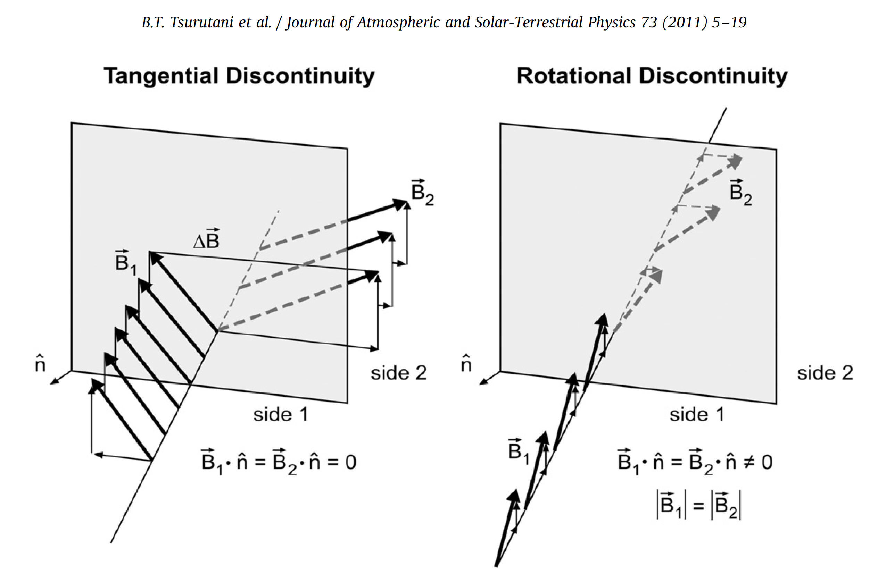
PVI detection of coherent structures in the solar wind
Increments of magnetic field and Partial Variance of Increments (PVI) Method
PVI method is focused to detect
planar discontinuities
[e.g., Veltri & Mangeney 1999, Servidio, et al. 2008, Greco, et al. 2009, 2012, 2014, Perri et al. 2012]
Tsurutani 2011

Slide 5
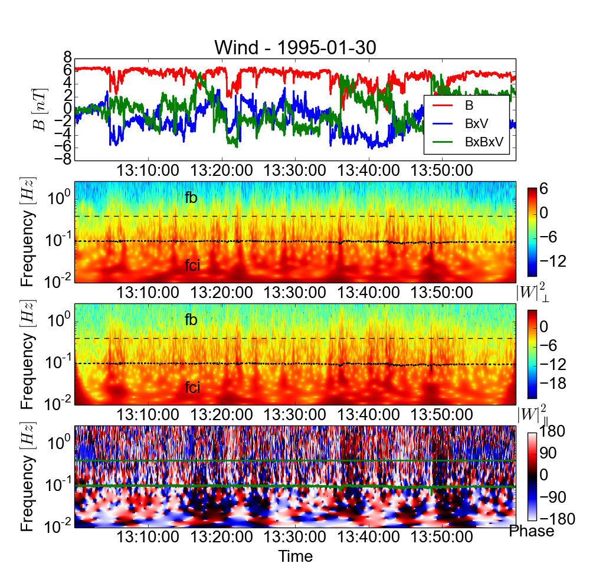
Wavelet detection of ion-scale coherent structures (1 AU)
Current sheet
Alfven vortex
f_{ci}
f_{b}
f_{ρi}
time
δB/B₀=0.7
At the times of events,
in physical space we see:
1. current sheets
2. Alfven vortices
(oblique Θ_{BV})
[Lion, Alexandrova & Zaslavskiy, 2016, APJ, Perrone et al 2016, 2017, Roberts et al 2016]

Slide 6
Coherent structures
Greco 2009, 2016, 2018, Chhiber 2020
PVI detection, MHD scales and ion scales
Waiting times statistics -> clustering/strong embedding (forming groups of structures)
Perrone 2016, 2017:
Ion scale coherent structures (detection using wavelets)
Fast solar wind is dominated by Alfvenic structures
Slow slow solar wind is populated by mixture of both compressible and Alfvenic structures
Role of coherent structures in heating:
Observations (ACE,WIND): Coherent structures correlate with enhancements in (Q_{e},T_{e},T_{i}). [Osman 2011]
Kinetic simulation [Karimabadi 2013] -> reconnection-like heating
We investigate coherent structures from MHD to sub-ion scales
(Cluster 1 au)
At sub-ion scales
Alfvenic
Compressible
[Greco 2016]
Waiting times occurring between isolated Poissonian events, must be distributed according to an exponential function.

Slide 7
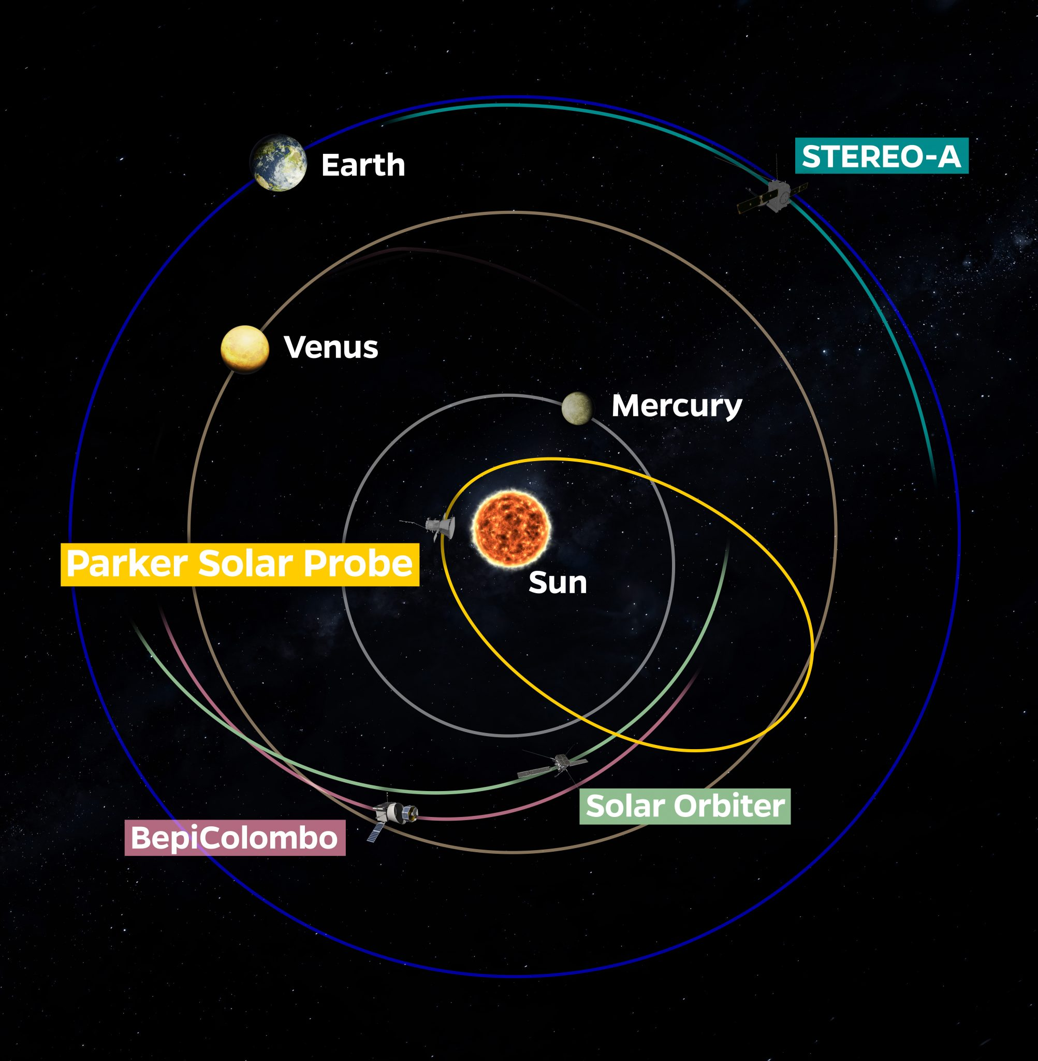
Parker Solar Probe
First encounter: 2018-11-06
• Unique opportunity exploring the turbulence in the “young” solar wind
Radial distance R~25*10⁹ m ~ 0.17 au
• The main goal of our investigation is to characterize solar wind coherent structures from MHD to sub-ion scales
Bale et al., 2019, Nature

Slide 8
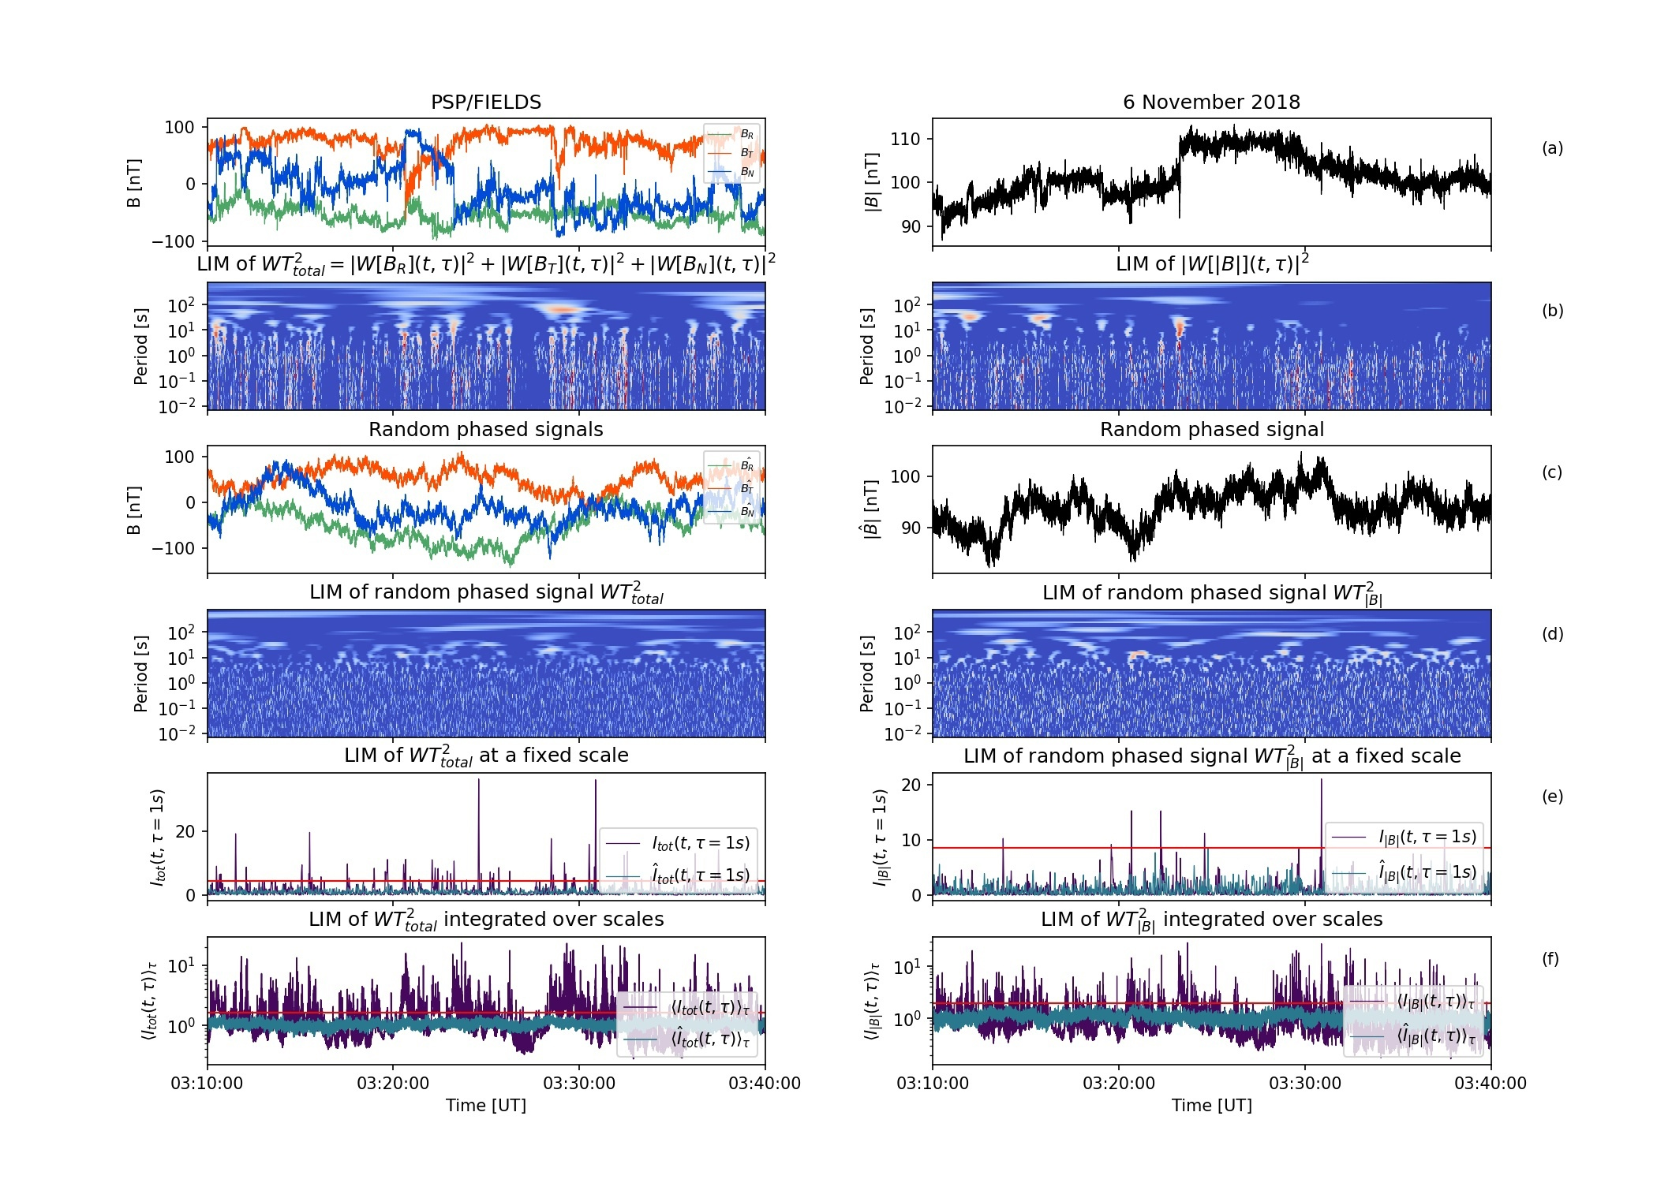
Detection of coherent structures in the solar wind
Data
Total local intermittency measure I(t,τ)_{tot} shows the relative total energy of fluctuations at a given moment in time at a given scale τ
To detect the structures we compare magnetic field measurements with an random-phased signal
Vertical lines: coupled phases across scales ->
Coherent structures
Random phase signal

Slide 9
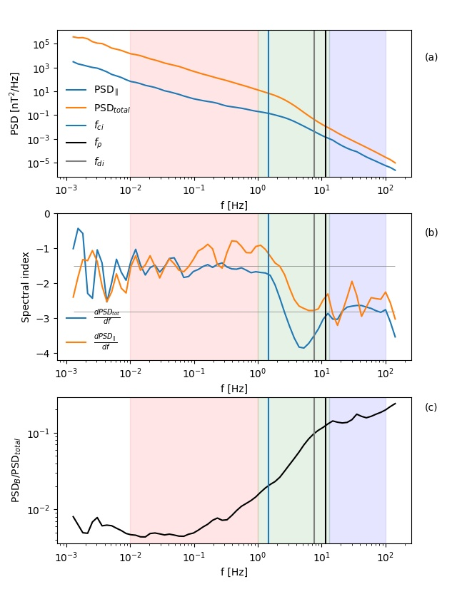
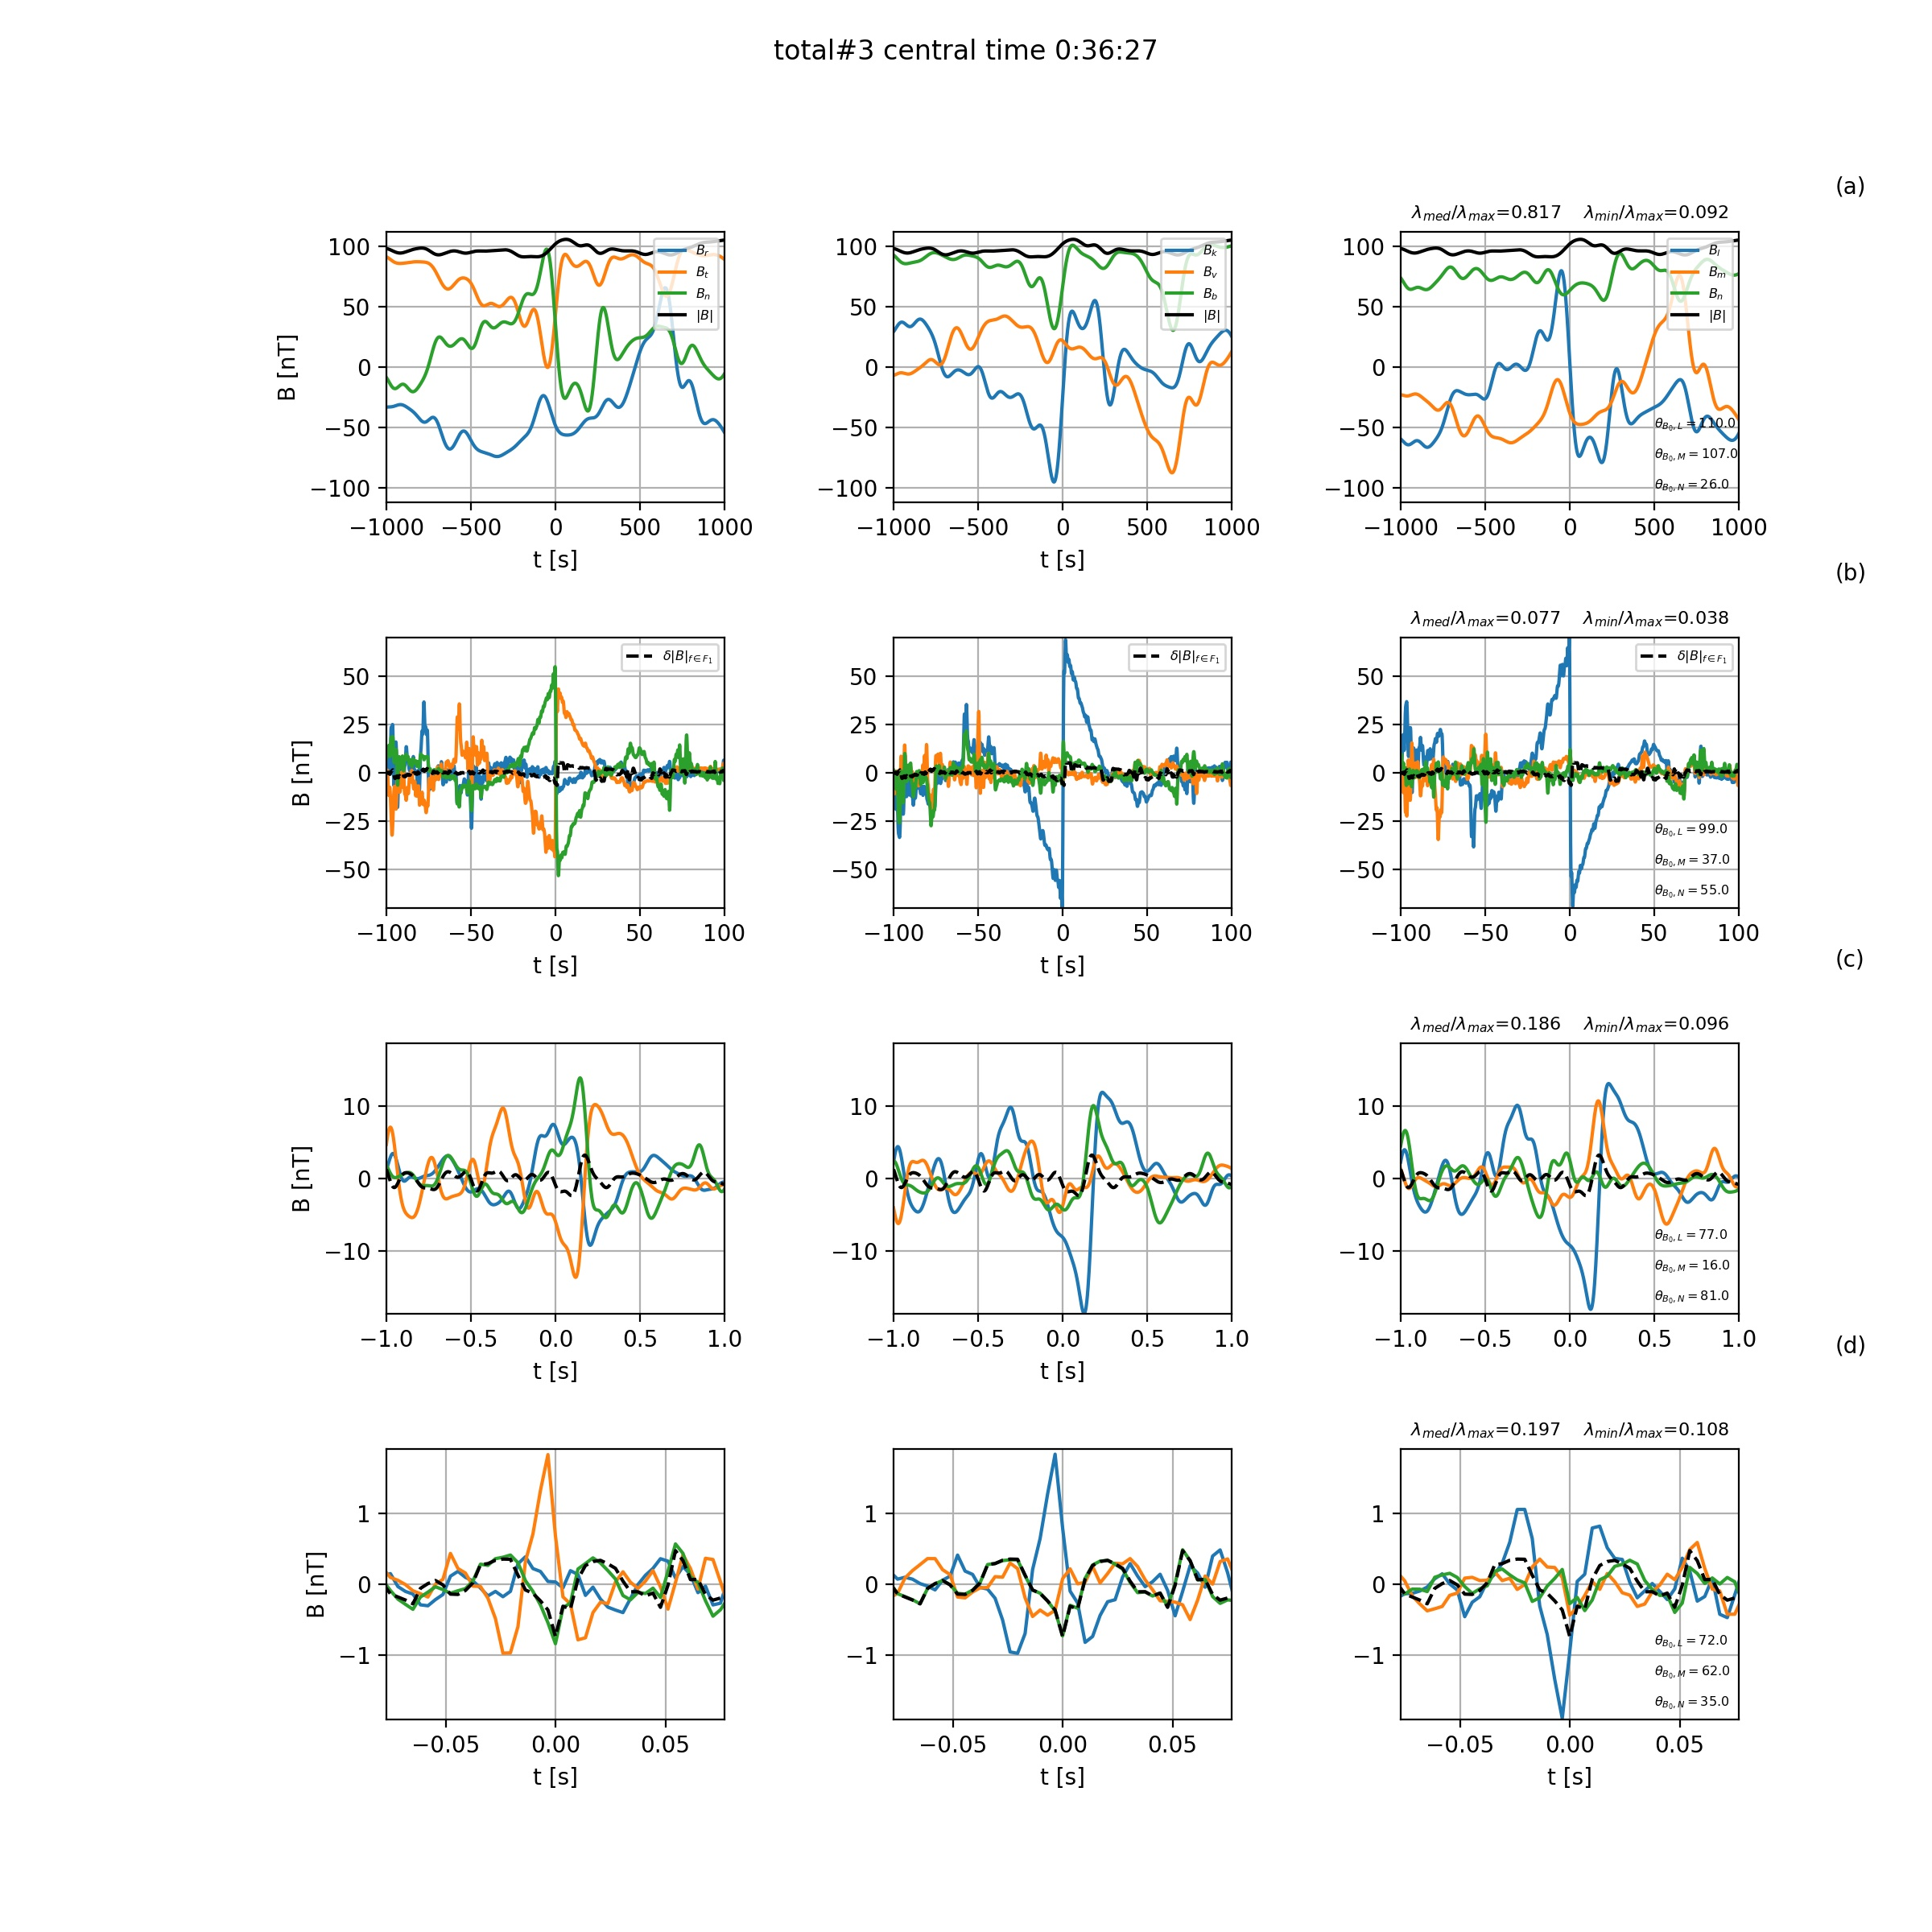
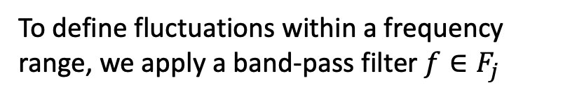
1. Discontinuity
To define fluctuations within a frequency range, we apply a band-pass filter $f∈F_{j}$
• Current sheet at MHD scales
• Interesting sub-ion scale vortex-like structure
• Is it possible that sub-ion structure has been formed as a result of current sheet instability/ reconnection?
(a) (b) (c) (d)
RTN reference frame

Slide 10
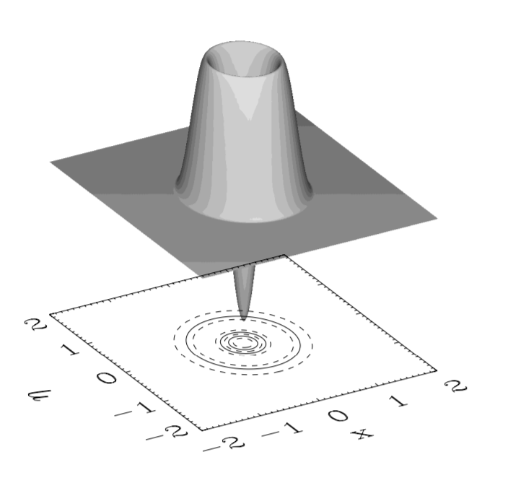
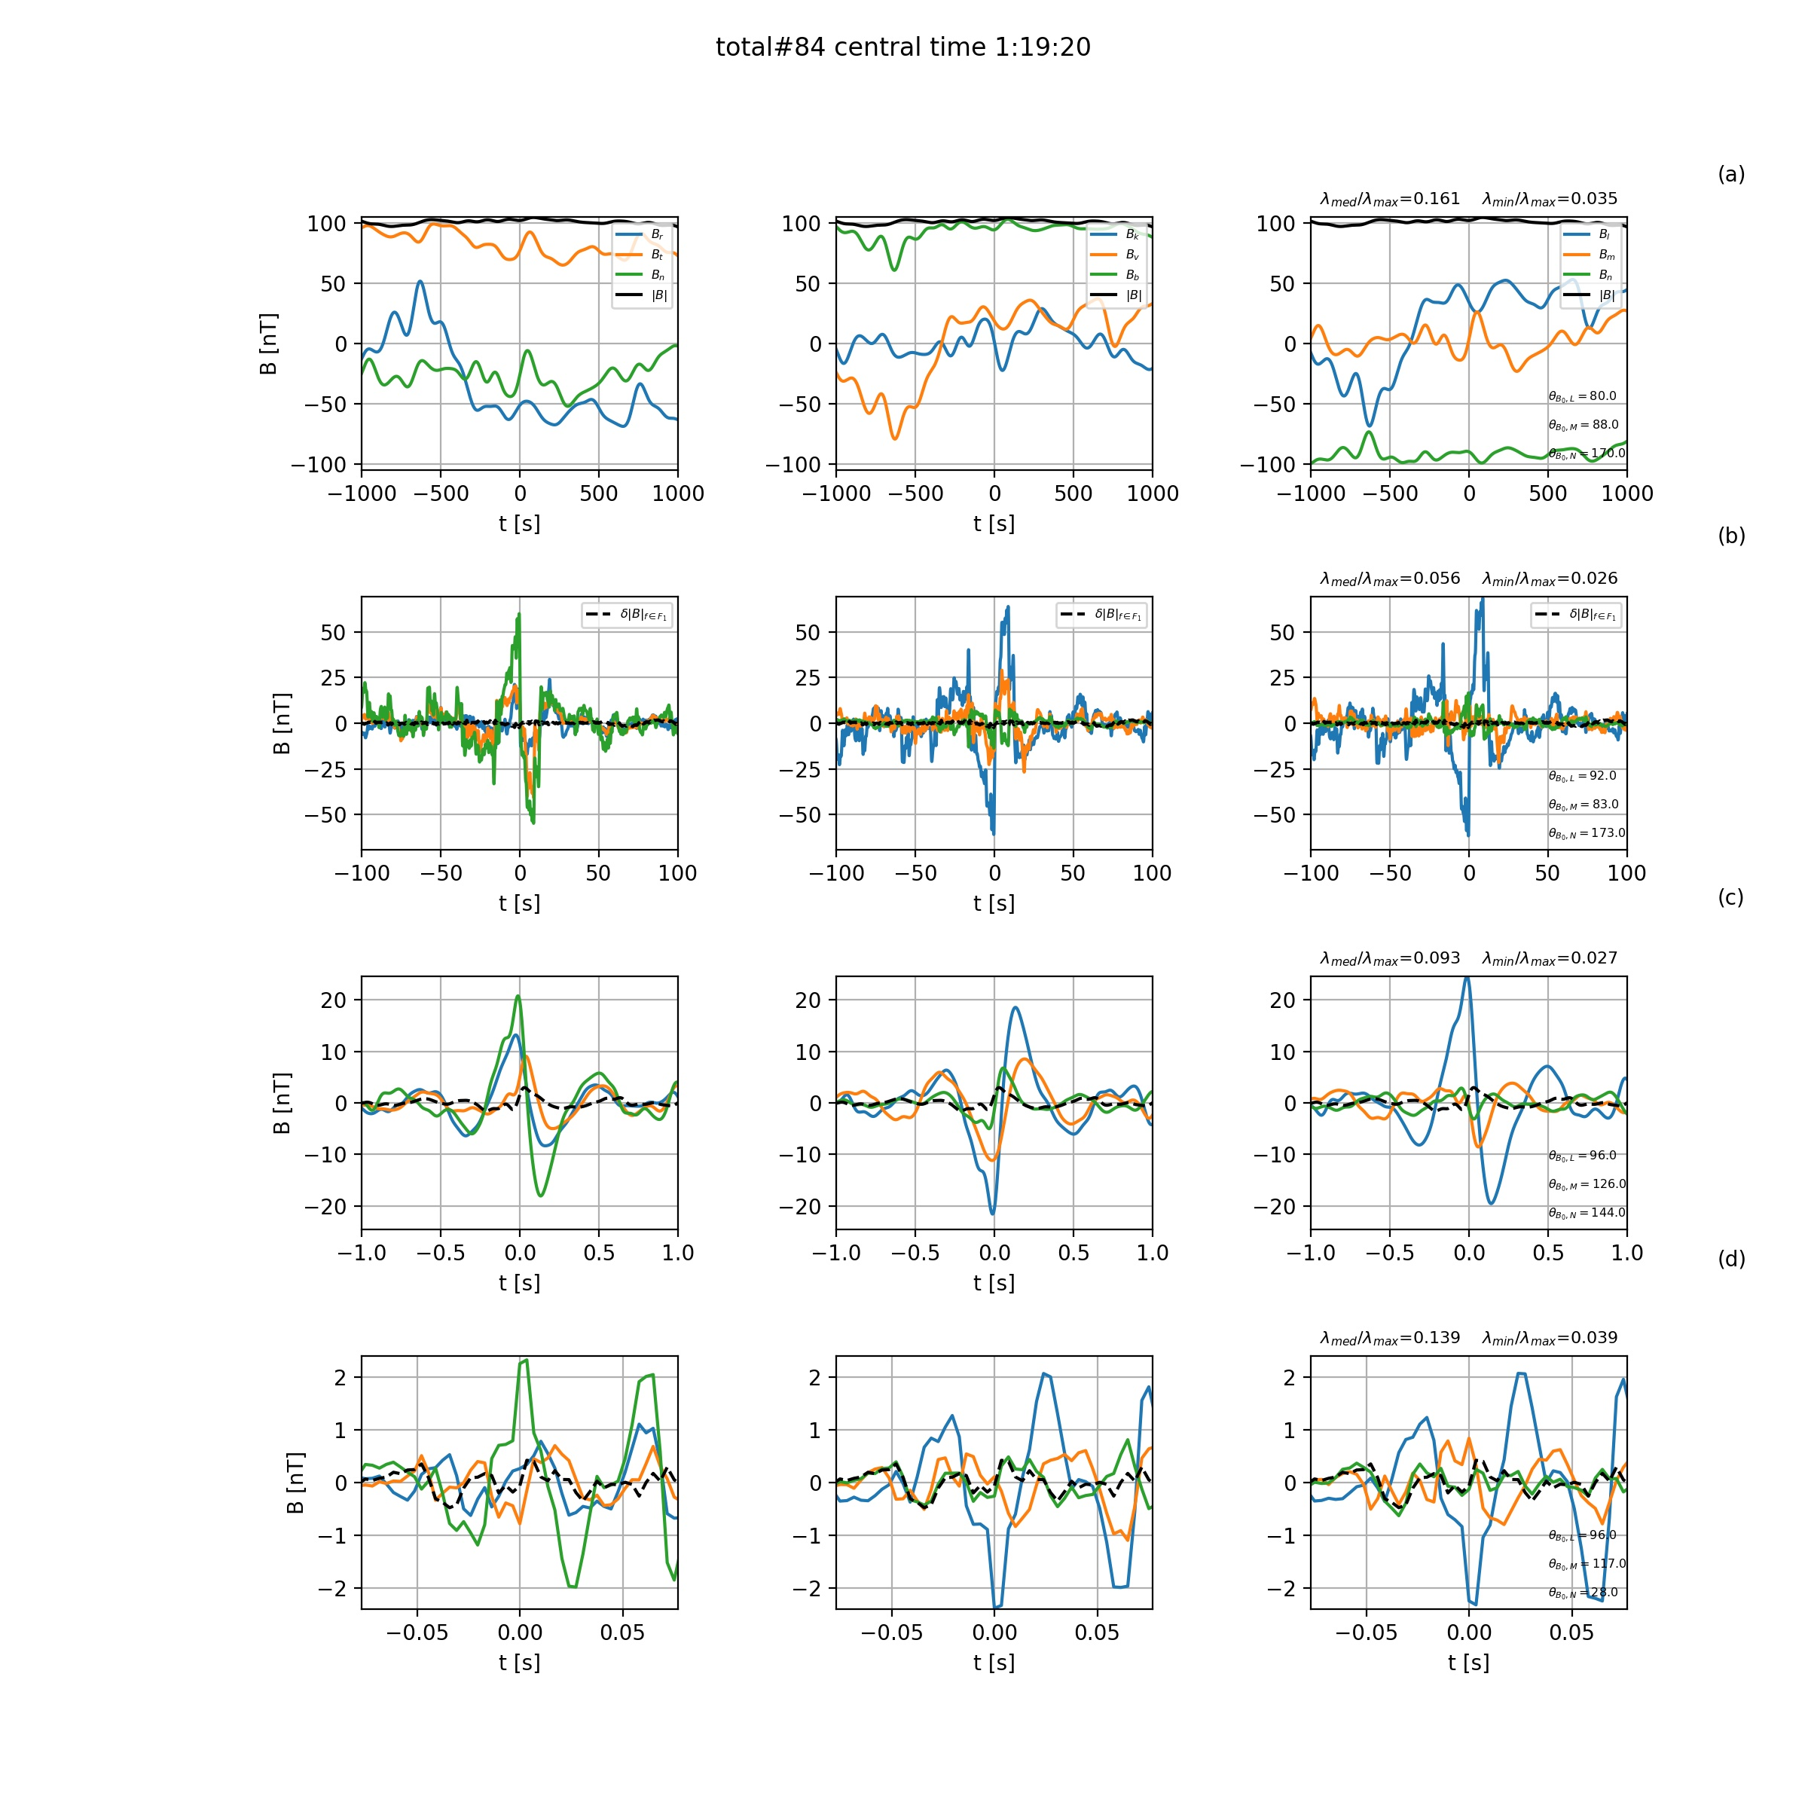
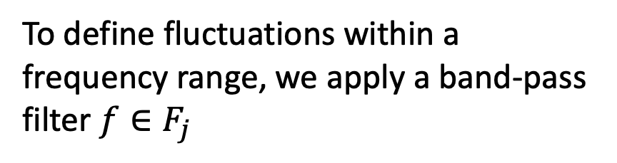
2. Alfven vortex
To define fluctuations within a frequency range, we apply a band-pass filter $f∈F_{j}$
Incompressible MHD vortex [Petviashvilli & Pokhotelov 1992]
Compressible MHD + Ion-scales vortex model: Jovanovic et al. 2020;
Figure from Alexandrova 2008.
(a) (b) (c) (d)
RTN reference frame

Slide 11
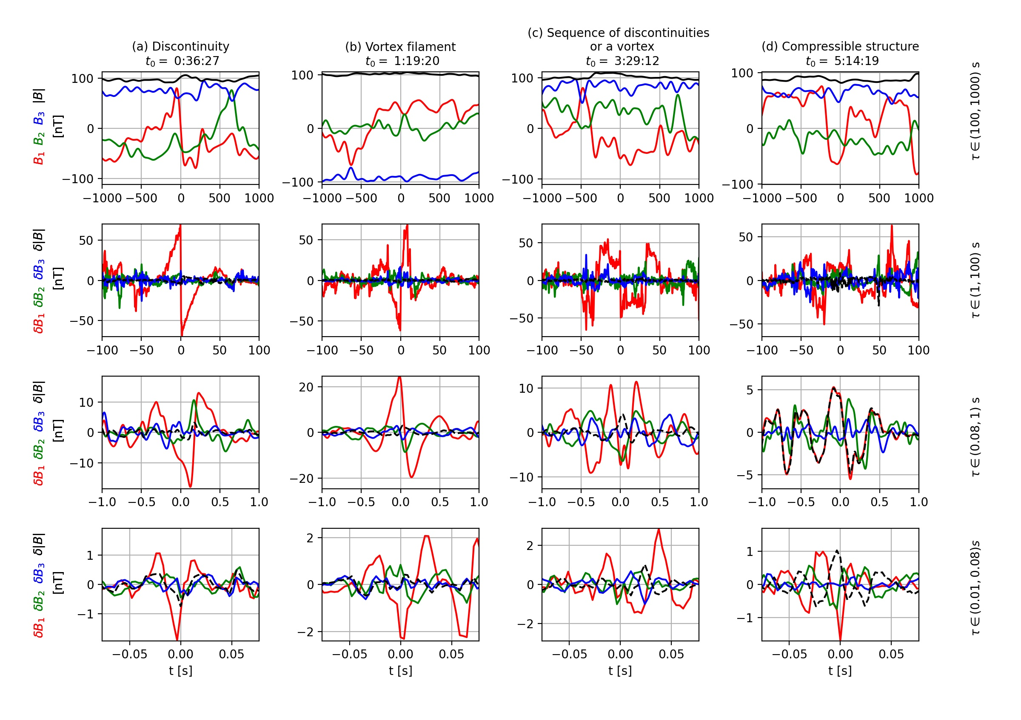
Minimum variance frame

Slide 12
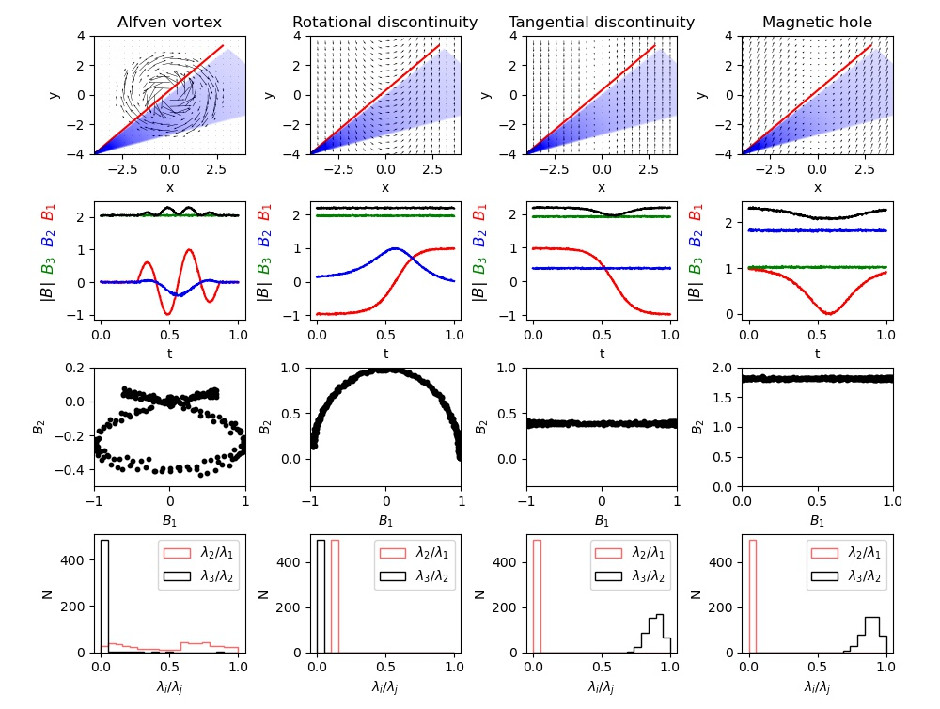
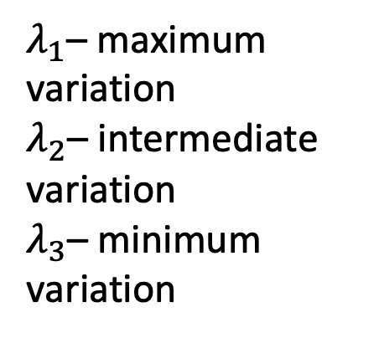
$λ_{1}$– maximum variation
$λ_{2}$– intermediate variation
$λ_{3}$– minimum variation

Slide 13
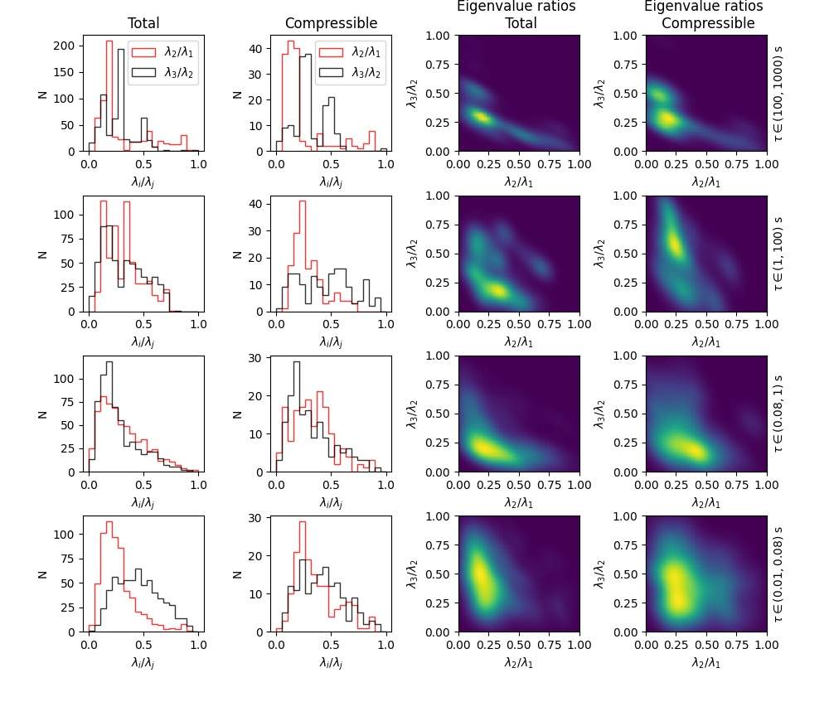
Statistics: 600 structures
Upper left area – tangential discontinuities/magnetic holes
Lower elongated rectangle – Alfven vortexes
Area at the zero vicinity – rotational discontinuities
Both MVA eigenvalue ratios allow to distinguish between different types of structures.
At the largest scales the rotational discontinuities and vortexes dominate.
At the ion scales the vortexes are dominant.
The population of tangential discontinuities/ magnetic holes increases towards the smallest scales.

Slide 14
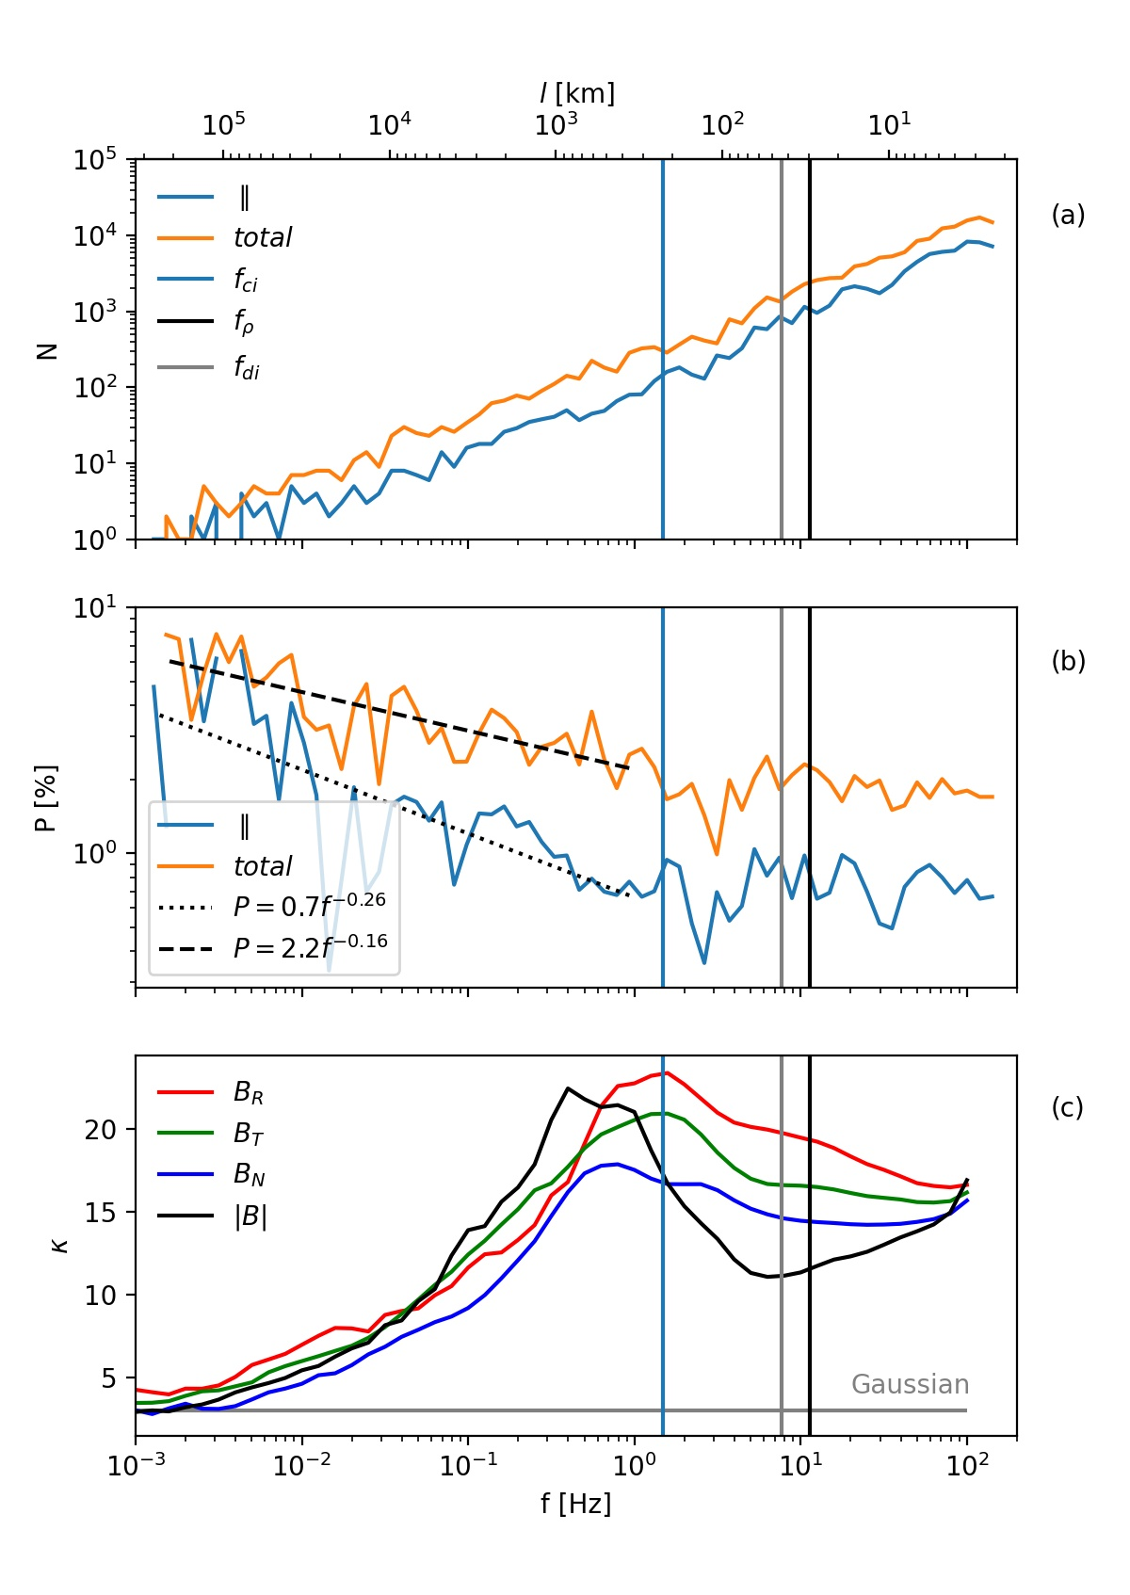
Filling factor of coherent structures
Data
Random phase signal

Slide 15
Preliminary discussion:
Number of coherent structures and flux ropes
Smaller scales structures are more numerous (f=1/time-scale), number of structures N follows the power low: N ~ f^{γ} , γ=0.8
Formation of high-LIM events is not only at MHD scales, but it also continues to sub-ion scales (without any particular change at ion scales).
[Janvier et al 2014] The in-situ measurements were fitted with the cylindrical force-free flux rope (FR) model -> radius and orientation.
Two populations:
large FR (associated with Magnetic Clouds)
smaller-scale flux ropes (probably, formed by blowout jets in the low corona or in coronal streamers) with power-low radius distribution
[Janvier et al 2014]

Slide 16
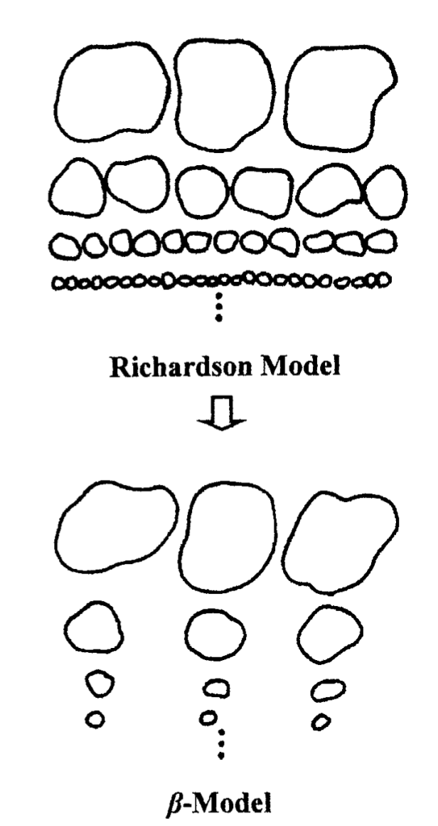
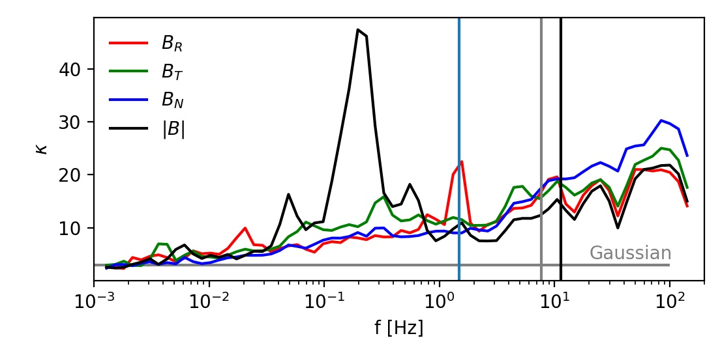
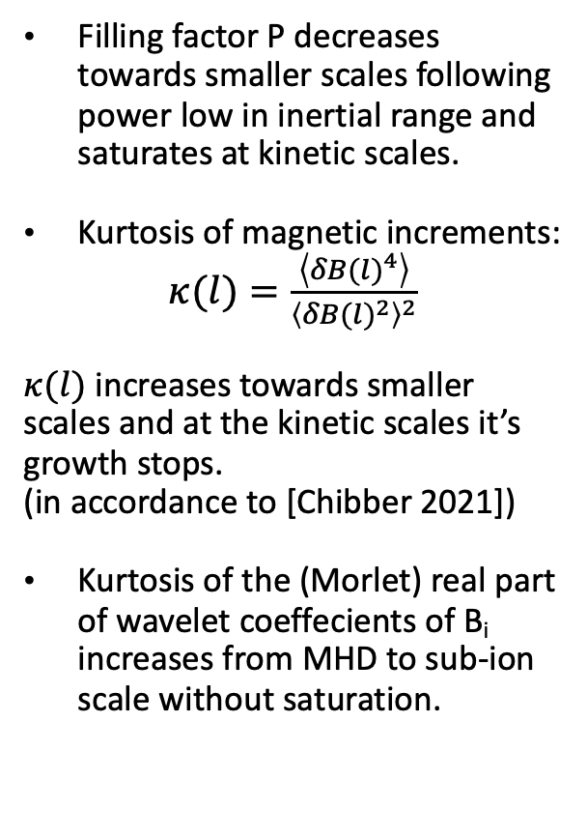
Inertial range
Sub-ion scales
Filling factor
Filling factor P decreases towards smaller scales following power low in inertial range and saturates at kinetic scales.
Kurtosis of magnetic increments:
$κ(l)=\frac{\left\langle {δB(l)}^{4}\right\rangle }{{\left\langle {δB(l)}^{2}\right\rangle }^{2}}$
$κ(l)$ increases towards smaller scales and at the kinetic scales it’s growth stops.
(in accordance to [Chibber 2021])
Kurtosis of the (Morlet) real part of wavelet coeffecients of B_{i} increases from MHD to sub-ion scale without saturation.
?

Slide 17
Conclusion (1)
We observe solar wind coherent structures to cover wide range of scales: from MHD to ion kinetic scales and below.
In order to classify the structures we compare properties of magnetic fluctuations in the vicinity of coherent structure centres with the simulation of coherent structures crossing.
Statistics of MVA eigenvalue ratios suggest that magnetic fluctuations are consistent with crossing different types of coherent structures:
MHD Inertal range | Rotational discontinuities
Ion scales | Alfven vortexes & rotational discontinuities
Sub-ion scales | Tangential discontinuities/ Magnetic holes

Slide 18
Conclusion (2)
Intermittent events increase in number towards smaller scales without any significant change at ion kinetic scales.
Continious transition from Inertial range coherent structures to independent observations of flux ropes (Janvier 2014)
The filling factor decrease at MHD inertial range following the power low and saturates at constant value staring from ion scales.

Slide 19
Opened questions:
How do structures dissipate and heat plasma? Are sub-ion scale structures dissipating the most efficiently?
Filling factor decrease in the inertial range and saturates at ion scales - is it due to different properties of MHD and sub-ion scale structures? Is it related to multifractality on MHD scales and monofractality on sub-ion scales?
How many MHD scale coherent structures are isolated (doesn’t contain any smaller embedded substructures)? Isolated=stable?
Are the embedded structures formed as a result of instability?
Larger scale flux ropes: are they assotiated with the turbulent energy injection?

Slide 20
Additional slides

Slide 21
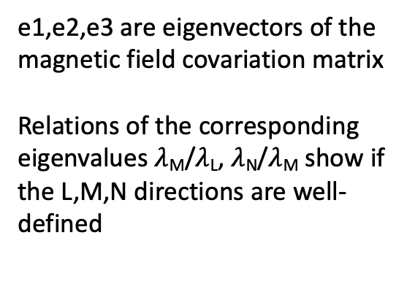
Reference frames
Radial Tangential Normal
(RTN) reference frame
Minimum variance (MVA)
Reference frame
N
T
e3
SC
e2
Sun
SC
R
SC
e1
Ecliptic plane
B
e1,e2,e3 are eigenvectors of the
magnetic field covariation matrix
Relations of the corresponding eigenvalues $λ$_{M}/$λ$_{L}, $λ$_{N}/$λ$_{M} show if the L,M,N directions are well-defined
Ecliptic plane related reference frame

Slide 22
Spectral properties and intermittent events
LIM (Local Intermittency Measure)
[Farge 1990]:

Slide 23
Detection of the events with strong magnetic field modulus variation
Data
The approach of selecting structures by total energy alone is not complete, as it can miss structures with change in magnetic field modulus.
For completeness, we perform the same analysis on longitudinal magnetic fluctuations.
Random phase signal

Slide 24
Current density in 2D MHD simulations:
Intermittency in space plasma turbulence (MHD)
• Intermittency is due to appearance of coherent structures.
What is the nature of coherent structures in the solar wind at MHD and kinetic scales ?
Matthaeus W.H. et al, “Intermittency, nonlinear dynamics and dissipation in the solar wind and astrophysical plasmas.” Phil. Trans. R. Soc. A, 2015.

Slide 25
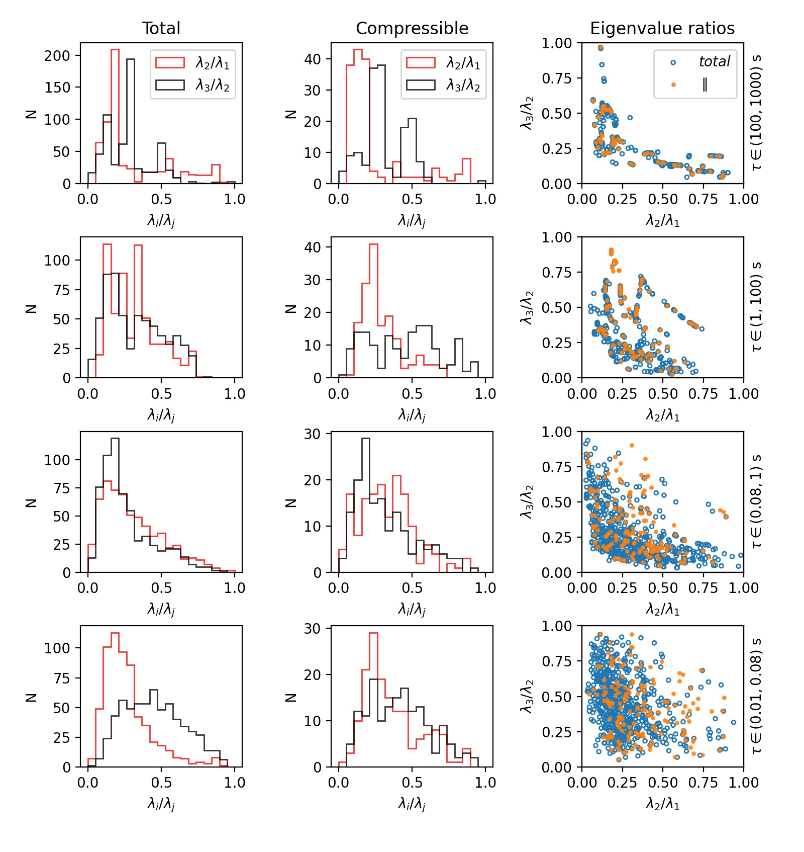
Eigenvalues histograms from MHD to subion scales
Green area – rotational discontinuities
Blue area – Alfven vortexes
Red area – tangential discontinuities/magnetic holes
At the largest scales the rotational discontinuities and vortexes dominate.
At the ion scales the vortexes are dominant.
The population of tangential discontinuities/ magnetic holes increases towards the smallest scales.

Slide 26
Amplitude anisotropy from MHD to subion scales
600 total
160compressible
Upper left area – rotational discontinuities
Lower elongated rectangle – Alfven vortexes
Area at the zero vicinity – tangential discontinuities/magnetic holes
Both MVA eigenvalue ratios allow to distinguish between different types of structures.
At the largest scales the rotational discontinuities and vortexes dominate.
At the ion scales the vortexes are dominant.
The population of tangential discontinuities/ magnetic holes increases towards the smallest scales.

Slide 27
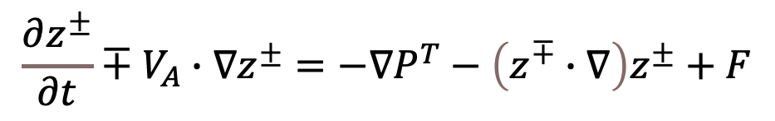
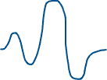

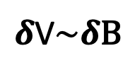



Iroshnikov-Kraichnan (IK) model (1963,1965)
Amplitude variation after one interaction:
Incompressible MHD in terms of the Elsasser variables with B₀:
Changes in wave packet amplitude are random.
Wave packet dissipates after N interactions:
$$z^{±}=δV±δB$$
$$\frac{∂z^{±}}{∂t}∓V_{A}∙∇z^{±}=−∇P^{T}−\left(z^{∓}∙∇\right)z^{±}+F$$
Time of the energy transfer to the smaller scales:
Only oppositely propagating Alfven wave packets interact nonlinearly:
Assuming constant energy transfer rate:
V_{A}
V_{A}
This yields to power spectrum with index -3/2:
$δ$V$\sim δ\text{B}$
IK model describes isotropic MHD turbulent cascade
Interaction time: $τ=\frac{λ}{V_{A}}$
$$λ$$

Slide 28




Critically balanced model of Goldreich & Sridhar (1995)
Anisotropy of the fluctuations
Magnetic field spectrum
for :
Incompressible, Alfvenic (dV=dB), anisotropic turbulence in presence of large scale magnetic field B
The eddies become anisotropic with scales λ transverse to B and l parallel to B, λ < l (i.e. the eddies are elongated along the average magnetic field).
Critical balance condition: linear (along B) and non-linear (perp to B) times are of the same order:
t_{NL}=λ /δv_{λ⊥} ∼ t_{L}=t_{A} = l/v_{A}
$$E_{GS}(k)\sim k_{⊥}^{−5/3}$$
Magnetic field spectrum
for :
$$E_{GS}(k)\sim k_{∥}^{−2}$$
S. Boldyrev, Phys. Rev. Lett. (2006)

Slide 29


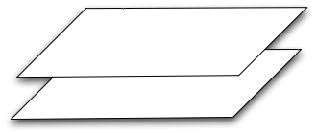


How to measure k-anisotropy of turbulent fluctuations with one satellite?
B₀
V
B₀
Slab
2D
[Image credit:
Olga Alexandrova]
V
If Taylor hypothesis (V_{ϕ}<< V) is verified ⇒ variation of field-flow angle allows to resolve slab fluctuations while V is || to B and 2D fluctuations while V is ⊥ to B.
See [Bieber et al., 1996; Mangeney et al., 2006; Horbury et al., 2008; …]
Slab
2D
[Image credit:
Tim Horbury]
Power
Power
0°
Field/flow angle
90°
0°
Field/flow angle
90°

Slide 30
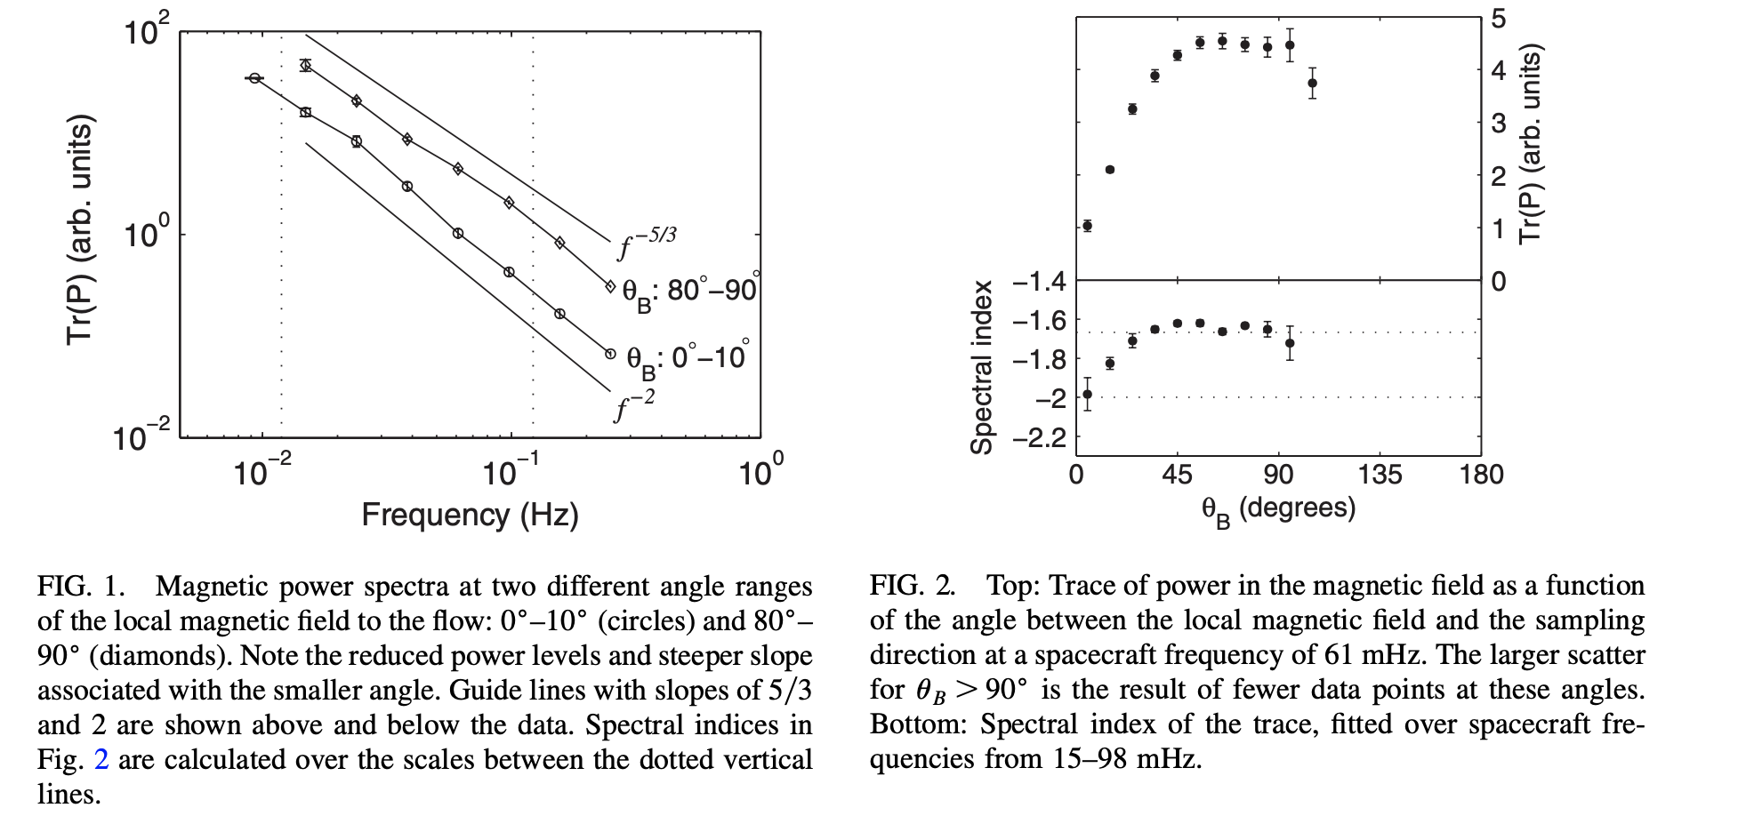
Оbservations of k-anisotropy in the solar wind
Horbury, T. S., Forman, M., and Oughton, S., “Anisotropic Scaling of Magnetohydrodynamic Turbulence”, Physical Review Letters, 2008.
2D
Power
0°
Field/flow angle
90°
2D turbulence dominates
Spectral indices are in agreement with critical balance (CB) model
But δV-spectra in the solar wind are not the same as δB-spectra => problem with CB… not resolved.

Slide 31
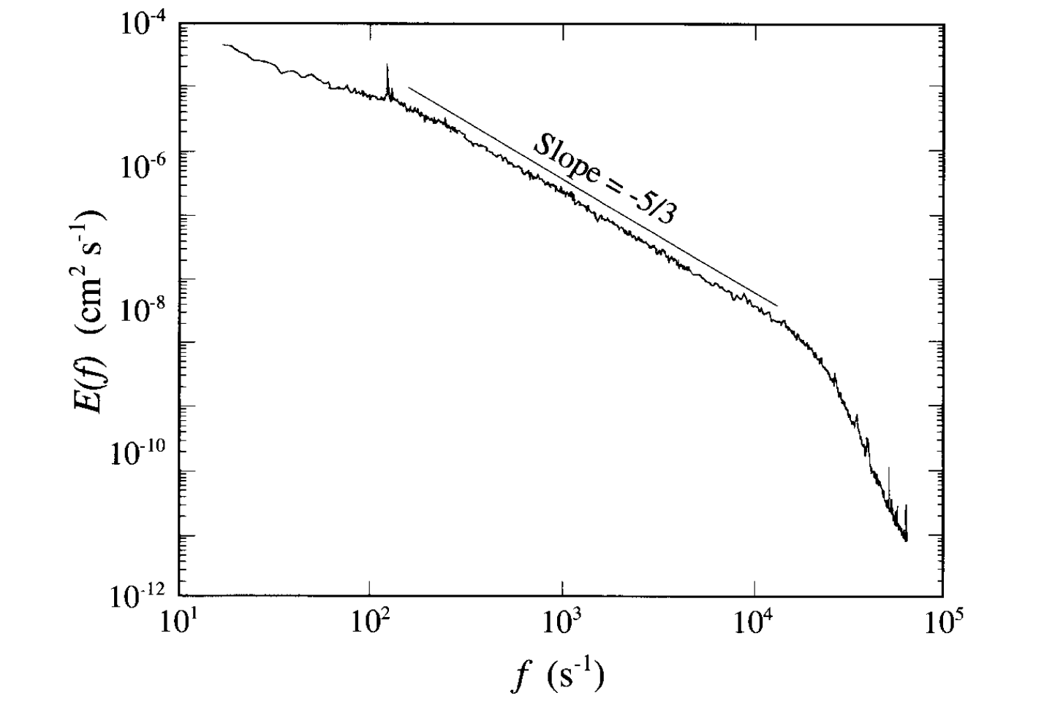
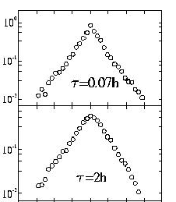
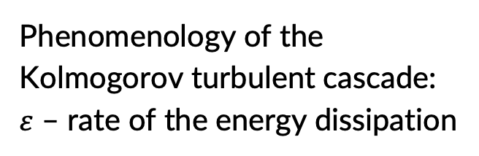
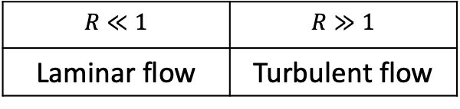

Phenomenology of the fluid turbulence
Phenomenology of the Kolmogorov turbulent cascade:
$ε$ – rate of the energy dissipation
Intermittency: It is known to be related to appearance of coherent structures (vortex filaments), Frisch 1995.
Navier-Stokes equation:
Kolmogorov spectrum:
Reynolds number*:
$$E\left(k\right)=C∙ε^{2/3}k^{−5/3}$$
$$R≪1$$ | $$R≫1$$
Laminar flow | Turbulent flow
PDF(δv)
Small scale
Large scale
δv_{l}=v(r+l)-v(r)
* υ - viscosity, L and V – characteristic scale and velocity of the flow

Slide 32
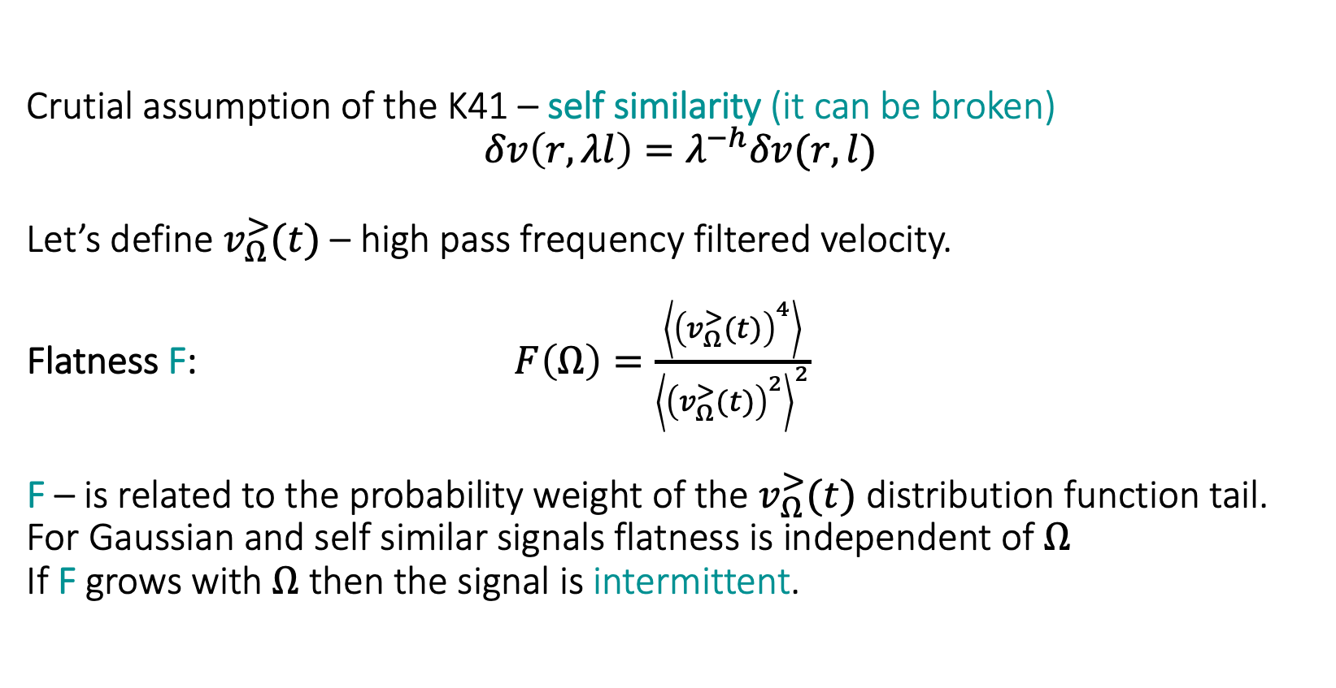
Intermittency in neutral fluid
Crutial assumption of the K41 – self similarity (it can be broken)
$δv\left(r,λl\right)=λ^{−h}δv(r, l)$
Let’s define $v_{Ω}^{>}(t)$ – high pass frequency filtered velocity.
Flatness F: $F\left(Ω\right)=\frac{\left\langle {\left(v_{Ω}^{>}(t)\right)}^{4}\right\rangle }{{\left\langle {\left(v_{Ω}^{>}(t)\right)}^{2}\right\rangle }^{2}}$
F – is related to the probability weight of the $v_{Ω}^{>}(t)$ distribution function tail.
For Gaussian and self similar signals flatness is independent of $Ω$
If F grows with $Ω$ then the signal is intermittent.

Slide 33
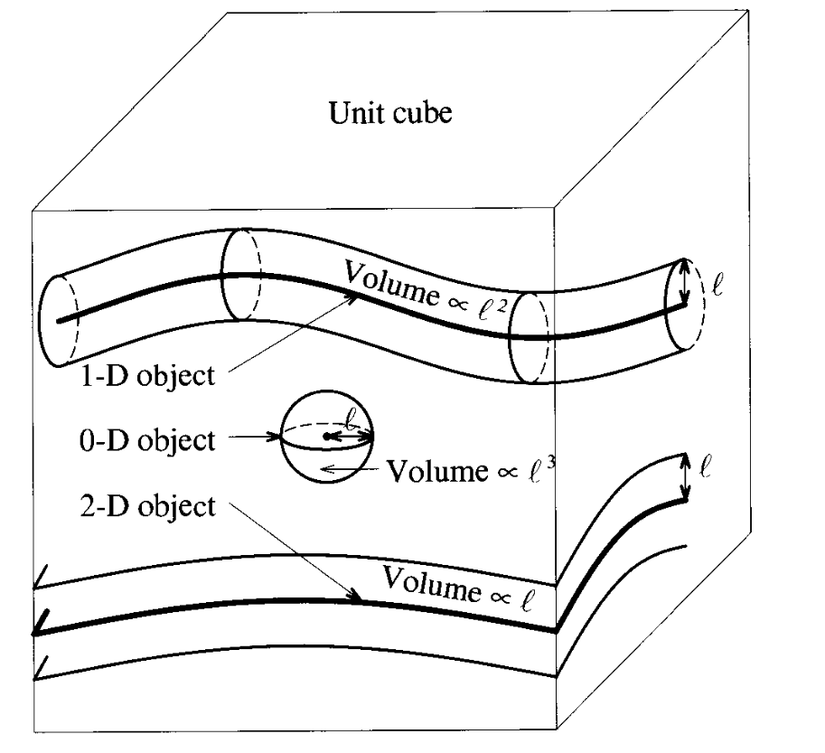
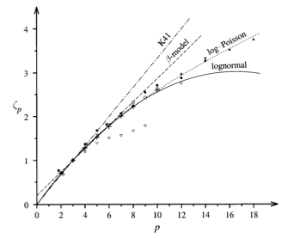
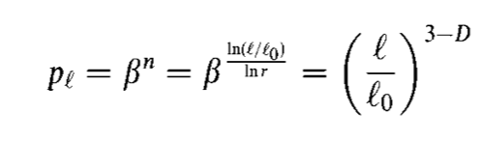


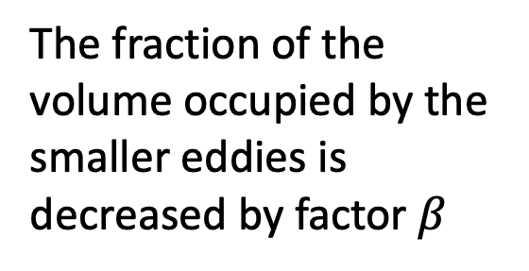
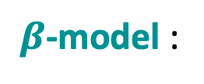
Intermittency in neutral fluid
$β$-model :
The fraction of the volume occupied by the smaller eddies is decreased by factor $β$
D(L) – fractal dimention of the set L on which the cascade accumulates when l->0
Decreasing filling factor for smaller scale fluctuations
Structure function S_{p}
Steeper spectrum
Linear-plus constant scaling exponent

Slide 34
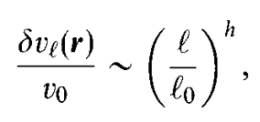

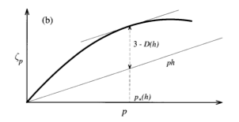

Multifractal model
Structure function
The turbulent volume is thought to be locally scale invariant with scaling exponents I=(h_{min,}h_{max}). For each h in this range there is a volume V of fractal dimention D(h) such that:
Structure function exponent
h(x) quantifies the local regularity of the observed fields at the point x: when h(x) is close to 0, the field is very irregular at the point x, while larger values of h(x) are related to a smoother behavior at x.
V_{PSP}
Anomalious scaling of the structure functions
h=1/3 (K41)
PSP
h=1/3-(D-3)/3
(β model)
Bifractal model

Slide 35
Coherent structures cause multifractal scaling exponent
Multifractal
SOLAR WIND MAGNETOHYDRODYNAMICS TURBULENCE: ANOMALOUS SCALING AND ROLE OF INTERMITTENCY
Salem (2009)

Slide 36
Radial dependence of the filling factor of
high-PVI events (HELIOS 2)
End of inertial range
PVI(dt=6s) (in case of fast solar wind)
PVI(dt=12s) (in case of slow solar wind)
Chhiber 2020
[Greco 2012]

Slide 37
Coherent structures in the solar wind
Coherent structures
Alfvenic (transverce)
Magnetic holes
Solitons
Compressive
Current sheets
Alfvenic vortex
Shocks
Compressional vortex
[Veltri et al. 1999;
Salem, PHD, 2000;
Mangeney et al. 2001;
…
Greco et al. 2008, 2009,
…
Lion et al. 2016, Roberts et al. 2016;
Perrone et al. 2016, 2017, 2020]

