Slide 1
The Helicity Sign of Flux Transfer Event Flux Ropes and its Relationship to the Guide Field and Hall Physics in Magnetic Reconnection at the Magnetopause
Souhail Dahani¹, R. Kieokaew¹, V. Génot¹, B. Lavraud^{1,2}, Y. Chen³, B. Michotte de Welle⁴, N. Aunai⁴, G. Toth⁵, P. A. Cassak⁶, N. Fargette¹, R. C. Fear⁷, A. Marchaudon¹, D. Gershman⁸, B. Giles⁸, R. Torbert⁹, and J. Burch¹⁰
¹Institut de Recherche en Astrophysique et Planétologie, CNRS, UPS, CNES, Université de Toulouse, Toulouse, France
²Laboratoire d’Astrophysique de Bordeaux, Univ. Bordeaux, CNRS, B18N, allée Geoffroy Saint-Hilaire, 33615 Pessac, France
³Departement of Astrophysical Sciences and Princeton Plasma Physics Laboratory, Princeton University, Princeton, NJ, USA
⁴Laboratory of Plasma Physics, CNRS, Ecole Polytechnique, UPMC, Université Paris Sud, Orsay, France
⁵Departement of Climate and Space sciences and Engineering, University of Michigan, Ann Arbor, MI, USA
⁶Departement of Physics and Astronomy and center for KINETIC Plasma Physics, West Virginia University, Morgantown, WV, USA
⁷School of Physics & Astronomy, University of Southampton, Southampton, UK
⁸NASA Goddard Space Flight Center, Greenbelt, MD, USA
⁹Space Science Center, University of New Hampshire, Durham, NH, USA
¹⁰Southwest Research Institute, San Antonio, TX, USA
PNST (Programme National Soleil Terre)
Colloque scientifique, Marseille
16-20 mai 2022
sdahani@irap.omp.eu
The background is a simulation result from Y. Chen (Chen et al. (2020))

Slide 2
Outline
1
Introduction
2
Data & methods
3
Results & discussion
4
Conclusions
sdahani@irap.omp.eu
PNST 16-20 mai 2022
2

Slide 3
Outline
1
Introduction
2
Data & methods
3
Results & discussion
4
Conclusions
sdahani@irap.omp.eu
PNST 16-20 mai 2022
3

Slide 4
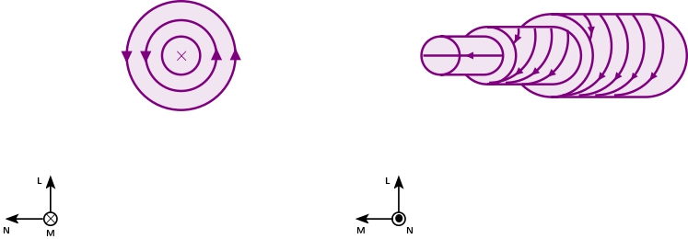
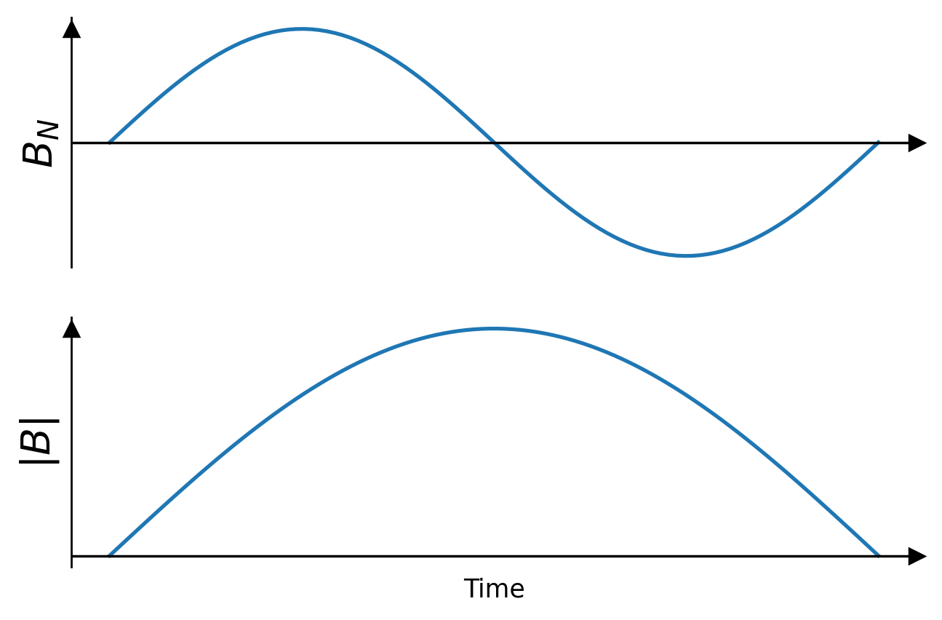
Flux Transfer Events (FTEs)
s/c trajectory
FTEs are magnetic flux ropes produced at the dayside magnetopause as a consequence of magnetic reconnection
FTEs are characterized by bipolar variation of $B_{N}$ and an enhancement of $|B|$
sdahani@irap.omp.eu
PNST 16-20 mai 2022
4

Slide 5
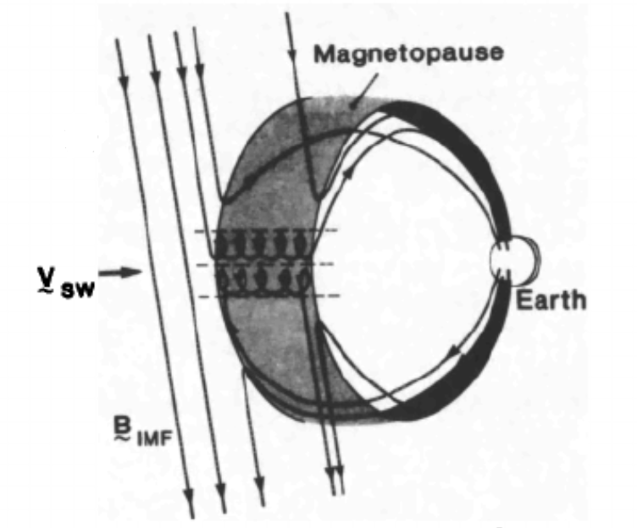
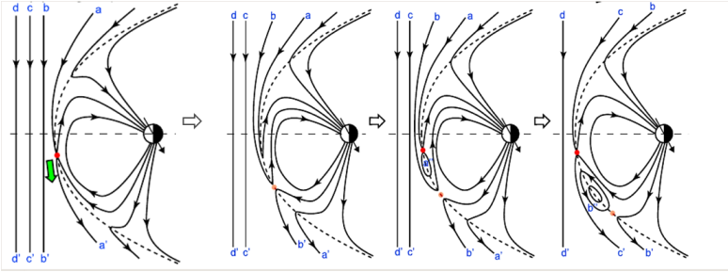
Generation of FTEs
FTEs can be generated by multiple (simultaneous or sequential) magnetic reconnection) (Lee and Fu (1985), Raeder (2006) and Dorelli and Bhattacharjee (2009))
Simultaneous magnetic reconnection at multiple locations (Lee & Fu (1985))
Sequential X line reconnection under a large Earth’s dipole tilt (Raeder (2006)).
Credit: Hasegawa et al. (2010)
sdahani@irap.omp.eu
PNST 16-20 mai 2022
5

Slide 6
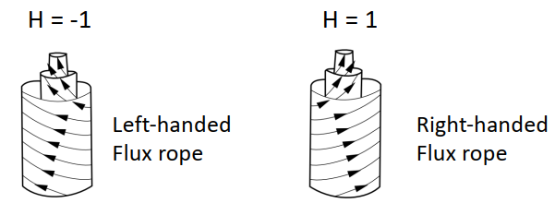
Magnetic helicity
Magnetic helicity is a quantity that describes topological features of magnetic field lines, defined as:
$ℋ=\int_{V}{B⋅A dV}$ $(B=∇×A)$
We consider the twisting feature of FTE flux ropes
_{H =-1}
_{H =+1}
(LH)
(RH)
Adapted from Bothmer and Schwenn (1998)
sdahani@irap.omp.eu
PNST 16-20 mai 2022
6

Slide 7
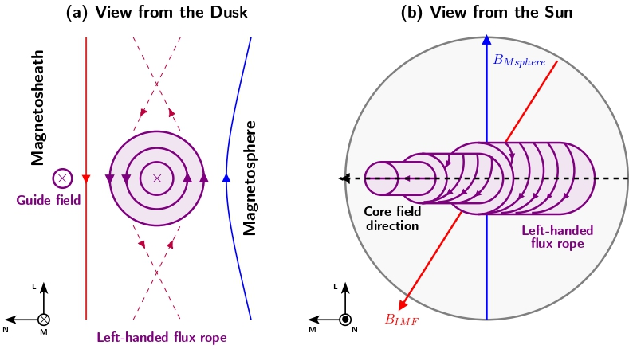
Motivation
Kieokaew et al. (2021): using data from Magnetospheric Multiscale (MMS)→ the helicity sign of FTE flux ropes are mostly controlled by the interplanetary magnetic field (IMF) $B_{y}$, but not all!
Statistics and spatial coverage extended with Cluster mission
Flux ropes preceded by IMF $B_{y}>0$ are RH $(H=+1)$
Flux ropes preceded by IMF $B_{y}<0$ are LH $(H=−1)$
sdahani@irap.omp.eu
PNST 16-20 mai 2022
7
Notes:
Add small description about the figure

Slide 8
Outline
1
Introduction
2
Data & methods
3
Results & discussion
4
Conclusions
sdahani@irap.omp.eu
PNST 16-20 mai 2022
8

Slide 9
Data
84 events from MMS studied by Kieokaew et al. (2021), compiled by Fargette et al. (2020)
82 events from Cluster, a subset from a list published by Fear et al. (2012)
sdahani@irap.omp.eu
PNST 16-20 mai 2022
9
Notes:
Add small description about the figure

Slide 10
Burlaga’s model
While the helicity could be determined from magnetic field data, we verify it by fitting our events to a force-free ($ΔB=−α^{2}B$) flux rope model (Burlaga (1988))
The model is defined as:
$B_{A}=B_{0}J_{0}\left(αR\right)$
$B_{T}=B_{0}HJ_{1}\left(αR\right)$
$B_{R}=0$
$B_{0}$ is the maximum field found at $t=t_{0}$
$H$ is the helicity sign
$J_{0}, J_{1}$ are Bessel’s functions
$R=R(t_{0}, θ_{0},φ_{0},b_{0})$
sdahani@irap.omp.eu
PNST 16-20 mai 2022
10
Notes:
Add small description about the figure

Slide 11
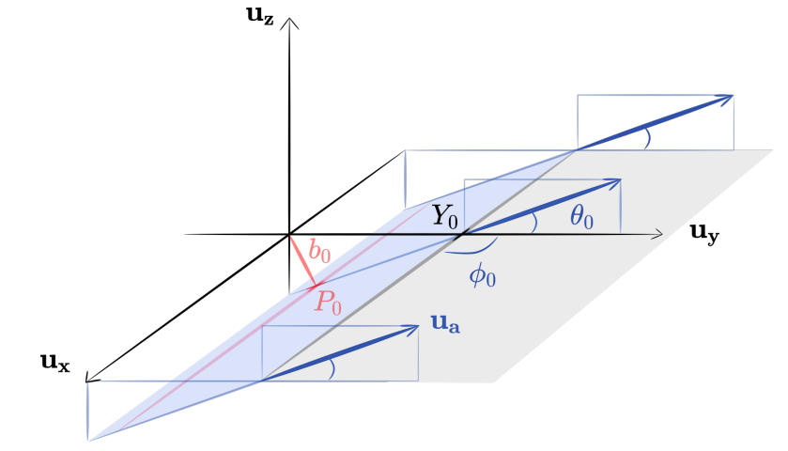
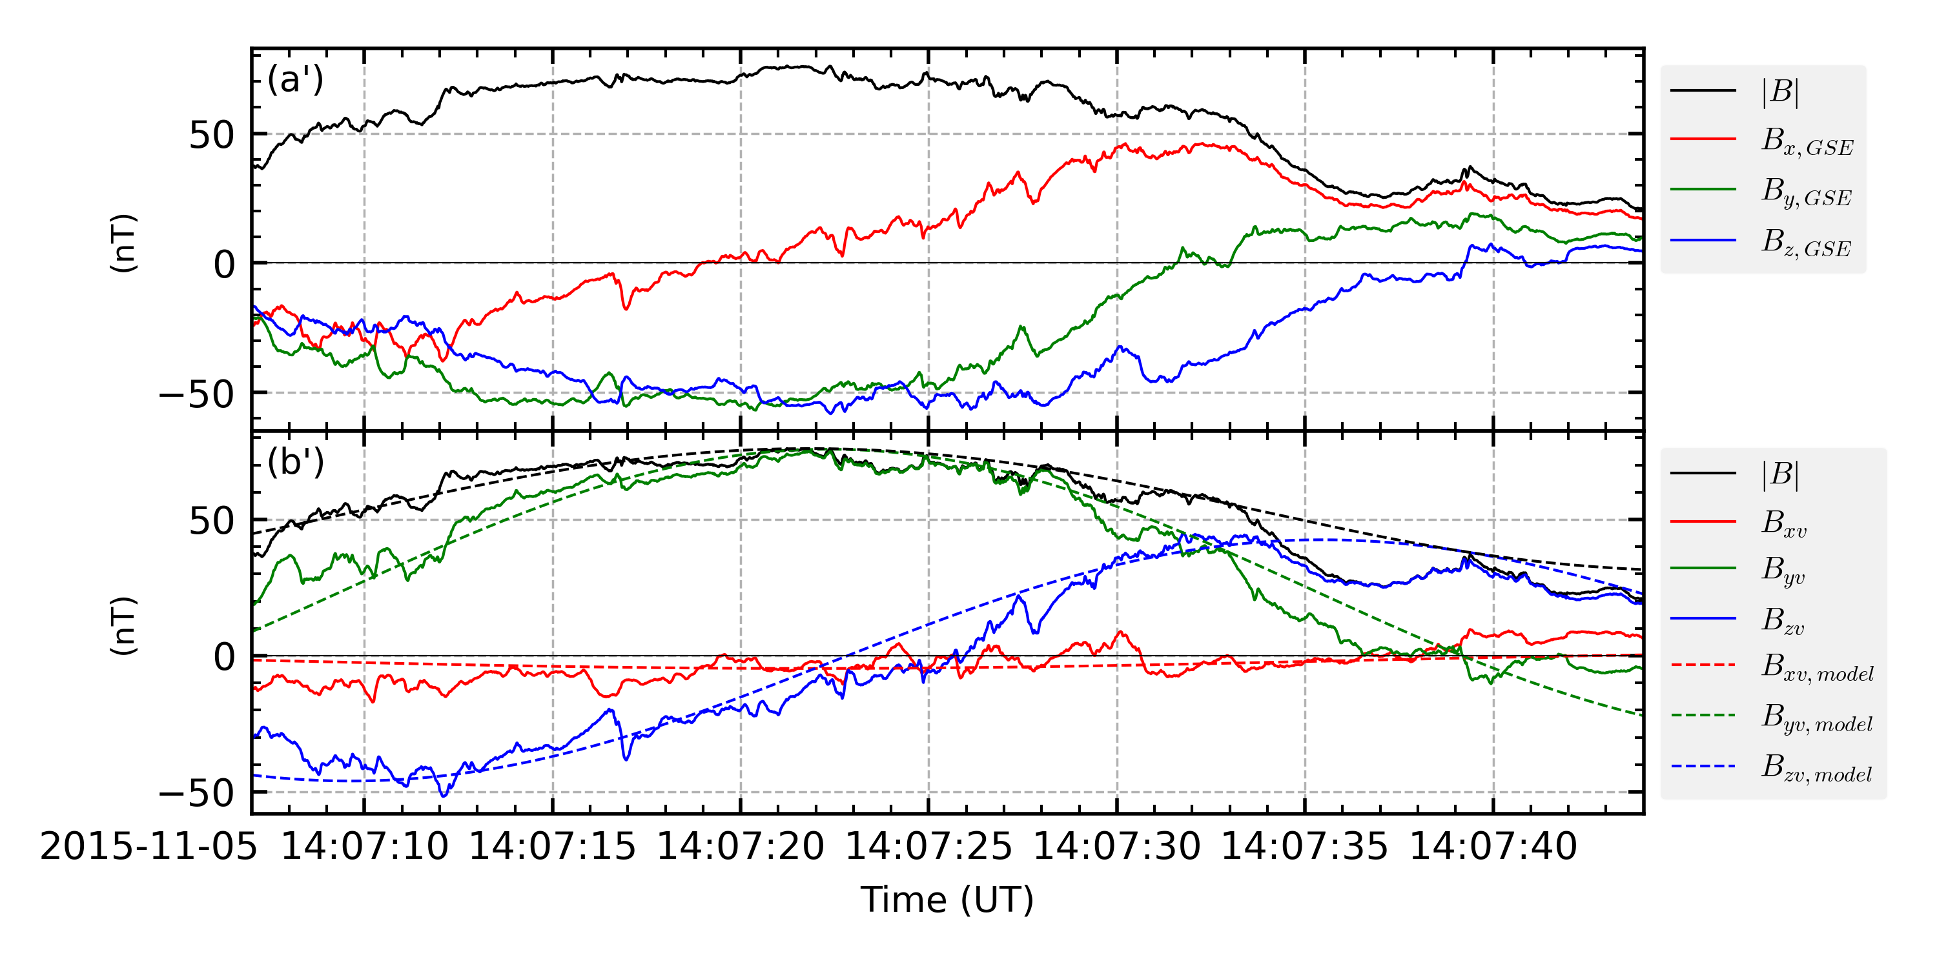
Flux rope fitting
Thanks to Naïs
The fit is done in a local frame (Lepping et al. (1990)) defined as:
$x_{v}=−V/V_{av}$
$z_{v}=n$
$y_{v}=z_{v}×x_{v}$
Fitting parameters: ($θ_{0}, φ_{0},b_{0},t_{0},α$)
Example of a left-handed flux rope
Sketch by N. Fargette
sdahani@irap.omp.eu
PNST 16-20 mai 2022
11
Notes:
Add small description about the figure

Slide 12
Outline
1
Introduction
2
Data & methods
3
Results & discussion
Conclusions
4
sdahani@irap.omp.eu
PNST 16-20 mai 2022
12

Slide 13
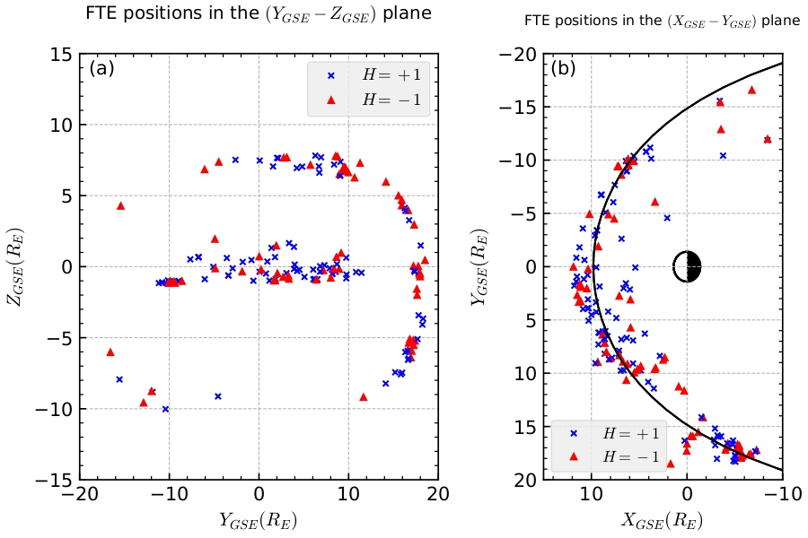
Spatial distribution
Spatial distribution of MMS+Cluster events in $\left(Y_{GSE}−Z_{GSE}\right), (X_{GSE}−Y_{GSE})$
Blue crosses denote right-handed FRs, red triangles left-handed FRs
No spatial preferences for the RH, LH flux ropes
sdahani@irap.omp.eu
PNST 16-20 mai 2022
13
Notes:
Add small description about the figure

Slide 14
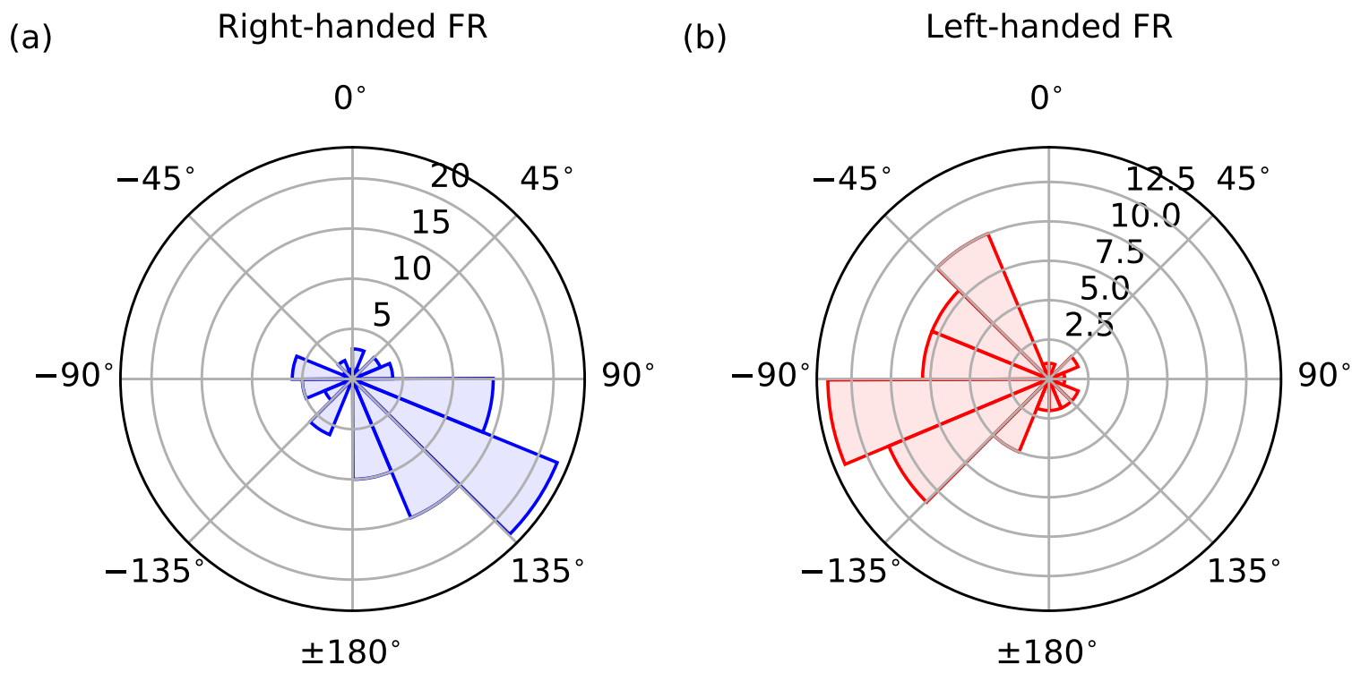
Clock angle
IMF clock angle:
$θ_{clock}=\arctan\left(\frac{B_{y}}{B_{z}}\right)$
The IMF clock angles are measured using OMNI data
$$Z_{GSM}$$
$$Z_{GSM}$$
$$Z_{GSM}$$
$$Z_{GSM}$$
$$Z_{GSM}$$
IMF
+Z
+Z
IMF
IMF
IMF
IMF $B_{z}$
IMF $B_{z}$
IMF $B_{z}$
IMF $B_{z}$
$$θ_{clock}$$
$$θ_{clock}$$
$$Y_{GSM}$$
$$Y_{GSM}$$
$$Y_{GSM}$$
IMF $B_{y}$
IMF $B_{y}$
IMF $B_{y}$
IMF $B_{y}$
+Y
-Y
-Y
+Y
Helicity and IMF $B_{y}$ signs…
…are the same: regular group
…are different: outlier group
-Z
-Z
The outlier population present $21\% (35$ cases out of 166$)$
sdahani@irap.omp.eu
PNST 16-20 mai 2022
14
Notes:
Add small description about the figure

Slide 15
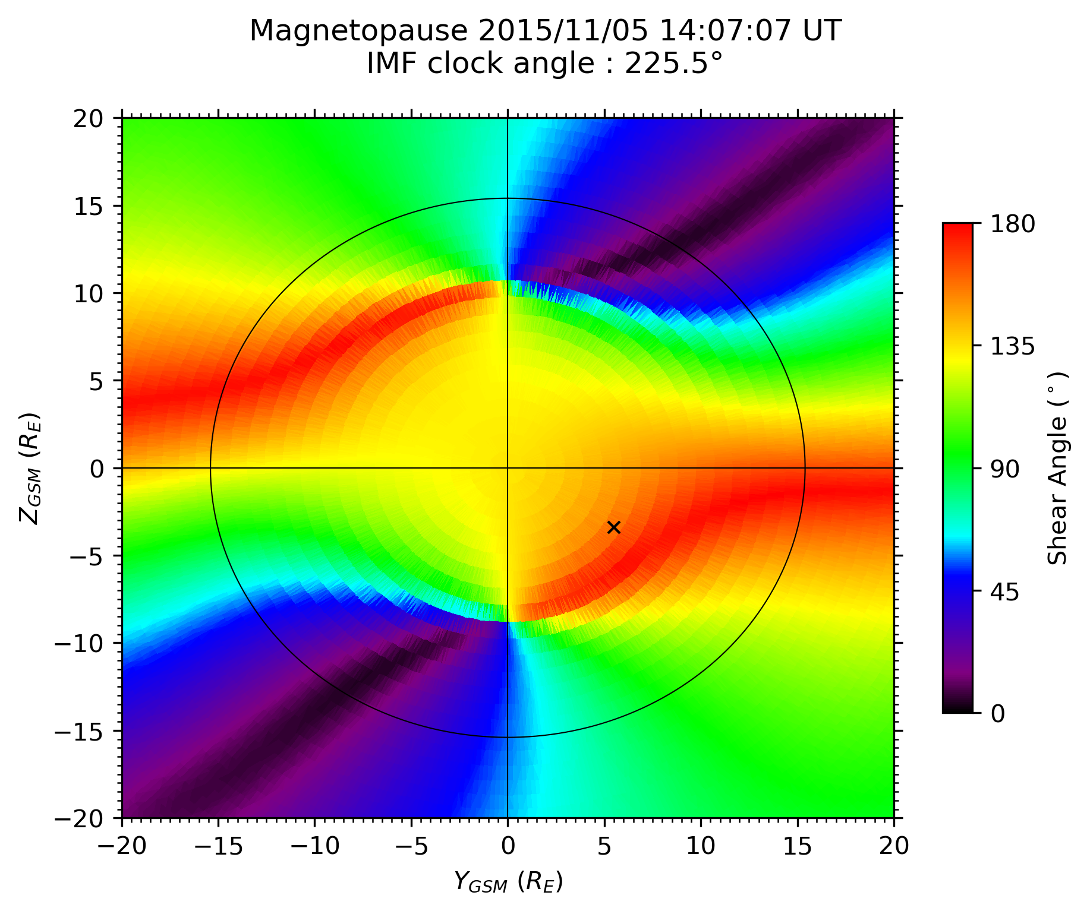
Magnetic shear angle (model)
Thanks to Bayane and Nicolas
Local magnetopause properties: the magnetic shear angle
Model based on Trattner et al. (2007): estimates the magnetic shear angle across the magnetopause surface
The magnetic shear angle was investigated at where each event was located
sdahani@irap.omp.eu
PNST 16-20 mai 2022
15
Notes:
Add small description about the figure

Slide 16
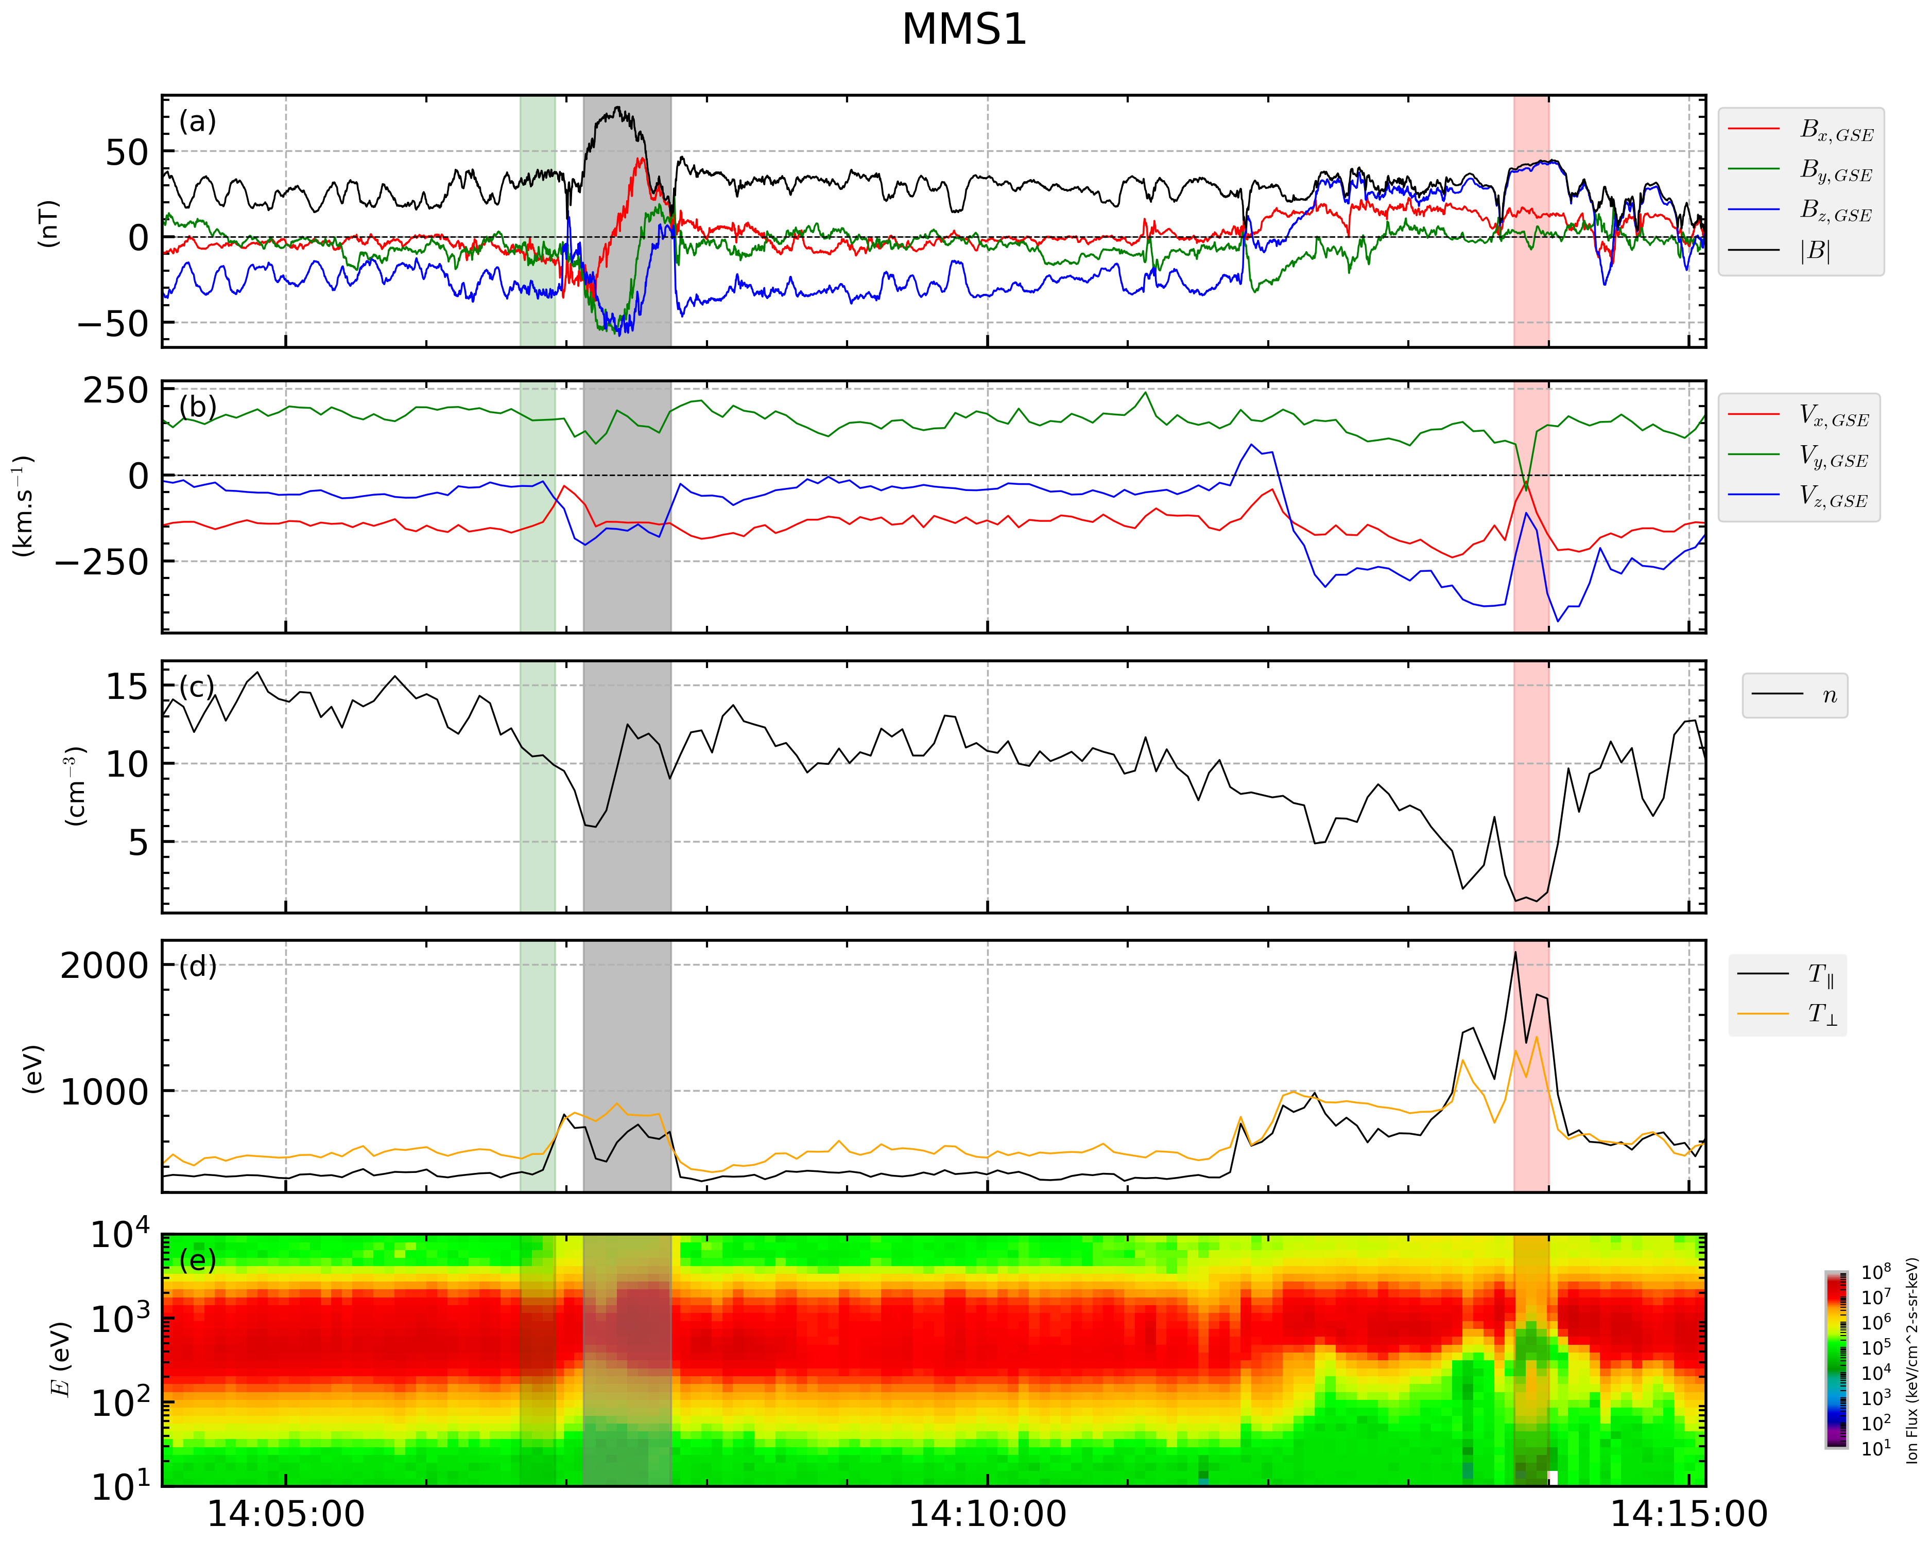
Magnetic shear angle (data)
Magnetosheath
Flux rope
Magnetosphere
The local shear with spacecraft data
Two regions: the magnetosphere and the magnetosheath
The local shear:
$\arccos\left(\frac{B_{sp}⋅B_{sh}}{\left|B_{sp}\right| \left|B_{sh}\right| }\right)$
sdahani@irap.omp.eu
PNST 16-20 mai 2022
16
Notes:
Add small description about the figure

Slide 17
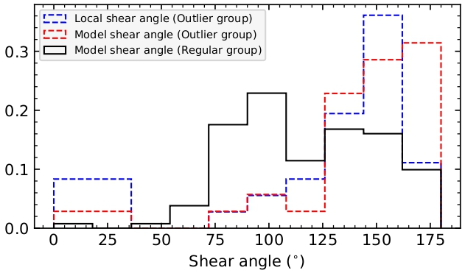
Magnetic shear angle (results)
Distributions of the magnetic shear angle
Regular flux ropes have a broad distribution
But outlier flux ropes mostly characterized by high magnetic shears
sdahani@irap.omp.eu
PNST 16-20 mai 2022
17
Notes:
Add small description about the figure

Slide 18
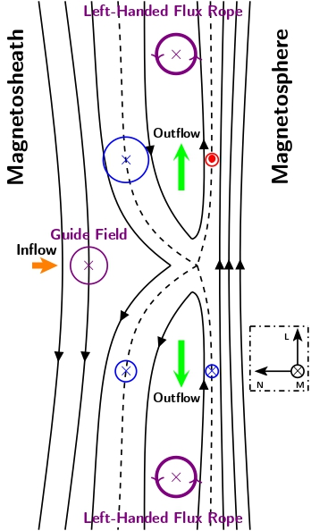
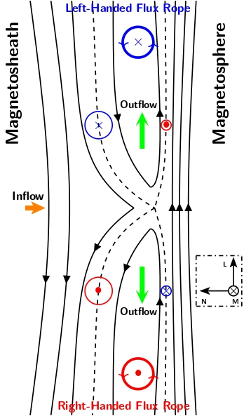
Hall magnetic field
(a)
(b)
At intermediate shear angle (component reconnection), the guide field (IMF $B_{y}$) determines FTE’s core field (Karimabadi et al. (1999)) and helicity
At high shear angle (anti-parallel reconnection) guide field is weak:
→ the Hall magnetic field may determine the core field (Karimabadi et al. (1999)) and helicity
sdahani@irap.omp.eu
PNST 16-20 mai 2022
18
Notes:
Add small description about the figure

Slide 19
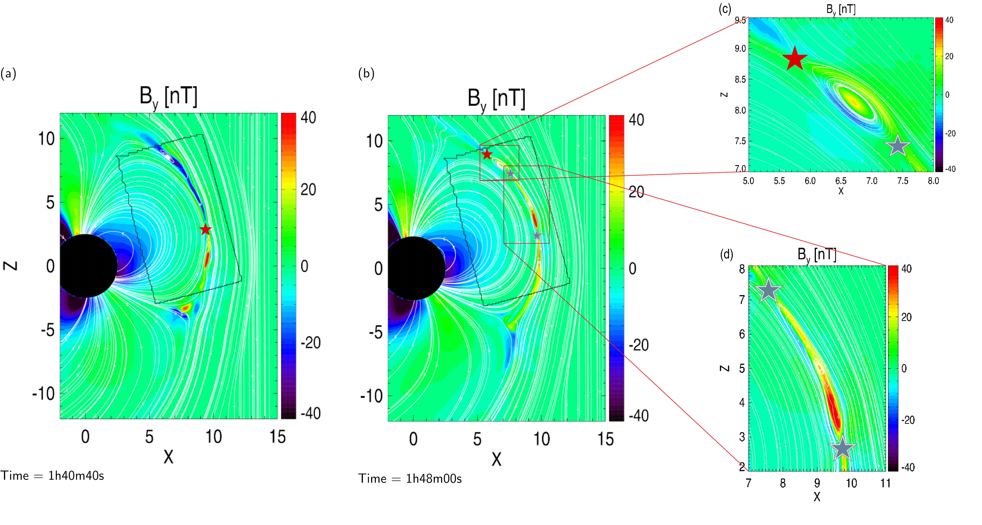
Hall magnetic field
Simulation result using an MHD-EPIC model (Chen et al. (2020))
Panel (a): presence of a bipolar Hall field pattern surrounding the X-line (red star)
Panels (c), (d): FTEs have a core field signature similar to the Hall field pattern of the initial X-line
Open questions:
Which X-line’s Hall field would dominate ?
Would the temporal sequence of the X-line presence or the reconnection rate determine the dominant X-line ?
Figure by Y. Chen (Chen et al. (2020))
sdahani@irap.omp.eu
PNST 16-20 mai 2022
19
Notes:
Add small description about the figure

Slide 20
Outline
1
Introduction
2
Data & methods
3
Results & discussion
4
Conclusions
sdahani@irap.omp.eu
PNST 16-20 mai 2022
20

Slide 21
Conclusions
Most of FTEs are controlled by the IMF $B_{y},$ however a minority does not (the outliers)
Modelling and in-situ data (only for outliers) were used to obtain the magnetic shear angle
Regular FTEs (helicity sign corresponding to IMF $B_{y}$): broader shear angle distribution,
Outilier FTEs: found at high shear angles
The IMF $B_{y}$ is the main component that provides reconnection guide field $→$ explains the regular flux ropes
At anti-parallel reconnection (high shear angle) the presence of the Hall magnetic field would determine the core field and the helicity sign of an FTE (Karimabadi et al. (1999))
In a multiple X-line FTE formation mechanism, there is a main open question on which X-line’s Hall magnetic field surrounding the FTE would dominate the other..
sdahani@irap.omp.eu
PNST 16-20 mai 2022
21
Notes:
Add small description about the figure

Slide 22
Merci pour votre attention!
Questions?
sdahani@irap.omp.eu
PNST 16-20 mai 2022
22
Notes:
Add small description about the figure

