Slide 1
Colloque du PNST 2022 – 16 mai 2022 - Marseille
Multi-spacecraft observations
of solar radio emissions
in the Solar Orbiter era
Sophie Musset, ESA Research Fellow
Milan Maksimovic, Eduard Kontar, Vratislav Krupar, Nicolina Chrysaphi, Xavier Bonnin, Antonio Vecchio, Baptiste Cecconi, Arnaud Zaslavsky, Karine Issautier, Stuart Bale, Marc Pulupa

Slide 2
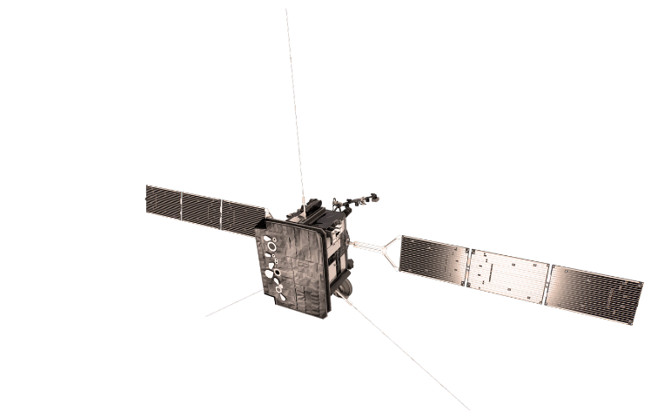
Origins of solar energetic particles
Escape of energetic electrons to the interplanetary medium
In-situ measurements of energetic electrons
Solar flare:
particle acceleration in the corona
Propagation effects?
How many particles?
e-
e-
e-
e-
Energy distribution?
How do they escape?

Slide 3
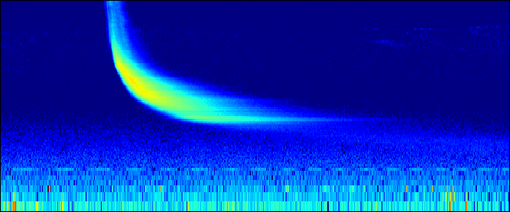
Radio diagnostics of propagating electron beams
Radio emission (radio bursts) = signatures of escaping electron beams
Frequency
Time
e-
Remote detection of radio waves
e-
e-
e-

Slide 4
Radio diagnostics of propagating electron beams
Radio emission (radio bursts) = signatures of escaping electron beams
Propagation effects on radio waves?
e-
e-
e-
e-
Mechanism to produce EM radiation?
Coherent emission
Non-linear process
Numerical simulations
How many particles?
Energy distribution?

Slide 5
Propagation of radio waves in the heliosphere
Free-free absorption of radio-waves
Large scale refraction due to gradual variation of the density (e.g. ICME)
Scattering on small scale, turbulent density fluctuations
What is the dominant effect on the observed properties of radio bursts?
A. Refraction
B. Absorption
C. Scattering

Slide 6
Propagation of radio waves in the heliosphere
Free-free absorption of radio-waves
Large scale refraction due to gradual variation of the density (e.g. ICME)
Scattering on small scale, turbulent density fluctuations
What is the dominant effect on the observed properties of radio bursts?
A. Refraction
B. Absorption
C. Scattering

Slide 7
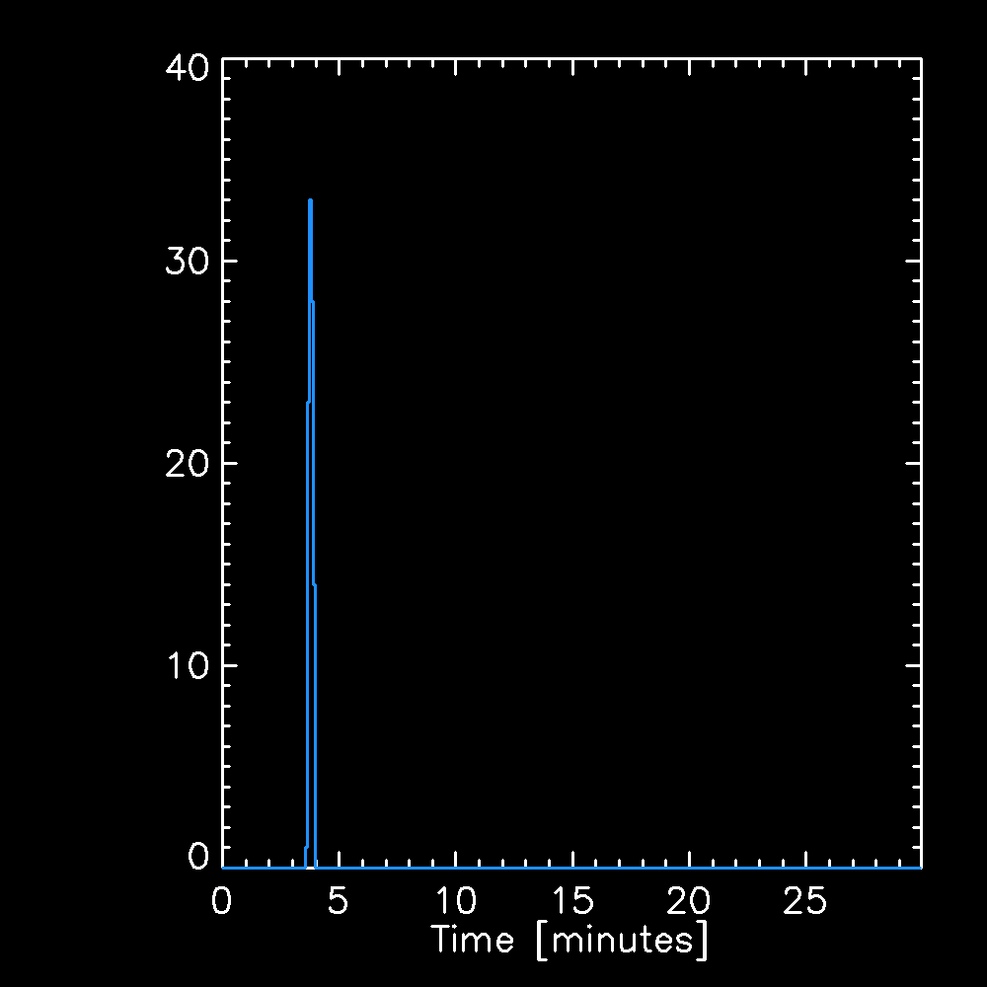
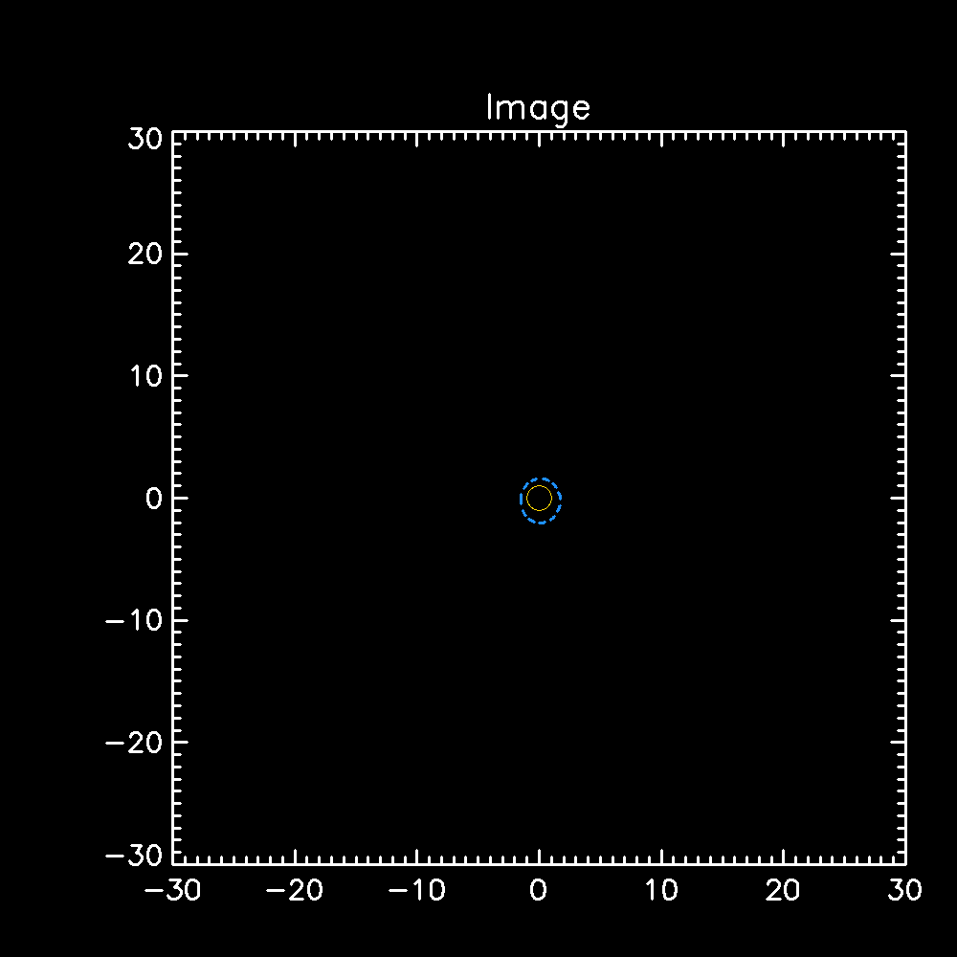
Effects of radio-wave scattering
(Almost) no scattering
Facing the radio source
Top view
Measurements at 1 spacecraft
(and one frequency)

Slide 8
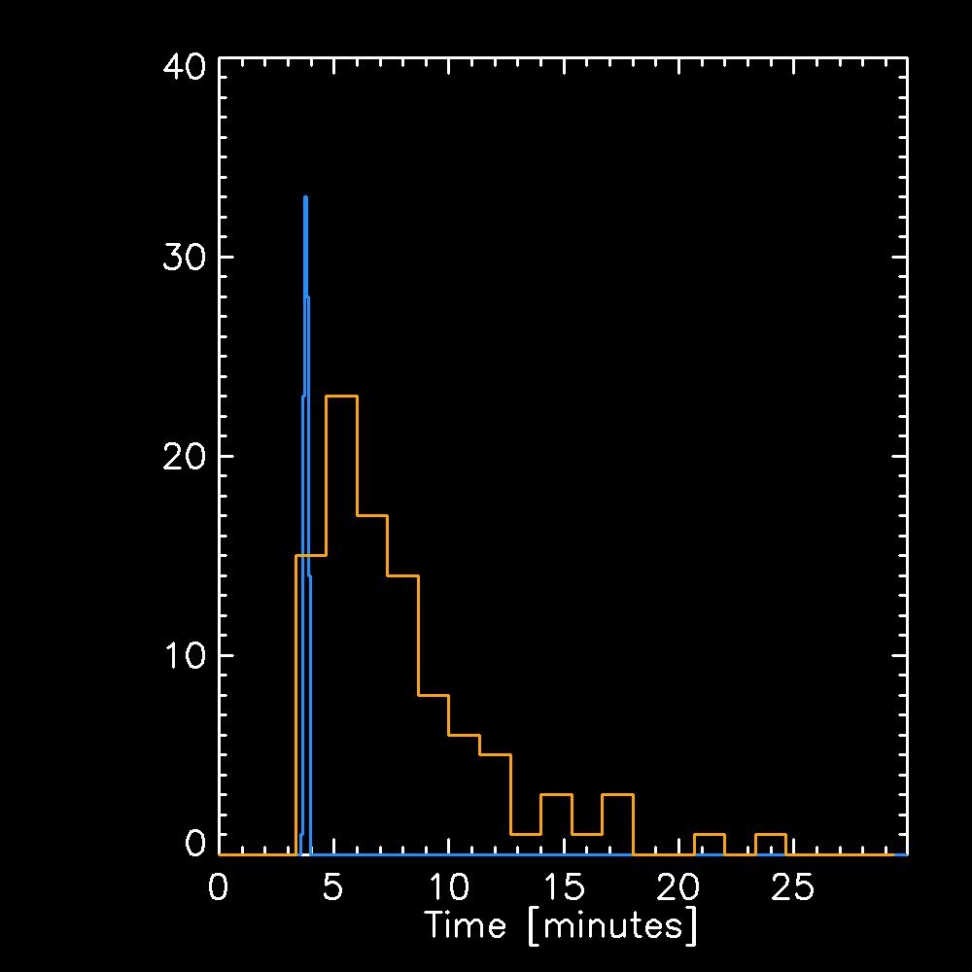
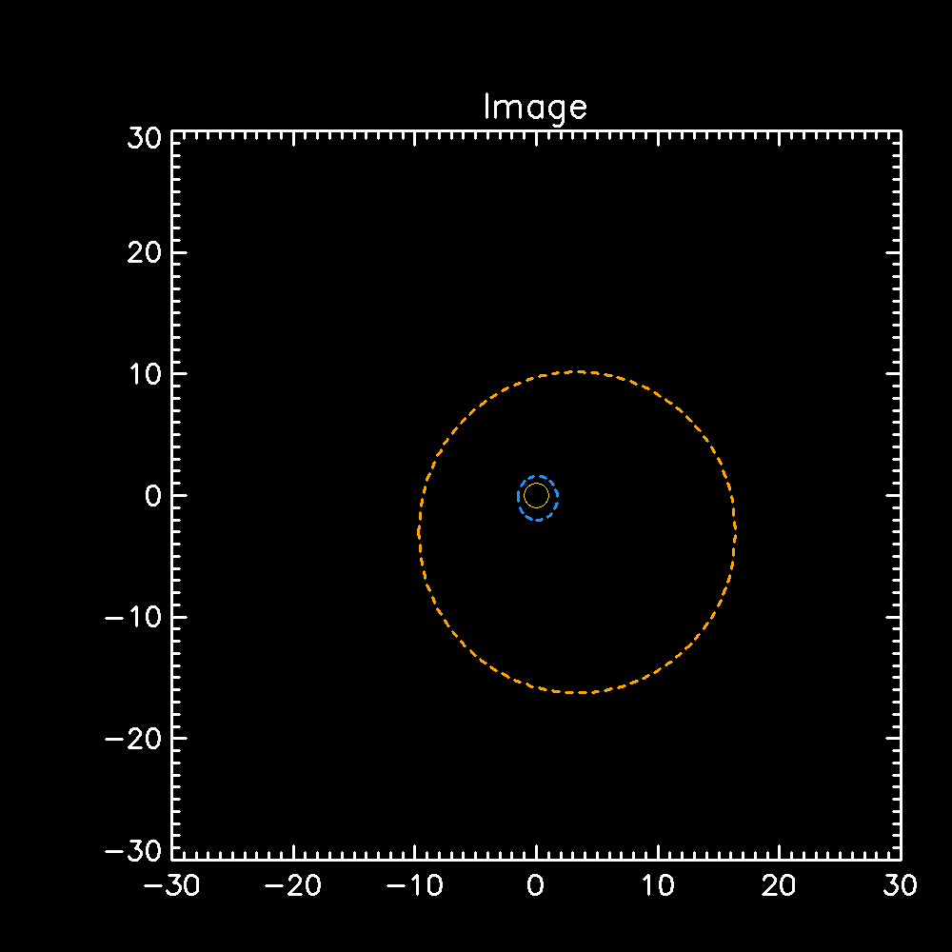
Effects of radio-wave scattering
Stronger level of density fluctuations: more scattering
Facing the radio source
Top view
Measurements at 1 spacecraft
(and one frequency)
Scattering ⟂ radial direction
Increase spatial distribution
Scattering ∥ radial direction
Increase time distribution

Slide 9
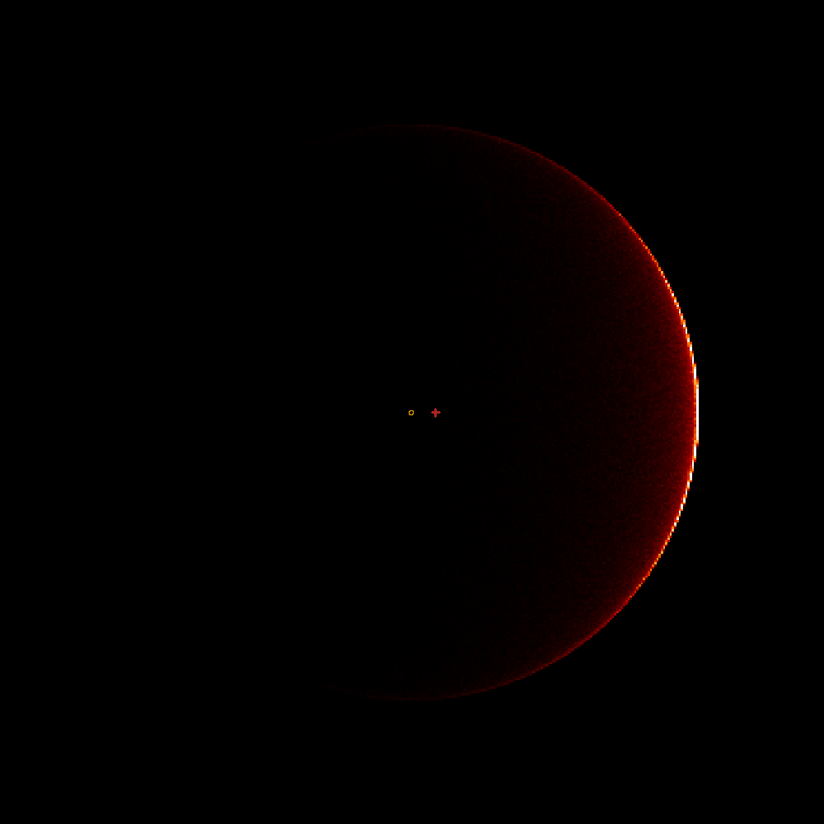
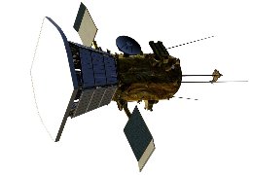
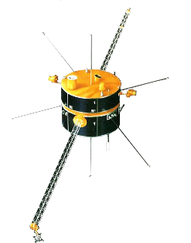
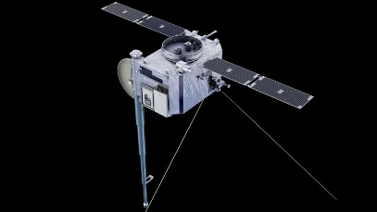
Effects of radio-wave scattering: directivity
The radio emission is more intense when facing the source
→ Directivity of the radio emission
Top view
2 spacecraft = 1 ratio
Parker Solar Probe
→ Not enough to determine the shape of the directivity
Wind
Now: 4 spacecraft
→ Simultaneous observations
➔ Measure of the directivity
Solar Orbiter
STEREO-A

Slide 10
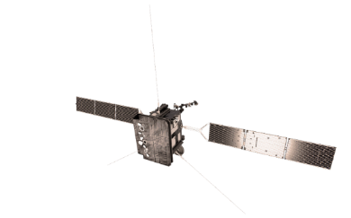
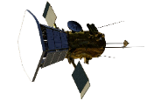
Example of simultaneous observations of a radio burst
What is the most probable radio source location?
Solar Orbiter
B
A
C
STEREO-A
Parker Solar Probe
Top view
11 July 2020
~2:30 UT
Wind

Slide 11
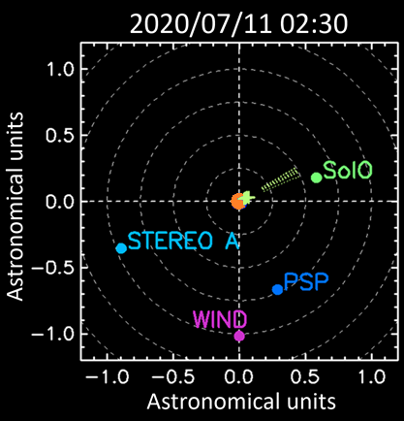
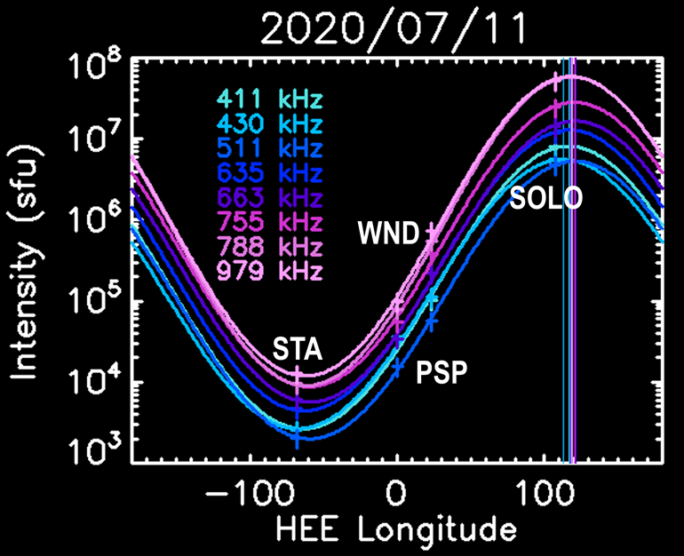
Example of simultaneous observations of a radio burst
What is the most probable radio source location?
Solar Orbiter
STEREO-A
Parker Solar Probe
Top view
11 July 2020
~2:30 UT
Wind
Musset et al, 2021

Slide 12
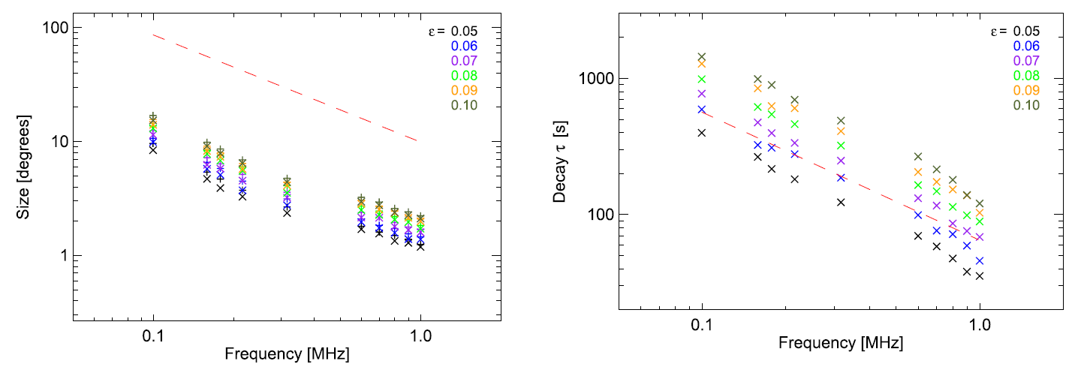
Simulations vs. observations
Source size (image)
Decay time (lightcurve)
Directivity (intensity ratios)
Level of density fluctuations
(i.e. of scattering)
Source size
Decay time
In average,
Need more scattering to explain observed source sizes
Than to explain decay times
Observations
Model runs
Model runs
Observations
Kontar et al, 2019

Slide 13
Solving the puzzle
Top view
Increase decay time
Need more scattering to explain observed source sizes
Than to explain decay times
Scattering ∥ radial direction
Anisotropic scattering:
More efficient in the ⟂direction than in the ∥ direction
Increase source size
Scattering ⟂ radial direction

Slide 14
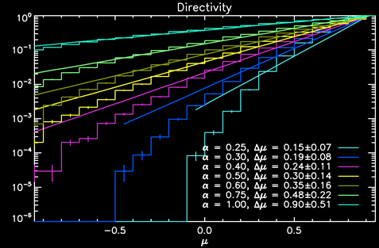
Anisotropic scattering and directivity
Anisotropic scattering:
More efficient in the ⟂direction than in the ∥ direction
Strong effect on the directivity
Anisotropy factor α
α = 1 → isotropic case
α < 1 → stronger scattering in the ⟂ direction
Isotropic case
Directivity measurements with multi-spacecraft analysis for 5 radio bursts
compared to simulation results
Need α between 0.3 and 0.6
Anisotropic scattering needed to explain observations
Intensity
Musset et al, 2021
Cosine of angle between source and observer

Slide 15
Conclusion
Multi-spacecraft observations of radio bursts ➔ constraints on radio-wave scattering
→ Anisotropic density fluctuations of plasma
Bonus!
Constraints on plasma conditions close to radio sources (closer to the Sun than PSP and SOLO perihelia!)
Radio-wave propagation:
key ingredient to understand the origin of solar energetic electrons in the heliosphere
e-
e-
e-
e-
Go check:
Musset et al, A&A Solar Orbiter first results (cruise phase), 2021

Slide 16
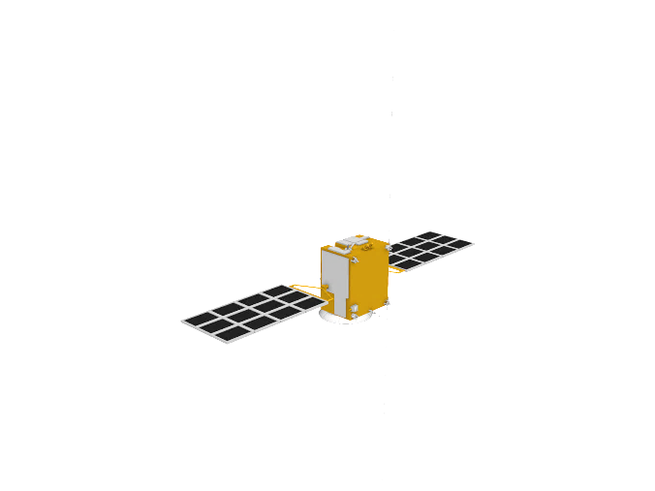
More instruments?
Solar Orbiter
STEREO-A
Mars Express
Parker Solar Probe
Wind
Courtesy of O. Witasse
Top view

Slide 17
Leaving the ecliptic plane!
Solar Orbiter → observations out of the ecliptic plane (in a few years)
➔ Constraints on the source location and emission directivity in 3D!

