Slide 1
What is the role of whistler waves in shaping the solar wind electron distribution function between 0.17 and 1 AU ?
Lucas COLOMBAN
M. Kretzschmar, V. Krasnoselskikh, C. Froment , M. Maksimovic, D. Graham, Y. Khotyainsev, L. Berĉiĉ, O. Agapitov, M. Berthomier, and T. Dudok de Wit

Slide 2
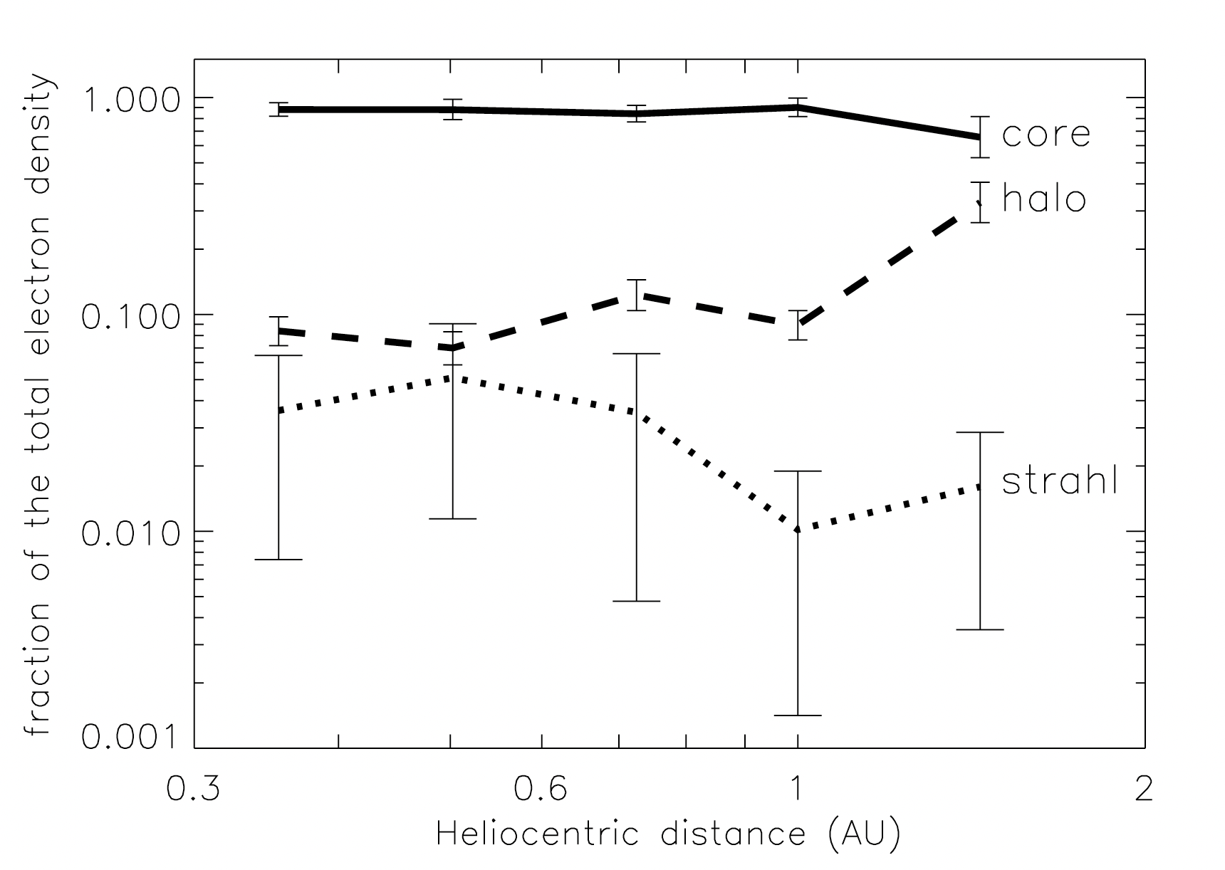
Solar wind electron distribution function
1)
2) Decrease of the heat flux is too fast to be explain by explained by collisions alone
Wave-particle interaction (Tong et al 2018/2019, Bale et al 2013, Vasko et al 2019, Cattell et al 2020)
Core
Strahl
Maksimovic et al 2005
Marsch 2006
Halo
(Halekas et al 2020)
Whistlers ?

Slide 3
Objectives
Statistical analysis of whistlers observed between 0.17 and 1 AU with Solar Orbiter and Parker Solar Probe data (occurrence and properties...)
Evaluate their role in the evolution of the distribution function by calculating the local and integrated (along the propagation) diffusion coefficients

Slide 4
Whistlers and their role in the particle diffusion
Electromagnetic right-handed circularly polarized waves with a frequency smaller than the electron cyclotron frequency
Intense oblique whistlers (Fan instability Strahl electrons,Vasko et al 2019)
can theoretically diffuse strahl electrons but there are limited observations (Vasko et al 2019, Micera et al 2020,2021, Cattell et al 2021, Agapitov 2020)
2) Small amplitude quasi-parallel whistlers (Whistler heat flux instability halo electrons, Gary et al 1975 )
there role is still under debate (Kretzschmar et al 2021, Tong et al 2019, Lacombe et al 2014, Berĉiĉ et al 2021 )
The direction of propagation sunward/anti sunward is very important

Slide 5
Statistical study of whistlers with Solar Orbiter (SolO) and Parker Solar Probe (PSP)

Slide 6
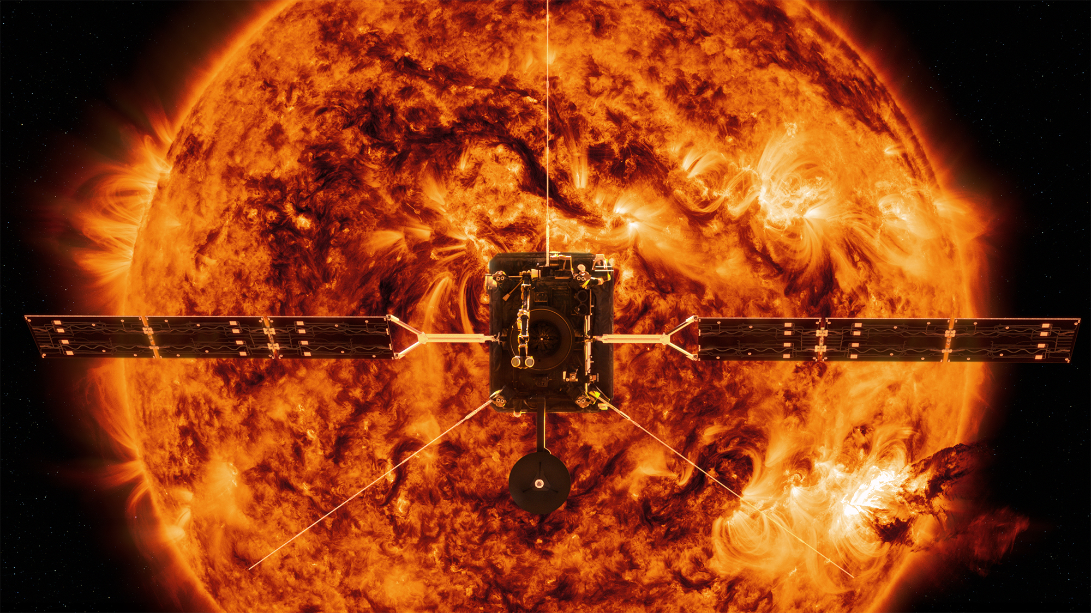
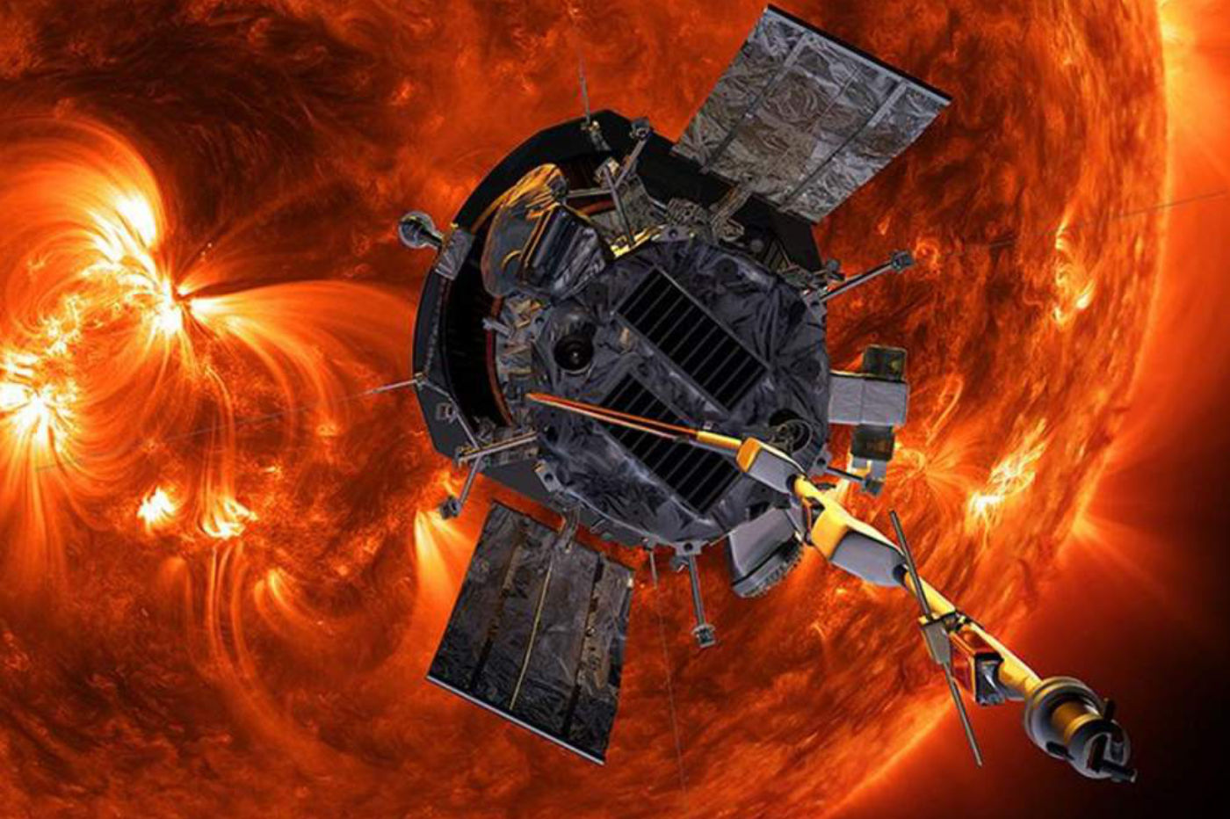
Data
We used waveforms of Solar Orbiter and Parker Solar Probe
Solar Orbiter
We categorized more than 100 000 waves packets as whistlers
(extension of Kretzschmar et al 2021)
Parker Solar Probe
Just the first perihelion 0.17 AU
About a hundred waves packets categorized as whistlers

Slide 7
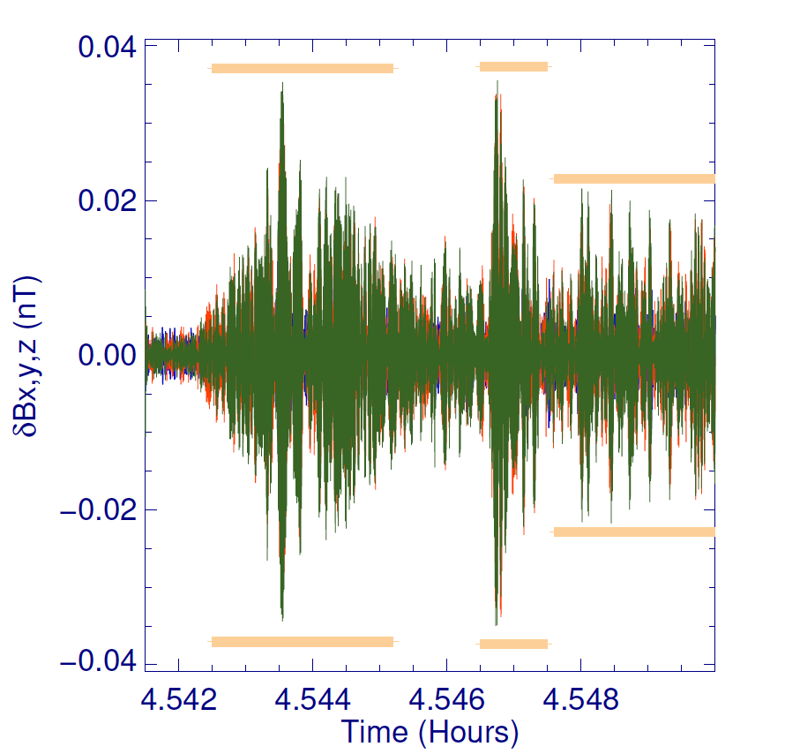
Whistler waves detection
SolO : RPW (E and B), SWA (velocity and density), MAG (background B0)
PSP : FIELD (E and B, background B0) and SWEAP (velocity and density)
Choose RH cases with coherence, polarization and planarity >0.6 (Santolik et al 2003, Taubenschuss et al 2019)
Minimum variance analysis and spectral matrices θ ( Paschmann et al 1998)
E and B sunward/anti sunward
θ
B0
K

Slide 8
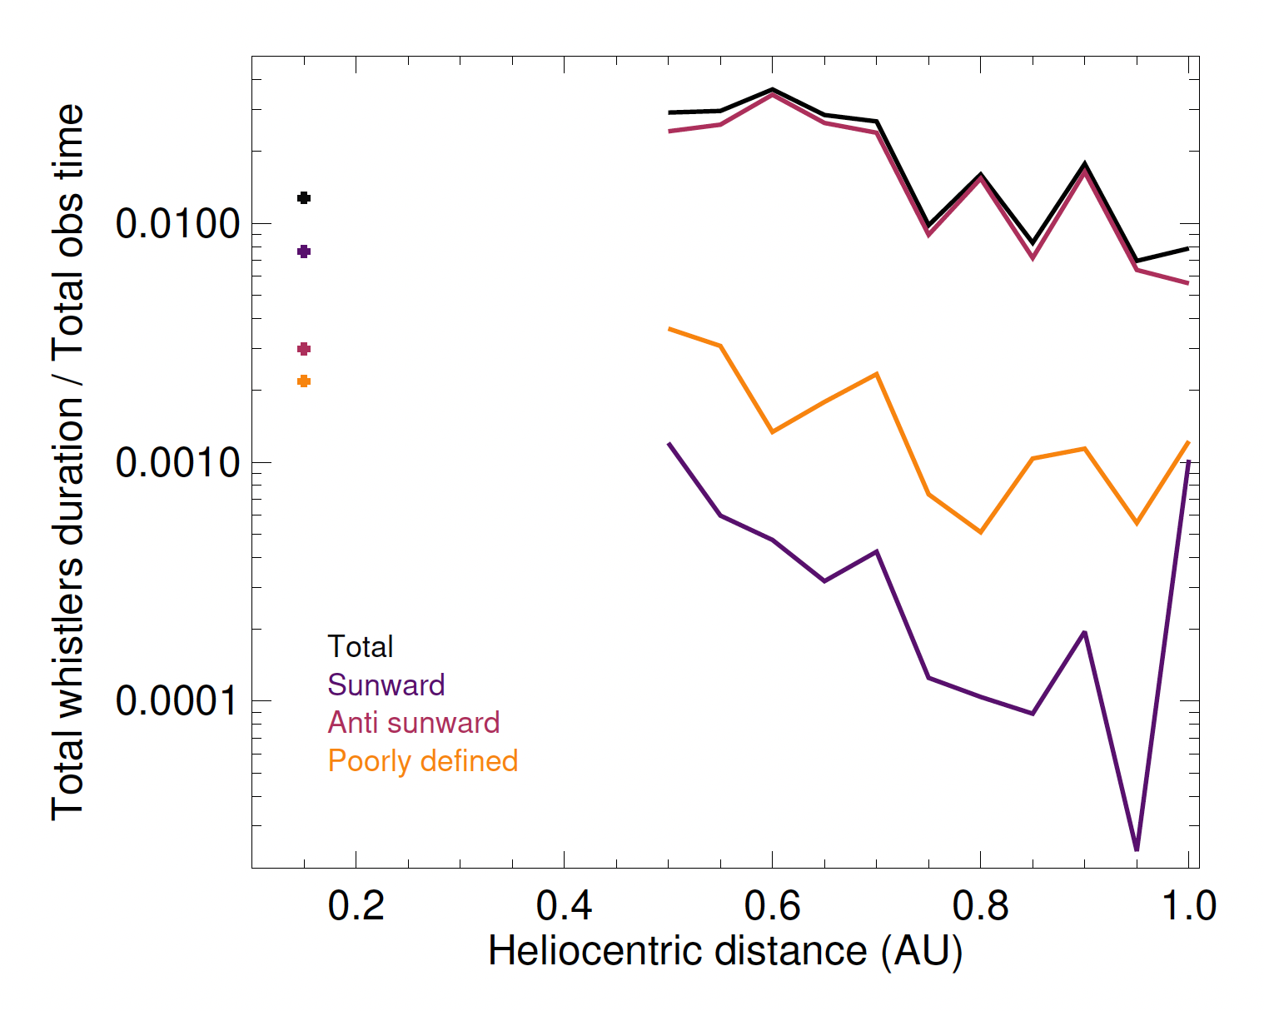
Dependence upon radial distance : occurrence
Poster of C. Froment
Increase in occurrence when we get closer to the sun (between 0.5 et 1 AU, different from Helios Jagarlamudi 2020 )
Huge majority of anti-sunward whistlers between 0.5 and 1 AU.
Increase of sunward whistlers closer to the sun BUT these are often unclear cases

Slide 9
Dependence upon radial distance : θ
We have very aligned whistlers
Very few obliques: only 2% have a propagation angle > 30°
The angle does not clearly depend on the radial distance

Slide 10
Dependence upon radial distance

Slide 11
Calculation of diffusion coefficients

Slide 12
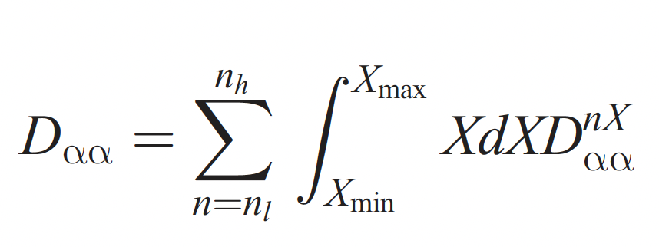
Electron diffusion coefficients
Quasilinear theory
: Pitch angle (𝜶) diffusion coefficient (radian²/s) ability of the wave to diffuse an electron at a given 𝜶
(Kennel Engellman 1966 )
We need : Angle of propagation (θ), amplitude, frequency, direction of propagation (in the plasma frame), plasma parameters ( , , )
We calculate (function of 𝜶) for a given energy (halo and strahl)
(Lyons 1974b, Horne 2003, Glauert And Horne 2005, Artemyev et al 2012 )

Slide 13
Local diffusion coefficients
By anti sunward whistlers (average parameters between 0.5 and 1 AU)
Θ [0-30°] (aligned)
Θ [30-90°] (oblique)
Very low scattering of strahl electrons by anti-sunward aligned whistler
Strong scattering of halo electrons
Wave amplitude is an important parameter
the 20% more intense
the remaining 80%
Halo
Strahl

Slide 14
Integrated diffusion coefficients
Θ [0-30°] (aligned)
Θ [30-90°] (oblique)
Too small proportion of obliques to scatter the strahl
Important scattering of halo electrons by the aligned ones
6°
6°
Halo
Strahl

Slide 15
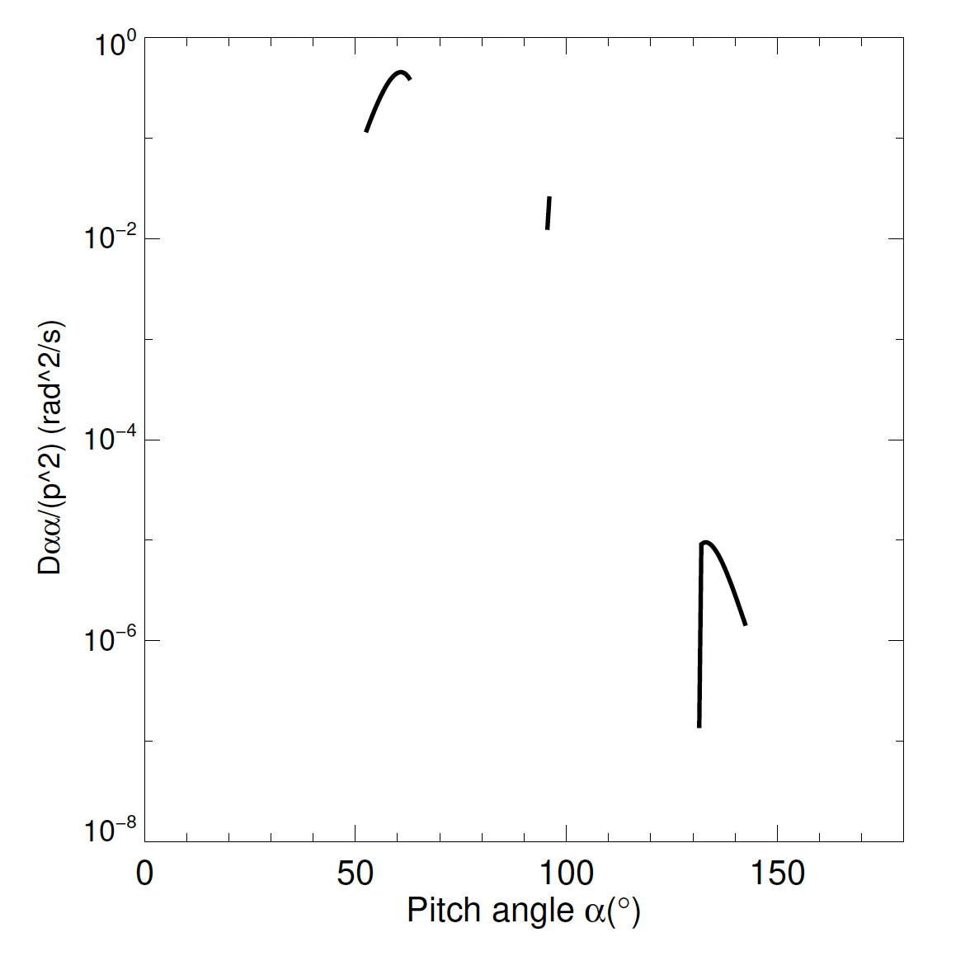
Diffusion coefficients (with Parker Solar Probe)
Sunward cases
Picth angle
Cattell et al 2021
Quasi parallel sunward whistlers can diffuse strahl effectively !!

Slide 16
Conclusion
Sufficient number of quasi parralel anti-sunward whistler to diffuse halo electrons
A sunward whistler can diffuse the strahl effectively, how many of them ?
Angular diffusion by oblique whistler of the strahl is possible but it seems that they are not present enough to have an important impact
The sunward and anti sunward quasi parallel whistlers may play an important role in the evolution of heat flux
The evolution of the strahl and halo fractions may comes more from sunward whistlers than from obliques

