Slide 1
3D MHD simulation of interchange reconnection in a solar coronal pseudo-streamer
T. Pellegrin-Frachon¹
with
S. Masson^{1,2}, E. Pariat¹, P. Wyper³, R. DeVore⁴
¹ Sorbonne Université, Ecole polytechnique, Institut Polytechnique de Paris, Université Paris Saclay, Observatoire de Paris, CNRS, Laboratoire de Physique des Plasmas (LPP), 75005 Paris, France
² Station de Radioastronomie de Nançay, Observatoire de Paris, CNRS, PSL, Université d'Orléans, Nançay, France
³ Department of Mathematical Sciences, Durham University, Durham, DH1 3LE, UK. ⁴ Heliophysics Science Division, NASA Goddard Space Flight Center, 8800 Greenbelt Rd, Greenbelt, MD 20771, USA

Slide 2
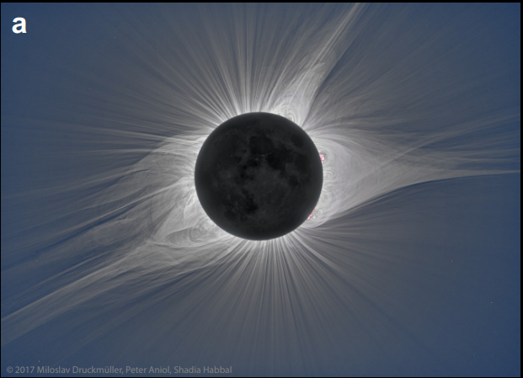
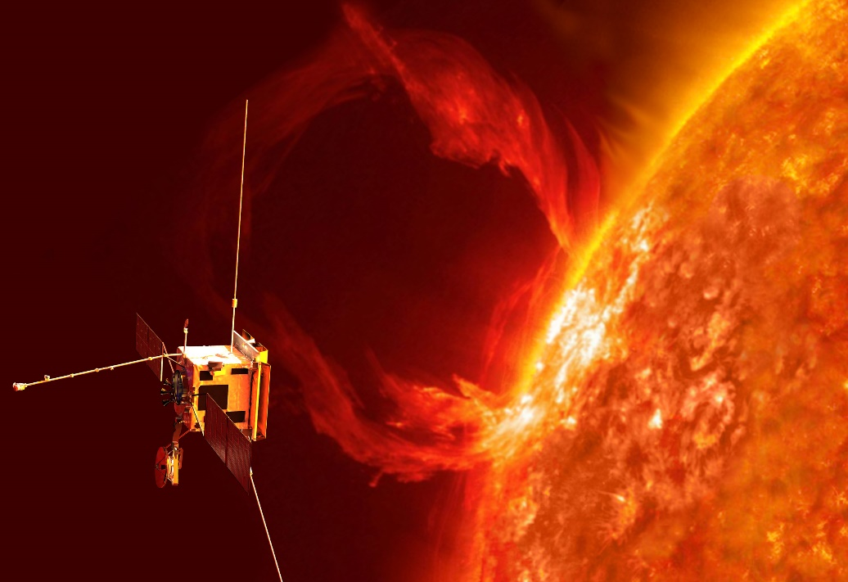
Slow solar wind generalities: from observations
Context : Solar Orbiter & Parker Solar Probe
Explaining the coupling between the corona and the heliosphere
Slow solar wind origin
Fast wind
Steady in properties and composition (photospherical plasma)
Seems to originate from coronal holes
Slow wind
Unsteady in properties (flux, waves), may be highly structured (Alfven, whistler)
Unsteady composition, mainly typical from the low coronal loops plasma
fast wind
slow wind
slow/fast wind at every latitude
Minimum solar activity
Maximum solar activity
pseudo-streamer
helmet streamer
SOLAR ORBITER
White light, 21/08/2017
Artist view, Solar Orbiter. Credit: ESA
Solar corona during an eclipse (bottom). Crédit : Mikic et al 2018

Slide 3
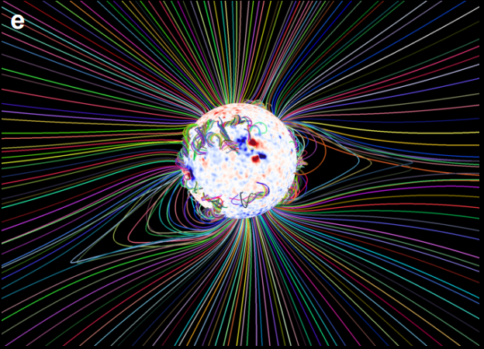
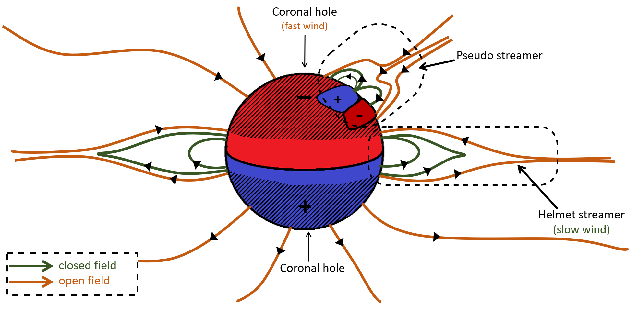
Solar corona: large-scale magnetic structures
pseudo-streamer
MHD prediction, 21/08/2017
pseudo-streamer
helmet streamer
White light, 21/08/2017
Data driven MHD model for coronal field (top) corona image during eclipse (bottom). Crédit : Mikic et al 2018

Slide 4
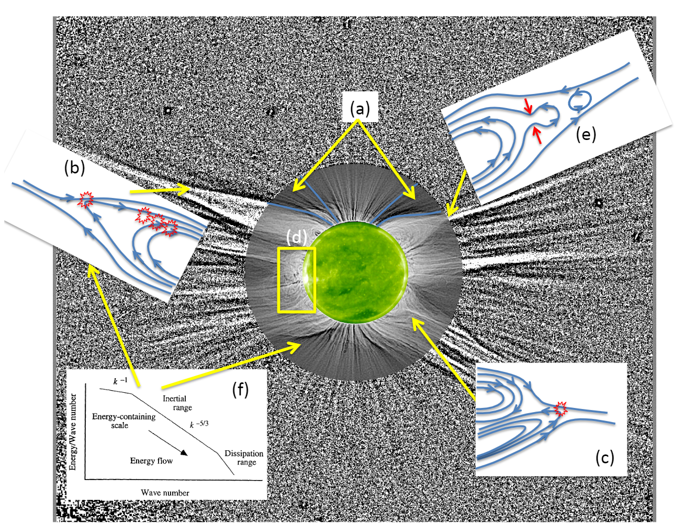
Explaining the slow wind origin: categories of models
How to explain…
Variability
Latitudinal extension up to $60°$
Expansion factor (Wang et al 1997)
Empirical model calculating the wind velocity from observed magnetic field divergence
Slow wind origin : inner boundaries of the coronal holes
Explain the divergence
Interchange reconnection
Exchange of connectivity between two magnetic fields
Explain variability
First models (Fisk et al 1998): slow wind originates from HS and propagates in HCS. Does not explain the latitudinal extension
S-Web model (Antiochos et al 2011): explain the latitudinal extension
IR in helmet streamer
Expansion factor
Plasmas blobs in HS
Slow wind models. Credit : Abbo et al 2016
IR in pseudo-streamer

Slide 5
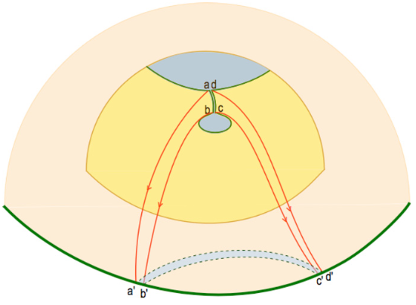
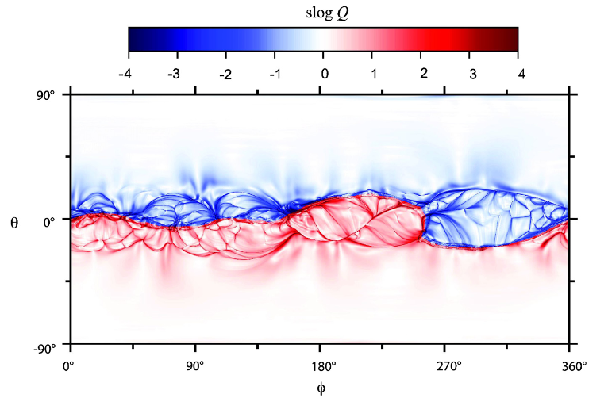
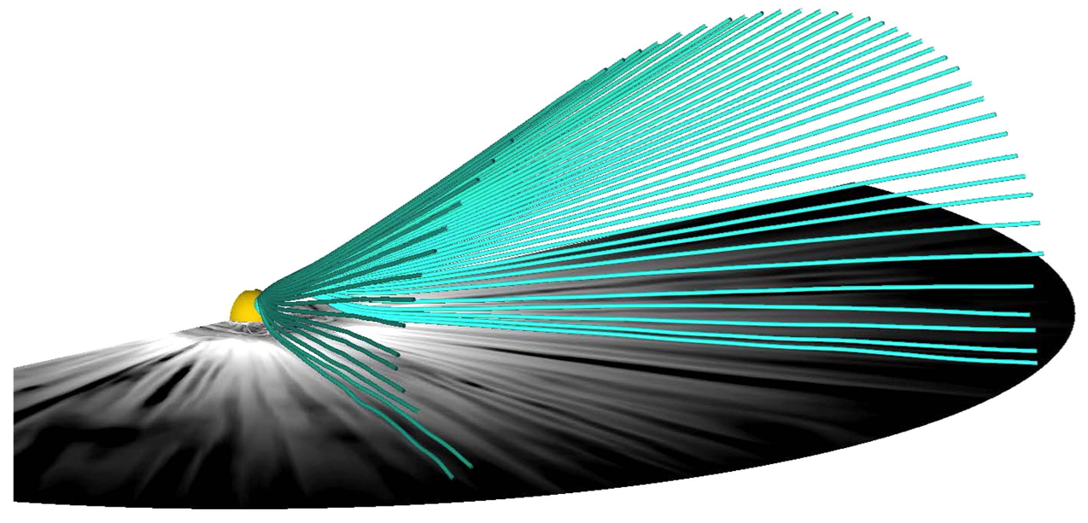
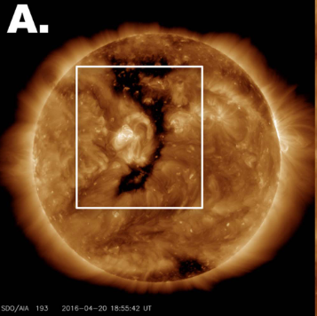
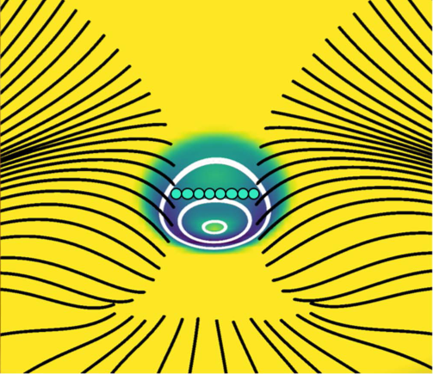
S-Web model
Core of the model
The coronal magnetic topology : (Q)SL structures, has an impact in the heliosphere
Origin of structures
Narrow open-field corridors (Antiochos et al 2011, Higginson et al 2017)
Pseudo-streamers (Titov et al 2011, Scott et al 2018, Aslanyan et al 2021)
(Q)SL arcs
Coronal hole with SDO. Credit : Antiochos et al 2011
$$10°$$
HCS
Heliospheric Q arcs are coronal structures. Credit : Titov et al 2011
Extension of a narrow corridor. Credit : Higginson et al 2017
Coronal hole with SDO.
Credit : Higginson et al 2018

Slide 6
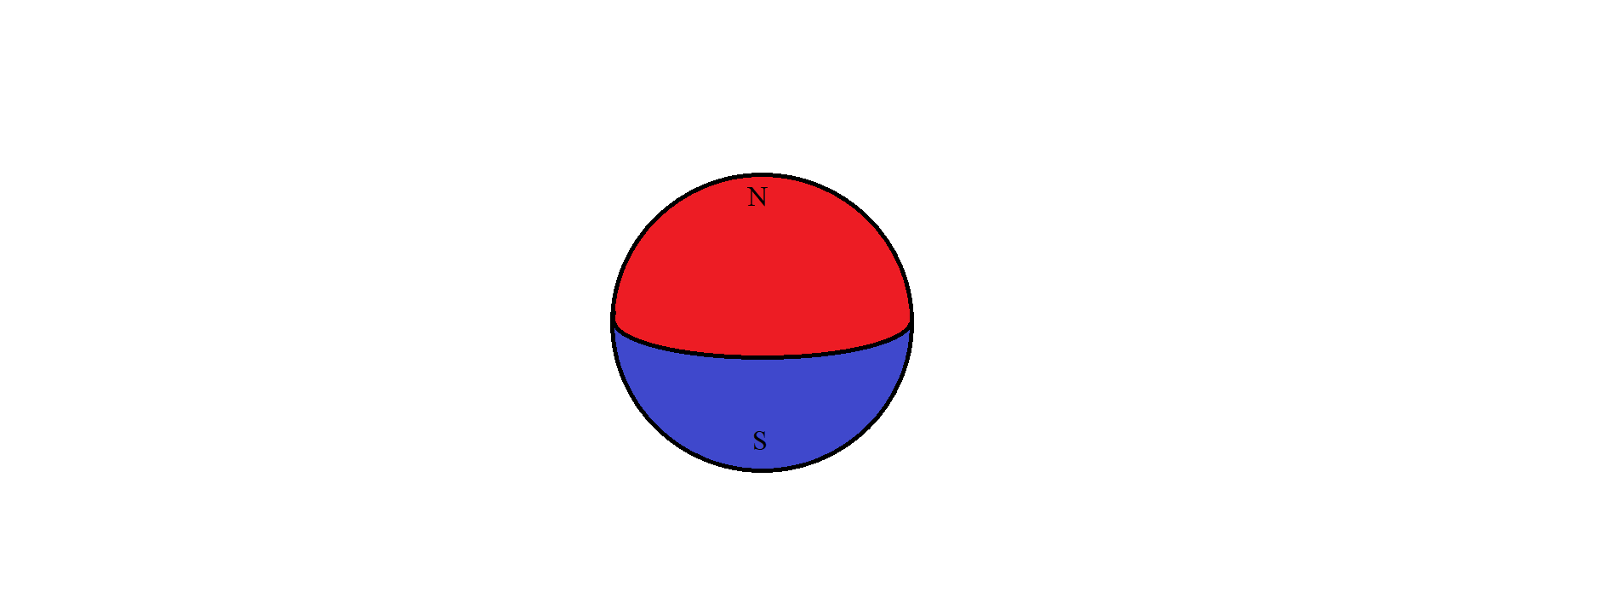
Interchange reconnection scenario
Coronal hole
(fast wind)
Interchange reconnection
Injection of coronal plasma in the interplanetary medium
Exchange of connectivity: closed/open ➔ open/closed
Pseudo streamer
–
+
+
-
+
Helmet streamer
(slow wind)
closed field
open field
Coronal hole

Slide 7
Interchange reconnection scenario
Coronal hole
(fast wind)
plasma flow
Interchange reconnection
Injection of coronal plasma in the interplanetary medium
Exchange of connectivity: closed/open ➔ open/closed
Pseudo streamer
–
+
+
-
+
Helmet streamer
(slow wind)
closed field
open field
Coronal hole

Slide 8
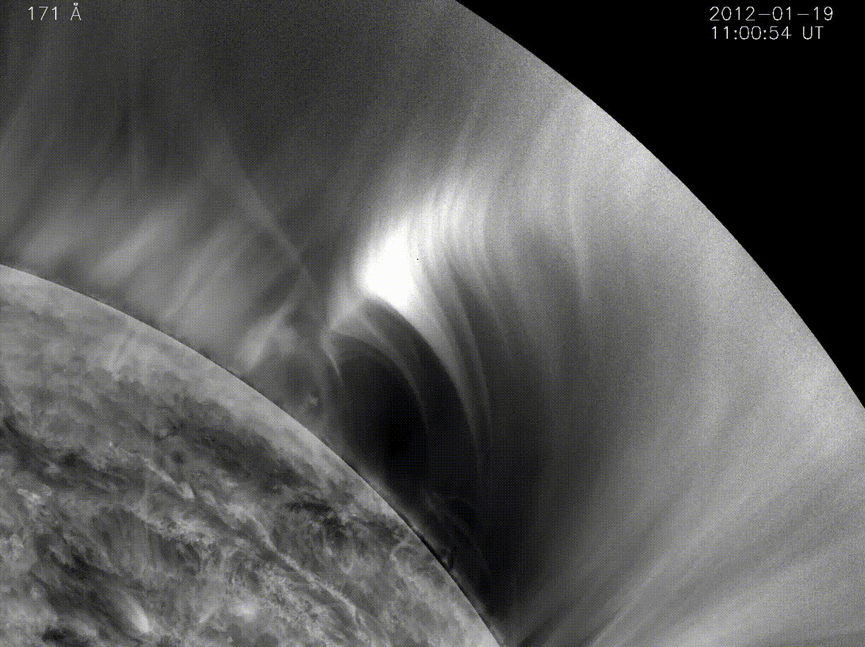
Interchange reconnection scenario
Coronal hole
(fast wind)
plasma flow
Interchange reconnection
Injection of coronal plasma in the interplanetary medium
Exchange of connectivity: closed/open ➔ open/closed
Pseudo streamer
–
+
+
-
+
Helmet streamer
(slow wind)
closed field
open field
Coronal hole
Interchange reconnection event with AIA (EUV). Credit : Masson et al 2014

Slide 9
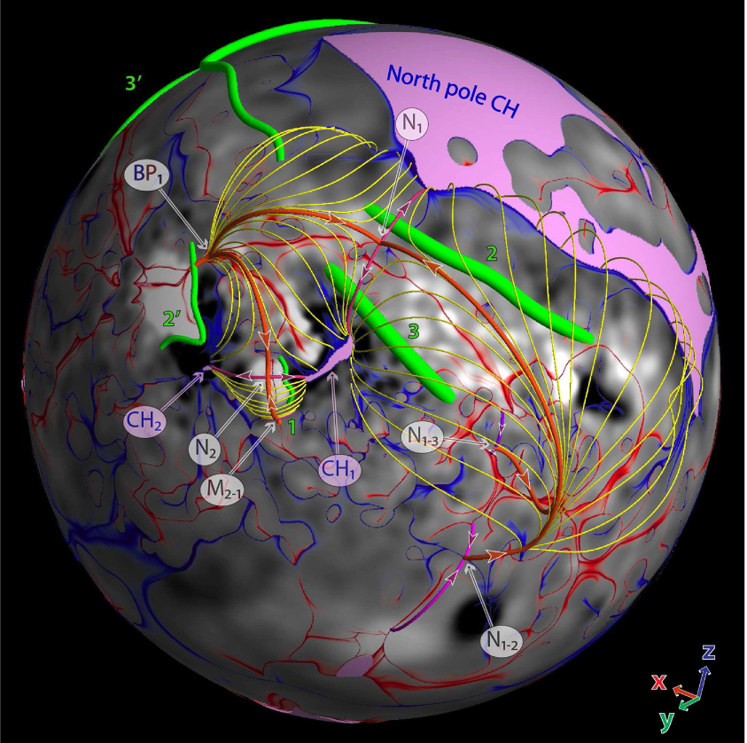
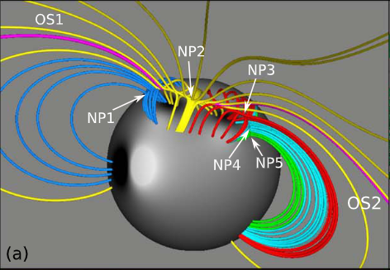
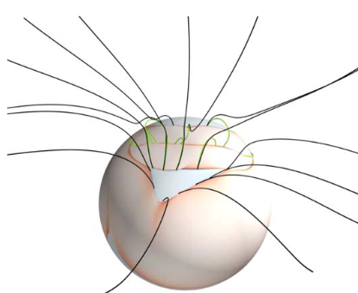
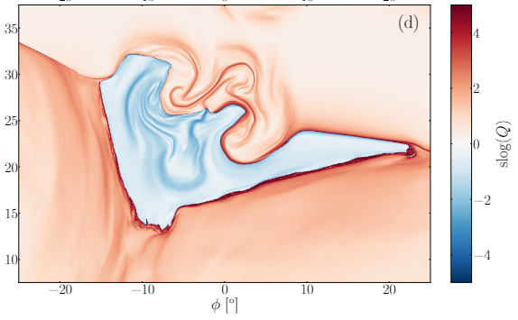
Some PS and interchange reconnection studies
Pseudo-streamer reconstructions from magnetograms
Modeling and simulations
interchange reconnection (Masson et al 2014, Pontin et Wyper 2015)
solar corona (Titov et al 2011, Wyper et al 2021, Aslanyan et al 2021 &2022)
Credit : Titov et al 2012
Dynamical simulations of the solar corona with a pseudo-streamer structure. Crédit : Wyper et al 2021
Slow wind generation in a simulation of the corona. Crédit : Aslanyan et al 2022

Slide 10
A dynamical model: objectives and methods
Objective
Building a dynamical interchange reconnection model in the pseudo-streamer structures
Studying the fine dynamics of reconnection
Method
3D MHD simulations of the solar corona with a particular magnetic structure: a pseudo-streamer
1) Initialization of the atmosphere and the magnetic field of the corona
2) Relaxation to a quasi-static equilibrium state
3) Forcing the structure by applying a velocity flow
4) Analyzing the fine dynamics

Slide 11
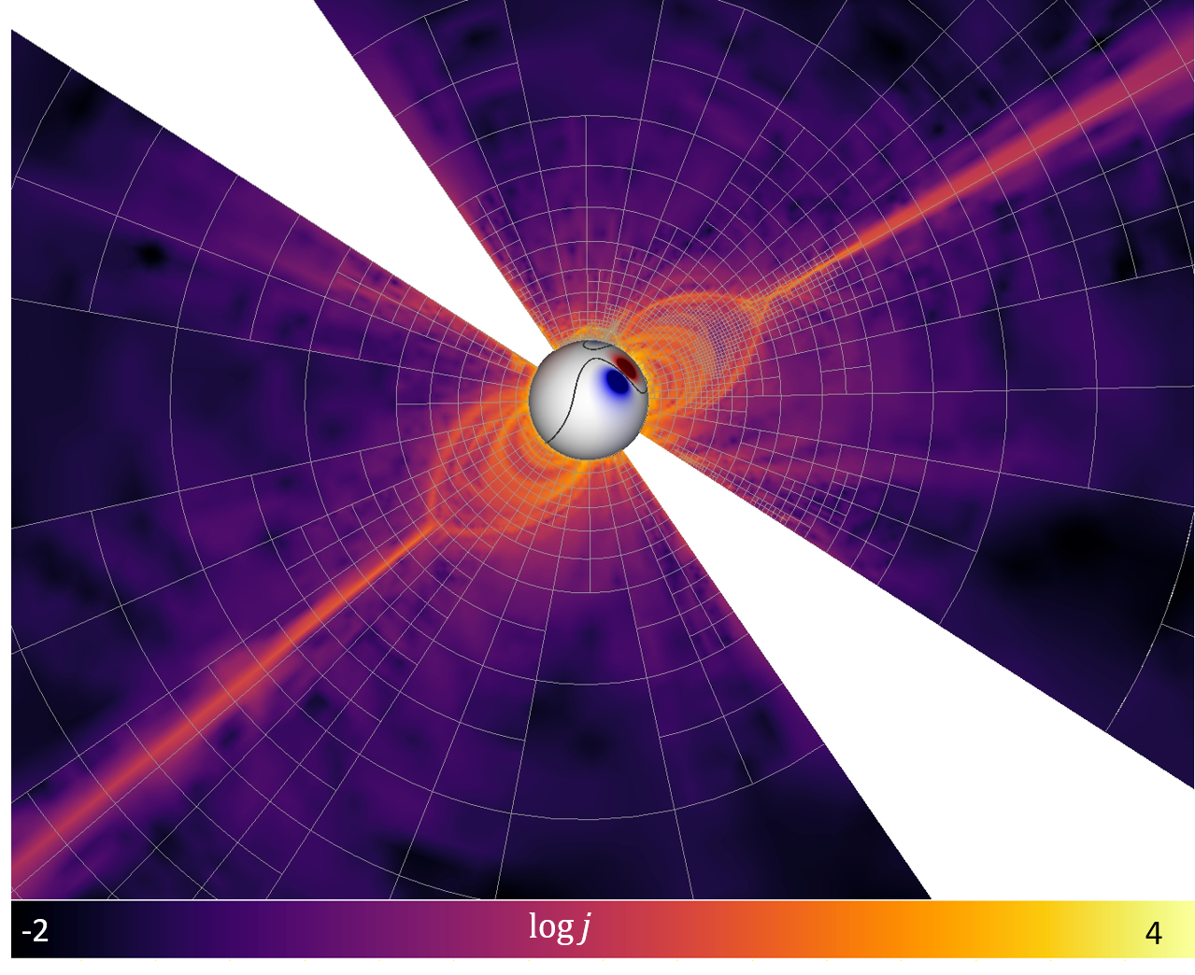
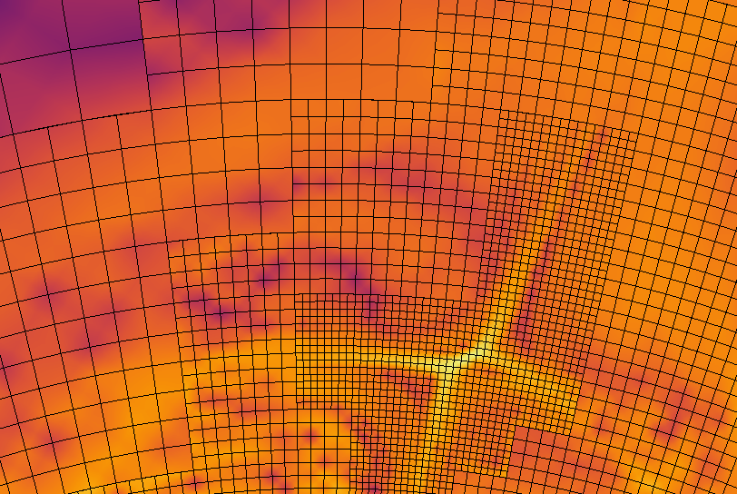
The code: Adaptive Refinement MHD Solver (ARMS), DeVore et al 1991
Physics
- Solves the 3D ideal MHD equations
- Perfect gas, fully ionized
Adaptive refinement (AMR)
- Dynamically adapts the grid refinement
- Simulation of large scales with small scales events
Flux corrected transport (FCT)
- Shock capture method
- Inhibit negative energy, mass problems near shocks and discontinuities during the computation of the conservation equations

Slide 12
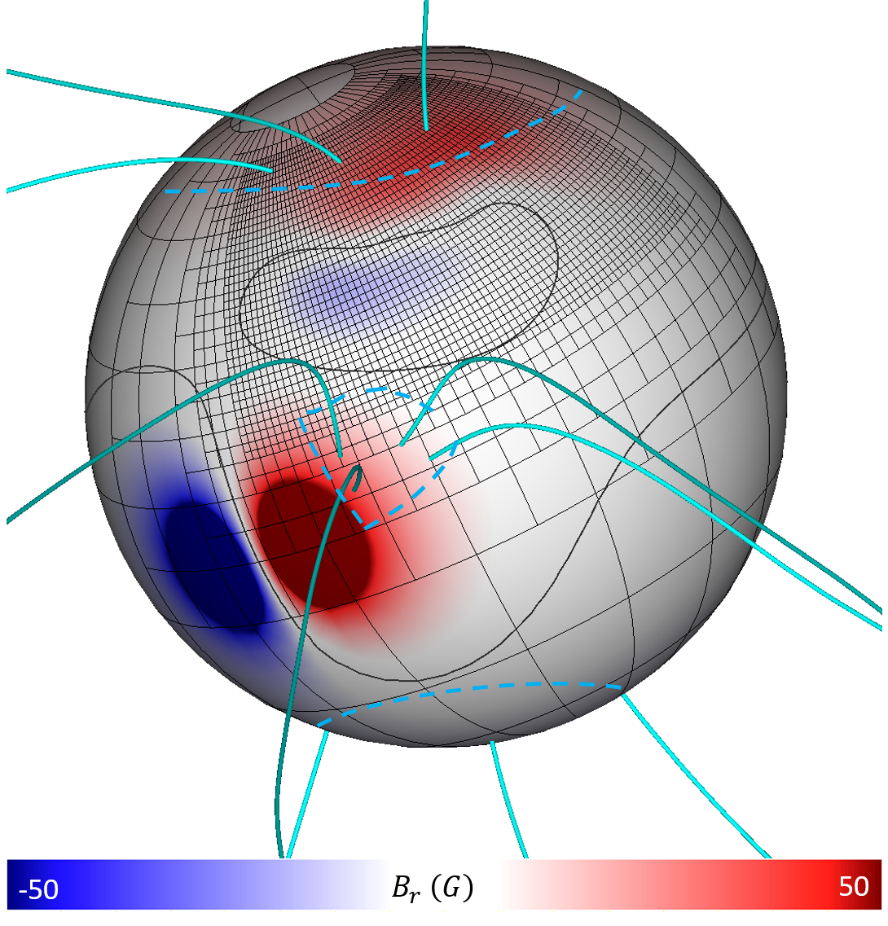
Stage 1 : Initialization
Objective
Simulating the solar corona with a pseudo-streamer structure
Atmosphere
Plasma density and velocity: Parker steady solution
Isotherm, homogeneous ${10}^{6} K$
Stratified in density
Radial plasma flow
Initial magnetic field: analytic, potential
Coronal magnetism: solar dipole + PFSS (source surface $2.5 R_{⊙}$)
Pseudo-streamer: equatorial dipole + parasitic, northern dipole
northern coronal hole
grid
PIL
equatorial coronal hole
southern coronal hole

Slide 13
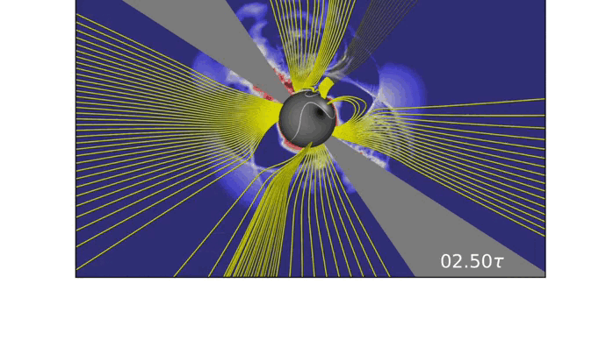
Stage 2: Relaxation
Objective
- Equilibrium between kinetic and magnetic pressure
Process
- Closure of the magnetic field lines
- Issue : the pseudo-streamer structure can disappear
- Consequence : 12 configurations have been tried, looking for a satisfying configuration with iteration
Relaxation phase. Yellow : magnetic field lines. 2D latitudinal sections : current density

Slide 14
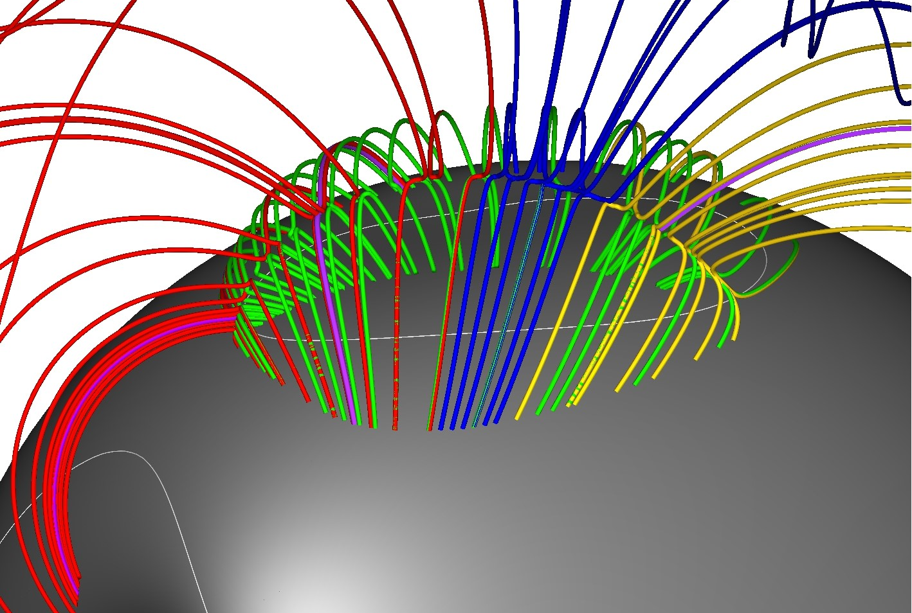
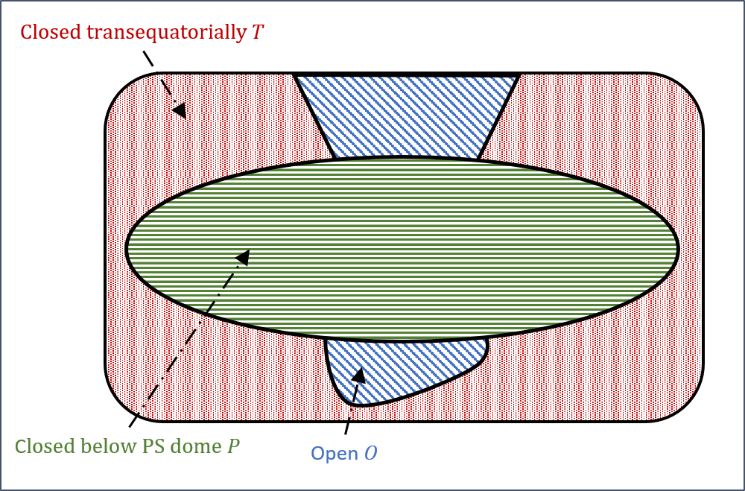
Stage 2: Relaxation
Open vertical fan
Outcome
- Solar corona at quasi-static equilibrium
- With a pseudo-streamer structure
Closed field dome bordered by open field and transequatorial closed field
Minimal topology : 3 null points $\left(B=0\right)$
- Connectivity map: 3 domains of connectivity
NP
Closed fan
Closed fan
PIL
NP
NP
dome

Slide 15
Stage 2: Relaxation
Open vertical fan
Outcome
- Solar corona at quasi-static equilibrium
- With a pseudo-streamer structure
Closed field dome bordered by open field and transequatorial closed field
Minimal topology : 3 null points $\left(B=0\right)$
- Connectivity map: 3 domains of connectivity
NP
Closed fan
Closed fan
PIL
NP
NP
dome
Pseudo-streamer dome
Open magnetic field

Slide 16
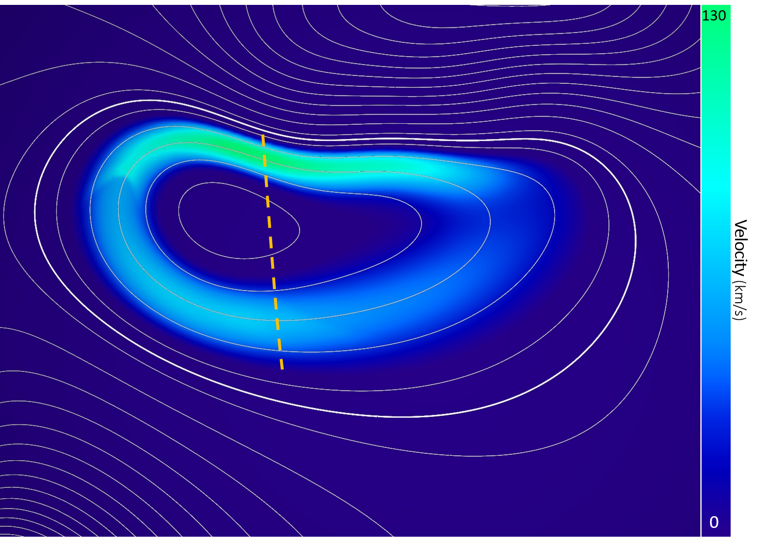
Stage 3: Forcing and Dynamics of the pseudo-streamer
OBJECTIVE
Precise study of the fine dynamics
No forcing on the dome footpoints
VELOCITY FLOW
Large-scale, low-speed, photospheric
Below on the feet of the vertical fan
PIL
Iso-$B_{r}$

Slide 17
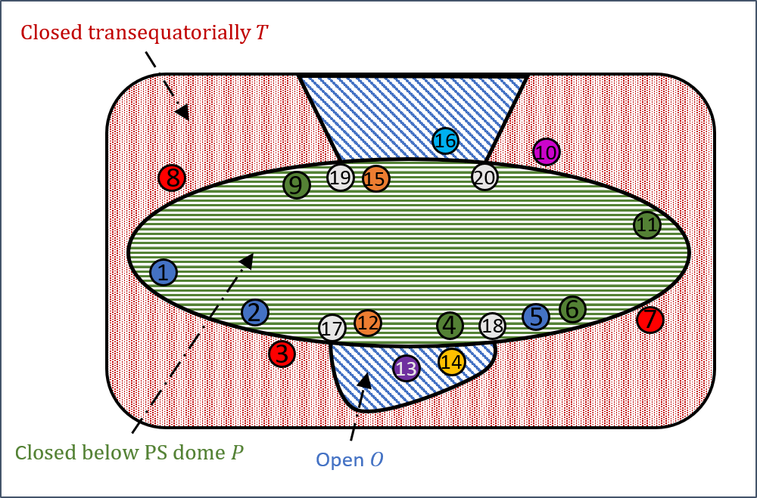
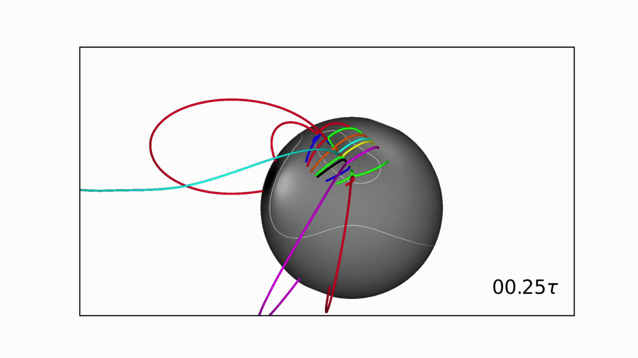
Stage 4: Analysis of the Dynamics
METHOD
Line-by-line analysis (> 1000) for each time step $\left(>200\right)$ to determine the evolution of field lines connectivity
1) fix field line footpoint 2) study the connectivity evolution over time steps
Evolution of particular field lines characteristic of the surrounding field
Connnectivity map with footpoints of field lines characteristic of the dynamics

Slide 18
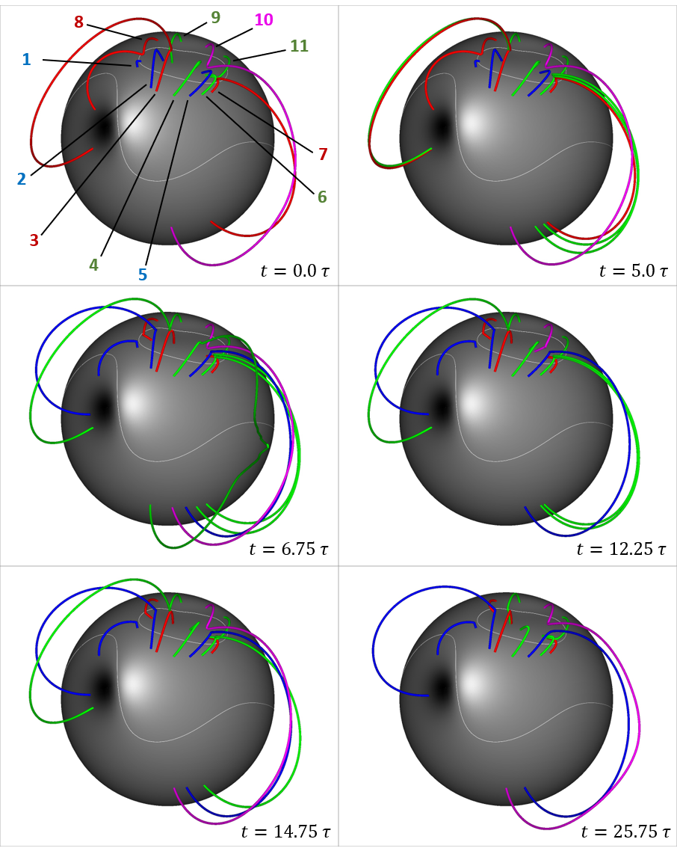
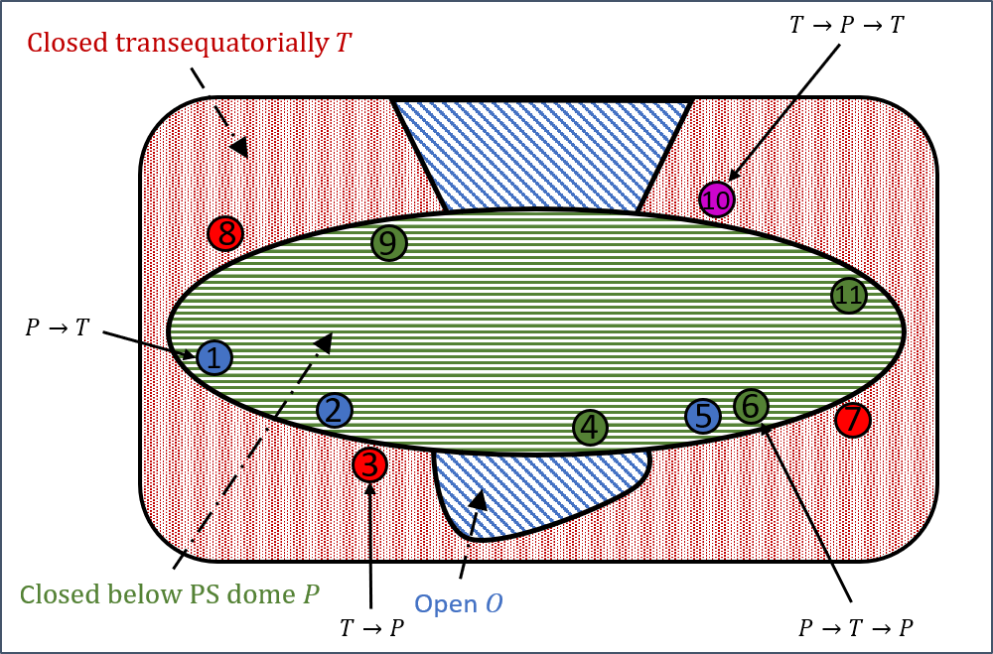
Stage 4: Analysis of the Dynamics
Connectivity exchange between pseudo-streamer closed field (P) and transequatorially closed field (T)
Reconnection in the current sheet on the top of the dome
Scenarios :
Blue : $P →T$ Red : $T→P$
Green : $P →T→P$ Fuchsia : $T→P →T$

Slide 19
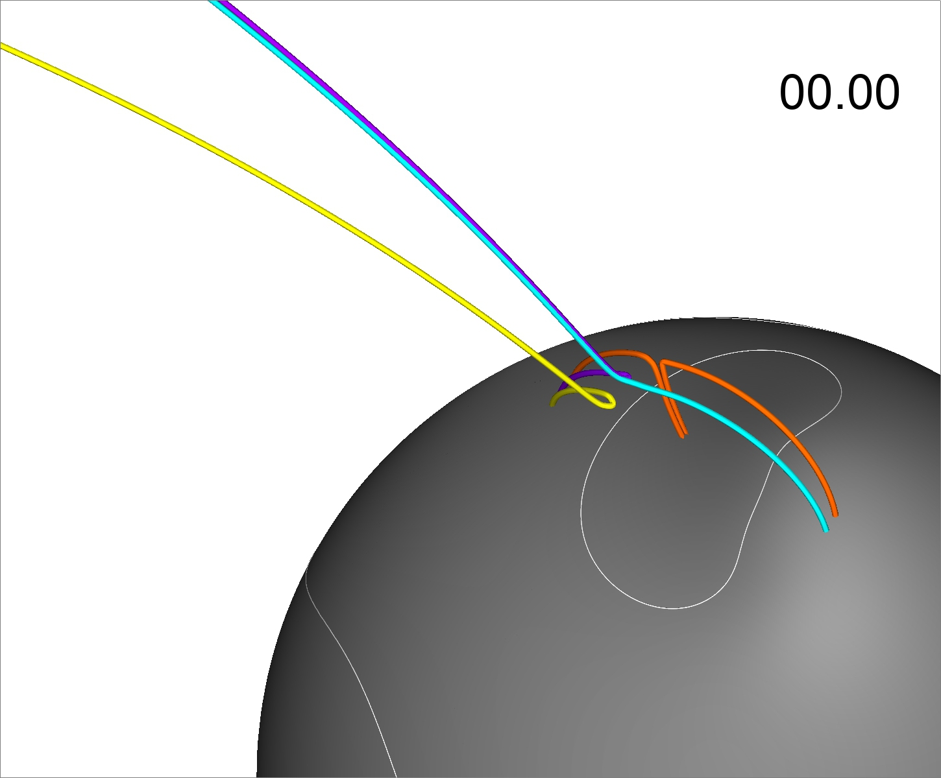
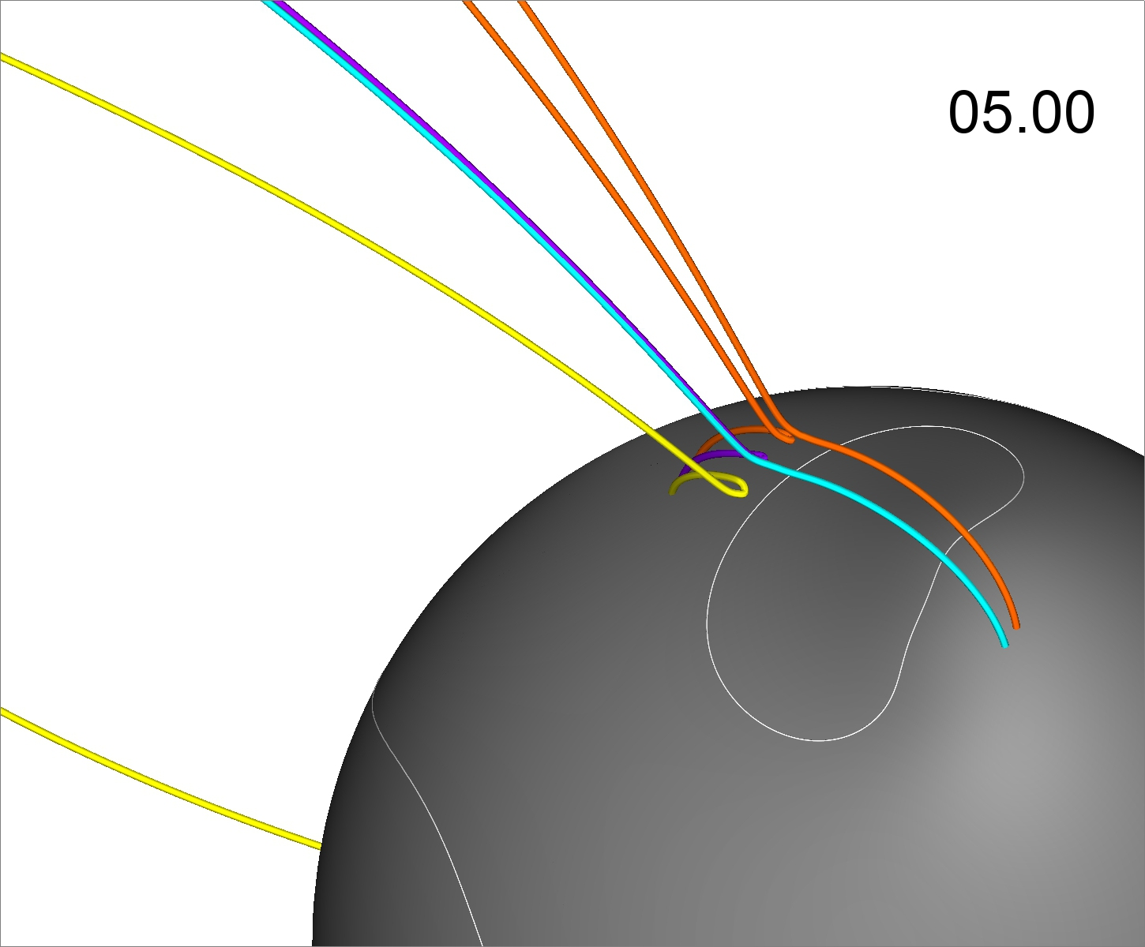
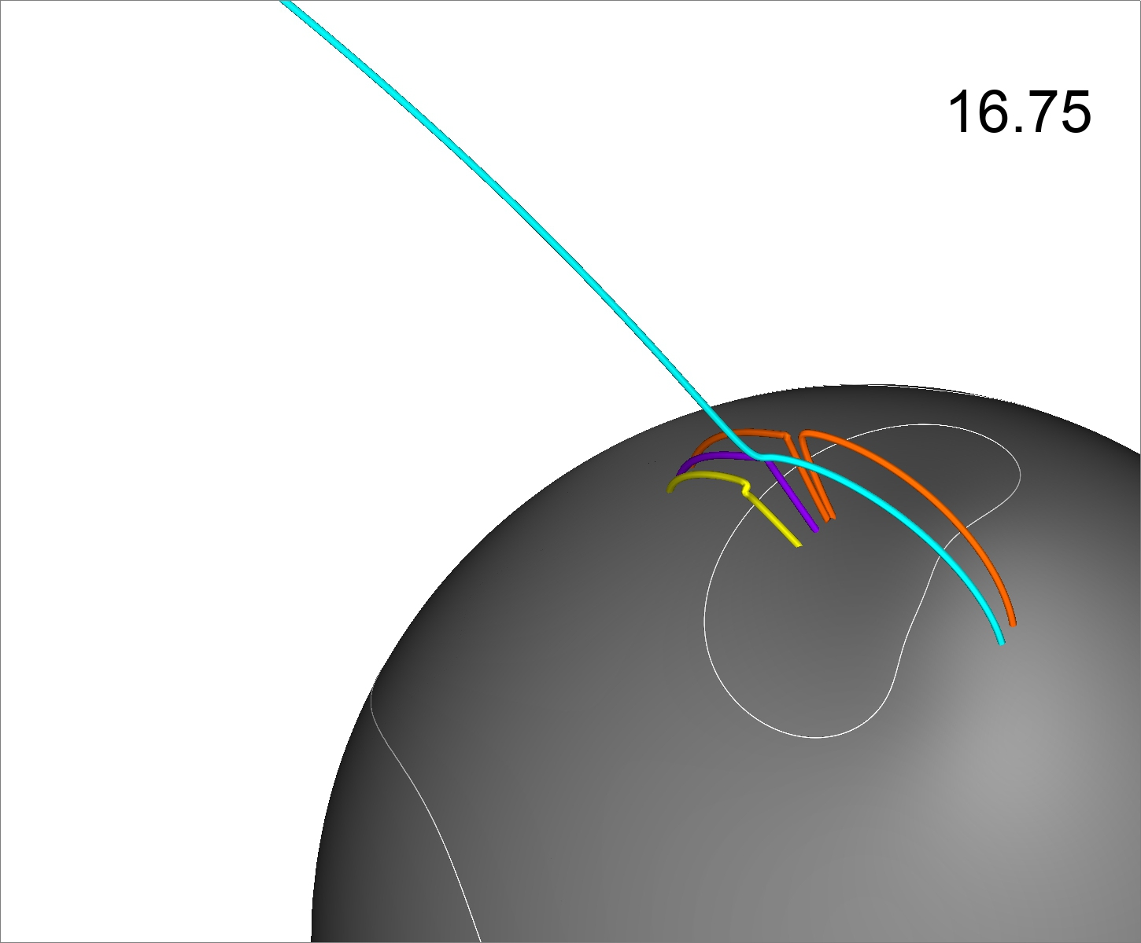
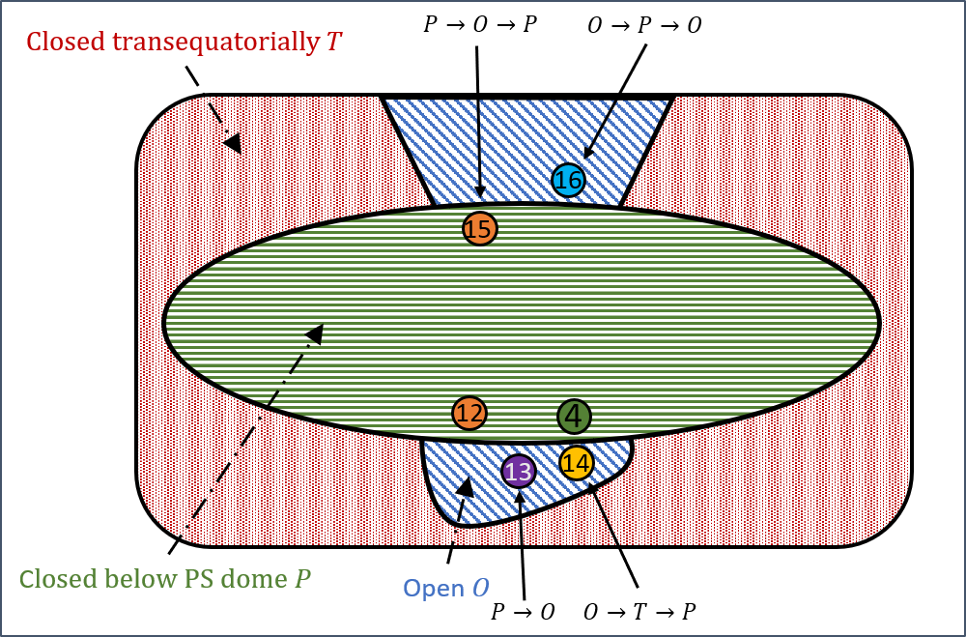
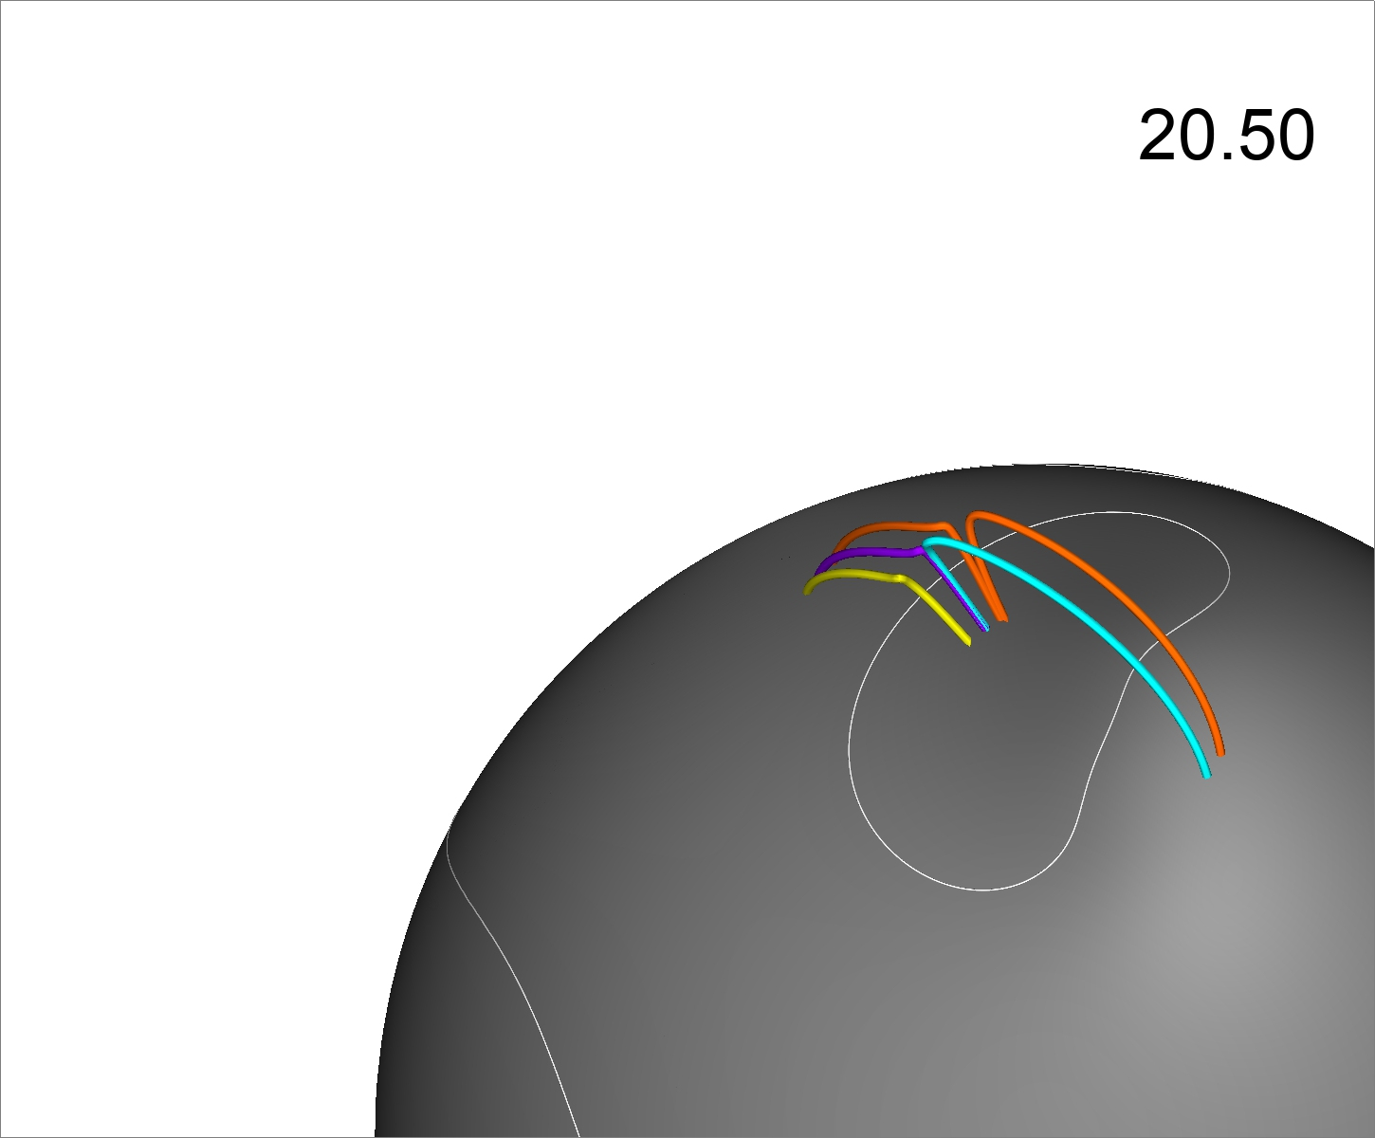
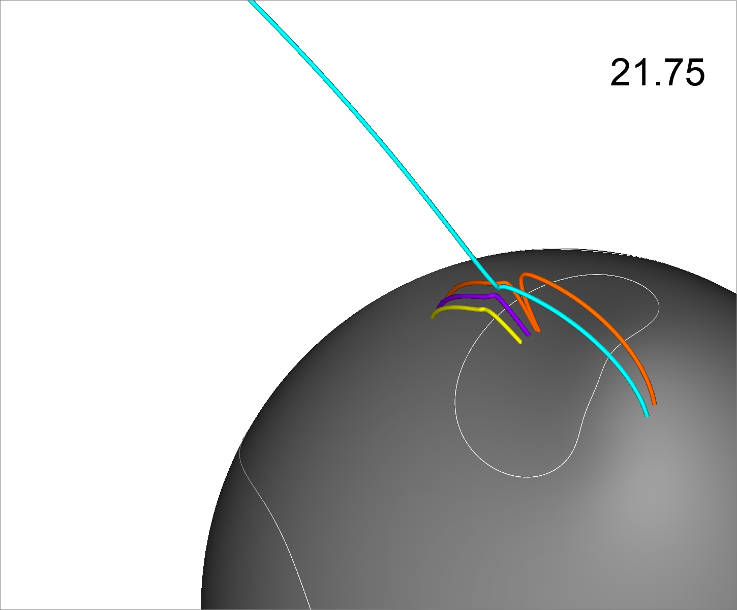
Stage 4: Analysis of the Dynamics
Opening/closing by classical, simple Interchange Reconnection
Scenarios :
Orange : $P→O→P$ Violet: $O→P$
Cyan : $O →P→O$
$$t=0.0 τ$$
$$t=5.0 τ$$
12
15
16
13
14
$$t=12.0 τ$$
$$t=16.75 τ$$
$$t=20.5 τ$$
$$t=21.75 τ$$

Slide 20
Stage 4: Analysis of the Dynamics
Two-steps opening : closed-closed reconnection + opening at the helmet streamer apex
$P→T→O$
Reconnections with open-closed and closed-closed alternations
$P→T→\left(P→\right) O→P$

Slide 21
Consequences: scenarios for opening the magnetic field of the PS dome
Several reconnection scenarios open the magnetic field initially below the pseudo-streamer dome
- classical / simple interchange reconnection scenario
$P→O$
- closure + opening by interchange reconnection
$O→P→O$
- closed-closed reconnection + reconnection at the helmet streamer apex
$P→T→O$
- Reconnections with open-closed and closed-closed alternations
$P→T→\left(P→\right) O→P$
$$P→T→O$$
+ alternations
19
20
$$P↔T$$
$$P→O$$
$$O→P→O$$
$$P↔T$$
17
18

Slide 22
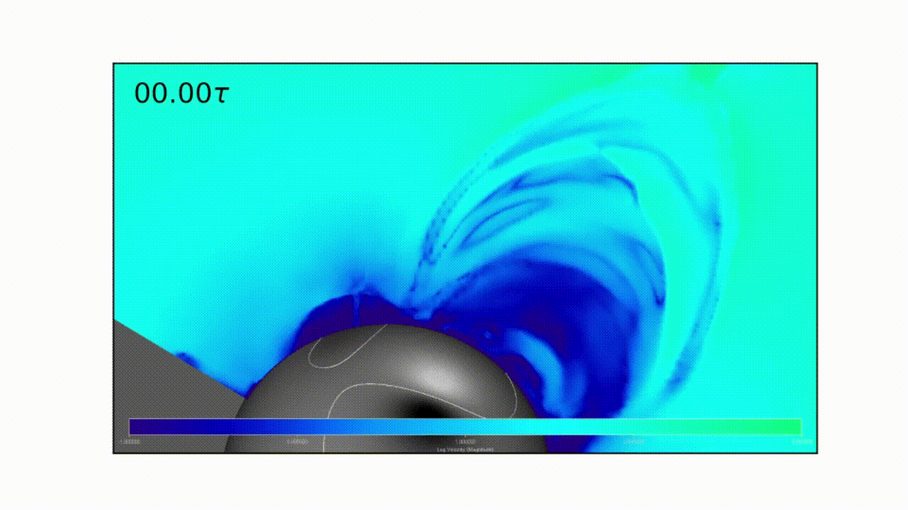
Mass and velocity flows
The opening of pseudo-streamer loops injects plasma in the interplanetary medium : plasma flows.
Mass density distribution :
Overdensity in pseudo-streamer loops, below the dome
Overdensity injected in the new open field lines
Mass density distribution in 2D longitudinal section $\left(φ=+5°\right)$
Velocity distribution in 2D longitudinal section $\left(φ=+5°\right)$

Slide 23
Conclusions and perspectives
Conclusion : opening of the field is not that simple
Simple forcing + complex topology → complex dynamics
The reconnection scenarios depend on where it takes place
Consequences
Opened, reconnected field have distinct properties
Different slow windS
What is next
Extract observables and constraints on the interchange reconnection model
Differences between scenarios ?
Analyzing the Solar Orbiter data for refining our models (magnetic field, velocities, UV density images)

