Slide 1
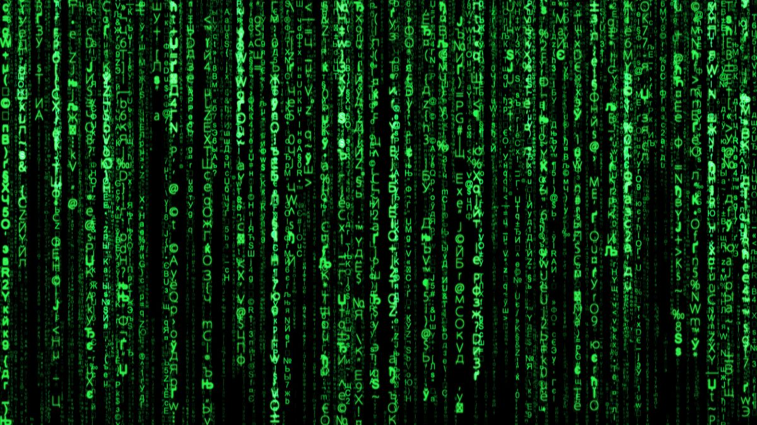
ANO7, HPC/IA/HPDA
Allan Sacha Brun (DAp-AIM)

Slide 2
ASTRONET: AN EUROPEAN ROADMAP
The key astronomical questions which may be answered in the next twenty years by a combination of observations, simulations, laboratory experiments, interpretation and theory.
the development of theory and computing capacity must go hand in hand with that of observational facilities. Systematic archiving of properly calibrated observational data in standardised, internationally recognised formats will preserve this precious information obtained with public funds for future use by other researchers, creating a Virtual Observatory. The Virtual Observatory will enable new kinds of multi-wavelength science and present new challenges to the way that results of theoretical models are presented and compared with real data. The Roadmap therefore proposes continued development of the Virtual Observatory, including recommending planning for the provision of a public, VO-compliant archive with any new facility.
5 working groups (no CEA members)
Origin and Evolution of the Universe
Formation and Evolution of Galaxies
Formation and Evolution of Stars
Formation and Evolution of Planetary Systems
Understanding the solar system and conditions for life
Observatoire Virtuel

Slide 3
Un Concept Clé: Continuum du numérique
Il y a donc un eco-système numérique à appréhender, développer et maintenir

Slide 4
Contexte NATIONAL
Prospective INSU 2020: Production et exploitation des données Big-Data,
IA (Défi 13), Partage et accès ouvert (Défi 14) Simulations num. (Défi 17)
Une demande similaire (HPC/IA/HPDA) a été faite aux OSU
La CID 55 (commission interdisciplinaire) : Science et Données
+ recrutements joints sections 17 et 6 en 2021 et 2022
Une revue des meso-centres « astro » sera faite en 2021-2022
Une Action Spécifique Numérique a été crée par la CSAA
(Y. Dubois responsable). Elle a lancé un nouveau service national (AN07):
le code-objet (plutôt que le code-moyen)

Slide 5
3 grandes activités numériques
HPC, AI, HPDA
HPC preparing exaflops machine
IA need to go beyond correlation and include physics driven constraints
HPDA needs FAIR approach + OV/easy to use interface/data
HPC: high performance computing
AI: Artificial Intelligence, HPDA: High Performance Data Analytics

Slide 6
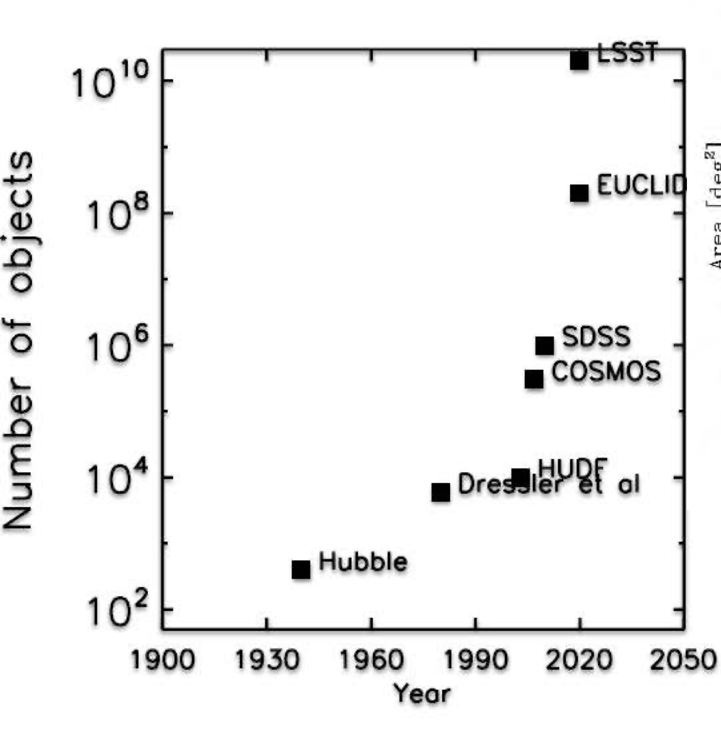
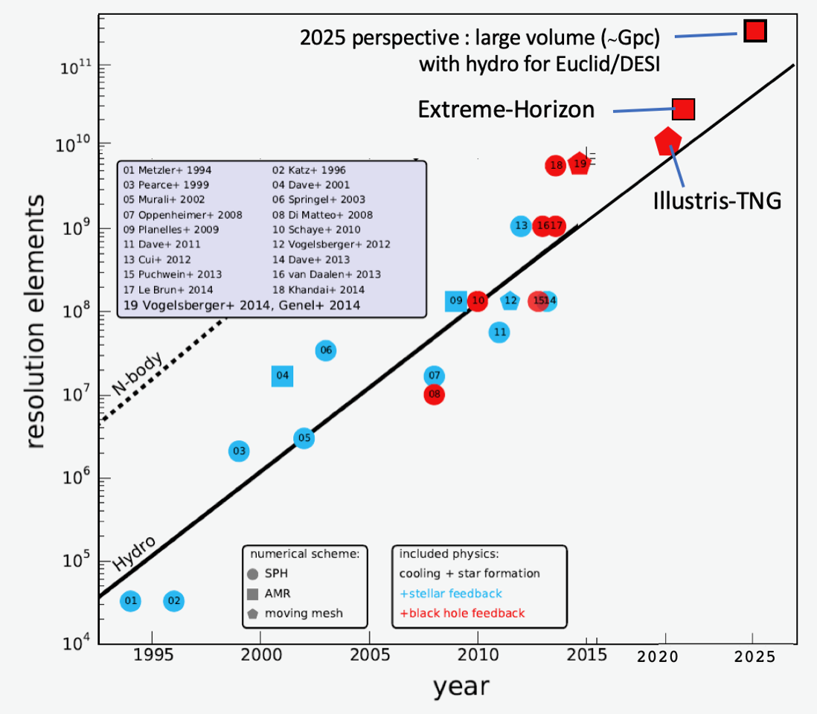
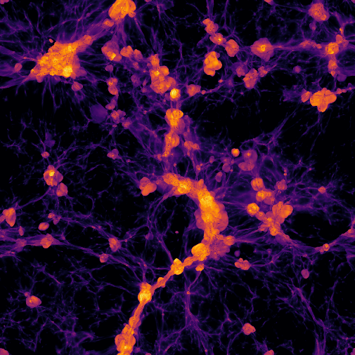
LES DÉFIS À VENIR en ASTROPHYSIQUE
Les « surveys » astro
Approche FAIR
FAIR: findability, accessibility, interoperability, and reusability

Slide 7
HPDA et Base de Données
Une communauté PNST bien en place ☺
Meta header key
in data file
http://www.cdpp.eu
AMDA, Propagation Tool, Space Weather
https://idoc.ias.u-psud.fr/MEDOC/Data
SDO: ~70,000 images/day
4kx4k
-> 10’s of Po
Observational Data (SOHO, SDO, Trace, STEREO…)
Data derived from observational data
Simulation results data

Slide 8
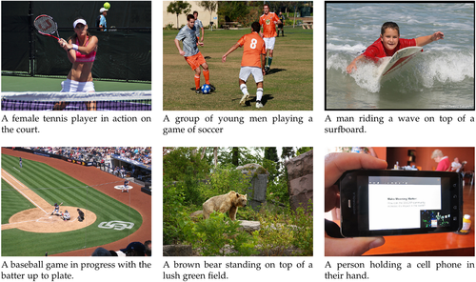
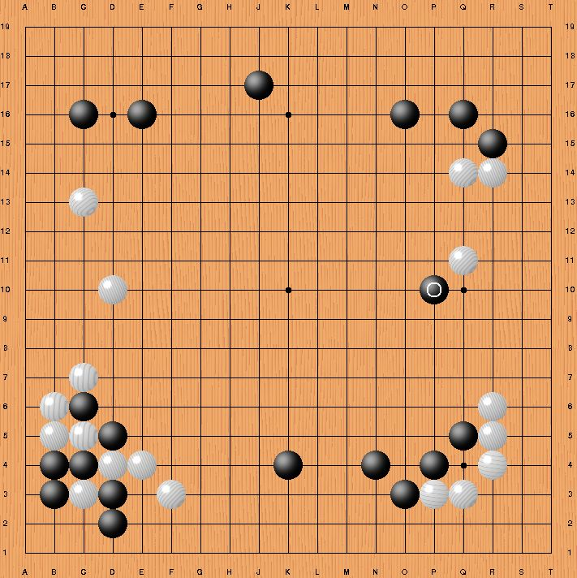
Machine learning is traditionnaly separated in 2 fields:
Can be used to accelerate and automate a number of well understood tasks
Can be used for « knowledge discovery », so to truly improved of our understanding
Automated caption
Move 37 of AlphaGo
Subclass of ML:
Reinforcement learning

Slide 9
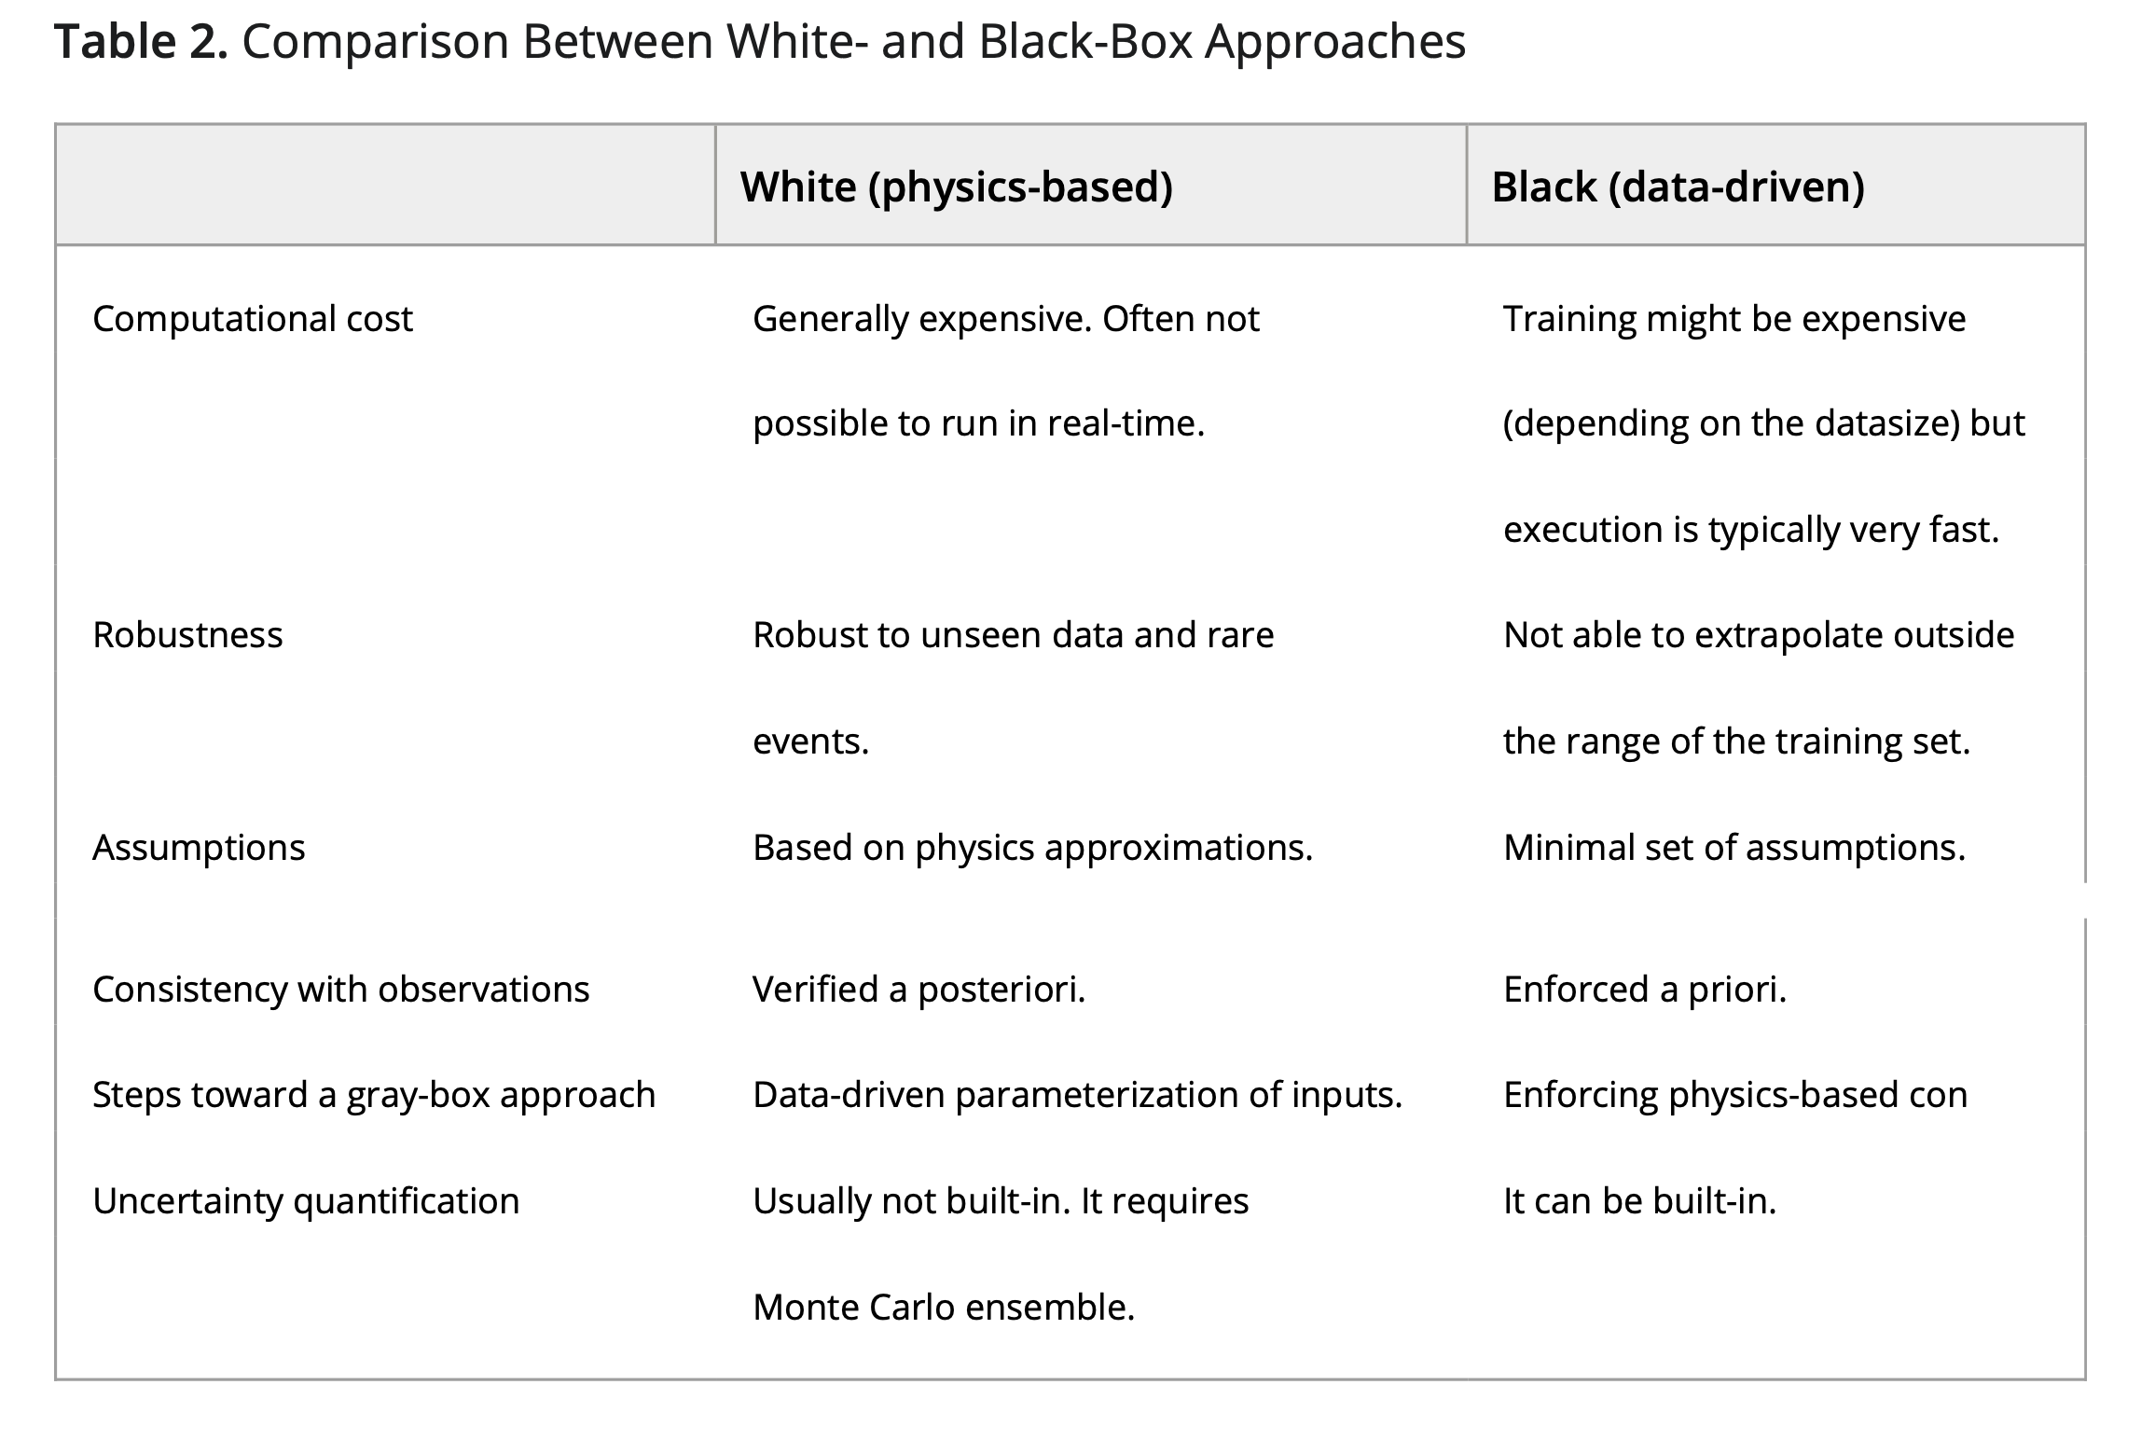
=> « grey approach » : data assimilation+AI/ML in advanced simulations
Camporeale 2019

Slide 10
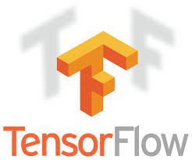
Possible new improvments
Physics-informed Neural Network
Automatic machine learning
(let the ML algorithm find the best ML/NN not necessarily one we easily understand)
Adversarial training
(need to provide difficult cases in learning process)
Highly parallel gpus based network
(to perform more efficient computations)
(for instance ensure Div B = 0 for SGS in MHD runs)
Open source AI/ML library

Slide 11
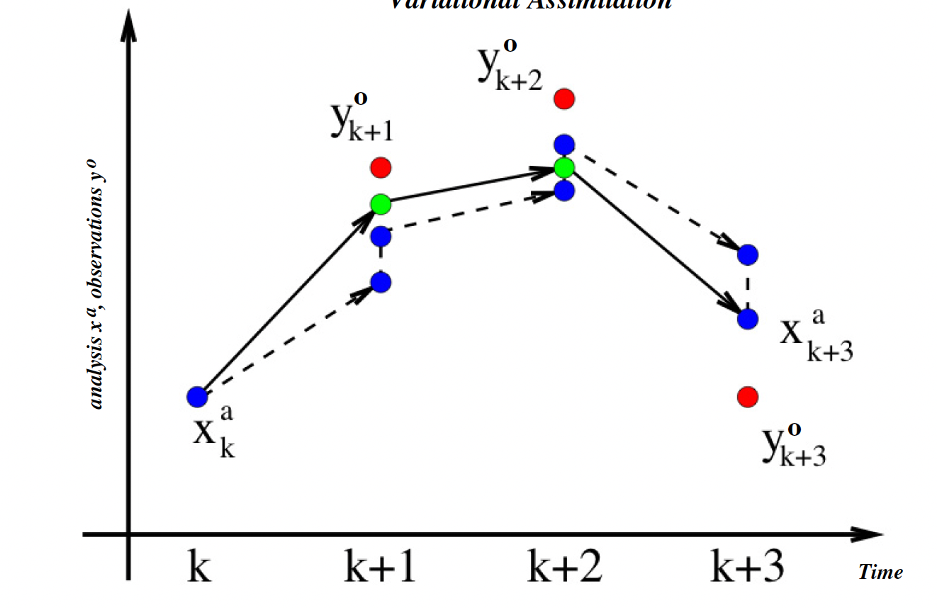
DATA ASSIMILATION: Sequencial vs variational
Merging models and data key approach for PNST activities

Slide 12
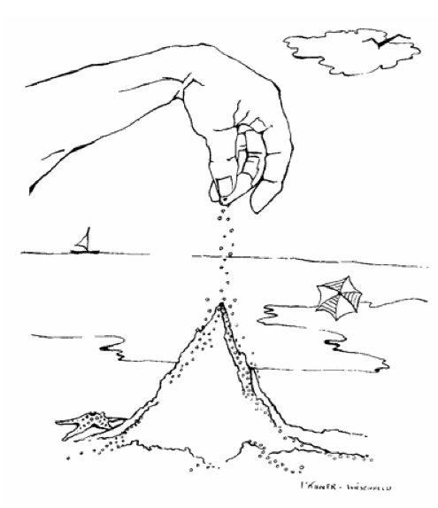
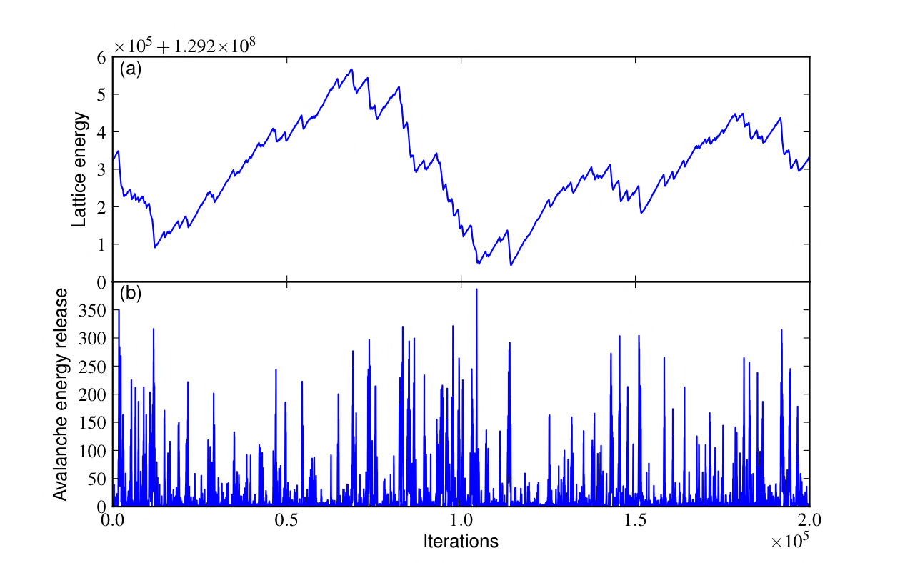
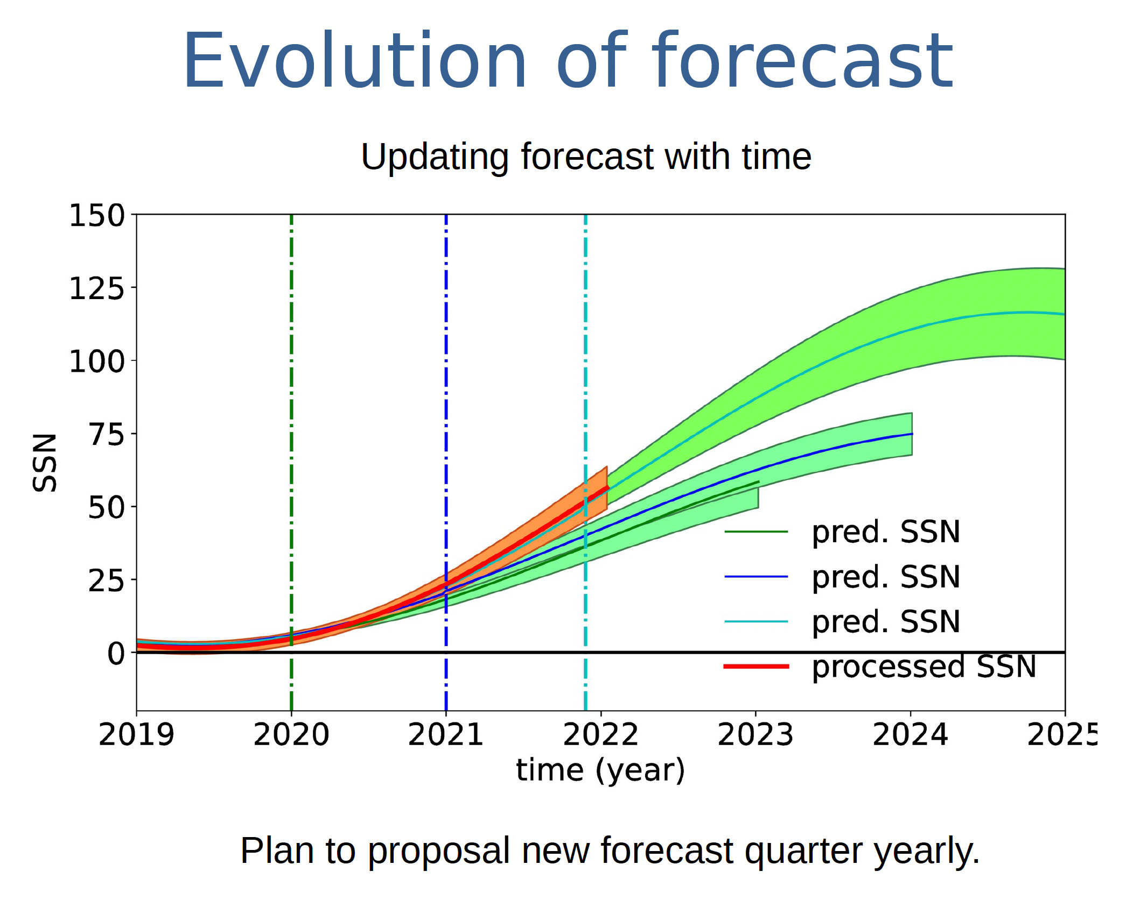
Non exhaustive list of Forecasting, coupling data and either a physical model or AI/ML
Forecasting Kp
Forecasting Dst
Solar Flares
CMEs and solar wind speed
Solar magnetic cycle
DATA ASSIMILATION
DATA DRIVEN
Strugarek et al. 2014
Brun et al. 2019

Slide 13
Le code Objet
Action Nationale d’Observation de l’INSU couvre déjà, entre autres, le développement
de chaînes d’analyse systématique ainsi que l’exécution à la demande d’outils et de codes
de modélisation ou d’exploitation (ANO5, ANO6).
La nouvelle ANO 7 autour des codes communautaires a donc un autre périmètre !
Son objet n’est pas la production de données par le moyen de codes mais l’élaboration
professionnelle de codes complexes à vocation générique demandant sur la durée
des développements multiples et des expertises variées.
On parle de code-objet vs code-moyen
PEPR NUMPEX
PEPR ORIGINES…
en attente

Slide 14
HPC infrastructures (Tiers)
Tiers 2: Meso centres (calmip, mesopsl, anais, etc…)
Tiers 1: GENCI (National, 2 calls per year) - TGCC, CINES, IDRIS (5 to 20 Mh/yr)
Tiers 0: PRACE (European, continuously open) (20 Mh/yr or more)
https://www.genci.fr/fr
https://prace-ri.eu/hpc-access/eurohpc-access/
EuroHPC + Center of Excellence + European processor
https://www.european-processor-initiative.eu
https://www.etp4hpc.eu/eurohpc.html

Slide 15
Need to agree on International Benchmark
See Talk by M. Delorme on Thursday (tmrw)

Slide 16
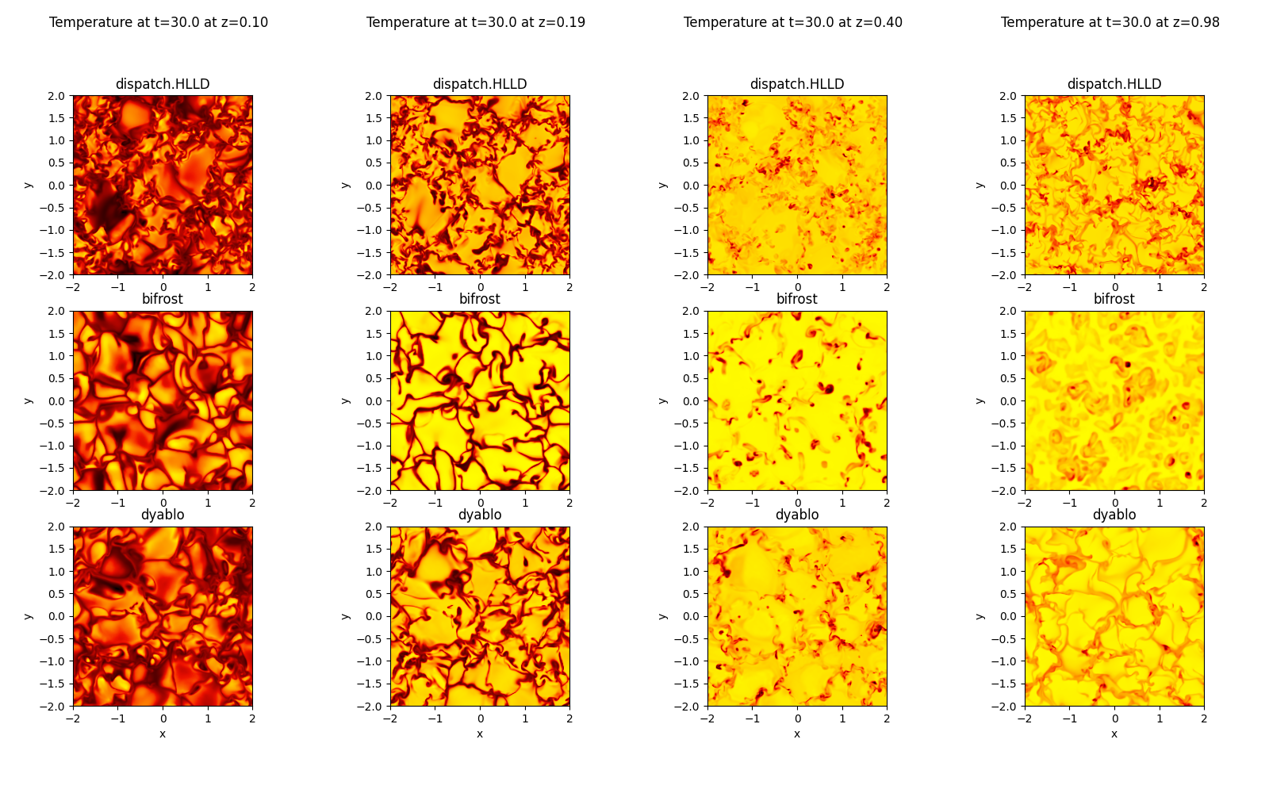
An international benchmark on solar convection
More than 11 codes involved (EU, USA, Japan).

Slide 17
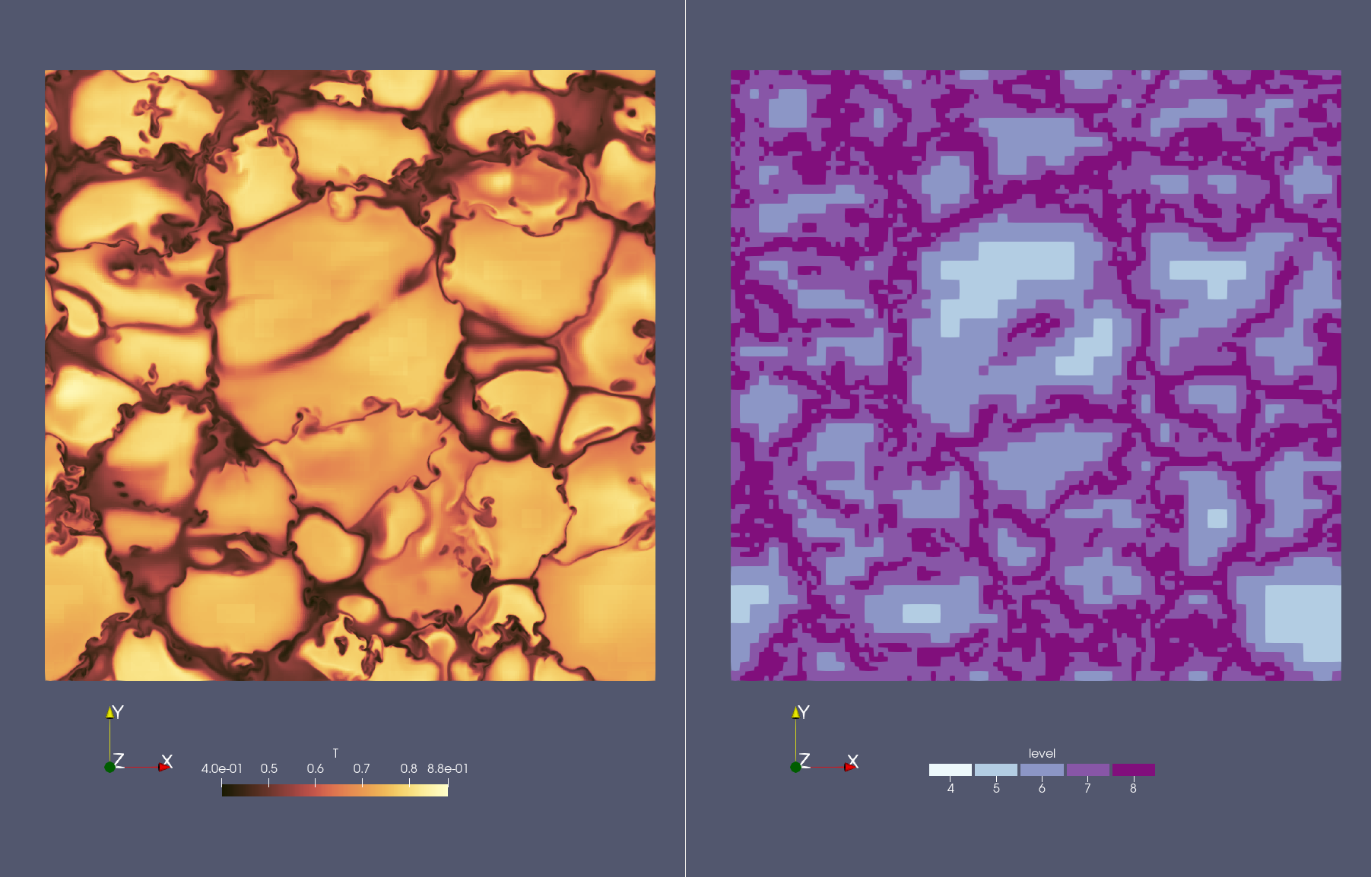
Dyablo-Whole Sun
Block or cell-Based AMR
Hybrid CPU-GPU
HD Rieman solver
See also Talk by N. Aunai
(code PHARE) on Thursday

